Slide 1
Light, Camera and Shading
CS 543 / ECE 549 – Saurabh Gupta
Spring 2021, UIUC
http://saurabhg.web.illinois.edu/teaching/ece549/sp2020/
Many slides adapted from S. Seitz, L. Lazebnik, D. Hoiem, D. Forsyth

Slide 2
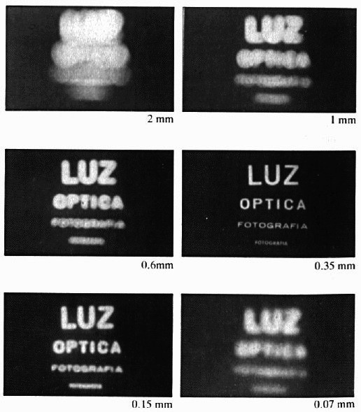

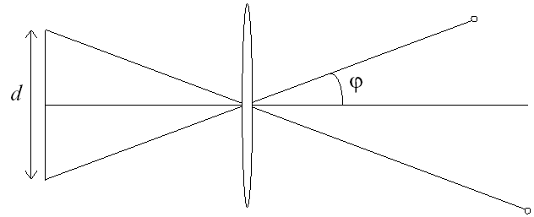
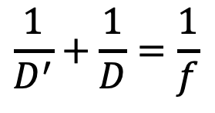
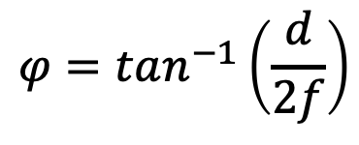
Recap
$$\frac{1}{D^{′}}+\frac{1}{D}=\frac{1}{f}$$
$$φ=tan^{−1}\left(\frac{d}{2f}\right)$$
Notes:
It gets inverted

Slide 3
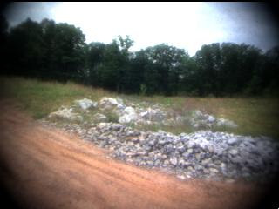
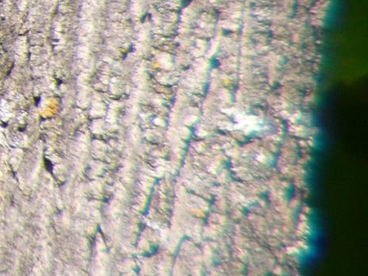
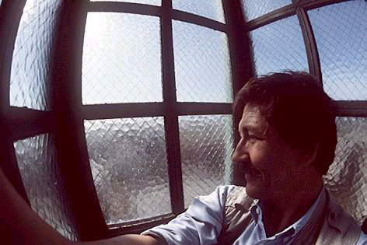
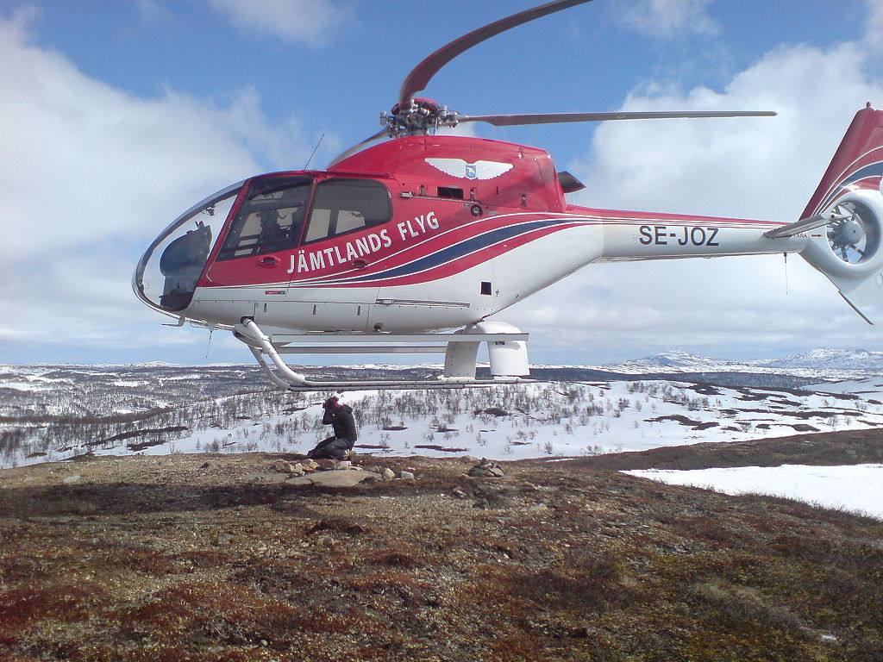
Recap
Notes:
It gets inverted

Slide 4
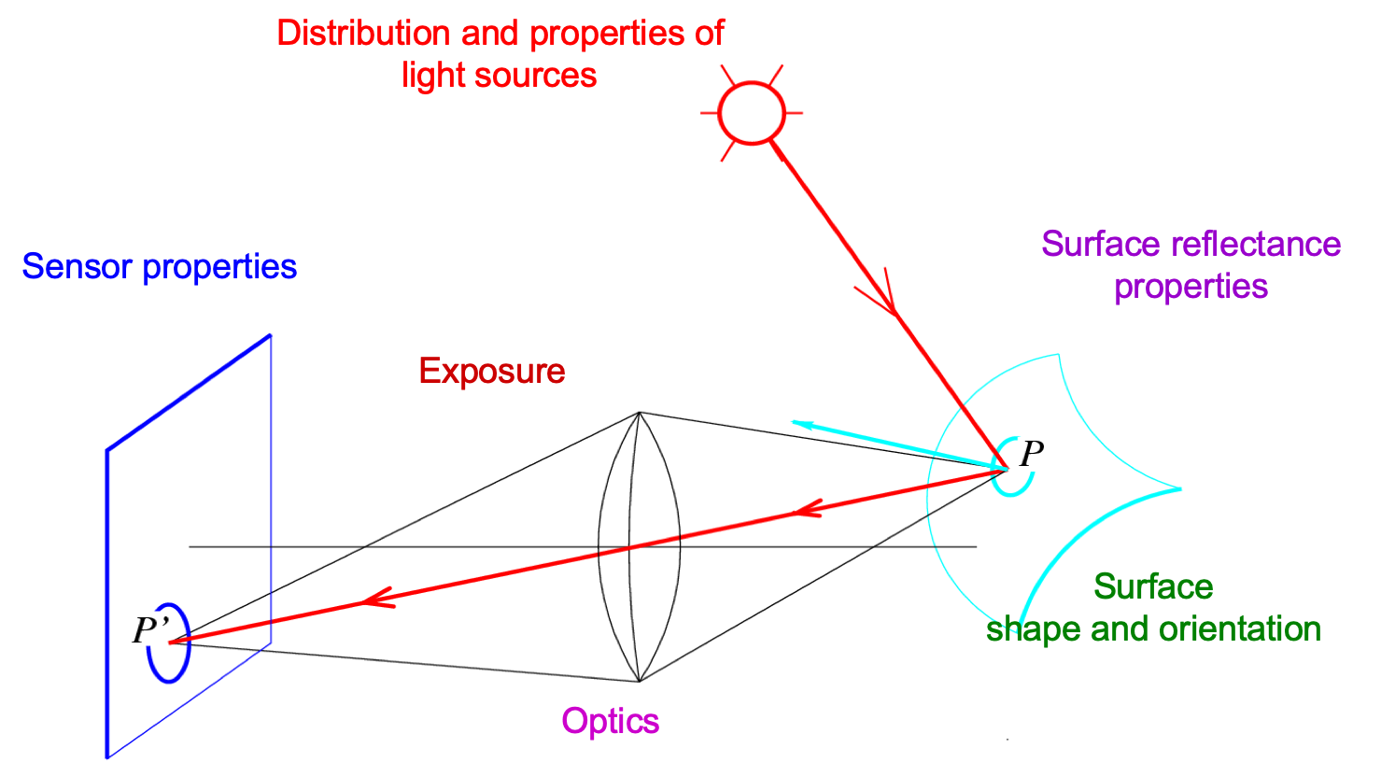
Recap
Notes:
Review slide (skip)

Slide 5
Overview
Cameras with lenses
  Depth of field
  Field of view
  Lens aberrations
Brightness of a pixel
  Small taste of radiometry
  In-camera transformation of light
  Reflectance properties of surfaces
  Lambertian reflection model
  Shape from shading

Slide 6
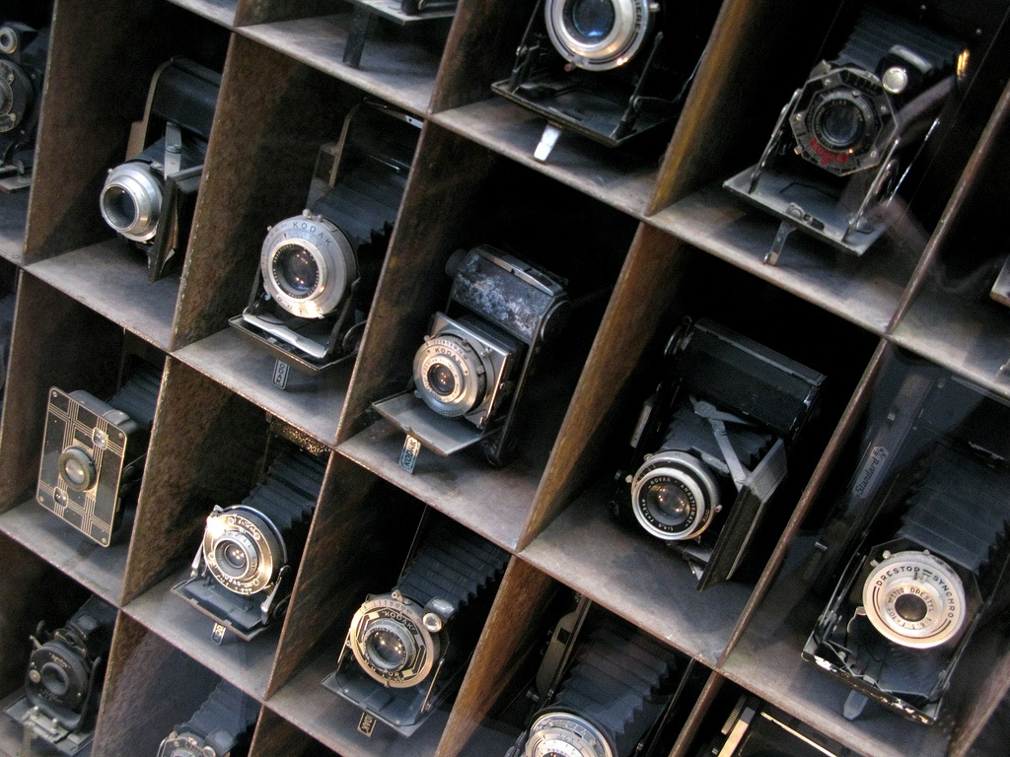
Building a Real Camera

Slide 7
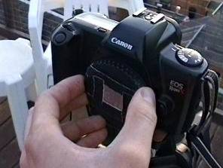
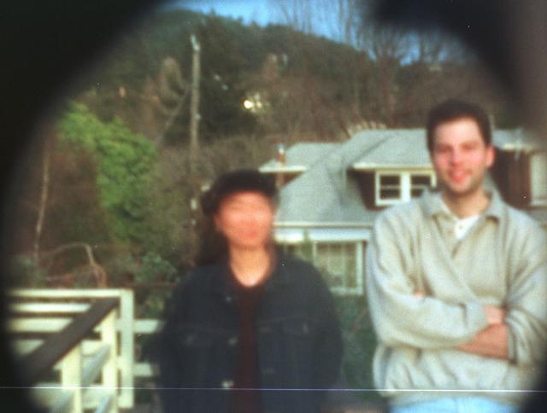
Home-made pinhole camera
Slide by A. Efros
http://www.debevec.org/Pinhole/

Slide 8
Shrinking the aperture
Why not make the aperture as small as possible?
  Less light gets through
  Diffraction effects…
Slide by Steve Seitz

Slide 9
Shrinking the aperture
Slide by Steve Seitz

Slide 10
Adding a lens

Slide 11
Adding a lens
A lens focuses light onto the film
  Thin lens model:
    Rays passing through the center are not deviated
    (pinhole projection model still holds)
Slide by Steve Seitz

Slide 12
Adding a lens
focal point
f
A lens focuses light onto the film
  Thin lens model:
    Rays passing through the center are not deviated
    (pinhole projection model still holds)
    All rays parallel to the optical axis pass through the focal point
    All parallel rays converge to points on the focal plane
Slide by Steve Seitz

Slide 13
Thin lens formula
Where does the lens focus the rays coming from a given point in the scene?
f
image plane
lens
object
Slide by Frédo Durand
Notes:
This is the relation between the focal length (f), the distance of the object from the camera (D), and the distance at which the object will be in focus (D’)

Slide 14
Thin lens formula
What is the relation between the focal length ( f ),
the distance of the object from the optical center (D),
and the distance at which the object will be in focus (D′)?
D′
D
f
image plane
lens
object
Slide by Frédo Durand
Notes:
This is the relation between the focal length (f), the distance of the object from the camera (D), and the distance at which the object will be in focus (D’)

Slide 15
Thin lens formula
Similar triangles everywhere!
D′
D
f
image plane
lens
object
Slide by Frédo Durand

Slide 16
Thin lens formula
y′/y = D′/D
Similar triangles everywhere!
D′
D
f
y
y′
image plane
lens
object
Slide by Frédo Durand

Slide 17
Thin lens formula
y′/y = D′/D
Similar triangles everywhere!
y′/y = (D′−f )/f
D′
D
f
y
y′
image plane
lens
object
Slide by Frédo Durand

Slide 18
Thin lens formula
1
1
1
Any point satisfying the thin lens equation is in focus.
+
=
D′
D
f
What happens when D is very large?
D′
D
f
image plane
lens
object
Slide by Frédo Durand
Notes:
And the set of all such points forms a plane parallel to the image (plane of focus).
Uses of the formula: given focal length and depth in scene that you want to be in focus, it tells you where to put the image plane. Given f and distance of image plane from camera center, it tells you which depth in the scene will be in focus.

Slide 19
Depth of Field
“circle of
confusion”
For a fixed focal length, there is a specific distance at which objects are “in focus”
  Other points project to a “circle of confusion” in the image
Slide by Steve Seitz

Slide 20
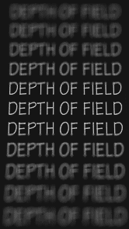
Depth of Field
http://www.cambridgeincolour.com/tutorials/depth-of-field.htm
Slide by A. Efros
Notes:
Depth of field is the distance between the nearest and farthest objects in a scene that appear acceptably sharp in an image (Wikipedia)

Slide 21
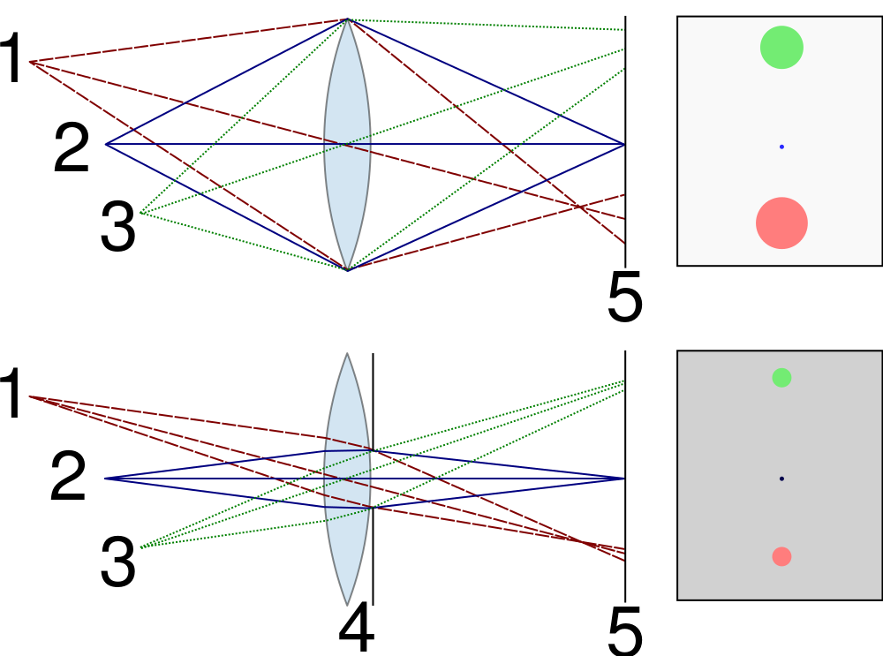


Controlling depth of field
Changing the aperture size affects depth of field
  A smaller aperture increases the range in which the object is approximately in focus
  But small aperture reduces amount of light – need to increase exposure
http://en.wikipedia.org/wiki/File:Depth_of_field_illustration.svg

Slide 22
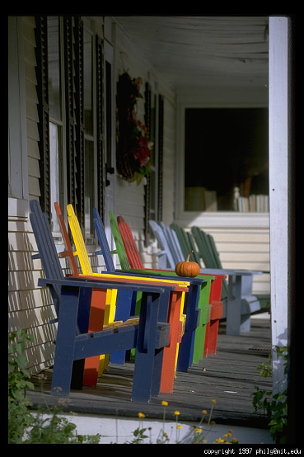
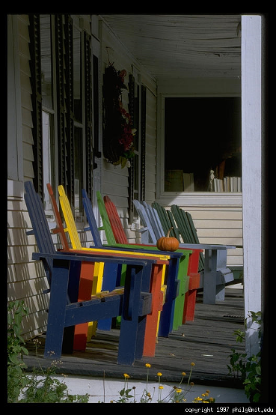
Varying the aperture
Large aperture = small DOF
Small aperture = large DOF
Slide by A. Efros

Slide 23
Field of View
f
FOV depends on focal length and size of the camera retina
Larger focal length = smaller FOV
Slide by A. Efros

Slide 24
Field of View
Slide by A. Efros
Notes:
The field of view is the angular extent of the world that is observed by the camera.

Slide 25
Field of View
Slide by A. Efros

Slide 26
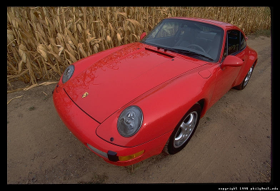
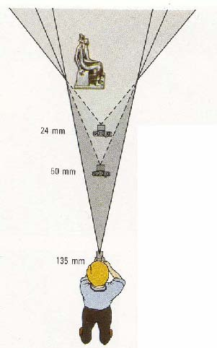
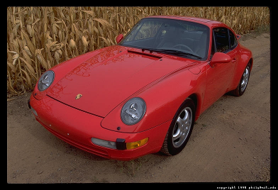
Field of View / Focal Length
Large FOV, small f
Camera close to car
Small FOV, large f
Camera far from the car
Sources: A. Efros, F. Durand

Slide 27



Same effect for faces
wide-angle
standard
telephoto
Source: F. Durand

Slide 28
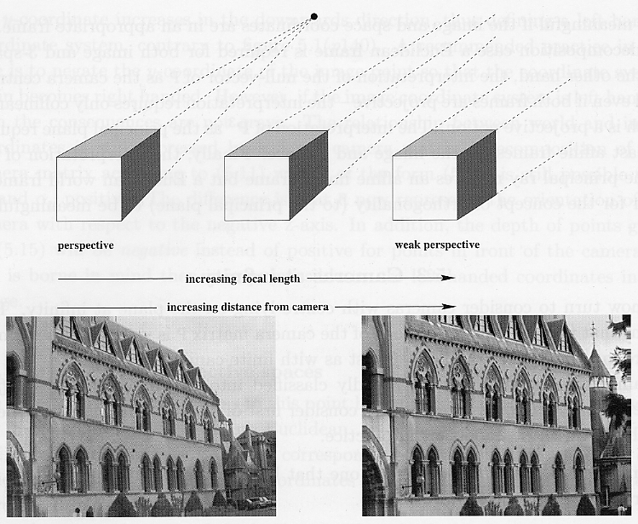
Approximating an orthographic camera
Source: Hartley & Zisserman

Slide 29
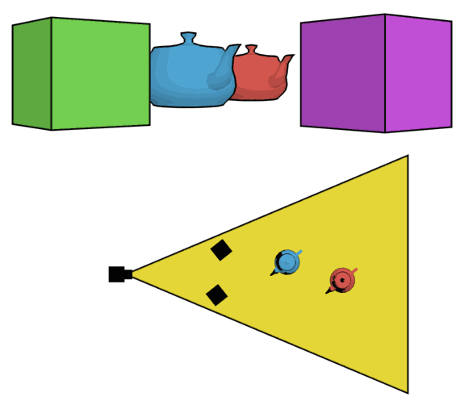
The dolly zoom
Continuously adjusting the focal length while the camera moves away from (or towards) the subject
http://en.wikipedia.org/wiki/Dolly_zoom

Slide 30
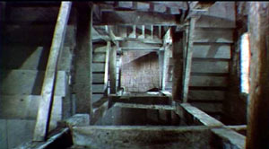
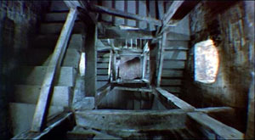
The dolly zoom
Continuously adjusting the focal length while the camera moves away from (or towards) the subject
“The Vertigo shot”
Example of dolly zoom from Goodfellas (YouTube)
Example of dolly zoom from La Haine (YouTube)

Slide 31
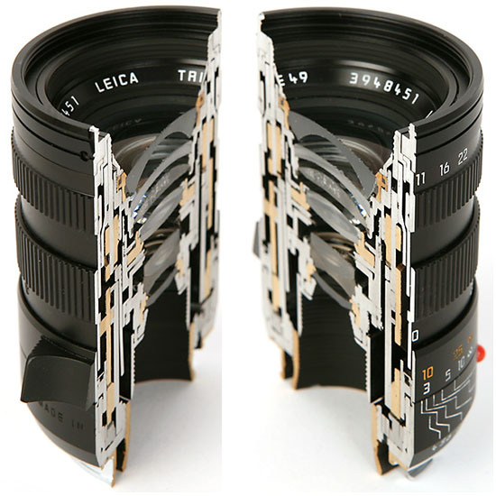
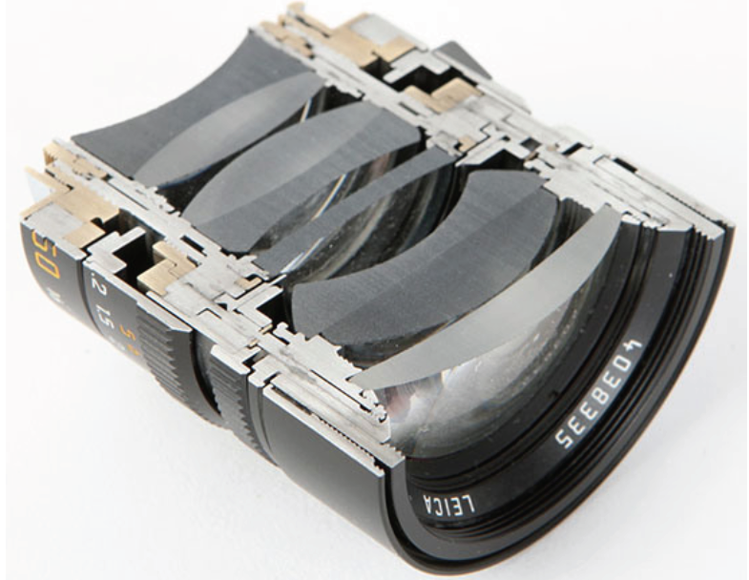
Real lenses

Slide 32
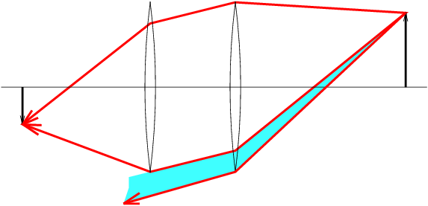
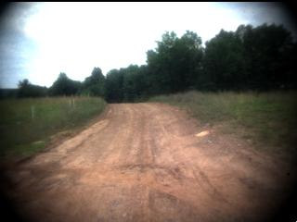
Lens flaws: Vignetting

Slide 33
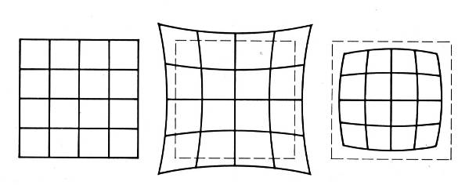
Radial Distortion
  Caused by imperfect lenses
  Deviations are most noticeable near the edge of the lens
No distortion
Pin cushion
Barrel

Slide 34
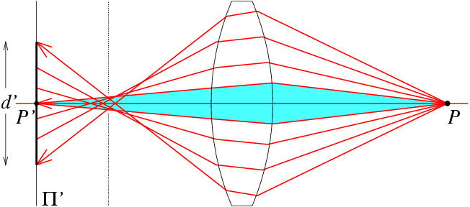
Lens flaws: Spherical aberration
Spherical lenses don’t focus light perfectly
Rays farther from the optical axis focus closer

Slide 35
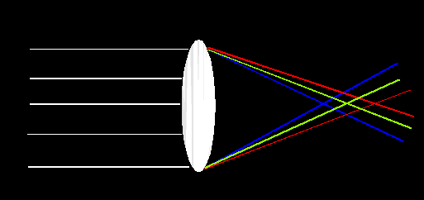
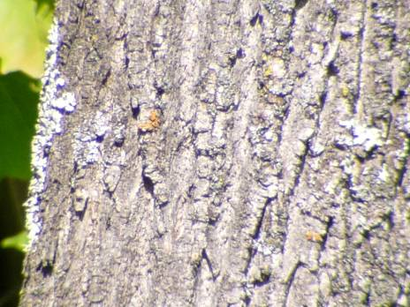
Lens Flaws: Chromatic Aberration
Lens has different refractive indices for different wavelengths: causes color fringing
Near Lens Center
Near Lens Outer Edge

Slide 36
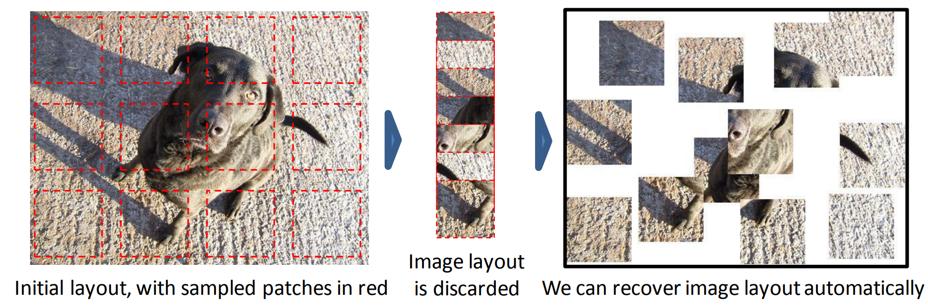
Lens Flaws: Chromatic Aberration
Researchers tried teaching a network about objects by forcing it to assemble jigsaws.
Slide Credit: C. Doersch

Slide 37
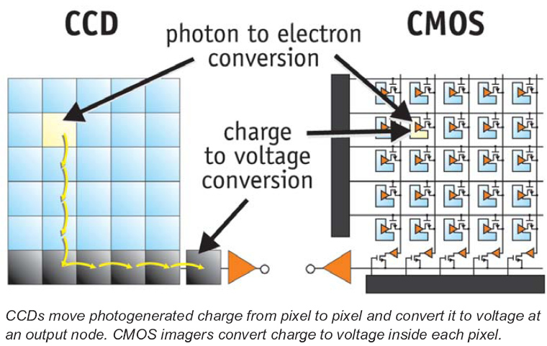
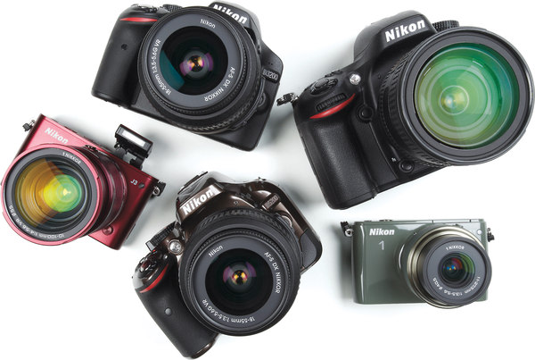
Digital camera sensors
Each cell in a sensor array is a light-sensitive diode that converts photons to electrons
  Dominant in the past: Charge Coupled Device (CCD)
  Dominant now: Complementary Metal Oxide Semiconductor (CMOS)
http://electronics360.globalspec.com/article/9464/ccd-vs-cmos-the-shift-in-image-sensor-technology

Slide 38
Rolling Shutter
Rolling Shutter: pixels read in sequence
Can get global reading, but $$$

Slide 39
Overview
Cameras with lenses
  Depth of field
  Field of view
  Lens aberrations
Brightness of a pixel
  Small taste of radiometry
  In-camera transformation of light
  Reflectance properties of surfaces
  Lambertian reflection model
  Shape from shading

Slide 40
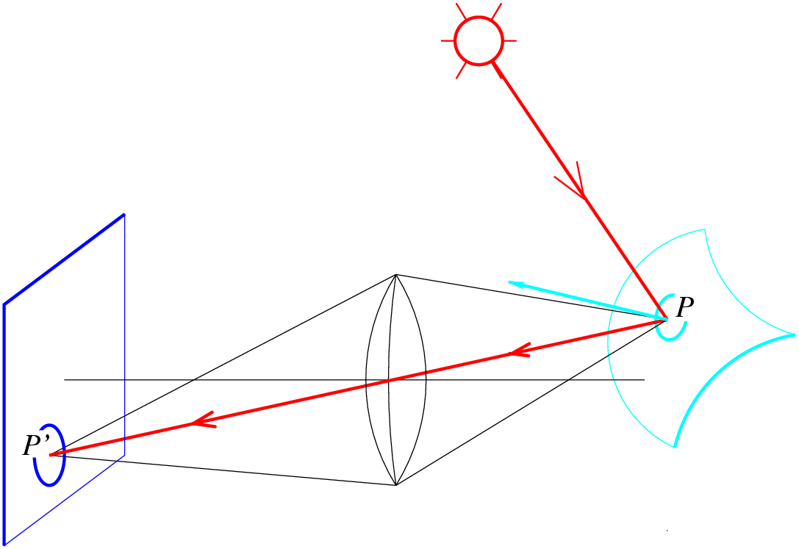
Image formation
What determines the brightness of an image pixel?
Distribution and properties of light sources
Surface reflectance
properties
Sensor properties
Exposure
Surface
shape and orientation
Optics
Slide by L. Fei-Fei
Notes:
Review slide (skip)

Slide 41
Fundamental radiometric relation
L: Radiance emitted from P toward P’
  Energy carried by a ray (Watts per sq. meter per steradian)
E: Irradiance falling on P’ from the lens
  Energy arriving at a surface (Watts per sq. meter)
P
d
α
P’
f
z
What is the relationship between E and L?
Szeliski 2.2.3
Notes:
Radiance: energy carried by a ray (light coming from a source)
• Measure of the density of photons passing near P and traveling in a small cone of directions towards P’.
• Power per unit area perpendicular to the direction of travel, per unit solid angle
• Units: Watts per square meter per steradian
Irradiance: energy arriving at a surface
• Incident power per unit area (not foreshortened)
• Units: Watts per square meter

Slide 42
Fundamental radiometric relation
P
d
α
P’
f
z
Image irradiance is linearly related to scene radiance
Irradiance is proportional to the area of the lens and inversely proportional to the squared distance between
the lens and the image plane
The irradiance falls off as the angle between the viewing ray and the optical axis increases
Szeliski 2.2.3
Notes:
Difference between the cos^4 alpha effect and mechanical vignetting: the former effect has nothing to do with light getting lost in the lens system but is a basic radiometric property even of a perfect lens; mechanical vignetting is usually much stronger.

Slide 43
Relation between Image Irradiance E and Scene Radiance L
image plane
surface patch
image patch
f
z
Solid angles of the double cone (orange and green):
Solid angle subtended by lens:
(1)
(2)
Slide from S Narasimhan.

Slide 44
Relation between Image Irradiance E and Scene Radiance L
image plane
surface patch
image patch
f
z
Flux received by lens from = Flux projected onto image
(3)
From (1), (2), and (3):
Image irradiance is proportional to Scene Radiance!
Small field of view → Effects of 4th power of cosine are small.
Slide from
S Narasimhan.

Slide 45

Fundamental radiometric relation
S. B. Kang and R. Weiss. Can we calibrate a camera using an image of a flat, textureless Lambertian surface? ECCV 2000
Notes:
The brightest point corresponds to the principal point (where the optical axis intersects the image plane). The shape of the curves of constant brightness tells us about the shape (scaling factors) of the pixels. The equation also includes the focal length (z’). Thus, we can in principle figure out all the intrinsic camera parameters using the constraints given by this equation (fundamental radiometric relation).

Slide 46
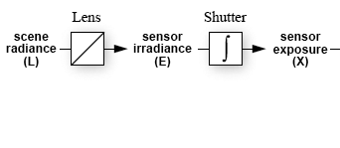
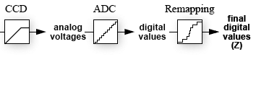
From light rays to pixel values
Camera response function: the mapping f from irradiance to pixel values
  Useful if we want to estimate material properties
  Enables us to create high dynamic range (HDR) images
  Classic reference: P. E. Debevec and J. Malik, Recovering High Dynamic Range Radiance Maps from Photographs, SIGGRAPH 97

Slide 47
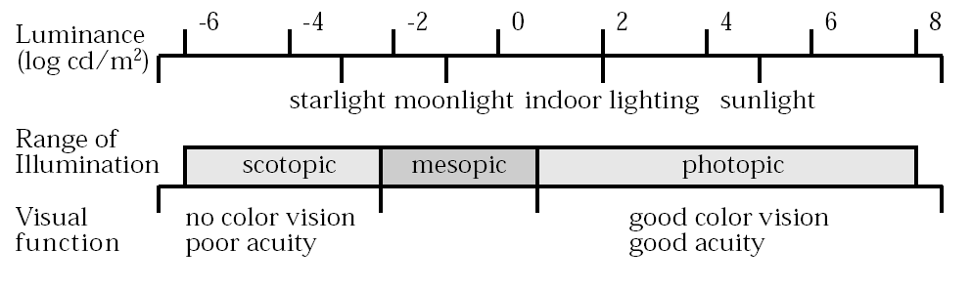
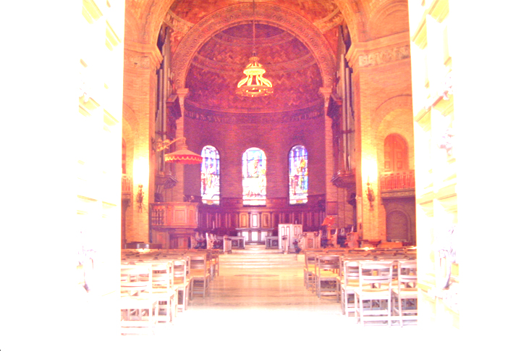
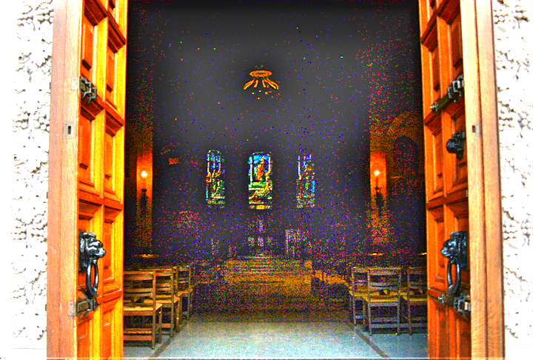
The Problem of Dynamic Range
Dynamic Range: Range of brightness values measurable with a camera
(Hood 1986)
Today’s Cameras: Limited Dynamic Range
High Exposure Image
Low Exposure Image
We need 5-10 million values to store all brightnesses around us.
But, typical 8-bit cameras provide only 256 values!!
Slide from S Narasimhan.

Slide 48
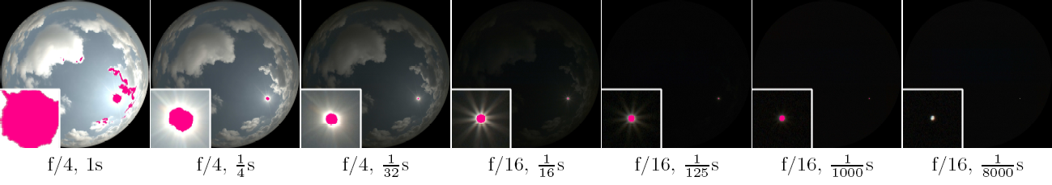
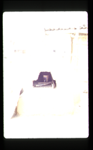

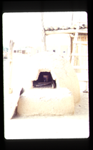

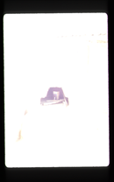

High Dynamic Range Imaging
Capture a lot of images with different exposure settings.
Apply radiometric calibration to each camera.
Combine the calibrated images (for example, using averaging weighted by exposures).
(Mitsunaga)
(Debevec)
Images taken with a fish-eye lens of the sky show the wide range of brightnesses.
Slide from S Narasimhan.

Slide 49


Basic models of reflection
Specular: light bounces off at the incident angle
  E.g., mirror
Diffuse: light scatters in all directions
  E.g., brick, cloth, rough wood
incoming light
specular reflection
$$Θ$$
$$Θ$$
incoming light
diffuse reflection
Slide from D. Hoiem

Slide 50

Other possible effects
light source
light source
transparency
refraction
Slide from D. Hoiem

Slide 51
Other possible effects
light source
λ
subsurface scattering
Slide from D. Hoiem
https://en.wikipedia.org/wiki/Subsurface_scattering#/media/File:Skin_Subsurface_Scattering.jpg

Slide 52
Other possible effects
fluorescence
phosphorescence
light source
light source
λ₁
t=1
λ₂
t>1
https://en.wikipedia.org/wiki/Fluorescence#/media/File:Fluorescent_minerals_hg.jpg
Slide from D. Hoiem

Slide 53
Overview
Cameras with lenses
  Depth of field
  Field of view
  Lens aberrations
Brightness of a pixel
  Small taste of radiometry
  In-camera transformation of light
  Reflectance properties of surfaces
  Lambertian reflection model
  Shape from shading

Slide 54



Lambertian reflectance model
Some light is absorbed (function of albedo$ρ$)
Remaining light is scattered (diffuse reflection)
Examples: soft cloth, concrete, matte paints
light source
light source
diffuse reflection
$$ρ$$
absorption
$$(1−ρ)$$
Slide from D. Hoiem
Notes:
albedo is the fraction of light reflected

Slide 55
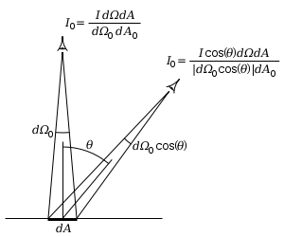
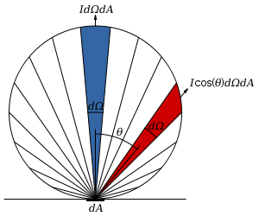

Diffuse reflection: Lambert’s cosine law
Intensity does not depend on viewer angle.
  Amount of reflected light proportional to $cos⁡(θ)$
  Visible solid angle also proportional to $cos⁡(θ)$
Slide from D. Hoiem
http://en.wikipedia.org/wiki/Lambert%27s_cosine_law

Slide 56

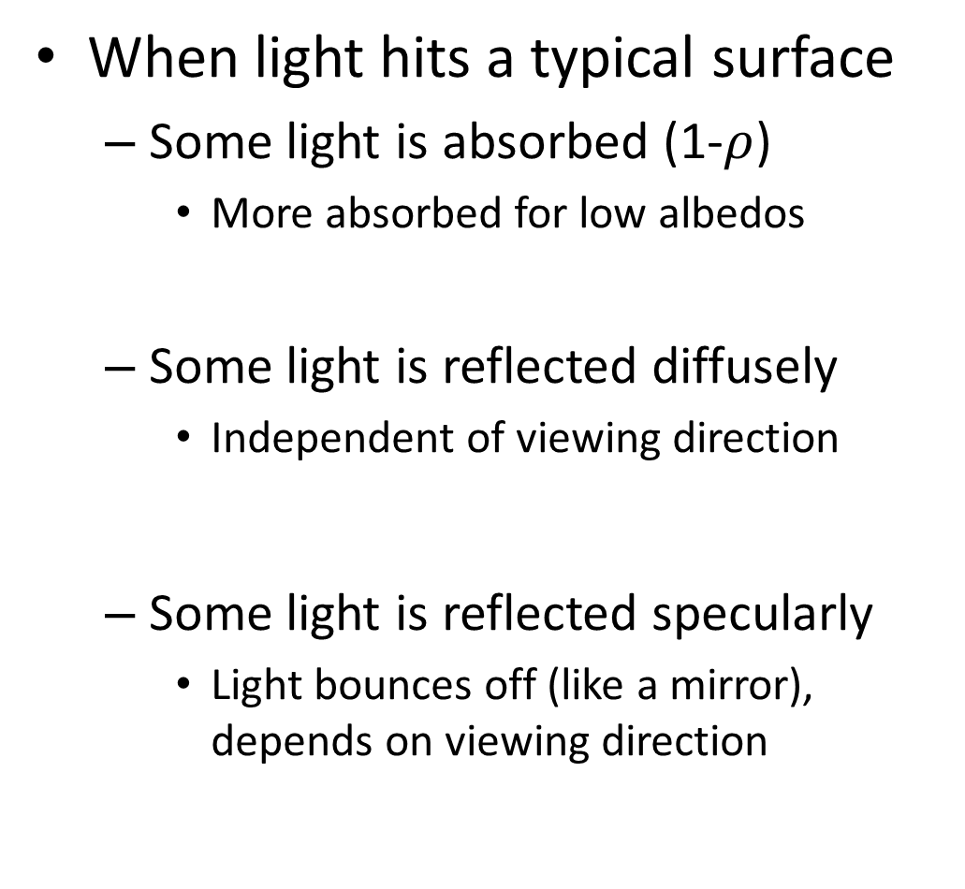

Recap
When light hits a typical surface
  Some light is absorbed (1-$ρ$)
    More absorbed for low albedos
  Some light is reflected diffusely
    Independent of viewing direction
  Some light is reflected specularly
    Light bounces off (like a mirror), depends on viewing direction
absorption
diffuse reflection
specular reflection
$$Θ$$
$$Θ$$
Slide from D. Hoiem

Slide 57

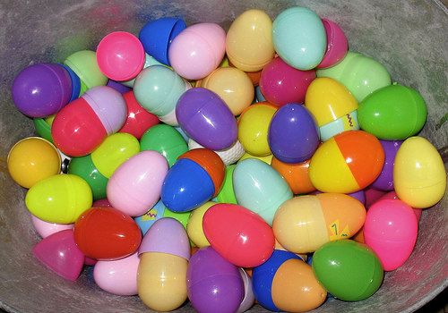


Specular Reflection
Reflected direction depends on light orientation and surface normal
  E.g., mirrors are fully specular
  Most surfaces can be modeled with a mixture of diffuse and specular components
Flickr, by suzysputnik
light source
specular reflection
$$Θ$$
$$Θ$$
Flickr, by piratejohnny
Slide from D. Hoiem

Slide 58

Most surfaces have both specular and diffuse components
Specularity = spot where specular reflection dominates (typically reflects light source)
Typically, specular component is small
Photo: northcountryhardwoodfloors.com
Slide from D. Hoiem

Slide 59



Intensity and Surface Orientation
Intensity depends on illumination angle because less light comes in at oblique angles.
$ρ=$albedo
$S=$ directional source
$N=$ surface normal
$I=$ reflected intensity
$$I\left(x\right)=ρ\left(x\right)\left(S⋅N(x)\right)$$
Slide: Forsyth

Slide 60

The interaction of light and surfaces
What happens when a light ray hits a point on an object?
  Some of the light gets absorbed
    converted to other forms of energy (e.g., heat)
  Some gets transmitted through the object
    possibly bent, through refraction
    or scattered inside the object (subsurface scattering)
  Some gets reflected
    possibly in multiple directions at once
  Really complicated things can happen
    fluorescence
Bidirectional reflectance distribution
function (BRDF)
  How bright a surface appears when viewed
  from one direction when light falls on it from
  another
  Definition: ratio of the radiance in the emitted
  direction to irradiance in the incident direction
Source: Steve Seitz

Slide 61
BRDF: Bidirectional Reflectance Distribution Function
Model of local reflection that tells how bright a surface appears when viewed from one direction when light falls on it from another
surface normal
Slide credit: S. Savarese

Slide 62







BRDFs can be incredibly complicated…

Slide 63


Diffuse reflection
Light is reflected equally in all directions
  Dull, matte surfaces like chalk or latex paint
  Microfacets scatter incoming light randomly
Brightness of the surface depends on
the incidence of illumination
brighter
darker

Slide 64

Diffuse reflection: Lambert’s law
N
S
θ
B: radiosity (total power leaving the surface per unit area)
ρ: albedo (fraction of incident irradiance reflected by the surface)
N: unit normal
S: source vector (magnitude proportional to intensity of the source)
Slide from L. Lazebnik
Notes:
BRDF is constant
Albedo: fraction of incident irradiance reflected by the surface
Radiosity: total power leaving the surface per unit area (regardless of direction)

Slide 65




Specular reflection
Radiation arriving along a source direction leaves along the specular direction (source direction reflected about normal)
On real surfaces, energy usually goes into a lobe of directions
Phong model: reflected energy falls of with
Moving the light source
Changing the exponent
Slide from L. Lazebnik

Slide 66

Specular reflection
Picture source
Slide from L. Lazebnik

Slide 67

Photometric stereo (shape from shading)
Can we reconstruct the shape of an object based on shading cues?
Luca della Robbia,
Cantoria, 1438
Slide from L. Lazebnik

Slide 68
Photometric stereo
Assume:
  A Lambertian object
  A local shading model (each point on a surface receives light only from sources visible at that point)
  A set of known light source directions
  A set of pictures of an object, obtained in exactly the same camera/object configuration but using different sources
  Orthographic projection
Goal: reconstruct object shape and albedo
S₂
S_{n}
S₁
???
Slide from L. Lazebnik
F&P 2nd ed., sec. 2.2.4

Slide 69








Example 1
Recovered albedo
Recovered normal field
Recovered surface model
Slide from L. Lazebnik
F&P 2nd ed., sec. 2.2.4

Slide 70











Example 2
Input
…
Recovered albedo
Recovered surface model
Recovered normal field
x
y
z
Slide from L. Lazebnik

Slide 71

Image model
Known: source vectors S_{j} and pixel values I_{j}(x,y)
Unknown: surface normal N(x,y) and albedo ρ(x,y)
Slide from L. Lazebnik
F&P 2nd ed., sec. 2.2.4

Slide 72
Image model
Known: source vectors S_{j} and pixel values I_{j}(x,y)
Unknown: surface normal N(x,y) and albedo ρ(x,y)
Assume that the response function of the camera is a linear scaling by a factor of k
Lambert’s law:
Slide from L. Lazebnik
F&P 2nd ed., sec. 2.2.4

Slide 73
Least squares problem
For each pixel, set up a linear system:
(n × 1)
(n × 3)
(3 × 1)
known
known
unknown
Obtain least-squares solution for g(x,y)
(which we defined as N(x,y) ρ (x,y))
Since N(x,y) is the unit normal, ρ (x,y) is given by the magnitude of g(x,y)
Finally, N(x,y) = g(x,y) / ρ (x,y)
Slide from L. Lazebnik
F&P 2nd ed., sec. 2.2.4

Slide 74
Synthetic example
Recovered albedo
Recovered normal field
Slide from L. Lazebnik
F&P 2nd ed., sec. 2.2.4

Slide 75
Recovering a surface from normals
Recall the surface is written as
This means the normal has the form:
If we write the estimated vector g as
Then we obtain values for the partial derivatives of the surface:
Slide from L. Lazebnik
F&P 2nd ed., sec. 2.2.4

Slide 76
Recovering a surface from normals
We can now recover the surface height at any point by integration along some path, e.g.
Integrability: for the surface f to exist, the mixed second partial derivatives must be equal:
(for robustness, should take integrals over many different paths and average the results)
(in practice, they should at least be similar)
Slide from L. Lazebnik
F&P 2nd ed., sec. 2.2.4

Slide 77
Surface recovered by integration
Slide from L. Lazebnik
F&P 2nd ed., sec. 2.2.4

Slide 78
Limitations
Orthographic camera model
Simplistic reflectance and lighting model
No shadows
No interreflections
No missing data
Integration is tricky
Slide from L. Lazebnik

Slide 79


Finding the direction of the light source
I(x,y) = N(x,y) ·S(x,y)
Full 3D case:
N
S
P. Nillius and J.-O. Eklundh, “Automatic estimation of the projected light source direction,” CVPR 2001
Notes:
We assume the object has uniform albedo, which gets “rolled into” the magnitude of the light source term

Slide 80
Finding the direction of the light source
Consider points on the occluding contour:
N_{z} = 0
N_{z} positive
N_{z} negative
Image
Projection direction (z)
P. Nillius and J.-O. Eklundh, “Automatic estimation of the projected light source direction,” CVPR 2001
Notes:
We assume the object has uniform albedo, which gets “rolled into” the magnitude of the light source term

Slide 81

Finding the direction of the light source
I(x,y) = N(x,y) ·S(x,y)
Full 3D case:
N
S
For points on the occluding contour, N_{z} = 0:
P. Nillius and J.-O. Eklundh, “Automatic estimation of the projected light source direction,” CVPR 2001
Notes:
We assume the object has uniform albedo, which gets “rolled into” the magnitude of the light source term

Slide 82

Finding the direction of the light source
P. Nillius and J.-O. Eklundh, “Automatic estimation of the projected light source direction,” CVPR 2001

Slide 83

Application: Detecting composite photos
Real photo
Fake photo
M. K. Johnson and H. Farid, Exposing Digital Forgeries by Detecting Inconsistencies in Lighting, ACM Multimedia and Security Workshop, 2005.

