Slide 1
Color
CS 543 / ECE 549 – Saurabh Gupta
Spring 2021, UIUC
http://saurabhg.web.illinois.edu/teaching/ece549/sp2021/
Many slides adapted from S. Seitz, L. Lazebnik, J. Hayes, S. Palmer

Slide 2
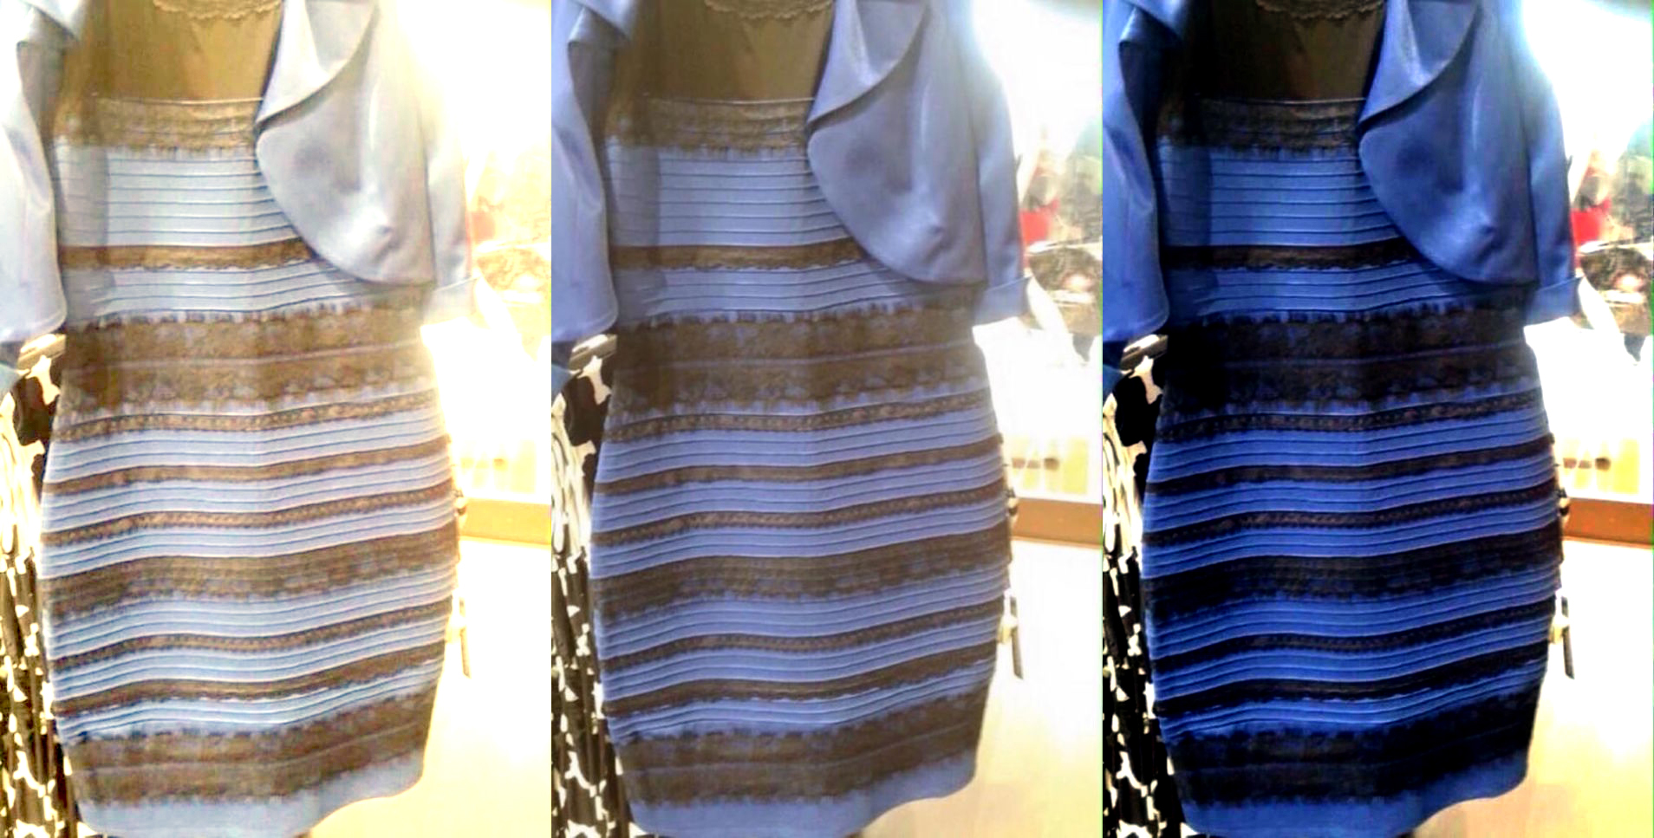
While we wait, what color is the dress?
Today,
Light & Shading
Color
Dynamic Perspective
A. White and gold
B. Blue and Black
C. Other (use chat)
https://www.wired.com/2015/02/science-one-agrees-color-dress/
Slide by L. Lazebnik

Slide 3
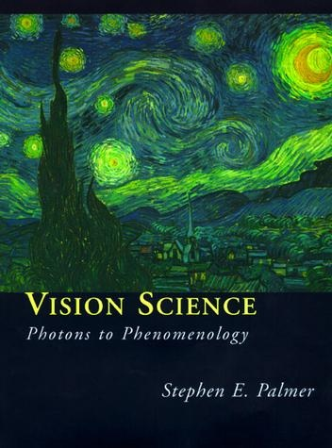
What is color?
Color is the result of interaction between physical light in the environment and our visual system
Color is a psychological property of our visual experiences when we look at objects and lights,
not a physical property of those objects or lights
(S. Palmer, Vision Science: Photons to Phenomenology)
Slide by L. Lazebnik

Slide 4
Outline
Physical origin of color
Spectra of sources and surfaces
Physiology of color vision
Trichromatic color theory
Color spaces
Color constancy, white balance

Slide 5
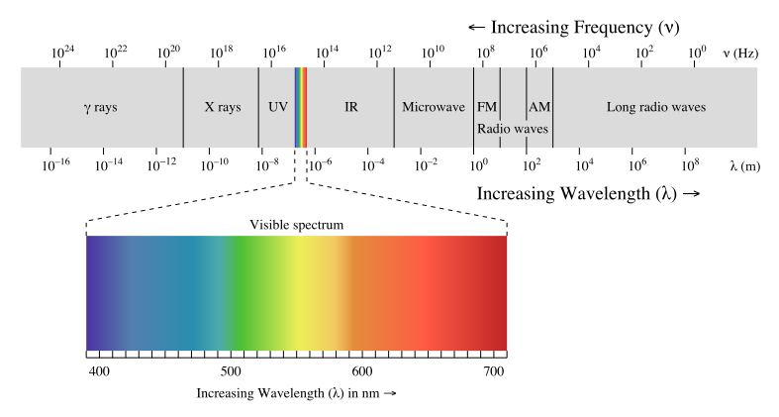
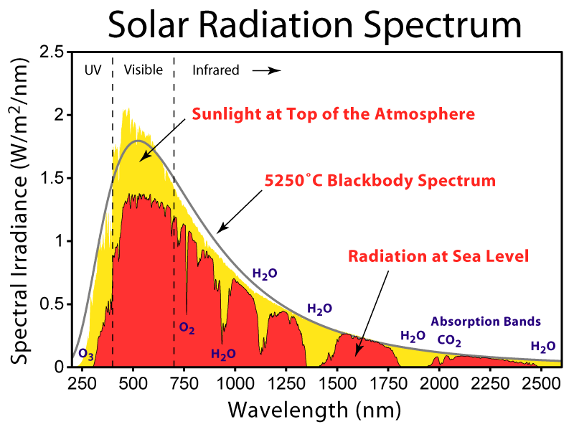

Electromagnetic spectrum
Human Luminance Sensitivity Function
Slide by L. Lazebnik

Slide 6
The Physics of Light
Any source of light can be completely described
physically by its spectrum: the amount of energy emitted
(per time unit) at each wavelength 400 - 700 nm.
Relative
spectral
power
© Stephen E. Palmer, 2002

Slide 7
Spectra of Light Sources
Some examples of the spectra of light sources
Rel. power
Rel. power
Rel. power
Rel. power
© Stephen E. Palmer, 2002

Slide 8
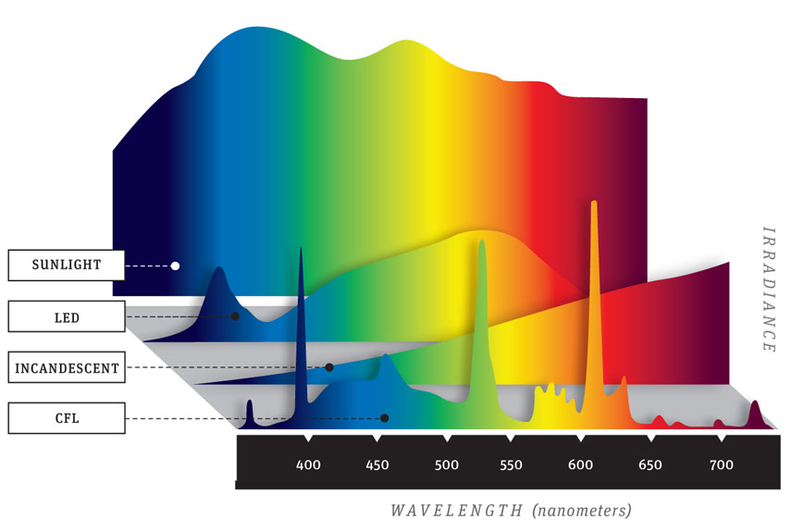
Spectra of light sources
Source: Popular Mechanics
Slide by L. Lazebnik

Slide 9
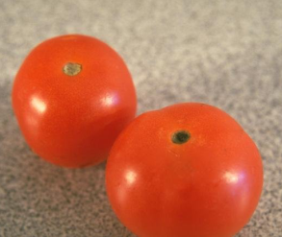
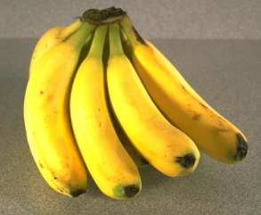
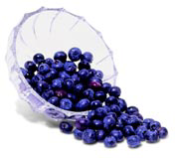
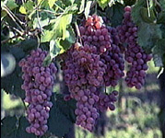
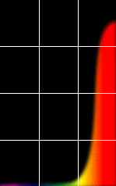
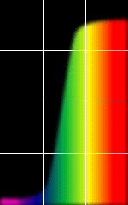
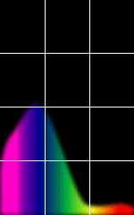
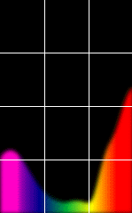
Reflectance Spectra of Surfaces
Some examples of the reflectance spectra of surfaces
Red
Yellow
Blue
Purple
% Light Reflected
400 700
400 700
400 700
400 700
Wavelength (nm)
© Stephen E. Palmer, 2002

Slide 10
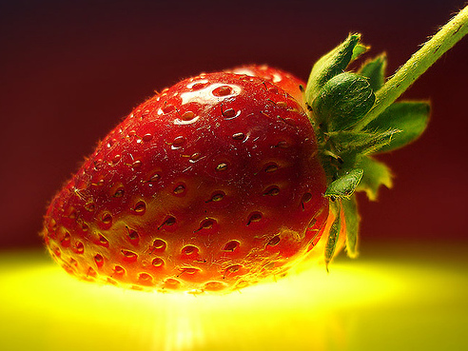
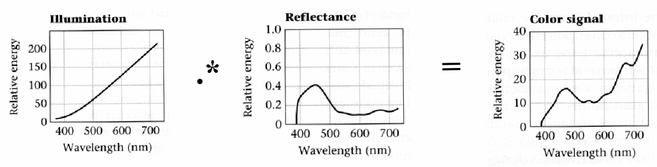
Interaction of light and surfaces
Reflected color is the result of interaction of light source spectrum with surface reflectance
Slide by L. Lazebnik

Slide 11
So, what is the dimensionality of color?
A. 3
B. (255)^3
C. 255
D. Infinite

Slide 12
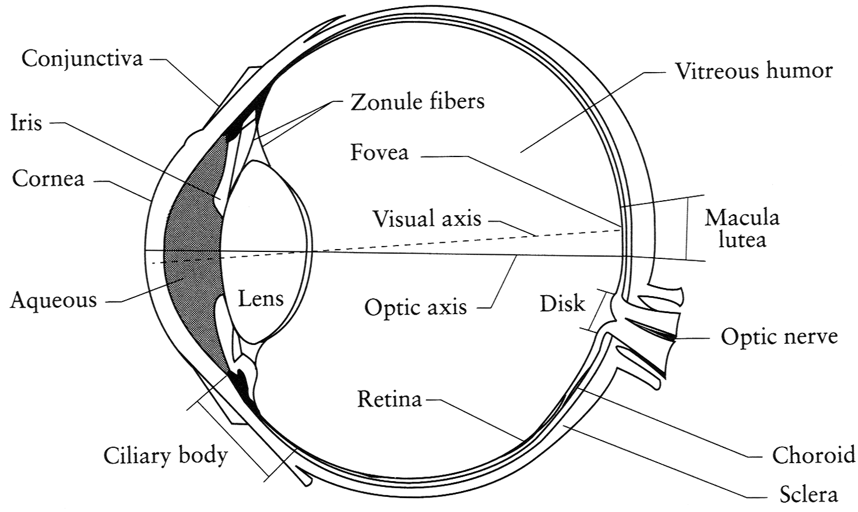
The Eye
The human eye is a camera!
  Lens - changes shape by using ciliary muscles (to focus on objects at different distances)
  Pupil - the hole (aperture) whose size is controlled by the iris
  Iris - colored annulus with radial muscles
  Retina - photoreceptor cells
Slide by Steve Seitz

Slide 13
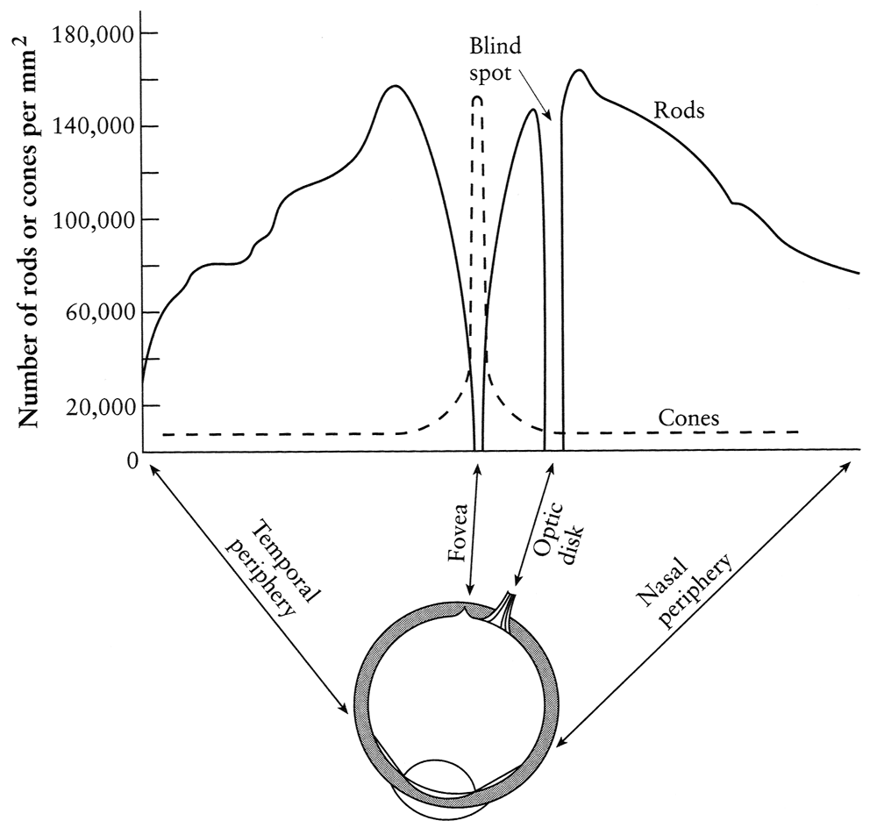
Rods and cones, fovea
pigment
molecules
Rods are responsible for intensity, cones for color perception
Rods and cones are non-uniformly distributed on the retina
  Fovea - Small region (1 or 2°) at the center of the visual field containing the highest density of cones – and no rods
Slide by Steve Seitz

Slide 14
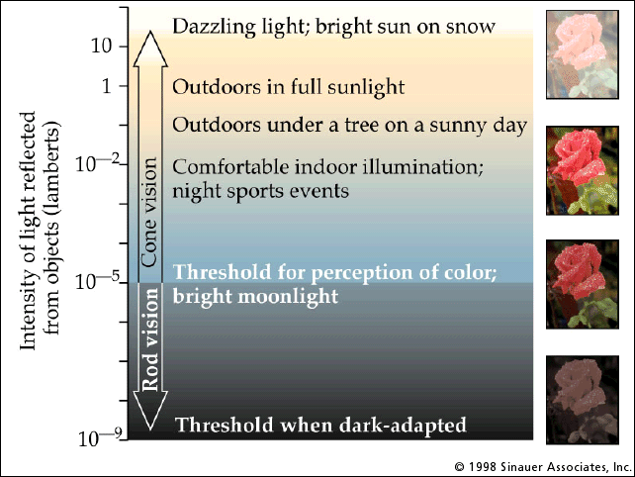
Rod / Cone sensitivity
Why can’t we read in the dark?
Slide by A. Efros

Slide 15
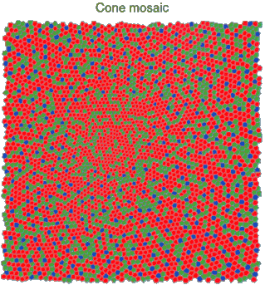
Physiology of Color Vision
Three kinds of cones:
Ratio of L to M to S cones: approx. 10:5:1
Almost no S cones in the center of the fovea
© Stephen E. Palmer, 2002

Slide 16
Physiology of Color Vision: Fun facts
“M” and “L” pigments are encoded on the
X-chromosome
  That’s why men are more likely to be color blind
  “L” gene has high variation, so some women may be tetrachromatic
Some animals have one (night animals), two (e.g., dogs), four (fish, birds), five (pigeons, some reptiles/amphibians), or even 12 (mantis shrimp) types of cones
  http://ngm.nationalgeographic.com/2016/02/evolution-of-eyes-text
http://en.wikipedia.org/wiki/Color_vision
Slide by D. Hoiem

Slide 17
Color perception
M
L
Power
S
Wavelength
Rods and cones act as filters on the spectrum
  To get the output of a filter, multiply its response curve by the spectrum, integrate over all wavelengths
    Each cone yields one number
  How can we represent an entire spectrum with three numbers?
  We can’t! Most of the information is lost
    As a result, two different spectra may appear indistinguishable
      such spectra are known as metamers
Slide by Steve Seitz

Slide 18
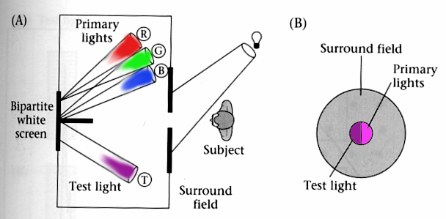
Color matching experiments
We would like to understand which spectra produce the same color sensation in people under similar viewing conditions
Slide by L. Lazebnik
Wandell, Foundations of Vision, 1995

Slide 19
Color matching experiment 1
Source: W. Freeman

Slide 20
Color matching experiment 1
p₁ p₂ p₃
Source: W. Freeman

Slide 21
Color matching experiment 1
p₁ p₂ p₃
Source: W. Freeman

Slide 22
Color matching experiment 1
The primary color amounts needed for a match
p₁ p₂ p₃
Source: W. Freeman

Slide 23
Color matching experiment 2
Source: W. Freeman

Slide 24
Color matching experiment 2
p₁ p₂ p₃
Source: W. Freeman

Slide 25
Color matching experiment 2
p₁ p₂ p₃
Source: W. Freeman

Slide 26
Color matching experiment 2
The primary color amounts needed for a match:
We say a “negative” amount of p₂ was needed to make the match, because we added it to the test color’s side.
p₁ p₂ p₃
p₁ p₂ p₃
p₁ p₂ p₃
Source: W. Freeman

Slide 27
Trichromacy
In color matching experiments, most people can match any given light with three primaries
  Primaries must be independent
For the same light and same primaries, most people select the same weights
  Exception: color blindness
Trichromatic color theory
  Three numbers seem to be sufficient for encoding color
  Dates back to 18th century (Thomas Young)
https://en.wikipedia.org/wiki/Young_Helmholtz_theory
Slide by L. Lazebnik

Slide 28


Artificial Cones
Estimate RGB at ‘G’ cells from neighboring values.
Slide by Steve Seitz

Slide 29
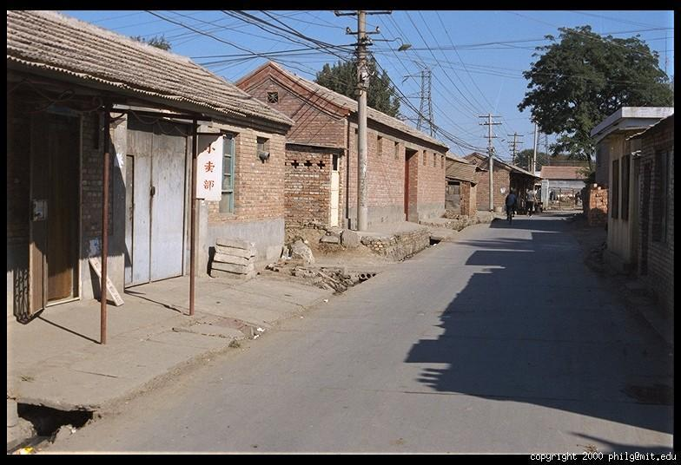
Color Image
Slide Credit: J. Hays

Slide 30
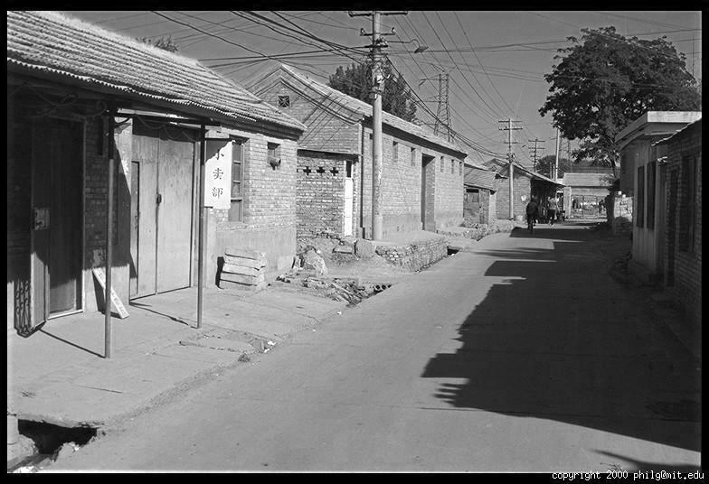
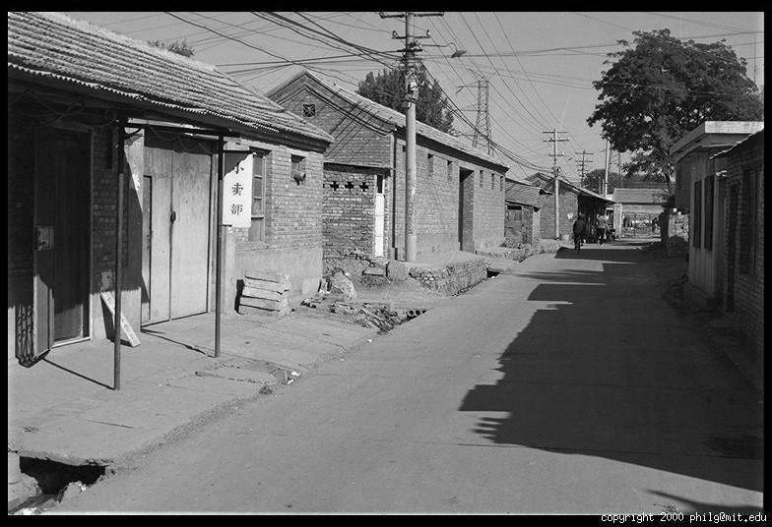
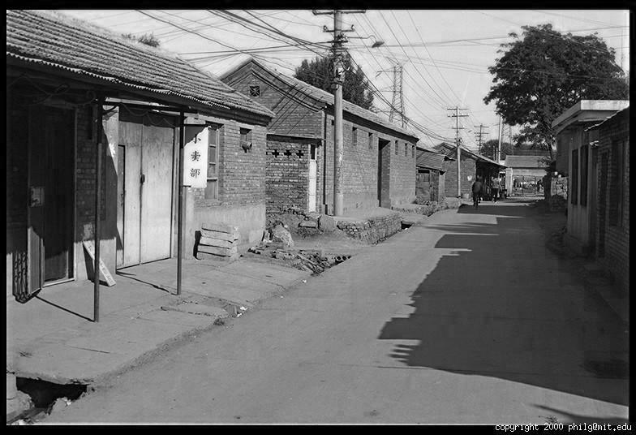
Color Image
Combined
Red
Green
Blue
Slide Credit: J. Hays

Slide 31
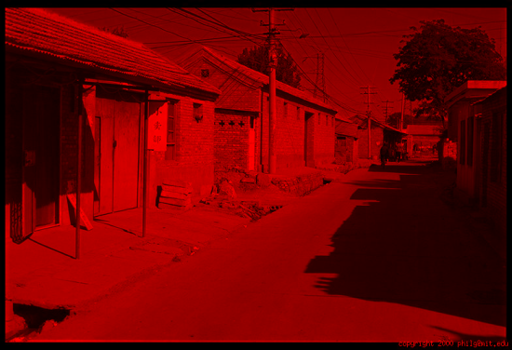
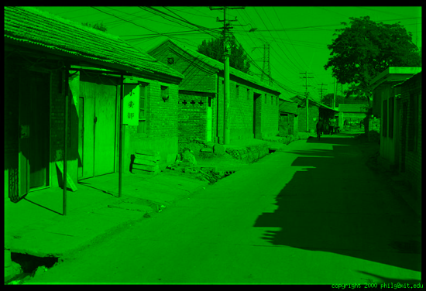
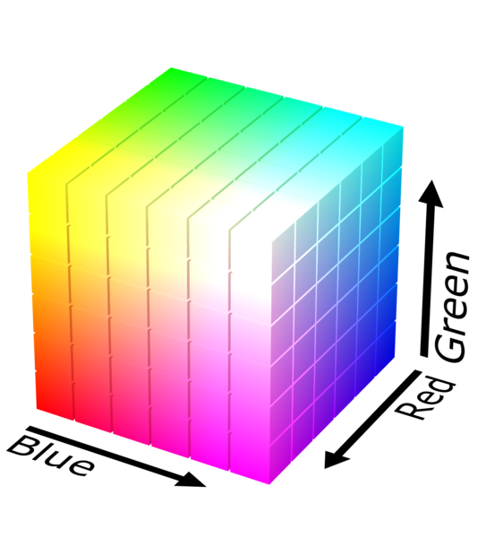
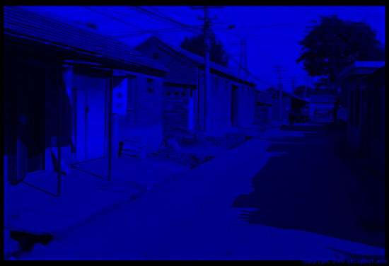
One Option: RGB
Pros
1. Simple
2. Common
R
Cons
1. Distances don’t make sense
2. Correlated
G
B
Slide Credit: J. Hays, RGB cube: https://en.wikipedia.org/wiki/RGB_color_model

Slide 32
RGB
Photo credit: J. Hays

Slide 33
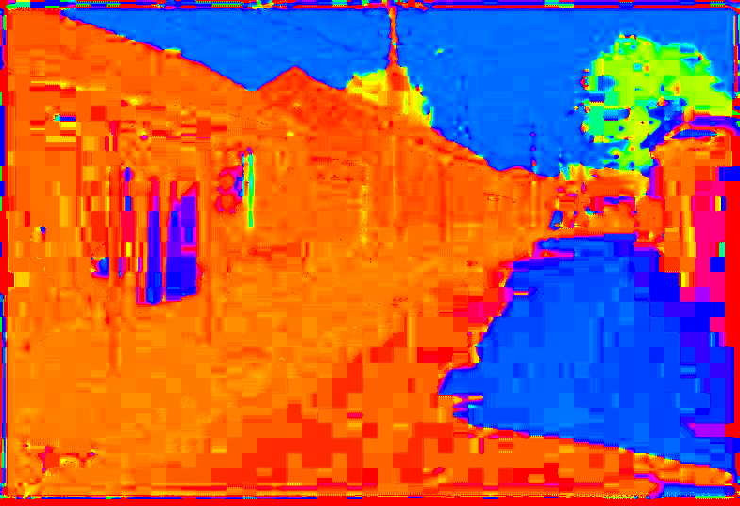
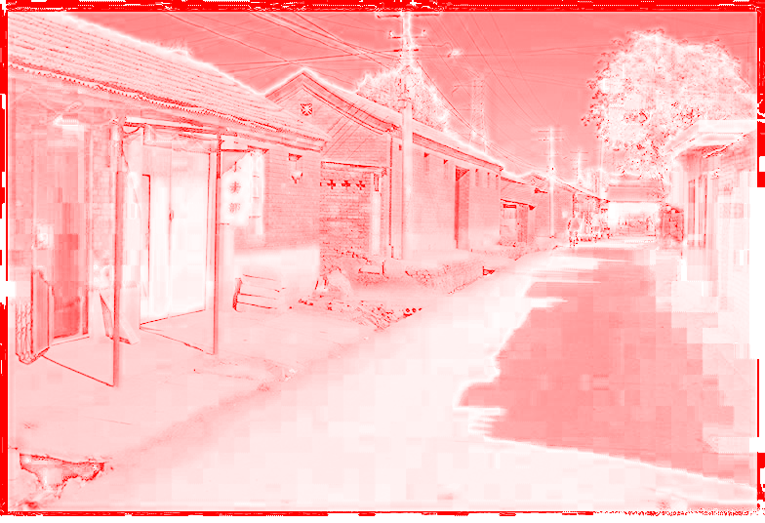
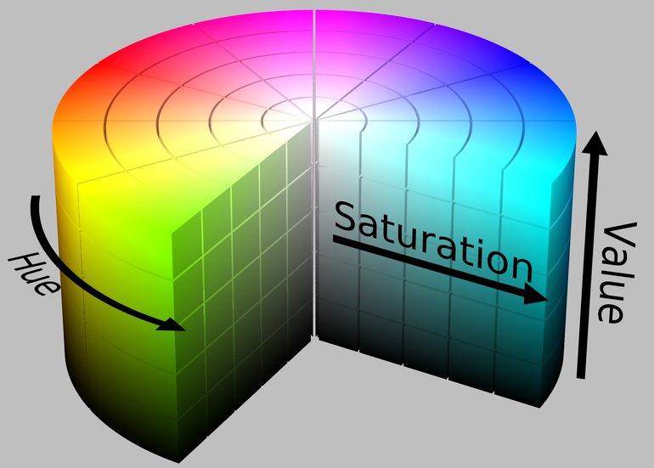
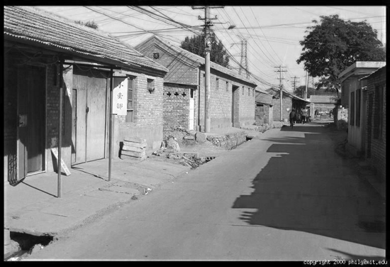
Another Option: HSV
Pros
1. Intuitive for picking colors
2. Sort of common
3. Fast to convert
H
(S=1,V=1)
Cons
1. Not as perceptual
S
(H=1,V=1)
V
(H=1,S=0)
Slide Credit: J. Hays, HSV cylinder: https://en.wikipedia.org/wiki/HSL_and_HSV

Slide 34
HSV
Photo credit: J. Hays

Slide 35
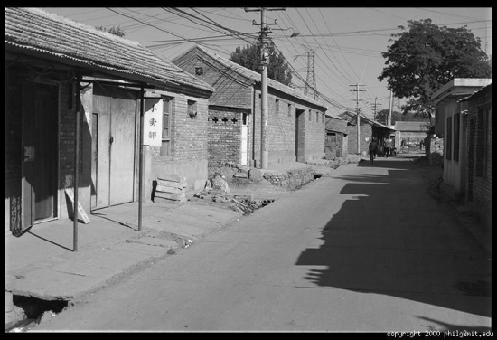
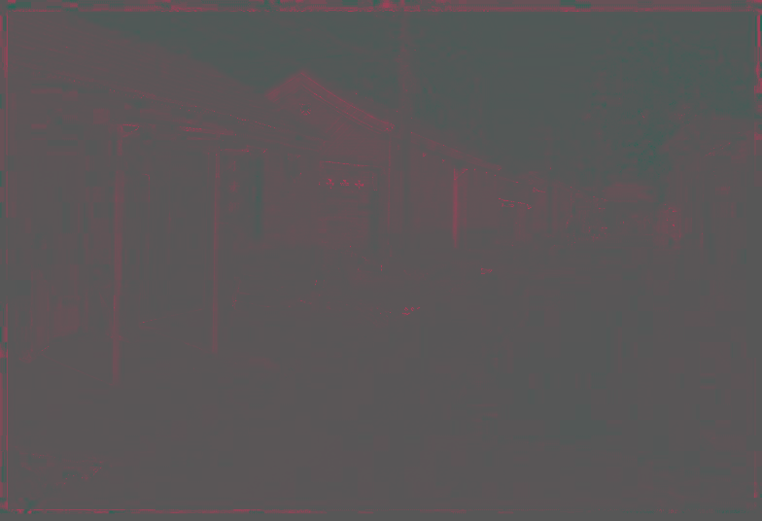
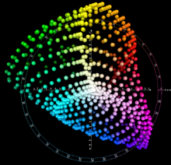

Another Option: Lab
Pros
1. Distances correspond with human judgment
L
(a=0,b=0)
Cons
1. Complex to calculate
a
(L=65,b=0)
b
(L=65,a=0)
Slide Credit: J. Hays, Lab diagram cube: https://en.wikipedia.org/wiki/CIELAB_color_space

Slide 36
Lab
Photo credit: J. Hays

Slide 37
Why Are There So Many?
Each serves different functions
  RGB: sort of intuitive, standard, everywhere
  HSV: good for picking, fast to compute
  YCbCr/YUV: fast to compute, compresses well
  Lab: the right(?) thing to do, but “slow” to compute
Pick based on what you need and don’t sweat it: color really isn’t crucial

Slide 38
Color perception
Color/lightness constancy
  The ability of the human visual system to perceive the intrinsic reflectance properties of the surfaces despite changes in illumination conditions
Slide by L. Lazebnik

Slide 39
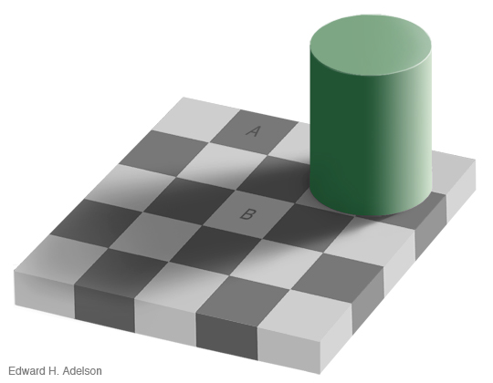
Checker shadow illusion
https://en.wikipedia.org/wiki/Checker_shadow_illusion
Slide by L. Lazebnik

Slide 40
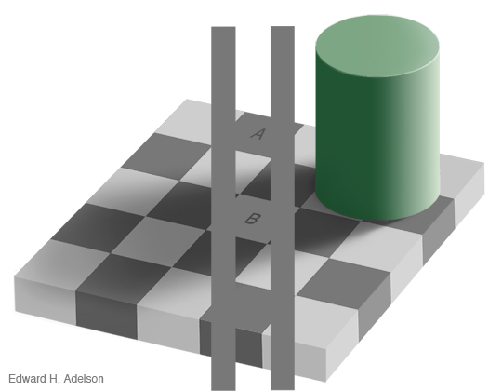
Checker shadow illusion
Possible explanations
  Simultaneous contrast
  Reflectance edges vs. illumination edges
https://en.wikipedia.org/wiki/Checker_shadow_illusion
Slide by L. Lazebnik

Slide 41
What color is the dress?
https://www.wired.com/2015/02/science-one-agrees-color-dress/
Slide by L. Lazebnik

Slide 42
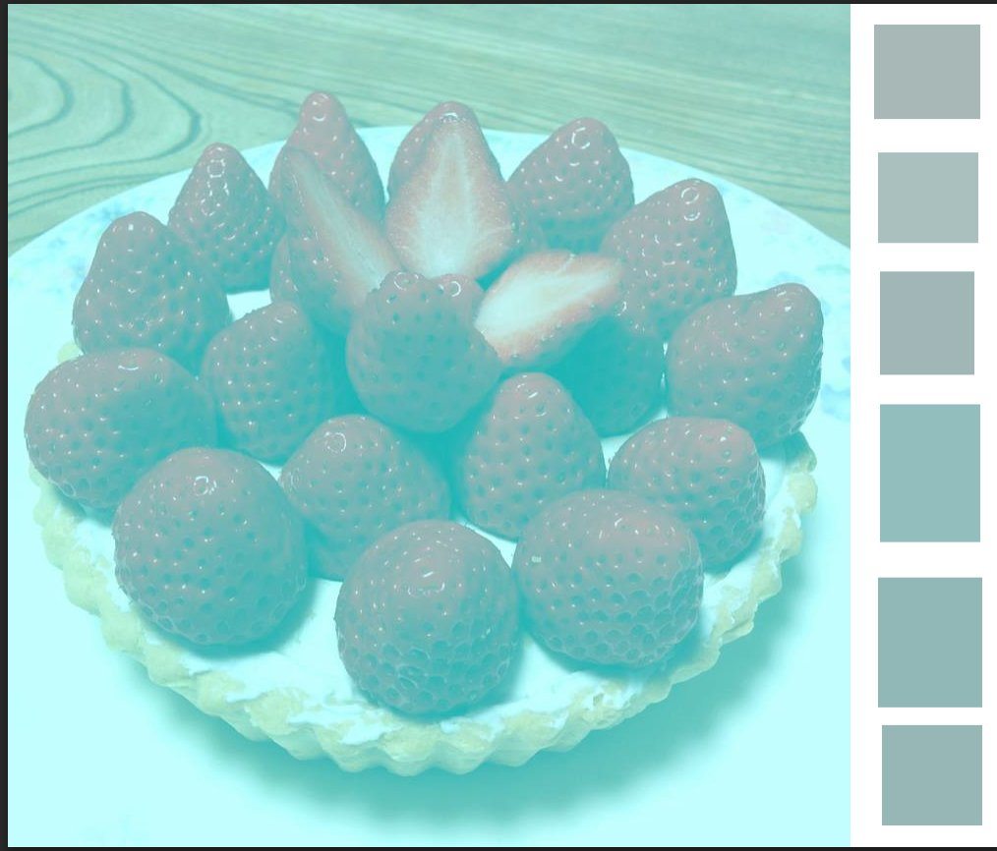
This strawberry cake has no red pixels!
https://www.digitaltrends.com/photography/non-red-strawberries/
Slide by L. Lazebnik
Notes:
From the website: When the brain sees the blueish tint to the photograph, it assumes the blue is not from the objects but from the light source and subtracts that blue as an automatic color correction. “Your brain says, ‘the light source that I am viewing these strawberries under has some blue component to it, so I’m going to subtract that automatically from every pixel.’ And when you take gray pixels and subtract out the blue bias, you end up with red,” the National Eye Institute’s Bevil Conway told Motherboard.

Slide 43
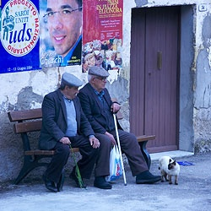
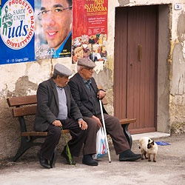
White balance
Analogous to color constancy mechanisms in human vision, cameras have mechanisms to adapt to the illumination in the environment so that neutral (white or gray) objects look neutral
Incorrect white balance
Correct white balance
http://www.cambridgeincolour.com/tutorials/white-balance.htm
Slide by L. Lazebnik

Slide 44
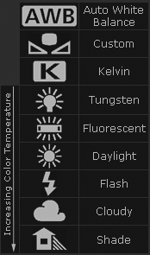
White balance
Film cameras:
  Different types of film or different filters for different illumination conditions
Digital cameras:
  Automatic white balance
  White balance settings corresponding to
  several common illuminants
  Custom white balance using a reference
  object
http://www.cambridgeincolour.com/tutorials/white-balance.htm
Slide by L. Lazebnik

Slide 45
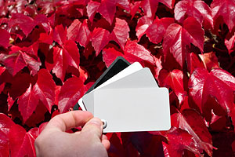
White balance
Von Kries adaptation: Multiply each channel
by a gain factor
Best way: gray card
  Take a picture of a neutral object (white or gray)
  If the object is recorded as r_{w}, g_{w}, b_{w} use weights 1/r_{w}, 1/g_{w}, 1/b_{w}
Slide by L. Lazebnik

Slide 46
White balance
Without gray cards: we need to “guess” which pixels correspond to white objects
Gray world assumption
  The image average r_{ave}, g_{ave}, b_{ave} is gray
  Use weights 1/r_{ave}, 1/g_{ave}, 1/b_{ave}
Brightest pixel assumption
  Highlights usually have the color of the light source
  Use weights inversely proportional to the values of the brightest pixels
Gamut mapping
  Gamut: convex hull of all pixel colors in an image
  Find the transformation that matches the gamut of the image to the gamut of a “typical” image under white light
Use image statistics, learning techniques
Slide by L. Lazebnik

Slide 47
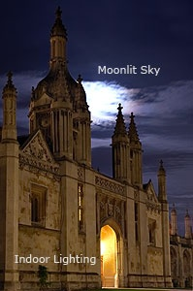
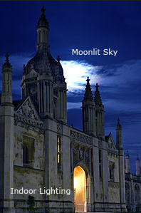
Mixed illumination
When there are several types of illuminants in the scene, different reference points will yield different results
Reference: moon
Reference: stone
http://www.cambridgeincolour.com/tutorials/white-balance.htm
Slide by L. Lazebnik

Slide 48
Outline
Physical origin of color
Spectra of sources and surfaces
Physiology of color vision
Trichromatic color theory
Color spaces
Color constancy, white balance

