Slide 1
Dynamic Perspective
CS 543 / ECE 549 – Saurabh Gupta
Spring 2021, UIUC
http://saurabhg.web.illinois.edu/teaching/ece549/sp2021/
Many slides adapted from J. Malik.

Slide 2
Perspective Projection
P
Y
$\left(X,Y,Z\right)→\left(\frac{fX}{Z},\frac{fY}{Z}\right)$
f
Z
O
y
Suppose the camera moves with respect to the world…
p
Point P $(X,Y,Z)$ in the world moves relative to the camera, its projection in the image $(x,y)$ moves as well.
This movement in the image plane is called optical flow.
Suppose the image of the point $(x,y)$ moves to $(x+∆x, y+∆y)$ in time $∆t$, then $\left(\frac{Δx}{Δt}, \frac{Δy}{Δt }\right)$ are the two components of the optical flow.

Slide 3
Outline
Relate optical flow to camera motion
Special cases

Slide 4
How does a point X in the scene move?
Assume that the camera moves with a translational velocity $t=(t_{x}, t_{y}, t_{z})$ and angular velocity $ω=\left(ω_{x}, ω_{y}, ω_{z}\right).$
Linear velocity of point $P=\left(X,Y,Z\right)$ is given by $\dot{P}=−t −ω×P.$
$\left[\dot{\begin{aligned}X \\ \dot{Y} \\ \dot{Z}\end{aligned}}\right]=−\left[\begin{aligned}t_{x} \\ t_{y} \\ t_{z}\end{aligned}\right] −$ $\left[\begin{aligned}ω_{y}Z−ω_{z}Y \\ ω_{z}X−ω_{x}Z \\ ω_{x}Y−ω_{y}X\end{aligned}\right]$

Slide 5
Now, lets consider the effect of projection
$\left[\dot{\begin{aligned}X \\ \dot{Y} \\ \dot{Z}\end{aligned}}\right]=−\left[\begin{aligned}t_{x} \\ t_{y} \\ t_{z}\end{aligned}\right] −$ $\left[\begin{aligned}ω_{y}Z−ω_{z}Y \\ ω_{z}X−ω_{x}Z \\ ω_{x}Y−ω_{y}X\end{aligned}\right]$
Assume, $f=1$, $x=\frac{X}{Z}, y=\frac{Y}{Z}.$
$\dot{x}=\frac{\dot{X}Z−\dot{Z}X}{Z^{2}}$, $\dot{y}=\frac{\dot{Y}Z−\dot{Z}Y}{Z^{2}}$
Substitute $\dot{X,}\dot{Y},\dot{Z}$, from equation above:
$$\left[\begin{aligned}u \\ v\end{aligned}\right]=\left[\begin{aligned}\dot{x} \\ \dot{y}\end{aligned}\right]=\frac{1}{Z}\left[\begin{matrix}−1 & 0 & x \\ 0 & −1 & y\end{matrix}\right]\left[\begin{aligned}t_{x} \\ t_{y} \\ t_{z}\end{aligned}\right]+\left[\begin{matrix}xy & −\left(1+x^{2}\right) & y \\ (1+y^{2}) & −xy & −x\end{matrix}\right]\left[\begin{aligned}ω_{x} \\ ω_{y} \\ ω_{z}\end{aligned}\right]$$

Slide 6
Dynamic Perspective Equations
$$\left[\begin{aligned}u \\ v\end{aligned}\right]=\left[\begin{aligned}\dot{x} \\ \dot{y}\end{aligned}\right]=\frac{1}{Z}\left[\begin{matrix}−1 & 0 & x \\ 0 & −1 & y\end{matrix}\right]\left[\begin{aligned}t_{x} \\ t_{y} \\ t_{z}\end{aligned}\right]+\left[\begin{matrix}xy & −\left(1+x^{2}\right) & y \\ (1+y^{2}) & −xy & −x\end{matrix}\right]\left[\begin{aligned}ω_{x} \\ ω_{y} \\ ω_{z}\end{aligned}\right]$$
Translation Component
Rotation Component

Slide 7
Optical flow for pure rotation
$$\left[\begin{aligned}u \\ v\end{aligned}\right]=\left[\begin{aligned}\dot{x} \\ \dot{y}\end{aligned}\right]=\frac{1}{Z}\left[\begin{matrix}−1 & 0 & x \\ 0 & −1 & y\end{matrix}\right]\left[\begin{aligned}t_{x} \\ t_{y} \\ t_{z}\end{aligned}\right]+\left[\begin{matrix}xy & −\left(1+x^{2}\right) & y \\ (1+y^{2}) & −xy & −x\end{matrix}\right]\left[\begin{aligned}ω_{x} \\ ω_{y} \\ ω_{z}\end{aligned}\right]$$
$\left[\begin{aligned}u \\ v\end{aligned}\right]=\left[\begin{matrix}xy & −\left(1+x^{2}\right) & y \\ (1+y^{2}) & −xy & −x\end{matrix}\right]\left[\begin{aligned}ω_{x} \\ ω_{y} \\ ω_{z}\end{aligned}\right]$
We can determine $ω$ from the flow field.
Flow field is independent of $Z(x,y)$.

Slide 8
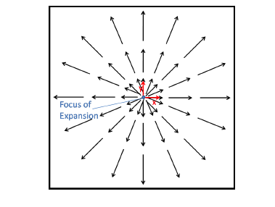
Optical flow for pure translation along Z-axis
$$\left[\begin{aligned}u \\ v\end{aligned}\right]=\left[\begin{aligned}\dot{x} \\ \dot{y}\end{aligned}\right]=\frac{1}{Z}\left[\begin{matrix}−1 & 0 & x \\ 0 & −1 & y\end{matrix}\right]\left[\begin{aligned}t_{x} \\ t_{y} \\ t_{z}\end{aligned}\right]+\left[\begin{matrix}xy & −\left(1+x^{2}\right) & y \\ (1+y^{2}) & −xy & −x\end{matrix}\right]\left[\begin{aligned}ω_{x} \\ ω_{y} \\ ω_{z}\end{aligned}\right]$$
$\left[\begin{aligned}u \\ v\end{aligned}\right]=\frac{t_{z}}{Z(x,y)}\left[\begin{aligned}x \\ y\end{aligned}\right]$
Optical flow vector is a scalar multiple of position vector.
Scale factor ambiguity, if $t_{z}→kt_{z}$, and $Z→kZ$, optical flow remains unchanged.
But, you can get time to collision, $Z/t_{z}$.

Slide 13
Optical flow for pure translation along Z-axis
$$\left[\begin{aligned}u \\ v\end{aligned}\right]=\left[\begin{aligned}\dot{x} \\ \dot{y}\end{aligned}\right]=\frac{1}{Z}\left[\begin{matrix}−1 & 0 & x \\ 0 & −1 & y\end{matrix}\right]\left[\begin{aligned}t_{x} \\ t_{y} \\ t_{z}\end{aligned}\right]+\left[\begin{matrix}xy & −\left(1+x^{2}\right) & y \\ (1+y^{2}) & −xy & −x\end{matrix}\right]\left[\begin{aligned}ω_{x} \\ ω_{y} \\ ω_{z}\end{aligned}\right]$$
$u=\frac{−t_{x}+xt_{z}}{Z(x,y)}\text{, }v=\frac{−t_{y}+yt_{z}}{Z(x,y)}$

Slide 14
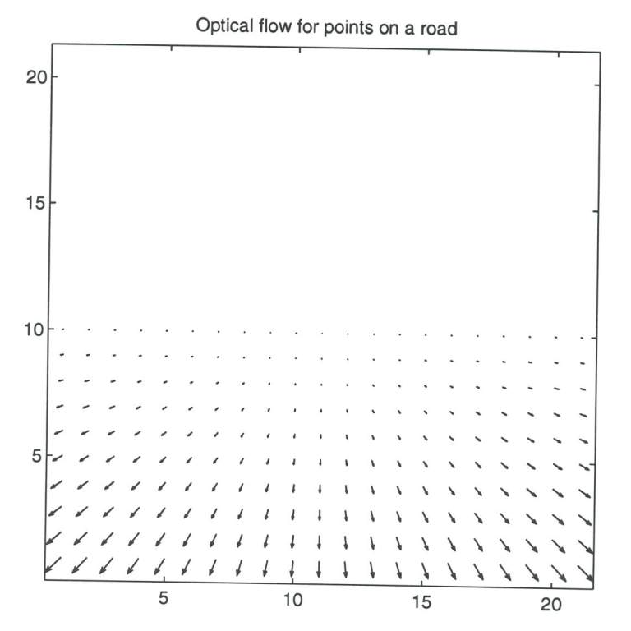
Optical flow for points on a road
Slide by J. Malik

Slide 15
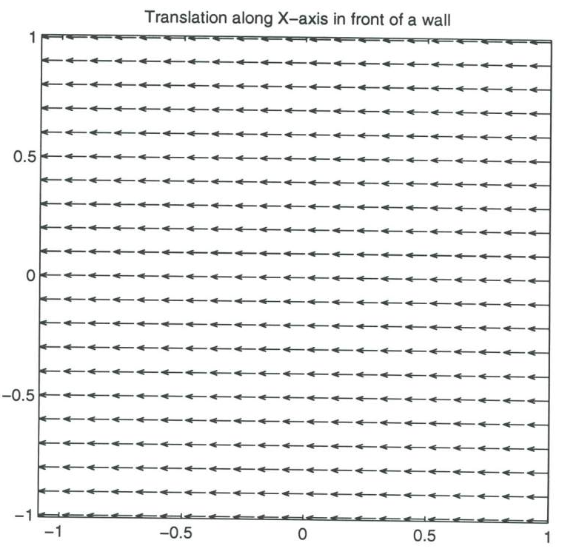
Translating along X-axis in front of a wall
Slide by J. Malik

Slide 16
Recap
Relate optical flow to camera motion
Special cases
Pure rotation / pure translation / time to collision
$$\left[\begin{aligned}u \\ v\end{aligned}\right]=\left[\begin{aligned}\dot{x} \\ \dot{y}\end{aligned}\right]=\frac{1}{Z}\left[\begin{matrix}−1 & 0 & x \\ 0 & −1 & y\end{matrix}\right]\left[\begin{aligned}t_{x} \\ t_{y} \\ t_{z}\end{aligned}\right]+\left[\begin{matrix}xy & −\left(1+x^{2}\right) & y \\ (1+y^{2}) & −xy & −x\end{matrix}\right]\left[\begin{aligned}ω_{x} \\ ω_{y} \\ ω_{z}\end{aligned}\right]$$

