Slide 1
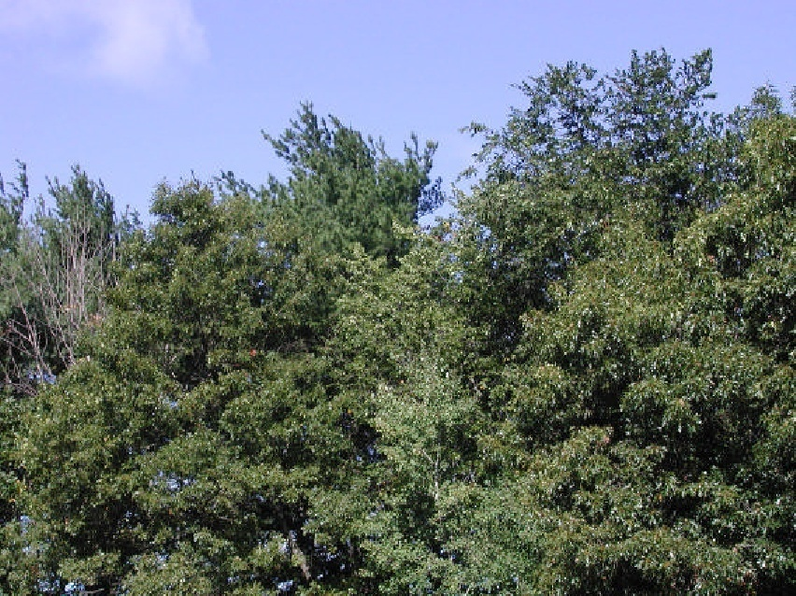
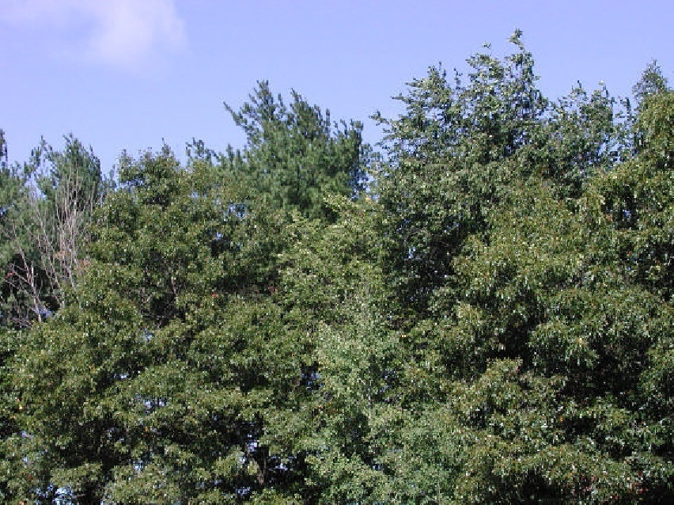
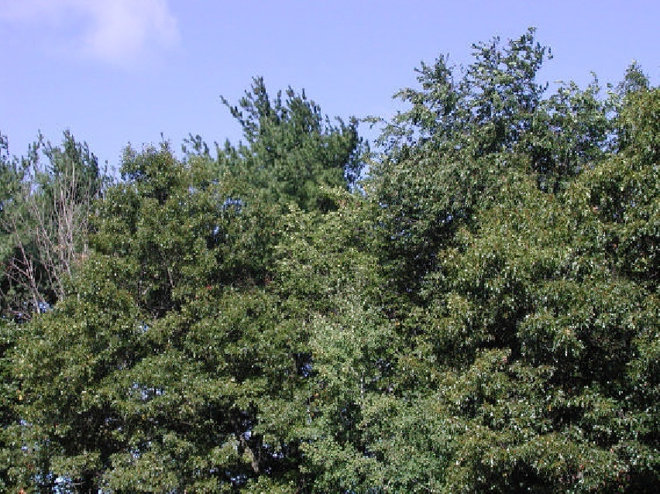
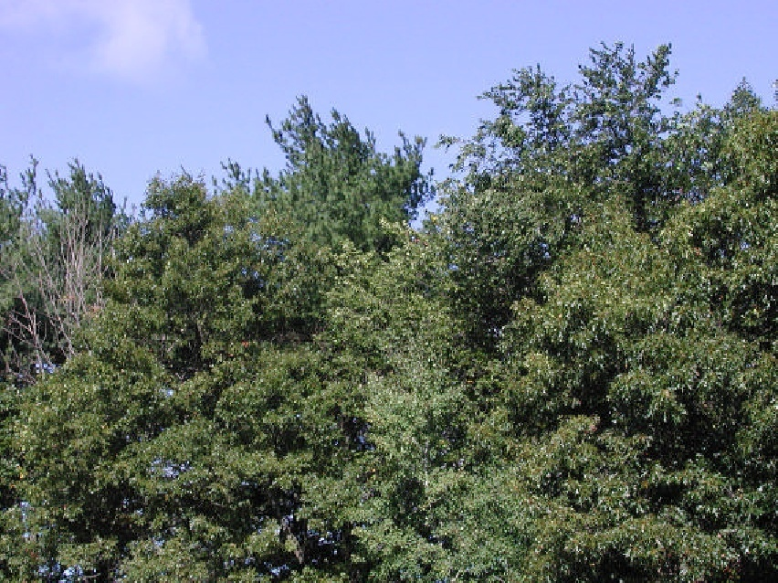
Optical flow
Many slides adapted from S. Seitz, R. Szeliski, M. Pollefeys
Slides from S. Lazebnik.

Slide 2
Motion is a powerful perceptual cue
Sometimes, it is the only cue

Slide 3
Motion is a powerful perceptual cue
Even “impoverished” motion data can evoke a strong percept
G. Johansson, “Visual Perception of Biological Motion and a Model For Its Analysis", Perception and Psychophysics 14, 201-211, 1973.
Source: L. Lazebnik

Slide 4
Motion is a powerful perceptual cue
Even “impoverished” motion data can evoke a strong percept
G. Johansson, “Visual Perception of Biological Motion and a Model For Its Analysis", Perception and Psychophysics 14, 201-211, 1973.
Source: L. Lazebnik

Slide 5
Uses of motion in computer vision
3D shape reconstruction
Object segmentation
Learning and tracking of dynamical models
Event and activity recognition
Self-supervised and predictive learning
Source: L. Lazebnik

Slide 6
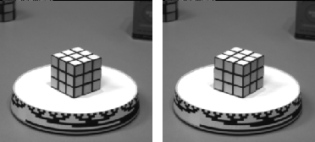
Motion field
The motion field is the projection of the 3D scene motion into the image
Source: L. Lazebnik

Slide 7
Optical flow
Definition: optical flow is the apparent motion of brightness patterns in the image
Ideally, optical flow would be the same as the motion field
Have to be careful: apparent motion can be caused by lighting changes without any actual motion
Think of a uniform rotating sphere under fixed lighting vs. a stationary sphere under moving illumination
Source: L. Lazebnik

Slide 8
Estimating optical flow
I(x,y,t–1)
I(x,y,t)
Given two subsequent frames, estimate the apparent motion field u(x,y) and v(x,y) between them
Key assumptions
Brightness constancy: projection of the same point looks the same in every frame
Small motion: points do not move very far
Spatial coherence: points move like their neighbors
Source: L. Lazebnik

Slide 9
The brightness constancy constraint
I(x,y,t–1)
I(x,y,t)
Brightness Constancy Equation:
Linearizing the right side using Taylor expansion:
Hence,
Source: L. Lazebnik

Slide 10
The brightness constancy constraint
How many equations and unknowns per pixel?
One equation, two unknowns
What does this constraint mean?
The component of the flow perpendicular to the gradient (i.e., parallel to the edge) is unknown!
Source: L. Lazebnik
Notes:
A: u and v are unknown, 1 equation

Slide 11
The brightness constancy constraint
How many equations and unknowns per pixel?
One equation, two unknowns
What does this constraint mean?
The component of the flow perpendicular to the gradient (i.e., parallel to the edge) is unknown!
gradient
(u,v)
If (u, v) satisfies the equation, so does (u+u’, v+v’) if
(u’,v’)
(u+u’,v+v’)
edge
Source: L. Lazebnik
Notes:
A: u and v are unknown, 1 equation

Slide 12
The aperture problem
Perceived motion
Source: L. Lazebnik

Slide 13
The aperture problem
Actual motion
Source: L. Lazebnik

Slide 14
The barber pole illusion
http://en.wikipedia.org/wiki/Barberpole_illusion
Source: L. Lazebnik

Slide 15
The barber pole illusion
http://en.wikipedia.org/wiki/Barberpole_illusion
Source: L. Lazebnik

Slide 16
Solving the aperture problem
How to get more equations for a pixel?
Spatial coherence constraint: assume the pixel’s neighbors have the same (u,v)
E.g., if we use a 5x5 window, that gives us 25 equations per pixel
B. Lucas and T. Kanade. An iterative image registration technique with an application to
stereo vision. In Proceedings of the International Joint Conference on Artificial Intelligence, pp. 674–679, 1981.
Source: L. Lazebnik

Slide 17
Lucas-Kanade flow
Linear least squares problem:
When is this system solvable?
B. Lucas and T. Kanade. An iterative image registration technique with an application to
stereo vision. In Proceedings of the International Joint Conference on Artificial Intelligence, pp. 674–679, 1981.
Source: L. Lazebnik

Slide 18
Lucas-Kanade flow
Linear least squares problem:
Solution given by
M = A^{T}A is the second moment matrix!
(summations are over all pixels in the window)
B. Lucas and T. Kanade. An iterative image registration technique with an application to
stereo vision. In Proceedings of the International Joint Conference on Artificial Intelligence, pp. 674–679, 1981.
Source: L. Lazebnik

Slide 19
Recall: second moment matrix
Estimation of optical flow is well-conditioned precisely for regions with high “cornerness”:
λ₂
“Edge” λ₂ >> λ₁
“Corner” λ₁ and λ₂ are large, λ₁ ~ λ₂
λ₁ and λ₂ are small
“Flat” region
“Edge” λ₁ >> λ₂
λ₁
Source: L. Lazebnik

Slide 20
Conditions for solvability
“Bad” case: single straight edge
Source: L. Lazebnik

Slide 21
Conditions for solvability
“Good” case
Source: L. Lazebnik

Slide 22
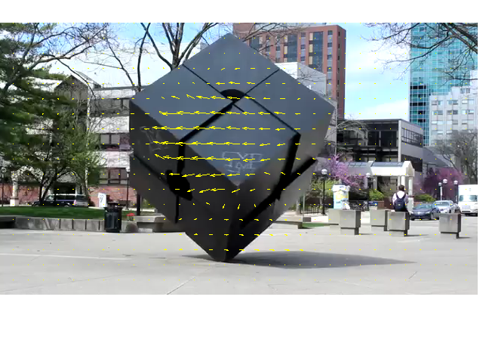
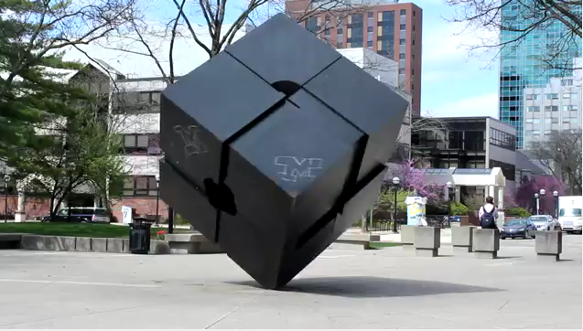
Lucas-Kanade flow example
Input frames
Output
Source: MATLAB Central File Exchange
Source: L. Lazebnik

Slide 23
Errors in Lucas-Kanade
The motion is large (larger than a pixel)
A point does not move like its neighbors
Brightness constancy does not hold
Source: L. Lazebnik
Notes:
Iterative refinement:
Estimate velocity at each pixel using one iteration of Lucas and Kanade estimation
Warp one image toward the other using the estimated flow field
Refine estimate by repeating the process

Slide 24
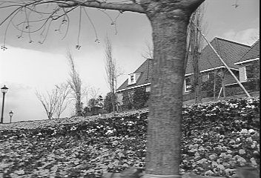
“Flower garden” example
Source: L. Lazebnik
* From Khurram Hassan-Shafique CAP5415 Computer Vision 2003

Slide 25
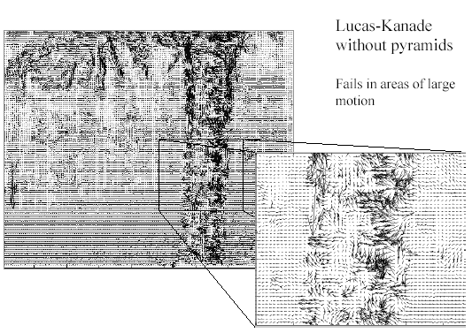
“Flower garden” example
Lucas-Kanade fails in areas of large motion
Source: L. Lazebnik
* From Khurram Hassan-Shafique CAP5415 Computer Vision 2003

Slide 26
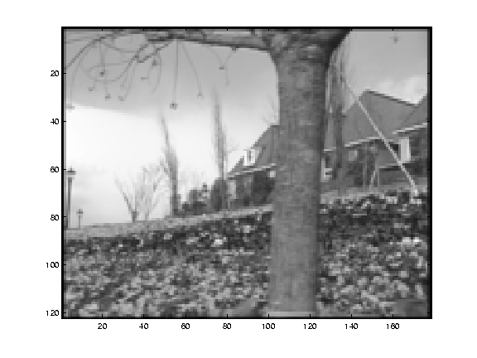
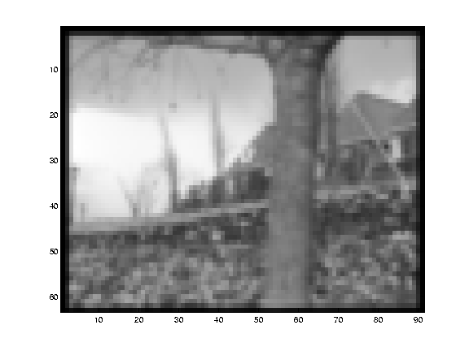
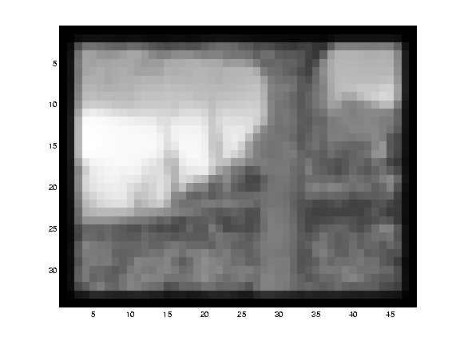
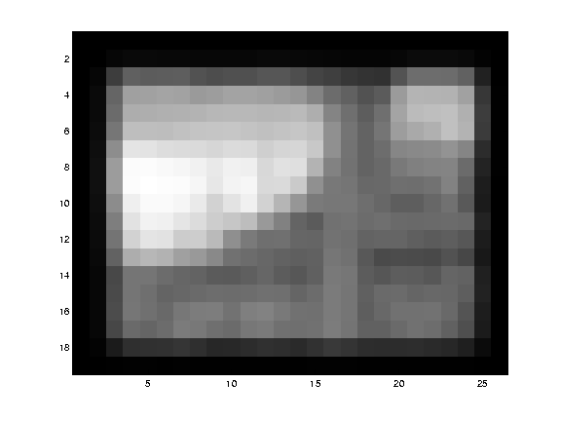
Multi-resolution estimation
Source: L. Lazebnik
* From Khurram Hassan-Shafique CAP5415 Computer Vision 2003

Slide 27
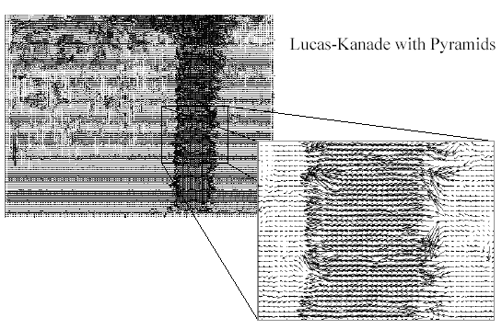
Multi-resolution estimation
With multi-resolution estimation
Source: L. Lazebnik
* From Khurram Hassan-Shafique CAP5415 Computer Vision 2003

Slide 28
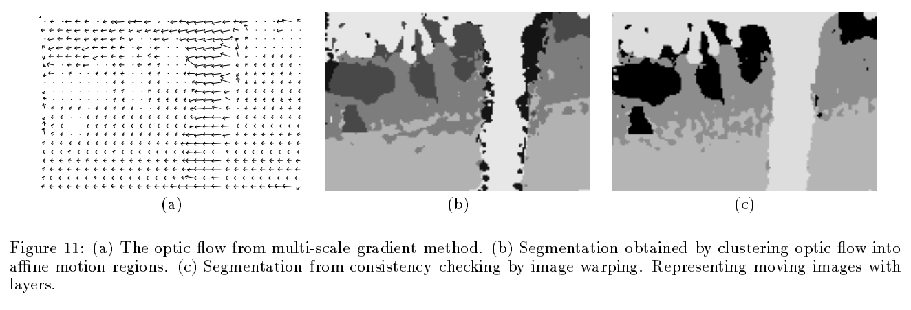
Fixing the errors in Lucas-Kanade
The motion is large (larger than a pixel)
Multi-resolution estimation, iterative refinement
Feature matching
A point does not move like its neighbors
Motion segmentation
J. Wang and E. Adelson, Representing Moving Images with Layers, IEEE Transactions on Image Processing, 1994
Source: L. Lazebnik
Notes:
Iterative refinement:
Estimate velocity at each pixel using one iteration of Lucas and Kanade estimation
Warp one image toward the other using the estimated flow field
Refine estimate by repeating the process

Slide 29
Fixing the errors in Lucas-Kanade
The motion is large (larger than a pixel)
Multi-resolution estimation, iterative refinement
Feature matching
A point does not move like its neighbors
Motion segmentation
Brightness constancy does not hold
Feature matching
Source: L. Lazebnik
Notes:
Iterative refinement:
Estimate velocity at each pixel using one iteration of Lucas and Kanade estimation
Warp one image toward the other using the estimated flow field
Refine estimate by repeating the process

