Slide 1
Geometry of a single camera
Slides from Derek Hoiem, Svetlana Lazebnik

Slide 2
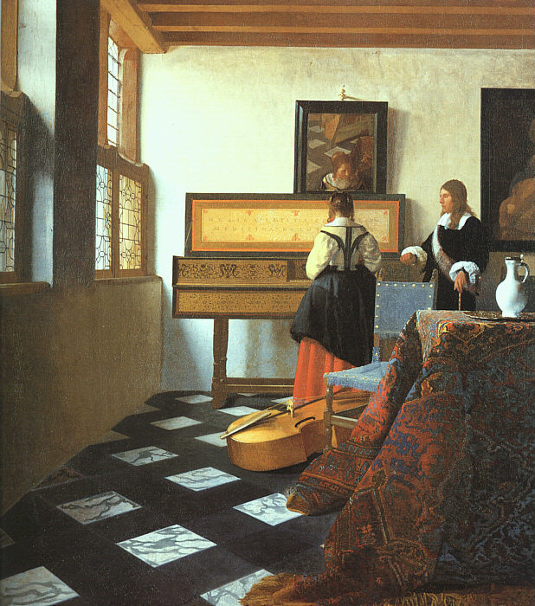
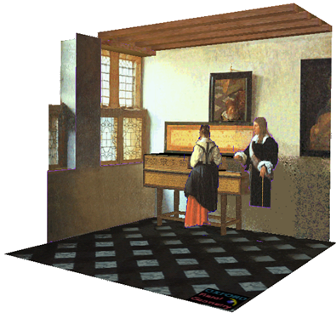
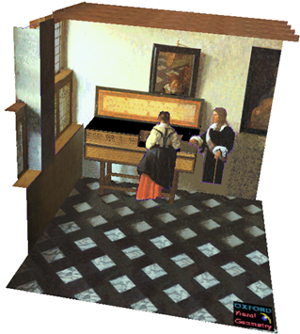
Our goal: Recovery of 3D structure
J. Vermeer, Music Lesson, 1662
A. Criminisi, M. Kemp, and A. Zisserman,Bringing Pictorial Space to Life: computer techniques for the analysis of paintings, Proc. Computers and the History of Art, 2002

Slide 3
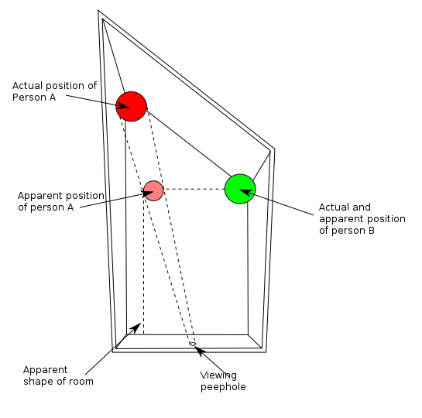
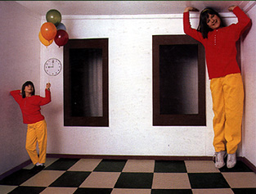
Things aren’t always as they appear…
http://en.wikipedia.org/wiki/Ames_room

Slide 4
Single-view ambiguity
X?
X?
X?
x

Slide 5
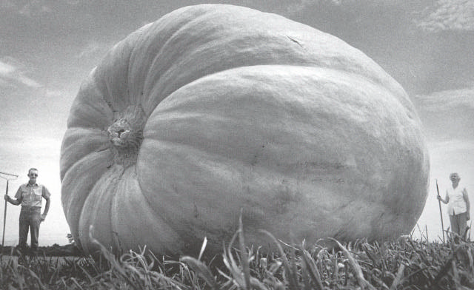
Single-view ambiguity

Slide 6
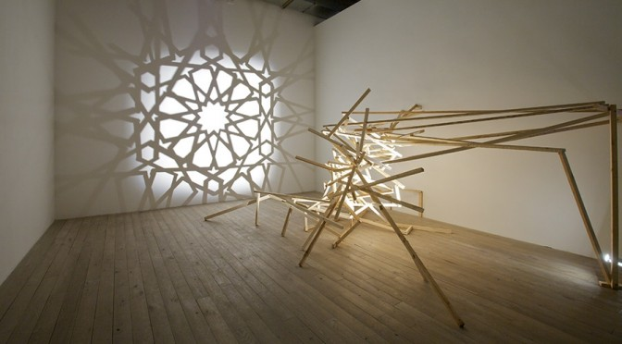
Single-view ambiguity
Rashad Alakbarov shadow sculptures

Slide 7
Anamorphic perspective
Image source

Slide 8
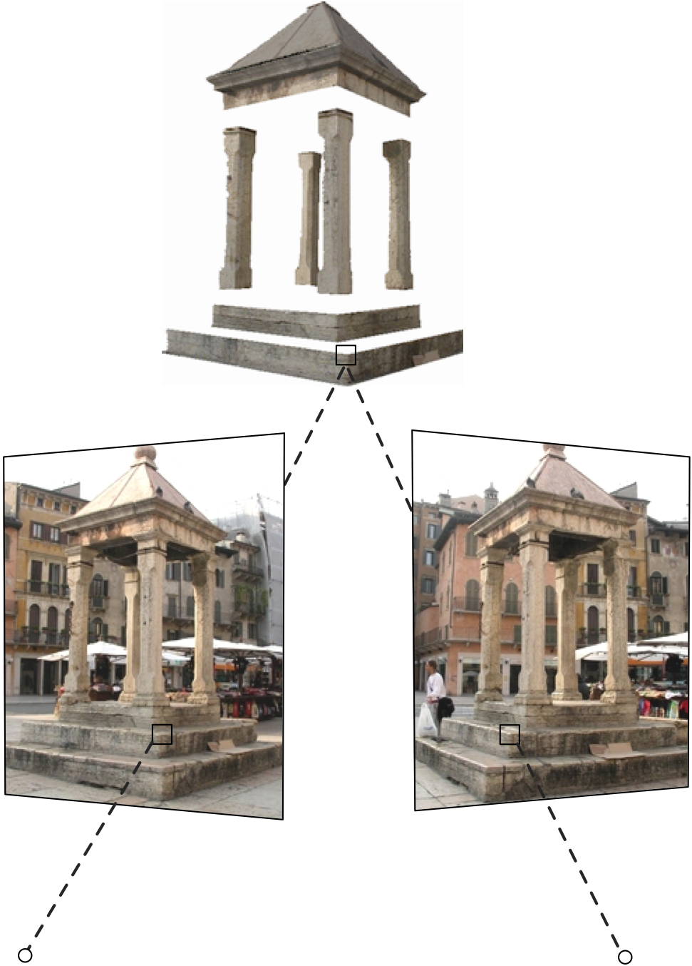
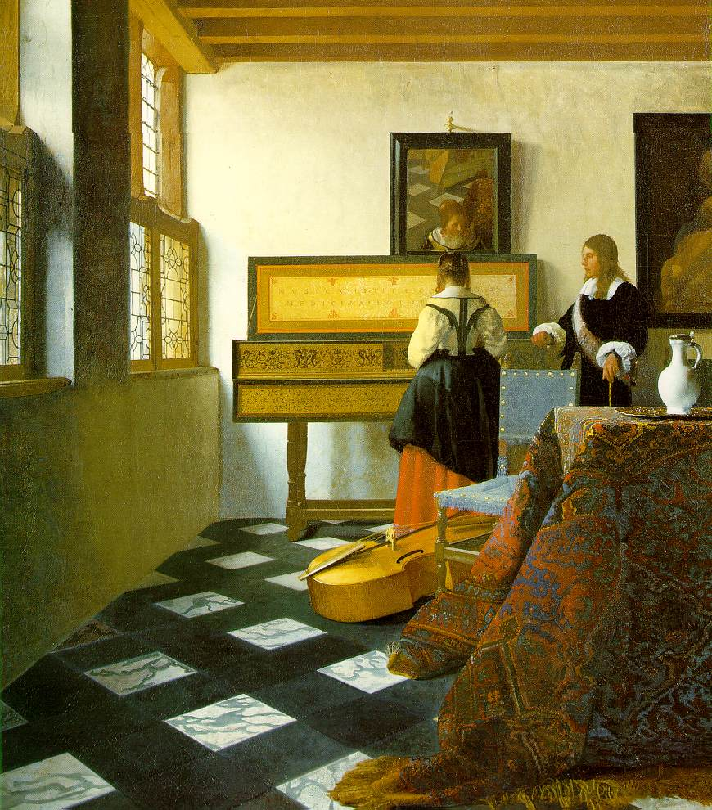
Our goal: Recovery of 3D structure
When certain assumptions hold, we can recover structure from a single view
In general, we need multi-view geometry
Image source
But first, we need to understand the geometry of a single camera…

Slide 9
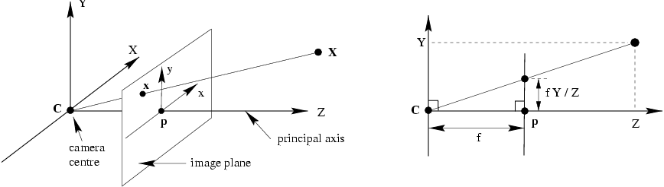
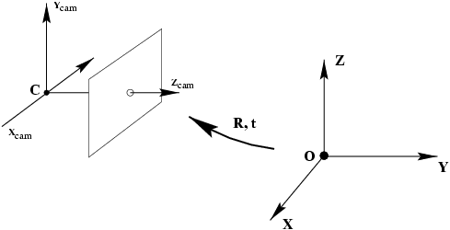
Camera calibration
world coordinate system
Normalized (camera) coordinate system: camera center is at the origin, the principal axis is the z-axis,
x and y axes of the image plane are parallel to x and y axes of the world
Camera calibration: figuring out transformation from world coordinate system to image coordinate system

Slide 10

Review: Pinhole camera model

Slide 11
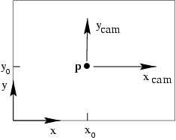
Principal point
Principal point (p): point where principal axis intersects the image plane
Normalized coordinate system: origin of the image is at the principal point
Image coordinate system: origin is in the corner

Slide 12
Principal point offset
We want the principal point to map to (p_{x}, p_{y}) instead of (0,0)
p_{y}
p_{x}

Slide 13
Principal point offset
p_{y}
principal point:
p_{x}

Slide 14
Principal point offset
p_{y}
principal point:
p_{x}
calibration matrix K
projection matrix [I | 0]

Slide 15
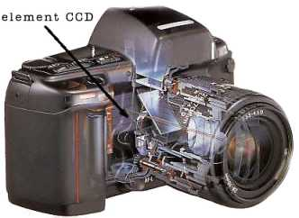
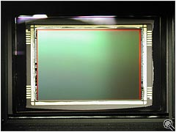
Pixel coordinates
Pixel size:
m_{x} pixels per meter in horizontal direction,
m_{y} pixels per meter in vertical direction
pixels/m
m
pixels
Notes:
To convert from metric image coordinates to pixel coordinates, we have to multiply the x, y coordinates by the x, y pixel magnification factors (pix/m)
Beta_x, beta_y is the principal point coordinates in pixels

Slide 16
Camera rotation and translation
In general, the camera coordinate frame will be related to the world coordinate frame by a rotation and a translation
camera coordinate system
world coordinate system
Conversion from world to camera coordinate system
(in non-homogeneous coordinates):
coords. of point
in camera frame
coords. of camera center
in world frame
coords. of a point
in world frame

Slide 17
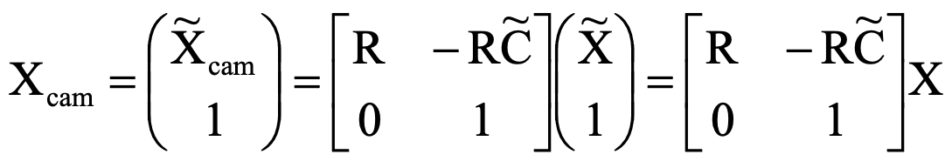
Camera rotation and translation
3D transformation matrix (4 x 4)

Slide 18
Camera rotation and translation
3D transformation matrix (4 x 4)

Slide 19
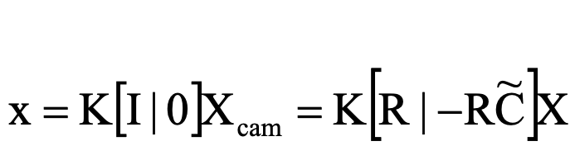
Camera rotation and translation
2D transformation matrix (3 x 3)
3D transformation matrix (4 x 4)
perspective projection matrix (3 x 4)

Slide 20
Camera rotation and translation

Slide 21

Camera rotation and translation

Slide 22
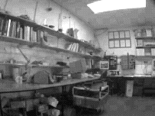
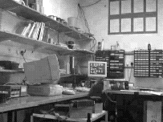
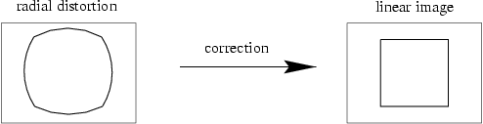
Camera parameters
Intrinsic parameters
  Principal point coordinates
  Focal length
  Pixel magnification factors
  Skew (non-rectangular pixels)
  Radial distortion

Slide 23
Camera parameters
Intrinsic parameters
  Principal point coordinates
  Focal length
  Pixel magnification factors
  Skew (non-rectangular pixels)
  Radial distortion
Extrinsic parameters
  Rotation and translation relative
  to world coordinate system
  What is the projection of the
  camera center?
coords. of camera center
in world frame
The camera center is the null space of the projection matrix!

Slide 24
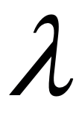
Camera calibration

Slide 25

Camera calibration
Given n points with known 3D coordinates X_{i} and known image projections x_{i}, estimate the camera parameters
X_{i}
x_{i}

Slide 26
Camera calibration: Linear method
Two linearly independent equations

Slide 27
Camera calibration: Linear method
P has 11 degrees of freedom
One 2D/3D correspondence gives us two linearly independent equations
  6 correspondences needed for a minimal solution
Homogeneous least squares: find p minimizing ||Ap||²
  Solution given by eigenvector of A^{T}A with smallest eigenvalue

Slide 28
Camera calibration: Linear method
Note: for coplanar points that satisfy Π^{T}X=0,
we will get degenerate solutions (Π,0,0),
(0,Π,0), or (0,0,Π)

Slide 29
Camera calibration: Linear vs. nonlinear
Linear calibration is easy to formulate and solve, but it doesn’t directly tell us the camera parameters
In practice, non-linear methods are preferred
  Write down objective function in terms of intrinsic and extrinsic parameters
  Define error as sum of squared distances between measured 2D points and estimated projections of 3D points
  Minimize error using Newton’s method or other non-linear optimization
  Can model radial distortion and impose constraints such as known focal length and orthogonality
vs.

Slide 30


Homography Example
Camera Center
Slide from A. Efros, S. Seitz, D. Hoiem

Slide 31
Problem set-up
x = K [R t] X
x' = K' [R' t'] X
t=t'=0
x'=Hx where H = K' R' R⁻¹ K⁻¹
Typically only R and f will change (4 parameters), but, in general, H has 8 parameters
.
X
x
x'
f
f'

Slide 32
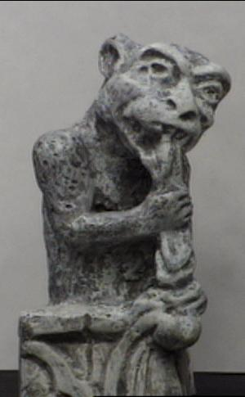
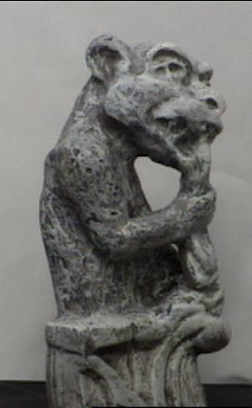
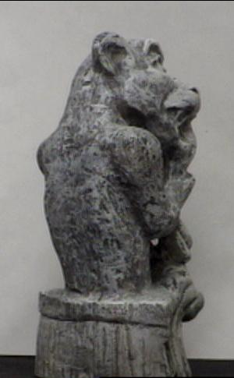
A taste of multi-view geometry: Triangulation
Given projections of a 3D point in two or more images (with known camera matrices), find the coordinates of the point

Slide 33
Triangulation
Given projections of a 3D point in two or more images (with known camera matrices), find the coordinates of the point
X?
x₂
x₁
O₁
O₂

Slide 34
Triangulation
We want to intersect the two visual rays corresponding to x₁ and x₂, but because of noise and numerical errors, they don’t meet exactly
X?
x₂
x₁
O₁
O₂

Slide 35
Triangulation: Geometric approach
Find shortest segment connecting the two viewing rays and let X be the midpoint of that segment
X
x₂
x₁
O₁
O₂

Slide 36
Triangulation: Nonlinear approach
Find X that minimizes
X?
P₁X
x₂
x₁
P₂X
O₁
O₂

Slide 37
Triangulation: Linear approach
Cross product as matrix multiplication:

Slide 38
Triangulation: Linear approach
Two independent equations each in terms of
three unknown entries of X

Slide 39

Camera calibration revisited
What if world coordinates of reference 3D points are not known?
We can use scene features such as vanishing points
Slide from Efros, Photo from Criminisi

Slide 40
Camera calibration revisited
What if world coordinates of reference 3D points are not known?
We can use scene features such as vanishing points
Vertical vanishing
point
(at infinity)
Vanishing
line
Vanishing
point
Vanishing
point
Slide from Efros, Photo from Criminisi

Slide 41
Recall: Homogenous Coordinates
Points
Points at infinity
Lines
Lines passing through 2 points
Intersection of 2 lines
Intersection of 2 parallel lines?

Slide 42
Recall: Homogenous Coordinates
Points
Points at infinity
Lines
Lines passing through 2 points
Intersection of 2 lines
Intersection of 2 parallel lines?

Slide 43
Recall: Vanishing points
image plane
vanishing point v
camera
center
line in the scene
All lines having the same direction share the same vanishing point

Slide 44
Computing vanishing points
v
X₀
X_{t}
X∞ is a point at infinity, v is its projection: v = PX∞
The vanishing point depends only on line direction
All lines having direction d intersect at X∞

Slide 45
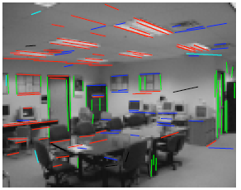
Calibration from vanishing points
Consider a scene with three orthogonal vanishing directions:
Note: v₁, v₂ are finite vanishing points and v₃ is an infinite vanishing point
.
.
v₁
v₂
v₃
Notes:
The third homogeneous coordinate of an infinite vanishing point is 0. Infinite vanishing points correspond to directions of lines that are parallel to the image plane.

Slide 46
Calibration from vanishing points
Consider a scene with three orthogonal vanishing directions:
We can align the world coordinate system with these directions
.
.
v₁
v₂
v₃

Slide 47
Calibration from vanishing points
p₁ = P(1,0,0,0)^{T} – the vanishing point in the x direction
Similarly, p₂ and p₃ are the vanishing points in the y and z directions
p₄ = P(0,0,0,1)^{T} – projection of the origin of the world coordinate system
Problem: we can only know the four columns up to independent scale factors, additional constraints needed to solve for them

Slide 48
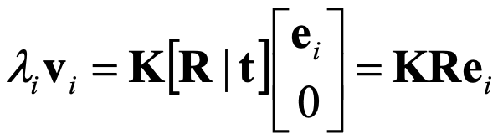
Calibration from vanishing points
Let us align the world coordinate system with three orthogonal vanishing directions in the scene:

Slide 49


Calibration from vanishing points
Let us align the world coordinate system with three orthogonal vanishing directions in the scene:
Orthogonality constraint:

Slide 50
Calibration from vanishing points
Let us align the world coordinate system with three orthogonal vanishing directions in the scene:
Orthogonality constraint:
Rotation disappears, each pair of vanishing points gives constraint on focal length and principal point

Slide 51
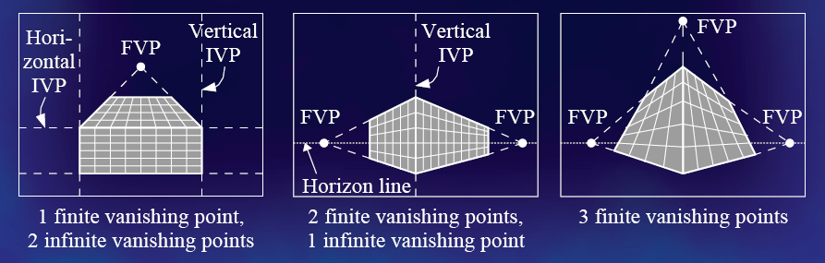
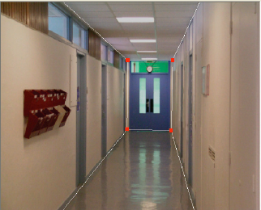
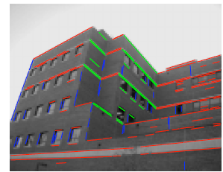
Calibration from vanishing points
Cannot recover focal length, principal point is the third vanishing point
Can solve for focal length, principal point

Slide 52

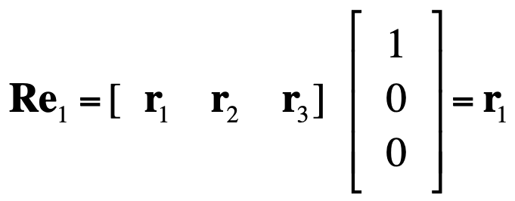

Rotation from vanishing points
Constraints on vanishing points:
After solving for the calibration matrix:
Notice:
Thus,
Get λ_{i} by using the constraint ||r_{i}||² = 1.

Slide 53
Calibration from vanishing points: Summary
Solve for K (focal length, principal point) using three orthogonal vanishing points
Get rotation directly from vanishing points once calibration matrix is known
Advantages
  No need for calibration chart, 2D-3D correspondences
  Could be completely automatic
Disadvantages
  Only applies to certain kinds of scenes
  Inaccuracies in computation of vanishing points
  Problems due to infinite vanishing points

Slide 54
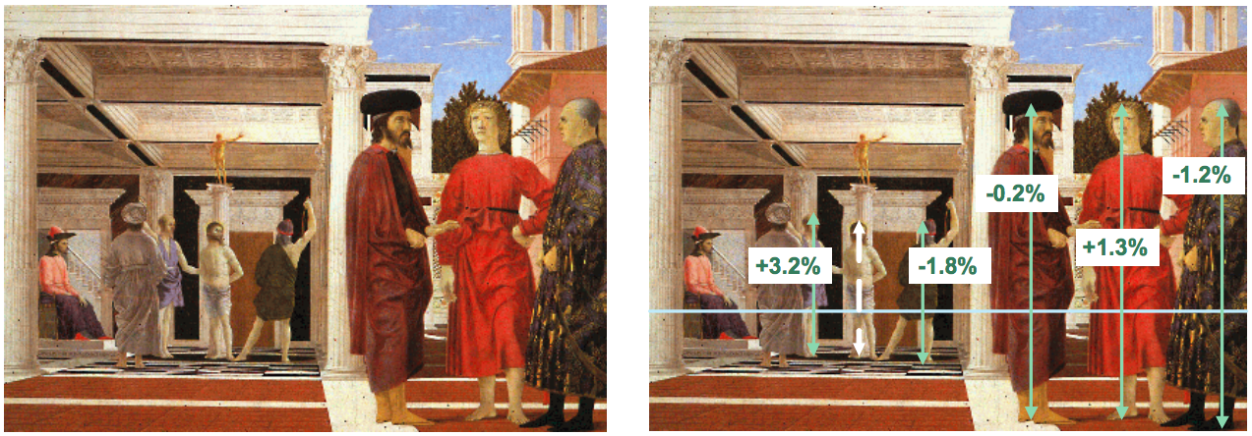
Example
Are the heights of the two groups of people consistent with one another?
  Measure heights using Christ as reference
Piero della Francesca, Flagellation, ca. 1455
A. Criminisi, M. Kemp, and A. Zisserman,Bringing Pictorial Space to Life: computer techniques for the analysis of paintings,
Proc. Computers and the History of Art, 2002

Slide 55


Measurements on planes
4
3
2
1
1
2
3
4
Approach: unwarp then measure
What kind of warp is this?
Notes:
homography!

Slide 56
Image rectification
p′
p
To unwarp (rectify) an image
solve for homography H given p and p′
how many points are necessary to solve for H?

Slide 57
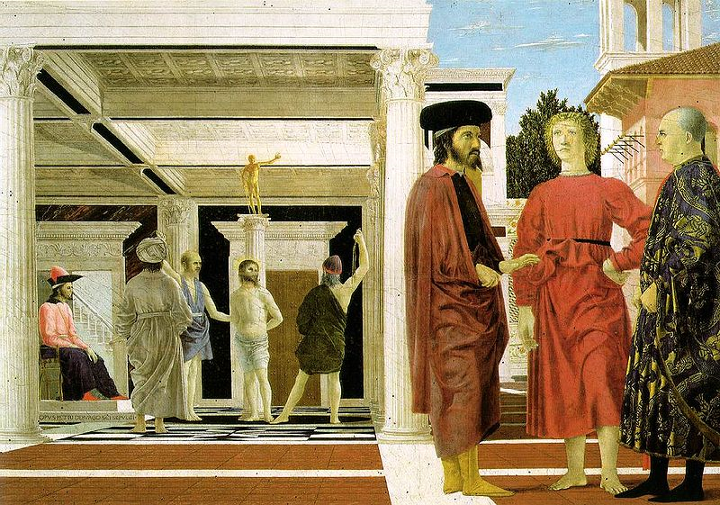
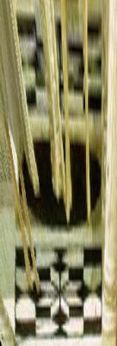
Image rectification: example
Piero della Francesca, Flagellation, ca. 1455

Slide 58
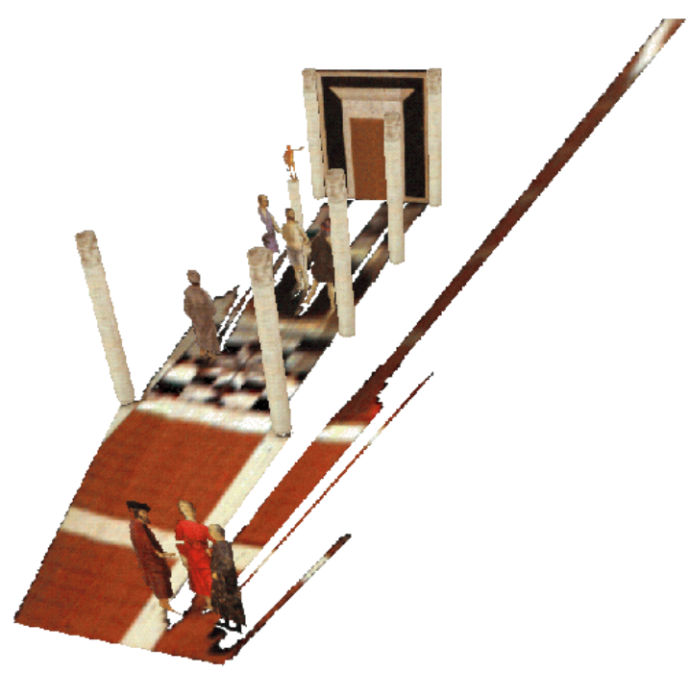
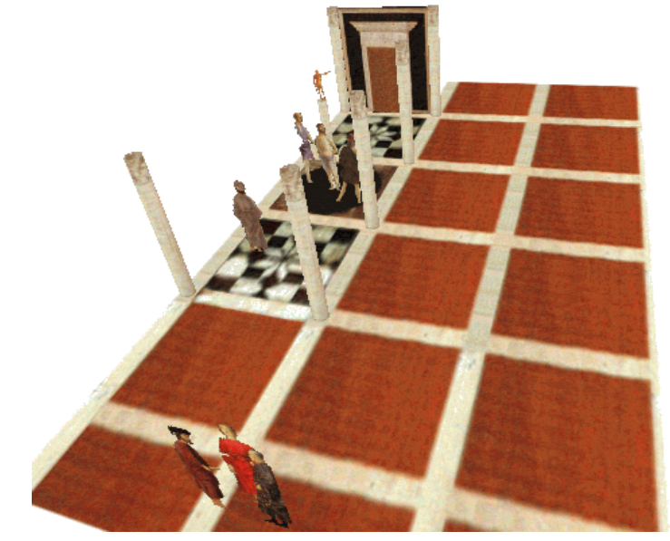
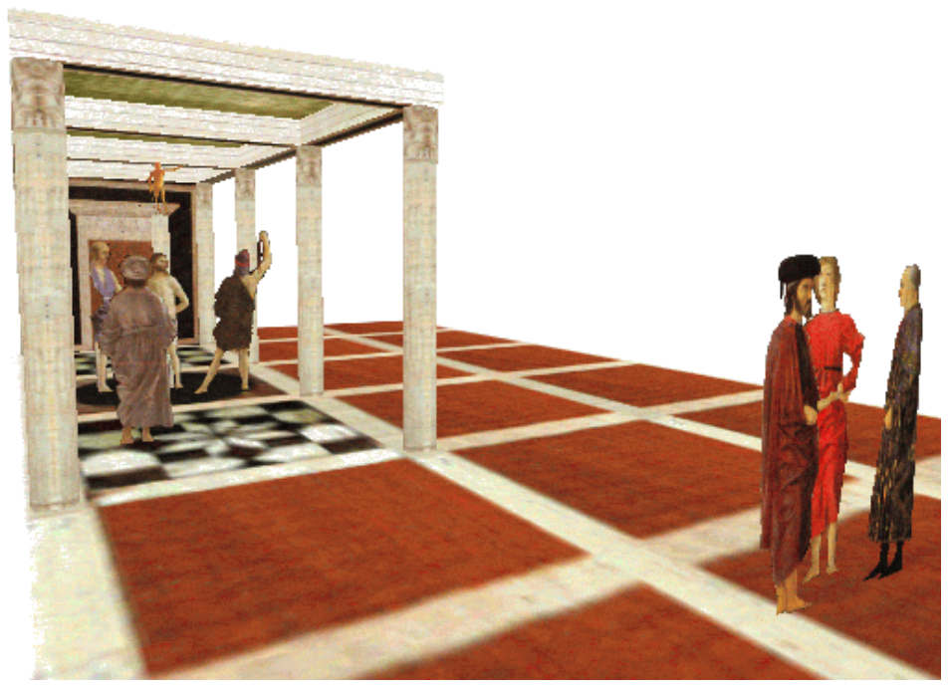
Application: 3D modeling from a single image
A. Criminisi, M. Kemp, and A. Zisserman,Bringing Pictorial Space to Life: computer techniques for the analysis of paintings,
Proc. Computers and the History of Art, 2002

Slide 59
Application: 3D modeling from a single image
J. Vermeer, Music Lesson, 1662
A. Criminisi, M. Kemp, and A. Zisserman,Bringing Pictorial Space to Life: computer techniques for the analysis of paintings,
Proc. Computers and the History of Art, 2002

Slide 60
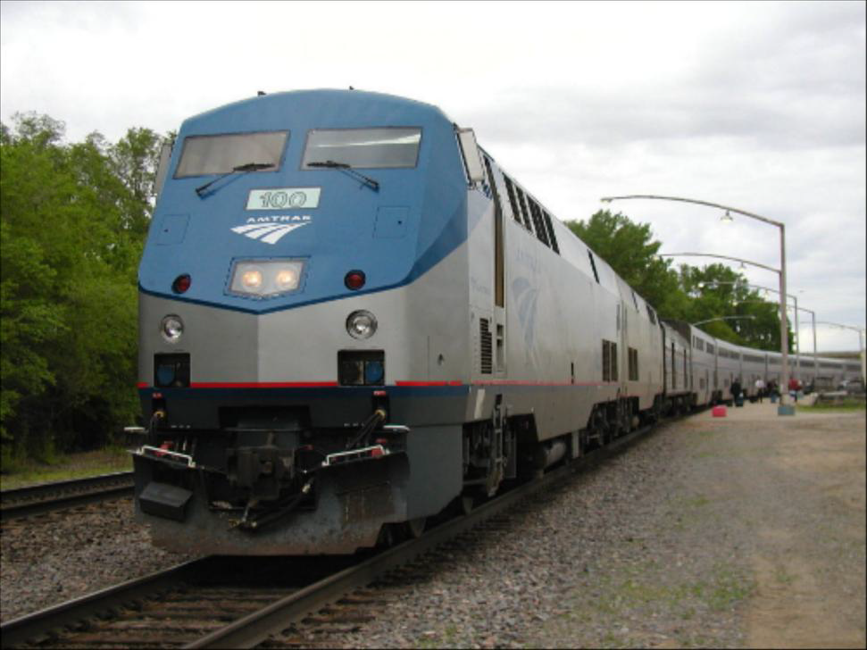
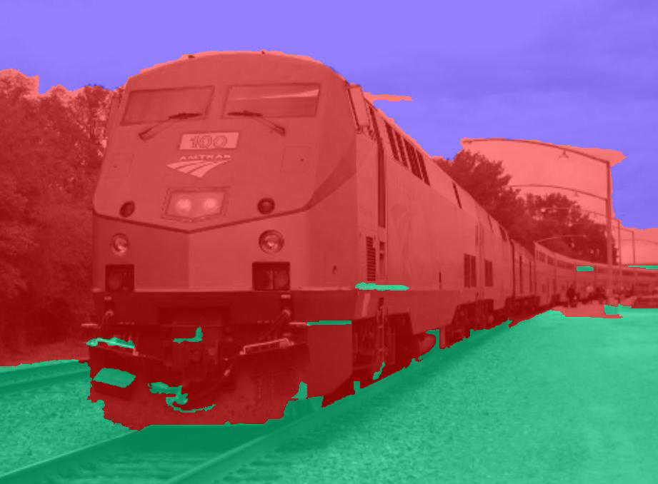
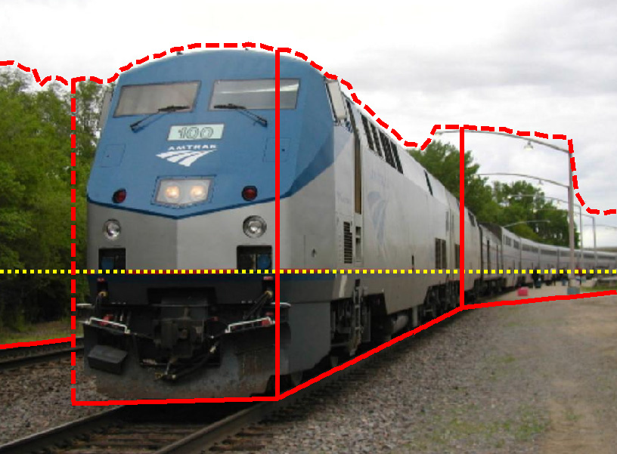
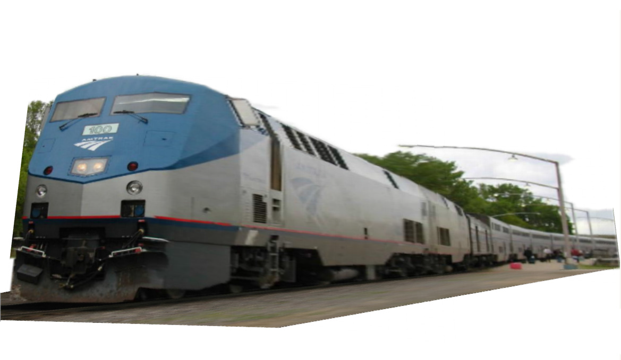
Application: Fully automatic modeling
sky
vertical
ground
D. Hoiem, A.A. Efros, and M. Hebert, Automatic Photo Pop-up, SIGGRAPH 2005.
http://dhoiem.cs.illinois.edu/projects/popup/popup_movie_450_250.mp4

Slide 61
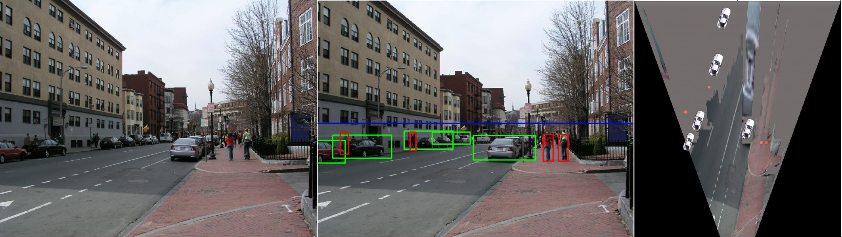
Application: Object detection
D. Hoiem, A.A. Efros, and M. Hebert, Putting Objects in Perspective, CVPR 2006

Slide 62
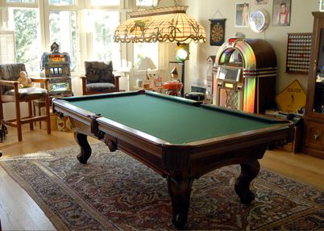
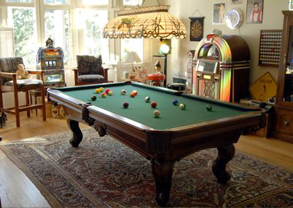
Application: Image editing
Inserting synthetic objects into images: http://vimeo.com/28962540
K. Karsch and V. Hedau and D. Forsyth and D. Hoiem, Rendering Synthetic Objects into Legacy Photographs, SIGGRAPH Asia 2011

Slide 63
Preview: Structure from motion
Figure credit: Noah Snavely
Camera 1
Camera 3
R₁,t₁
Camera 2
R₃,t₃
R₂,t₂
Given 2D point correspondences between multiple images, compute the camera parameters and the 3D points
Notes:
Structure from motion solves the following problem:
Given a set of images of a static scene with 2D points in correspondence, shown here as color-coded points, find…
a set of 3D points P and
a rotation R and position t of the cameras that explain the observed correspondences. In other words, when we project a point into any of the cameras, the reprojection error between the projected and observed 2D points is low.
This problem can be formulated as an optimization problem where we want to find the rotations R, positions t, and 3D point locations P that minimize sum of squared reprojection errors f. This is a non-linear least squares problem and can be solved with algorithms such as Levenberg-Marquart. However, because the problem is non-linear, it can be susceptible to local minima. Therefore, it’s important to initialize the parameters of the system carefully. In addition, we need to be able to deal with erroneous correspondences.

Slide 64
Preview: Structure from motion
?
Camera 1
Camera 3
R₁,t₁
Camera 2
R₃,t₃
R₂,t₂
Structure: Given known cameras and projections of the same 3D point in two or more images, compute the 3D coordinates of that point
  Triangulation!
Notes:
Structure from motion solves the following problem:
Given a set of images of a static scene with 2D points in correspondence, shown here as color-coded points, find…
a set of 3D points P and
a rotation R and position t of the cameras that explain the observed correspondences. In other words, when we project a point into any of the cameras, the reprojection error between the projected and observed 2D points is low.
This problem can be formulated as an optimization problem where we want to find the rotations R, positions t, and 3D point locations P that minimize sum of squared reprojection errors f. This is a non-linear least squares problem and can be solved with algorithms such as Levenberg-Marquart. However, because the problem is non-linear, it can be susceptible to local minima. Therefore, it’s important to initialize the parameters of the system carefully. In addition, we need to be able to deal with erroneous correspondences.

Slide 65
Preview: Structure from motion
Camera 1
?
Camera 3
R₁,t₁
Camera 2
?
?
R₂,t₂
R₃,t₃
Motion: Given a set of known 3D points seen by a camera, compute the camera parameters
  Calibration!
Notes:
Structure from motion solves the following problem:
Given a set of images of a static scene with 2D points in correspondence, shown here as color-coded points, find…
a set of 3D points P and
a rotation R and position t of the cameras that explain the observed correspondences. In other words, when we project a point into any of the cameras, the reprojection error between the projected and observed 2D points is low.
This problem can be formulated as an optimization problem where we want to find the rotations R, positions t, and 3D point locations P that minimize sum of squared reprojection errors f. This is a non-linear least squares problem and can be solved with algorithms such as Levenberg-Marquart. However, because the problem is non-linear, it can be susceptible to local minima. Therefore, it’s important to initialize the parameters of the system carefully. In addition, we need to be able to deal with erroneous correspondences.

Slide 66
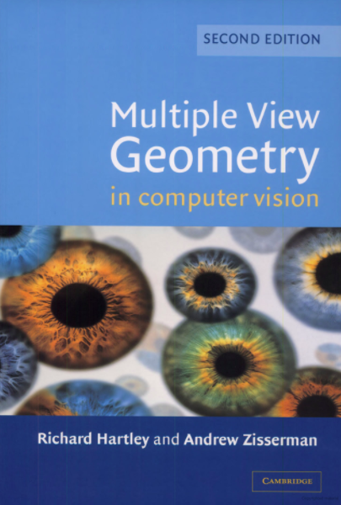
Useful reference

