Slide 1
Informal Early Feedback
MPs
  Provide more detailed comments in code
  Be clear about the deliverables
  Provide sample output
Lectures
  More opportunities for interaction
  Provide more context / better specify what to do in break-out rooms.
Slides
  Better pointers to suggested readings
Piazza
  Monitor and respond more often
More office hours
Notes:
Structure from motion solves the following problem:
Given a set of images of a static scene with 2D points in correspondence, shown here as color-coded points, find…
a set of 3D points P and
a rotation R and position t of the cameras that explain the observed correspondences. In other words, when we project a point into any of the cameras, the reprojection error between the projected and observed 2D points is low.
This problem can be formulated as an optimization problem where we want to find the rotations R, positions t, and 3D point locations P that minimize sum of squared reprojection errors f. This is a non-linear least squares problem and can be solved with algorithms such as Levenberg-Marquart. However, because the problem is non-linear, it can be susceptible to local minima. Therefore, it’s important to initialize the parameters of the system carefully. In addition, we need to be able to deal with erroneous correspondences.

Slide 2
Will try, but can’t promise
MPs
  Faster grading
Slides
  Annotated slides. PPT on IPad doesn’t work well with videos / equations.
Lectures
  More examples
Notes:
Structure from motion solves the following problem:
Given a set of images of a static scene with 2D points in correspondence, shown here as color-coded points, find…
a set of 3D points P and
a rotation R and position t of the cameras that explain the observed correspondences. In other words, when we project a point into any of the cameras, the reprojection error between the projected and observed 2D points is low.
This problem can be formulated as an optimization problem where we want to find the rotations R, positions t, and 3D point locations P that minimize sum of squared reprojection errors f. This is a non-linear least squares problem and can be solved with algorithms such as Levenberg-Marquart. However, because the problem is non-linear, it can be susceptible to local minima. Therefore, it’s important to initialize the parameters of the system carefully. In addition, we need to be able to deal with erroneous correspondences.

Slide 3
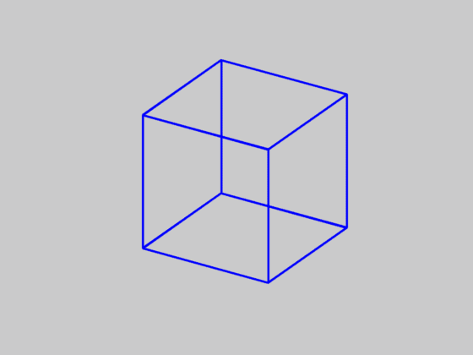
Which way is the cube rotating?
A. Left to right
B. Right to left
Necker cube
Source: N. Snavely

Slide 4
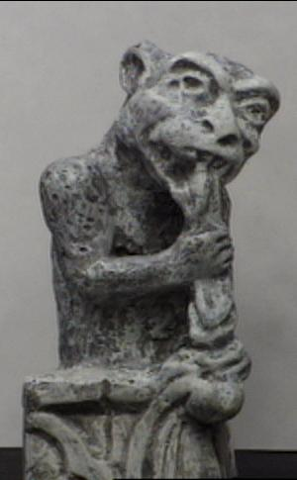
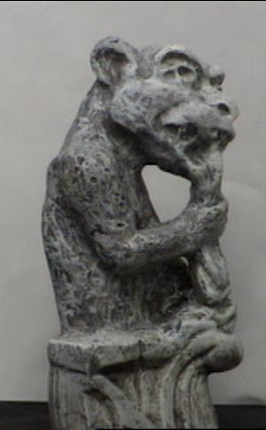
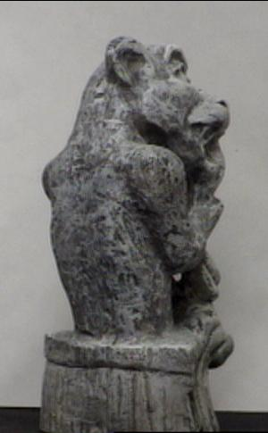
Multi-view geometry
Slides from L. Lazebnik

Slide 5
Structure from motion
Camera 1
Camera 3
R₁,t₁
Camera 2
R₃,t₃
R₂,t₂
Figure credit: Noah Snavely
Notes:
Structure from motion solves the following problem:
Given a set of images of a static scene with 2D points in correspondence, shown here as color-coded points, find…
a set of 3D points P and
a rotation R and position t of the cameras that explain the observed correspondences. In other words, when we project a point into any of the cameras, the reprojection error between the projected and observed 2D points is low.
This problem can be formulated as an optimization problem where we want to find the rotations R, positions t, and 3D point locations P that minimize sum of squared reprojection errors f. This is a non-linear least squares problem and can be solved with algorithms such as Levenberg-Marquart. However, because the problem is non-linear, it can be susceptible to local minima. Therefore, it’s important to initialize the parameters of the system carefully. In addition, we need to be able to deal with erroneous correspondences.

Slide 6
Structure from motion
?
Camera 1
Camera 3
R₁,t₁
Camera 2
R₃,t₃
R₂,t₂
Structure: Given known cameras and projections of the same 3D point in two or more images, compute the 3D coordinates of that point
Notes:
Structure from motion solves the following problem:
Given a set of images of a static scene with 2D points in correspondence, shown here as color-coded points, find…
a set of 3D points P and
a rotation R and position t of the cameras that explain the observed correspondences. In other words, when we project a point into any of the cameras, the reprojection error between the projected and observed 2D points is low.
This problem can be formulated as an optimization problem where we want to find the rotations R, positions t, and 3D point locations P that minimize sum of squared reprojection errors f. This is a non-linear least squares problem and can be solved with algorithms such as Levenberg-Marquart. However, because the problem is non-linear, it can be susceptible to local minima. Therefore, it’s important to initialize the parameters of the system carefully. In addition, we need to be able to deal with erroneous correspondences.

Slide 7
Structure from motion
Camera 1
?
Camera 3
R₁,t₁
Camera 2
?
?
R₂,t₂
R₃,t₃
Motion: Given a set of known 3D points seen by a camera, compute the camera parameters
Notes:
Structure from motion solves the following problem:
Given a set of images of a static scene with 2D points in correspondence, shown here as color-coded points, find…
a set of 3D points P and
a rotation R and position t of the cameras that explain the observed correspondences. In other words, when we project a point into any of the cameras, the reprojection error between the projected and observed 2D points is low.
This problem can be formulated as an optimization problem where we want to find the rotations R, positions t, and 3D point locations P that minimize sum of squared reprojection errors f. This is a non-linear least squares problem and can be solved with algorithms such as Levenberg-Marquart. However, because the problem is non-linear, it can be susceptible to local minima. Therefore, it’s important to initialize the parameters of the system carefully. In addition, we need to be able to deal with erroneous correspondences.

Slide 8
Structure from motion
Camera 1
?
R₁,t₁
Camera 2
?
R₂,t₂
Bootstrapping the process: Given a set of 2D point correspondences in two images, compute the camera parameters
Notes:
Structure from motion solves the following problem:
Given a set of images of a static scene with 2D points in correspondence, shown here as color-coded points, find…
a set of 3D points P and
a rotation R and position t of the cameras that explain the observed correspondences. In other words, when we project a point into any of the cameras, the reprojection error between the projected and observed 2D points is low.
This problem can be formulated as an optimization problem where we want to find the rotations R, positions t, and 3D point locations P that minimize sum of squared reprojection errors f. This is a non-linear least squares problem and can be solved with algorithms such as Levenberg-Marquart. However, because the problem is non-linear, it can be susceptible to local minima. Therefore, it’s important to initialize the parameters of the system carefully. In addition, we need to be able to deal with erroneous correspondences.

Slide 9


Two-view geometry

Slide 10

Epipolar geometry
X
x
x’
Baseline – line connecting the two camera centers
Epipolar Plane – plane containing baseline (1D family)
Epipoles
= intersections of baseline with image planes
= projections of the other camera center
= vanishing points of the motion direction

Slide 11
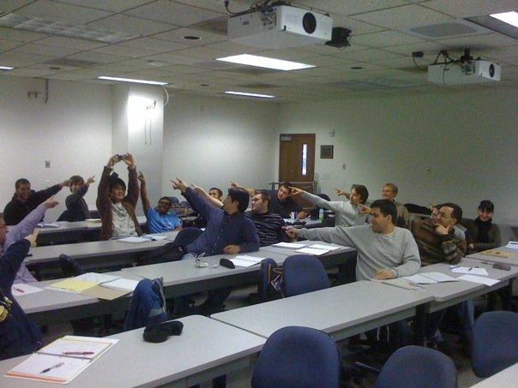
The Epipole
Photo by Frank Dellaert

Slide 12
Epipolar geometry
X
x
x’
Baseline – line connecting the two camera centers
Epipolar Plane – plane containing baseline (1D family)
Epipoles
= intersections of baseline with image planes
= projections of the other camera center
= vanishing points of the motion direction
Epipolar Lines - intersections of epipolar plane with image
planes (always come in corresponding pairs)

Slide 13

Example 1
Converging cameras

Slide 14



Example 2
Motion parallel to the image plane

Slide 15
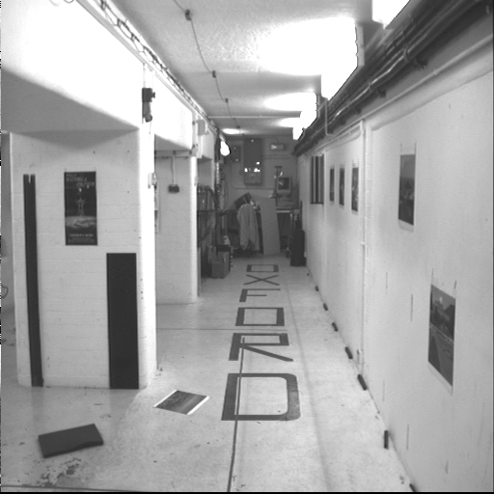
Example 3

Slide 16
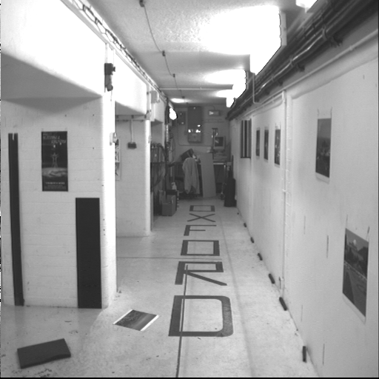
Example 3
Motion is perpendicular to the image plane
Epipole is the “focus of expansion” and the principal point

Slide 17
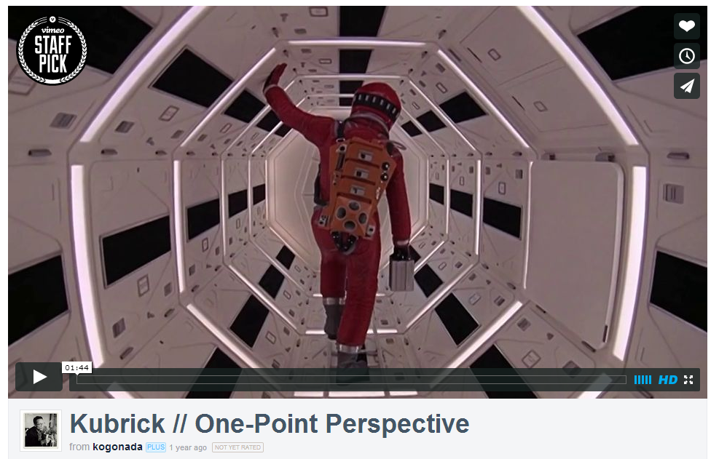
Motion perpendicular to image plane
http://vimeo.com/48425421

Slide 18

Epipolar constraint
X
x
x’
If we observe a point x in one image, where can the corresponding point x’ be in the other image?

Slide 19
Epipolar constraint
X
X
X
x
x’
x’
x’
Potential matches for x have to lie on the corresponding
epipolar line l’.
Potential matches for x’ have to lie on the corresponding
epipolar line l.

Slide 20
Epipolar constraint example

Slide 21
Epipolar constraint: Calibrated case
X
x
x’

Slide 22
Epipolar constraint: Calibrated case
X
x
x’
Intrinsic and extrinsic parameters of the cameras are known, world coordinate system is set to that of the first camera
Then the projection matrices are given by K[I | 0] and K’[R | t]
We can multiply the projection matrices (and the image points) by the inverse of the calibration matrices to get normalized image coordinates:

Slide 23
Epipolar constraint: Calibrated case
Derivation
X
x
x’

Slide 24
Epipolar constraint: Calibrated case
Derivation
X
x
x’

Slide 25




Epipolar constraint: Calibrated case
Simplification
X
= (x,1)^{T}
x
x’
$$x′$$
$$Rx$$
t
$$t$$
R
Recall:
The vectors $Rx$, $t$, and $x′$ are coplanar
Notes:
X’ is X in the second camera’s coordinate system
We can identify the non-homogeneous 3D vectors X and X’ with the homogeneous coordinate vectors x and x’ of the projections of the two points into the two respective images

Slide 26



Epipolar constraint: Calibrated case
Simplification
X
= (x,1)^{T}
x
x’
$$x′$$
$$Rx$$
t
$$t$$
R
$$x^{′}.\left[t×\left(Rx\right)\right]=0$$
Recall:
$$x^{′T}Ex=0$$
$$x^{′}. \left[t_{×}\right]Rx=0$$
The vectors $Rx$, $t$, and $x′$ are coplanar
Notes:
X’ is X in the second camera’s coordinate system
We can identify the non-homogeneous 3D vectors X and X’ with the homogeneous coordinate vectors x and x’ of the projections of the two points into the two respective images

Slide 27
Epipolar constraint: Calibrated case
X
= (x,1)^{T}
x
x’
$$x′$$
$$Rx$$
$$t$$
Essential Matrix
(Longuet-Higgins, 1981)
The vectors $Rx$, $t$, and $x′$ are coplanar
Notes:
X’ is X in the second camera’s coordinate system
We can identify the non-homogeneous 3D vectors X and X’ with the homogeneous coordinate vectors x and x’ of the projections of the two points into the two respective images

Slide 28
Epipolar constraint: Calibrated case
X
x
x’
E x is the epipolar line associated with x (l' = E x)
  Recall: a line is given by ax + by + c = 0 or

Slide 29
Epipolar constraint: Calibrated case
X
x
x’
E x is the epipolar line associated with x (l' = E x)
E^{T}x' is the epipolar line associated with x' (l = E^{T}x')
E e = 0 and E^{T}e' = 0
E is singular (rank two)
E has five degrees of freedom

Slide 30
Epipolar constraint: Uncalibrated case
X
x
x’
The calibration matrices K and K’ of the two cameras are unknown
We can write the epipolar constraint in terms of unknown normalized coordinates:

Slide 31
Epipolar constraint: Uncalibrated case
X
x
x’
The calibration matrices K and K’ of the two cameras are unknown
We can write the epipolar constraint in terms of unknown normalized coordinates:

Slide 32
Epipolar constraint: Uncalibrated case
X
x
x’
Fundamental Matrix
(Faugeras and Luong, 1992)

Slide 33
Epipolar constraint: Uncalibrated case
X
x
x’
F x is the epipolar line associated with x (l' = F x)
F^{T}x' is the epipolar line associated with x' (l = F^{T}x')
F e = 0 and F^{T}e' = 0
F is singular (rank two)
F has seven degrees of freedom

Slide 34
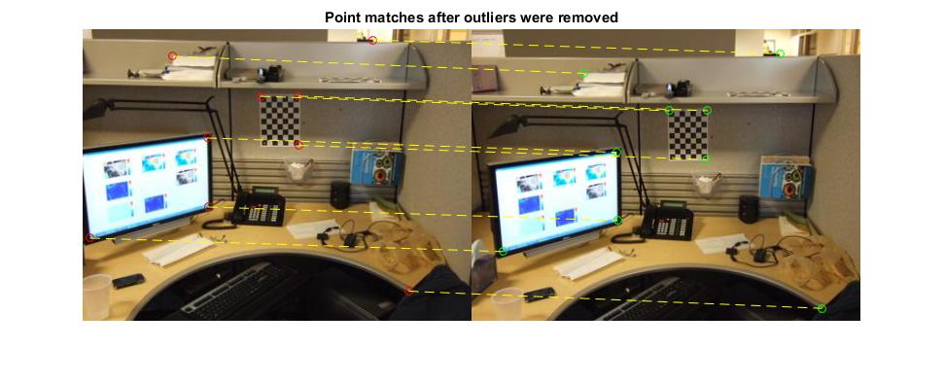
Estimating the fundamental matrix

Slide 35
The eight-point algorithm

Slide 36
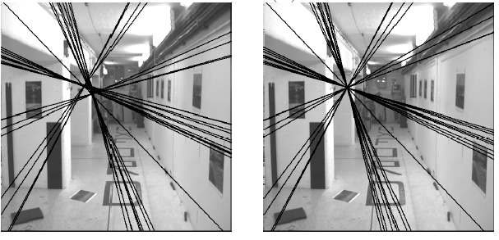
The eight-point algorithm
Solve homogeneous linear system using eight or more matches
Enforce rank-2 constraint (take SVD
of F and throw out the smallest singular value)

Slide 37
Problem with eight-point algorithm

Slide 38
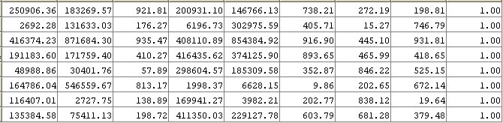
Problem with eight-point algorithm
Poor numerical conditioning
Can be fixed by rescaling the data

Slide 39
The normalized eight-point algorithm
(Hartley, 1995)
Center the image data at the origin, and scale it so the mean squared distance between the origin and the data points is 2 pixels
Use the eight-point algorithm to compute F from the normalized points
Enforce the rank-2 constraint (for example, take SVD of F and throw out the smallest singular value)
Transform fundamental matrix back to original units: if T and T’ are the normalizing transformations in the two images, than the fundamental matrix in original coordinates is T’^{T} F T

Slide 40
Seven-point algorithm
Set up least squares system with seven pairs of correspondences and solve for null space (two vectors) using SVD
Solve for linear combination of null space vectors that satisfies det(F)=0
Source: D. Hoiem

Slide 41
Nonlinear estimation
Linear estimation minimizes the sum of squared algebraic distances between points x’_{i} and epipolar lines F x_{i} (or points x_{i} and epipolar lines F^{T}x’_{i}):
Nonlinear approach: minimize sum of squared geometric distances
x_{i}

Slide 42

Comparison of estimation algorithms
 | 8-point | Normalized 8-point | Nonlinear least squares
Av. Dist. 1 | 2.33 pixels | 0.92 pixel | 0.86 pixel
Av. Dist. 2 | 2.18 pixels | 0.85 pixel | 0.80 pixel

Slide 43
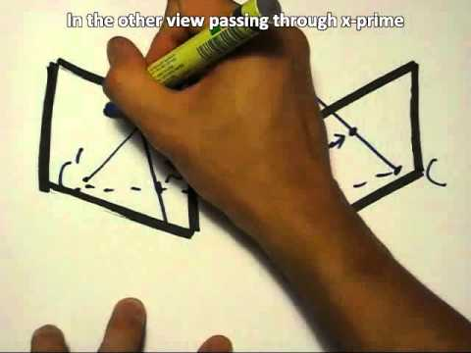
The Fundamental Matrix Song
http://danielwedge.com/fmatrix/

Slide 44
From epipolar geometry to camera calibration
Estimating the fundamental matrix is known as “weak calibration”
If we know the calibration matrices of the two cameras, we can estimate the essential matrix: E = K’^{T}FK
The essential matrix gives us the relative rotation and translation between the cameras, or their extrinsic parameters
Alternatively, if the calibration matrices are known, the five-point algorithm can be used to estimate relative camera pose

