Slide 1
Structure from motion
Slides from L. Lazebnik, N. Snavely, M. Herbert

Slide 2
Outline
Representative SfM pipeline
  Incremental SfM
  Bundle adjustment
Ambiguities in SfM
Special Case: Affine structure from motion
  Factorization
SfM in practice

Slide 3
Structure from motion
Given a set of corresponding points in two or more images, compute the camera parameters and the 3D point coordinates
?
Camera 1
?
Camera 2
?
?
Camera 3
R₁,t₁
R₃,t₃
R₂,t₂
Slide credit: Noah Snavely
Notes:
Structure from motion solves the following problem:
Given a set of images of a static scene with 2D points in correspondence, shown here as color-coded points, find…
a set of 3D points P and
a rotation R and position t of the cameras that explain the observed correspondences. In other words, when we project a point into any of the cameras, the reprojection error between the projected and observed 2D points is low.
This problem can be formulated as an optimization problem where we want to find the rotations R, positions t, and 3D point locations P that minimize sum of squared reprojection errors f. This is a non-linear least squares problem and can be solved with algorithms such as Levenberg-Marquart. However, because the problem is non-linear, it can be susceptible to local minima. Therefore, it’s important to initialize the parameters of the system carefully. In addition, we need to be able to deal with erroneous correspondences.

Slide 4
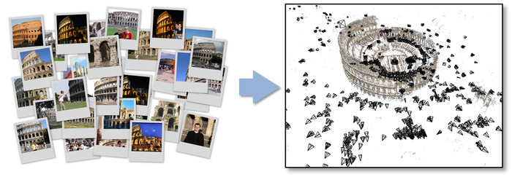
Representative SFM pipeline
N. Snavely, S. Seitz, and R. Szeliski, Photo tourism: Exploring photo collections in 3D,
SIGGRAPH 2006.
http://phototour.cs.washington.edu/
Slide from L. Lazebnik.
Notes:
Here’s how the same set of photos appear in our photo explorer. Our system takes the set of photos and automatically determines the relative positions and orientations from which each photo was taken. We can then load the photos into our immersive 3D browser where the user can visualize and explore the photos using spatial relationships.

Slide 5
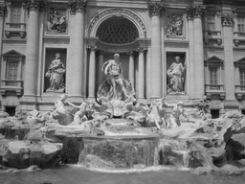
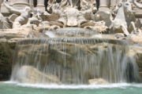
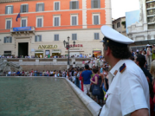
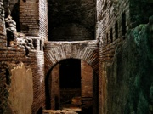

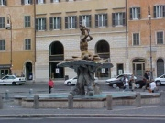
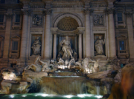
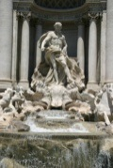

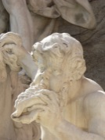
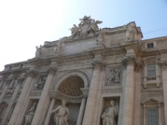
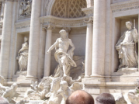
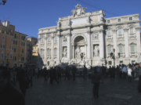
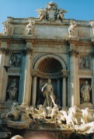
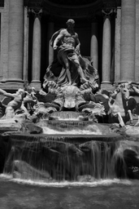
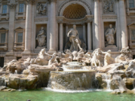
Feature detection
Detect SIFT features
Source: N. Snavely
Notes:
So, we begin by detecting SIFT features in each photo.
[We detect SIFT features in each photo, resulting in a set of feature locations and 128-byte feature descriptors…]

Slide 6



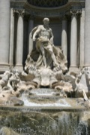



Feature detection
Detect SIFT features
Source: N. Snavely

Slide 7
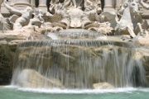




Feature matching
Match features between each pair of images
Source: N. Snavely
Notes:
Next, we match features across each pair of photos using approximate nearest neighbor matching.

Slide 8


Feature matching
Use RANSAC to estimate fundamental matrix between each pair
Source: N. Snavely
Notes:
The matches are refined by using RANSAC, which is a robust model-fitting technique, to estimate a fundamental matrix between each pair of matching images and keeping only matches consistent with that fundamental matrix.
We then link connected components of pairwise feature matches together to form correspondences across multiple images.
Once we have correspondences, we run structure from motion to recover the camera and scene geometry. Structure from motion solves the following problem:

Slide 9
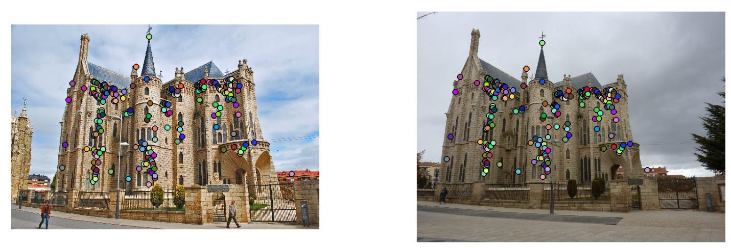
Feature matching
Use RANSAC to estimate fundamental matrix between each pair
Slide from L. Lazebnik.
Image source
Notes:
The matches are refined by using RANSAC, which is a robust model-fitting technique, to estimate a fundamental matrix between each pair of matching images and keeping only matches consistent with that fundamental matrix.
We then link connected components of pairwise feature matches together to form correspondences across multiple images.
Once we have correspondences, we run structure from motion to recover the camera and scene geometry. Structure from motion solves the following problem:

Slide 10
Feature matching
Use RANSAC to estimate fundamental matrix between each pair
Source: N. Snavely
Notes:
The matches are refined by using RANSAC, which is a robust model-fitting technique, to estimate a fundamental matrix between each pair of matching images and keeping only matches consistent with that fundamental matrix.
We then link connected components of pairwise feature matches together to form correspondences across multiple images.
Once we have correspondences, we run structure from motion to recover the camera and scene geometry. Structure from motion solves the following problem:

Slide 11
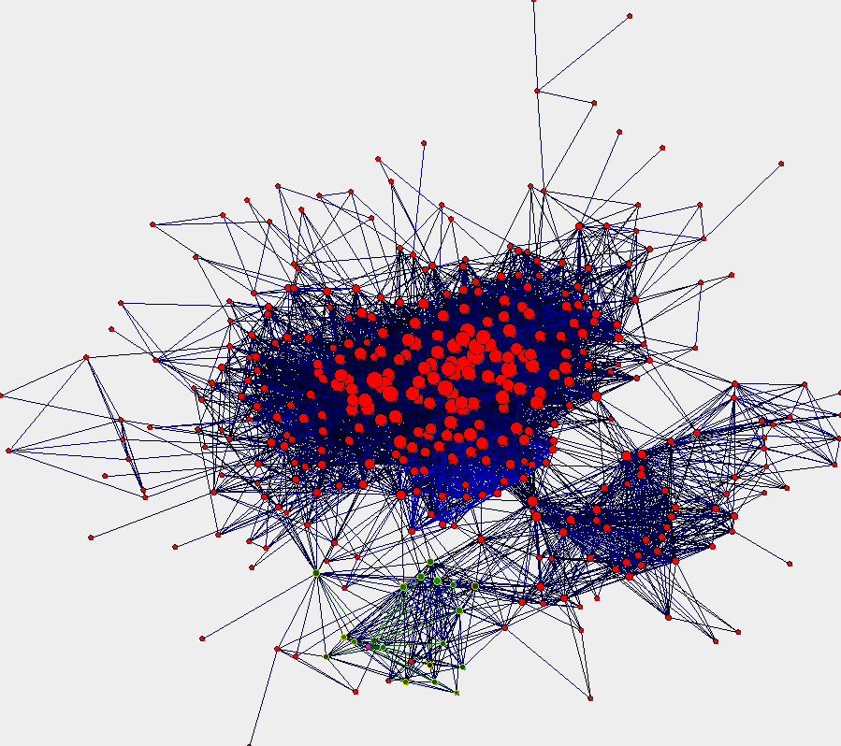
Image connectivity graph
(graph layout produced using the Graphviz toolkit: http://www.graphviz.org/)
Source: N. Snavely

Slide 12
Structure from motion
Given: m images of n fixed 3D points
λ_{ij} x_{ij} = P_{i} X_{j} , i = 1, … , m, j = 1, … , n
Problem: estimate m projection matrices P_{i} and
n 3D points X_{j} from the mn correspondences x_{ij}
X_{j}
x_{1j}
x_{3j}
x_{2j}
P₁
P₃
P₂
Slide from L. Lazebnik.

Slide 13
Projective structure from motion
Given: m images of n fixed 3D points
λ_{ij} x_{ij} = P_{i} X_{j} , i = 1,… , m, j = 1, … , n
Problem: estimate m projection matrices P_{i} and n 3D points X_{j} from the mn correspondences x_{ij}
X_{j}
x_{1j}
x_{3j}
x_{2j}
P₁
P₃
P₂
Slide from L. Lazebnik.

Slide 14
Projective structure from motion
Given: m images of n fixed 3D points
λ_{ij} x_{ij} = P_{i} X_{j} , i = 1,… , m, j = 1, … , n
Problem: estimate m projection matrices P_{i} and n 3D points X_{j} from the mn correspondences x_{ij}
With no calibration info, cameras and points can only be recovered up to a 4x4 projective transformation Q:
X → QX, P → PQ⁻¹
We can solve for structure and motion when
2mn >= 11m +3n – 15
For two cameras, at least 7 points are needed
Slide from L. Lazebnik.

Slide 15
Projective structure from motion
Given: m images of n fixed 3D points
λ_{ij} x_{ij} = P_{i} X_{j} , i = 1,… , m, j = 1, … , n
Problem: estimate m projection matrices P_{i} and n 3D points X_{j} from the mn correspondences x_{ij}
With no calibration info, cameras and points can only be recovered up to a 4x4 projective transformation Q:
X → QX, P → PQ⁻¹
We can solve for structure and motion when
2mn >= 11m +3n – 15
For two cameras, at least 7 points are needed

Slide 16
Projective SFM: Two-camera case
Compute fundamental matrix F between the two views
First camera matrix: [I | 0]
Second camera matrix: [A | b]
Then b is the epipole (F^{T}b = 0), A = –[b×]F
Slide from L. Lazebnik.
F&P sec. 8.3.2

Slide 17
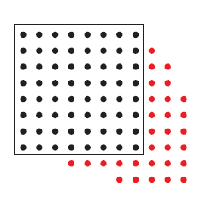
Incremental structure from motion
Initialize motion from two images using fundamental matrix
Initialize structure by triangulation
For each additional view:
  Determine projection matrix of new camera using all the known 3D points that are visible in its image – calibration
points
cameras
Slide from L. Lazebnik.

Slide 18
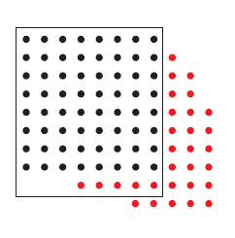
Incremental structure from motion
Initialize motion from two images using fundamental matrix
Initialize structure by triangulation
For each additional view:
  Determine projection matrix of new camera using all the known 3D points that are visible in its image – calibration
  Refine and extend structure: compute new 3D points,
  re-optimize existing points that are also seen by this camera – triangulation
points
cameras
Slide from L. Lazebnik.

Slide 19
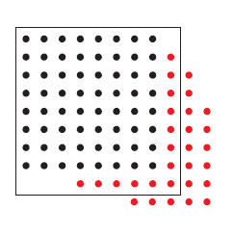
Incremental structure from motion
Initialize motion from two images using fundamental matrix
Initialize structure by triangulation
For each additional view:
  Determine projection matrix of new camera using all the known 3D points that are visible in its image – calibration
  Refine and extend structure: compute new 3D points,
  re-optimize existing points that are also seen by this camera – triangulation
Refine structure and motion: bundle adjustment
points
cameras
Slide from L. Lazebnik.

Slide 20
Bundle adjustment
Non-linear method for refining structure and motion
Minimize reprojection error
X_{j}
visibility flag: is point j visible in
view i?
P₁X_{j}
x_{1j}
x_{3j}
P₃X_{j}
P₂X_{j}
x_{2j}
P₁
P₃
P₂
Slide from L. Lazebnik.

Slide 21
Self-calibration
Self-calibration (auto-calibration) is the process of determining intrinsic camera parameters directly from uncalibrated images
For example, when the images are acquired by a single moving camera, we can use the constraint that the intrinsic parameter matrix remains fixed for all the images
  Compute initial projective reconstruction and find 3D projective transformation matrix Q such that all camera matrices are in the form P_{i} = K [R_{i} | t_{i}]
Can use constraints on the form of the calibration matrix: zero skew
Can use vanishing points

Slide 22
Incremental SFM
Pick a pair of images with lots of inliers
(and preferably, good EXIF data)
  Initialize intrinsic parameters (focal length, principal point) from EXIF
  Estimate extrinsic parameters (R and t) using five-point algorithm
  Use triangulation to initialize model points
While remaining images exist
  Find an image with many feature matches with images in the model
  Run RANSAC on feature matches to register new image to model
  Triangulate new points
  Perform bundle adjustment to re-optimize everything
Slide from L. Lazebnik.

Slide 23

N. Snavely, S. Seitz, and R. Szeliski, Photo tourism: Exploring photo collections in 3D,
SIGGRAPH 2006. http://phototour.cs.washington.edu/
See also: http://grail.cs.washington.edu/projects/rome/

Slide 24
Outline
Representative SfM pipeline
  Incremental SfM
  Bundle adjustment
Ambiguities in SfM
Special Case: Affine structure from motion
  Factorization
SfM in practice

Slide 25
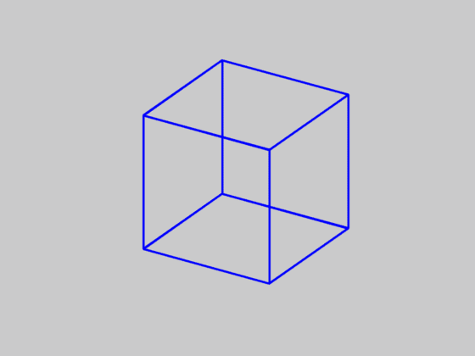
Is SFM always uniquely solvable?
Necker cube
Source: N. Snavely

Slide 26
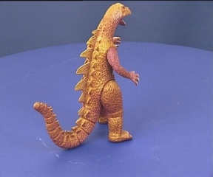
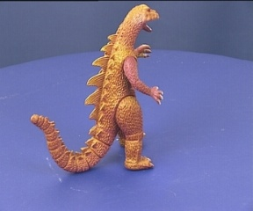
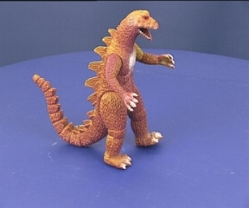
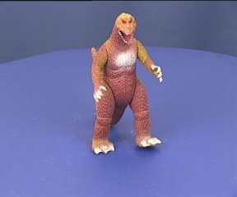
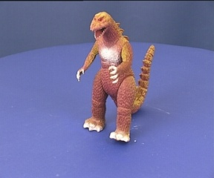
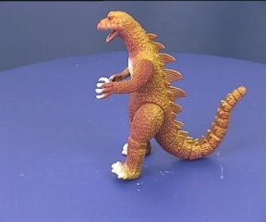
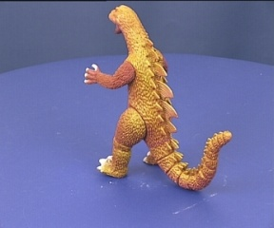
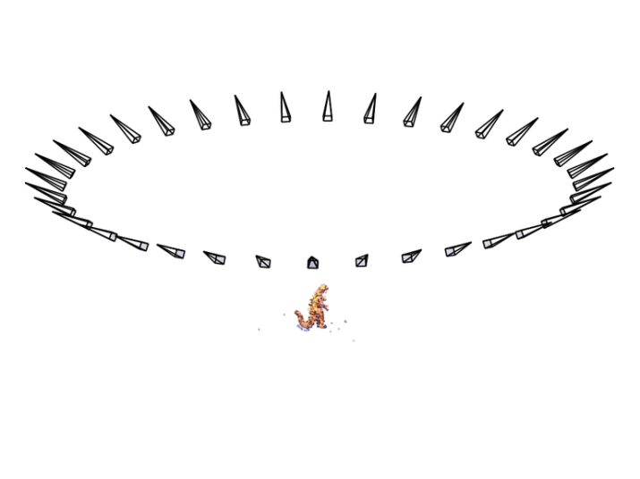
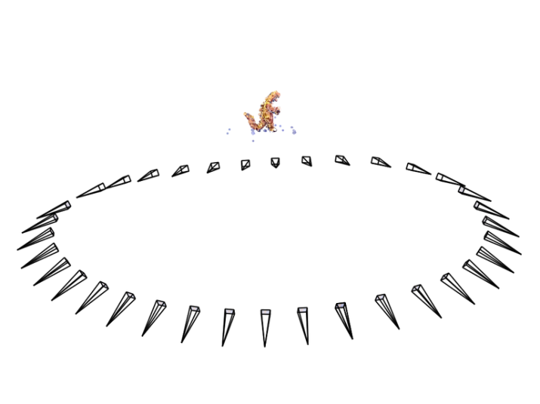
Is SFM always uniquely solvable?
Necker reversal
Source: N. Snavely
Notes:
Necker reversal ambiguity:
This arises because an object rotating by ρ and its mirror image rotating by −ρ generate the same image under parallel projection, see figure 14.9(a). Thus, structure is only recovered up to a reflection about the frontal plane. This ambiguity is absent in the perspective case because the points have different depths in the two interpretations and so do not project to coincident image points.

Slide 27
Structure from motion ambiguity
If we scale the entire scene by some factor k and, at the same time, scale the camera matrices by the factor of 1/k, the projections of the scene points in the image remain exactly the same:
  It is impossible to recover the absolute scale of the scene!
Slide from L. Lazebnik.

Slide 28
Structure from motion ambiguity
If we scale the entire scene by some factor k and, at the same time, scale the camera matrices by the factor of 1/k, the projections of the scene points in the image remain exactly the same:
  It is impossible to recover the absolute scale of the scene!
Slide from L. Lazebnik.

Slide 29
Structure from motion ambiguity
If we scale the entire scene by some factor k and, at the same time, scale the camera matrices by the factor of 1/k, the projections of the scene points in the image remain exactly the same
More generally, if we transform the scene using a transformation Q and apply the inverse transformation to the camera matrices, then the images do not change:
Slide from L. Lazebnik.

Slide 30
Structure from motion ambiguity
If we scale the entire scene by some factor k and, at the same time, scale the camera matrices by the factor of 1/k, the projections of the scene points in the image remain exactly the same
More generally, if we transform the scene using a transformation Q and apply the inverse transformation to the camera matrices, then the images do not change:
Slide from L. Lazebnik.

Slide 31
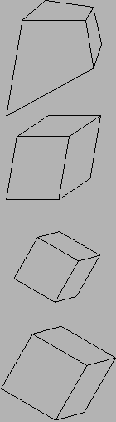
Types of ambiguity
Projective
15dof
Preserves intersection and tangency
Affine
12dof
Preserves parallellism, volume ratios
Similarity
7dof
Preserves angles, ratios of length
Euclidean
6dof
Preserves angles, lengths
With no constraints on the camera calibration matrix or on the scene, we get a projective reconstruction
Need additional information to upgrade the reconstruction to affine, similarity, or Euclidean
Slide from L. Lazebnik.

Slide 32
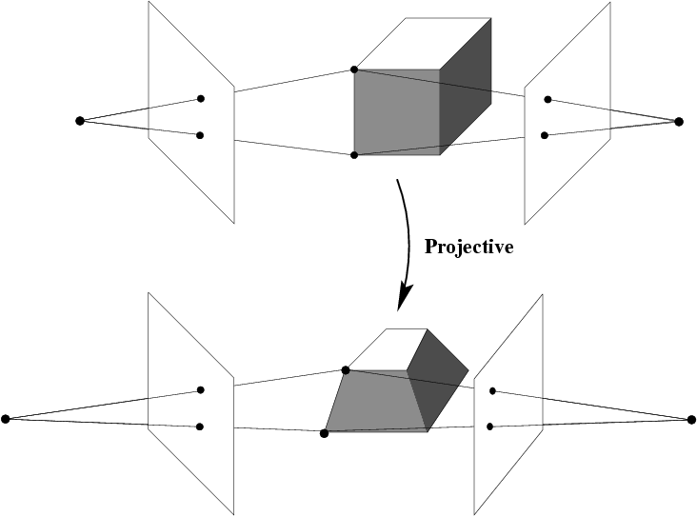
Projective ambiguity
With no constraints on the camera calibration matrix or on the scene, we can reconstruct up to a projective ambiguity
Slide from L. Lazebnik.

Slide 33
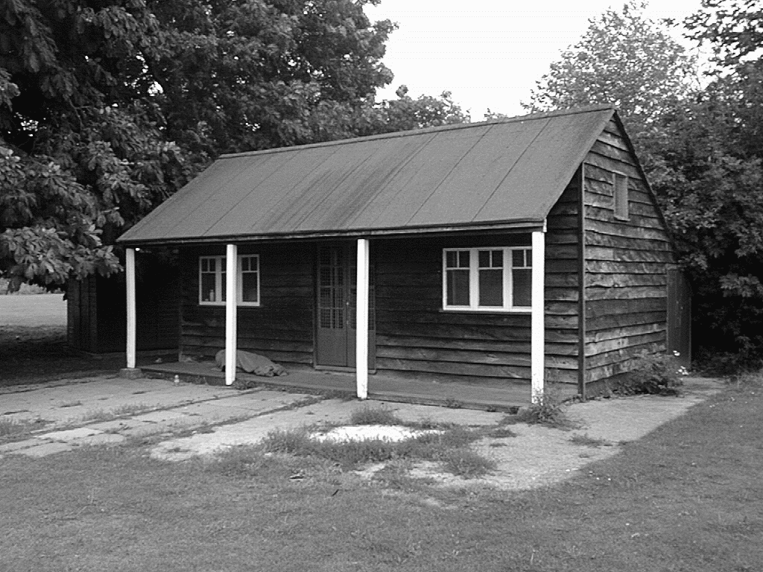
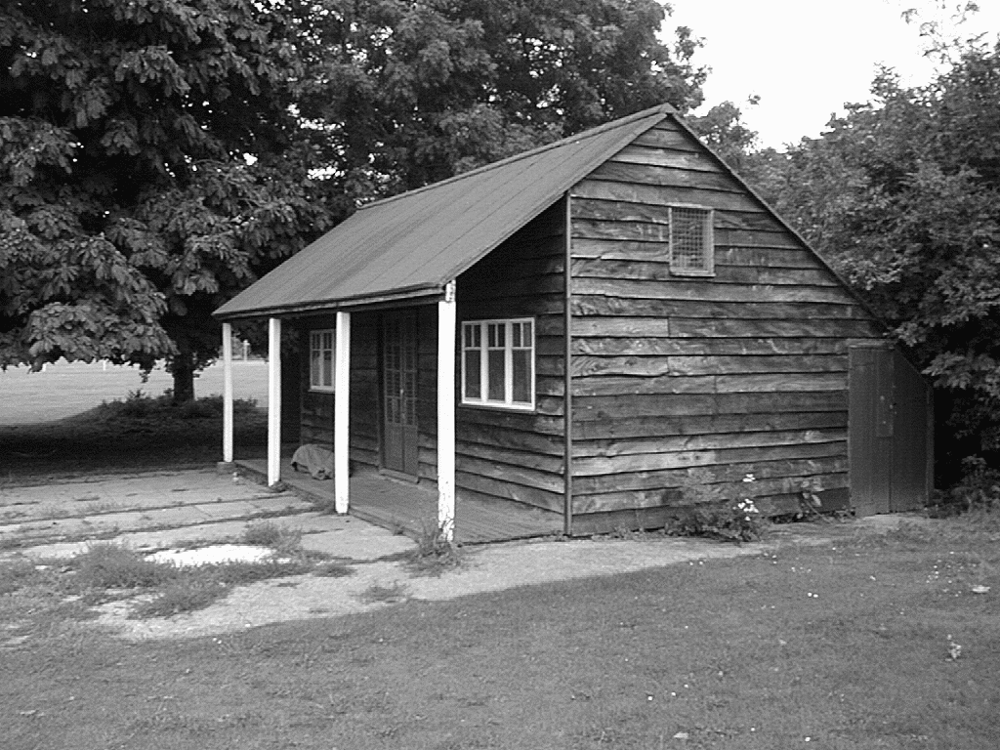
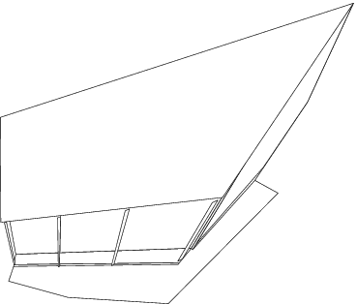
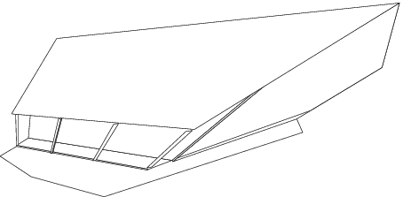
Projective ambiguity
Slide from L. Lazebnik.

Slide 34
Affine ambiguity
If we impose parallelism constraints, we can get a reconstruction up to an affine ambiguity
Affine
Slide from L. Lazebnik.

Slide 35
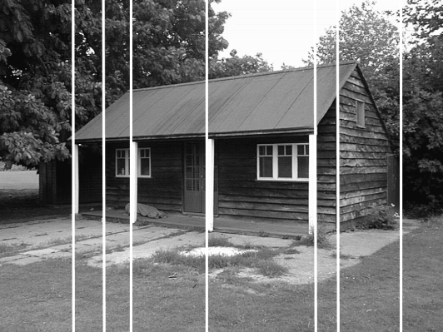
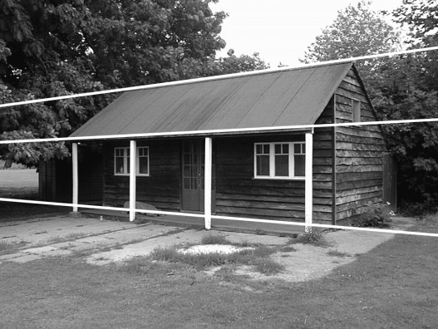
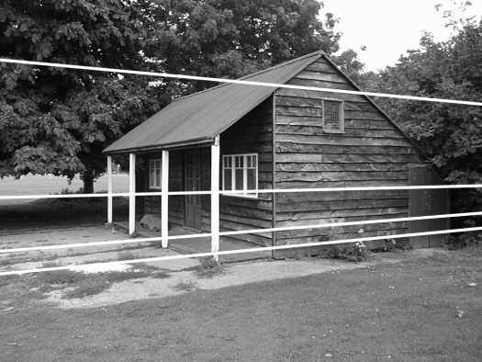
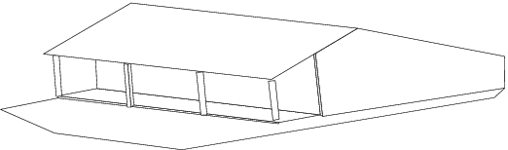
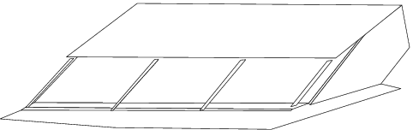
Affine ambiguity
Slide from L. Lazebnik.

Slide 36
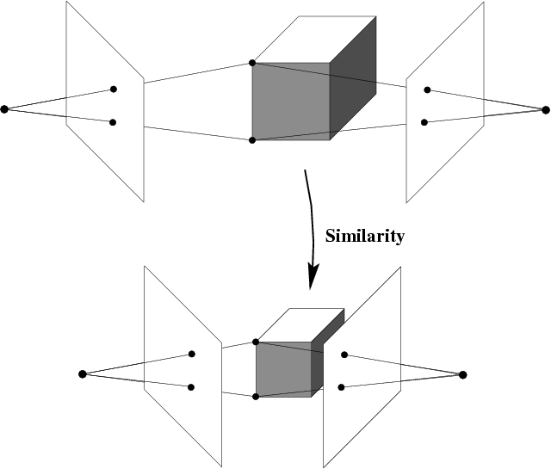
Similarity ambiguity
A reconstruction that obeys orthogonality constraints on camera parameters and/or scene
Slide from L. Lazebnik.

Slide 37
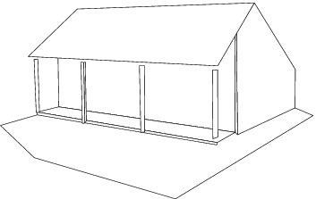
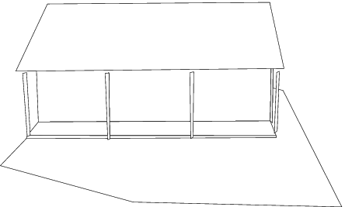
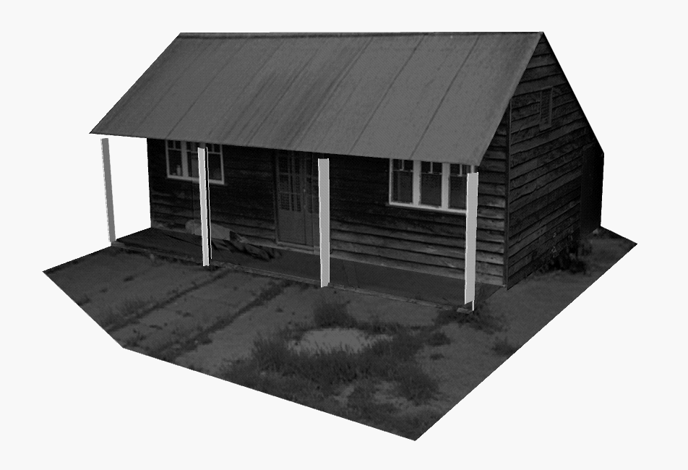
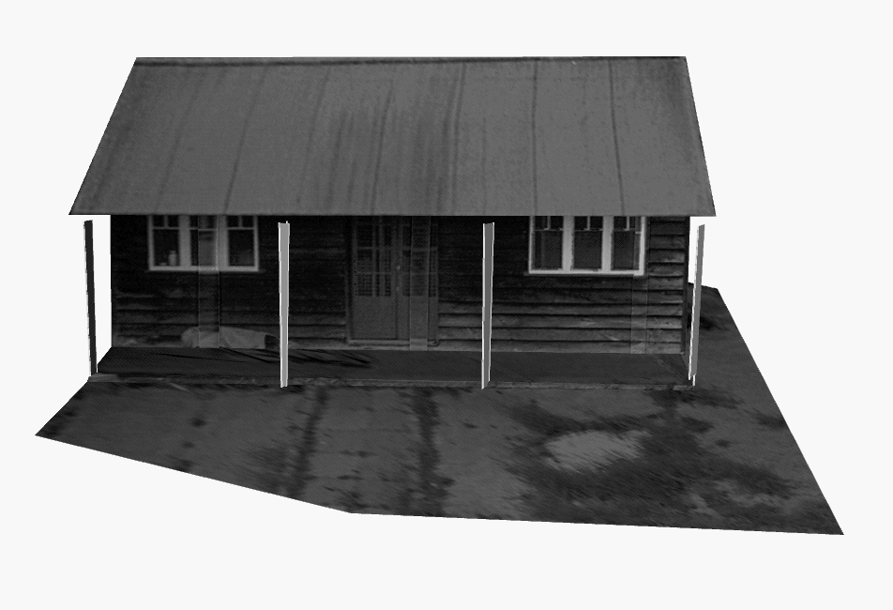
Similarity ambiguity
Slide from L. Lazebnik.

Slide 38
Outline
Representative SfM pipeline
  Incremental SfM
  Bundle adjustment
Ambiguities in SfM
Special Case: Affine structure from motion
  Factorization
SfM in practice

Slide 39
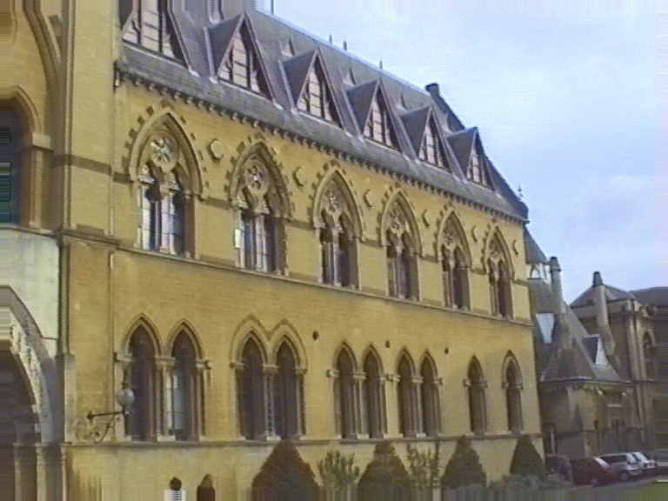
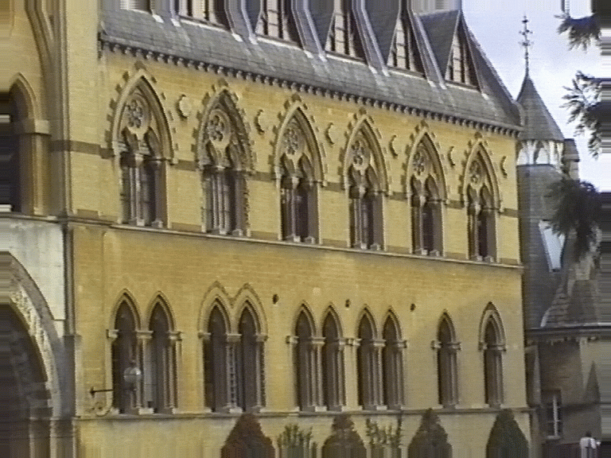

Special Case: Affine structure from motion
Let’s start with affine or weak perspective cameras (the math is easier)
center at
infinity
Slide from L. Lazebnik.

Slide 40



Recall: Orthographic Projection
Image
World
Projection along the z direction
Slide from L. Lazebnik.

Slide 41


Affine cameras
Orthographic Projection
Parallel Projection
Slide from L. Lazebnik.

Slide 42
Affine cameras
A general affine camera combines the effects of an affine transformation of the 3D space, orthographic projection, and an affine transformation of the image:
Affine projection is a linear mapping + translation in non-homogeneous coordinates
x
a₂
X
Projection of
world origin
a₁
Slide from L. Lazebnik.

Slide 43
Affine structure from motion
Given: m images of n fixed 3D points:
x_{ij} = A_{i} X_{j} + b_{i} , i = 1,… , m, j = 1, … , n
Problem: use the mn correspondences x_{ij} to estimate m projection matrices A_{i} and translation vectors b_{i},
and n points X_{j}
The reconstruction is defined up to an arbitrary affine transformation Q (12 degrees of freedom):
We have 2mn knowns and 8m + 3n unknowns (minus 12 dof for affine ambiguity)
Thus, we must have 2mn >= 8m + 3n – 12
For two views, we need four point correspondences
Slide from L. Lazebnik.

Slide 44
Affine structure from motion
Centering: subtract the centroid of the image points in each view
For simplicity, set the origin of the world coordinate system to the centroid of the 3D points
After centering, each normalized 2D point is related to the 3D point X_{j} by
Slide from L. Lazebnik.

Slide 45
Affine structure from motion
Let’s create a 2m × n data (measurement) matrix:
cameras
(2 m)
points (n)
C. Tomasi and T. Kanade. Shape and motion from image streams under orthography:
A factorization method. IJCV, 9(2):137-154, November 1992.

Slide 46
Affine structure from motion
Let’s create a 2m × n data (measurement) matrix:
points (3 × n)
cameras
(2 m × 3)
The measurement matrix D = MS must have rank 3!
C. Tomasi and T. Kanade. Shape and motion from image streams under orthography:
A factorization method. IJCV, 9(2):137-154, November 1992.

Slide 47

Factorizing the measurement matrix
Source: M. Hebert

Slide 48

Factorizing the measurement matrix
Singular value decomposition of D:
Source: M. Hebert

Slide 49
Factorizing the measurement matrix
Singular value decomposition of D:
Source: M. Hebert

Slide 50

Factorizing the measurement matrix
Obtaining a factorization from SVD:
Source: M. Hebert

Slide 51
Factorizing the measurement matrix
Obtaining a factorization from SVD:
This decomposition minimizes
|D-MS|²
Source: M. Hebert

Slide 52

Affine ambiguity
The decomposition is not unique. We get the same D by using any 3×3 matrix C and applying the transformations M → MC, S →C⁻¹S
That is because we have only an affine transformation and we have not enforced any Euclidean constraints (like forcing the image axes to be perpendicular, for example)
Source: M. Hebert

Slide 53
Eliminating the affine ambiguity
Transform each projection matrix A to another matrix AC to get orthographic projection
  Image axes are perpendicular and scale is 1
This translates into 3m equations:
(A_{i}C)(A_{i}C)^{T} = A_{i}(CC^{T})A_{i} = Id, i = 1, …, m
  Solve for L = CC^{T}
  Recover C from L by Cholesky decomposition: L = CC^{T}
  Update M and S: M = MC, S = C⁻¹S
a₁ · a₂ = 0
x
|a₁|² = |a₂|² = 1
a₂
a₁
X
Source: M. Hebert

Slide 54
Reconstruction results
C. Tomasi and T. Kanade, Shape and motion from image streams under orthography:
A factorization method, IJCV 1992

Slide 55

Dealing with missing data
So far, we have assumed that all points are visible in all views
In reality, the measurement matrix typically looks something like this:
Possible solution: decompose matrix into dense sub-blocks, factorize each sub-block, and fuse the results
  Finding dense maximal sub-blocks of the matrix is NP-complete (equivalent to finding maximal cliques in a graph)
cameras
points
Slide from L. Lazebnik.

Slide 56

Dealing with missing data
Incremental bilinear refinement
Perform factorization on a dense sub-block
(2) Solve for a new 3D point visible by at least two known cameras (triangulation)
(3) Solve for a new camera that sees at least three known 3D points (calibration)
F. Rothganger, S. Lazebnik, C. Schmid, and J. Ponce. Segmenting, Modeling, and Matching Video Clips Containing Multiple Moving Objects. PAMI 2007.

Slide 57
Outline
Representative SfM pipeline
  Incremental SfM
  Bundle adjustment
Ambiguities in SfM
Special Case: Affine structure from motion
  Factorization
SfM in practice

Slide 58
The devil is in the details
Handling degenerate configurations (e.g., homographies)
Eliminating outliers
Dealing with repetitions and symmetries
Slide from L. Lazebnik.

Slide 59




Repetitive structures
https://demuc.de/tutorials/cvpr2017/sparse-modeling.pdf

Slide 60
The devil is in the details
Handling degenerate configurations (e.g., homographies)
Eliminating outliers
Dealing with repetitions and symmetries
Handling multiple connected components
Closing loops
Making the whole thing efficient!
  See, e.g., Towards Linear-Time Incremental Structure from Motion
Slide from L. Lazebnik.

Slide 61
SFM software
Bundler
OpenSfM
OpenMVG
VisualSFM
See also Wikipedia’s list of toolboxes
Slide from L. Lazebnik.

Slide 62
Outline
Representative SfM pipeline
  Incremental SfM
  Bundle adjustment
Ambiguities in SfM
Special Case: Affine structure from motion
  Factorization
SfM in practice

