Slide 1
Introduction to Recognition
Computer Vision
CS 543 / ECE 549
University of Illinois
Many Slides from D. Hoiem, L. Lazebnik.

Slide 2
Outline
Overview
  Task descriptions
  Basic approach
Classifiers
Features
Basic Machine Learning Concepts
Convolutional neural networks (CNNs)

Slide 3
Recognition as 3D Matching
http://www.robots.ox.ac.uk/~vgg/research/oxbuildings/index.html

Slide 4
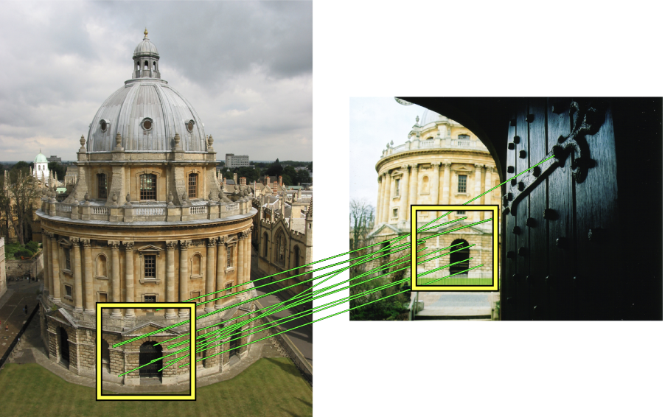
Recognition as 3D Matching
Recognizing solid objects by alignment with an image. Huttenlocher and Ullman IJCV 1990.

Slide 5
Recognition as 3D Matching
Distinctive Image Features from Scale-Invariant Keypoints. Lowe IJCV 2004.

Slide 6
Recognition as 3D Matching
“Instance” Recognition
“Category-level” Recognition

Slide 7
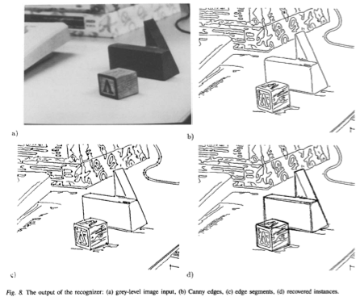
Recognition as 3D Matching
“Instance” Recognition
“Category-level” Recognition
Recognizing solid objects by alignment with an image. Huttenlocher and Ullman IJCV 1990.

Slide 8
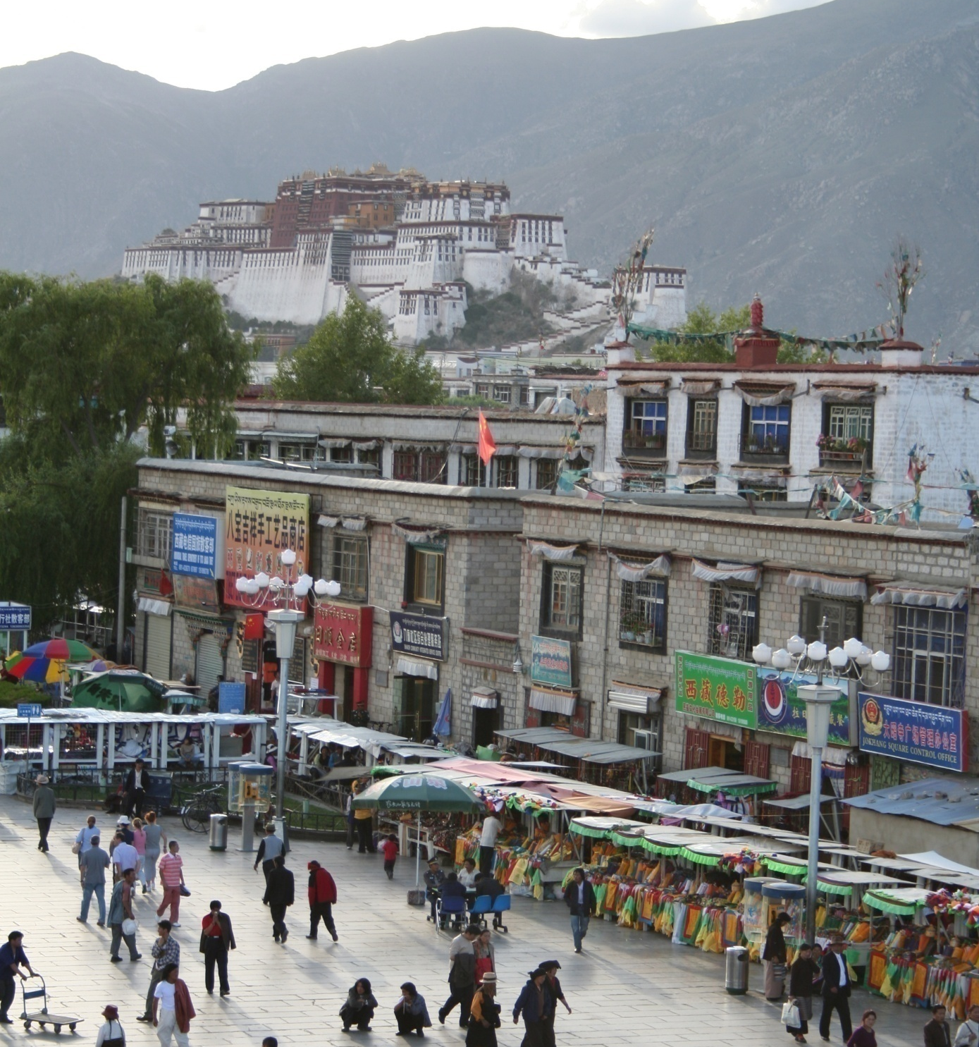
Common recognition tasks
Adapted from Fei-Fei Li

Slide 9
Image classification and tagging
outdoor
mountains
city
Asia
Lhasa
…
Adapted from Fei-Fei Li

Slide 10
Object detection
find pedestrians
Adapted from Fei-Fei Li

Slide 11
Activity recognition
walking
shopping
rolling a cart
sitting
talking
…
Adapted from Fei-Fei Li

Slide 12
Semantic segmentation
Adapted from Fei-Fei Li

Slide 13
Semantic segmentation
sky
mountain
building
tree
building
lamp
lamp
umbrella
umbrella
person
market stall
person
person
person
person
ground
Adapted from Fei-Fei Li

Slide 14
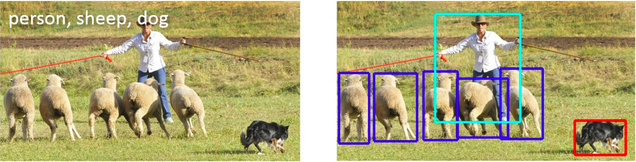
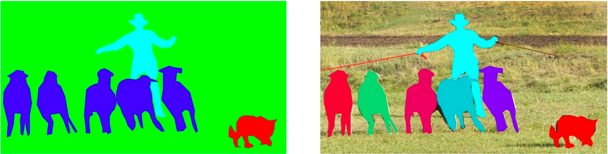
Detection, semantic segmentation, instance segmentation
image classification
object detection
semantic segmentation
instance segmentation
Image source

Slide 15
Image description
This is a busy street in an Asian city. Mountains and a large palace or fortress loom in the background. In the foreground, we see colorful souvenir stalls and people walking around and shopping. One person in the lower left is pushing an empty cart, and a couple of people in the middle are sitting, possibly posing for a photograph.
Adapted from Fei-Fei Li

Slide 16
Many vision problems involve categorization
Image: Classify as indoor/outdoor, which room, what objects are there, etc.
Object Detection: classify location (bounding box or region) as object or non-object
Semantic Segmentation: classify pixel into an object, material, part, etc.
Action Recognition: classify a frame or sequence into an action type
…

Slide 17
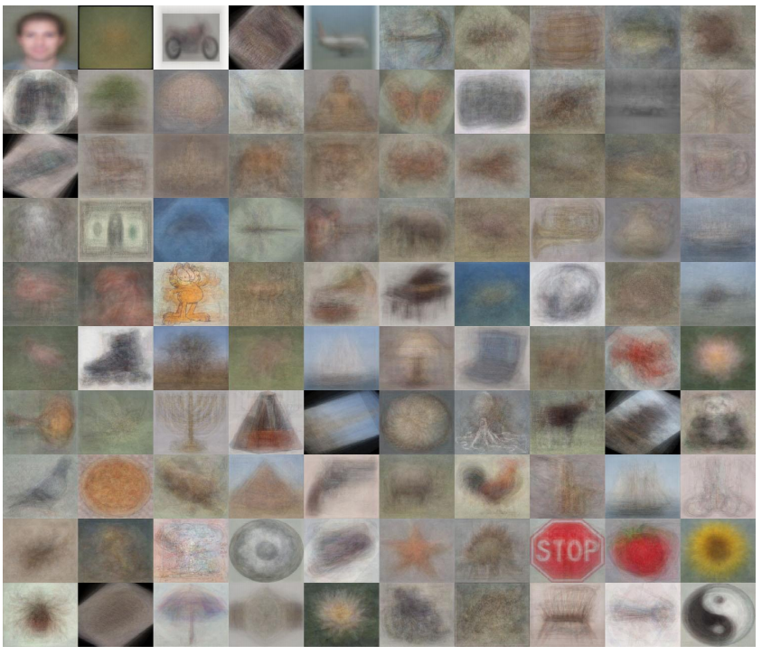
Image categorization
Object recognition
Caltech 101 Average Object Images

Slide 18
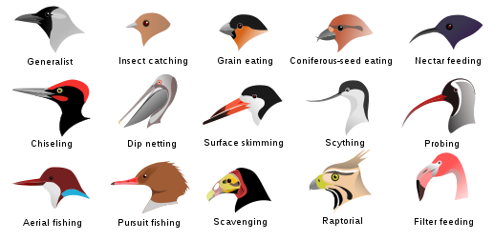
Image categorization
Fine-grained recognition
Visipedia Project

Slide 19
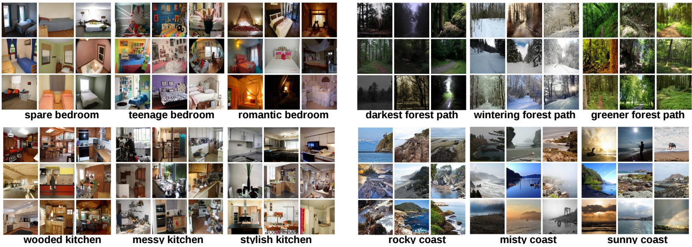
Image categorization
Place recognition
Places Database [Zhou et al. NIPS 2014]

Slide 20
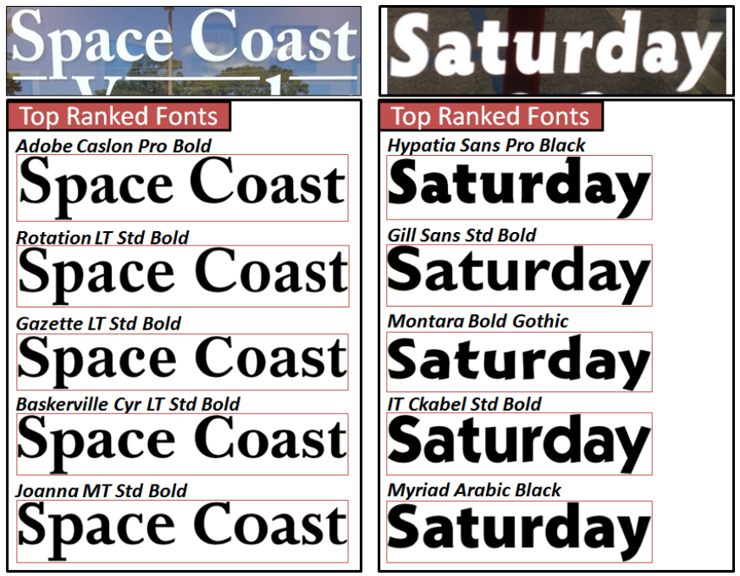
Image categorization
Visual font recognition
[Chen et al. CVPR 2014]

Slide 21
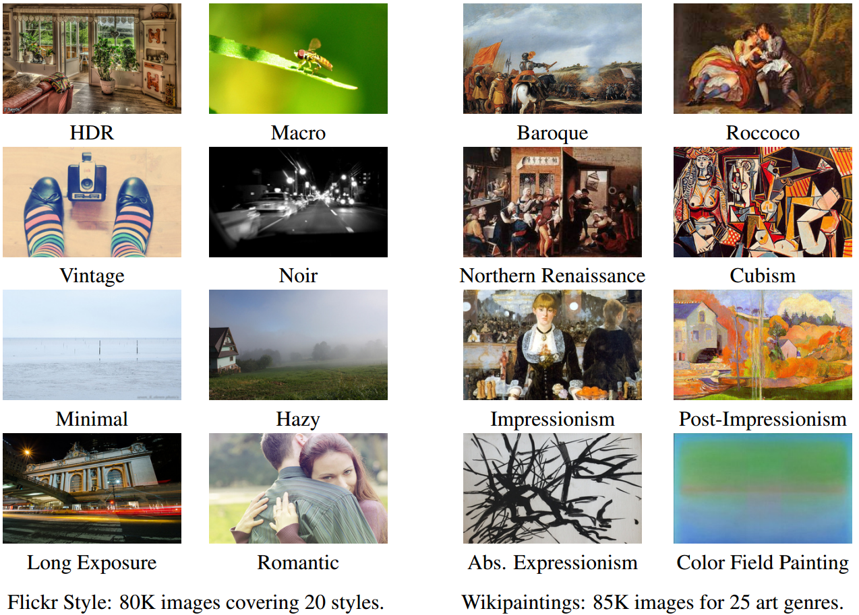
Image categorization
Image style recognition
[Karayev et al. BMVC 2014]

Slide 22
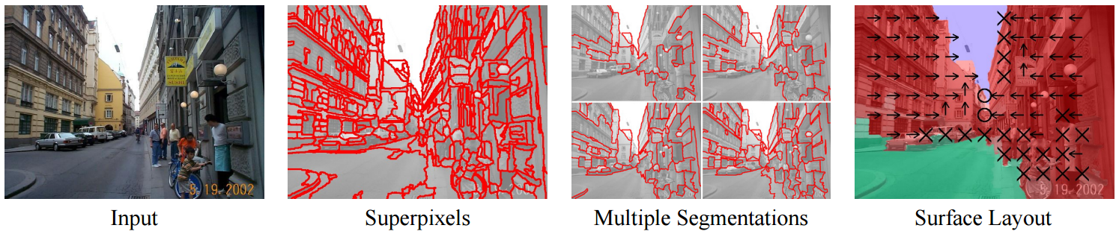
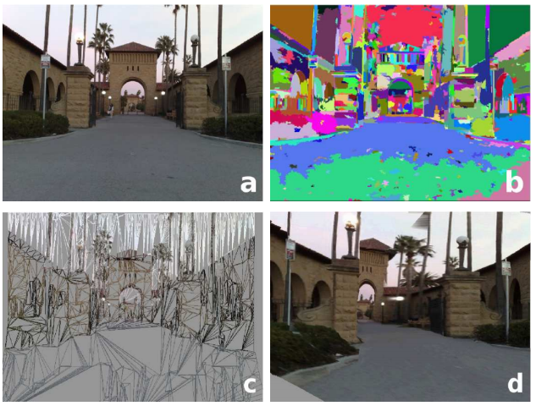
Region categorization
Layout prediction
Assign regions to orientation
Geometric context [Hoiem et al. IJCV 2007]
Assign regions to depth
Make3D [Saxena et al. PAMI 2008]

Slide 23
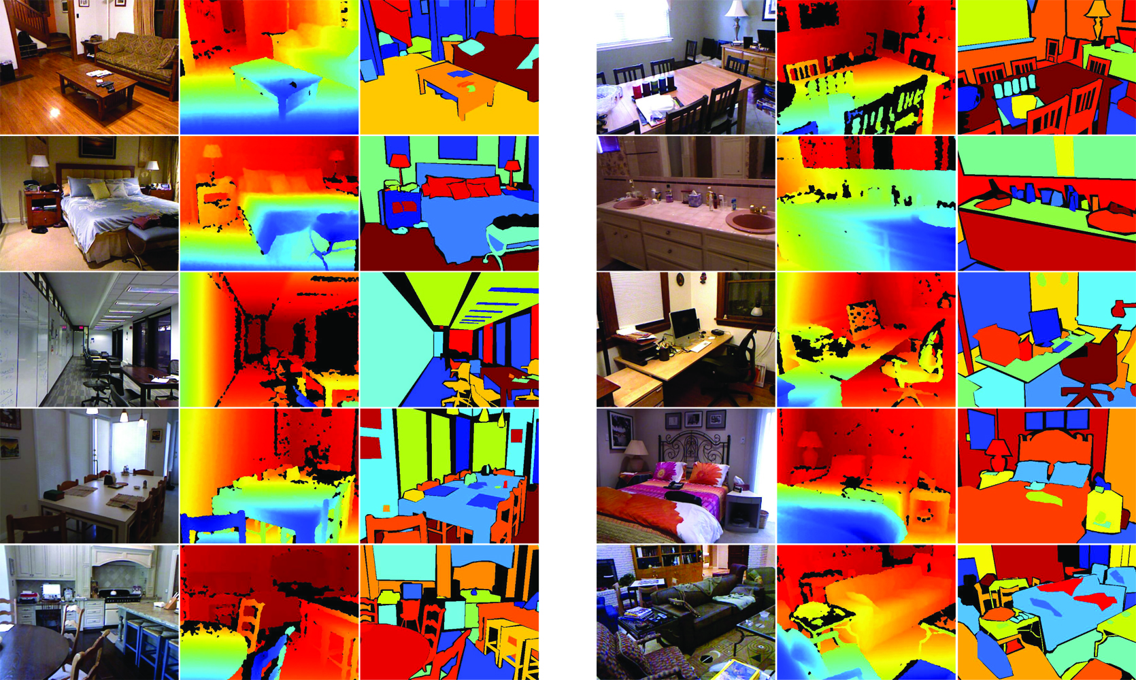
Region categorization
Semantic segmentation from RGBD images
[Silberman et al. ECCV 2012]

Slide 24
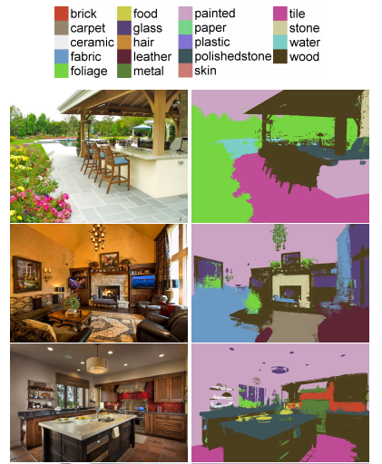
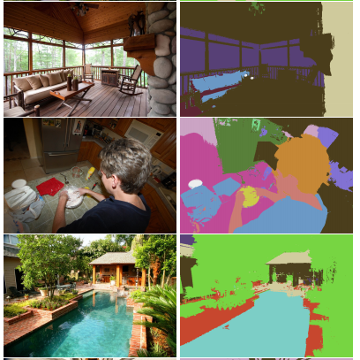
Region categorization
Material recognition
[Bell et al. CVPR 2015]

Slide 25
Detection, semantic segmentation, instance segmentation
image classification
object detection
semantic segmentation
instance segmentation
Image source

Slide 26
“Classic” recognition pipeline
Feature representation
Trainable
classifier
Image
Pixels
Class label

Slide 27





Basic Approach: Supervised Learning
Training
Training Labels
Training Images
Image Features
Classifier Training
Trained Classifier
Testing
Image Features
Trained Classifier
Prediction
Outdoor
Test Image
Notes:
At testing time, we are given a new image, we also represent it in terms of image features and apply the trained model to obtain the prediction

Slide 28
Do you know about the following? (Pick all)
  Nearest Neighbor Classifiers
  Support Vector Machines
  Kernelized Support Vector Machines
  Decision Tress
  Random Forests

Slide 29
Classifiers: Nearest neighbor
Test example
Training examples from class 2
Training examples from class 1
f(x) = label of the training example nearest to x
All we need is a distance or similarity function for our inputs
No training required!
Notes:
“Non-parametric” classifier: the entire training set is essentially the model parameters.
Pros:
Very fast at training time
Flexible: all it requires is a way to compute similarity or distances between pairs of features. Applies to many different kinds of features.
Works with any number of classes.
Works well in practice for large datasets (but see cons)
Cons:
Slow at test time (need to compute distances between test example and every training example)

Slide 30
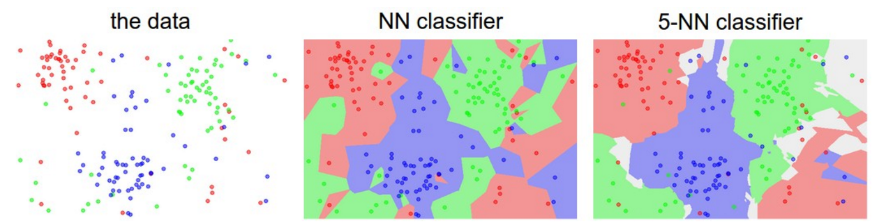
K-nearest neighbor classifier
Which classifier is more robust to outliers?
Credit: Andrej Karpathy, http://cs231n.github.io/classification/

Slide 31
Linear classifiers
Find a linear function to separate the classes:
f(x) = sign(w ⋅ x + b)
Notes:
“Parametric” classifier: model defined by a small number of parameters (w, b)
Pros:
Very fast at test time
Cons:
Slow at training time: need to estimate the parameters
Only works for two classes
Data may not be linearly separable

Slide 32
Linear classifiers
When the data is linearly separable, there may be more than one separator (hyperplane)
Which separator
is best?

Slide 33
Support vector machines
Find hyperplane that maximizes the margin between the positive and negative examples
For support vectors,
Distance between point and hyperplane:
Therefore, the margin is 2 / ||w||
Support vectors
Margin
C. Burges, A Tutorial on Support Vector Machines for Pattern Recognition, Data Mining and Knowledge Discovery, 1998

Slide 34
Finding the maximum margin hyperplane
Maximize margin 2 / ||w||
Correctly classify all training data:
Quadratic optimization problem:
C. Burges, A Tutorial on Support Vector Machines for Pattern Recognition, Data Mining and Knowledge Discovery, 1998

Slide 35
SVM parameter learning
Separable data:
Non-separable data:
Maximize margin
Classify training data correctly
Maximize margin
Minimize classification mistakes

Slide 36
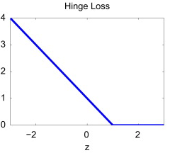
SVM parameter learning
+1
Margin
0
-1
Demo: http://cs.stanford.edu/people/karpathy/svmjs/demo

Slide 37
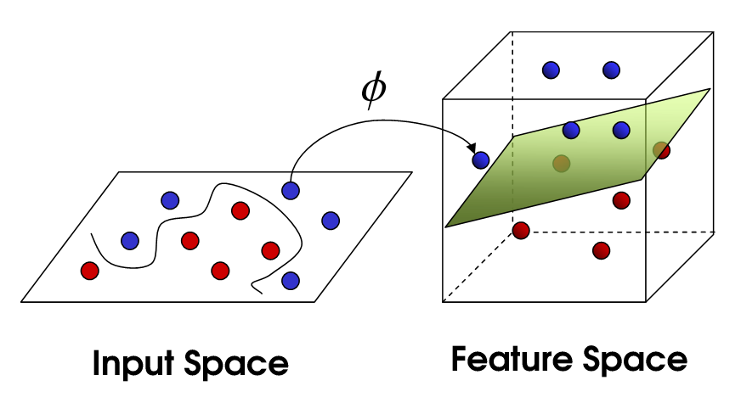
Nonlinear SVMs
General idea: the original input space can always be mapped to some higher-dimensional feature space where the training set is separable
Φ: x → φ(x)
Image source

Slide 38
Nonlinear SVMs
Linearly separable dataset in 1D:
Non-separable dataset in 1D:
We can map the data to a higher-dimensional space:
0
x
0
x
x²
0
x
Slide credit: Andrew Moore

Slide 39
The kernel trick
General idea: the original input space can always be mapped to some higher-dimensional feature space where the training set is separable
The kernel trick: instead of explicitly computing the lifting transformation φ(x), define a kernel function K such that
K(x , y) = φ(x) · φ(y)
(to be valid, the kernel function must satisfy Mercer’s condition)

Slide 40
The kernel trick
Linear SVM decision function:
learned
weight
Support
vector
C. Burges, A Tutorial on Support Vector Machines for Pattern Recognition, Data Mining and Knowledge Discovery, 1998

Slide 41
The kernel trick
Linear SVM decision function:
Kernel SVM decision function:
This gives a nonlinear decision boundary in the original feature space
C. Burges, A Tutorial on Support Vector Machines for Pattern Recognition, Data Mining and Knowledge Discovery, 1998

Slide 42
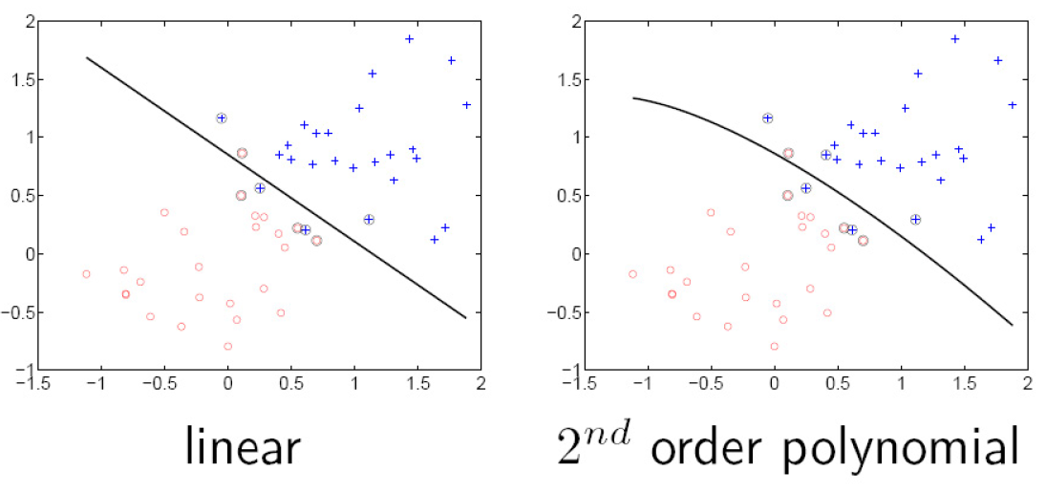
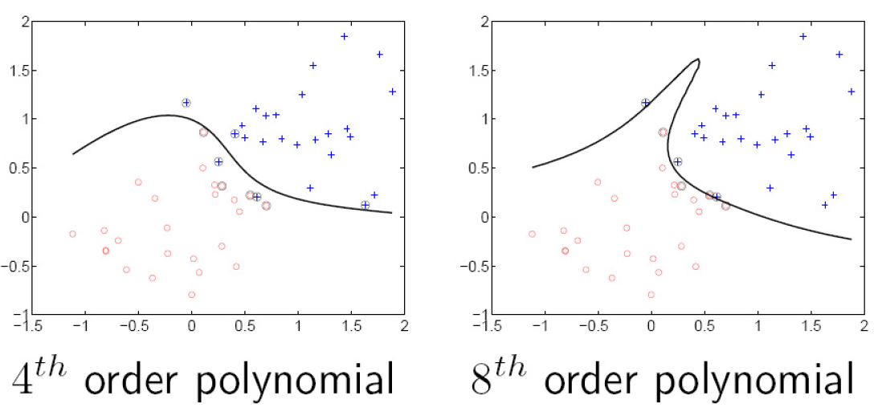
Polynomial kernel:

Slide 43
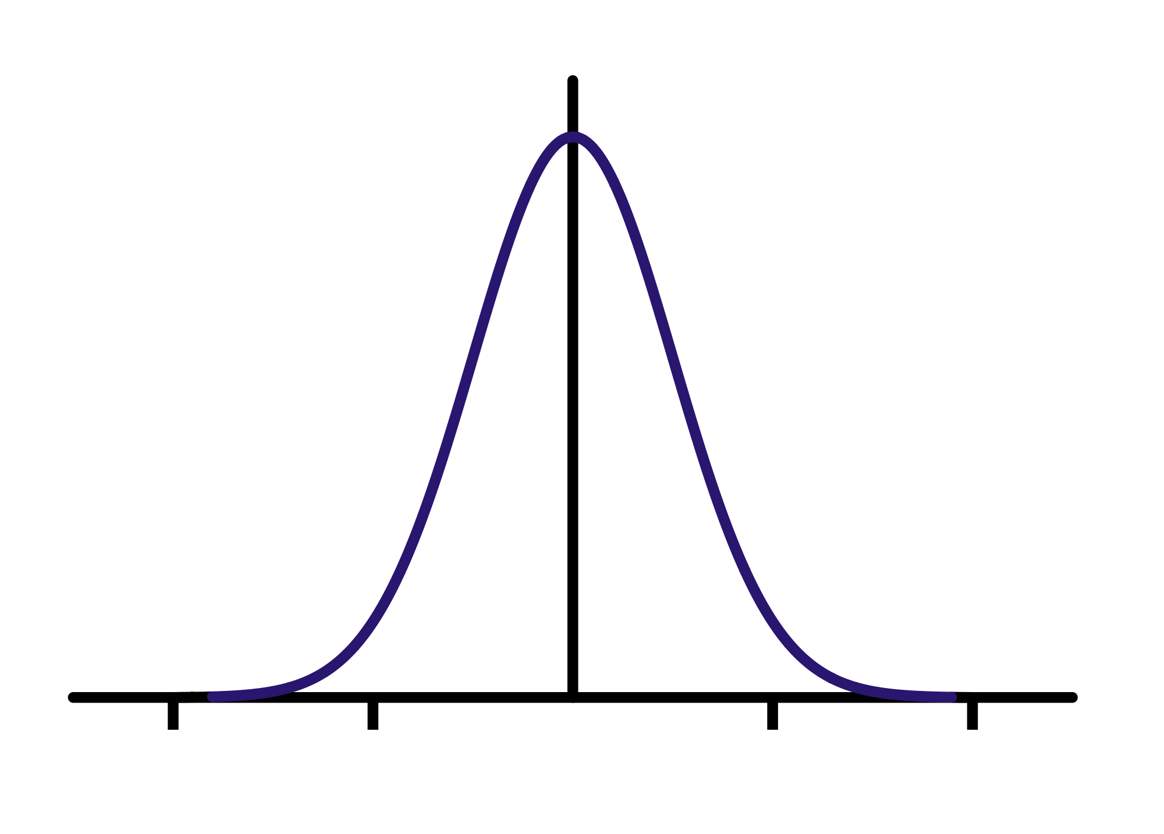
Gaussian kernel
Also known as the radial basis function (RBF) kernel:
K(x, y)
||x – y||

Slide 44
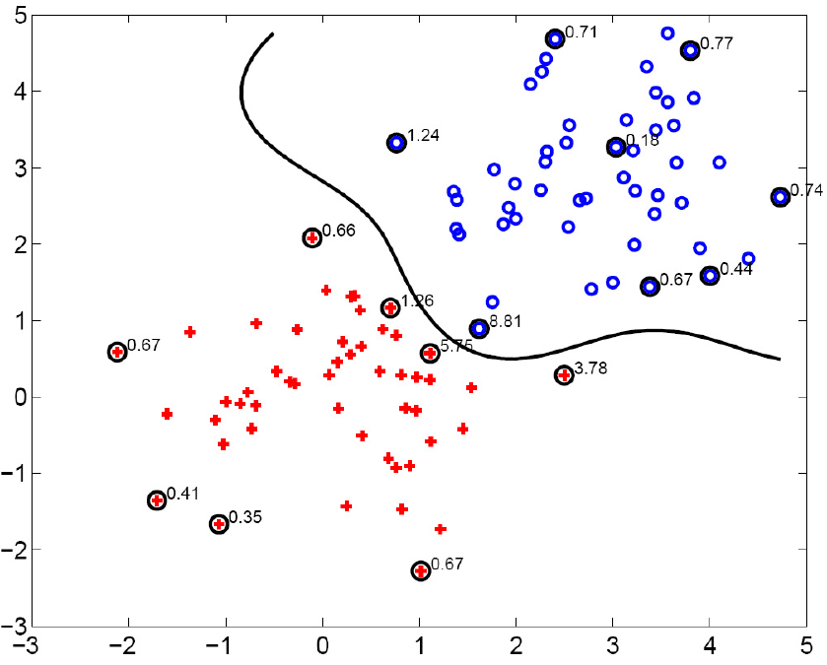
Gaussian kernel
SV’s

Slide 45



Bag of features
Extract local features
Learn “visual vocabulary”
Quantize local features using visual vocabulary
Represent images by frequencies of “visual words”

Slide 46
Outline
Overview
  Task descriptions
  Basic approach
Classifiers
Features
Basic Machine Learning Concepts
Convolutional neural networks (CNNs)

Slide 47
Digit Classification Case Study
Notes:
At testing time, we are given a new image, we also represent it in terms of image features and apply the trained model to obtain the prediction

Slide 48
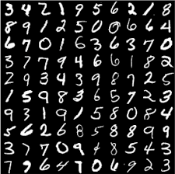
The MNIST DATABASE of handwritten digits
Yann LeCun & Corinna Cortes
Has a training set of 60 K examples (6K examples for each digit), and a test set of 10K examples.
Each digit is a 28 x 28 pixel grey level image. The digit itself occupies the central 20 x 20 pixels, and the center of mass lies at the center of the box.

Slide 49
Bias-Variance Trade-off
Notes:
At testing time, we are given a new image, we also represent it in terms of image features and apply the trained model to obtain the prediction

Slide 50
Bias and Variance
Notes:
Note: these figures don’t work in pdf

Slide 51
Bias-Variance Trade-off
Performance as a function of model complexity (SVM)

Slide 52
Model Selection
Notes:
Note: these figures don’t work in pdf

Slide 53
Bias-Variance Trade-off
As a function of dataset size

Slide 54
Generalization Error
Fixed classifier
Error
Testing
Generalization Error
Training
Number of Training Examples

Slide 55
Generalization Error
Fixed classifier
Error
Testing
Generalization Error
Training
Number of Training Examples

Slide 56
Bias-Variance Trade-off
E(MSE) = noise² + bias² + variance
Error due to variance parameter estimates from training samples
Unavoidable error
Error due to incorrect assumptions
See the following for explanation of bias-variance (also Bishop’s “Neural Networks” book):
http://www.inf.ed.ac.uk/teaching/courses/mlsc/Notes/Lecture4/BiasVariance.pdf

Slide 57
Bias and Variance
Error = noise² + bias² + variance
Few training examples
Test Error
Many training examples
High Bias
Low Variance
Complexity
Low Bias
High Variance
Notes:
Note: these figures don’t work in pdf

Slide 58
Model Selection
Error = noise² + bias² + variance
Few training examples
Test Error
Many training examples
High Bias
Low Variance
Complexity
Low Bias
High Variance
Notes:
Note: these figures don’t work in pdf

Slide 59
Features vs Classifiers
Notes:
At testing time, we are given a new image, we also represent it in terms of image features and apply the trained model to obtain the prediction

Slide 60
What are the right features?
Depend on what you want to know!
Object: shape
  Local shape info, shading, shadows, texture
Scene : geometric layout
  linear perspective, gradients, line segments
Material properties: albedo, feel, hardness
  Color, texture
Action: motion
  Optical flow, tracked points
Notes:
Object: shape, shadows

Slide 61
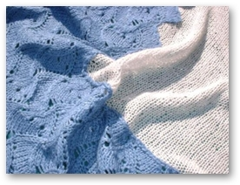
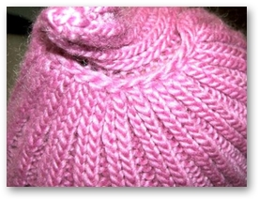
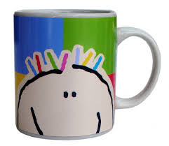
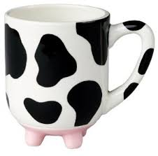
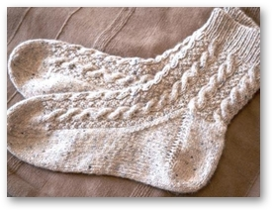
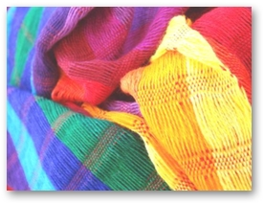
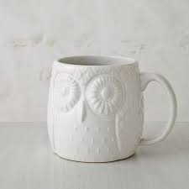


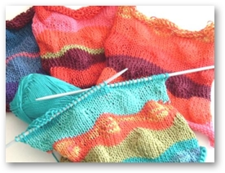

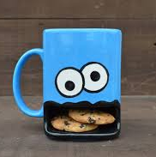
Stuff vs Objects
recognizing cloth fabric vs recognizing cups

Slide 62
Feature Design Process
Start with a model
Look at errors on development set
Think of features that can improve performance
Develop new model, test whether new features help.
If not happy, go to step 1.
“Ablations”: Simplify system, prune out features that don’t help anymore in presence of other features.

Slide 63
Features vs Classifiers
Notes:
At testing time, we are given a new image, we also represent it in terms of image features and apply the trained model to obtain the prediction

Slide 64
“Classic” recognition pipeline
Feature representation
Trainable
classifier
Image
Pixels
Class label

Slide 65
Categorization involves features and a classifier
Training Images
Training
Training Labels
Image Features
Classifier Training
Trained Classifier
Testing
Image Features
Trained Classifier
Prediction
Outdoor
Test Image
Notes:
At testing time, we are given with an new image, we also represent it in terms of image features and apply the trained model to obtain the prediction

Slide 66
New training setup with moderate sized datasets
Training Labels
Training Images
Tune CNN features and
Neural Network classifier
Trained Classifier
Initialize CNN Features
Dataset similar to task with millions of labeled examples

Slide 67
How do we build in transformational invariance?
Augment the dataset
  Include in it various transformed copies of the digit, and hope that the classifier will figure out a decision boundary that works
Build in invariance into the feature vector
  Orientation histograms do this for several common transformations and this is why they are so popular for building feature vectors in computer vision
Build in invariance into the classification strategy
  Multi-scale scanning deals with scaling and translation

Slide 68
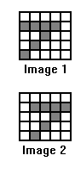
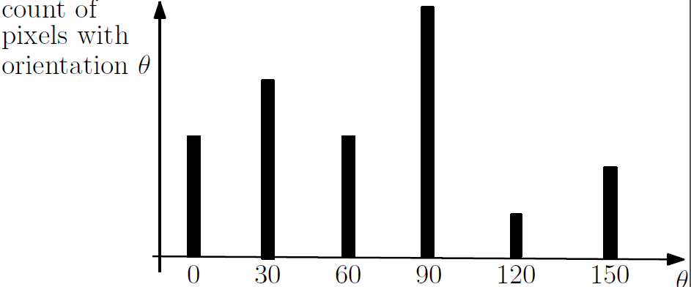
Orientation histograms
Orientation histograms can be computed on blocks of pixels, so we can obtain tolerance to small shifts of a part of the object.
For gray-scale images of 3d objects, the process of computing orientations, gives partial invariance to illumination changes.
Small deformations when the orientation of a part changes only by a little causes no change in the histogram, because we bin orientations

Slide 69
Some more intuition
The information retrieval community had invented the “bag of words” model for text documents where we ignore the order of words and just consider their counts. It turns out that this is quite an effective feature vector – medical documents will use quite different words from real estate documents.
An example with letters: How many different words can you think of that contain a, b, e, l, t?
Throwing away the spatial arrangement in the process of constructing an orientation histogram loses some information, but not that much.
In addition, we can construct orientation histograms at different scales- the whole object, the object divided into quadrants, the object divided into even smaller blocks.

Slide 70
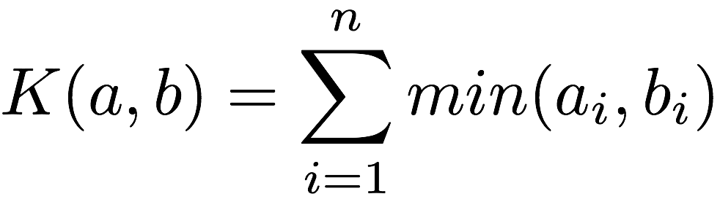


We compare histograms using the Intersection Kernel
Histogram Intersection kernel between histograms a, b
K small -> a, b are different
K large -> a, b are similar
Intro. by Swain and Ballard 1991 to compare color histograms.
Odone et al 2005 proved positive definiteness.
Can be used directly as a kernel for an SVM.

Slide 71
Orientation histograms

Slide 72
Categorization involves features and a classifier
Training Images
Training
Training Labels
Image Features
Classifier Training
Trained Classifier
Testing
Image Features
Trained Classifier
Prediction
Outdoor
Test Image
Notes:
At testing time, we are given with an new image, we also represent it in terms of image features and apply the trained model to obtain the prediction

Slide 73
New training setup with moderate sized datasets
Training Labels
Training Images
Tune CNN features and
Neural Network classifier
Trained Classifier
Initialize CNN Features
Dataset similar to task with millions of labeled examples

