Slide 1
Introduction to Neural Networks
Many Slides from L. Lazebnik, B. Hariharan

Slide 2
Outline
Perceptrons
  Perceptron update rule
Multi-layer neural networks
  Training method
Best practices for training classifiers
After that: convolutional neural networks

Slide 3
Recall: “Shallow” recognition pipeline
Feature representation
Trainable
classifier
Image
Pixels
Class label
  Hand-crafted feature representation
  Off-the-shelf trainable classifier

Slide 4
“Deep” recognition pipeline
Image pixels
Layer 1
Layer 2
Layer 3
Simple
Classifier
  Learn a feature hierarchy from pixels to classifier
  Each layer extracts features from the output of previous layer
  Train all layers jointly
Notes:
Make clear that classic methods, e.g. convnets are purely supervised.

Slide 5
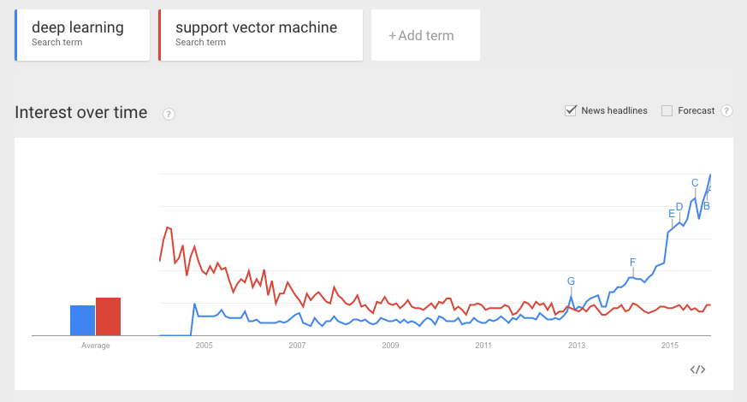

Neural networks vs. SVMs
(a.k.a. “deep” vs. “shallow” learning)

Slide 6
Linear classifiers revisited: Perceptron
Input
Weights
x₁
w₁
x₂
w₂
Output: sgn(w⋅x + b)
x₃
w₃
.
.
.
w_{D}
Can incorporate bias as component of the weight vector by always including a feature with value set to 1
x_{D}

Slide 7
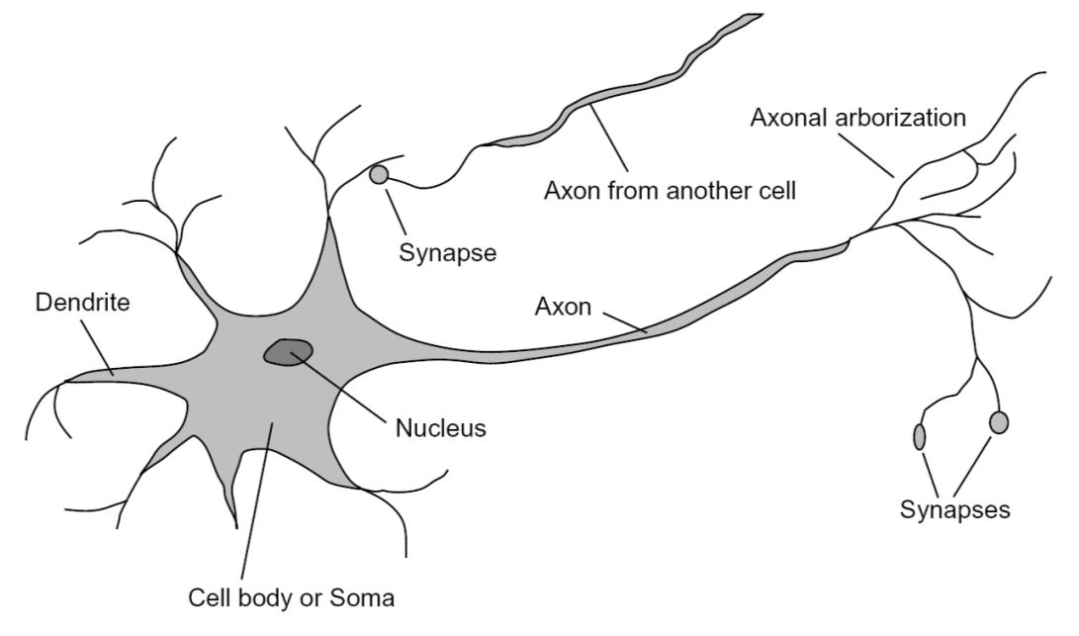
Loose inspiration: Human neurons
Notes:
From Wikipedia: At the majority of synapses, signals are sent from the axon of one neuron to a dendrite of another... All neurons are electrically excitable, maintaining voltage gradients across their membranes… If the voltage changes by a large enough amount, an all-or-none electrochemical pulse called an action potential is generated, which travels rapidly along the cell's axon, and activates synaptic connections with other cells when it arrives.

Slide 8
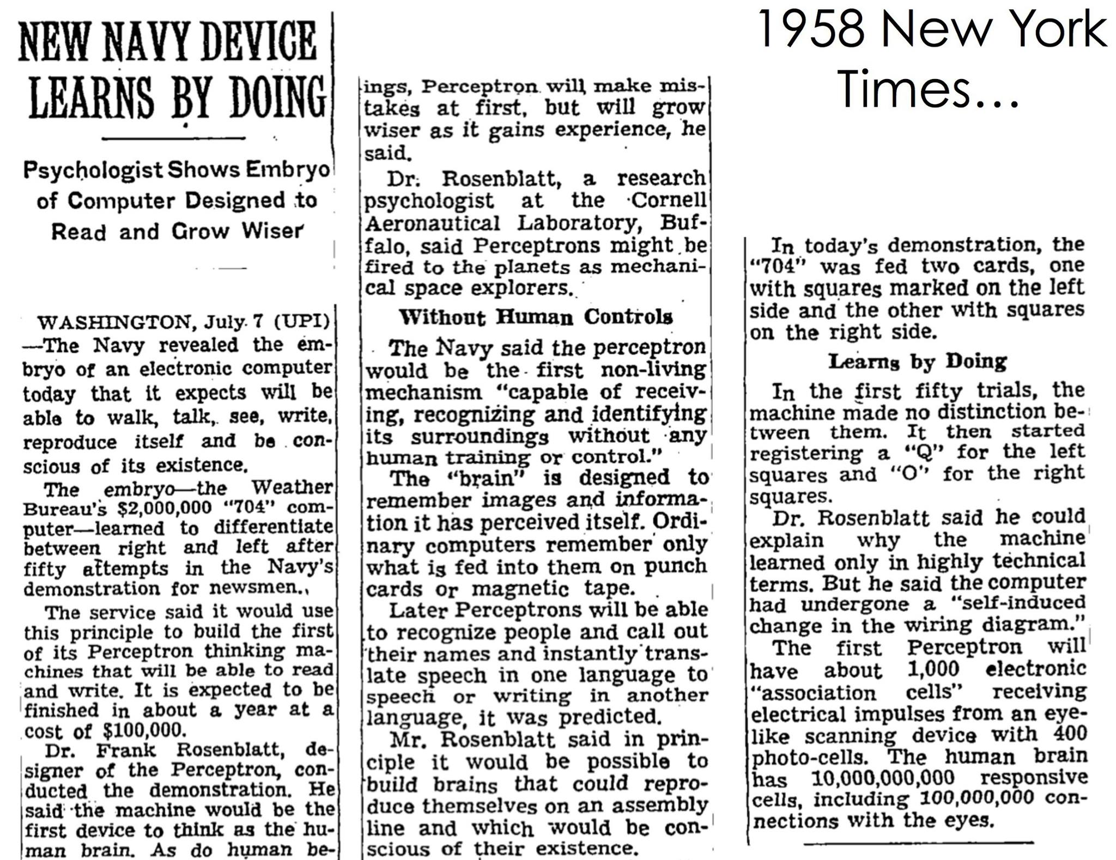

Slide 9

Multi-layer perceptrons
To make nonlinear classifiers out of perceptrons, build a multi-layer neural network!
  This requires each perceptron to have a nonlinearity

Slide 10
Multi-layer perceptrons
To make nonlinear classifiers out of perceptrons, build a multi-layer neural network!
  This requires each perceptron to have a nonlinearity
  To be trainable, the nonlinearity should be differentiable
Sigmoid:
Rectified linear unit (ReLU): g(t) = max(0,t)

Slide 11
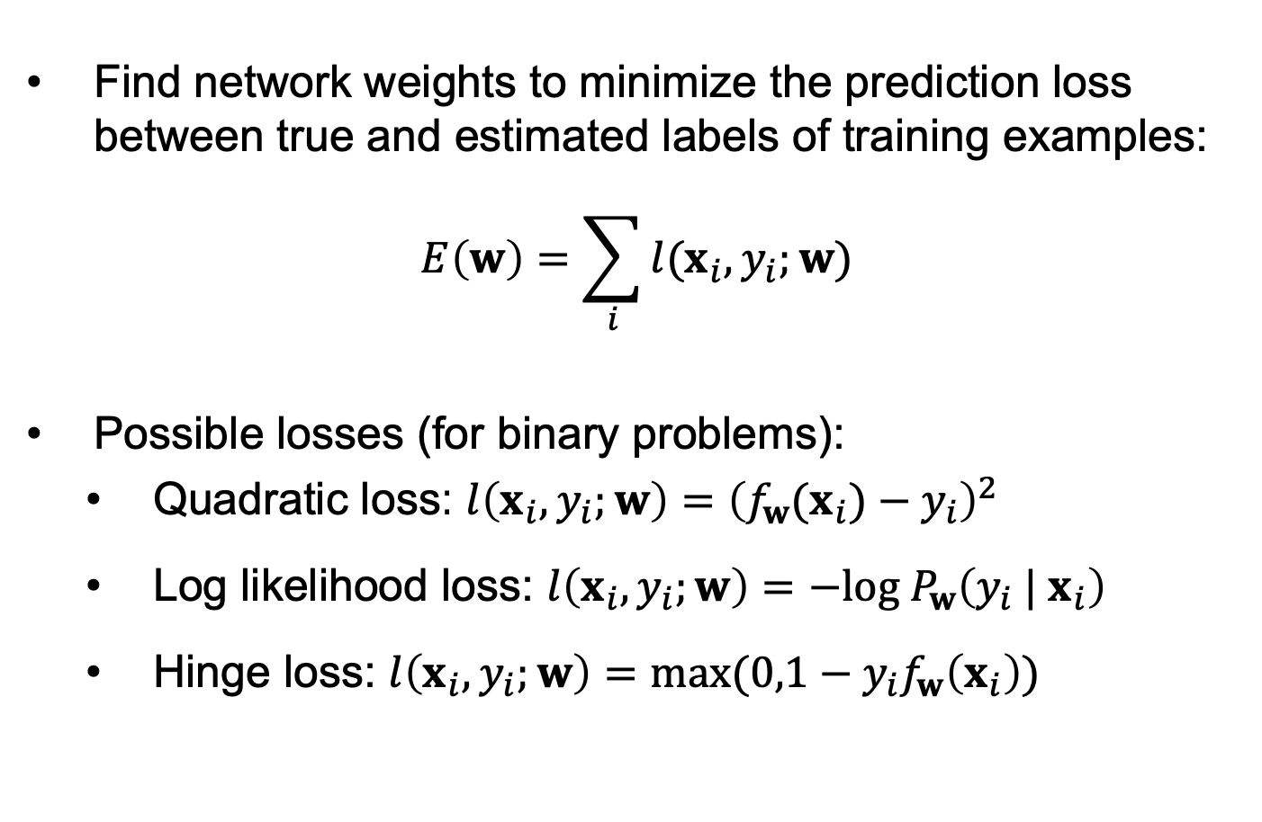
Training of multi-layer networks
Find network weights to minimize the prediction loss between true and estimated labels of training examples:
$$E\left(w\right)=\sum_{i}{l(x_{i},y_{i};w)}$$
Possible losses (for binary problems):
  Quadratic loss: $l\left(x_{i},y_{i};w\right)={\left(f_{w}(x_{i})−y_{i}\right)}^{2}$
  Log likelihood loss: $l\left(x_{i},y_{i};w\right)=−log⁡{ P}_{w}\left({y_{i} | x}_{i}\right)$
  Hinge loss: $l\left(x_{i},y_{i};w\right)=max⁡(0,1−y_{i}f_{w}\left(x_{i}\right))$

Slide 12
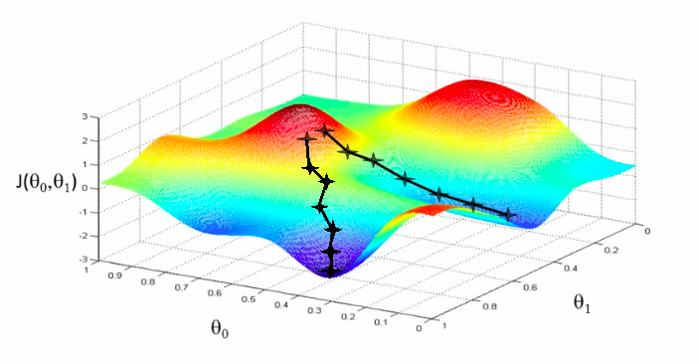
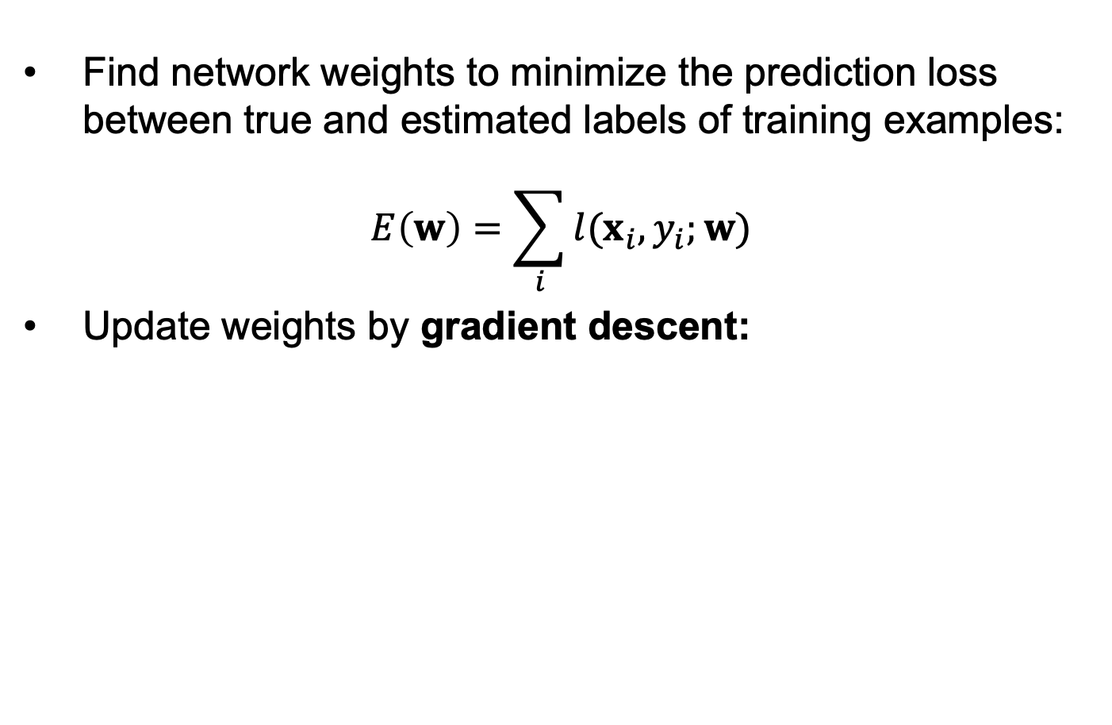
Training of multi-layer networks
Find network weights to minimize the prediction loss between true and estimated labels of training examples:
$$E\left(w\right)=\sum_{i}{l(x_{i},y_{i};w)}$$
Update weights by gradient descent:
w₂
w₁

Slide 13
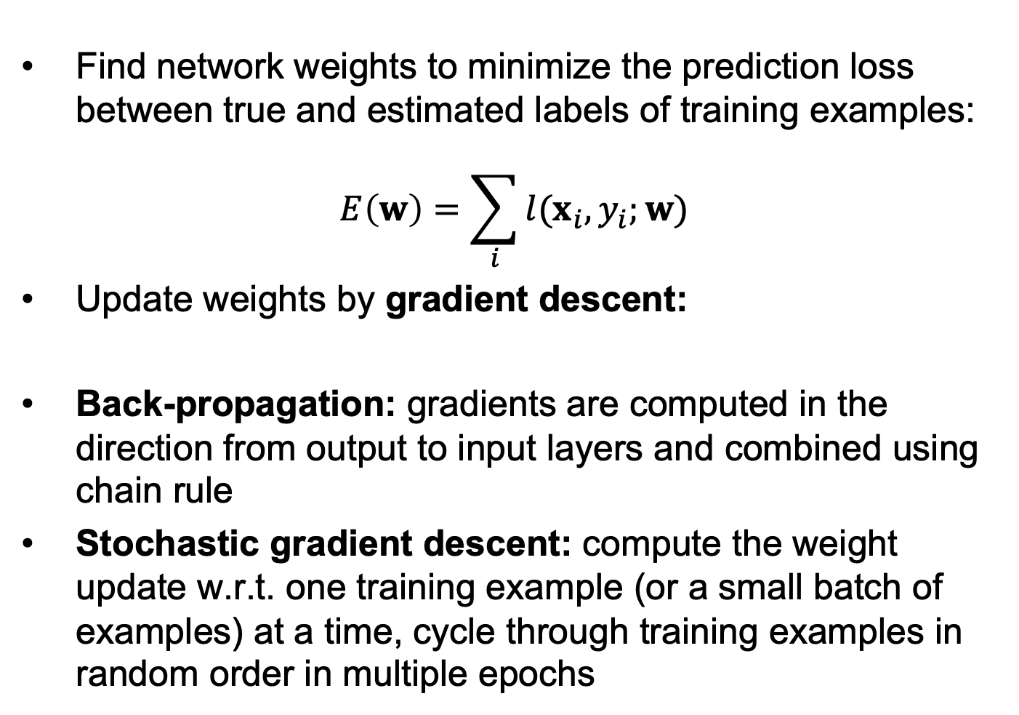
Training of multi-layer networks
Find network weights to minimize the prediction loss between true and estimated labels of training examples:
$$E\left(w\right)=\sum_{i}{l(x_{i},y_{i};w)}$$
Update weights by gradient descent:
Back-propagation: gradients are computed in the direction from output to input layers and combined using chain rule
Stochastic gradient descent: compute the weight update w.r.t. one training example (or a small batch of examples) at a time, cycle through training examples in random order in multiple epochs

Slide 14
Back-propagation

Slide 15
Back-propagation
Convolutional network
Gradient descent update
Slide from B. Hariharan

Slide 16
Computing the gradient of the loss
Slide from B. Hariharan

Slide 17
Convolutional networks
conv
subsample
conv
subsample
linear
filters
filters
weights
Slide from B. Hariharan

Slide 18
Gradient Computation
z₁
z₂
z₃
z₄
z₅ = z
f₁
f₂
f₃
f₄
f₅
x
w₁
w₂
w₃
w₄
w₅
Slide from B. Hariharan

Slide 19
Gradient Computation
z₁
z₂
z₃
z₄
z₅ = z
f₁
f₂
f₃
f₄
f₅
x
w₁
w₂
w₃
w₄
w₅
Slide from B. Hariharan

Slide 20
Gradient Computation
z₁
z₂
z₃
z₄
z₅ = z
f₁
f₂
f₃
f₄
f₅
x
w₁
w₂
w₃
w₄
w₅
Slide from B. Hariharan

Slide 21
Gradient Computation
z₁
z₂
z₃
z₄
z₅ = z
f₁
f₂
f₃
f₄
f₅
x
w₁
w₂
w₃
w₄
w₅
Slide from B. Hariharan

Slide 22
Gradient Computation
z₁
z₂
z₃
z₄
z₅ = z
f₁
f₂
f₃
f₄
f₅
x
w₁
w₂
w₃
w₄
w₅
Slide from B. Hariharan

Slide 23
Gradient Computation
z₁
z₂
z₃
z₄
z₅ = z
f₁
f₂
f₃
f₄
f₅
x
w₁
w₂
w₃
w₄
w₅
Slide from B. Hariharan

Slide 24
Gradient Computation
z₁
z₂
z₃
z₄
z₅ = z
f₁
f₂
f₃
f₄
f₅
x
w₁
w₂
w₃
w₄
w₅
Slide from B. Hariharan

Slide 25
Gradient Computation
z₁
z₂
z₃
z₄
z₅ = z
f₁
f₂
f₃
f₄
f₅
x
w₁
w₂
w₃
w₄
w₅
Slide from B. Hariharan

Slide 26
Gradient Computation
z₁
z₂
z₃
z₄
z₅ = z
f₁
f₂
f₃
f₄
f₅
x
w₁
w₂
w₃
w₄
w₅
Slide from B. Hariharan

Slide 27
Gradient Computation
z₁
z₂
z₃
z₄
z₅ = z
f₁
f₂
f₃
f₄
f₅
x
w₁
w₂
w₃
w₄
w₅
Slide from B. Hariharan

Slide 28
Gradient Computation
z₁
z₂
z₃
z₄
z₅ = z
f₁
f₂
f₃
f₄
f₅
x
w₁
w₂
w₃
w₄
w₅
Slide from B. Hariharan

Slide 29
Gradient Computation
z₁
z₂
z₃
z₄
z₅ = z
f₁
f₂
f₃
f₄
f₅
x
w₁
w₂
w₃
w₄
w₅
Slide from B. Hariharan

Slide 30
Gradient Computation
z₁
z₂
z₃
z₄
z₅ = z
f₁
f₂
f₃
f₄
f₅
x
w₁
w₂
w₃
w₄
w₅
Slide from B. Hariharan

Slide 31
Gradient Computation
z₁
z₂
z₃
z₄
z₅ = z
f₁
f₂
f₃
f₄
f₅
x
w₁
w₂
w₃
w₄
w₅
Recurrence going backward!!
Slide from B. Hariharan

Slide 32
Gradient Computation
z₁
z₂
z₃
z₄
z₅ = z
f₁
f₂
f₃
f₄
f₅
x
w₁
w₂
w₃
w₄
w₅
Back-Propagation
Slide from B. Hariharan

Slide 33
Backpropagation for a sequence of functions
Each “function” has a “forward” and “backward” module
Forward module for f_{i}
  takes z_{i-1} and weight w_{i} as input
  produces z_{i} as output
Backward module for f_{i}
  takes g(z_{i} ) as input
  produces g(z_{i-1} ) and g(w_{i}) as output
Slide from B. Hariharan

Slide 34
Backpropagation for a sequence of functions
z_{i-1}
f_{i}
z_{i}
w_{i}
Slide from B. Hariharan

Slide 35
Backpropagation for a sequence of functions
g(z_{i-1})
f_{i}
g(z_{i})
g(w_{i})
Slide from B. Hariharan

Slide 36
Computation graph - Functions
Each node implements two functions
  A “forward”
    Computes output given input
  A “backward”
    Computes derivative of z w.r.t input, given derivative of z w.r.t output
Slide from B. Hariharan

Slide 37
Computation graphs
a
f_{i}
b
d
c
Slide from B. Hariharan

Slide 38
Computation graphs
f_{i}
Slide from B. Hariharan

Slide 39
Computation graphs
a
f_{i}
b
d
c
Slide from B. Hariharan

Slide 40
Computation graphs
f_{i}
Slide from B. Hariharan

Slide 41




Neural network frameworks
Slide from B. Hariharan

Slide 42
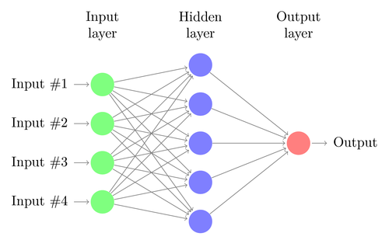
Network with a single hidden layer
Neural networks with at least one hidden layer are universal function approximators

Slide 43
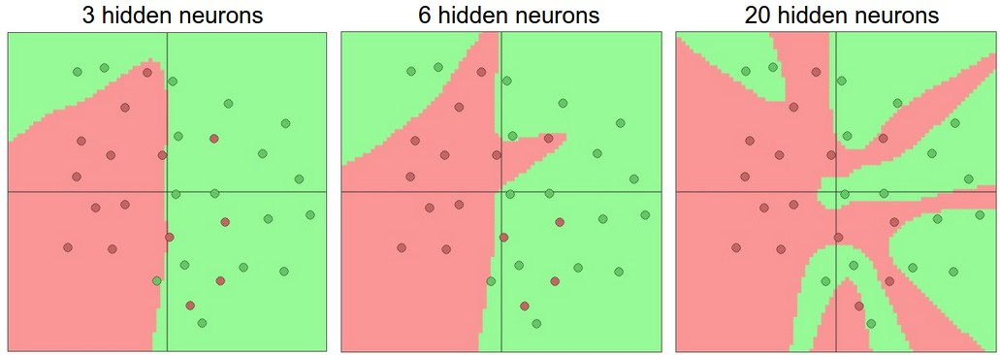
Network with a single hidden layer
Hidden layer size and network capacity:
Source: http://cs231n.github.io/neural-networks-1/

Slide 44
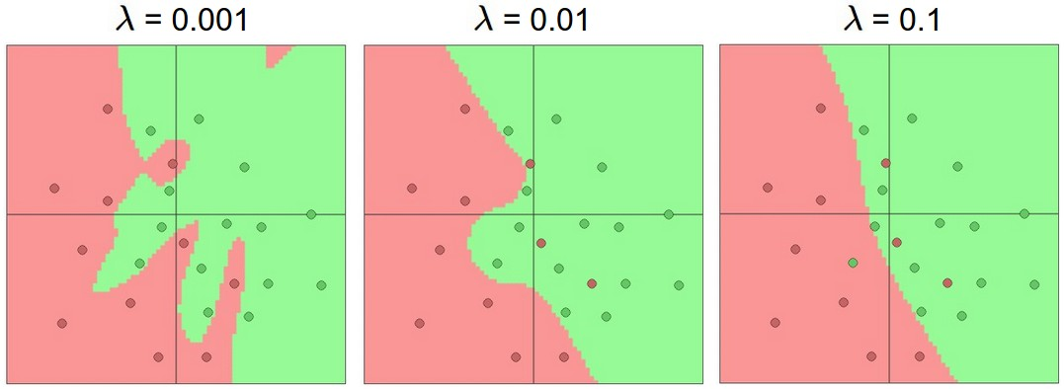
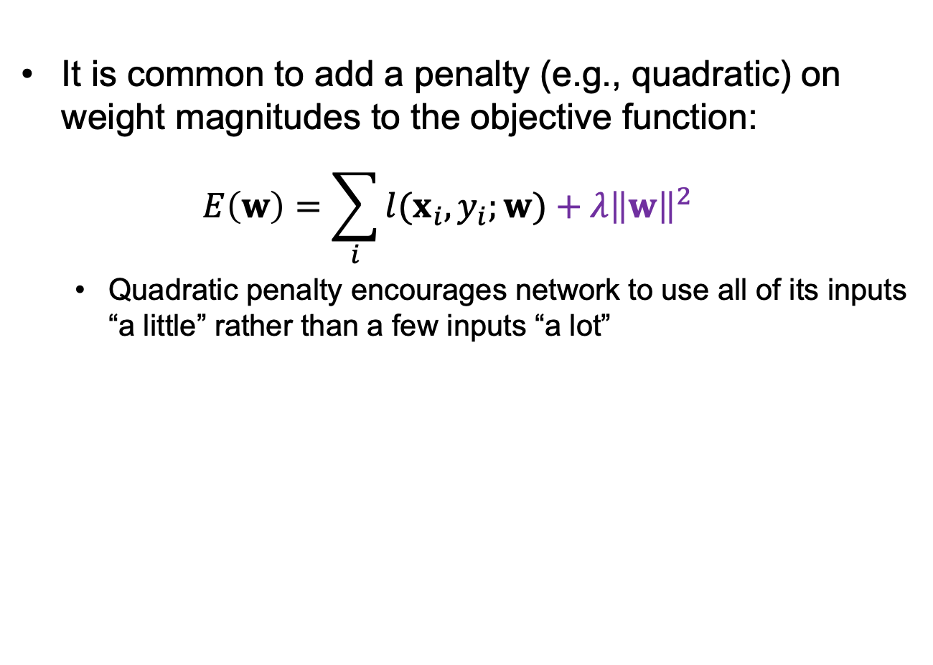
Regularization
It is common to add a penalty (e.g., quadratic) on weight magnitudes to the objective function:
$$E\left(w\right)=\sum_{i}{l(x_{i},y_{i};w)}+λ{\left\|w\right\|}^{2}$$
  Quadratic penalty encourages network to use all of its inputs “a little” rather than a few inputs “a lot”
Source: http://cs231n.github.io/neural-networks-1/

Slide 45
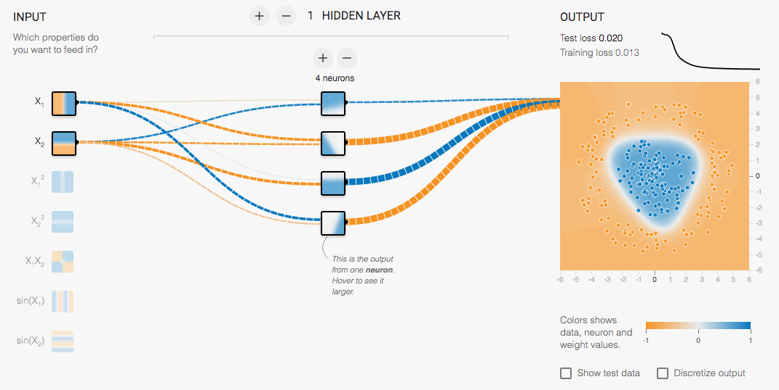
Multi-Layer Network Demo
http://playground.tensorflow.org/

Slide 46
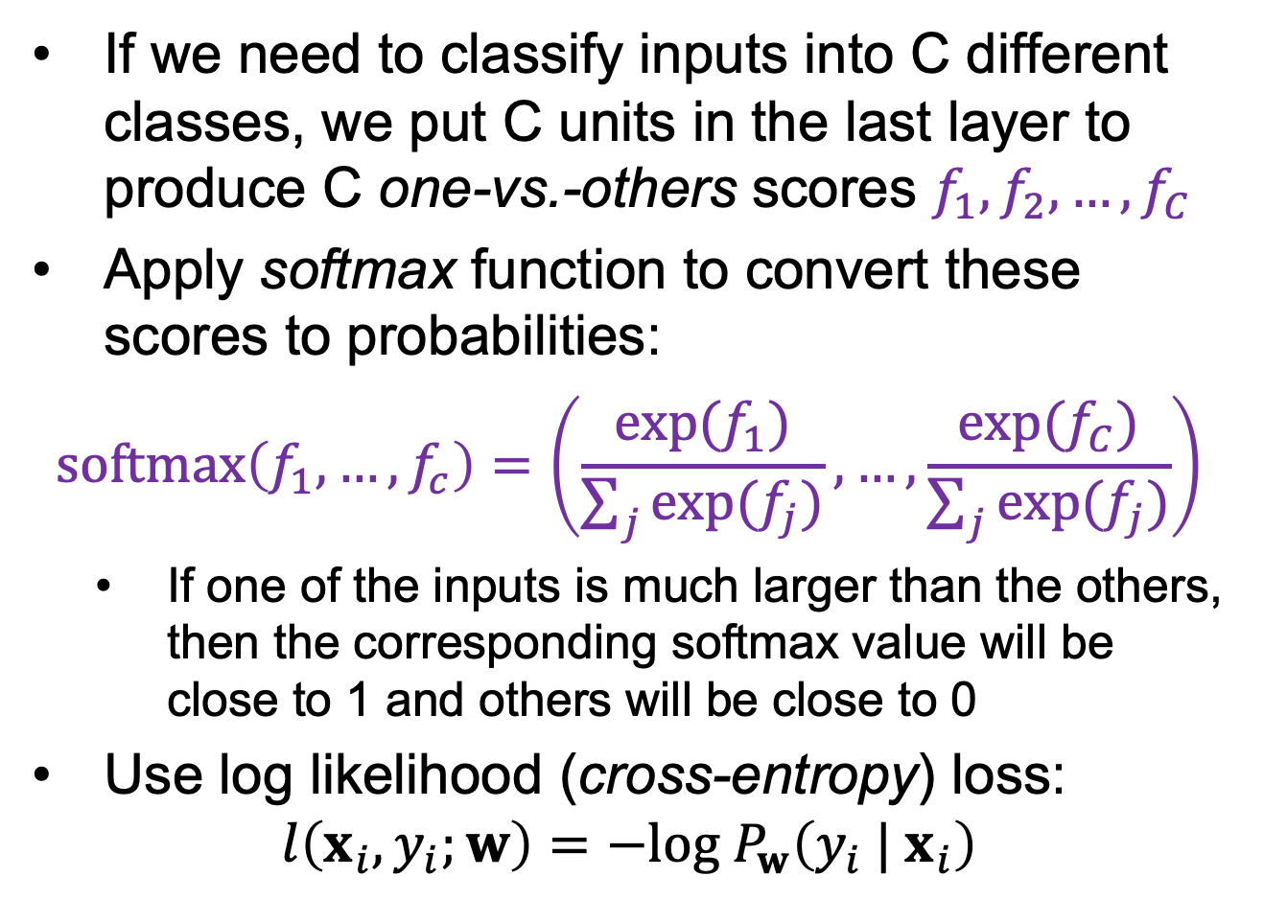
Dealing with multiple classes
If we need to classify inputs into C different classes, we put C units in the last layer to produce C one-vs.-others scores $f_{1}, f_{2},…,f_{C}$
Apply softmax function to convert these scores to probabilities:
$$softmax\left(f_{1},…,f_{c}\right)=\left(\frac{exp⁡(f_{1})}{\sum_{j}{exp⁡(f_{j})}},…,\frac{exp⁡(f_{C})}{\sum_{j}{exp⁡(f_{j})}}\right)$$
  If one of the inputs is much larger than the others, then the corresponding softmax value will be close to 1 and others will be close to 0
Use log likelihood (cross-entropy) loss:
$$l\left(x_{i},y_{i};w\right)=−log⁡{ P}_{w}\left({y_{i} | x}_{i}\right)$$

Slide 47
Neural networks: Pros and cons
Pros
  Flexible and general function approximation framework
  Can build extremely powerful models by adding more layers
Cons
  Hard to analyze theoretically (e.g., training is prone to local optima)
  Huge amount of training data, computing power may be required to get good performance
  The space of implementation choices is huge (network architectures, parameters)

Slide 48
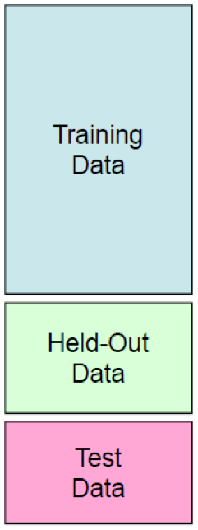
Best practices for training classifiers
Goal: obtain a classifier with good generalization or performance on never before seen data
Learn parameters on the training set
Tune hyperparameters (implementation choices) on the held out validation set
Evaluate performance on the test set
  Crucial: do not peek at the test set when iterating steps 1 and 2!

Slide 49
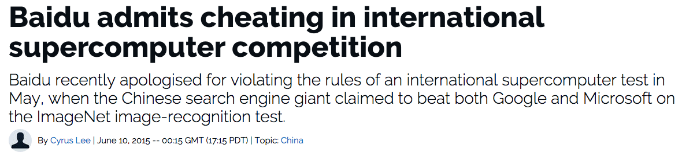

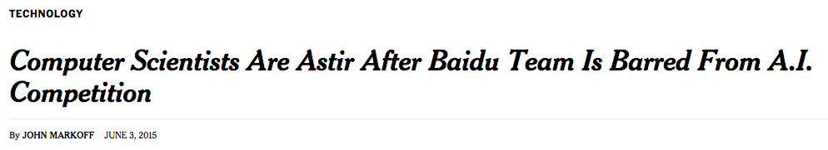



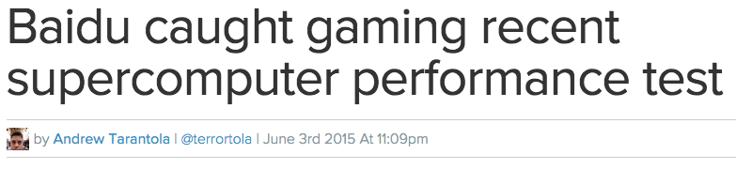
What’s the big deal?

Slide 50
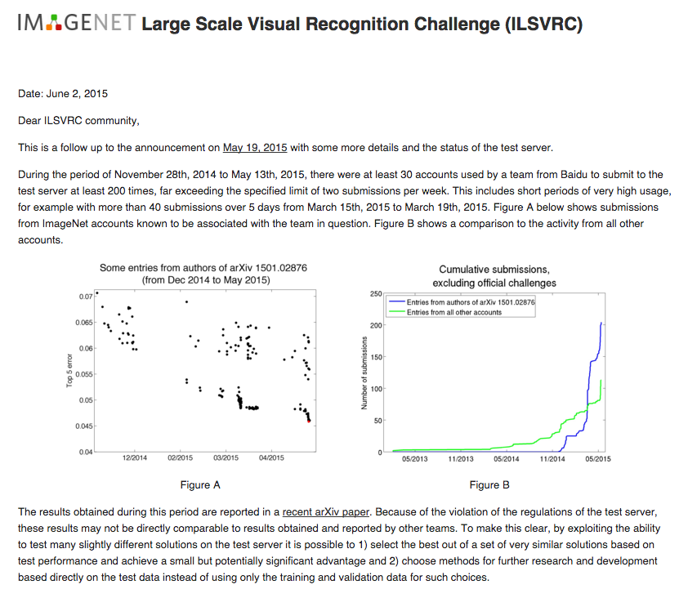
http://www.image-net.org/challenges/LSVRC/announcement-June-2-2015

Slide 51
Important Considerations
Inductive Bias
Data
Supervision
Loss functions
Optimization / Initialization

Slide 52
Development Process
Collect lots of labeled data
Setup network architecture
Setup loss function
Sanity checks
  Is your data correct?
  Can you overfit to a small set?
Hyperparameters
  Learning hyperparameters: batch size, learning rates, how much to train, regularization, optimizer.
  Architectural hyper-parameters: Non-linearities, #layers, #neurons, loss functions.
Hacking
  Reducing iteration time
  Maximizing GPU utilization

Slide 53
Optimizers
Stochastic gradient descent
Stochastic gradient descent with momentum
Adam

