Slide 1
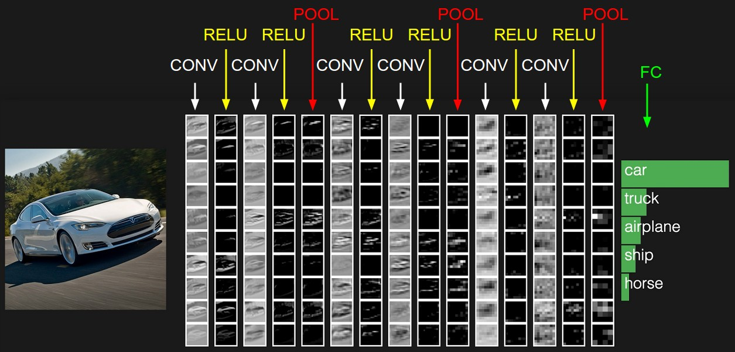
Convolutional neural networks
Slides from L. Lazebnik, Rob Fergus, Andrej Karpathy

Slide 2
Outline
Building blocks for CNNs
Motivation and history
Alexnet
Since Alexnet

Slide 3
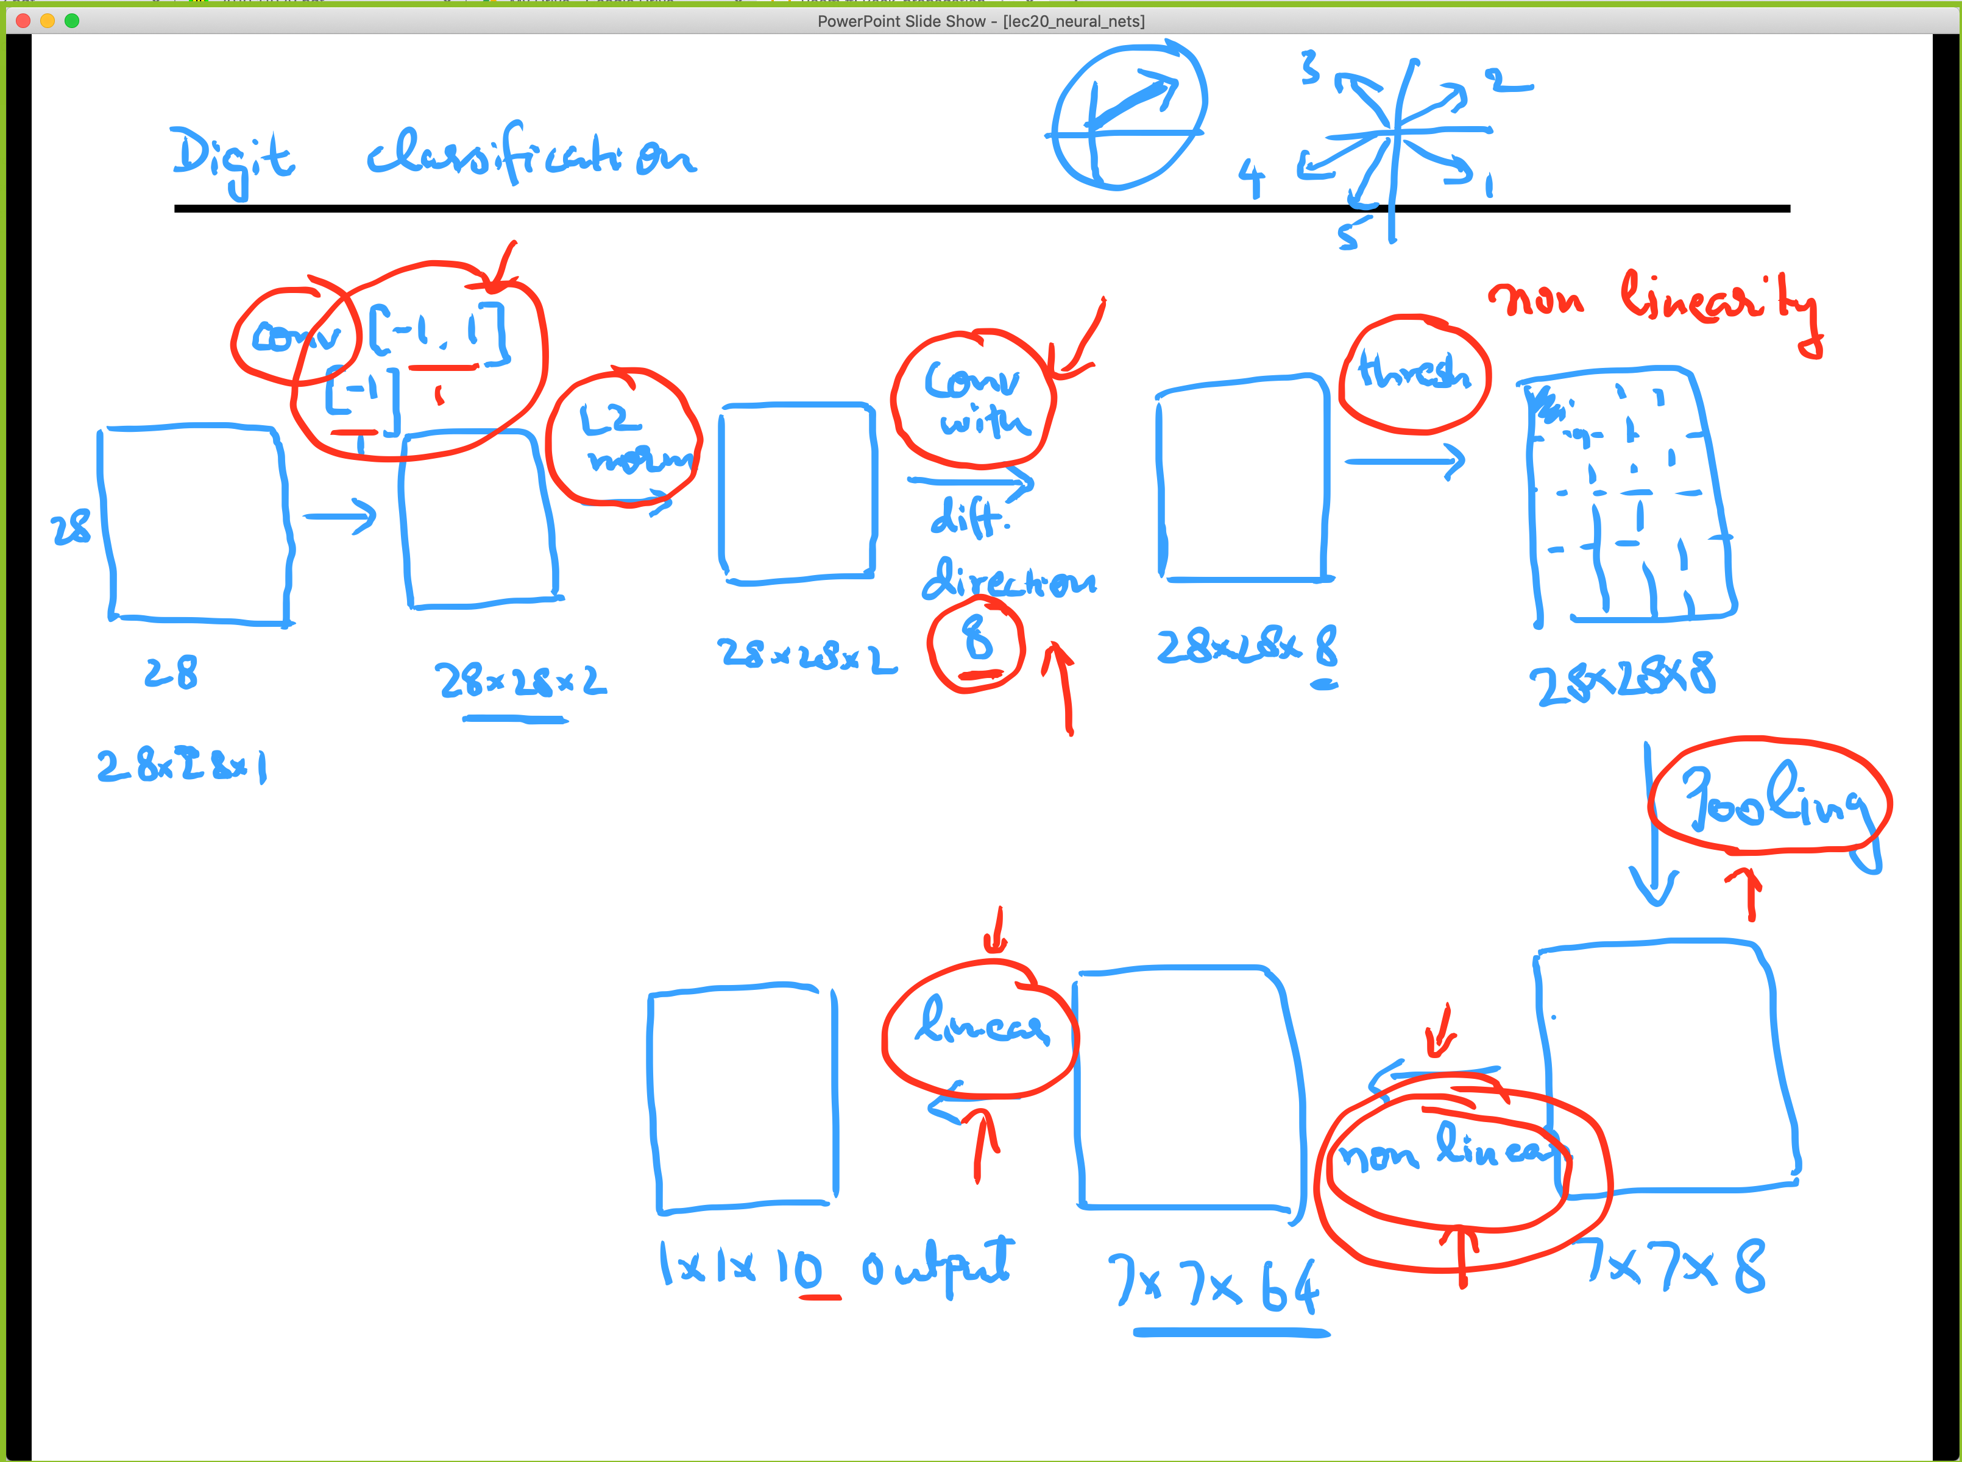
Compare: Digit Classification using SVMs

Slide 4
Components of a CNN architecture
Convolutional Layers
Non-linearities
Pooling
Fully-connected Layers
Normalization Layers
Rationale?

Slide 5
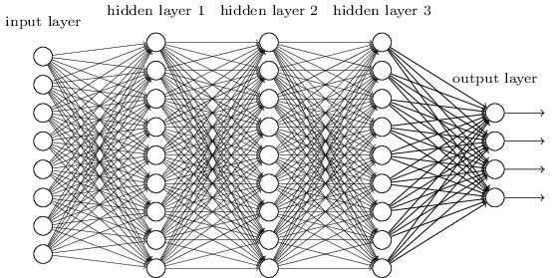
Neural networks for images
image
Fully connected layer

Slide 6
Neural networks for images
image

Slide 7
Neural networks for images
feature map
learned weights
image

Slide 8
Neural networks for images
another feature map
another set of learned weights
image

Slide 9
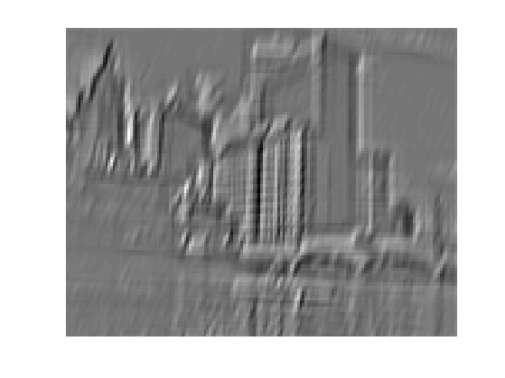
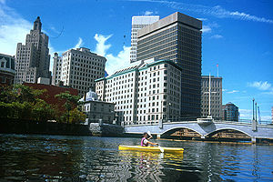
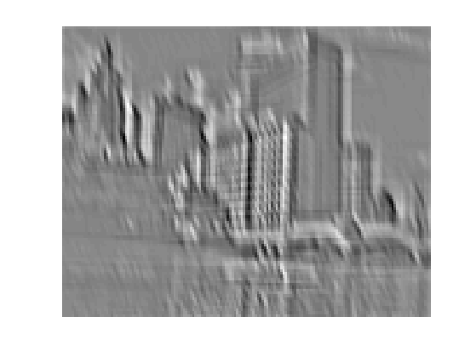
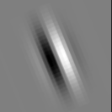
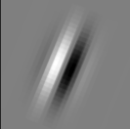
Convolution as feature extraction
bank of K filters
K feature maps
...
image
feature map

Slide 10
Convolutional layer
K feature maps
K filters
image
convolutional layer

Slide 11
Convolutional layer
L feature maps in the next layer
K feature maps
F x F x K filter
L filters
image
convolutional layer

Slide 12
Convolutional layer
Input
Convolutional Hyper-Parameters
  Kernel Size
  Number of Filters
  Padding
  Stride
Parameters
  Weights
  Biases
Output Size

Slide 13
Convolutional layer
K feature maps
Spatial resolution: (roughly) the same if stride of 1 is used, reduced by 1/S if stride of S is used
K filters
image
convolutional layer

Slide 14
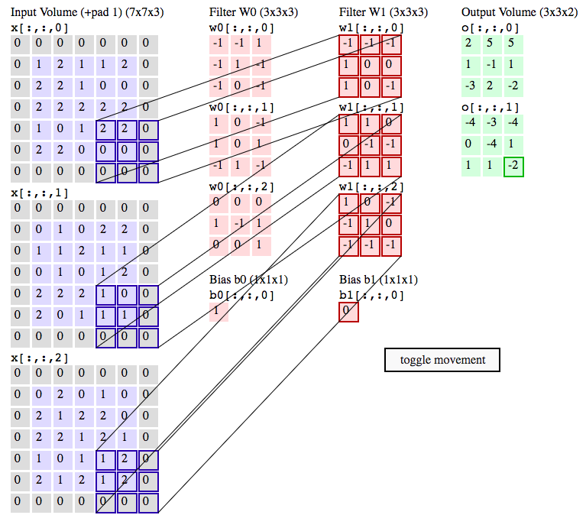
Convolutional layer demo
http://cs231n.github.io/convolutional-networks/#conv

Slide 15
Components of a CNN architecture
Convolutional Layers
Non-linearities
Pooling
Fully-connected Layers
Normalization Layers

Slide 16
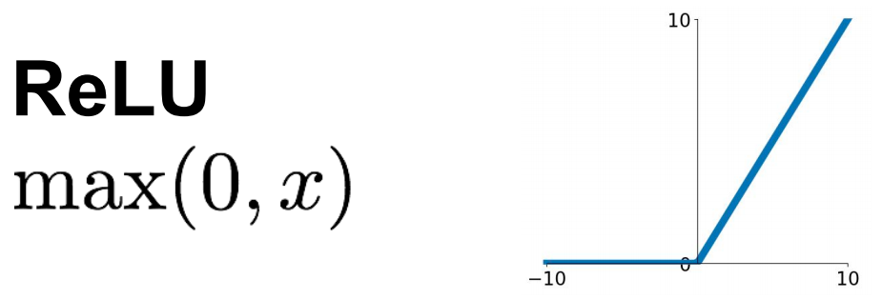
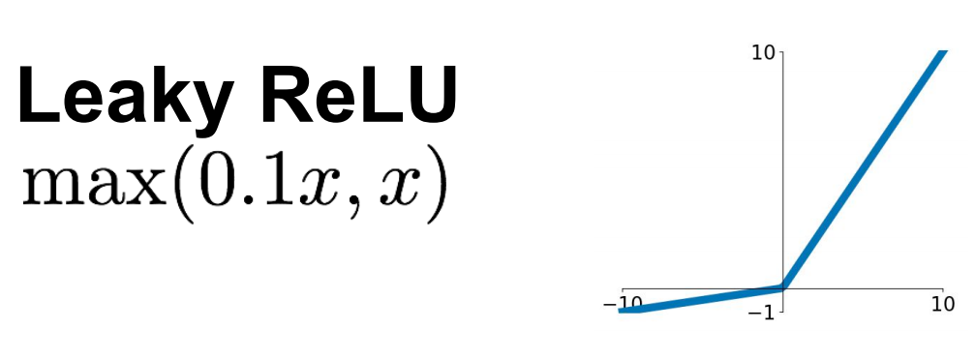
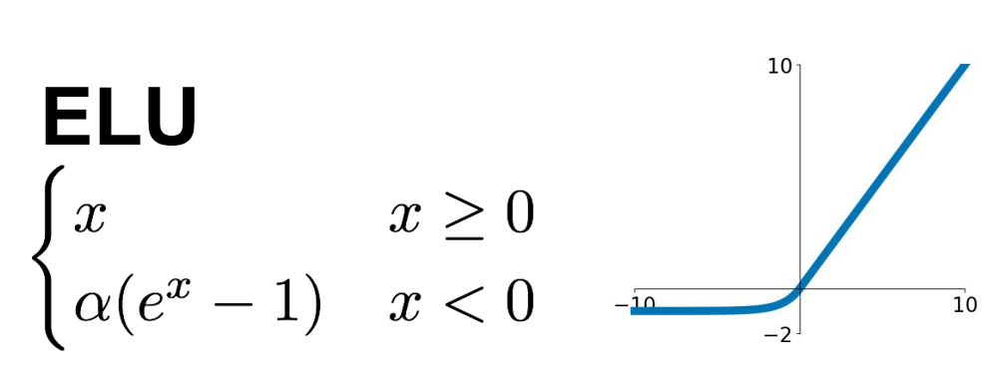
Non-Linearities
Source: R. Fergus, Y. LeCun
Source: Stanford 231n

Slide 17
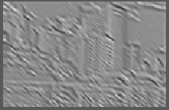
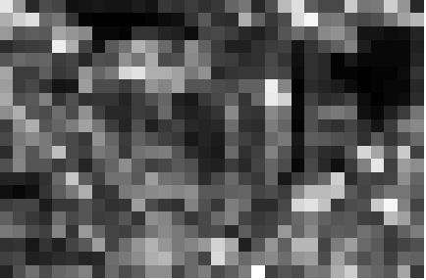
Pooling Layers
  Max
  (or Avg)
Source: R. Fergus, Y. LeCun

Slide 18
Pooling Layers
K feature maps, resolution 1/S
K feature maps
max value
F x F pooling filter, stride S
Usually: F=2 or 3, S=2

Slide 19
Components of a CNN architecture
Convolutional Layers
Non-linearities
Pooling
Fully-connected Layers
Normalization Layers (in just a bit)

Slide 20
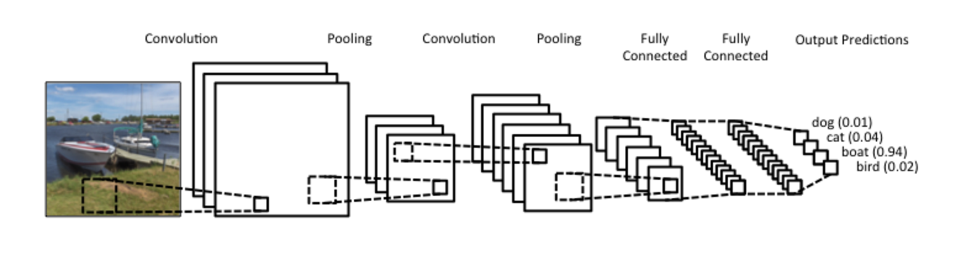
Putting it together
Softmax layer:

Slide 21
History: Neocognitron
K. Fukushima, 1980s
https://en.wikipedia.org/wiki/Neocognitron

Slide 22
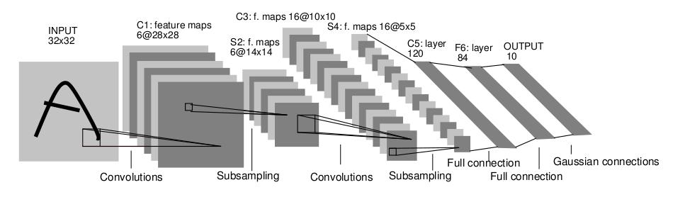
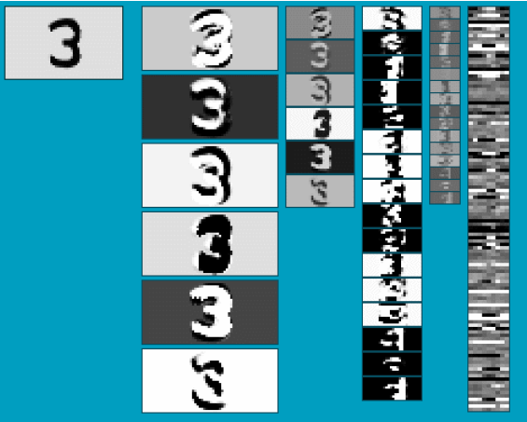
History: LeNet-5
Average pooling
Sigmoid or tanh nonlinearity
Fully connected layers at the end
Trained on MNIST digit dataset with 60K training examples
Y. LeCun, L. Bottou, Y. Bengio, and P. Haffner, Gradient-based learning applied to document recognition, Proc. IEEE 86(11): 2278–2324, 1998.

Slide 23
ImageNet Challenge
~14 million labeled images, 20k classes
Images gathered from Internet
Human labels via Amazon MTurk
ImageNet Large-Scale Visual Recognition Challenge (ILSVRC):
1.2 million training images, 1000 classes
www.image-net.org/challenges/LSVRC/

Slide 24
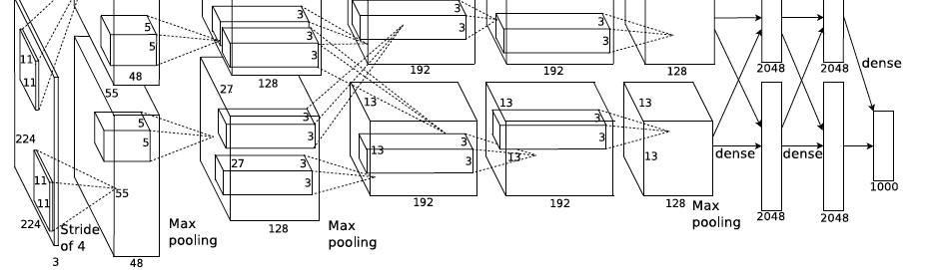
AlexNet: ILSVRC 2012 winner
Similar framework to LeNet but:
  Max pooling, ReLU nonlinearity
  More data and bigger model (7 hidden layers, 650K units, 60M params)
  GPU implementation (50x speedup over CPU)
    Trained on two GPUs for a week
  Dropout regularization
A. Krizhevsky, I. Sutskever, and G. Hinton, ImageNet Classification with Deep Convolutional Neural Networks, NIPS 2012
Notes:
Two-GPU architecture

Slide 25
ImageNet Challenge 2012-2014
Team | Year | Place | Error (top-5) | External data
XRCE | 2011 |  | 25.8% | no
SuperVision – Toronto (7 layers) | 2012 | - | 16.4% | no
SuperVision | 2012 | 1st | 15.3% | ImageNet 22k
http://karpathy.github.io/2014/09/02/what-i-learned-from-competing-against-a-convnet-on-imagenet/
Notes:
Best non-convnet in 2012: 26.2%

Slide 26
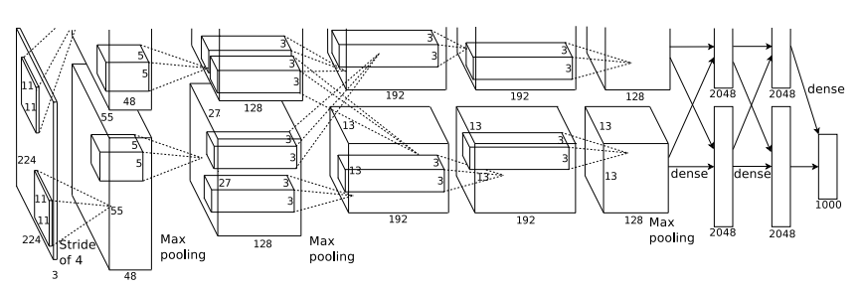
AlexNet
 | Input size |  | Layer |  |  |  | Output size
Layer | C | H / W | filters | kernel | stride | pad | C | H / W
conv1 | 3 | 227 | 64 | 11 | 4 | 2 | 64 | 56
pool1 | 64 | 56 |  | 3 | 2 | 0 | 64 | 27
conv2 | 64 | 27 | 192 | 5 | 1 | 2 | 192 | 27
pool2 | 192 | 27 |  | 3 | 2 | 0 | 192 | 13
conv3 | 192 | 13 | 384 | 3 | 1 | 1 | 384 | 13
conv4 | 384 | 13 | 256 | 3 | 1 | 1 | 256 | 13
conv5 | 256 | 13 | 256 | 3 | 1 | 1 | 256 | 13
pool5 | 256 | 13 |  | 3 | 2 | 0 | 256 | 6
flatten | 256 | 6 |  |  |  |  | 9216
fc6 | 9216 |  | 4096 |  |  |  | 4096
fc7 | 4096 |  | 4096 |  |  |  | 4096
fc8 | 4096 |  | 1000 |  |  |  | 1000
Source: Justin Johnson, David Fouhey.
Notes:
Best non-convnet in 2012: 26.2%

Slide 27
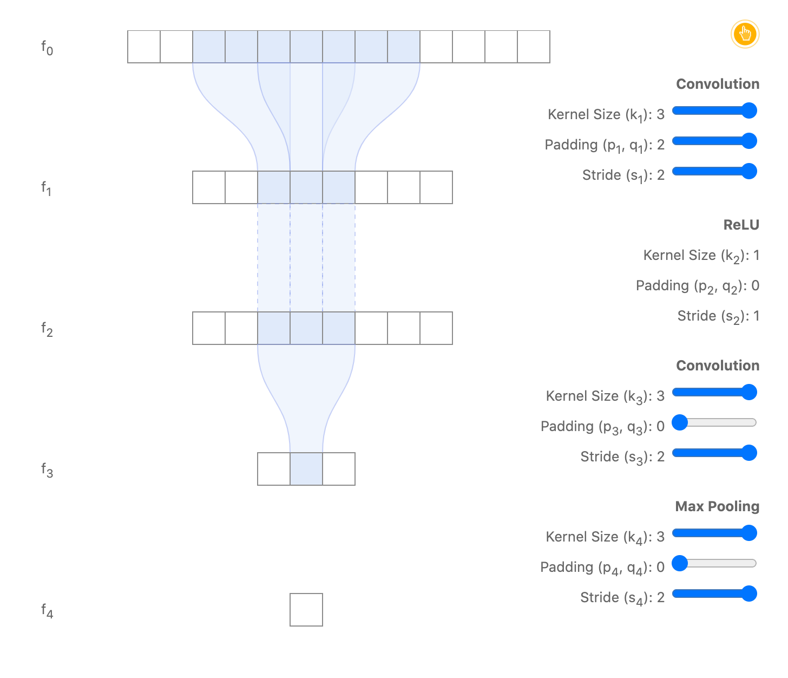
Receptive Field
Deep Nets with striding have large receptive fields
Source: https://distill.pub/2019/computing-receptive-fields/
Notes:
Best non-convnet in 2012: 26.2%

Slide 28
Receptive Field
 | Input size |  | Layer |  |  |  | Output size |  | Receptive Field | Effective Stride | Effective Padding
Layer | C | H / W | filters | kernel | stride | pad | C | H / W
conv1 | 3 | 227 | 64 | 11 | 4 | 2 | 64 | 56 | 11 | 4 | 2
pool1 | 64 | 56 |  | 3 | 2 | 0 | 64 | 27 | 19 | 8 | 2
conv2 | 64 | 27 | 192 | 5 | 1 | 2 | 192 | 27 | 51 | 8 | 18
pool2 | 192 | 27 |  | 3 | 2 | 0 | 192 | 13 | 67 | 16 | 34
conv3 | 192 | 13 | 384 | 3 | 1 | 1 | 384 | 13 | 99 | 16 | 50
conv4 | 384 | 13 | 256 | 3 | 1 | 1 | 256 | 13 | 131 | 16 | 66
conv5 | 256 | 13 | 256 | 3 | 1 | 1 | 256 | 13 | 163 | 16 | 66
pool5 | 256 | 13 |  | 3 | 2 | 0 | 256 | 6 | 195 | 32 | 66
flatten | 256 | 6 |  |  |  |  | 9216 |  | 259 | 32 | 66
fc6 | 9216 |  | 4096 |  |  |  | 4096 |  | 259 | 32 | 66
fc7 | 4096 |  | 4096 |  |  |  | 4096 |  | 259 | 32 | 66
fc8 | 4096 |  | 1000 |  |  |  | 1000 |  | 259 | 32 | 66
Notes:
Best non-convnet in 2012: 26.2%

Slide 29
Other Stats
 | Input size |  | Layer |  |  |  | Output size
Layer | C | H / W | filters | kernel | stride | pad | C | H / W | memory (KB) | params (k) | flop (M)
conv1 | 3 | 227 | 64 | 11 | 4 | 2 | 64 | 56 | 784 | 23 | 73
pool1 | 64 | 56 |  | 3 | 2 | 0 | 64 | 27 | 182 | 0 | 0
conv2 | 64 | 27 | 192 | 5 | 1 | 2 | 192 | 27 | 547 | 307 | 224
pool2 | 192 | 27 |  | 3 | 2 | 0 | 192 | 13 | 127 | 0 | 0
conv3 | 192 | 13 | 384 | 3 | 1 | 1 | 384 | 13 | 254 | 664 | 112
conv4 | 384 | 13 | 256 | 3 | 1 | 1 | 256 | 13 | 169 | 885 | 145
conv5 | 256 | 13 | 256 | 3 | 1 | 1 | 256 | 13 | 169 | 590 | 100
pool5 | 256 | 13 |  | 3 | 2 | 0 | 256 | 6 | 36 | 0 | 0
flatten | 256 | 6 |  |  |  |  | 9216 |  | 36 | 0 | 0
fc6 | 9216 |  | 4096 |  |  |  | 4096 |  | 16 | 37,749 | 38
fc7 | 4096 |  | 4096 |  |  |  | 4096 |  | 16 | 16,777 | 17
fc8 | 4096 |  | 1000 |  |  |  | 1000 |  | 4 | 4,096 | 4
Source: Justin Johnson, David Fouhey.
Notes:
Best non-convnet in 2012: 26.2%

Slide 30
AlexNet
Most of the memory usage is in the early convolution layers
Most floating-point ops occur in the convolution layers
Nearly all parameters are in the fully-connected layers
Source: Justin Johnson, David Fouhey.
Notes:
Best non-convnet in 2012: 26.2%

Slide 31
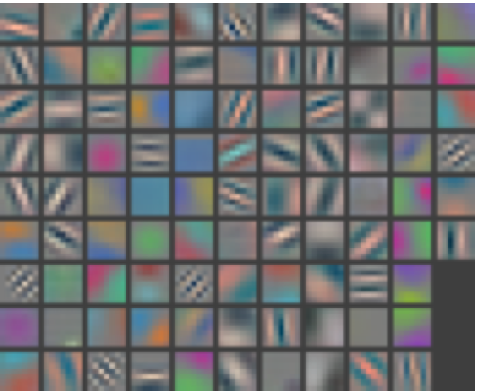
Layer 1 Filters
M. Zeiler and R. Fergus, Visualizing and Understanding Convolutional Networks,
ECCV 2014 (Best Paper Award winner)

Slide 32
Layer 1: Top-9 Patches
Notes:
receptive field sizes: 7, 27, 75, 107, 139

Slide 33
ReLU vs tanh
A. Krizhevsky, I. Sutskever, and G. Hinton, ImageNet Classification with Deep Convolutional Neural Networks, NIPS 2012
Notes:
Two-GPU architecture

Slide 34
Dropout
Randomly drop units in training
Prevents co-adaptation
Thought to sample from an exponential number of thinned networks
Acts as a regularizer
Fully Connected MNIST
N. Srivastava, G. Hinton et al., Dropout: A Simple Way to Prevent Neural Networks from Overfitting, JMLR 2014
Notes:
Two-GPU architecture

Slide 35
Outline
Building blocks for CNNs
Motivation and history
Alexnet
Since Alexnet

Slide 36
Components of a CNN architecture
Convolutional Layers
Non-linearities
Pooling
Fully-connected Layers
Normalization Layers
Rationale?

Slide 37
Since Alexnet
More efficient use of parameters
  No FC layers
  Smaller kernels
Normalization layers
  LRN layers don’t improve performance as much
  Batch Normalization
Deeper networks
  7 layers -> 19 layers -> 150 layers
  Residual connections
  Batch normalization
Self-attention
Notes:
LRN – local response normalization (doesn’t improve performance)

Slide 38
1x1 convolutions
K feature maps
L feature maps
F x F x K filter
L filters
conv layer

Slide 39
1x1 convolutions
K feature maps
L feature maps
1 x 1 x K filter
L filters
1 x 1 conv layer

Slide 40
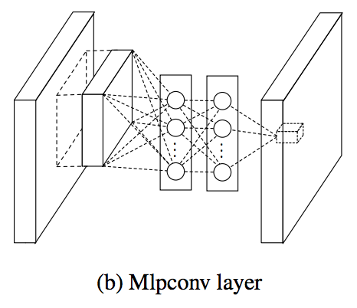
1x1 convolutions
“network in network”

Slide 41
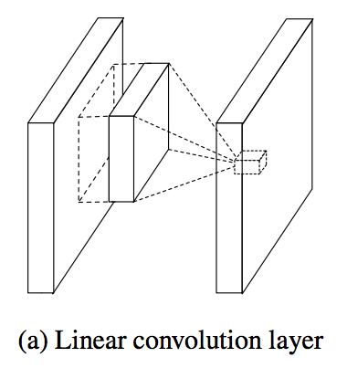
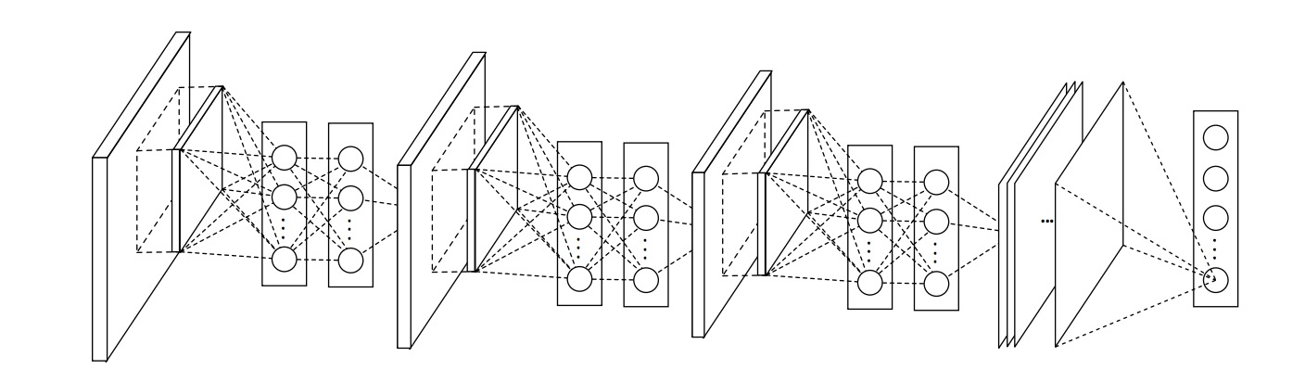
Network in network
M. Lin, Q. Chen, and S. Yan, Network in network, ICLR 2014

Slide 42
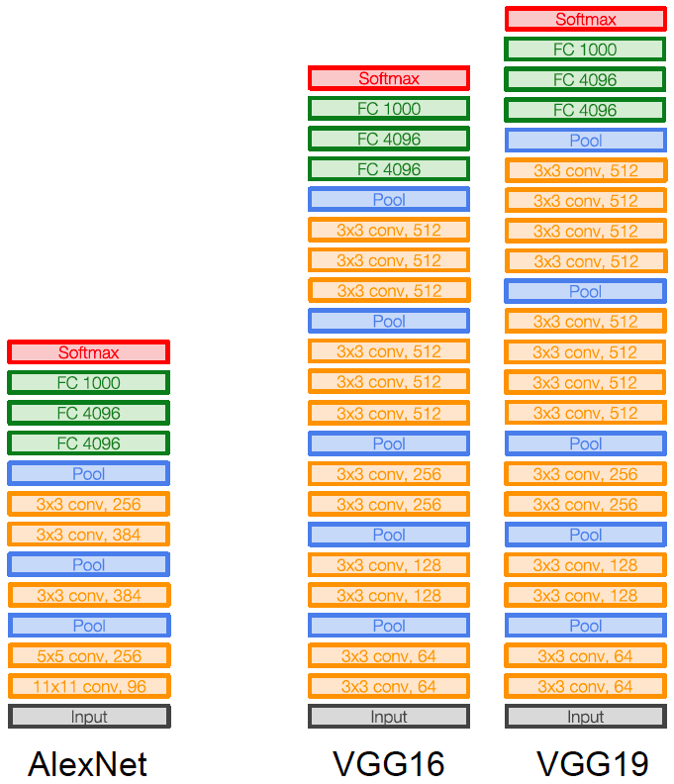
VGGNet: ILSVRC 2014 2nd place
Image source
K. Simonyan and A. Zisserman, Very Deep Convolutional Networks for Large-Scale Image Recognition, ICLR 2015
Notes:
LRN – local response normalization (doesn’t improve performance)

Slide 43
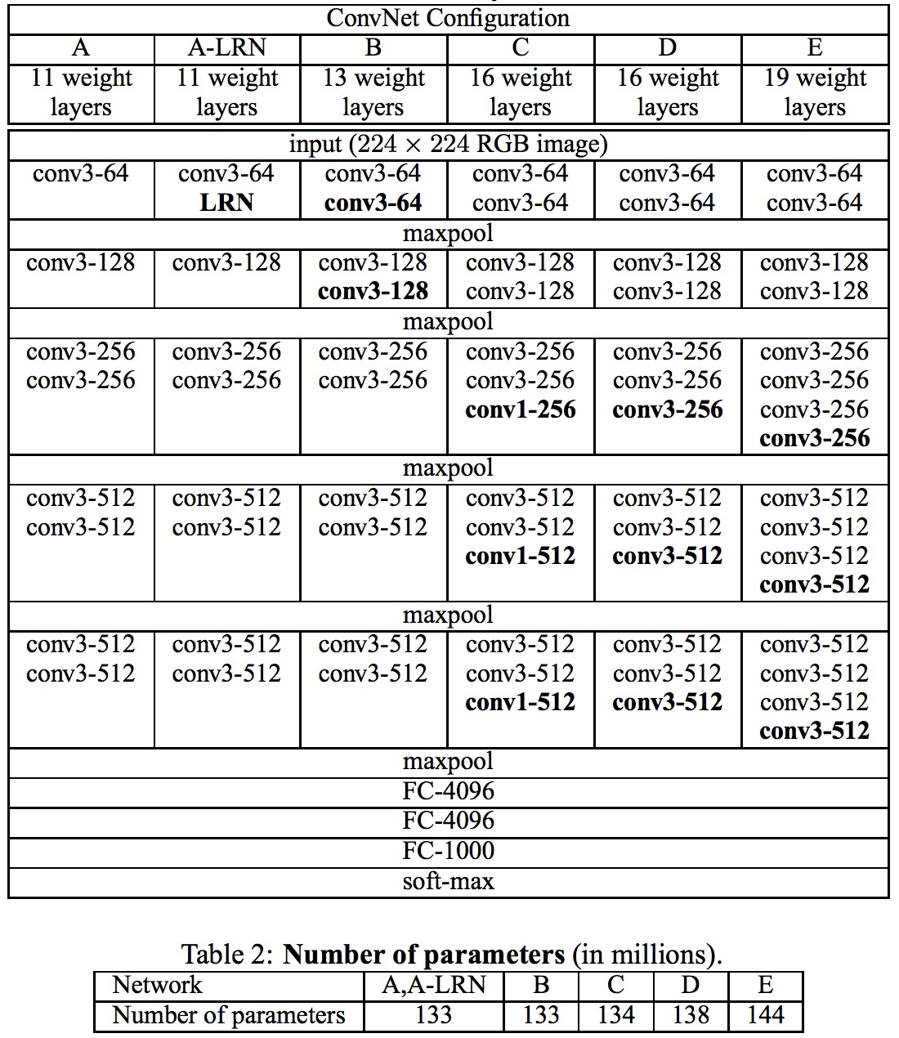
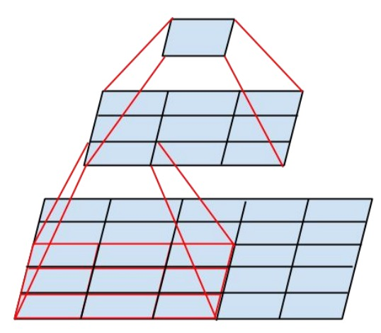
VGGNet: ILSVRC 2014 2nd place
Sequence of deeper networks trained progressively
Large receptive fields replaced by successive layers of 3x3 convolutions (with ReLU in between)
One 7x7 conv layer with K feature maps needs 49K² weights, three 3x3 conv layers need only 27K² weights
Experimented with 1x1 convolutions
K. Simonyan and A. Zisserman, Very Deep Convolutional Networks for Large-Scale Image Recognition, ICLR 2015
Notes:
LRN – local response normalization (doesn’t improve performance)

Slide 44
Batch Normalization
Multi-layer training can suffer from “covariate shift”
Distribution of hidden layer 2 input’s changes over time.
S. Iofffe and C. Szegedy, Batch Normalization: Accelerating Deep Network Training by Reducing Internal Covariate Shift, arXiv 2015
Notes:
LRN – local response normalization (doesn’t improve performance)

Slide 45
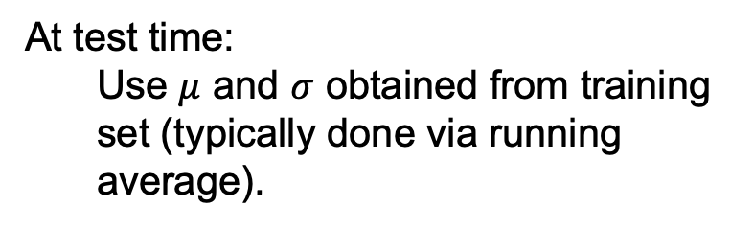
Batch Normalization
At test time:
  Use $μ$ and $σ$ obtained from training set (typically done via running average).
Single biggest source of bugs in my code!!
S. Iofffe and C. Szegedy, Batch Normalization: Accelerating Deep Network Training by Reducing Internal Covariate Shift, arXiv 2015
Notes:
LRN – local response normalization (doesn’t improve performance)

Slide 46
Batch Normalization
Multi-layer training can suffer from “covariate shift”
S. Iofffe and C. Szegedy, Batch Normalization: Accelerating Deep Network Training by Reducing Internal Covariate Shift, arXiv 2015
Notes:
LRN – local response normalization (doesn’t improve performance)

Slide 47
Batch Normalization
Multi-layer training can suffer from “covariate shift”
Accelerates training
Regularizes the model
Less sensitive to initialization
See also: How Does Batch Normalization Help Optimization?
S. Iofffe and C. Szegedy, Batch Normalization: Accelerating Deep Network Training by Reducing Internal Covariate Shift, arXiv 2015
Notes:
LRN – local response normalization (doesn’t improve performance)

Slide 48
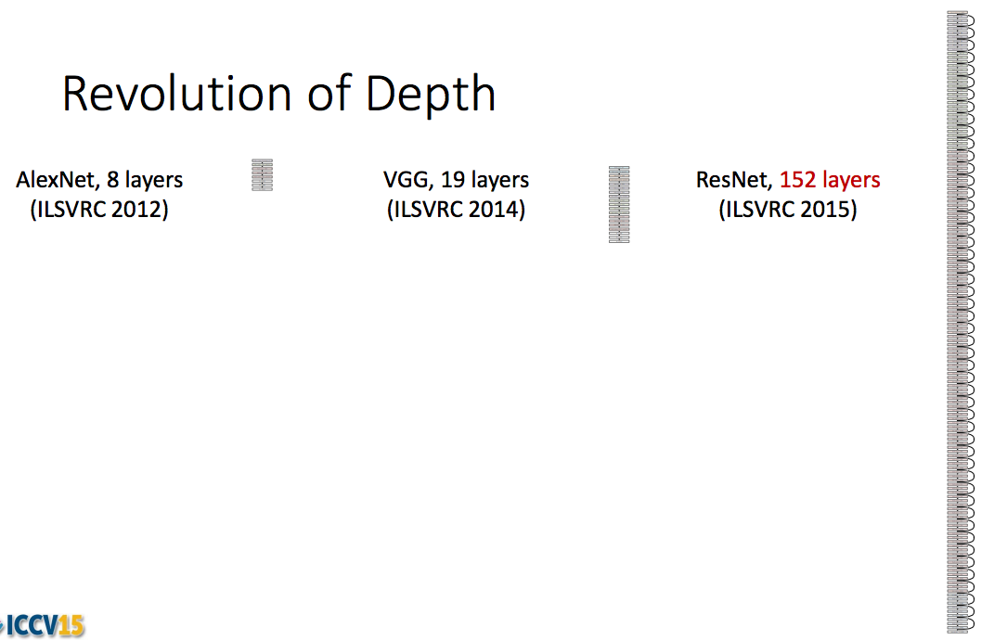
ResNet: ILSVRC 2015 winner
K. He, X. Zhang, S. Ren, and J. Sun, Deep Residual Learning for Image Recognition, CVPR 2016 (Best Paper)

Slide 49
ResNet: ILSVRC 2015 winner
K. He, X. Zhang, S. Ren, and J. Sun, Deep Residual Learning for Image Recognition, CVPR 2016 (Best Paper)

Slide 50
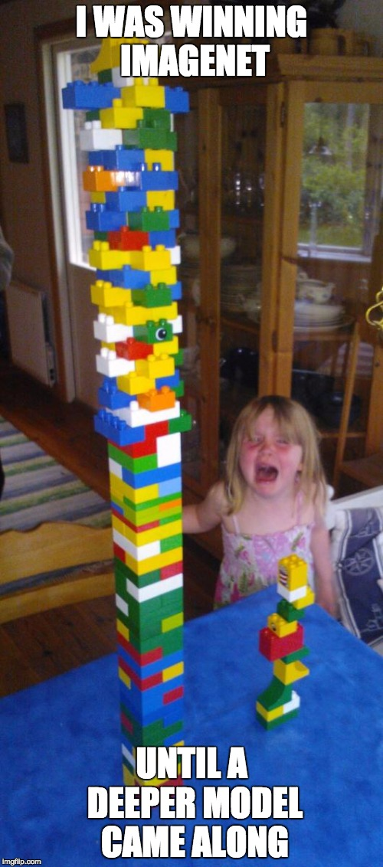
Source (?)

Slide 51
Slide from Kaiming He.

Slide 52
Slide from Kaiming He.

Slide 53
Slide from Kaiming He.

Slide 54
Slide from Kaiming He.

Slide 55
Slide from Kaiming He.

Slide 56
Slide from Kaiming He.

Slide 57
Slide from Kaiming He.

Slide 58
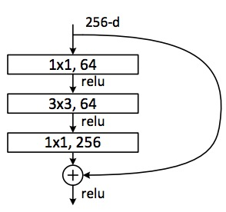
ResNet
Deeper residual module (bottleneck)
  Directly performing 3x3 convolutions with 256 feature maps at input and output:
  256 x 256 x 3 x 3 ~ 600K operations
  Using 1x1 convolutions to reduce 256 to 64 feature maps, followed by 3x3 convolutions, followed by 1x1 convolutions to expand back to 256 maps:
  256 x 64 x 1 x 1 ~ 16K
  64 x 64 x 3 x 3 ~ 36K
  64 x 256 x 1 x 1 ~ 16K
  Total: ~70K
K. He, X. Zhang, S. Ren, and J. Sun, Deep Residual Learning for Image Recognition, CVPR 2016 (Best Paper)

Slide 59
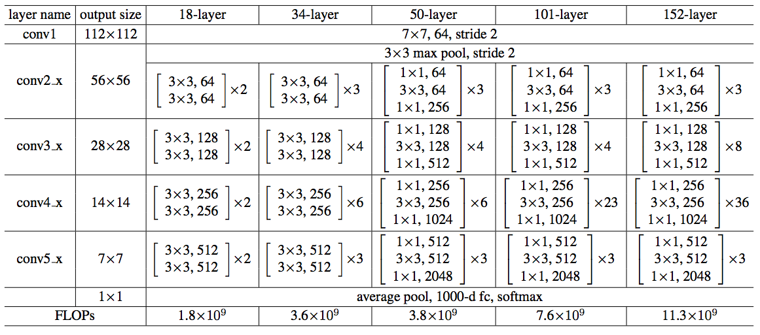
ResNet
Architectures for ImageNet:
K. He, X. Zhang, S. Ren, and J. Sun, Deep Residual Learning for Image Recognition, CVPR 2016 (Best Paper)

Slide 60
Slide from Kaiming He.

Slide 61
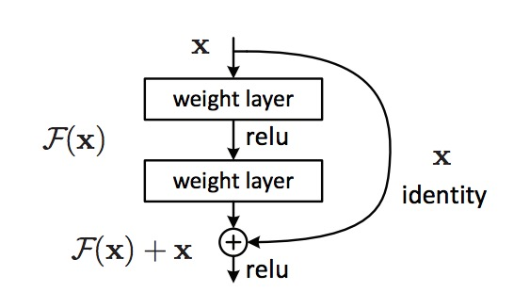
ResNet
The residual module
  Introduce skip or shortcut connections (existing before in various forms in literature)
  Make it easy for network layers to represent the identity mapping
K. He, X. Zhang, S. Ren, and J. Sun, Deep Residual Learning for Image Recognition, CVPR 2016 (Best Paper)

Slide 62
Summary: ILSVRC 2012-2015
Team | Year | Place | Error (top-5) | External data
SuperVision – Toronto (AlexNet, 7 layers) | 2012 | - | 16.4% | no
SuperVision | 2012 | 1st | 15.3% | ImageNet 22k
Clarifai – NYU (7 layers) | 2013 | - | 11.7% | no
Clarifai | 2013 | 1st | 11.2% | ImageNet 22k
VGG – Oxford (16 layers) | 2014 | 2nd | 7.32% | no
GoogLeNet (19 layers) | 2014 | 1st | 6.67% | no
ResNet (152 layers) | 2015 | 1st | 3.57%
Human expert* |  |  | 5.1%
http://karpathy.github.io/2014/09/02/what-i-learned-from-competing-against-a-convnet-on-imagenet/

Slide 63
Other Things
Training data augmentation
Averaging classifier outputs over multiple crops/flips
Ensembles of networks
Officially, starting with 2015, image classification is not part of ILSVRC challenge, but people continue to benchmark on the data

Slide 64
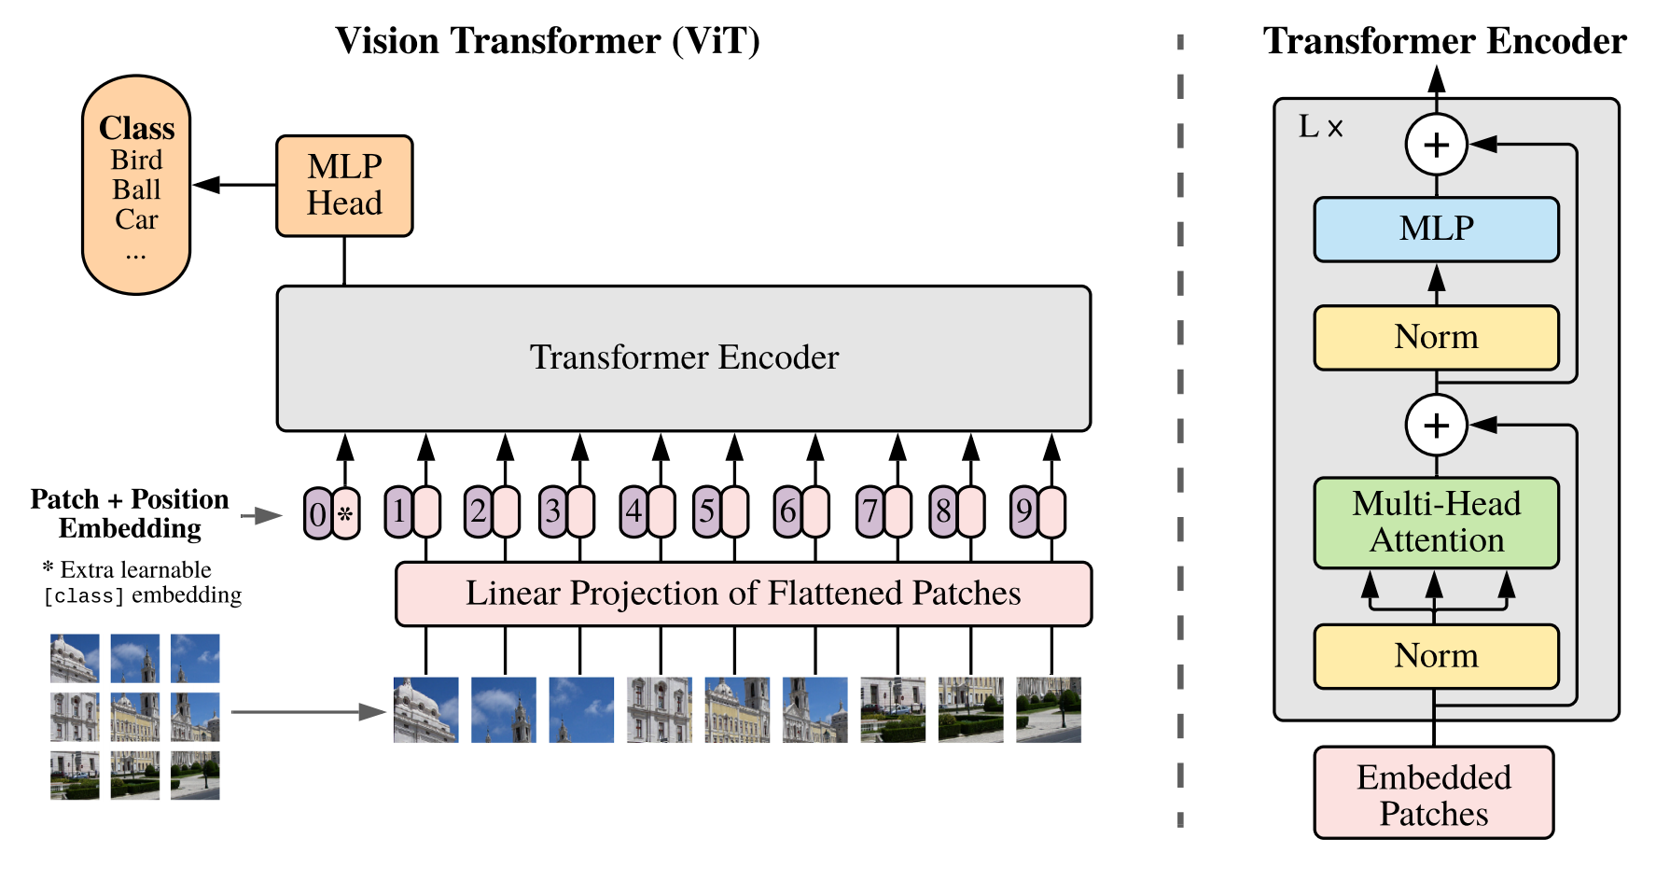
Attention (Vision Transformers)
A. Dosovitskiy et al., An Image is Worth 16x16 Words: Transformers for Image Recognition at Scale.

Slide 65
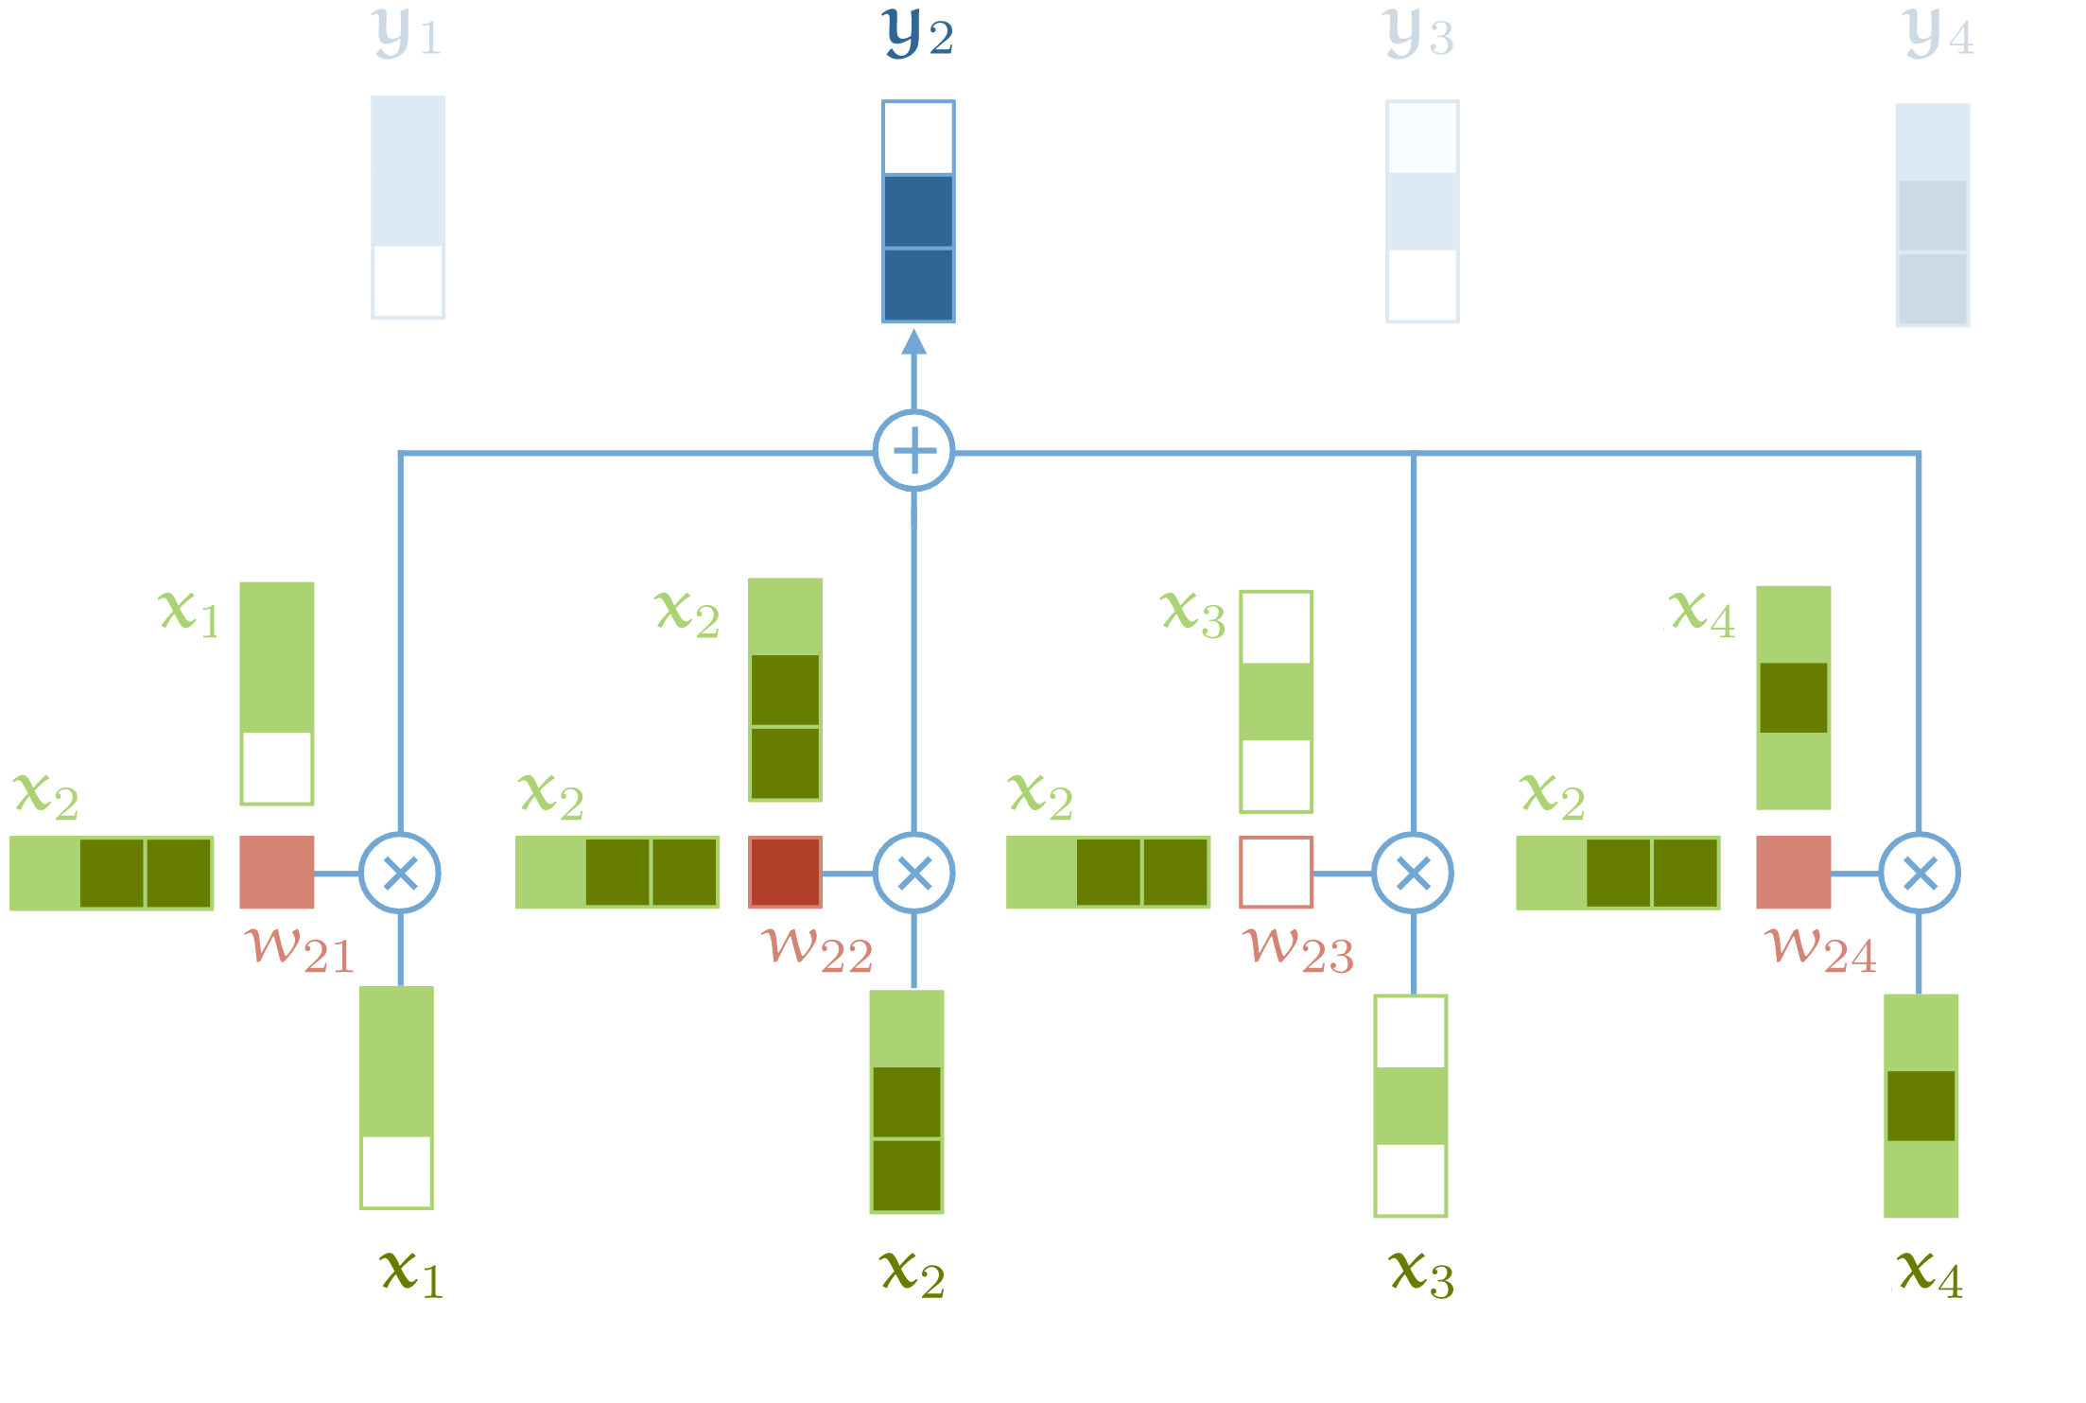
Attention
Source: http://peterbloem.nl/blog/transformers
See also: Attention is all you need

Slide 66
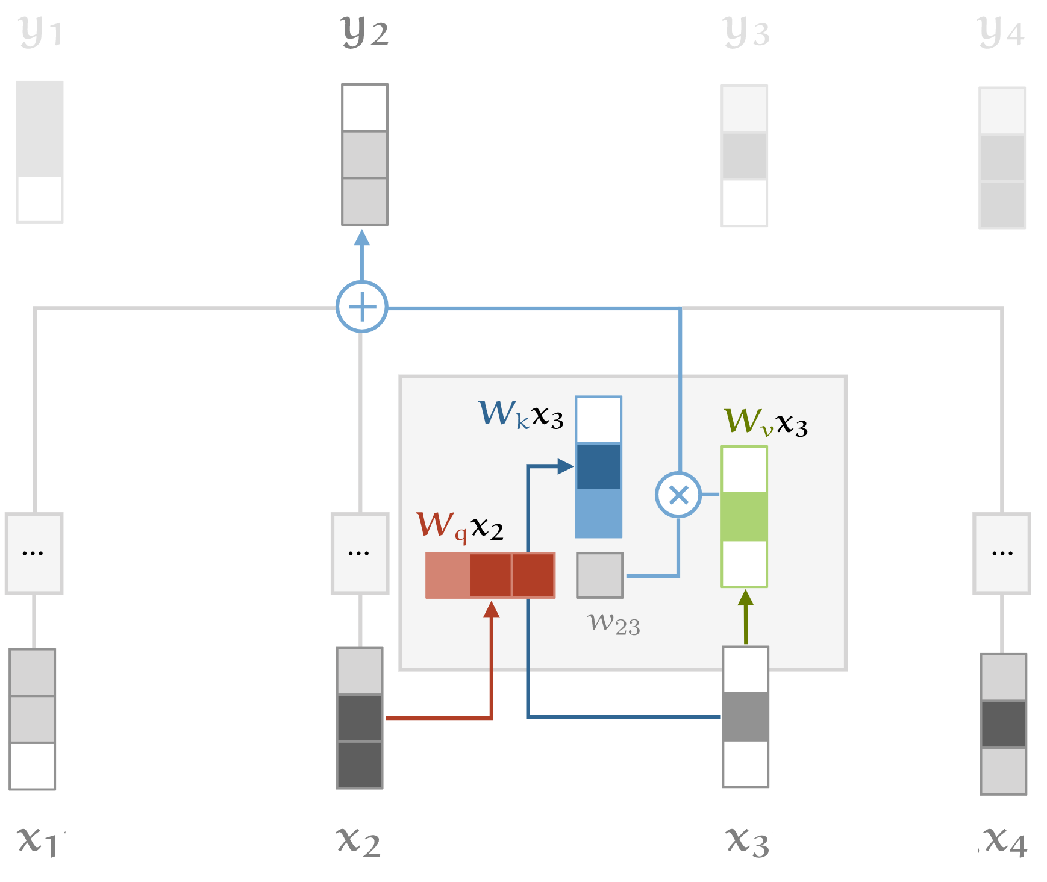
Attention (with key, query and value)
Source: http://peterbloem.nl/blog/transformers
See also: Attention is all you need

Slide 67
Representing Positions
Positional Embeddings
  Learn embeddings for different positions
Positional Encodings
  Explicitly encode positions using sin, cos terms
See also: Attention is all you need

Slide 68
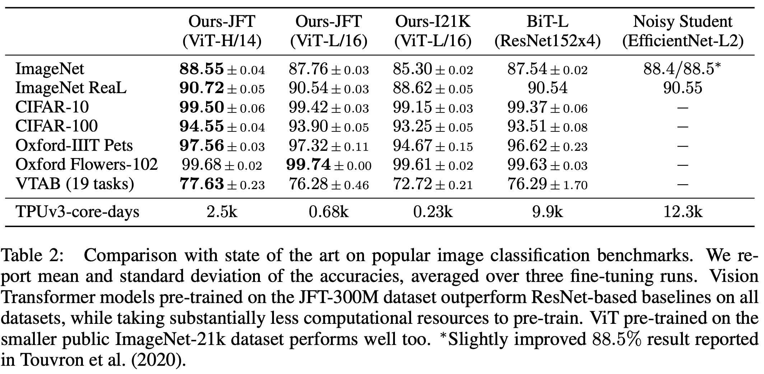
Attention (Vision Transformers)
A. Dosovitskiy et al., An Image is Worth 16x16 Words: Transformers for Image Recognition at Scale.

Slide 69
Learned Representations are Useful in General
Features extracted from CNNs trained on ImageNet were effective for many CV tasks.
Furthermore, learned network weights serve as an excellent starting point for other tasks.
J. Donahue, Y. Jia et al. DeCAF: A Deep Convolutional Activation Feature for Generic Visual Recognition. ICML 2014

Slide 70
How to use a trained network for a new task?
Caltech 101
Caltech 101
Fine-grained Classification
Domain Adaptation
Scene Classification
J. Donahue, Y. Jia et al. DeCAF: A Deep Convolutional Activation Feature for Generic Visual Recognition. ICML 2014

Slide 71
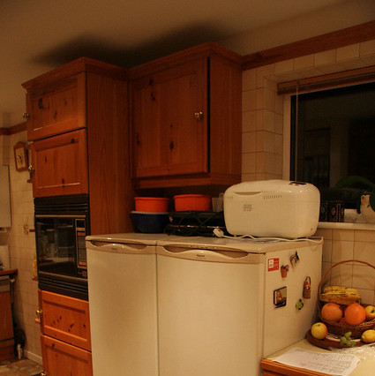
How to use a trained network for a new task?
Kitchen
Bedroom
Patio
Copy over
Classifier layer
Trained on ImageNet

Slide 72
How to use a trained network for a new task?
Classifier layer
FC vector
Take the vector of activations from one of the fully connected (FC) layers and treat it as an off-the-shelf feature
  Train a new classifier layer on top of the FC layer
Fine-tune the whole network

