Slide 1
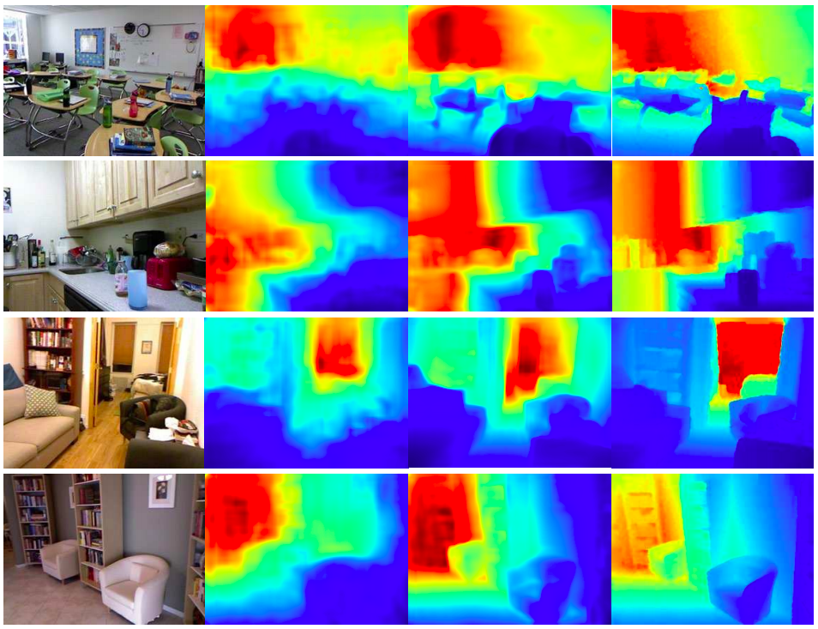
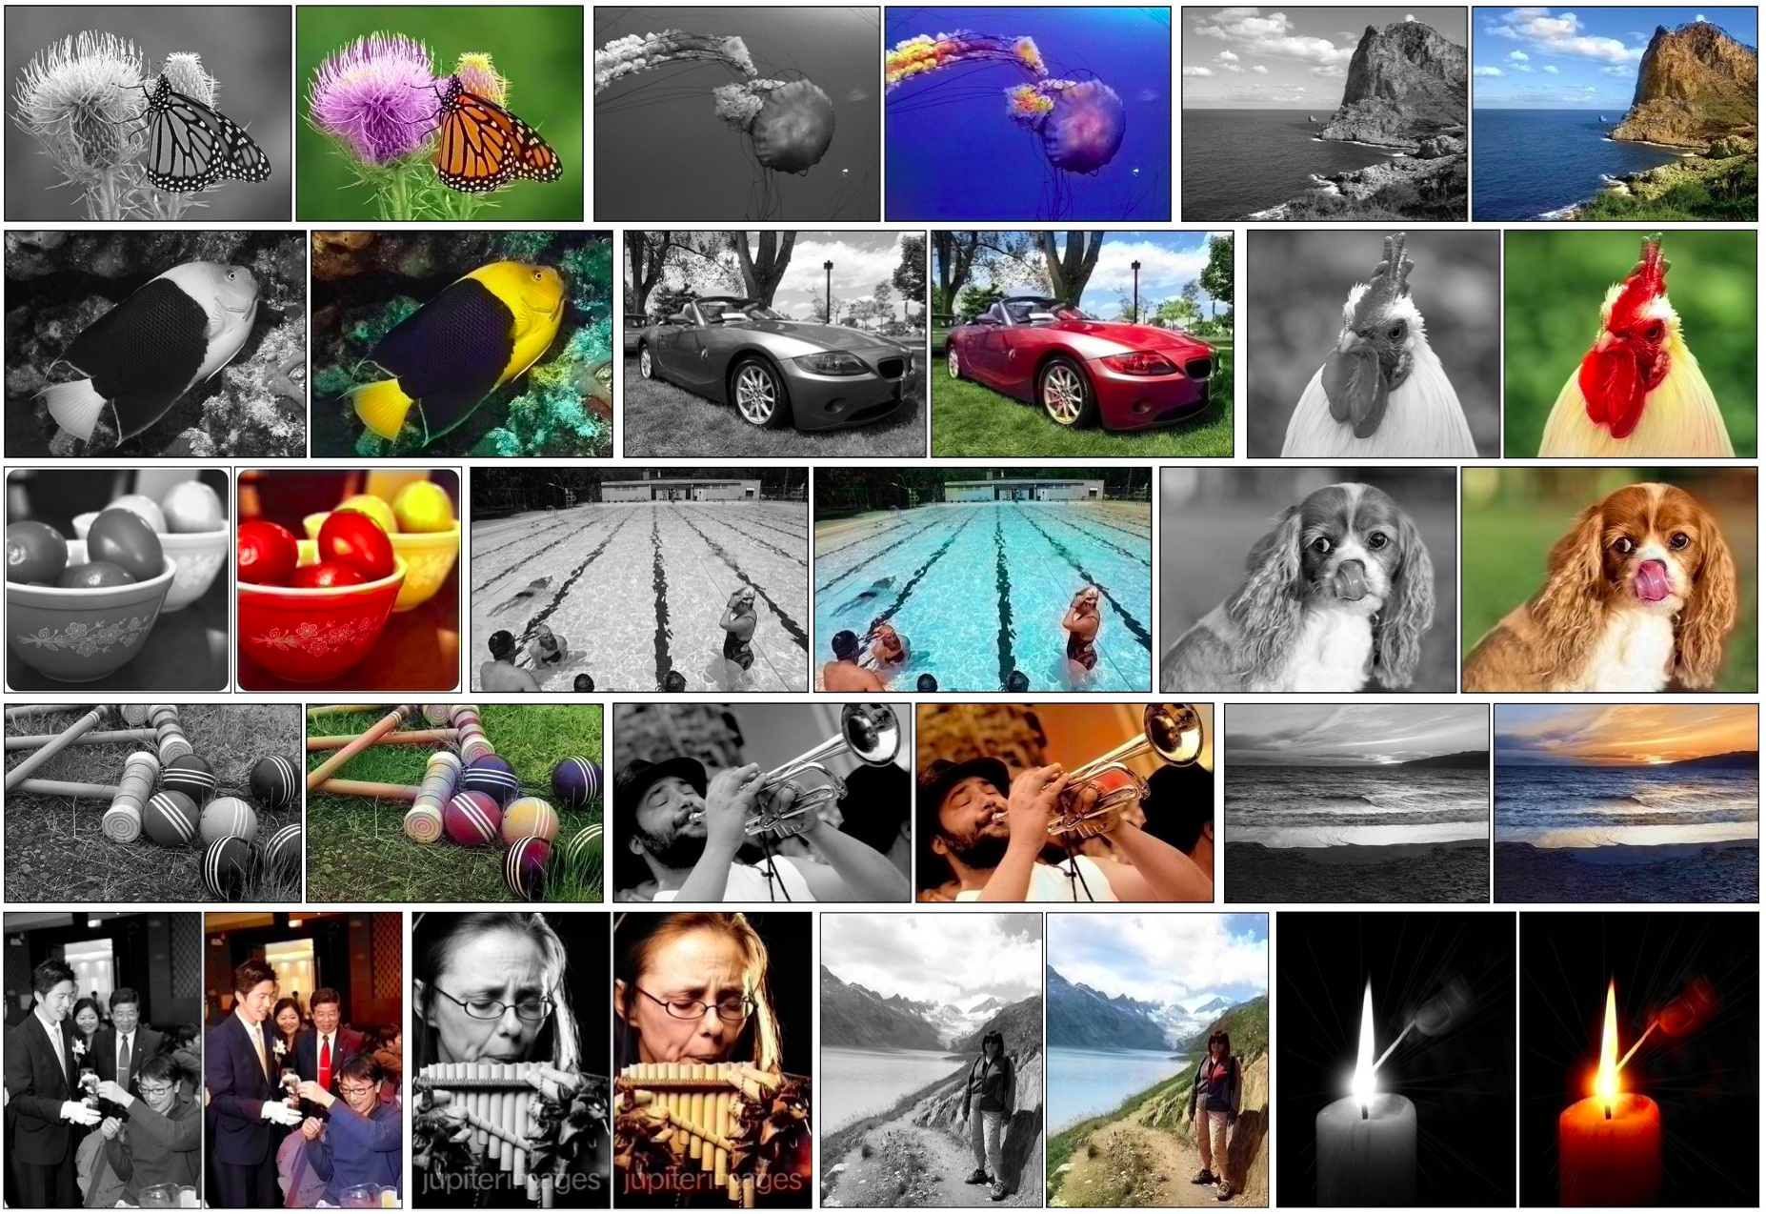
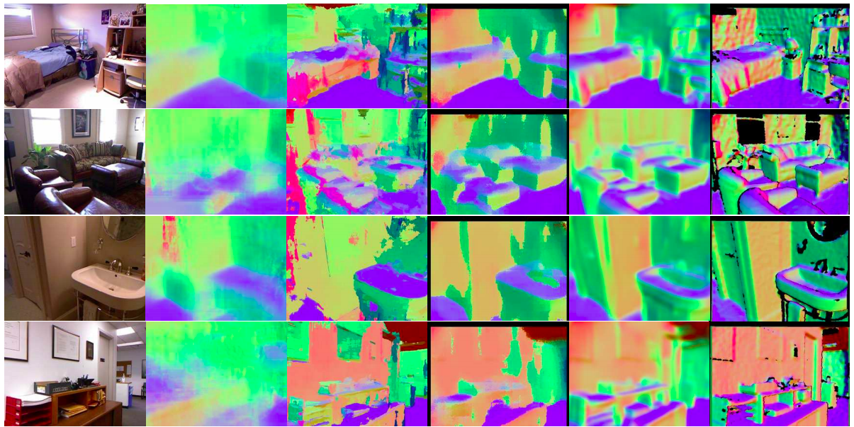
Pixel Prediction Tasks
Semantic segmentation
Colorization
Depth / Surface Normal Estimation
Many Slides from L. Lazebnik.

Slide 2
Outline
Semantic segmentation
  Metrics
  Architectures
    “Convolutionalization”
    Dilated convolutions
    Hyper-columns / skip-connections
    Learned up-sampling architectures
Other dense prediction problems

Slide 3
Semantic Segmentation: Metrics
Image
Ground Truth
Prediction
Pixel Classification Accuracy
Intersection over Union
Average Precision

Slide 4
Semantic Segmentation: Metrics

Slide 5
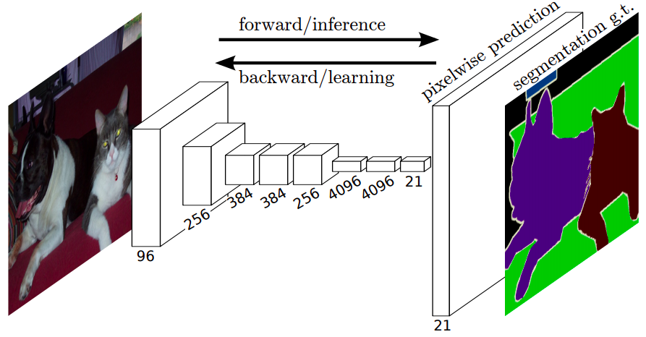
Semantic Segmentation
Do dense prediction as a post-process on top of an image classification CNN
Have: feature maps from image classification network
Want: pixel-wise predictions

Slide 6
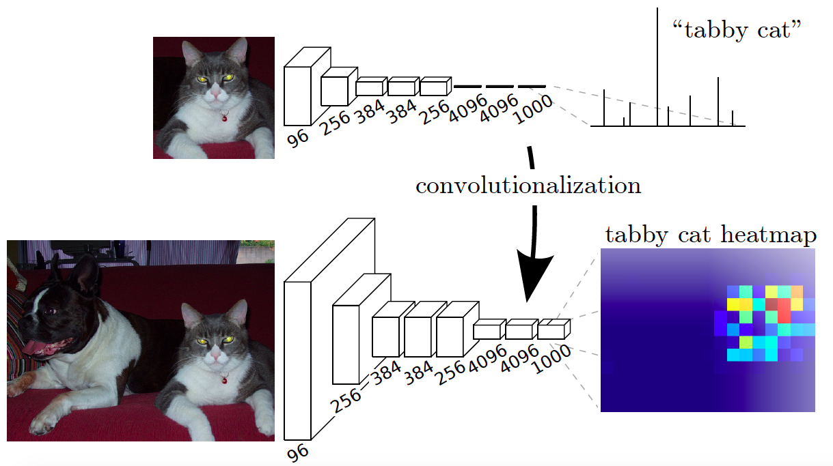
Convolutionalization
Design a network with only convolutional layers, make predictions for all pixels at once
J. Long, E. Shelhamer, and T. Darrell, Fully Convolutional Networks for Semantic Segmentation, CVPR 2015

Slide 7
Sparse, Low-resolution Output
J. Long, E. Shelhamer, and T. Darrell, Fully Convolutional Networks for Semantic Segmentation, CVPR 2015

Slide 8
Aside: Receptive Field, Stride
Receptive Field: Pixels in the image that are “connected” to a given unit.
Stride: Shift in receptive field between consecutive units in a convolutional feature map.
See: https://distill.pub/2019/computing-receptive-fields/

Slide 9
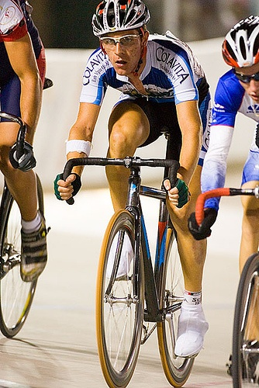
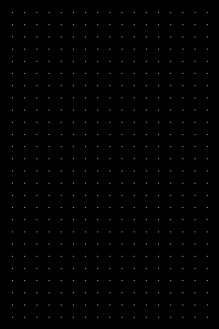
Sparse, Low-resolution Output
Bilinear Up sampling: Differentiable, train through up-sampling.
J. Long, et al., Fully Convolutional Networks for Semantic Segmentation, CVPR 2015

Slide 10

Fix 1: Shift and Stitch
Shift the image, and re-run CNN to get denser output.

Slide 11
Fix 1: A trous Conv., Dilated Conv.
Shift the image, and re-run CNN to get denser output.

Slide 12
Fix 1: A trous Conv., Dilated Conv.
B. 3x3 conv, stride1
A. 3x3 conv
stride 2

Slide 13

Fix 1: A trous Conv., Dilated Conv.
B. 3x3 conv, stride1, dilation 2
A. 3x3 conv
stride 1

Slide 14
Fix 1: A trous Conv., Dilated Conv.
Dilation factor 1
Dilation factor 2
Dilation factor 3
Image source

Slide 15
Fix 1: A trous Conv., Dilated Conv.
Use in FCN to remove downsampling:
change stride of max pooling layer from 2 to 1, dilate subsequent convolutions by factor of 2 (possibly without re-training any parameters)
Instead of reducing spatial resolution of feature maps, use a large sparse filter
L. Chen, G. Papandreou, I. Kokkinos, K. Murphy, A. Yuille, DeepLab: Semantic Image Segmentation with Deep Convolutional Nets, Atrous Convolution, and Fully Connected CRFs, PAMI 2017

Slide 16
Fix 1: A trous Conv., Dilated Conv.
Can increase receptive field size exponentially with a linear growth in the number of parameters
Feature map 1 (F1) produced from F0 by 1-dilated convolution
F2 produced from F1 by 2-dilated convolution
F3 produced from F2 by 4-dilated convolution
Receptive field: 3x3
Receptive field: 7x7
Receptive field: 15x15
F. Yu and V. Koltun, Multi-scale context aggregation by dilated convolutions,
ICLR 2016
Notes:
F1 is produced from F0 by a 1-dilated convolution; each element in F1 has a receptive field of 3×3. (b) F2 is produced from F1 by a 2-dilated convolution; each element in F2 has a receptive field of 7×7. (c) F3 is produced from F2 by a 4-dilated convolution; each element in F3 has a receptive field of 15×15. The number of parameters associated with each layer is identical. The receptive field grows exponentially while the number of parameters grows linearly.

Slide 17
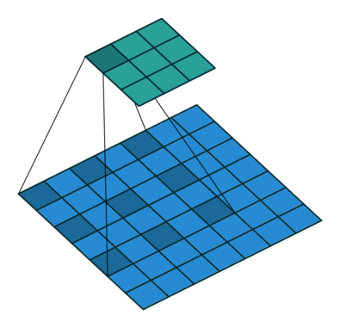
Dilated convolutions
Instead of reducing spatial resolution of feature maps, use a large sparse filter
output
Like 2x downsampling followed by 3x3 convolution followed by 2x upsampling
input
V. Dumoulin and F. Visin, A guide to convolution arithmetic for deep learning, arXiv 2018

Slide 18
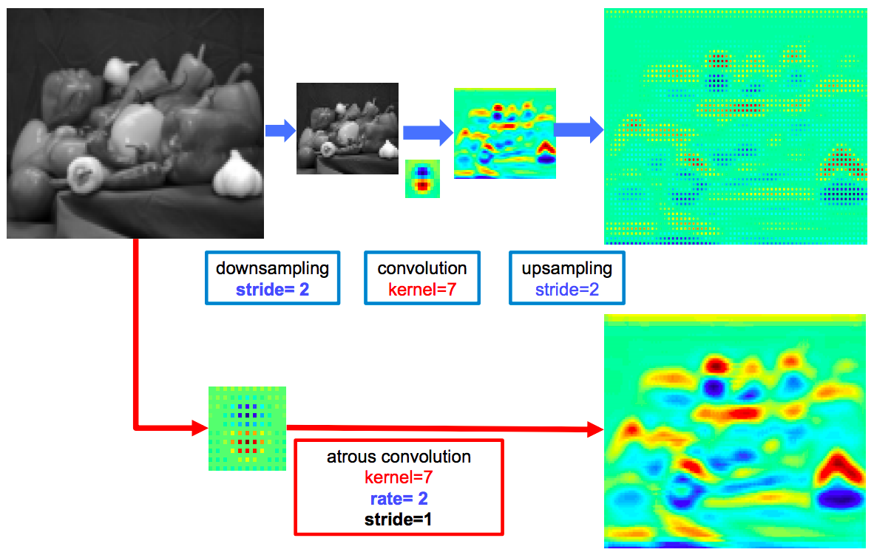
Dilated convolutions
L. Chen, G. Papandreou, I. Kokkinos, K. Murphy, A. Yuille, DeepLab: Semantic Image Segmentation with Deep Convolutional Nets, Atrous Convolution, and Fully Connected CRFs, PAMI 2017

Slide 19
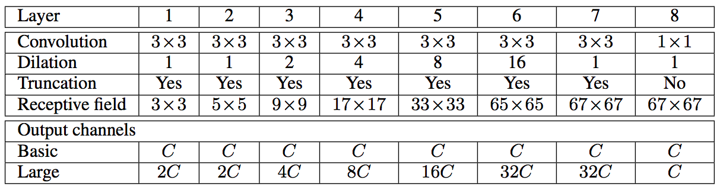
Dilated convolutions
Context module with dilation
  Returns same number of feature maps at the same resolution as the input, so can be plugged in to replace components of existing dense prediction architectures
  Requires identity initialization
F. Yu and V. Koltun, Multi-scale context aggregation by dilated convolutions,
ICLR 2016

Slide 20
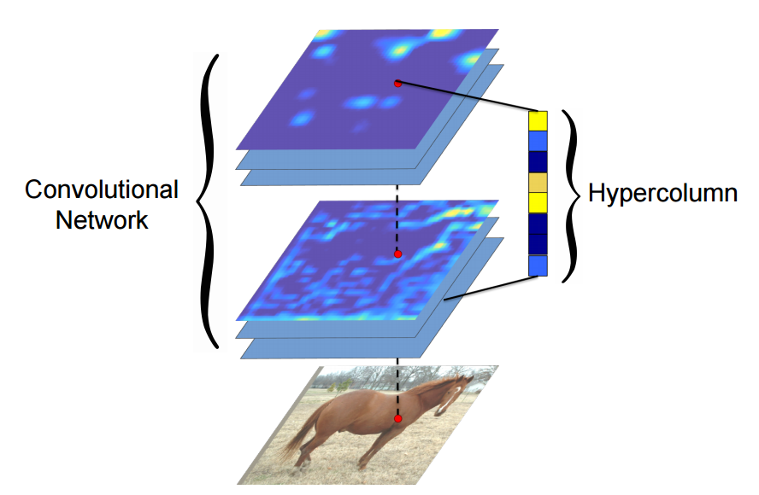
Fix 2: Hyper-columns/Skip Connections
Even though with dilation we can predict each pixel, fine-grained information needs to be propagated through the network.
Idea: Additionally use features from within the network.
B. Hariharan, P. Arbelaez, R. Girshick, and J. Malik, Hypercolumns for Object Segmentation and Fine-grained Localization, CVPR 2015
J. Long, et al., Fully Convolutional Networks for Semantic Segmentation, CVPR 2015
Notes:
F1 is produced from F0 by a 1-dilated convolution; each element in F1 has a receptive field of 3×3. (b) F2 is produced from F1 by a 2-dilated convolution; each element in F2 has a receptive field of 7×7. (c) F3 is produced from F2 by a 4-dilated convolution; each element in F3 has a receptive field of 15×15. The number of parameters associated with each layer is identical. The receptive field grows exponentially while the number of parameters grows linearly.

Slide 21
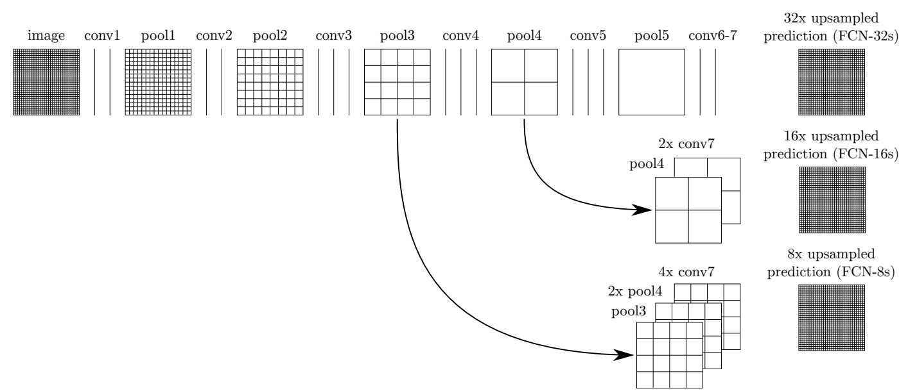
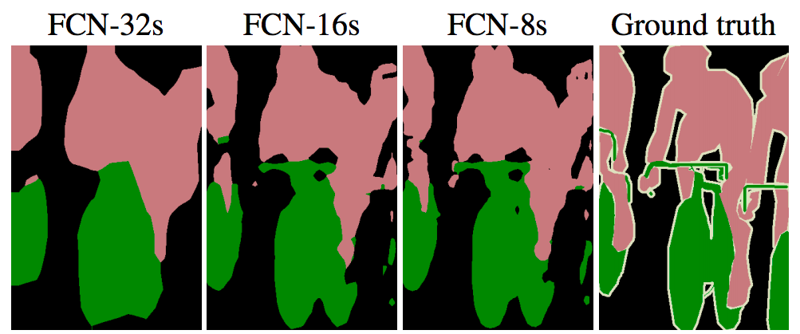
Fix 2: Hyper-columns/Skip Connections
Predictions by 1x1 conv layers, bilinear upsampling
Predictions by 1x1 conv layers, learned 2x upsampling,
fusion by summing
J. Long, E. Shelhamer, and T. Darrell, Fully Convolutional Networks for Semantic Segmentation, CVPR 2015

Slide 22
Fix 2: Hyper-columns/Skip Connections
J. Long, et al., Fully Convolutional Networks for Semantic Segmentation, CVPR 2015
Notes:
F1 is produced from F0 by a 1-dilated convolution; each element in F1 has a receptive field of 3×3. (b) F2 is produced from F1 by a 2-dilated convolution; each element in F2 has a receptive field of 7×7. (c) F3 is produced from F2 by a 4-dilated convolution; each element in F3 has a receptive field of 15×15. The number of parameters associated with each layer is identical. The receptive field grows exponentially while the number of parameters grows linearly.

Slide 23
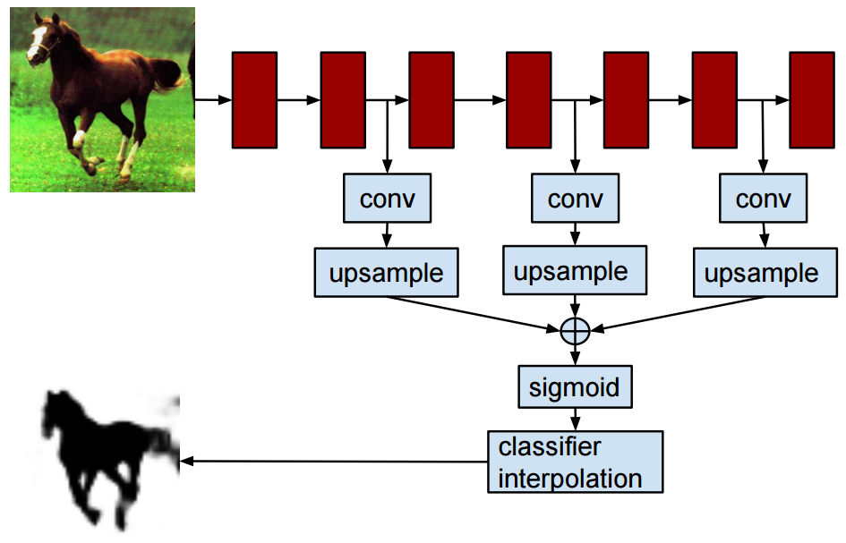
Hypercolumns
Idea: to obtain a feature representation for an individual pixel, upsample all feature maps to original image resolution and concatenate values from feature maps “above” that pixel
Representation as an end-to-end network:
B. Hariharan, P. Arbelaez, R. Girshick, and J. Malik, Hypercolumns for Object Segmentation and Fine-grained Localization, CVPR 2015

Slide 24
Fix 2b: Learned Upsampling
Predictions by 1x1 conv layers, bilinear upsampling
Predictions by 1x1 conv layers, learned 2x upsampling,
fusion by summing
J. Long, E. Shelhamer, and T. Darrell, Fully Convolutional Networks for Semantic Segmentation, CVPR 2015

Slide 25
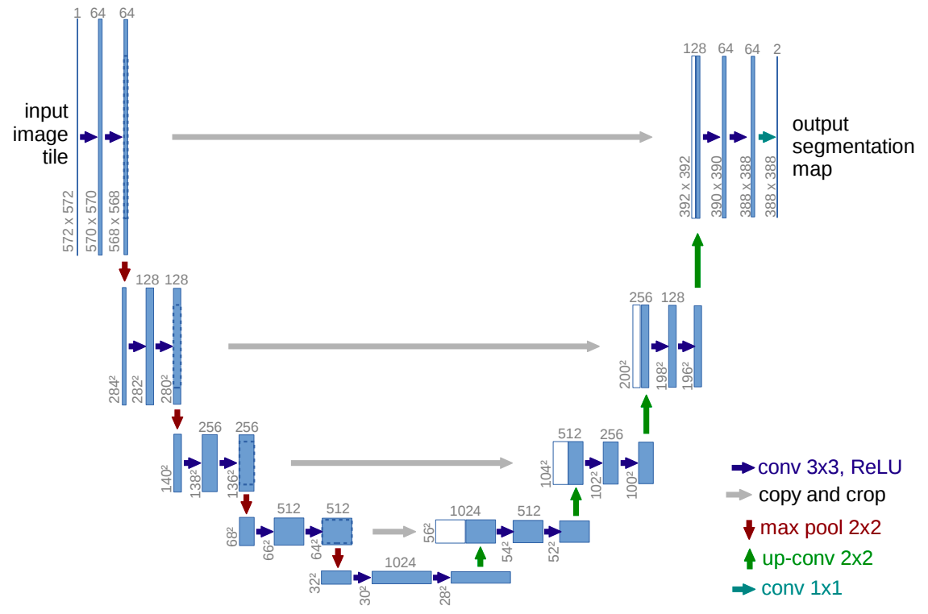
U-Net
Like FCN, fuse upsampled higher-level feature maps with higher-res, lower-level feature maps
Unlike FCN, fuse by concatenation, predict at the end
O. Ronneberger, P. Fischer, T. Brox U-Net: Convolutional Networks for Biomedical Image Segmentation, MICCAI 2015

Slide 26
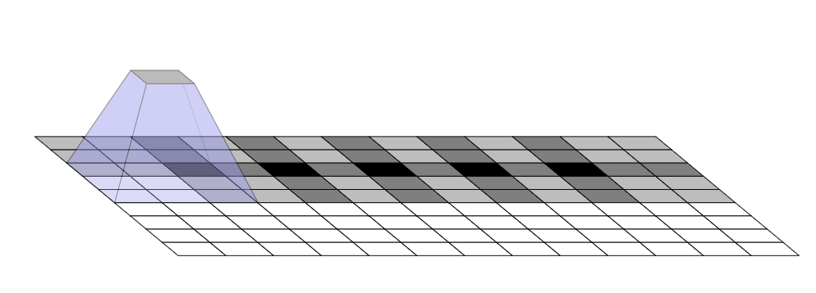
Up-convolution
“Paint” in the output feature map with the learned filter
  Multiply input value by filter, place result in the output, sum overlapping values
Animation: https://distill.pub/2016/deconv-checkerboard/

Slide 27
Upsampling in a deep network
Transposed or backwards-strided convolution: “paint” in the output feature map with the learned filter
  Multiply input value by filter, place result in the output, sum overlapping values
Animation: https://distill.pub/2016/deconv-checkerboard/

Slide 28
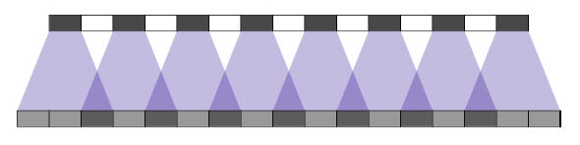










Upsampling in a deep network
Filter ${[w_{1},w}_{2},w_{3}]$, output stride = 2
$$x_{1}$$
$$x_{2}$$
$$x_{3}$$
$$x_{4}$$
$$x_{5}$$
$$x_{6}$$
$$x_{7}$$
$$x_{8}$$
input
stride 2
output
$${w_{1}x}_{1}$$
Animation: https://distill.pub/2016/deconv-checkerboard/

Slide 29

Upsampling in a deep network
Filter ${[w_{1},w}_{2},w_{3}]$, output stride = 2
$$x_{1}$$
$$x_{2}$$
$$x_{3}$$
$$x_{4}$$
$$x_{5}$$
$$x_{6}$$
$$x_{7}$$
$$x_{8}$$
input
stride 2
output
$${w_{2}x}_{1}$$
Animation: https://distill.pub/2016/deconv-checkerboard/

Slide 30

Upsampling in a deep network
Filter ${[w_{1},w}_{2},w_{3}]$, output stride = 2
$$x_{1}$$
$$x_{2}$$
$$x_{3}$$
$$x_{4}$$
$$x_{5}$$
$$x_{6}$$
$$x_{7}$$
$$x_{8}$$
input
stride 2
output
$${w_{3}x}_{1}+{w_{1}x}_{2}$$
Animation: https://distill.pub/2016/deconv-checkerboard/

Slide 31

Upsampling in a deep network
Filter ${[w_{1},w}_{2},w_{3}]$, output stride = 2
$$x_{1}$$
$$x_{2}$$
$$x_{3}$$
$$x_{4}$$
$$x_{5}$$
$$x_{6}$$
$$x_{7}$$
$$x_{8}$$
input
stride 2
output
$${w_{2}x}_{2}$$
Animation: https://distill.pub/2016/deconv-checkerboard/

Slide 32

Upsampling in a deep network
Filter ${[w_{1},w}_{2},w_{3}]$, output stride = 2
$$x_{1}$$
$$x_{2}$$
$$x_{3}$$
$$x_{4}$$
$$x_{5}$$
$$x_{6}$$
$$x_{7}$$
$$x_{8}$$
input
stride 2
output
$${w_{3}x}_{2}+{w_{1}x}_{3}$$
Animation: https://distill.pub/2016/deconv-checkerboard/

Slide 33
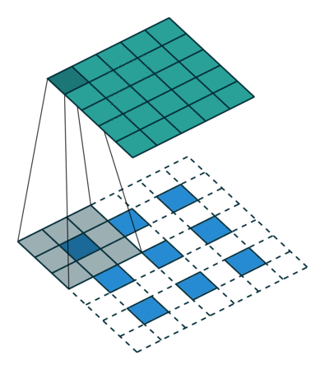
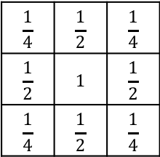
Up-convolution: Alternate view
2D case: for stride 2, dilate the input by inserting rows and columns of zeros between adjacent entries, convolve with flipped filter
Sometimes called convolution with fractional input stride 1/2
Q: What 3x3 filter would correspond to bilinear upsampling?
output
$$\frac{1}{4}$$ | $$\frac{1}{2}$$ | $$\frac{1}{4}$$
$$\frac{1}{2}$$ | $$1$$ | $$\frac{1}{2}$$
$$\frac{1}{4}$$ | $$\frac{1}{2}$$ | $$\frac{1}{4}$$
input
V. Dumoulin and F. Visin, A guide to convolution arithmetic for deep learning, arXiv 2018

Slide 34
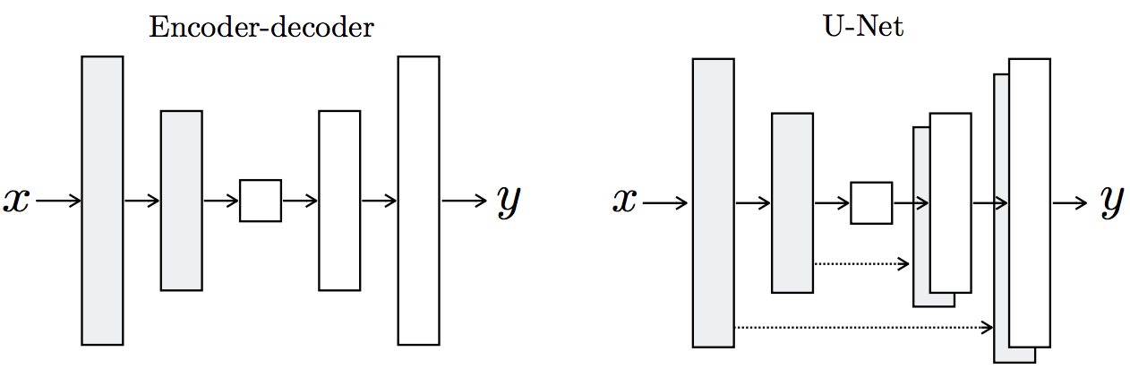
Summary of upsampling architectures
Figure source

Slide 35
Fix 3: Use local edge information (CRFs)
Source: B. Hariharan

Slide 36
Fix 3: Use local edge information (CRFs)
Idea: take convolutional network prediction and sharpen using classic techniques
Conditional Random Field
Label compatibility
Pixel similarity
Source: B. Hariharan

Slide 37
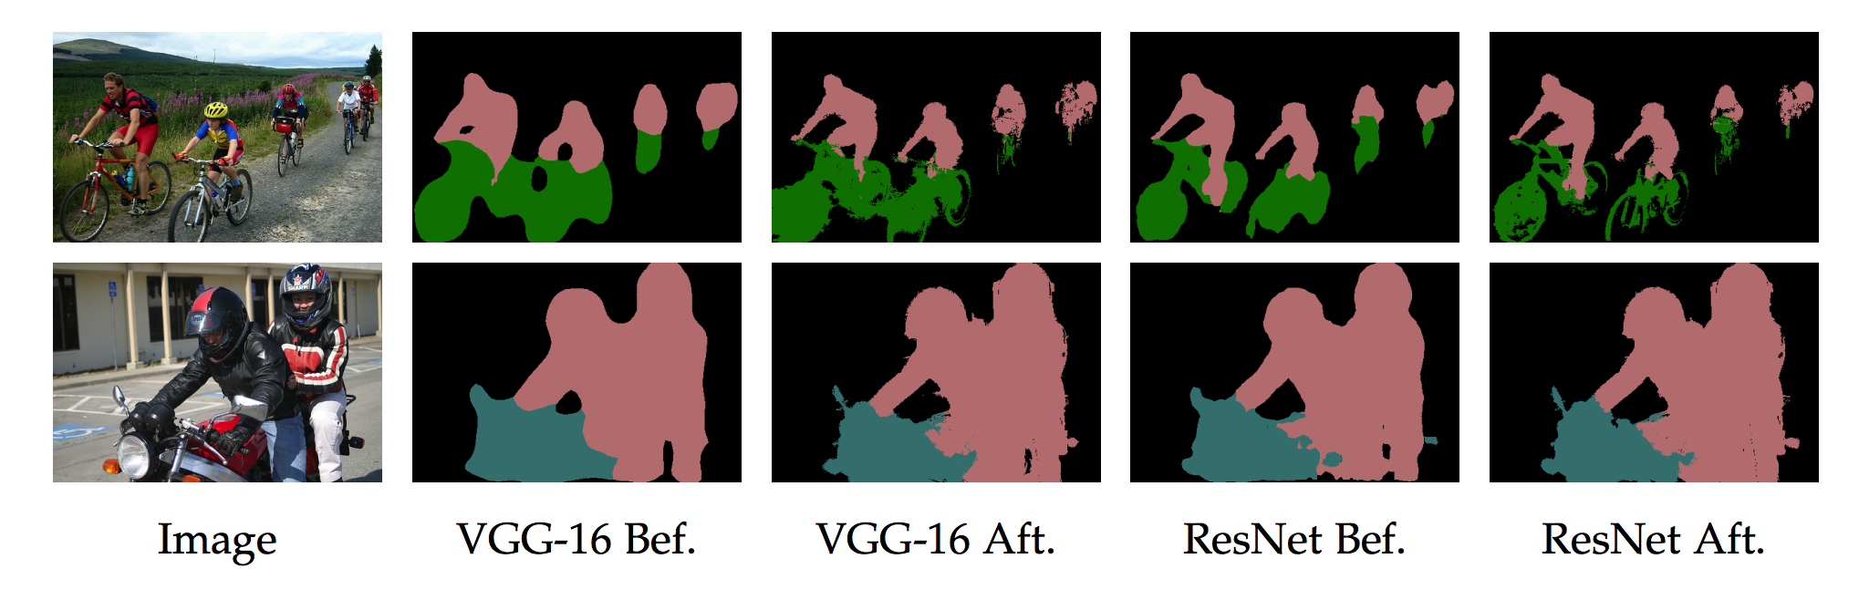
Fix 3: Use local edge information (CRFs)
Source: B. Hariharan

Slide 38
Semantic Segmentation Results
Liang-Chieh Chen, Yukun Zhu, George Papandreou, Florian Schroff, Hartwig Adam, DeepLabv3+: Encoder-Decoder with Atrous Separable Convolution, ECCV 2018

Slide 39
Other dense prediction tasks
Depth estimation
Surface normal estimation
Colorization
….

Slide 40
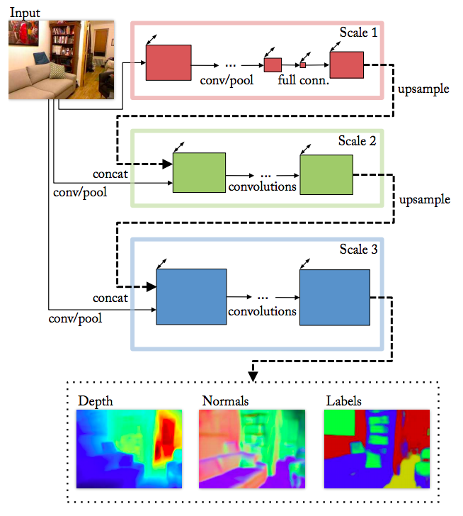
Depth and normal estimation
Predicted depth
Ground truth
D. Eigen and R. Fergus, Predicting Depth, Surface Normals and Semantic Labels with a Common Multi-Scale Convolutional Architecture, ICCV 2015

Slide 41
Depth and normal estimation
Predicted normals
Ground truth
D. Eigen and R. Fergus, Predicting Depth, Surface Normals and Semantic Labels with a Common Multi-Scale Convolutional Architecture, ICCV 2015

Slide 42
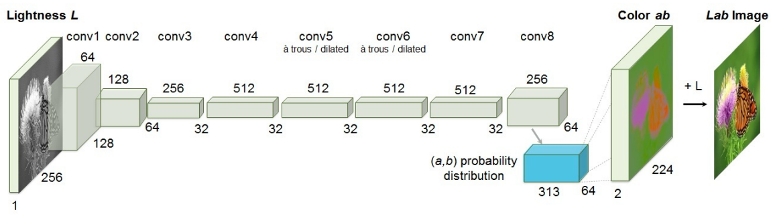
Colorization
R. Zhang, P. Isola, and A. Efros, Colorful Image Colorization, ECCV 2016

