Slide 1
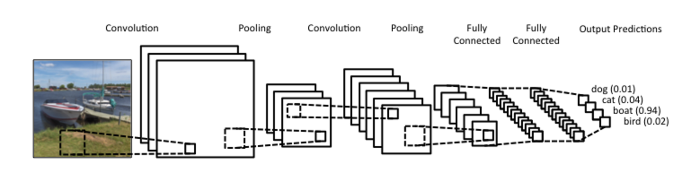
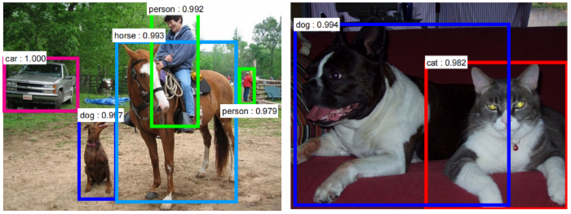
From image classification to object detection
Image classification
Object detection
Slides from L. Lazebnik
Image source

Slide 2
What are the challenges of object detection?
Images may contain more than one class, multiple instances from the same class
Bounding box localization
Evaluation
Image source

Slide 3
Outline
Task definition and evaluation
Generic object detection before deep learning
  Sliding windows
  HoG, DPMs (Components, Parts)
  Region Classification Methods
Deep detection approaches
  R-CNN
  Fast R-CNN
  Faster R-CNN
  SSD

Slide 4

Object detection evaluation
At test time, predict bounding boxes, class labels, and confidence scores
For each detection, determine whether it is a true or false positive
  PASCAL criterion: Area(GT $∩$ Det) / Area(GT $∪$ Det) > 0.5
  For multiple detections of the same ground truth
  box, only one considered a true positive
dog: 0.6
dog
dog: 0.55
cat: 0.8
cat
Ground truth (GT)

Slide 5
Object detection evaluation
At test time, predict bounding boxes, class labels, and confidence scores
For each detection, determine whether it is a true or false positive
For each class, plot Recall-Precision curve and compute Average Precision (area under the curve)
Take mean of AP over classes to get mAP
  Precision:
  true positive detections /
  total detections
  Recall:
  true positive detections /
  total positive test instances

Slide 6
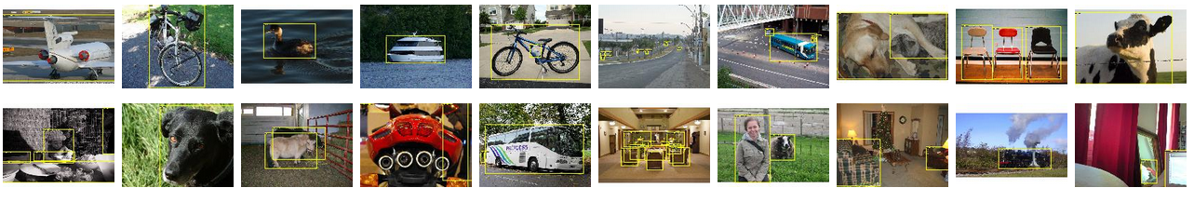
PASCAL VOC Challenge (2005-2012)
20 challenge classes:
  Person
  Animals: bird, cat, cow, dog, horse, sheep
  Vehicles: aeroplane, bicycle, boat, bus, car, motorbike, train
  Indoor: bottle, chair, dining table, potted plant, sofa, tv/monitor
Dataset size (by 2012): 11.5K training/validation images, 27K bounding boxes, 7K segmentations
http://host.robots.ox.ac.uk/pascal/VOC/

Slide 7
Progress on PASCAL detection
PASCAL VOC
Before CNNs

Slide 8
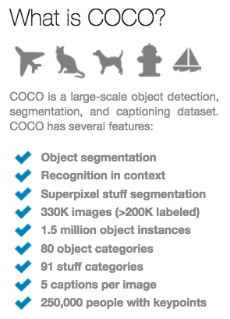
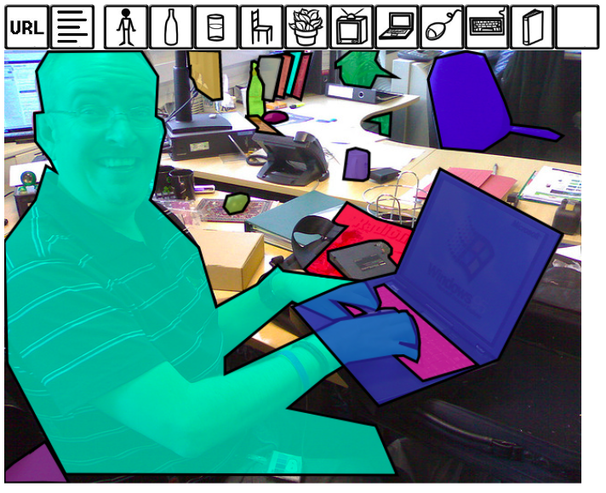
Newer benchmark: COCO
http://cocodataset.org/#home

Slide 9
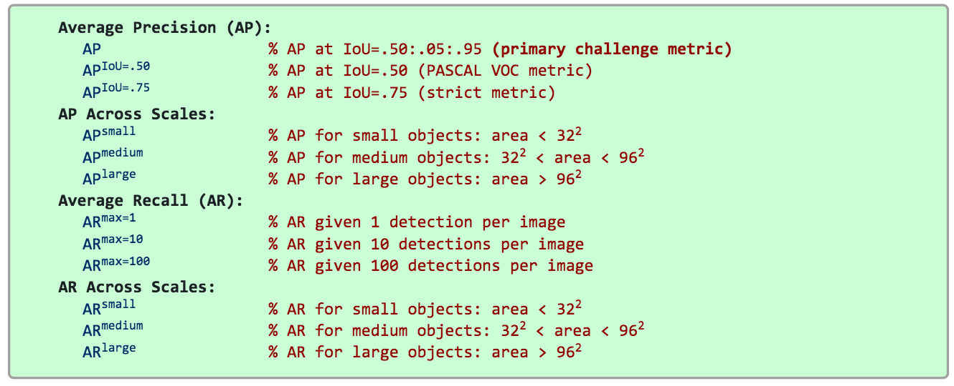
COCO detection metrics
Leaderboard: http://cocodataset.org/#detection-leaderboard
  Current best mAP: ~52%
Official COCO challenges no longer include detection
  More emphasis on instance segmentation and dense segmentation

Slide 10
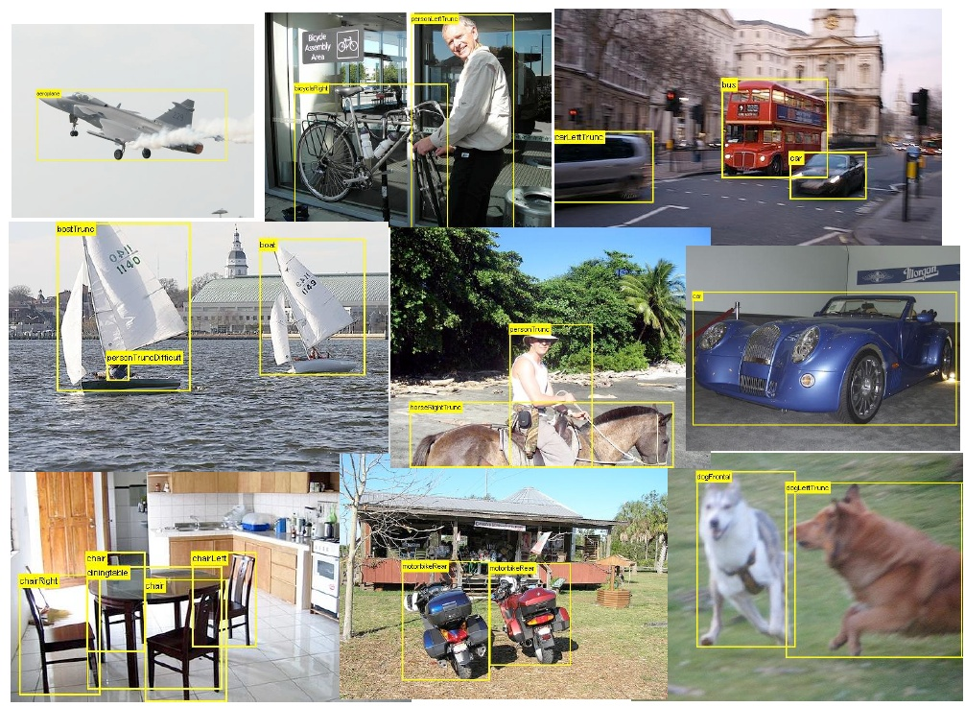
Detection before deep learning

Slide 11


Conceptual approach: Sliding window detection
Detection
Slide a window across the image and evaluate a detection model at each location
  Thousands of windows to evaluate: efficiency and low false positive rates are essential
  Difficult to extend to a large range of scales, aspect ratios

Slide 12

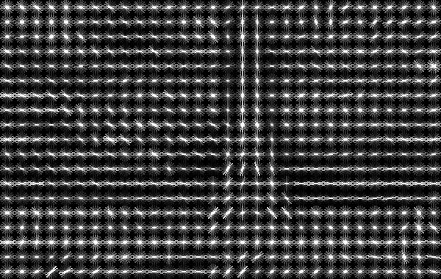
Histograms of oriented gradients (HOG)
Partition image into blocks and compute histogram of gradient orientations in each block
Image credit: N. Snavely
N. Dalal and B. Triggs, Histograms of Oriented Gradients for Human Detection, CVPR 2005

Slide 13
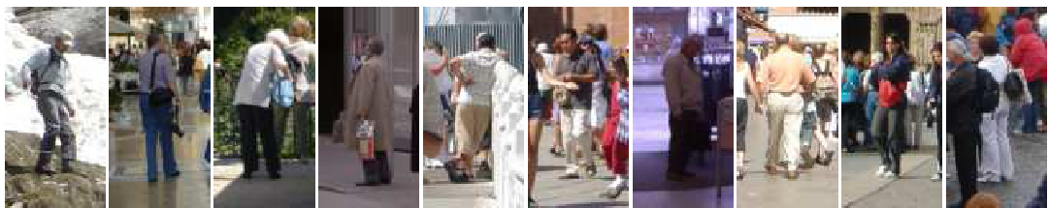
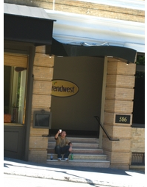
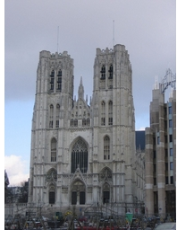
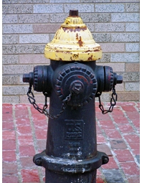
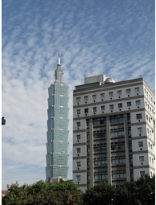
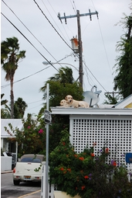
Pedestrian detection with HOG
Train a pedestrian template using a linear support vector machine
positive training examples
negative training examples
N. Dalal and B. Triggs, Histograms of Oriented Gradients for Human Detection, CVPR 2005

Slide 14
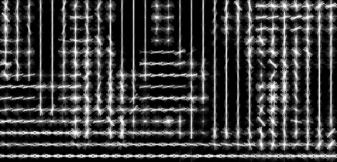
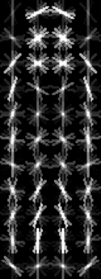
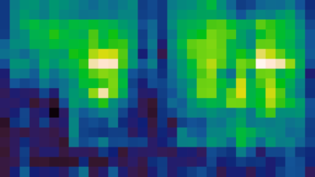
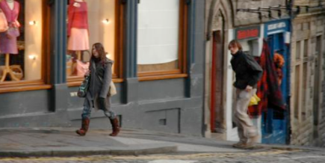
Pedestrian detection with HOG
Train a pedestrian template using a linear support vector machine
At test time, convolve feature map with template
Find local maxima of response
For multi-scale detection, repeat over multiple levels of a HOG pyramid
HOG feature map
Template
Detector response map
N. Dalal and B. Triggs, Histograms of Oriented Gradients for Human Detection, CVPR 2005

Slide 15
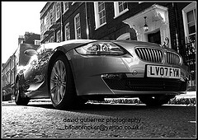
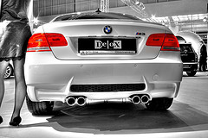
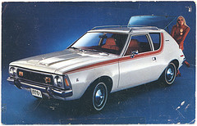
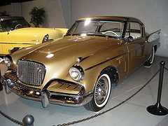
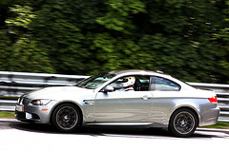
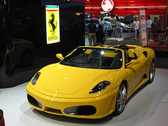
Discriminative part-based models
Single rigid template usually not enough to represent a category
  Many objects (e.g. humans) are articulated, or have parts that can vary in configuration
  Many object categories look very different from different viewpoints, or from instance to instance
Slide by N. Snavely

Slide 16
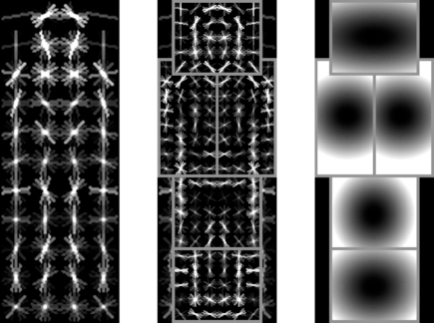
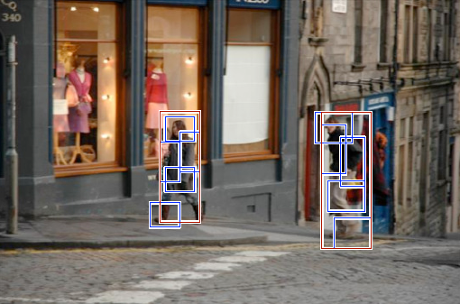
Discriminative part-based models
Root filter
Part filters
Deformation weights
P. Felzenszwalb, R. Girshick, D. McAllester, D. Ramanan, Object Detection with Discriminatively Trained Part Based Models, PAMI 32(9), 2010

Slide 17
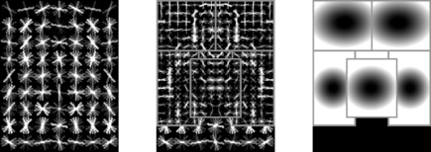
Discriminative part-based models
Multiple components
P. Felzenszwalb, R. Girshick, D. McAllester, D. Ramanan, Object Detection with Discriminatively Trained Part Based Models, PAMI 32(9), 2010

Slide 18

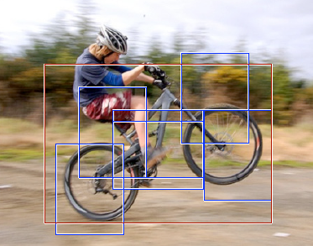
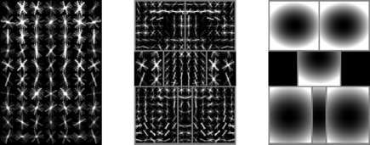
Discriminative part-based models
P. Felzenszwalb, R. Girshick, D. McAllester, D. Ramanan, Object Detection with Discriminatively Trained Part Based Models, PAMI 32(9), 2010

Slide 19
Progress on PASCAL detection
PASCAL VOC
Before CNNs
After CNNs

Slide 20
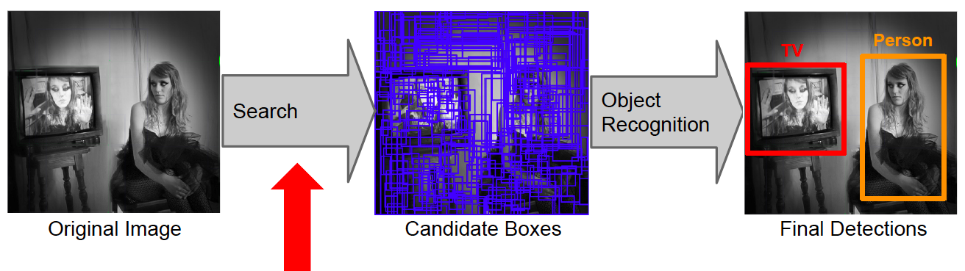
Conceptual approach: Proposal-driven detection
Generate and evaluate a few hundred region proposals
  Proposal mechanism can take advantage of low-level perceptual organization cues
  Proposal mechanism can be category-specific or category-independent, hand-crafted or trained
  Classifier can be slower but more powerful

Slide 21
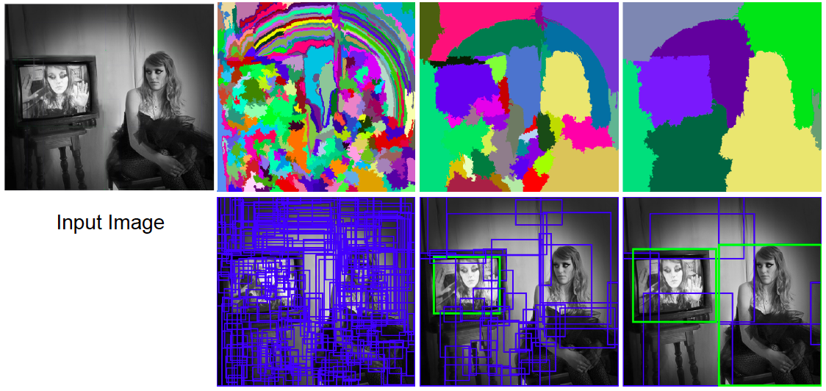
Selective search for detection
Use hierarchical segmentation: start with small superpixels and merge based on diverse cues
J. Uijlings, K. van de Sande, T. Gevers, and A. Smeulders, Selective Search for Object Recognition, IJCV 2013

Slide 22
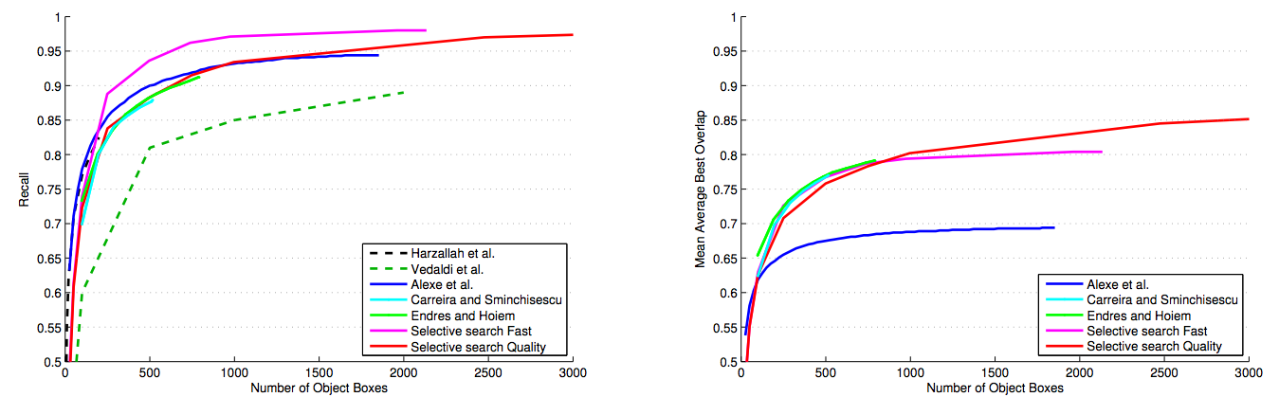
Selective search for detection
Evaluation of region proposals
J. Uijlings, K. van de Sande, T. Gevers, and A. Smeulders, Selective Search for Object Recognition, IJCV 2013

Slide 23
Multiscale Combinatorial Grouping
Use hierarchical segmentation: start with small superpixels and merge based on diverse cues
P. Arbelaez. et al., Multiscale Combinatorial Grouping, CVPR 2014

Slide 24
Region Proposals for Detection (Eval)
P. Arbelaez. et al., Multiscale Combinatorial Grouping, CVPR 2014

Slide 25
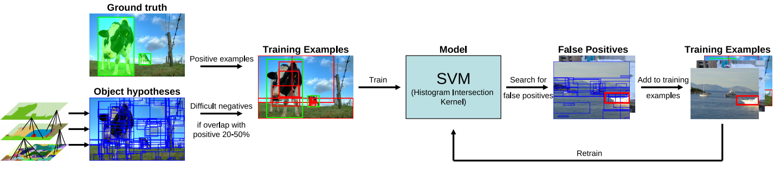
Region Proposals for Detection
Feature extraction: color SIFT, codebook of size 4K, spatial pyramid with four levels = 360K dimensions
J. Uijlings, K. van de Sande, T. Gevers, and A. Smeulders, Selective Search for Object Recognition, IJCV 2013

Slide 26
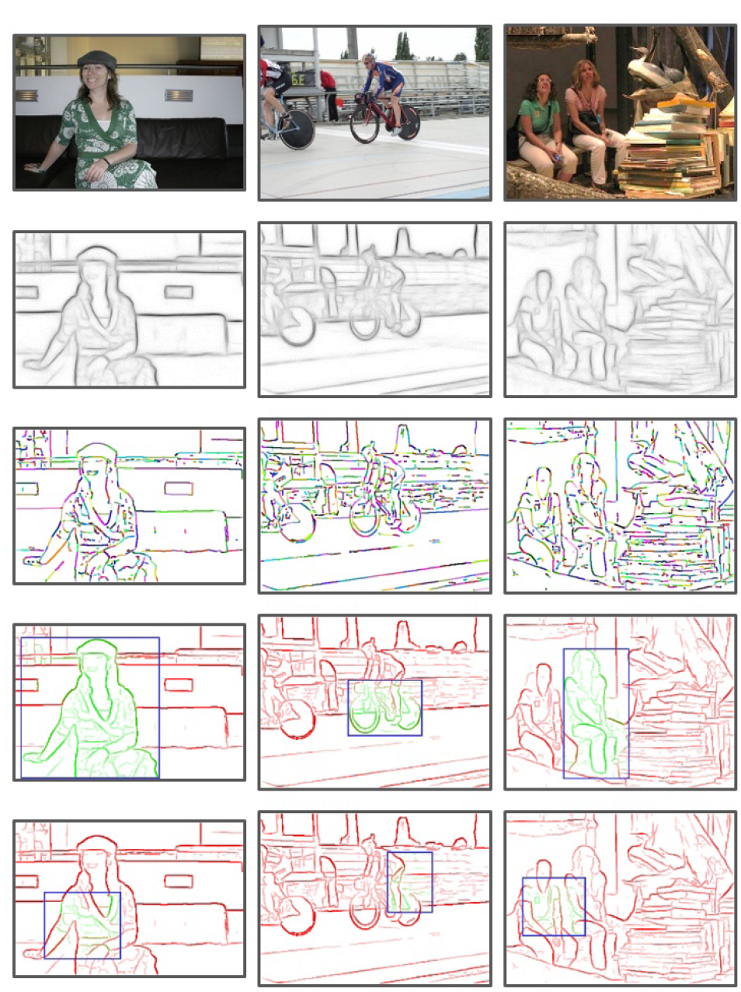
Another proposal method: EdgeBoxes
Box score: number of edges in the box minus number of edges that overlap the box boundary
Uses a trained edge detector
Uses efficient data structures (incl. integral images) for fast evaluation
Gets 75% recall with 800 boxes (vs. 1400 for Selective Search), is 40 times faster
C. Zitnick and P. Dollar, Edge Boxes: Locating Object Proposals from Edges, ECCV 2014

Slide 27
R-CNN: Region proposals + CNN features
Source: R. Girshick
SVMs
Classify regions with SVMs
SVMs
ConvNet
SVMs
ConvNet
Forward each region through ConvNet
ConvNet
Warped image regions
Region proposals
Input image
R. Girshick, J. Donahue, T. Darrell, and J. Malik, Rich Feature Hierarchies for Accurate Object Detection and Semantic Segmentation, CVPR 2014.
Notes:
The features are also sent to a linear regressor that improves object localization.
The components outlined in purple are “post hoc” in the sense that they are learned after the convnet weights are trained and forever frozen.

Slide 28
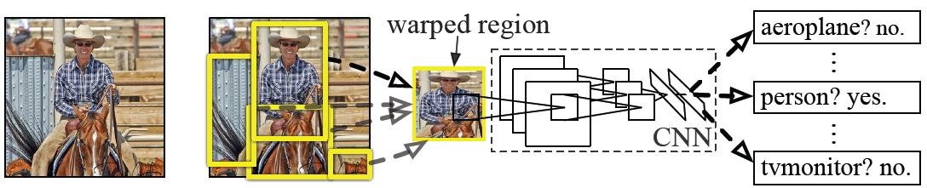
R-CNN details
Regions: ~2000 Selective Search proposals
Network: AlexNet pre-trained on ImageNet (1000 classes), fine-tuned on PASCAL (21 classes)
Final detector: warp proposal regions, extract fc7 network activations (4096 dimensions), classify with linear SVM
Bounding box regression to refine box locations
Performance: mAP of 53.7% on PASCAL 2010
(vs. 35.1% for Selective Search and 33.4% for Deformable Part Models)
Notes:
Object detection system overview. Our system (1) takes an input image, (2) extracts around 2000 bottom-up region proposals, (3) computes features for each proposal using a large convolutional neural network (CNN), and then (4) classifies each region using class-specific linear SVMs. R-CNN achieves a mean average precision (mAP) of 53.7% on PASCAL VOC 2010. For comparison, Uijlings et al. (2013) report 35.1% mAP using the same region proposals, but with a spatial pyramid and bag-of-visual-words approach. The popular deformable part models perform at 33.4%.

Slide 29
R-CNN pros and cons
Pros
  Accurate!
  Any deep architecture can immediately be “plugged in”
Cons
  Not a single end-to-end system
    Fine-tune network with softmax classifier (log loss)
    Train post-hoc linear SVMs (hinge loss)
    Train post-hoc bounding-box regressions (least squares)
  Training is slow (84h), takes a lot of disk space
    2000 CNN passes per image
  Inference (detection) is slow (47s / image with VGG16)

Slide 30
Fast R-CNN
Softmax classifier
Linear +
softmax
Linear
Bounding-box regressors
FCs
Fully-connected layers
RoI Pooling layer
Region proposals
Conv5 feature map of image
ConvNet
Forward whole image through ConvNet
Source: R. Girshick
R. Girshick, Fast R-CNN, ICCV 2015
Notes:
Rather than using post-hoc bounding-box regressors, bounding-box regression is implemented as an additional linear layer in the network

Slide 31
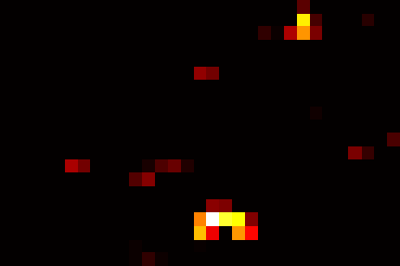
RoI pooling
“Crop and resample” a fixed-size feature representing a region of interest out of the outputs of the last conv layer
  Use nearest-neighbor interpolation of coordinates, max pooling
Conv feature map
RoI pooling layer
FC layers …
Region of Interest (RoI)
RoI feature
Source: R. Girshick, K. He

Slide 32
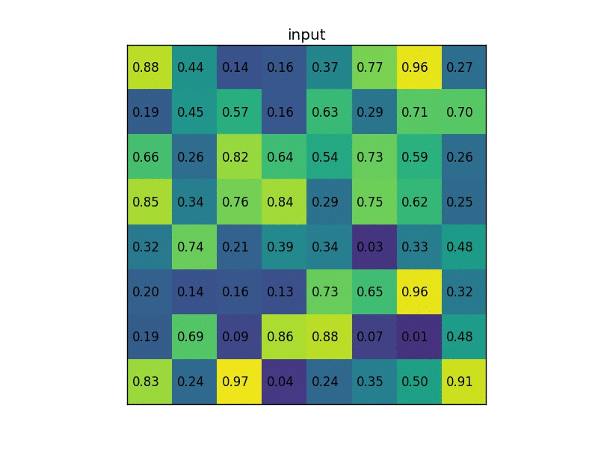
RoI pooling illustration
Image source

Slide 33
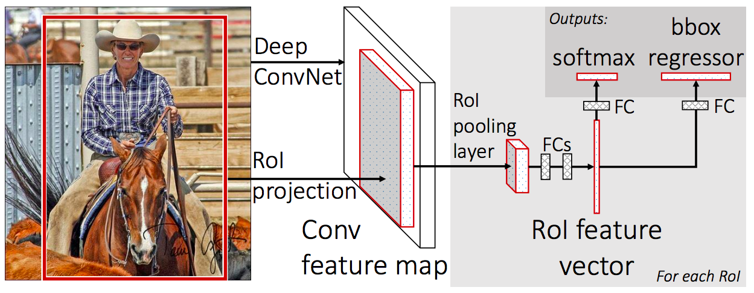
Prediction
For each RoI, network predicts probabilities for C+1 classes (class 0 is background) and four bounding box offsets for C classes
R. Girshick, Fast R-CNN, ICCV 2015

Slide 34
Fast R-CNN training
Log loss + smooth L1 loss
Multi-task loss
Linear +
softmax
Linear
FCs
Trainable
ConvNet
Source: R. Girshick
R. Girshick, Fast R-CNN, ICCV 2015
Notes:
Rather than using post-hoc bounding-box regressors, bounding-box regression is implemented as an additional linear layer in the network

Slide 35
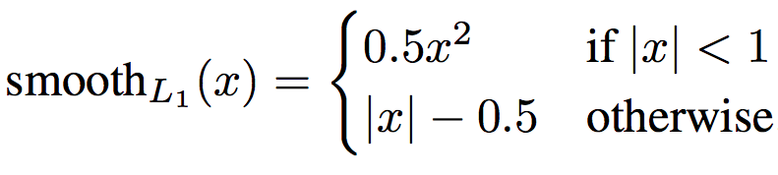
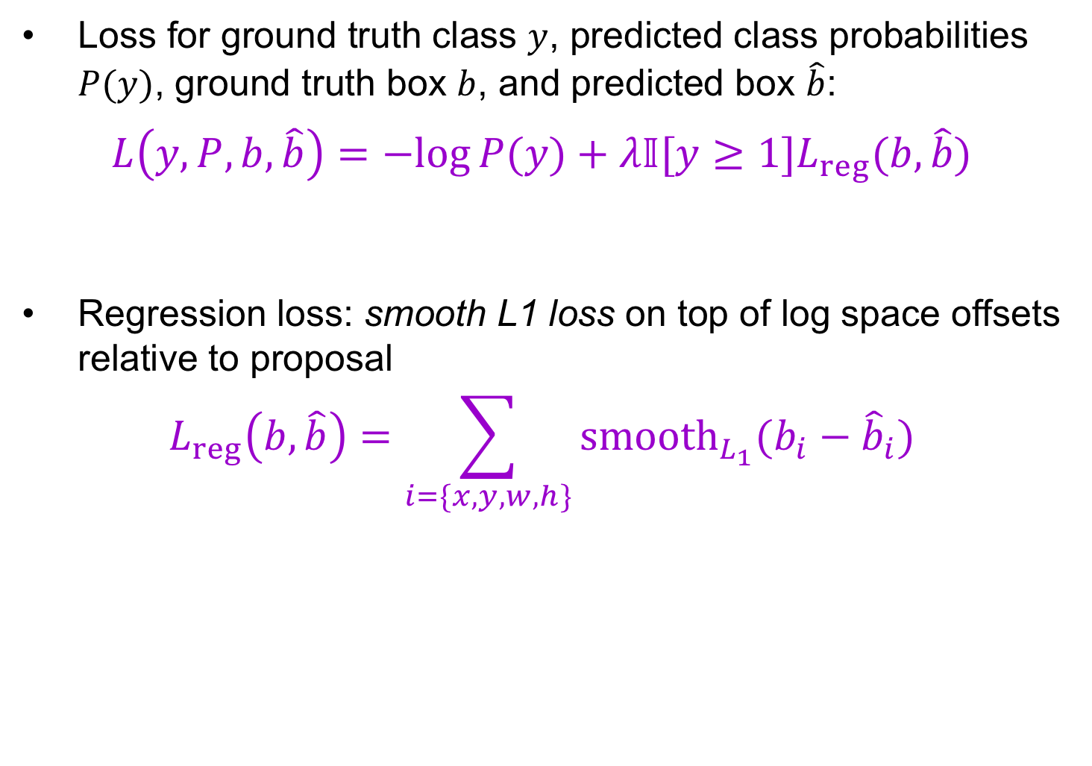
Multi-task loss
Loss for ground truth class $y$, predicted class probabilities $P(y)$, ground truth box $b$, and predicted box $\hat{b}$:
$$L\left(y, P, b,\hat{b}\right)=−log⁡P(y)+λ𝕀[y≥1]L_{reg}(b,\hat{b})$$
Regression loss: smooth L1 loss on top of log space offsets relative to proposal
$$L_{reg}\left(b,\hat{b}\right)=\sum_{i=\{x,y,w,h\}}{{smooth}_{L_{1}}(b_{i}−{\hat{b}}_{i}})$$
softmax loss
regression loss

Slide 36
Bounding box regression
Ground truth box
Target offset to predict*
Region proposal
(a.k.a default box, prior, reference, anchor)
Loss
Predicted offset
Predicted box
*Typically in transformed, normalized coordinates

Slide 37
Fast R-CNN results
 | Fast R-CNN | R-CNN
Train time (h) | 9.5 | 84
- Speedup | 8.8x | 1x
Test time / image | 0.32s | 47.0s
Test speedup | 146x | 1x
mAP | 66.9% | 66.0%
(vs. 53.7% for AlexNet)
Timings exclude object proposal time, which is equal for all methods.
All methods use VGG16 from Simonyan and Zisserman.
Source: R. Girshick
Notes:
These speed improvements do not sacrifice object detection accuracy. In fact, mean average precision is better than the baseline methods due to our improved training.

Slide 38
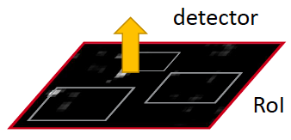
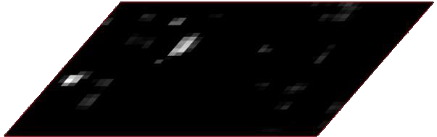
Faster R-CNN
Region proposals
Region Proposal Network
feature map
feature map
CNN
CNN
share features
S. Ren, K. He, R. Girshick, and J. Sun, Faster R-CNN: Towards Real-Time Object Detection with Region Proposal Networks, NIPS 2015

Slide 39
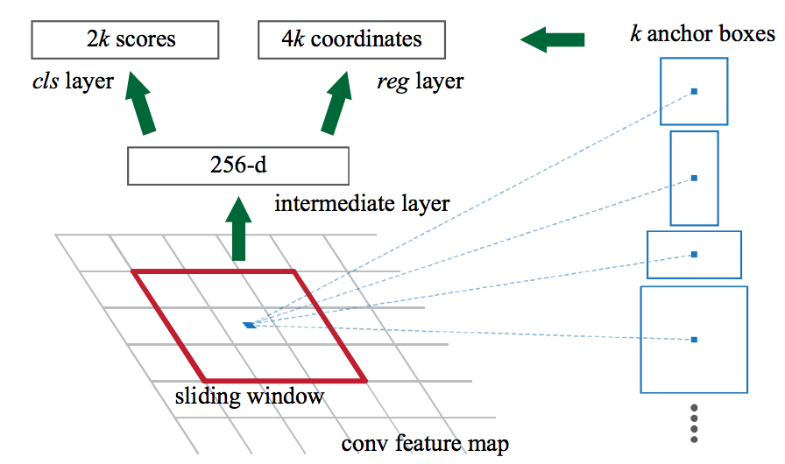
Region proposal network (RPN)
Slide a small window (3x3) over the conv5 layer
  Predict object/no object
  Regress bounding box coordinates with reference to anchors
  (3 scales x 3 aspect ratios)
Notes:
At each sliding-window location, we simultaneously predict multiple region proposals, where the number of maximum possible proposals for each location is denoted as k. So the reg layer has 4k outputs encoding the coordinates of k boxes, and the cls layer outputs 2k scores that estimate probability of object or not object for each proposal

Slide 40

One network, four losses
Classification loss
Bounding-box regression loss
…
Classification loss
Bounding-box regression loss
RoI pooling
proposals
Region Proposal Network
feature map
CNN
Source: R. Girshick, K. He
image

Slide 41
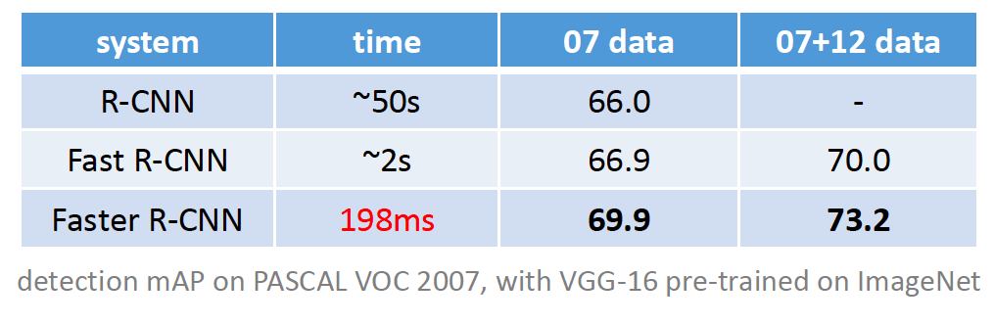
Faster R-CNN results

Slide 42
Object detection progress
Faster R-CNN
Fast R-CNN
Before CNNs
R-CNNv1
After CNNs

Slide 43
Streamlined detection architectures
The Faster R-CNN pipeline separates proposal generation and region classification:
Is it possible do detection in one shot?
Region Proposals
RPN
Classification + Regression
Conv feature map of the entire image
RoI features
Detections
RoI pooling
Classification + Regression
Conv feature map of the entire image
Detections

Slide 44
YOLO
Divide the image into a coarse grid and directly predict class label and a few candidate boxes for each grid cell
J. Redmon, S. Divvala, R. Girshick, and A. Farhadi, You Only Look Once: Unified, Real-Time Object Detection, CVPR 2016

Slide 45
YOLO
Take conv feature maps at 7x7 resolution
Add two FC layers to predict, at each location,
a score for each class and 2 bboxes w/ confidences
  For PASCAL, output is 7x7x30 (30 = 20 + 2*(4+1))
J. Redmon, S. Divvala, R. Girshick, and A. Farhadi, You Only Look Once: Unified, Real-Time Object Detection, CVPR 2016

Slide 46
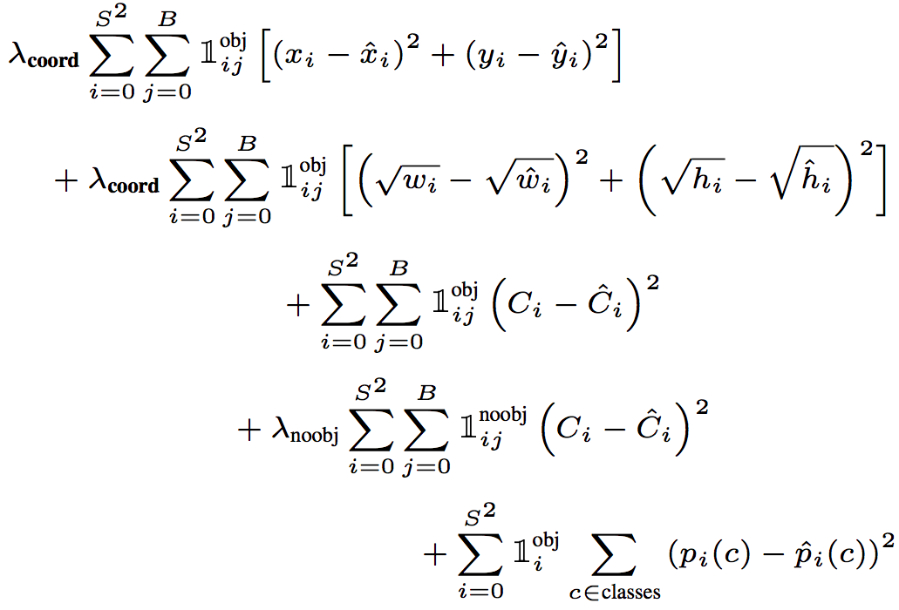
YOLO
Objective function:
Regression
Object/no object confidence
Class prediction
Notes:
At training time we only want one bounding box predictor to be responsible for each object. We assign one predictor to be “responsible” for predicting an object based on which prediction has the highest current IOU with the ground truth.

Slide 47

YOLO
Objective function:
Cell i contains object, predictor j is responsible for it
Small deviations matter less for larger boxes than for smaller boxes
Confidence for object
Confidence for no object
Down-weight loss from boxes that don’t contain objects ($λ_{noobj}=0.5)$
Class probability
Notes:
At training time we only want one bounding box predictor to be responsible for each object. We assign one predictor to be “responsible” for predicting an object based on which prediction has the highest current IOU with the ground truth.

Slide 48
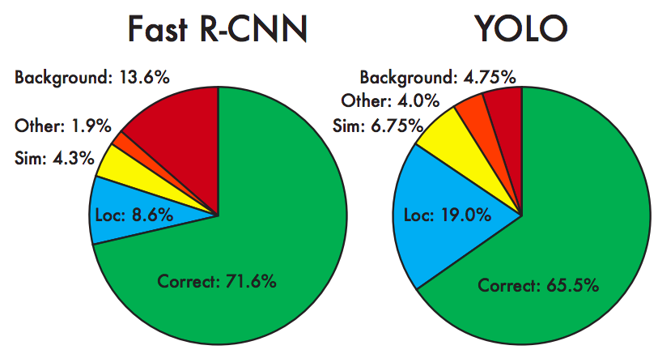
YOLO: Results
Each grid cell predicts only two boxes and can only have one class – this limits the number of nearby objects that can be predicted
Localization accuracy suffers compared to Fast(er) R-CNN due to coarser features, errors on small boxes
7x speedup over Faster R-CNN (45-155 FPS vs. 7-18 FPS)
Performance on PASCAL 2007

Slide 49
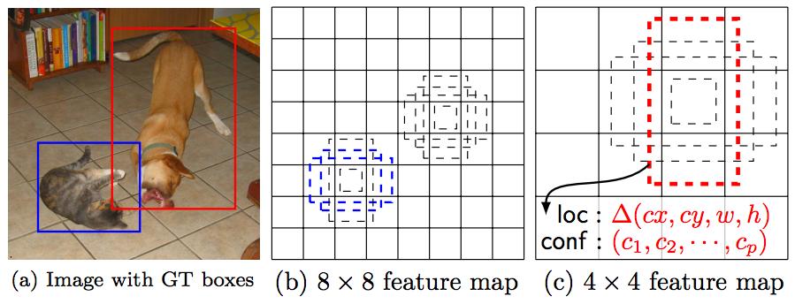
SSD
Similarly to RPN, use anchors and directly predict class-specific bounding boxes.
W. Liu, D. Anguelov, D. Erhan, C. Szegedy, S. Reed, C.-Y. Fu, and A. Berg, SSD: Single Shot MultiBox Detector, ECCV 2016.
Notes:
In a convolutional fashion, we evaluate a small set (e.g. 4) of default boxes of different aspect ratios at each location in several feature maps with different scales (e.g. 8 × 8 and 4 × 4 in (b) and (c)). For each default box, we predict both the shape offsets and the confidences for all object categories ((c1, c2, · · · , cp)). At training time, we first match these default boxes to the ground truth boxes. For example, we have matched two default boxes with the cat and one with the dog, which are treated as positives and the rest as negatives. The model loss is a weighted sum between localization loss (e.g. Smooth L1 [6]) and confidence loss (e.g. Softmax).

Slide 50
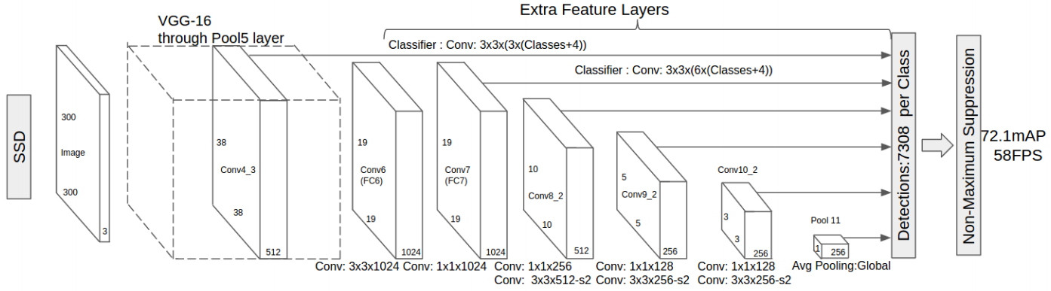
SSD
W. Liu, D. Anguelov, D. Erhan, C. Szegedy, S. Reed, C.-Y. Fu, and A. Berg, SSD: Single Shot MultiBox Detector, ECCV 2016.
Notes:
In a convolutional fashion, we evaluate a small set (e.g. 4) of default boxes of different aspect ratios at each location in several feature maps with different scales (e.g. 8 × 8 and 4 × 4 in (b) and (c)). For each default box, we predict both the shape offsets and the confidences for all object categories ((c1, c2, · · · , cp)). At training time, we first match these default boxes to the ground truth boxes. For example, we have matched two default boxes with the cat and one with the dog, which are treated as positives and the rest as negatives. The model loss is a weighted sum between localization loss (e.g. Smooth L1 [6]) and confidence loss (e.g. Softmax).

Slide 51

SSD: Results (PASCAL 2007)
More accurate and faster than YOLO and Faster R-CNN

Slide 52

YOLO v2
Remove FC layer, do convolutional prediction with anchor boxes instead
Increase resolution of input images and conv feature maps
Improve accuracy using batch normalization and other tricks
VOC 2007 results
YouTube demo
J. Redmon and A. Farhadi, YOLO9000: Better, Faster, Stronger, CVPR 2017

Slide 53

Newer benchmark: COCO
J. Huang et al., Speed/accuracy trade-offs for modern convolutional object detectors, CVPR 2017

Slide 54
Multi-resolution prediction
SSD predicts boxes of different size from different conv maps, but each level of resolution has its own predictors and higher-level context does not get propagated back to lower-level feature maps
Can we have a more elegant multi-resolution prediction architecture?

Slide 55
Feature Pyramid Networks
Tsung-Yi Lin, Piotr Dollar, Ross Girshick, Kaiming He, Bharath Hariharan, and Serge Belongie, Feature Pyramid Networks for Object Detection, CVPR 2017.
Notes:
In a convolutional fashion, we evaluate a small set (e.g. 4) of default boxes of different aspect ratios at each location in several feature maps with different scales (e.g. 8 × 8 and 4 × 4 in (b) and (c)). For each default box, we predict both the shape offsets and the confidences for all object categories ((c1, c2, · · · , cp)). At training time, we first match these default boxes to the ground truth boxes. For example, we have matched two default boxes with the cat and one with the dog, which are treated as positives and the rest as negatives. The model loss is a weighted sum between localization loss (e.g. Smooth L1 [6]) and confidence loss (e.g. Softmax).

Slide 56

Feature pyramid networks
Improve predictive power of lower-level feature maps by adding contextual information from higher-level feature maps
Predict different sizes of bounding boxes from different levels of the pyramid (but share parameters of predictors)
T.-Y. Lin, P. Dollar, R. Girshick, K. He, B. Hariharan, and S. Belongie, Feature pyramid networks for object detection, CVPR 2017.

Slide 57

RetinaNet
Combine feature pyramid network with focal loss to reduce the standard cross-entropy loss for well-classified examples
T.-Y. Lin, P. Goyal, R. Girshick, K. He, P. Dollar, Focal loss for dense object detection,
ICCV 2017.

Slide 58

RetinaNet
Combine feature pyramid network with focal loss to reduce the standard cross-entropy loss for well-classified examples
T.-Y. Lin, P. Goyal, R. Girshick, K. He, P. Dollar, Focal loss for dense object detection,
ICCV 2017.
Notes:
From the paper: (1) When an example is misclassified and pt is small, the modulating factor is near 1 and the loss is unaffected. As pt → 1, the factor goes to 0 and the loss for well-classified examples is down-weighted. (2) The focusing parameter γ smoothly adjusts the rate at which easy examples are downweighted. When γ = 0, FL is equivalent to CE, and as γ is increased the effect of the modulating factor is likewise increased (we found γ = 2 to work best in our experiments)

Slide 59

RetinaNet: Results
T.-Y. Lin, P. Goyal, R. Girshick, K. He, P. Dollar, Focal loss for dense object detection,
ICCV 2017.
Notes:
From the paper: Speed (ms) versus accuracy (AP) on COCO test-dev. Enabled by the focal loss, our simple one-stage RetinaNet detector outperforms all previous one-stage and two-stage detectors, including the best reported Faster R-CNN [28] system from [20]. We show variants of RetinaNet with ResNet-50-FPN (blue circles) and ResNet-101-FPN (orange diamonds) at five scales (400-800 pixels). Ignoring the low-accuracy regime (AP)

Slide 60

Deconvolutional SSD
Improve performance of SSD by increasing resolution through learned “deconvolutional” layers
C.-Y. Fu, W. Liu, A. Ranga, A. Tyagi, A. Berg, DSSD: Deconvolutional single-shot detector, arXiv 2017.

Slide 61

YOLO v3
https://pjreddie.com/media/files/papers/YOLOv3.pdf

Slide 62
Review: R-CNN
SVMs
Classify regions with SVMs
SVMs
ConvNet
SVMs
ConvNet
Forward each region through ConvNet
ConvNet
Warped image regions
Region proposals
Input image
R. Girshick, J. Donahue, T. Darrell, and J. Malik, Rich Feature Hierarchies for Accurate Object Detection and Semantic Segmentation, CVPR 2014.
Notes:
The features are also sent to a linear regressor that improves object localization.
The components outlined in purple are “post hoc” in the sense that they are learned after the convnet weights are trained and forever frozen.

Slide 63
Review: Fast R-CNN
Softmax classifier
Linear +
softmax
Linear
Bounding-box regressors
FCs
Fully-connected layers
“RoI Pooling” layer
Region proposals
“conv5” feature map of image
ConvNet
Forward whole image through ConvNet
R. Girshick, Fast R-CNN, ICCV 2015
Notes:
Rather than using post-hoc bounding-box regressors, bounding-box regression is implemented as an additional linear layer in the network

Slide 64
Review: Faster R-CNN
Region proposals
Region Proposal Network
feature map
feature map
CNN
CNN
share features
S. Ren, K. He, R. Girshick, and J. Sun, Faster R-CNN: Towards Real-Time Object Detection with Region Proposal Networks, NIPS 2015

Slide 65
Review: RPN
Slide a small window (3x3) over the conv5 layer
  Predict object/no object
  Regress bounding box coordinates with reference to anchors
  (3 scales x 3 aspect ratios)
Notes:
At each sliding-window location, we simultaneously predict multiple region proposals, where the number of maximum possible proposals for each location is denoted as k. So the reg layer has 4k outputs encoding the coordinates of k boxes, and the cls layer outputs 2k scores that estimate probability of object or not object for each proposal

Slide 66
Review: YOLO
Take 7x7 conv feature map
Add two FC layers to predict, at each location, a score for each class and 2 bboxes w/ confidences
  For PASCAL, output is 7x7x30
  (30 = 20 + 2*(4+1))
J. Redmon, S. Divvala, R. Girshick, and A. Farhadi, You Only Look Once: Unified, Real-Time Object Detection, CVPR 2016

Slide 67
Review: SSD
W. Liu, D. Anguelov, D. Erhan, C. Szegedy, S. Reed, C.-Y. Fu, and A. Berg, SSD: Single Shot MultiBox Detector, ECCV 2016.
Notes:
In a convolutional fashion, we evaluate a small set (e.g. 4) of default boxes of different aspect ratios at each location in several feature maps with different scales (e.g. 8 × 8 and 4 × 4 in (b) and (c)). For each default box, we predict both the shape offsets and the confidences for all object categories ((c1, c2, · · · , cp)). At training time, we first match these default boxes to the ground truth boxes. For example, we have matched two default boxes with the cat and one with the dog, which are treated as positives and the rest as negatives. The model loss is a weighted sum between localization loss (e.g. Smooth L1 [6]) and confidence loss (e.g. Softmax).

Slide 68
Summary: Object detection with CNNs
R-CNN: region proposals + CNN on cropped, resampled regions
Fast R-CNN: region proposals + RoI pooling on top of a conv feature map
Faster R-CNN: RPN + RoI pooling
Next generation of detectors
  Direct prediction of BB offsets, class scores on top of conv feature maps
  Get better context by combining feature maps at multiple resolutions

Slide 69


Instance segmentation
Evaluation
Average Precision like detection, except region IoU as opposed to box IoU.
B. Hariharan et al., Simultaneous Detection and Segmentation, ECCV 2014

Slide 70

Mask R-CNN
Mask R-CNN = Faster R-CNN + FCN on RoIs
Classification+regression branch
Mask branch: separately predict segmentation for each possible class
K. He, G. Gkioxari, P. Dollar, and R. Girshick, Mask R-CNN,
ICCV 2017 (Best Paper Award)

Slide 71

RoIAlign vs. RoIPool
RoIPool: nearest neighbor quantization
K. He, G. Gkioxari, P. Dollar, and R. Girshick, Mask R-CNN,
ICCV 2017 (Best Paper Award)

Slide 72

RoIAlign vs. RoIPool
RoIPool: nearest neighbor quantization
RoIAlign: bilinear interpolation
K. He, G. Gkioxari, P. Dollar, and R. Girshick, Mask R-CNN,
ICCV 2017 (Best Paper Award)

Slide 73

Mask R-CNN
From RoIAlign features, predict class label, bounding box, and segmentation mask
Feature Pyramid Networks (FPN) architecture
K. He, G. Gkioxari, P. Dollar, and R. Girshick, Mask R-CNN,
ICCV 2017 (Best Paper Award)

Slide 74

Mask R-CNN
K. He, G. Gkioxari, P. Dollar, and R. Girshick, Mask R-CNN,
ICCV 2017 (Best Paper Award)

Slide 75

Example results

Slide 76

Example results

Slide 77

Instance segmentation results on COCO
AP at different IoU thresholds
AP for different size instances
K. He, G. Gkioxari, P. Dollar, and R. Girshick, Mask R-CNN,
ICCV 2017 (Best Paper Award)

Slide 78
Unifying Semantic and Instance Segm.
Alexander Kirillov, Kaiming He, Ross Girshick, Carsten Rother, Piotr Dollár, Panoptic Segmentation, CVPR 2019.

Slide 79

Keypoint prediction
Given K keypoints, train model to predict K
m x m one-hot maps

