Slide 1
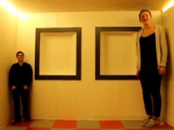
Perspective Projection
CS 543 / ECE 549
Video source: Camera Obscura & World of Illusions
Many slides adapted from S. Seitz, L. Lazebnik, B. Hariharan.

Slide 2
Overview of next two lectures
The pinhole projection model
  Geometric properties
  Perspective projection matrix
Cameras with lenses
  Depth of focus
  Field of view
  Lens aberrations
Digital sensors

Slide 3
Let’s design a camera
Idea 1: put a piece of film in front of an object
Do we get a reasonable image?
Slide by Steve Seitz

Slide 4
Pinhole camera
Add a barrier to block off most of the rays
Slide by Steve Seitz
Notes:
It gets inverted

Slide 5
Pinhole camera
Captures pencil of rays – all rays through a single point: aperture, center of projection, optical center, focal point, camera center
The image is formed on the image plane
Slide by Steve Seitz

Slide 6
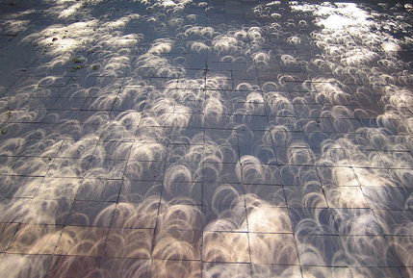
Pinhole cameras are everywhere
Tree shadow during a solar eclipse
photo credit: Nils van der Burg
http://www.physicstogo.org/index.cfm
Slide by Steve Seitz

Slide 7
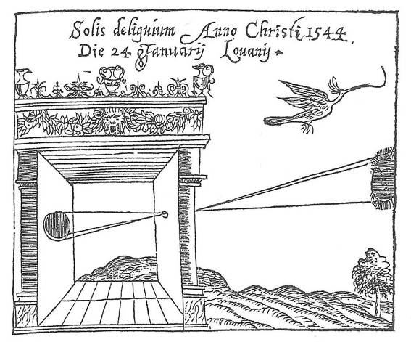
Camera obscura
Basic principle known to Mozi (470-390 BCE), Aristotle (384-322 BCE)
Drawing aid for artists: described by Leonardo da Vinci (1452-1519)
Gemma Frisius, 1558
Slide by L. Lazebnik.
Image source

Slide 8
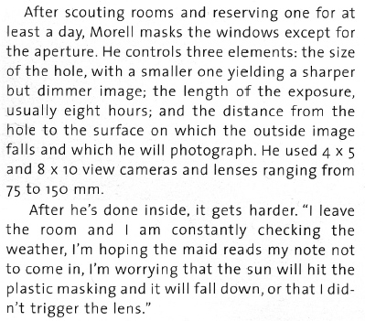
Turning a room into a camera obscura
From Grand Images Through a Tiny Opening, Photo District News, February 2005
Camera Obscura: View of Central Park Looking West in Bedroom. Summer, 2018
http://www.abelardomorell.net/project/camera-obscura/
Adapted from L. Lazebnik.

Slide 9
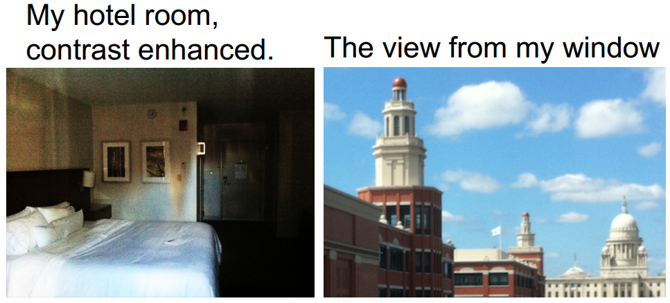
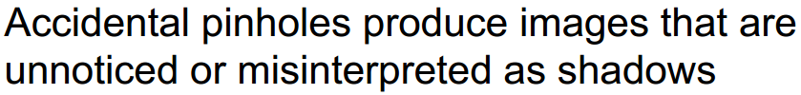
Turning a room into a camera obscura
A. Torralba and W. Freeman, Accidental Pinhole and Pinspeck Cameras, CVPR 2012
Slide by L. Lazebnik.

Slide 10
Pinhole projection model
P
O
p
To compute the projection p of a scene point P, form the visual ray connecting P to the camera center O and find where it intersects the image plane
Slide by L. Lazebnik.

Slide 11
Pinhole projection model
P
y
z
O
x
p
The coordinate system
  The optical center (O) is at the origin
  The image plane is parallel to xy-plane or perpendicular to the z-axis, which is the optical axis
Slide by L. Lazebnik.

Slide 12
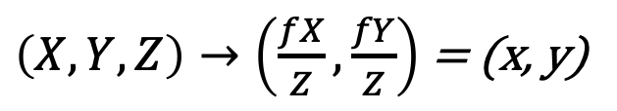
Pinhole projection model
P
Y
f
Z
O
y
p
Projection equations
  Derived using similar triangles
$\left(X,Y,Z\right)→\left(\frac{fX}{Z},\frac{fY}{Z}\right)$ = (x, y)
Note: instead of dealing with an image that is upside down, most of the time we will pretend that the image plane is in front of the camera center.
Slide by L. Lazebnik.

Slide 13
Dimensionality reduction: from 3D to 2D
3D world
2D image
What properties of the world are preserved?
  Straight Lines
  Angles between lines
  Incidence
  Lengths
  Parallel Lines
  Ratio of lengths
Slide by A. Efros
Figures © Stephen E. Palmer, 2002

Slide 14
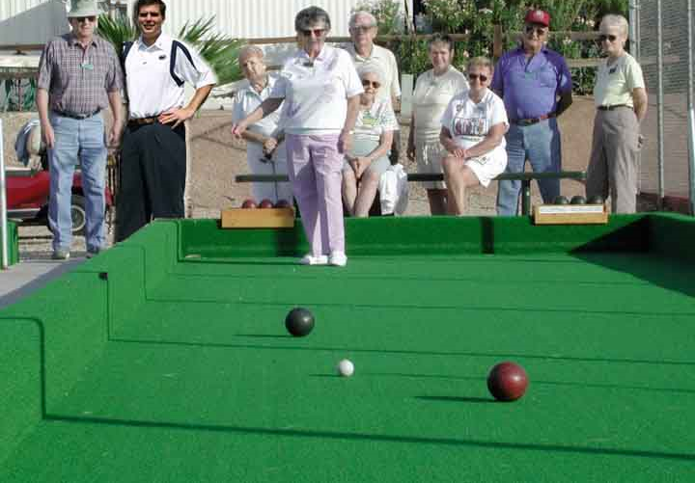
Properties of projection
Who is taller?
Which is closer?
Slide by Derek Hoiem

Slide 15
Properties of projection
Parallel?
Perpendicular?
Slide by Derek Hoiem

Slide 16
Vanishing Point

Slide 17

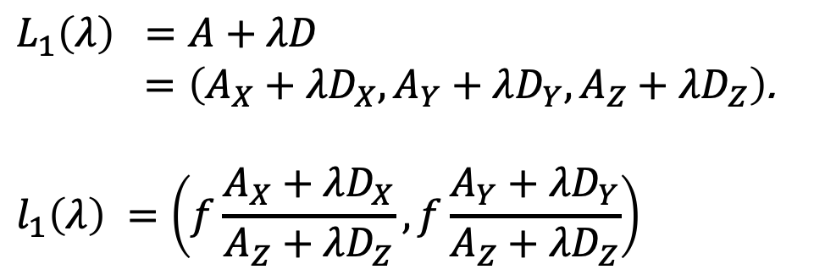
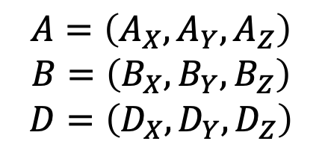
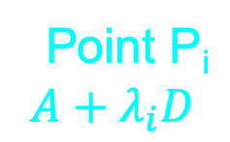
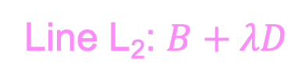
Parallel lines converge at a point
Point P_{i}
$$A+λ_{i}D$$
Line L₁: $A+λD$
Line L₂: $B+λD$
$$L_{1}\left(λ\right) =A+λD$$
$=\left(A_{X}+λD_{X},A_{Y}+λD_{Y},A_{Z}+λD_{Z}\right)$.
$$l_{1}\left(λ\right) =\left(f\frac{A_{X}+λD_{X}}{A_{Z}+λD_{Z}}, f\frac{A_{Y}+λD_{Y}}{A_{Z}+λD_{Z}}\right)$$
$$A=\left(A_{X}, A_{Y}, A_{Z}\right)$$
$$B=\left(B_{X}, B_{Y}, B_{Z}\right)$$
$$D=\left(D_{X}, D_{Y}, D_{Z}\right)$$
Adapted from B. Hariharan.

Slide 18
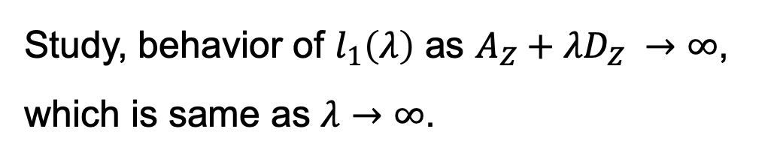
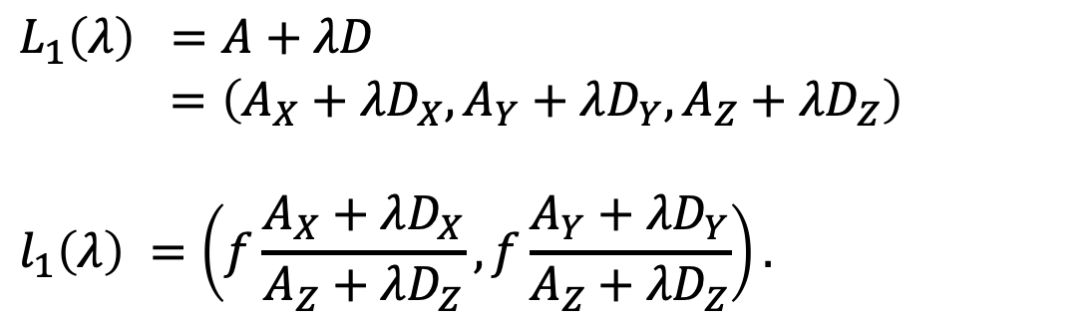
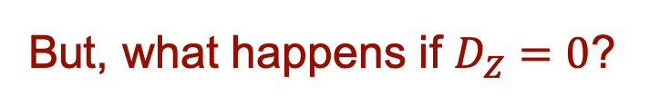
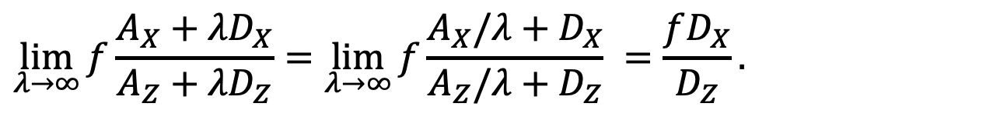
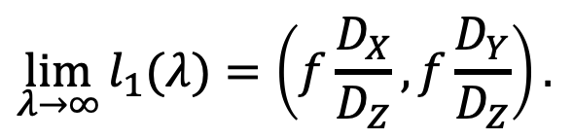
Parallel lines converge at a point
$$L_{1}\left(λ\right) =A+λD$$
$=\left(A_{X}+λD_{X},A_{Y}+λD_{Y},A_{Z}+λD_{Z}\right)$
$$l_{1}\left(λ\right) =\left(f\frac{A_{X}+λD_{X}}{A_{Z}+λD_{Z}},f\frac{A_{Y}+λD_{Y}}{A_{Z}+λD_{Z}}\right).$$
Study, behavior of $l_{1}\left(λ\right)$ as $A_{Z}+λD_{Z} →∞$,
which is same as $λ→∞$.
$$\lim_{λ→∞}{f\frac{A_{X}+λD_{X}}{A_{Z}+λD_{Z}}=\lim_{λ→∞}{f\frac{A_{X}/λ+D_{X}}{A_{Z}/λ+D_{Z}} }}=\frac{fD_{X}}{D_{Z}}.$$
$$\lim_{λ→∞}{l_{1}(λ)}=\left(f\frac{D_{X}}{D_{Z}},f\frac{D_{Y}}{D_{Z}}\right).$$
But, what happens if $D_{Z}=0$?
Adapted from B. Hariharan.

Slide 19
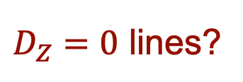
Parallel lines converge at a point
$D_{Z}=0$ lines?
Adapted from B. Hariharan.

Slide 20

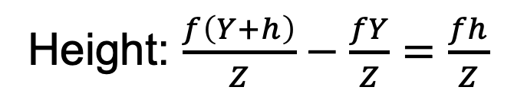
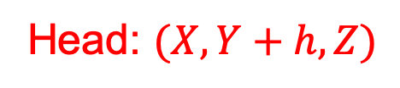
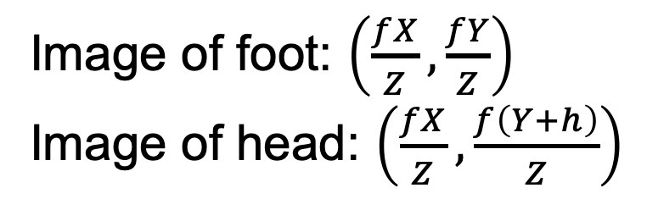
Farther away objects are smaller
Head: $(X, Y+h, Z)$
Foot: $(X, Y, Z)$
Image of foot: $\left(\frac{fX}{Z},\frac{fY}{Z}\right)$
Image of head: $\left(\frac{fX}{Z},\frac{f\left(Y+h\right)}{Z}\right)$
Height: $\frac{f\left(Y+h\right)}{Z}−\frac{fY}{Z}=\frac{fh}{Z}$
Adapted from B. Hariharan.

Slide 21
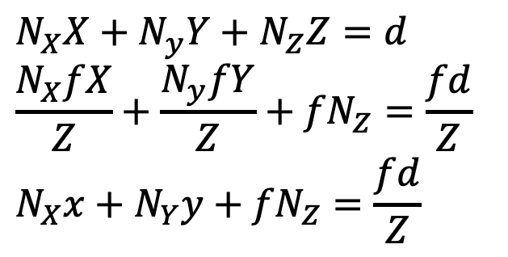
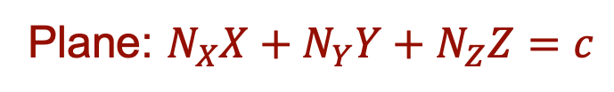
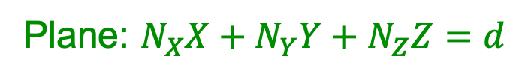
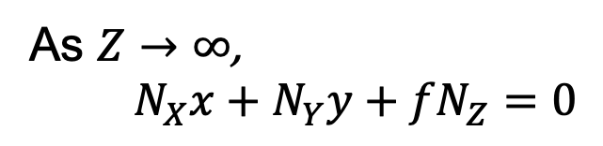
What about planes?
Plane: $N_{X}X+N_{Y}Y+N_{Z}Z=c$
Plane: $N_{X}X+N_{Y}Y+N_{Z}Z=d$
$$N_{X}X+N_{y}Y+N_{Z}Z=d$$
$$\frac{N_{X}fX}{Z}+\frac{N_{y}fY}{Z}+{fN}_{Z}=\frac{fd}{Z}$$
$$N_{X}x+N_{Y}y+{fN}_{Z}=\frac{fd}{Z}$$
As $Z→∞$,
$N_{X}x+N_{Y}y+{fN}_{Z}=0$
Planes vanish into a line.
Parallel planes vanish into the same line.
Adapted from B. Hariharan.

Slide 22
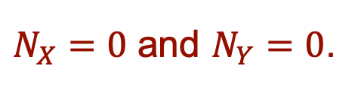
Except?
$N_{X}=0$ and $N_{Y}=0$.
Fronto-parallel plane.

Slide 23
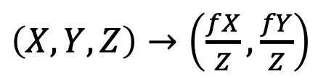
Fronto-parallel planes
What happens to the projection of a pattern on a plane parallel to the image plane?
  All points on that plane are at a fixed depth z
  The pattern gets scaled by a factor of f / z, but angles and ratios of lengths/areas are preserved
$\left(X,Y,Z\right)→\left(\frac{fX}{Z},\frac{fY}{Z}\right)$
Slide from L. Lazebnik

Slide 24





Horizon: Vanishing line of ground plane
$$N_{X}x+N_{Y}y+{fN}_{Z}=0$$
camera
$$y=0$$
$$h$$
$$A$$
$$a$$
Ground plane

Slide 25

Vanishing lines of planes
  Is the parachutist above or below the camera?
Image source: S. Seitz
Notes:
Is this parachutist higher or lower than the person taking this picture?
Lower - below the horizon

Slide 26

Comparing heights
Vanishing
Point
Slide by Steve Seitz

Slide 27

Measuring height
5.4
5
Camera height
4
3.3
3
2.8
2
1
What is the height of the camera?
Slide by Steve Seitz

Slide 28



Horizon: Vanishing line of ground plane
  Horizon: vanishing line of the ground plane
    All points at the same height as the camera project to the horizon
    Points higher (resp. lower) than the camera project above (resp. below) the horizon
    Provides way of comparing height of objects
camera
$$h$$
$$A$$
$$a$$
Ground plane
Adapted from Steve Seitz

Slide 29

Horizon: Vanishing line of ground plane
$$N_{X}x+N_{Y}y+{fN}_{Z}=0$$
camera
$$y=0$$
$$h$$
$$A$$
$$a$$
Ground plane
camera
$$h$$
$$A$$
$$a$$
Ground plane

Slide 30
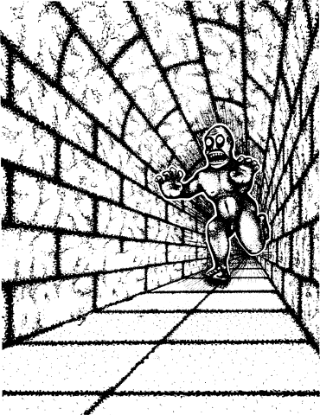

Fun with Projective Geometry
Illusion Credit: RN Shepard, Mind Sights: Original Visual Illusions, Ambiguities, and other Anomalies

Slide 31
Perspective distortion
What is the shape of the projection of a sphere?
Image source: F. Durand

Slide 32
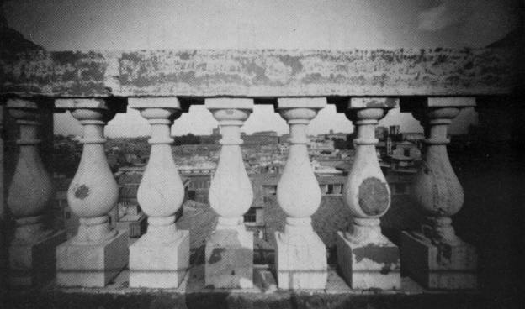
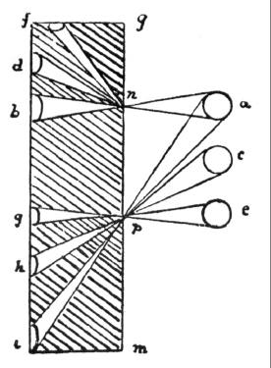
Perspective distortion
Are the widths of the projected columns equal?
  The exterior columns are wider
  This is not an optical illusion, and is not due to lens flaws
  Phenomenon pointed out by Da Vinci
Source: F. Durand

Slide 33

Perspective distortion: People
Slide from L. Lazebnik

Slide 34

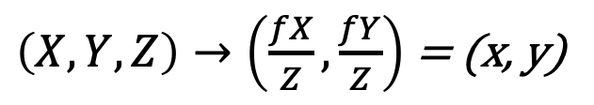
Modeling projection
y
f
z
x
$\left(X,Y,Z\right)→\left(\frac{fX}{Z},\frac{fY}{Z}\right)$ = (x, y)
Projection equation:
Note: instead of dealing with an image that is upside down, most of the time we will pretend that the image plane is in front of the camera center.
Source: J. Ponce, S. Seitz
Notes:
The camera projection scales the apparent height of objects by the inverse of the depth. This results in the well-known effect that objects farther away from the camera look smaller.
We don’t care that the image is upside down: we can simply pretend that the image plane is in front of the camera center.

Slide 35




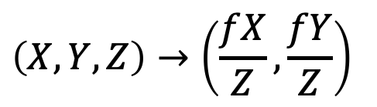
Homogeneous coordinates
$$\left(X,Y,Z\right)→\left(\frac{fX}{Z},\frac{fY}{Z}\right)$$
Is this a linear transformation?
Trick: add one more coordinate:
  no—division by z is nonlinear
homogeneous image
coordinates
homogeneous scene
coordinates
Converting from homogeneous coordinates
Slide by Steve Seitz

Slide 36
Perspective Projection Matrix
Projection is a matrix multiplication using homogeneous coordinates
divide by the third coordinate
In practice: lots of coordinate transformations…
World to
camera coord.
trans. matrix
(4x4)
3D
point
(4x1)
2D
point
(3x1)
Camera to
pixel coord.
trans. matrix
(3x3)
Perspective
projection matrix
(3x4)
=
Slide from L. Lazebnik

Slide 37
Orthographic Projection
Special case of perspective projection
  Distance from center of projection to image plane is infinite
  Also called “parallel projection”
Image
World
Slide by Steve Seitz
Notes:
Is this a linear function?

Slide 38
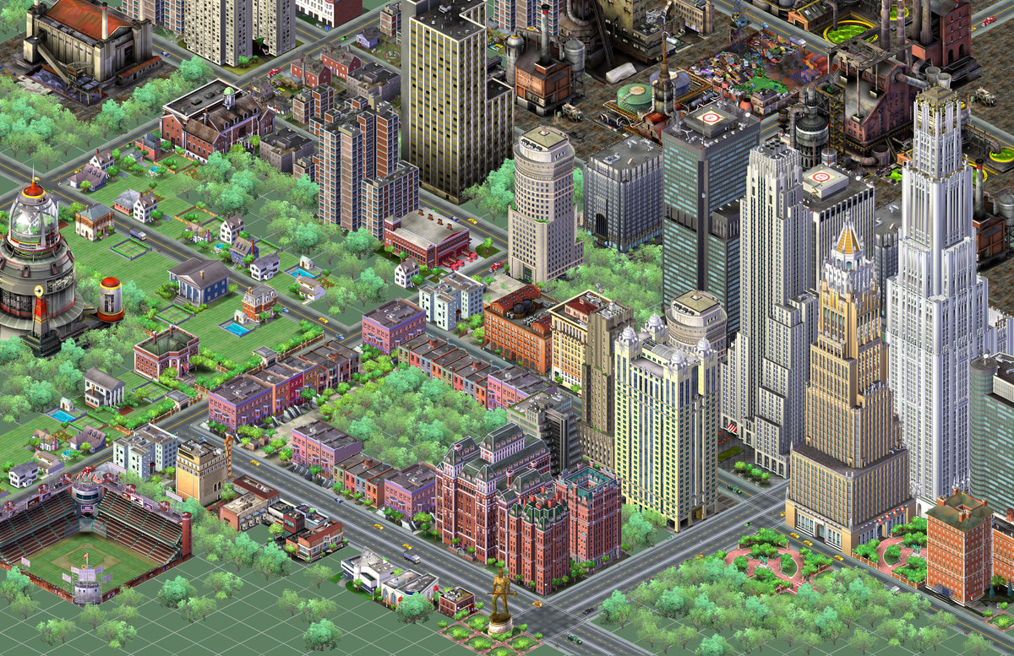
Orthographic Projection
Special case of perspective projection
  Distance from center of projection to image plane is infinite
  Also called “parallel projection”
Slide from L. Lazebnik
Notes:
Is this a linear function?

Slide 39
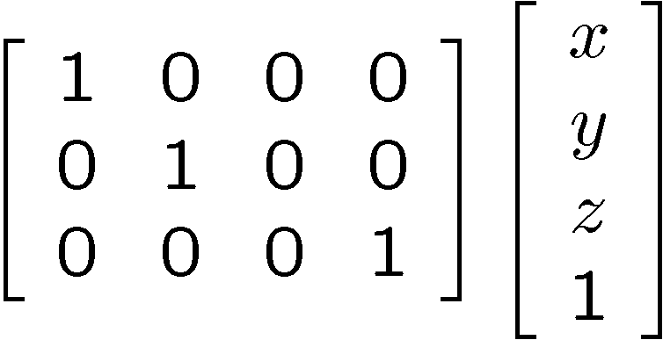
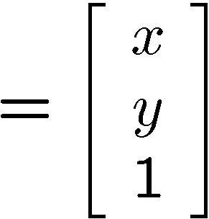

Orthographic Projection
Special case of perspective projection
  Distance from center of projection to image plane is infinite
  Also called “parallel projection”
  What’s the projection matrix?
Image
World
Slide by Steve Seitz
Notes:
Is this a linear function?

Slide 40



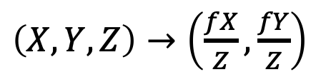
Recap
P
Y
f
Z
O
y
$\left(X,Y,Z\right)→\left(\frac{fX}{Z},\frac{fY}{Z}\right)$
p
Notes:
It gets inverted

Slide 41
Perspective Projection
Video source: Camera Obscura & World of Illusions

