Slide 1


Linear filtering
Slides from Lana Lazebnik

Slide 2
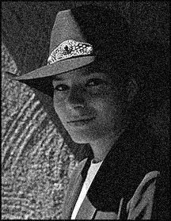
Motivation: Image denoising
How can we reduce noise in a photograph?
Slide from Lana Lazebnik
Notes:
Answer: take lots of images, average them

Slide 3

Moving average
Let’s replace each pixel with a weighted average of its neighborhood
The weights are called the filter kernel
What are the weights for the average of a
3x3 neighborhood?
1
1
1
1
1
1
1
1
1
“box filter”
Source: D. Lowe

Slide 4


Defining convolution
Let f be the image and g be the kernel. The output of convolving f with g is denoted f * g.
f
Convention:
kernel is “flipped”
Source: F. Durand
Notes:
If we want to know the value of the filtered image at any location, we overlay the filter kernel over the image centered at that location, multiply the image values by the corresponding kernel values, and sum the result. To produce the entire filtered output image, we slide the filter kernel over every location and perform this operation.

Slide 5
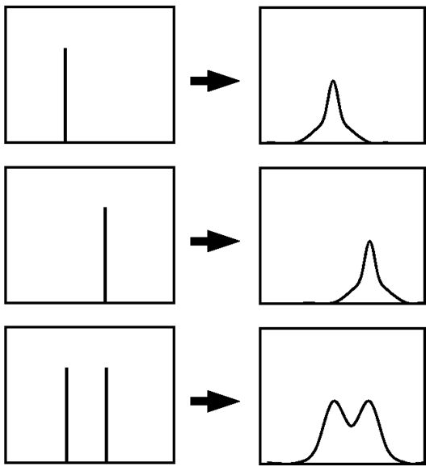
Key properties
Shift invariance: same
behavior regardless of
pixel location:
filter(shift(f)) = shift(filter(f))
Linearity:
filter(f₁ + f₂) =
filter(f₁) + filter(f₂)
Theoretical result: any linear shift-invariant operator can be represented as a convolution
Slide from Lana Lazebnik

Slide 6
Properties in more detail
Commutative: a * b = b * a
  Conceptually no difference between filter and signal
Associative: a * (b * c) = (a * b) * c
  Often apply several filters one after another: (((a * b₁) * b₂) * b₃)
  This is equivalent to applying one filter: a * (b₁ * b₂ * b₃)
Distributes over addition: a * (b + c) = (a * b) + (a * c)
Scalars factor out: ka * b = a * kb = k (a * b)
Identity: unit impulse e = […, 0, 0, 1, 0, 0, …],
a * e = a
Slide from Lana Lazebnik

Slide 7
Dealing with edges
If we convolve image f with filter g, what is the size of the output?
Output is smaller than input
Output is same size as input
Output is larger than input
g
g
g
g
f
g
g
f
f
g
g
g
g
g
g
Slide from Lana Lazebnik

Slide 8
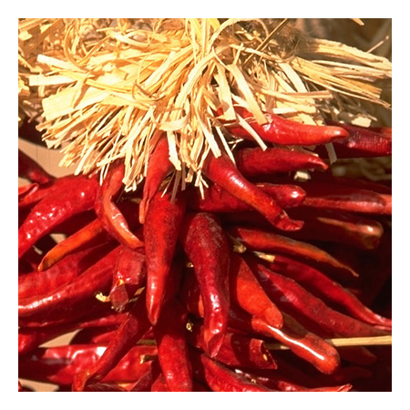
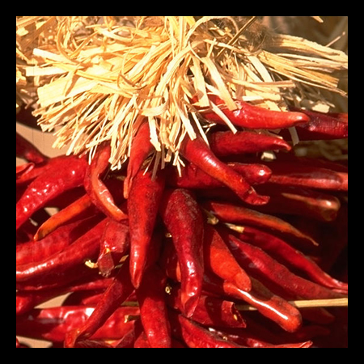

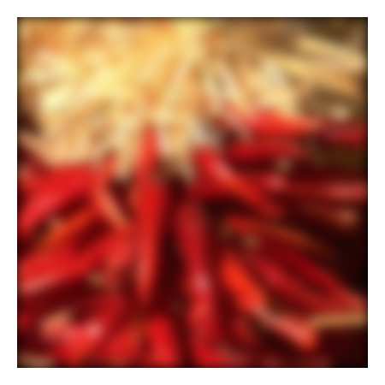


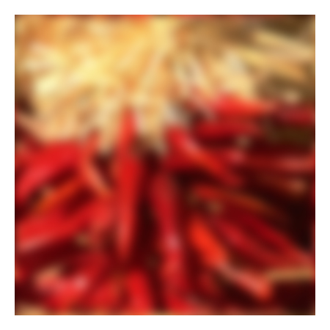






Dealing with edges
If the filter window falls off the edge of the image, we need to pad the image
  Zero pad (or clip filter)
  Wrap around
  Copy edge
  Reflect across edge
Source: S. Marschner

Slide 9

Practice with linear filters
0
0
0
?
0
1
0
0
0
0
Original
Source: D. Lowe

Slide 10
Practice with linear filters
0
0
0
0
1
0
0
0
0
Original
Filtered
(no change)
Source: D. Lowe

Slide 11
Practice with linear filters
0
0
0
?
0
0
1
0
0
0
Original
Source: D. Lowe

Slide 12
Practice with linear filters
0
0
0
0
0
1
0
0
0
Original
Shifted left
By 1 pixel
Source: D. Lowe

Slide 13
Practice with linear filters
1
1
1
?
1
1
1
1
1
1
Original
Source: D. Lowe

Slide 14
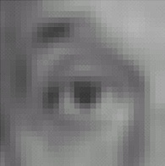
Practice with linear filters
1
1
1
1
1
1
1
1
1
Original
Blur (with a
box filter)
Source: D. Lowe

Slide 15
Practice with linear filters
0
0
0
-
1
1
1
?
0
2
0
1
1
1
0
0
0
1
1
1
(Note that filter sums to 1)
Original
Source: D. Lowe

Slide 16

Practice with linear filters
0
0
0
-
1
1
1
0
2
0
1
1
1
0
0
0
1
1
1
Original
Sharpening filter
  Accentuates differences with local average
Source: D. Lowe

Slide 17

Sharpening
Source: D. Lowe

Slide 18
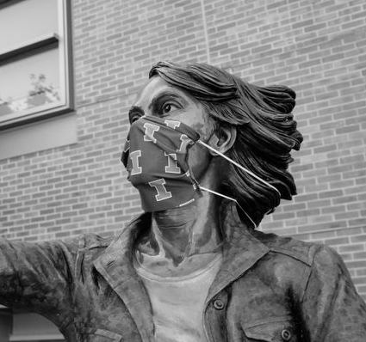

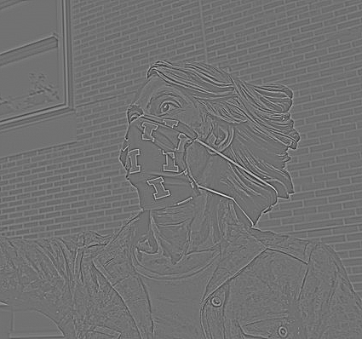
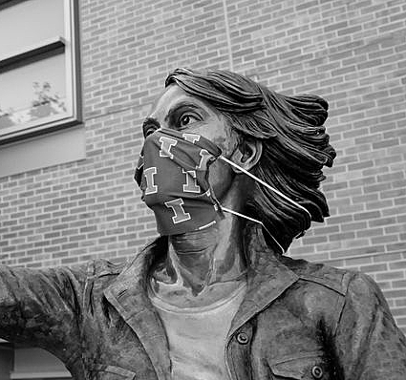
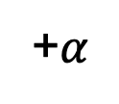
Sharpening
What does blurring take away?
Original
Smoothed
Detail
–
=
Let’s add it back in.
Original
Detail
Sharpened
+$α$
=

Slide 19

Smoothing with box filter revisited
What’s wrong with this picture?
What’s the solution?
Source: D. Forsyth

Slide 20
Smoothing with box filter revisited
What’s wrong with this picture?
What’s the solution?
  To eliminate edge effects, weight contribution of neighborhood pixels according to their closeness to the center
“fuzzy blob”
Slide from Lana Lazebnik

Slide 21

Gaussian Kernel
0.003 0.013 0.022 0.013 0.003
0.013 0.059 0.097 0.059 0.013
0.022 0.097 0.159 0.097 0.022
0.013 0.059 0.097 0.059 0.013
0.003 0.013 0.022 0.013 0.003
5 x 5, σ = 1
Constant factor at front makes volume sum to 1 (can be ignored when computing the filter values, as we should renormalize weights to sum to 1 in any case)
Source: C. Rasmussen

Slide 22
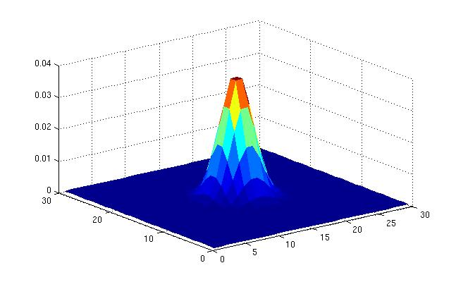
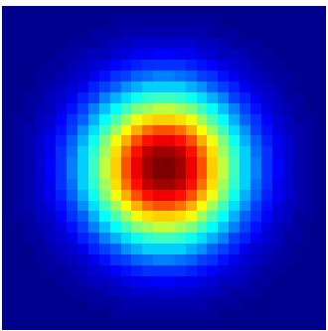
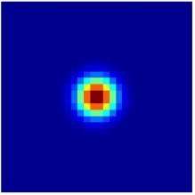
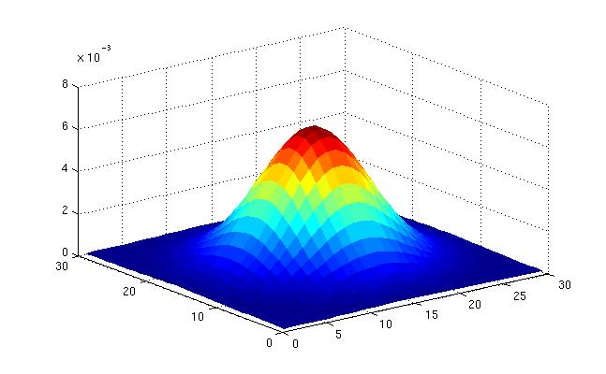
Gaussian Kernel
σ = 2 with 30 x 30 kernel
σ = 5 with 30 x 30 kernel
Standard deviation σ: determines extent of smoothing
Source: K. Grauman

Slide 23
Choosing kernel width
The Gaussian function has infinite support, but discrete filters use finite kernels
Source: K. Grauman

Slide 24
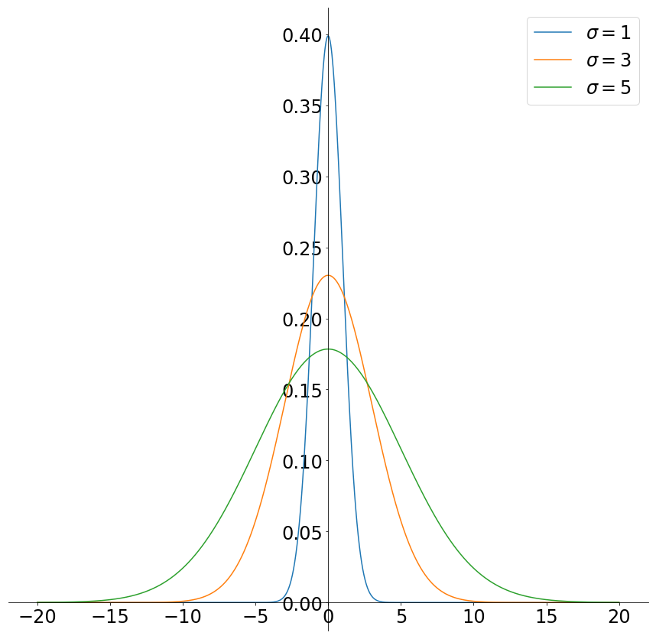
Choosing kernel width
Rule of thumb: set filter half-width to about 3σ

Slide 25
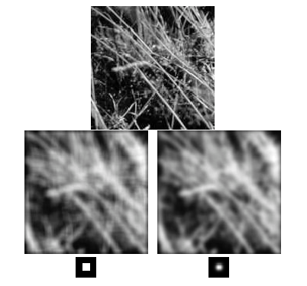
Gaussian vs. box filtering
Slide from Lana Lazebnik

Slide 26
Gaussian filters
Remove high-frequency components from the image (low-pass filter)
Convolution with self is another Gaussian
  So can smooth with small-σ kernel, repeat, and get same result as larger-σ kernel would have
  Convolving two times with Gaussian kernel with std. dev. σ
  is same as convolving once with kernel with std. dev.
Separable kernel
  Factors into product of two 1D Gaussians
  Discrete example:
Source: K. Grauman
Notes:
Linear vs. quadratic in mask size

Slide 27
Separability of the Gaussian filter
The 2D Gaussian can be expressed as the product of two functions, one a function of x and the other a function of y.
In this case the two functions are the (identical) 1D Gaussian.
Source: D. Lowe
Notes:
G_\sigma (x,y) &= \frac{1}{2\pi\sigma^2}e^{-\left(\frac{x^2+y^2}{2\sigma^2}\right)} \\
&= \left(\frac{1}{\sqrt{2\pi\sigma^2}}e^{-\frac{x^2}{2\sigma^2}}\right) \left(\frac{1}{\sqrt{2\pi\sigma^2}}e^{-\frac{y^2}{2\sigma^2}}\right)

Slide 28

Separability
1D Gaussian ⁎ 1D Gaussian = 2D Gaussian
Image ⁎ 2D Gauss = Image ⁎ (1D Gauss ⁎ 1D Gauss )
= (Image ⁎ 1D Gauss) ⁎ 1D Gauss
⁎
=

Slide 29
Why is separability useful?
Separability means that a 2D convolution can be reduced to two 1D convolutions (one along rows and one along columns)
What is the complexity of filtering an n×n image with an m×m kernel?
  O(n² m²)
What if the kernel is separable?
  O(n² m)
Slide from Lana Lazebnik

Slide 30
Noise
Salt and pepper noise: contains random occurrences of black and white pixels
Impulse noise: contains random occurrences of white pixels
Gaussian noise: variations in intensity drawn from a Gaussian normal distribution
Source: S. Seitz
Notes:
Salt and pepper and impulse noise can be due to transmission errors (e.g., from deep space probe), dead CCD pixels, specks on lens

Slide 31
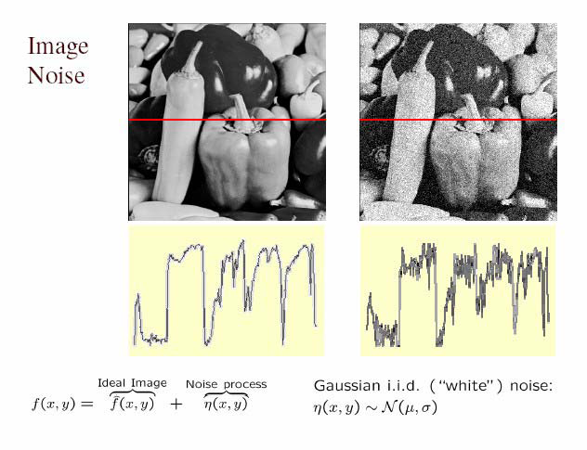
Gaussian noise
Mathematical model: sum of many independent factors
Good for small standard deviations
Assumption: independent, zero-mean noise
Source: M. Hebert

Slide 32
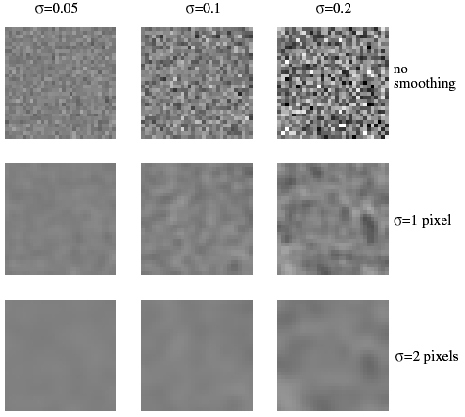
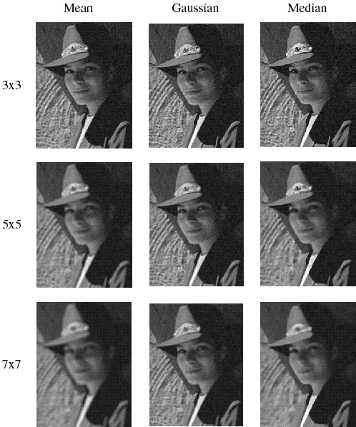
Reducing Gaussian noise
Smoothing with larger standard deviations suppresses noise, but also blurs the image
Slide from Lana Lazebnik

Slide 33
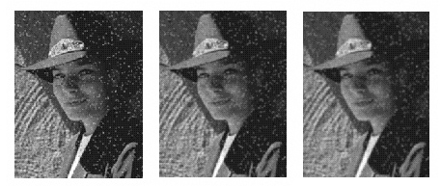
Reducing salt-and-pepper noise
3x3
5x5
7x7
What’s wrong with the results?
Slide from Lana Lazebnik

Slide 34
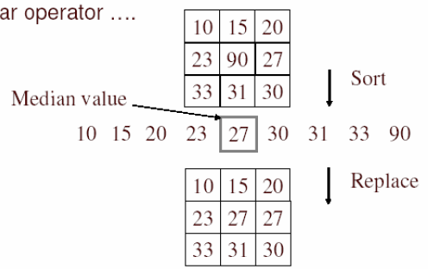
Alternative idea: Median filtering
A median filter operates over a window by selecting the median intensity in the window
Is median filtering linear?
Source: K. Grauman
Notes:
Linearity of median filter: try filter([0 0 0; 0 1 0; 0 0 0] + [1 1 1; 1 1 2; 2 2 2])

Slide 35
Median filter
Is median filtering linear?
Let’s try filtering
Slide from Lana Lazebnik

Slide 36
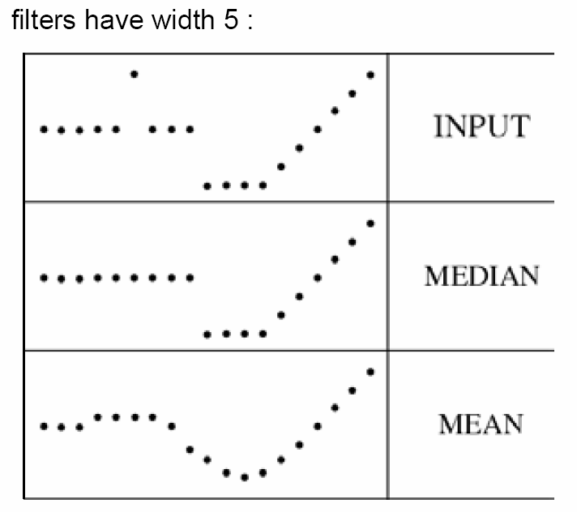
Median filter
What advantage does median filtering have over Gaussian filtering?
  Robustness to outliers
Source: K. Grauman

Slide 37
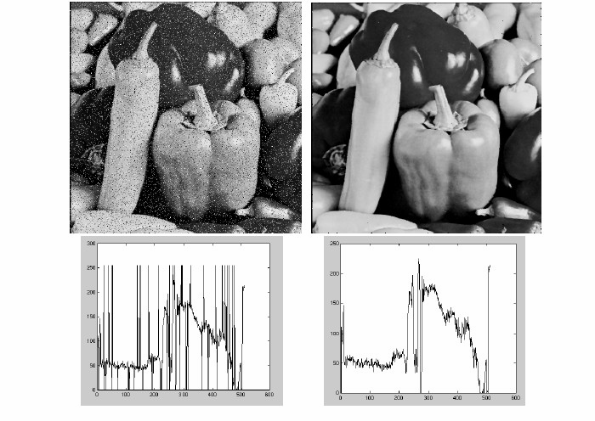
Median filter
Salt-and-pepper noise
Median filtered
Source: M. Hebert

Slide 38
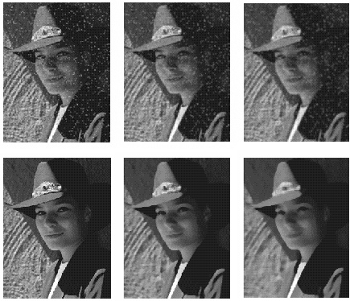
Gaussian vs. median filtering
3x3
5x5
7x7
Gaussian
Median
Slide from Lana Lazebnik

Slide 39
Sharpening revisited
Source: D. Lowe

Slide 40
Sharpening
What does blurring take away?
Original
Smoothed
Detail
–
=
Let’s add it back in.
Original
Detail
Sharpened
+$α$
=

Slide 41



Unsharp mask filter
image
blurred
image
unit impulse
(identity)
unit impulse
Gaussian
Laplacian of Gaussian
Next Class: Frequency view of filtering
Slide from Lana Lazebnik
Notes:
f + a(f - f * g) = (1+a)f-af*g = f*((1+a)e-g)

Slide 42
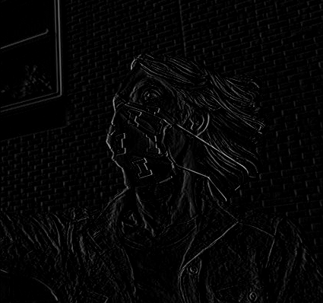
Guess the filter

Slide 43
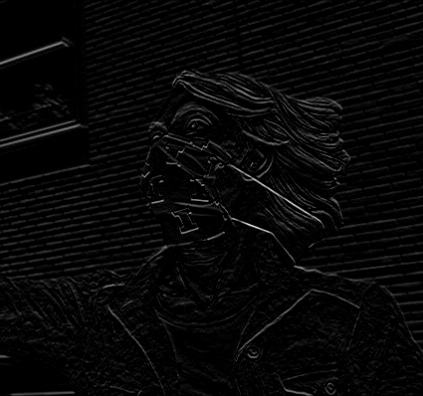
Guess the filter

Slide 44
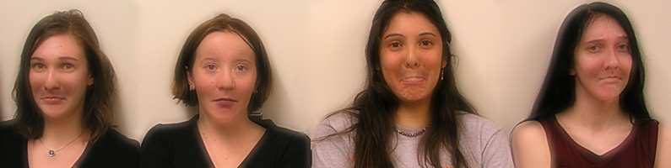
Application: Hybrid Images
A. Oliva, A. Torralba, P.G. Schyns,
Hybrid Images, SIGGRAPH 2006

Slide 45
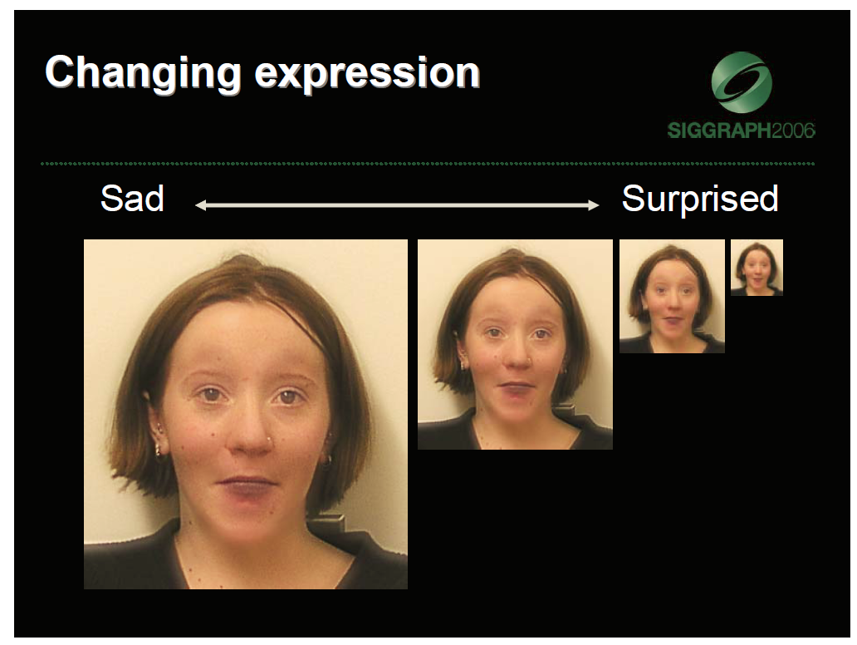

Slide 46

Application: Hybrid Images
Gaussian Filter
Laplacian Filter
A. Oliva, A. Torralba, P.G. Schyns,
Hybrid Images, SIGGRAPH 2006

Slide 47
Review: Image filtering
Convolution
Box vs. Gaussian filter
Separability
Median filter

