Slide 1
Edge Detection
CS 543 / ECE 549 – Saurabh Gupta
Many slides from S. Lazebnik.

Slide 2
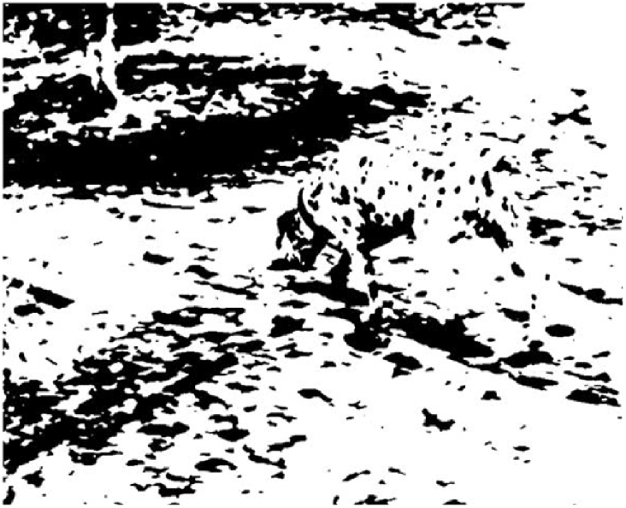
Edge Detection
While we wait, what do you see in this image?
CS 543 / ECE 549 – Saurabh Gupta
Many slides from S. Lazebnik.

Slide 3
Are Edges an Input or an Output?
Source: Gregory, R. L. (1970). The Intelligent Eye. New York, NY: McGraw-Hill Paperbacks.

Slide 4

Edge detection
Goal: Identify sudden changes (discontinuities) in an image
Intuitively, edges carry most of the semantic and shape information from the image
surface normal discontinuity
depth discontinuity
surface color discontinuity
illumination discontinuity
Sources: D. Lowe and S. Seitz

Slide 5
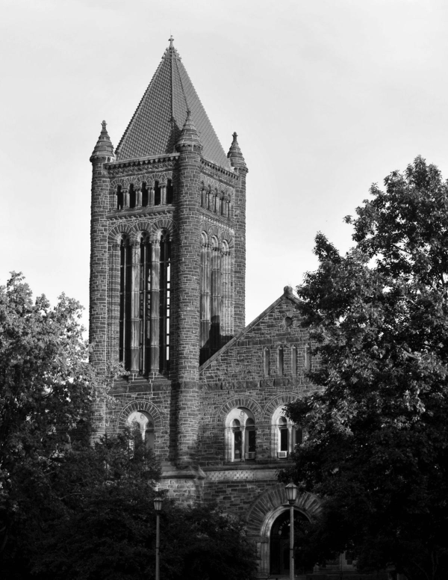

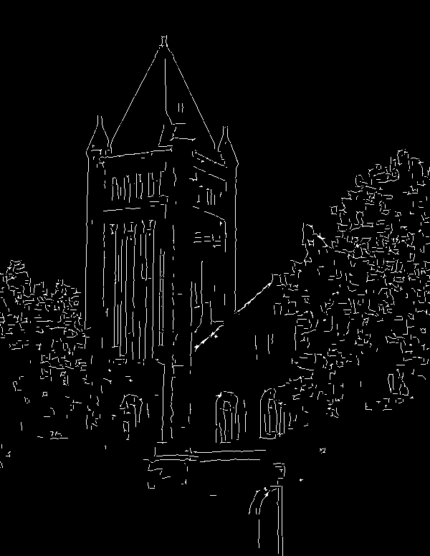
Edge detection
Ideal: artist’s line drawing
Reality
Source: https://www.clipartkey.com/view/wRJixi_drawing-of-altgeld-hall-chapel/

Slide 6

Edge detection
An edge is a place of rapid change in the image intensity function
intensity function
(along horizontal scanline)
image
first derivative
edges correspond to
extrema of derivative
Source: L. Lazebnik

Slide 7
Derivatives with convolution
For 2D function f(x,y), the partial derivative is:
For discrete data, we can approximate using finite differences:
To implement the above as convolution, what would be
the associated filter?
Source: K. Grauman

Slide 8
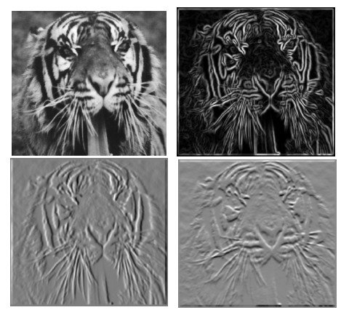
Partial derivatives of an image
-1 1
1 -1
-1 1
or
Which shows changes with respect to x?
Source: L. Lazebnik

Slide 9
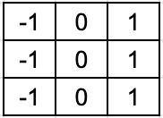
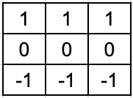
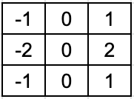
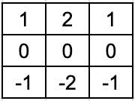


Finite difference filters
Other approximations of derivative filters exist:
Prewitt
Sobel
Roberts
Source: K. Grauman

Slide 10






Image gradient
The gradient of an image:
The gradient points in the direction of most rapid increase in intensity
How does this direction relate to the direction of the edge?
The gradient direction is given by
The edge strength is given by the gradient magnitude
Source: Steve Seitz

Slide 11
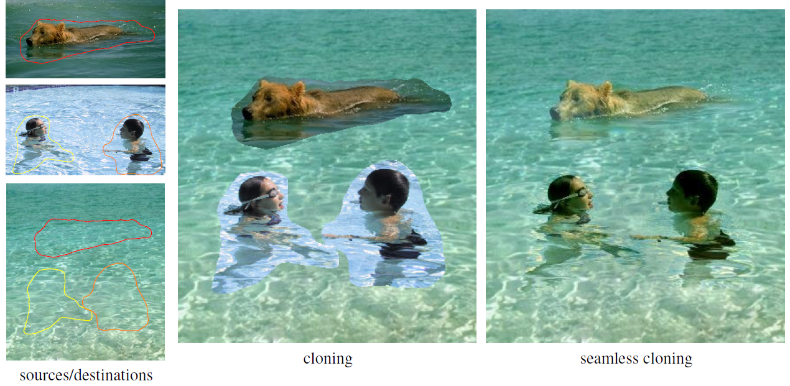
Application: Gradient-domain image editing
Goal: solve for pixel values in the target region to match gradients of the source region while keeping background pixels the same
P. Perez, M. Gangnet, A. Blake, Poisson Image Editing, SIGGRAPH 2003
Source: L. Lazebnik

Slide 12




Effects of noise
Consider a single row or column of the image
Where is the edge?
Source: S. Seitz
Notes:
How to fix?

Slide 13
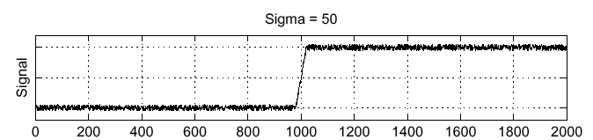
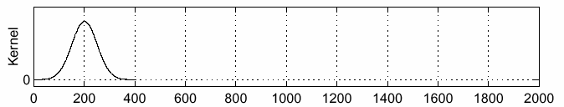
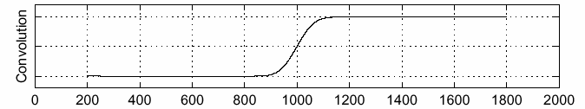
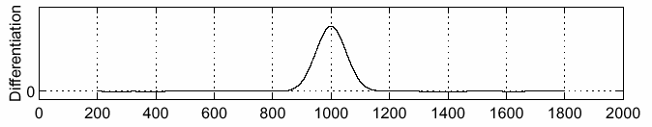
Solution: smooth first
f
g
f * g
To find edges, look for peaks in
Source: S. Seitz

Slide 14

Derivative theorem of convolution
Differentiation is convolution, and convolution is associative:
This saves us one operation:
f
Source: S. Seitz

Slide 15


Derivative of Gaussian filters
x-direction
y-direction
Which one finds horizontal/vertical edges?
Source: L. Lazebnik

Slide 16
Derivative of Gaussian filters
x-direction
y-direction
Are these filters separable?

Slide 17
Recall: Separability of the Gaussian filter
The 2D Gaussian can be expressed as the product of two functions, one a function of x and the other a function of y.
In this case the two functions are the (identical) 1D Gaussian.
Source: D. Lowe
Notes:
G_\sigma (x,y) &= \frac{1}{2\pi\sigma^2}e^{-\left(\frac{x^2+y^2}{2\sigma^2}\right)} \\
&= \left(\frac{1}{\sqrt{2\pi\sigma^2}}e^{-\frac{x^2}{2\sigma^2}}\right) \left(\frac{1}{\sqrt{2\pi\sigma^2}}e^{-\frac{y^2}{2\sigma^2}}\right)

Slide 18
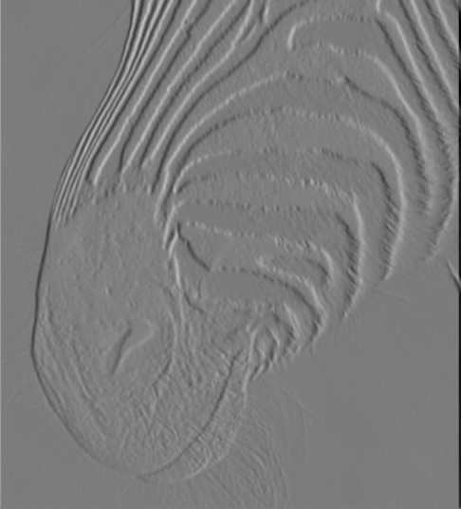
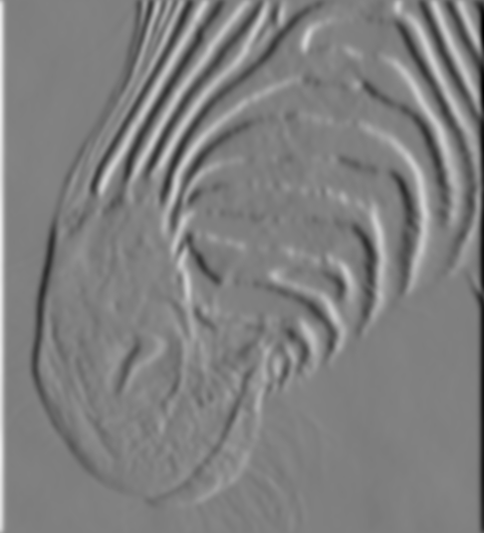
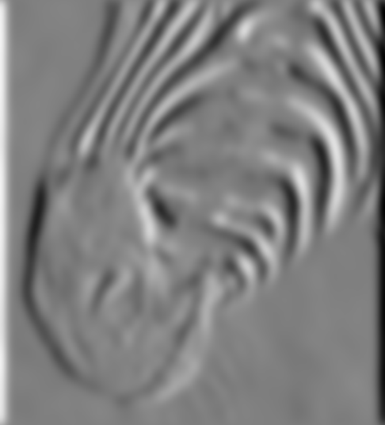
Scale of Gaussian derivative filter
1 pixel
3 pixels
7 pixels
Smoothed derivative removes noise, but blurs edge. Also finds edges at different “scales”
Source: D. Forsyth

Slide 19
Review: Smoothing vs. derivative filters
Smoothing filters
  Gaussian: remove “high-frequency” components;
  “low-pass” filter
  Can the values of a smoothing filter be negative?
  What should the values sum to?
    One: constant regions are not affected by the filter
Derivative filters
  Derivatives of Gaussian
  Can the values of a derivative filter be negative?
  What should the values sum to?
    Zero: no response in constant regions
Source: L. Lazebnik

Slide 20
Building an edge detector
original image
final output

Slide 21
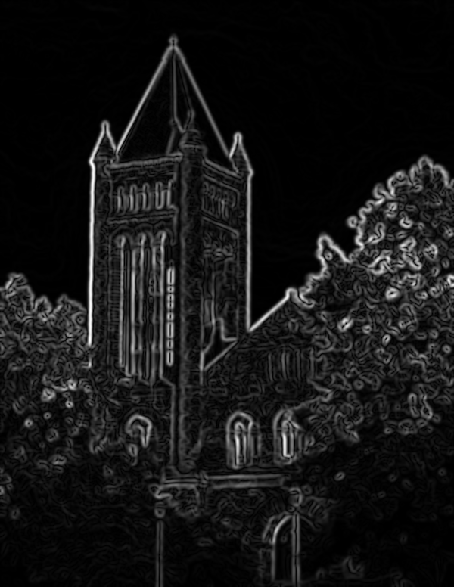
Building an edge detector
norm of the gradient

Slide 22
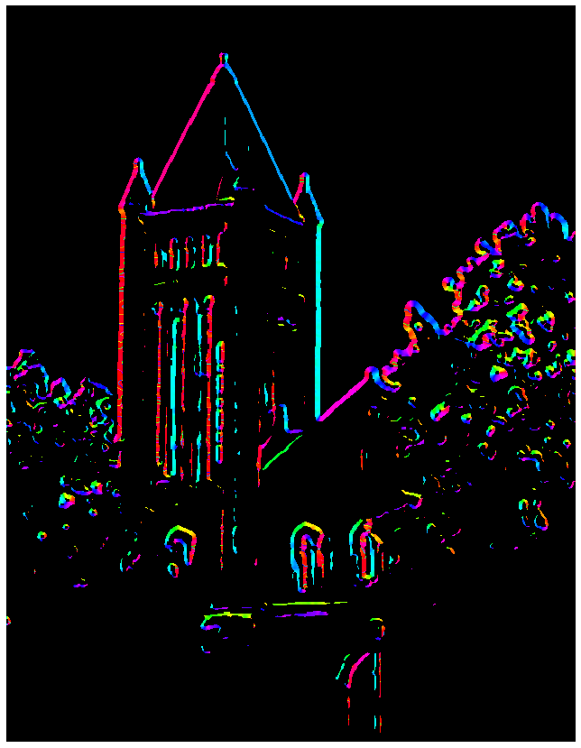

Building an edge detector
orientation of the gradient

Slide 23
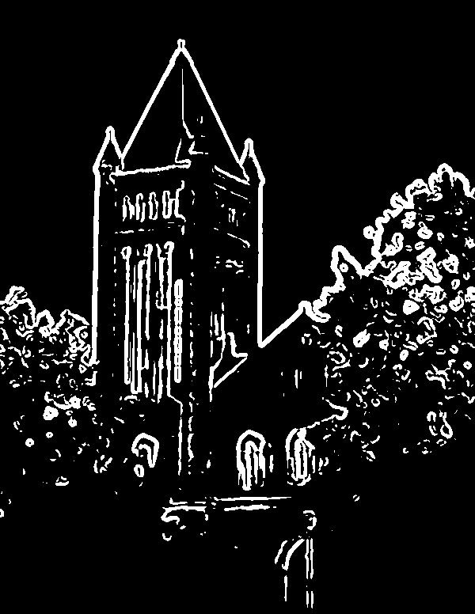
Building an edge detector
How to turn these thick regions of the gradient into curves?
Norm of the gradient > threshold

Slide 24

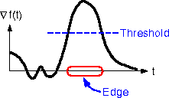
Non-maximum suppression
For each location q above threshold, check that the gradient magnitude is higher than at neighbors p and r along the direction of the gradient
  May need to interpolate to get the magnitudes at p and r
Source: L. Lazebnik

Slide 25
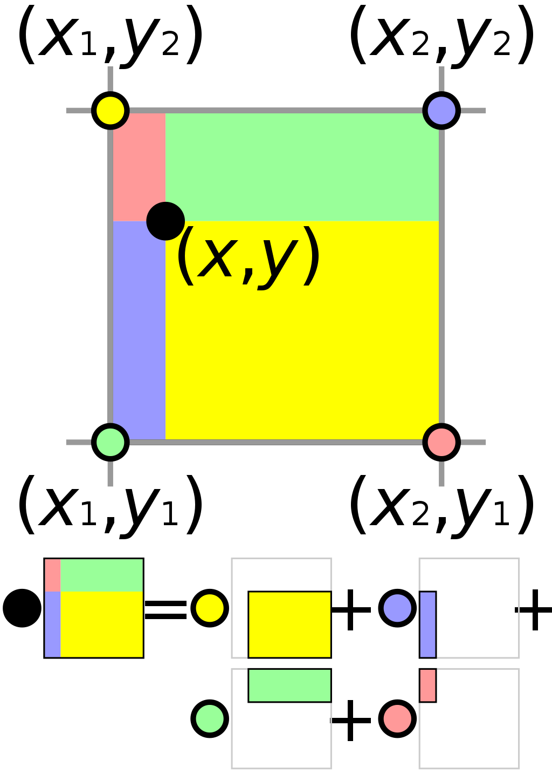
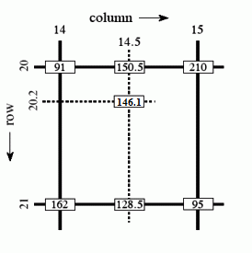
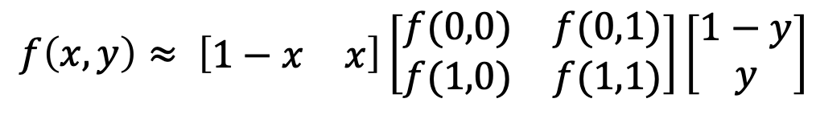
Bilinear Interpolation
$$f\left(x,y\right)≈ \left[\begin{matrix}1−x & x\end{matrix}\right]\left[\begin{matrix}f(0,0) & f(0,1) \\ f(1,0) & f(1,1)\end{matrix}\right]\left[\begin{matrix}1−y \\ y\end{matrix}\right]$$
http://en.wikipedia.org/wiki/Bilinear_interpolation

Slide 26
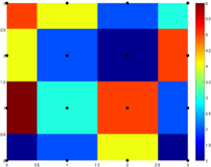
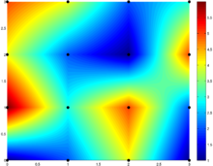
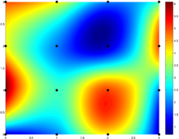
Sidebar: Interpolation options
imx2 = imresize(im, 2, interpolation_type)
‘nearest’
  Copy value from nearest known
  Very fast but creates blocky edges
‘bilinear’
  Weighted average from four nearest known pixels
  Fast and reasonable results
‘bicubic’ (default)
  Non-linear smoothing over larger area
  Slower, visually appealing, may create negative pixel values
Source: D. Hoeim
Examples from http://en.wikipedia.org/wiki/Bicubic_interpolation

Slide 27
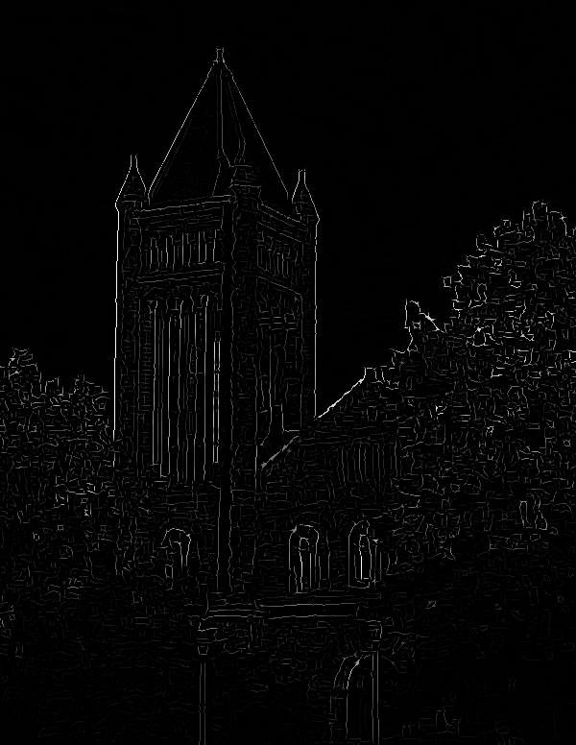

Non-maximum suppression
NMS
NMS > threshold
Another problem: pixels along this edge didn’t survive the thresholding

Slide 28
Hysteresis thresholding
Use a high threshold to start edge curves, and a low threshold to continue them.
Source: Steve Seitz

Slide 29
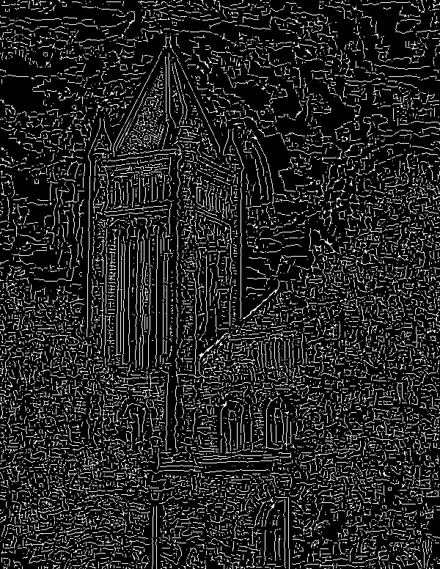
Hysteresis
high threshold
(strong edges)
low threshold
(weak edges)
hysteresis threshold

Slide 30
Hysteresis thresholding
original image
high threshold
(strong edges)
low threshold
(weak edges)
hysteresis threshold
Source: L. Fei-Fei

Slide 31





Effect of σ (Gaussian kernel spread/size)
original
Canny with
Canny with
The choice of σ depends on desired behavior
  large σ detects large scale edges
  small σ detects fine features
Source: S. Seitz

Slide 32
Recap: Canny edge detector
Compute x and y gradient images
Find magnitude and orientation of gradient
Non-maximum suppression:
  Thin wide “ridges” down to single pixel width
Linking and thresholding (hysteresis):
  Define two thresholds: low and high
  Use the high threshold to start edge curves and the low threshold to continue them
J. Canny, A Computational Approach To Edge Detection, IEEE Trans. Pattern Analysis and Machine Intelligence, 8:679-714, 1986.
Source: L. Lazebnik

Slide 33






Image gradients vs. meaningful contours
image
human segmentation
gradient magnitude
Berkeley segmentation database:
http://www.eecs.berkeley.edu/Research/Projects/CS/vision/grouping/segbench/
Source: L. Lazebnik
Notes:
Vision vs Signal Processing

Slide 34
Do humans consistently segment images?
Divide each image into pieces, where each piece represents a distinguished thing in the image. It is important that all of the pieces have approximately equal importance. The number of things in each image is up to you. Something between 2 and 20 should be reasonable for any of our images.
A Database of Human Segmented Natural Images and its Application to Evaluating Segmentation Algorithms and Measuring Ecological Statistics
Notes:
Vision vs Signal Processing

Slide 35
Aside: Datasets, Metrics and Benchmarks
Standard image sets
Standard metrics
Possible to quantitatively compare different methods
A Database of Human Segmented Natural Images and its Application to Evaluating Segmentation Algorithms and Measuring Ecological Statistics
Notes:
Vision vs Signal Processing

Slide 36
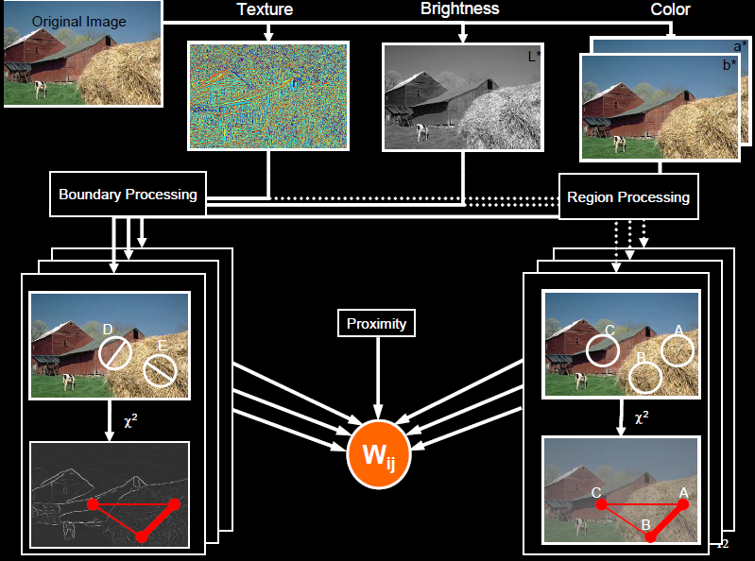
pB boundary detector
Martin, Fowlkes, Malik 2004: Learning to Detection Natural Boundaries…
http://www.eecs.berkeley.edu/Research/Projects/CS/vision/grouping/papers/mfm-pami-boundary.pdf
Figure from Fowlkes

Slide 37
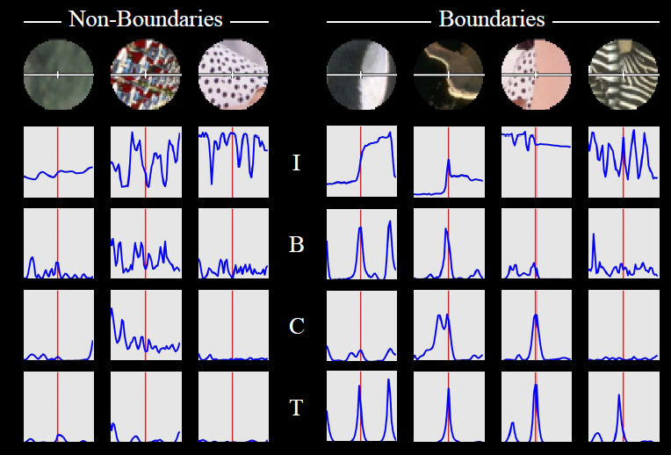
pB Boundary Detector
Figure from Fowlkes

Slide 38
pB Boundary Detector
Contour Detection and Hierarchical Image Segmentation P. Arbeláez. PAMI 2010.

Slide 39
Contour Detection and Hierarchical Image Segmentation P. Arbeláez. PAMI 2010.

Slide 40
Lots of Tricks
“Bird Edge” Problem with Texture Gradients
Sky Breaking
Information Leakage across Orientations
Learning to Detect Natural Image Boundaries Using Brightness and Texture
Contour Detection and Hierarchical Image Segmentation

Slide 41
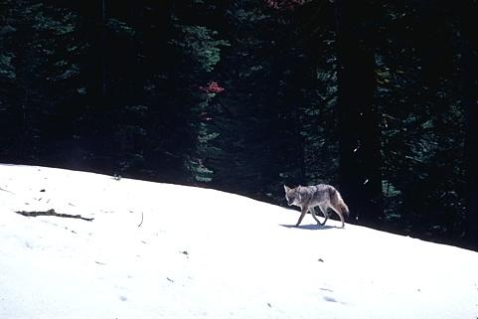
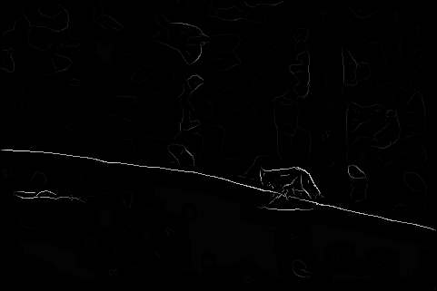
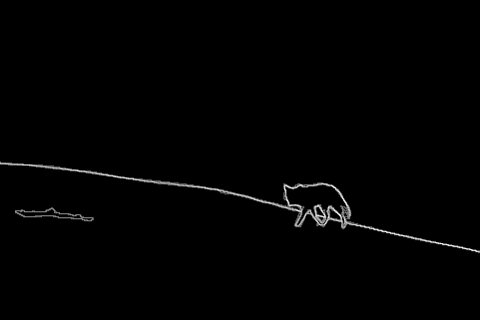
Results
Pb (0.88)
Human (0.95)

Slide 42
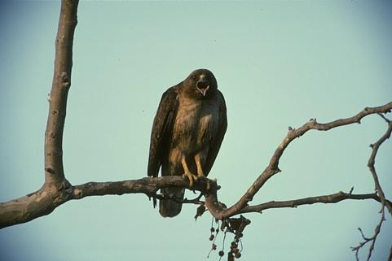
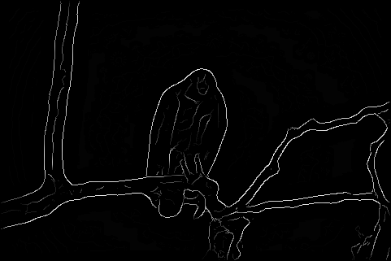
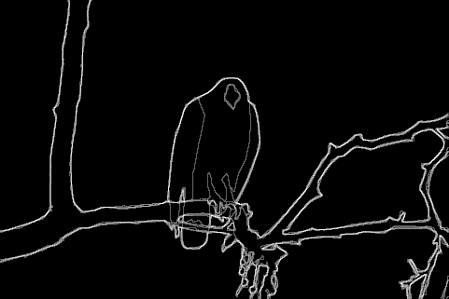
Results
Pb (0.88)
Human
Human (0.96)

Slide 43
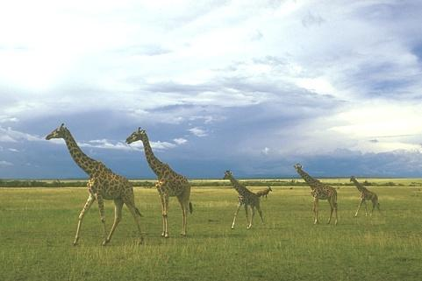
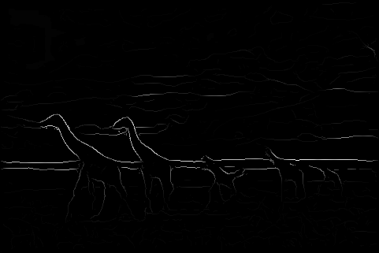
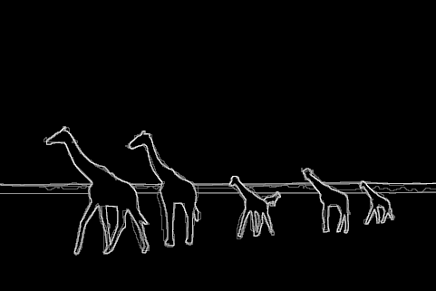
Pb (0.63)
Human (0.95)

Slide 44
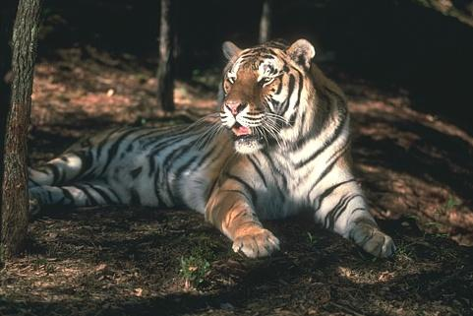
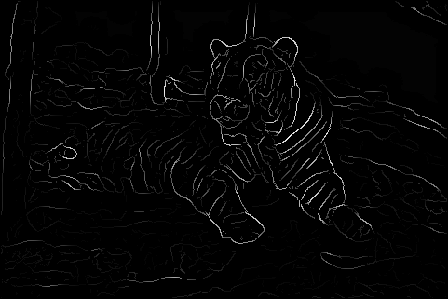
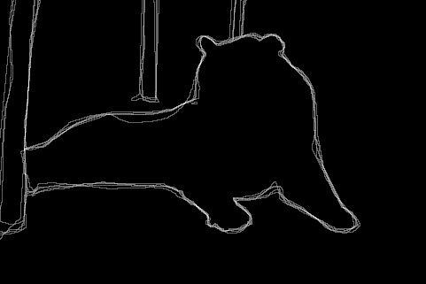
Pb (0.35)
Human (0.90)
For more: http://www.eecs.berkeley.edu/Research/Projects/CS/vision/bsds/bench/html/108082-color.html

Slide 45
Empirical Research
Contour Detection and Hierarchical Image Segmentation

Slide 46
Applications: Interactive Segmentation
Contour Detection and Hierarchical Image Segmentation. P. Arbeláez et al. PAMI 2010

Slide 47
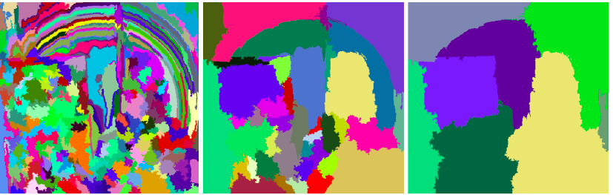
Applications: Pre-processing for Object Detection
J. Uijlings, K. van de Sande, T. Gevers, and A. Smeulders,
Selective Search for Object Recognition, IJCV 2013

Slide 48
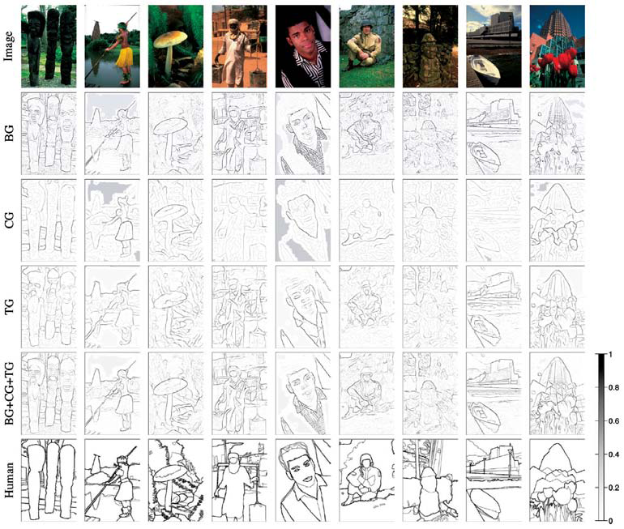
Brightness
Color
Texture
Combined
Human

Slide 49
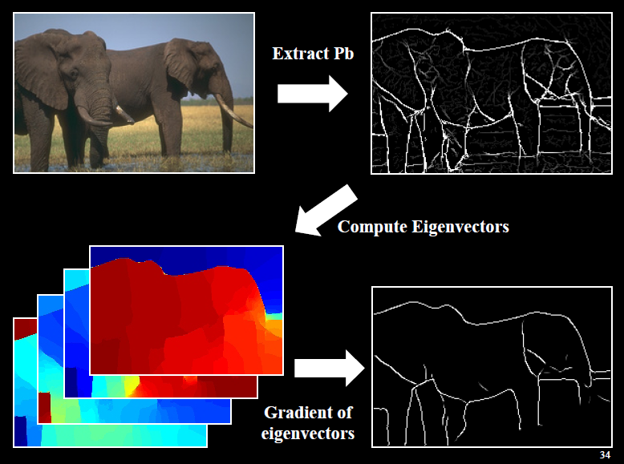
Global pB boundary detector
Figure from Fowlkes

Slide 50
Edge Detection with Structured Random Forests
Goal: quickly predict whether each pixel is an edge
Insights
  Predictions can be learned from training data
  Predictions for nearby pixels should not be independent
Solution
  Train structured random forests to split data into patches with similar boundaries based on features
  Predict boundaries at patch level, rather than pixel level, and aggregate (average votes)
Boundaries in patch
http://research.microsoft.com/pubs/202540/DollarICCV13edges.pdf

Slide 51
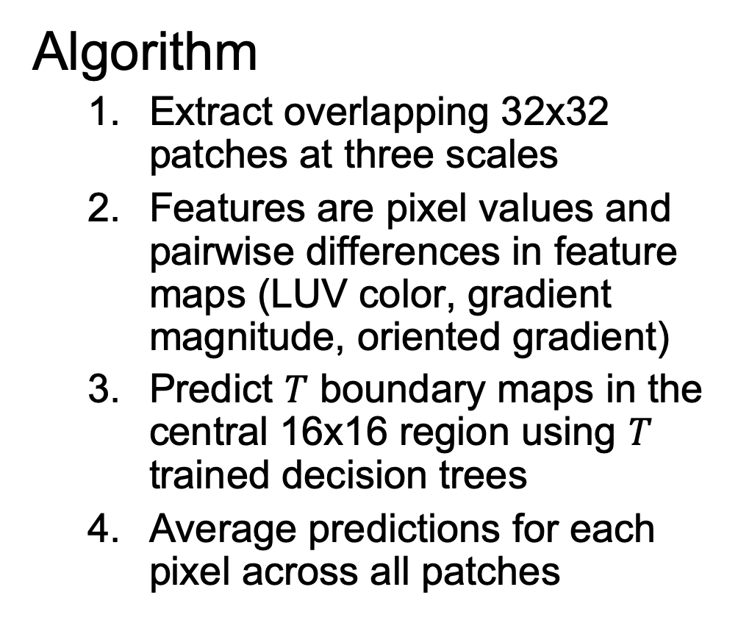
Edge Detection with Structured Random Forests
Algorithm
  Extract overlapping 32x32 patches at three scales
  Features are pixel values and pairwise differences in feature maps (LUV color, gradient magnitude, oriented gradient)
  Predict $T$ boundary maps in the central 16x16 region using $T$ trained decision trees
  Average predictions for each pixel across all patches

Slide 52
Edge Detection with Structured Random Forests
Results
BSDS 500
NYU Depth dataset edges

Slide 53
Edge Detection with Structured Random Forests
Ground truth
Results (multiscale)

Slide 54
Holistically nested edge detection
https://arxiv.org/pdf/1504.06375.pdf

Slide 55
Crisp Boundary Detection using Pointwise Mutual Information (Isola et al. ECCV 2014)
Pixel combinations that are unlikely to be together are edges
Algorithm:
Kernel density estimation
Spectral clustering
http://web.mit.edu/phillipi/www/publications/crisp_boundaries.pdf

Slide 56
Crisp Boundary Detection using Pointwise Mutual Information

Slide 57
State of edge detection
Local edge detection is mostly solved
  Intensity gradient, color, texture
  HED on BSDS 500 is near human performance
Some room for improvement by taking advantage of higher-level knowledge (e.g., objects)
Still hard to produce all objects within a small number of regions

Slide 58
Are Edges an Input or an Output?
Source: Gregory, R. L. (1970). The Intelligent Eye. New York, NY: McGraw-Hill Paperbacks.

Slide 59
Recap

Slide 60
Recap

