Slide 1
Corner Detection
CS 543 / ECE 549 – Saurabh Gupta
Slides from S. Lazebnik.

Slide 2
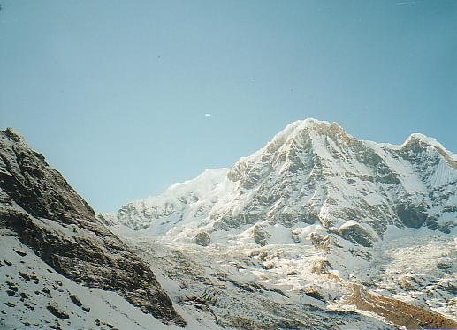
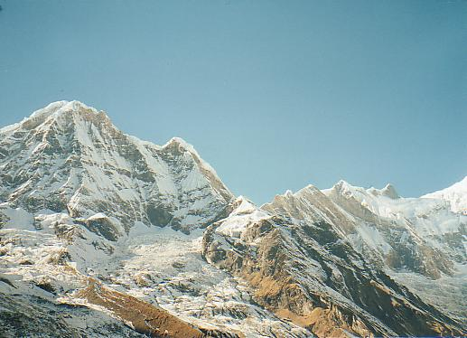
Why extract keypoints?
Motivation: panorama stitching
We have two images – how do we combine them?
Source: L. Lazebnik

Slide 3
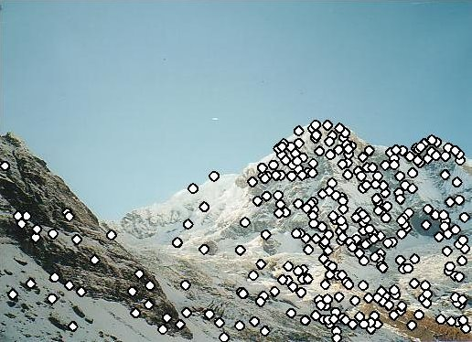
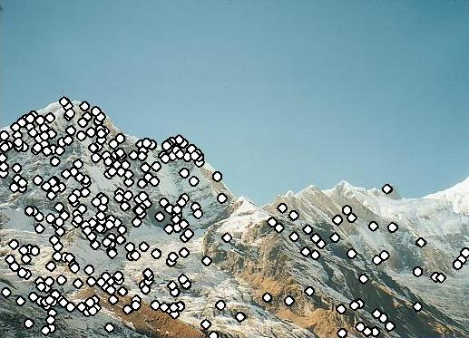
Why extract keypoints?
Motivation: panorama stitching
We have two images – how do we combine them?
Step 1: extract keypoints
Step 2: match keypoint features
Source: L. Lazebnik

Slide 4
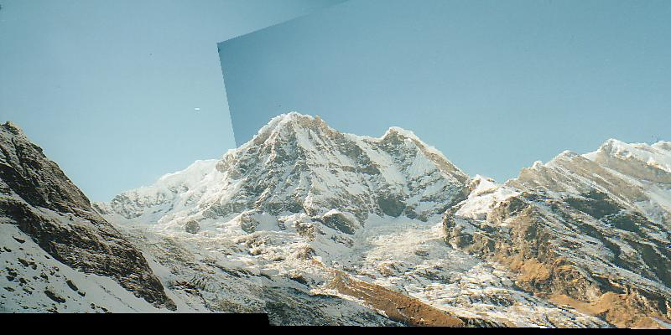
Why extract keypoints?
Motivation: panorama stitching
We have two images – how do we combine them?
Step 1: extract keypoints
Step 2: match keypoint features
Step 3: align images
Source: L. Lazebnik

Slide 5
Characteristics of good keypoints
Compactness and efficiency
Many fewer keypoints than image pixels
Saliency
Each keypoint is distinctive
Locality
A keypoint occupies a relatively small area of the image; robust to clutter and occlusion
Repeatability
The same keypoint can be found in several images despite geometric and photometric transformations
Source: L. Lazebnik

Slide 6
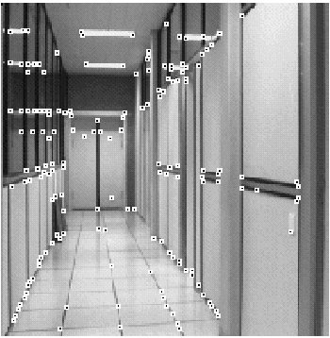
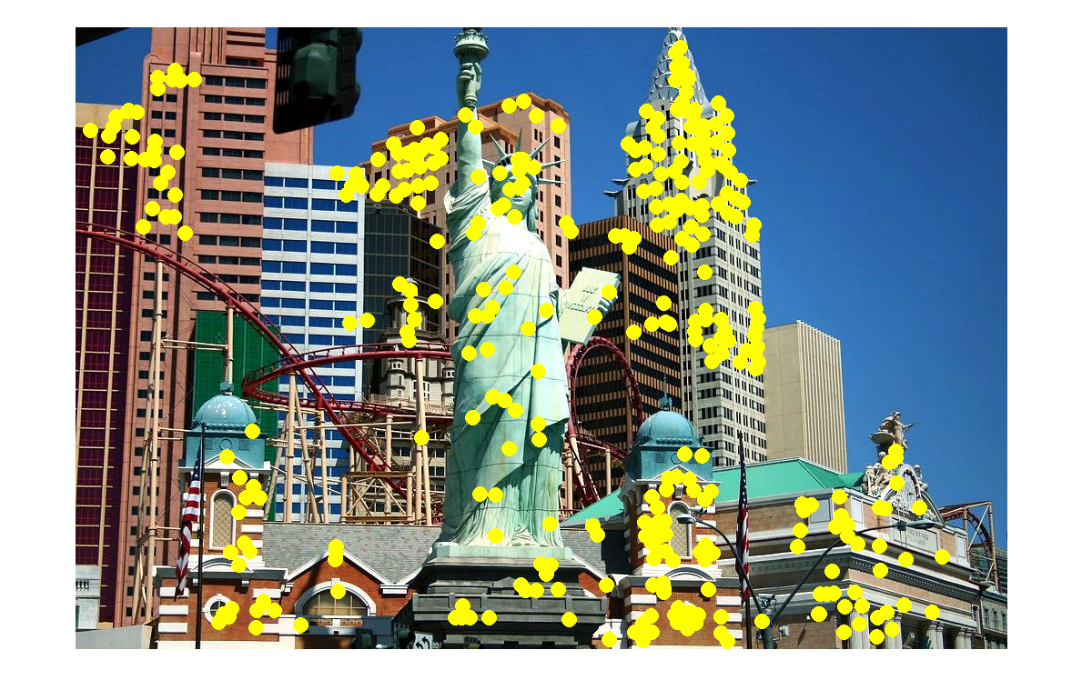
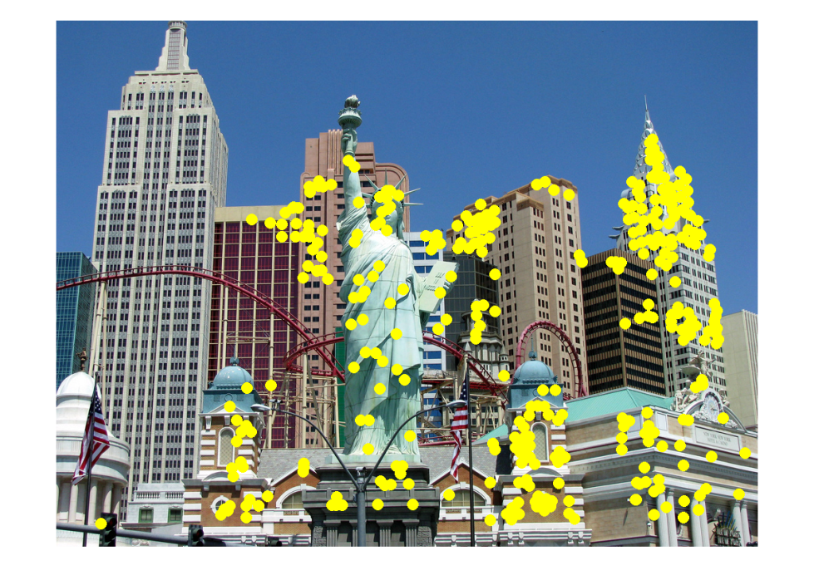
Applications
Keypoints are used for:
Image alignment
3D reconstruction
Motion tracking
Robot navigation
Database indexing and retrieval
Object recognition
Source: L. Lazebnik

Slide 7
Corner detection: Basic idea
Source: L. Lazebnik

Slide 8
Corner detection: Basic idea
We should easily recognize the point by looking through a small window
Shifting a window in any direction should give a large change in intensity
“flat” region: no change in all directions
“edge”: no change along the edge direction
“corner”: significant change in all directions
Source: L. Lazebnik

Slide 9
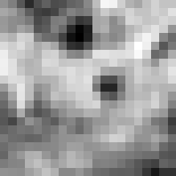
Corner Detection: Derivation
Change in appearance of window W for the shift [u,v]:
I(x, y)
E(u, v)
E(3,2)
Source: L. Lazebnik

Slide 10
Corner Detection: Derivation
Change in appearance of window W for the shift [u,v]:
I(x, y)
E(u, v)
E(0,0)
Source: L. Lazebnik

Slide 11
Corner Detection: Derivation
Change in appearance of window W for the shift [u,v]:
We want to find out how this function behaves for small shifts
E(u, v)
Source: L. Lazebnik
Notes:
Specifically, E has to have a unique minimum at (0,0)

Slide 12
Corner Detection: Derivation
First-order Taylor approximation for small motions [u, v]:
Let’s plug this into E(u,v):
Source: L. Lazebnik

Slide 13
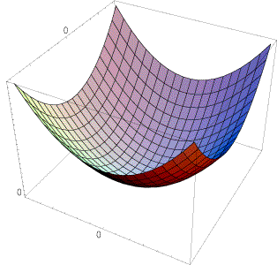
Corner Detection: Derivation
E(u,v) can be locally approximated by a quadratic surface:
In which directions does this surface have the fastest/slowest change?
E(u, v)
Source: L. Lazebnik

Slide 14
Corner Detection: Derivation
E(u,v) can be locally approximated by a quadratic surface:
Second moment matrix M
Source: L. Lazebnik

Slide 15
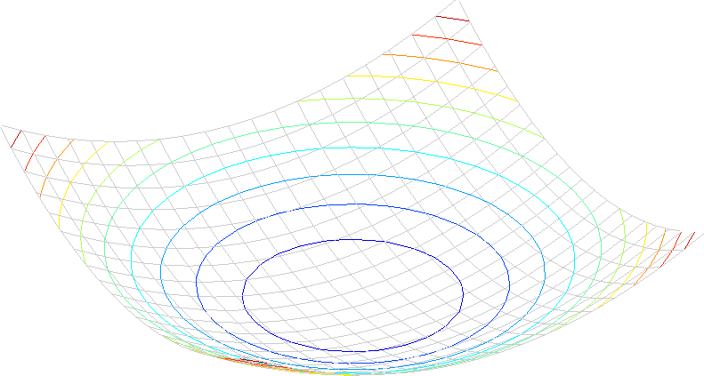
Interpreting the second moment matrix
A horizontal “slice” of E(u, v) is given by the equation of an ellipse:
Source: L. Lazebnik

Slide 16
Interpreting the second moment matrix
Consider the axis-aligned case (gradients are either horizontal or vertical):
a^{-1/2}
Minor axis
Major axis
b^{-1/2}
Source: L. Lazebnik

Slide 17
Interpreting the second moment matrix
Consider the axis-aligned case (gradients are either horizontal or vertical):
If either a or b is close to 0, then this is not a corner, so we want locations where both are large
Source: L. Lazebnik

Slide 18
Interpreting the second moment matrix
In the general case, need to diagonalize M:
The axis lengths of the ellipse are determined by the eigenvalues and the orientation is determined by R:
direction of the fastest change
direction of the slowest change
(λ_{max})^{-1/2}
(λ_{min})^{-1/2}
Source: L. Lazebnik

Slide 19
Visualization of second moment matrices
Source: L. Lazebnik

Slide 20
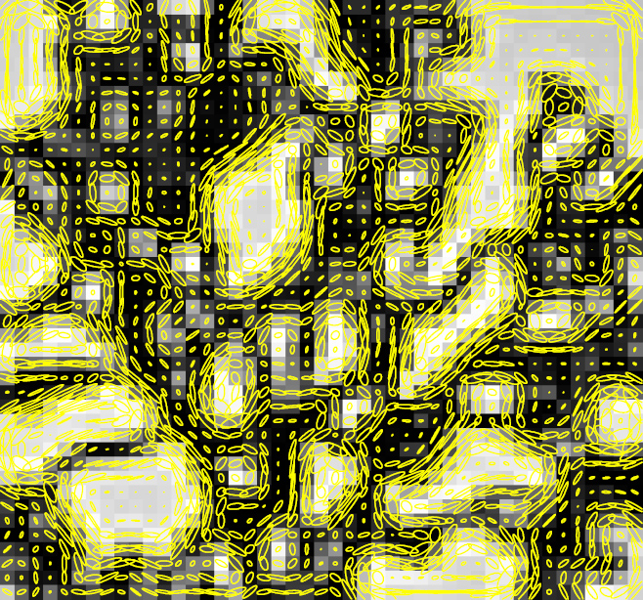
Visualization of second moment matrices
Source: L. Lazebnik

Slide 21
Interpreting the eigenvalues
Classification of image points using eigenvalues of M:
λ₂
“Edge” λ₂ >> λ₁
“Corner” λ₁ and λ₂ are large, λ₁ ~ λ₂; E increases in all directions
λ₁ and λ₂ are small; E is almost constant in all directions
“Flat” region
“Edge” λ₁ >> λ₂
λ₁
Source: L. Lazebnik

Slide 22
Corner response function
α: constant (0.04 to 0.06)
“Edge” R < 0
“Corner” R > 0
|R| small
“Flat” region
“Edge” R < 0
Source: L. Lazebnik

Slide 23
The Harris corner detector
Compute partial derivatives at each pixel
Compute second moment matrix M in a Gaussian window around each pixel:
C.Harris and M.Stephens, A Combined Corner and Edge Detector, Proceedings of the 4th Alvey Vision Conference: pages 147—151, 1988.
Source: L. Lazebnik

Slide 24
The Harris corner detector
Compute partial derivatives at each pixel
Compute second moment matrix M in a Gaussian window around each pixel
Compute corner response function R
C.Harris and M.Stephens, A Combined Corner and Edge Detector, Proceedings of the 4th Alvey Vision Conference: pages 147—151, 1988.
Source: L. Lazebnik

Slide 25
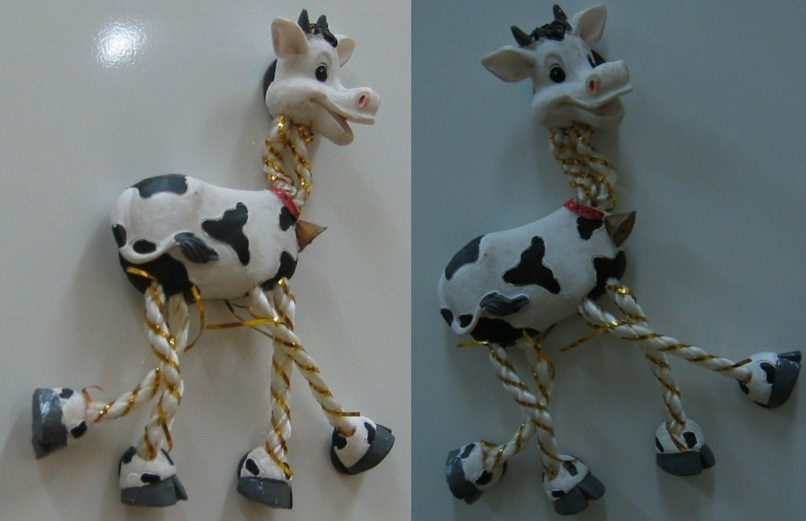
Harris Detector: Steps
Source: L. Lazebnik

Slide 26
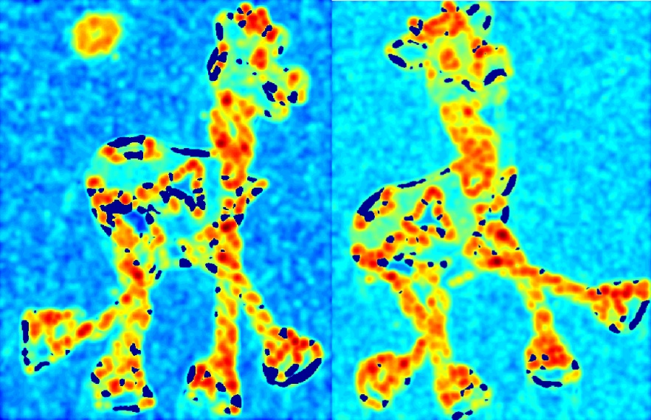
Harris Detector: Steps
Compute corner response R
Source: L. Lazebnik

Slide 27
The Harris corner detector
Compute partial derivatives at each pixel
Compute second moment matrix M in a Gaussian window around each pixel
Compute corner response function R
Threshold R
Find local maxima of response function (nonmaximum suppression)
C.Harris and M.Stephens, A Combined Corner and Edge Detector, Proceedings of the 4th Alvey Vision Conference: pages 147—151, 1988.
Source: L. Lazebnik

Slide 28
Harris Detector: Steps
Find points with large corner response: R > threshold
Source: L. Lazebnik

Slide 29
Harris Detector: Steps
Take only the points of local maxima of R
Source: L. Lazebnik

Slide 30
Harris Detector: Steps
Source: L. Lazebnik

Slide 31
Robustness of corner features
What happens to corner features when the image undergoes geometric or photometric transformations?
Source: L. Lazebnik

Slide 32
Affine intensity change
I → a I + b
Only derivatives are used, so invariant to intensity shift I → I + b
Intensity scaling: I → a I
R
R
threshold
x (image coordinate)
x (image coordinate)
Partially invariant to affine intensity change
Source: L. Lazebnik

Slide 33
Image translation
Derivatives and window function are shift-invariant
Corner location is covariant w.r.t. translation
Source: L. Lazebnik

Slide 34
Image rotation
Second moment ellipse rotates but its shape (i.e. eigenvalues) remains the same
Corner location is covariant w.r.t. rotation
Source: L. Lazebnik

Slide 35
Scaling
Corner
All points will be classified as edges
Corner location is not covariant w.r.t. scaling!
Source: L. Lazebnik

