Slide 1
Vision Transformers
Saurabh Gupta
CS 543 / ECE 549

Slide 2
Overview
Vision Transformers
Finetuning Vision Transformers
Multiscale Vision Transformers
Transformers for Detection
Transformers for Segmentation

Slide 3
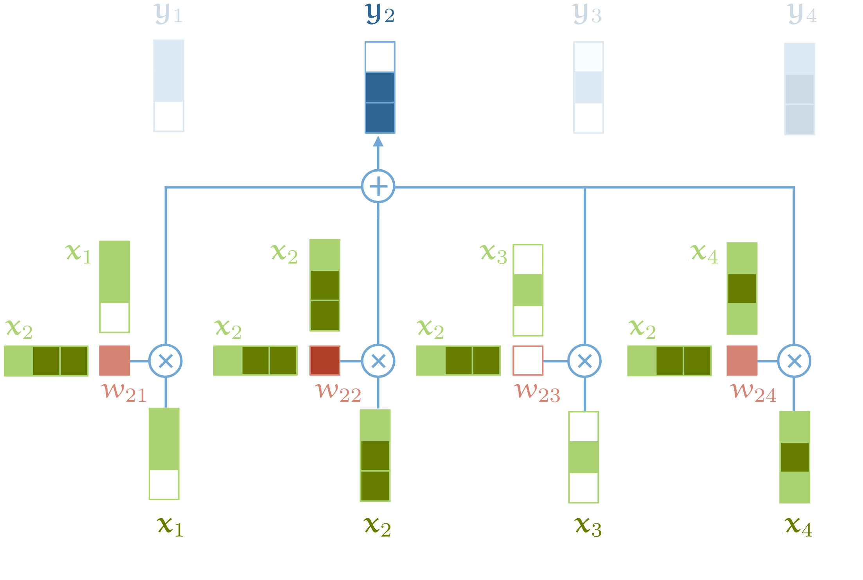
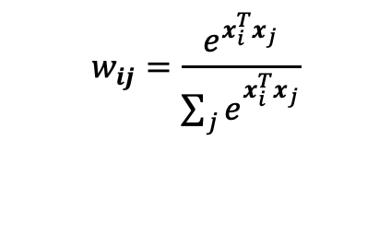

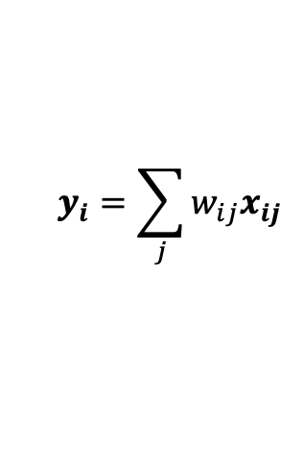
Attention
$$y_{i}=\sum_{j}{{w_{ij}x}_{ij}}$$
$$w_{ij}=softmax_{j}(x_{i}^{T}x_{j})$$
$$w_{ij}=\frac{e^{x_{i}^{T}x_{j}}}{\sum_{j}{e_{}^{x_{i}^{T}x_{j}}}}$$
Source: http://peterbloem.nl/blog/transformers See also: Attention is all you need

Slide 4
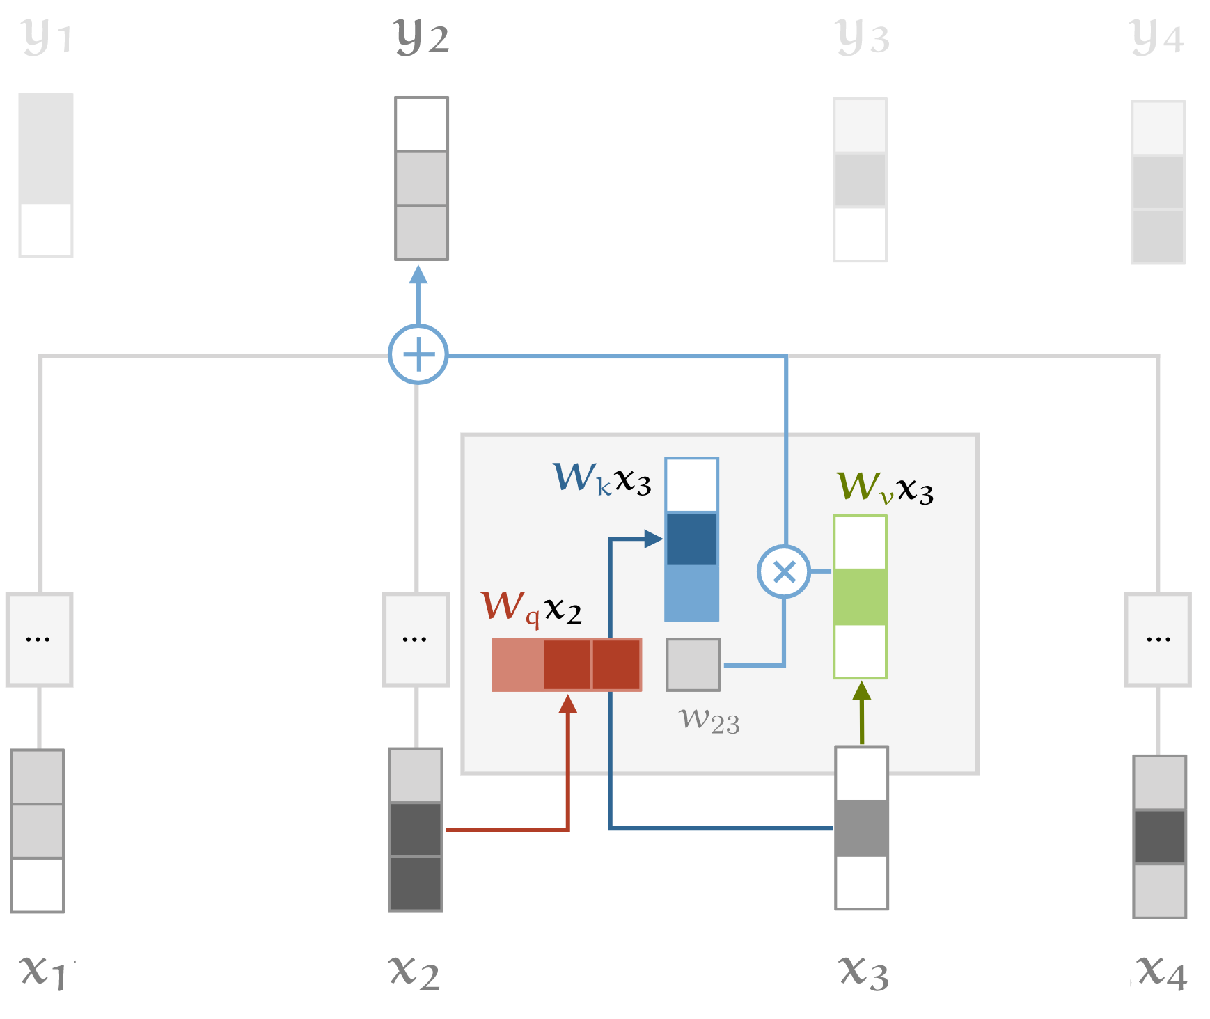

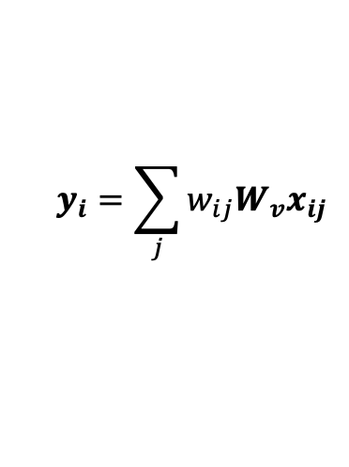
Attention (with key, query and value)
$$y_{i}=\sum_{j}{w_{ij}{W_{v}x}_{ij}}$$
$$w_{ij}=softmax_{j}({\left(W_{q}x_{i}\right)}^{T}{W_{k}x}_{j})$$
Source: http://peterbloem.nl/blog/transformers See also: Attention is all you need

Slide 5
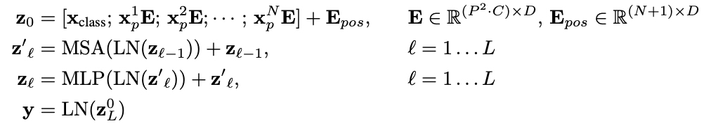
An Image is Worth 16x16 Words: Transformers for Image Recognition at Scale, Dosovitskiy ICLR 2021

Slide 6
Multihead Self-Attention

Slide 7
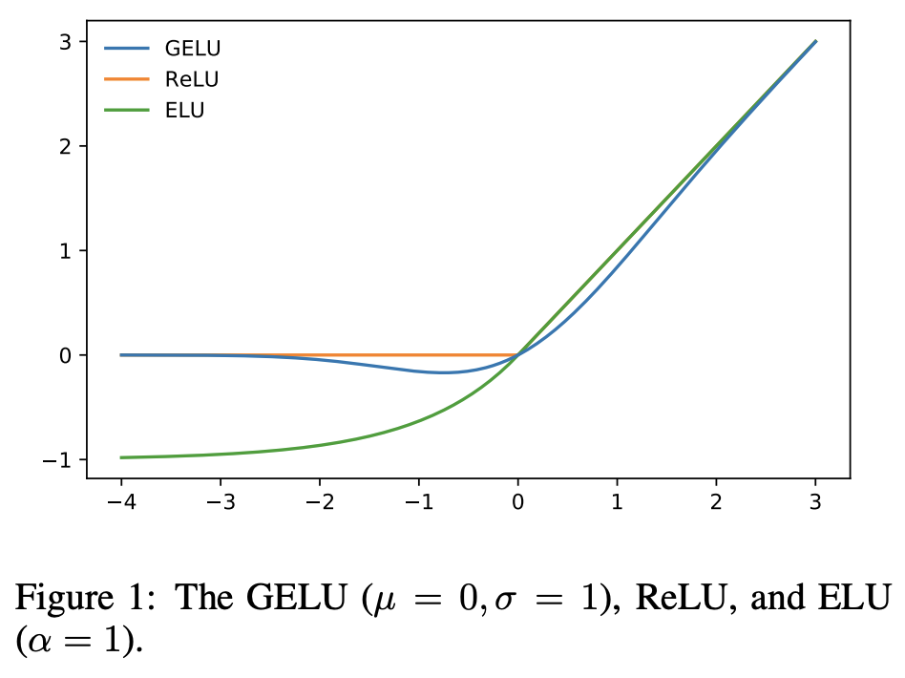
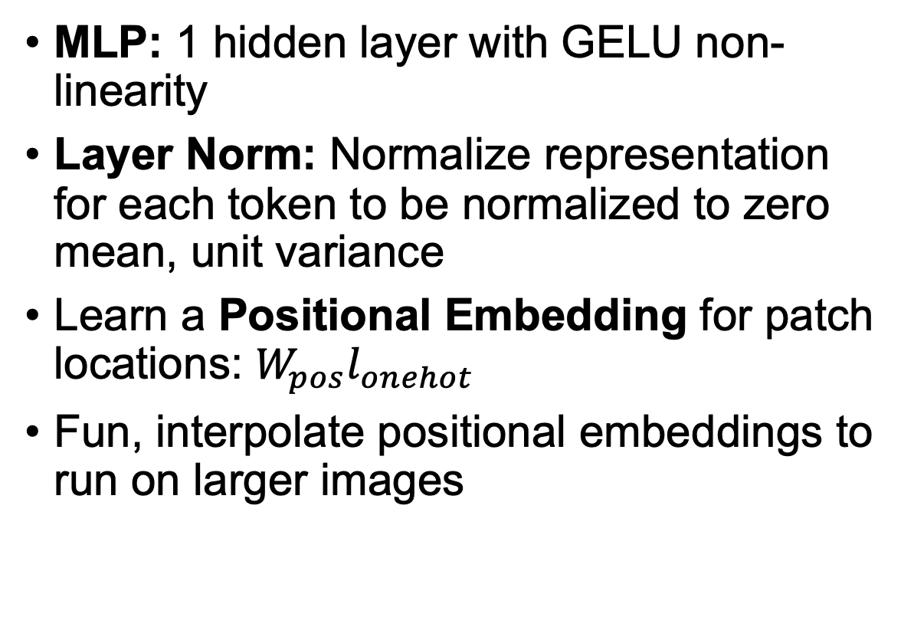
Other Details
MLP: 1 hidden layer with GELU non-linearity
Layer Norm: Normalize representation for each token to be normalized to zero mean, unit variance
Learn a Positional Embedding for patch locations: $W_{pos}l_{onehot}$
Fun, interpolate positional embeddings to run on larger images

Slide 8
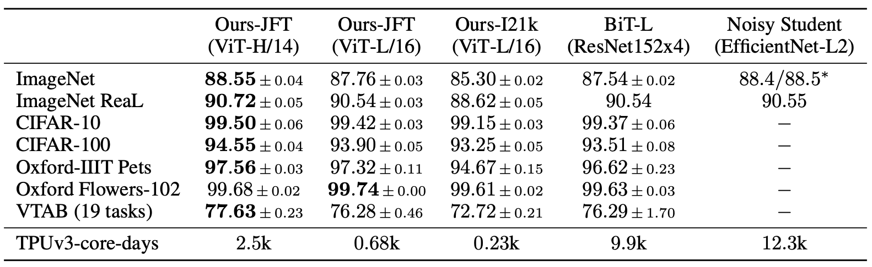
Results

Slide 9
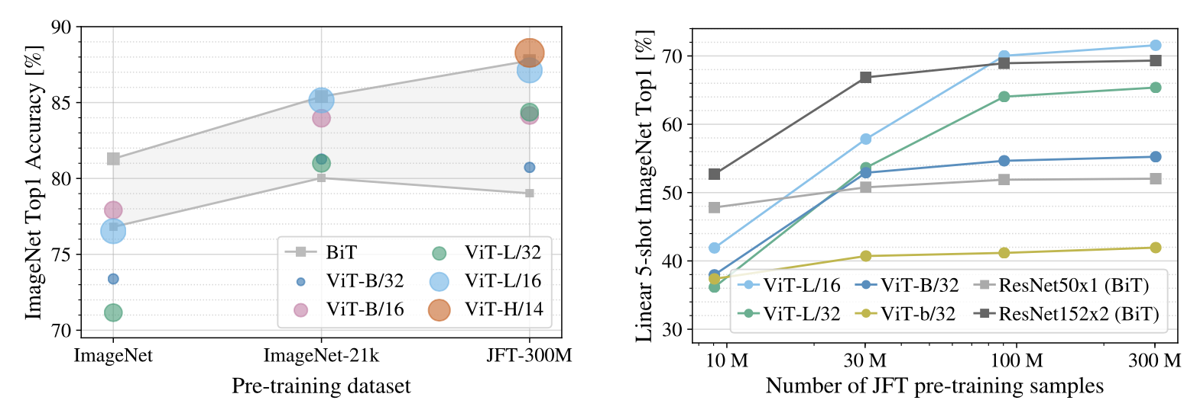
Scale Better with More Data

Slide 10
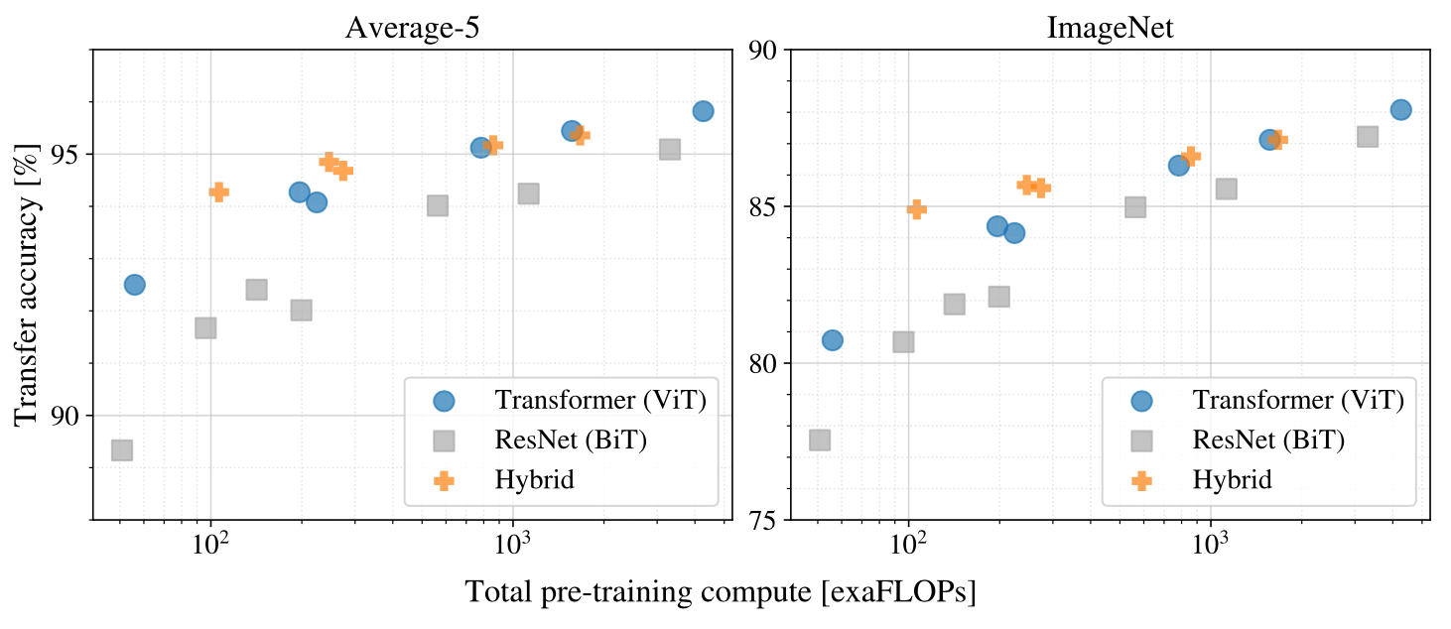
Surprisingly, faster than ResNets to train

Slide 11
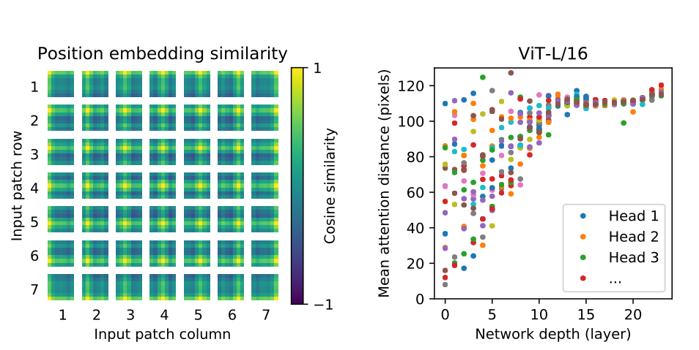
Visualization
Some early layers attend locally, others attend to quite far
Later layers attend to quite far!
Position encoding automatically learn spatial proximity

Slide 12
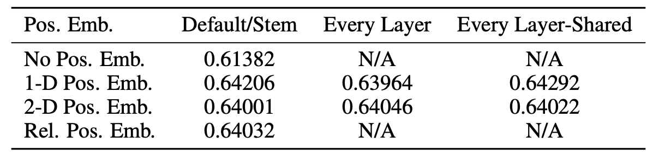
Positional Embedding
Bag of word is insufficient
Many encodings work well

Slide 13
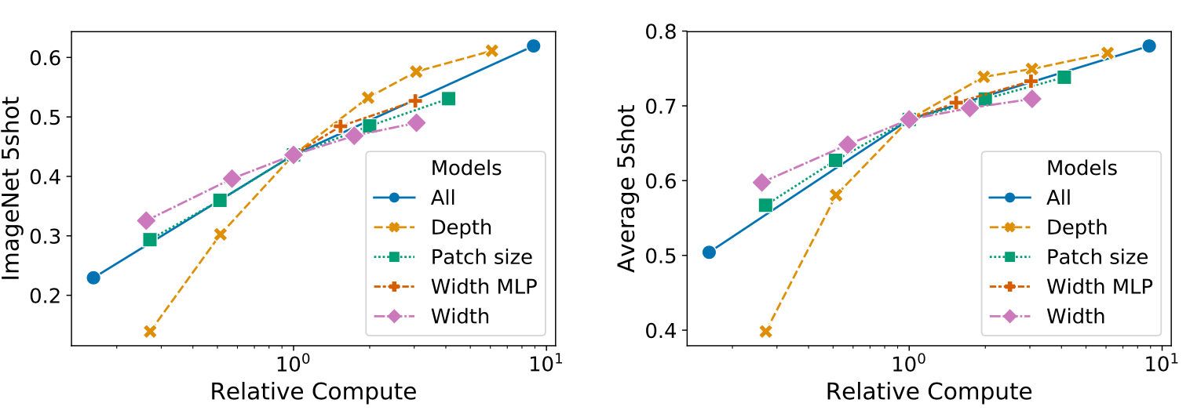
Scaling depth is most effective at current operating point

Slide 14
Finetuning at Higher-Resolution
Often beneficial to fine-tune at higher
Keep patch-size same, increase number of patches
ViT can in-principle handle longer sequence lengths
Except, positional encodings need to be interpolated.

Slide 15
How to finetune Transformer architectures?
Visual Prompt Tuning, Jia et al. ECCV 2022

Slide 16
How to finetune Transformer architectures?

Slide 17
Datasets
VTAB Dataset
  Collection of 19 diverse visual classification tasks from 3 groups:
    Natural: natural images captured using standard cameras
    Specialized: such as medical and satellite imagery
    Structured: geometric comprehension like object counting.
  Each task of VTAB contains 1000 training examples.
FGVC Dataset
  5 benchmarked Fine-Grained Visual Classification tasks
    CUB-200-2011 (birds), NABirds, Oxford Flowers, Stanford Dogs, Stanford Cars

Slide 18
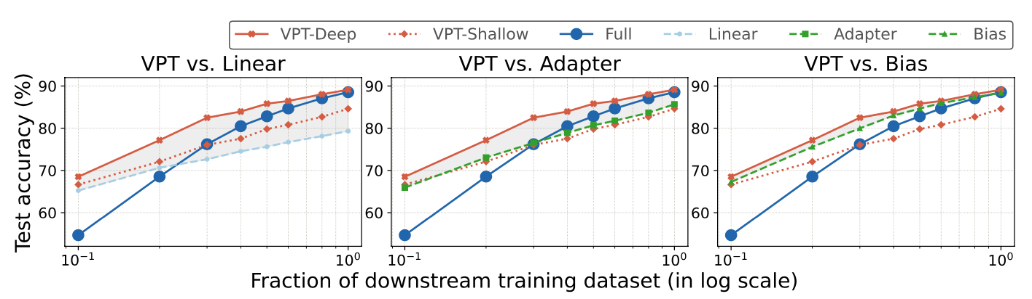
Outperforms CNN finetuning methods, deep better than shallow

Slide 19
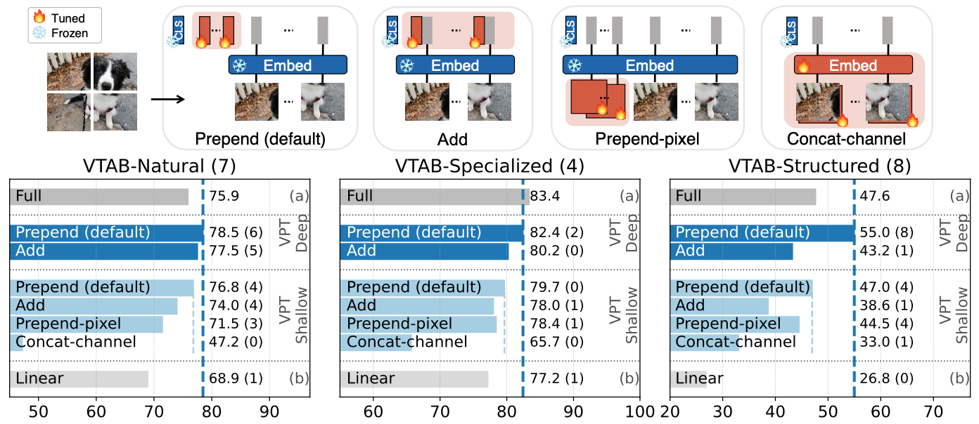
Appending tokens is best

Slide 20
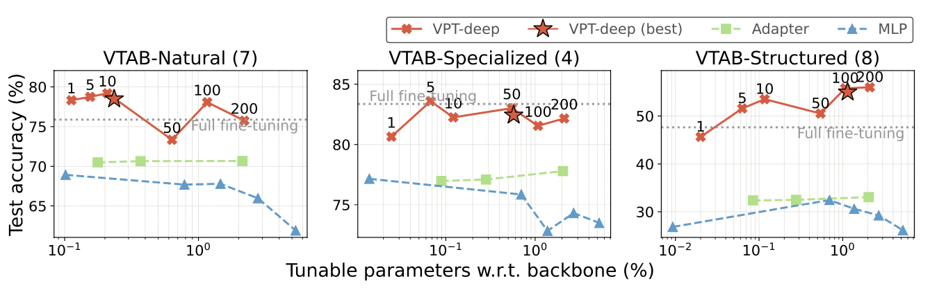
May need to add many tokens

Slide 21
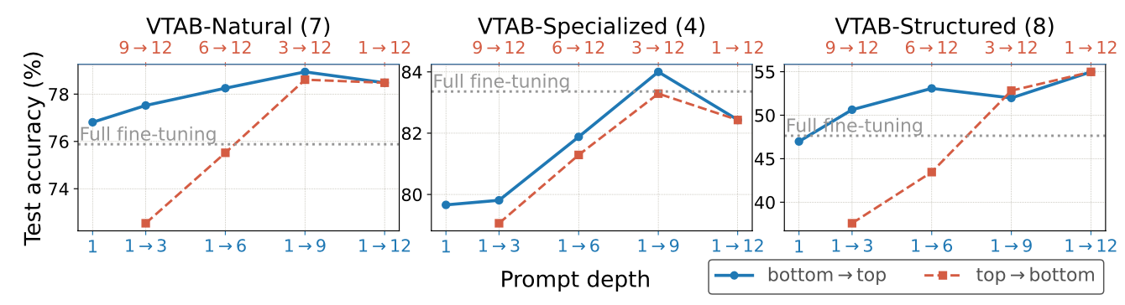
Tokens in early layers is better than later layers

Slide 22
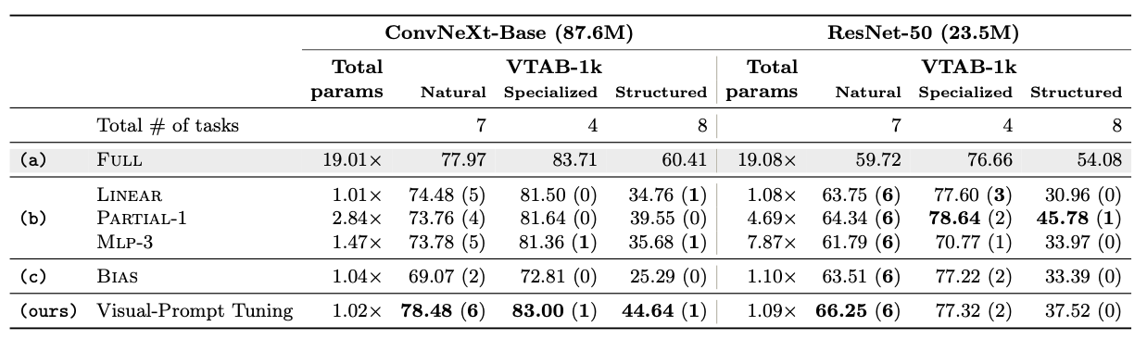
Also applicable to CNNs!

Slide 23
All representations are at the same scale

Slide 24
FPNs for CNN Object Detectors

Slide 25
SWin Transformer (Patch Merging)
Merge 2x2 neighboring patches
Apply linear layer on the 4C-dimensional concatenated features (no pooling?)
Reduces number of tokens by a factor of 4
Output channels is set to 2C

Slide 26
SWin Transformer

Slide 27
SWin Transformer

Slide 28
SWin Transformer

Slide 29
Plain ViT Backbones

Slide 30
Plain ViT Backbones

Slide 31
Plain ViT Backbones

Slide 32
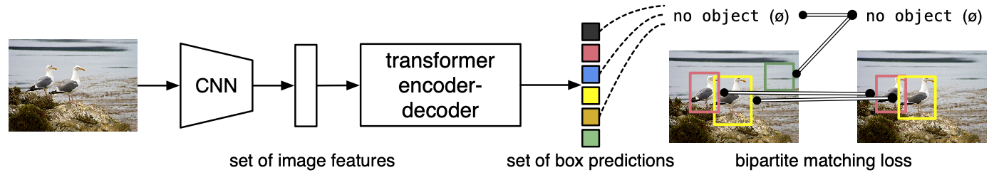
End-to-End Object Detection with Transformers
Do we need specialized machinery (i.e. Faster RCNN) for object detection?
Cast detection as a set prediction problem
End-to-End Object Detection with Transformers, Carion et al. ECCV 2020

Slide 33
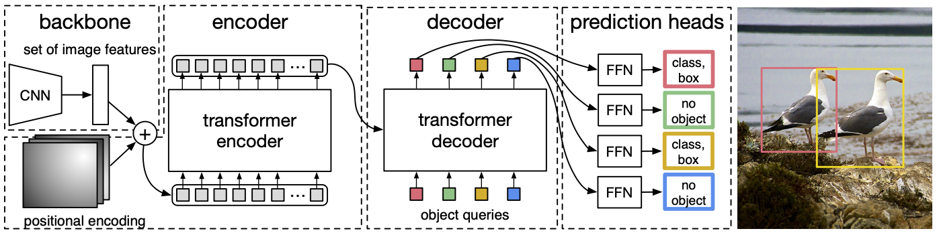
End-to-End Object Detection with Transformers
Architecture
End-to-End Object Detection with Transformers, Carion et al. ECCV 2020

Slide 34
End-to-End Object Detection with Transformers
Set matching loss function
End-to-End Object Detection with Transformers, Carion et al. ECCV 2020

Slide 35
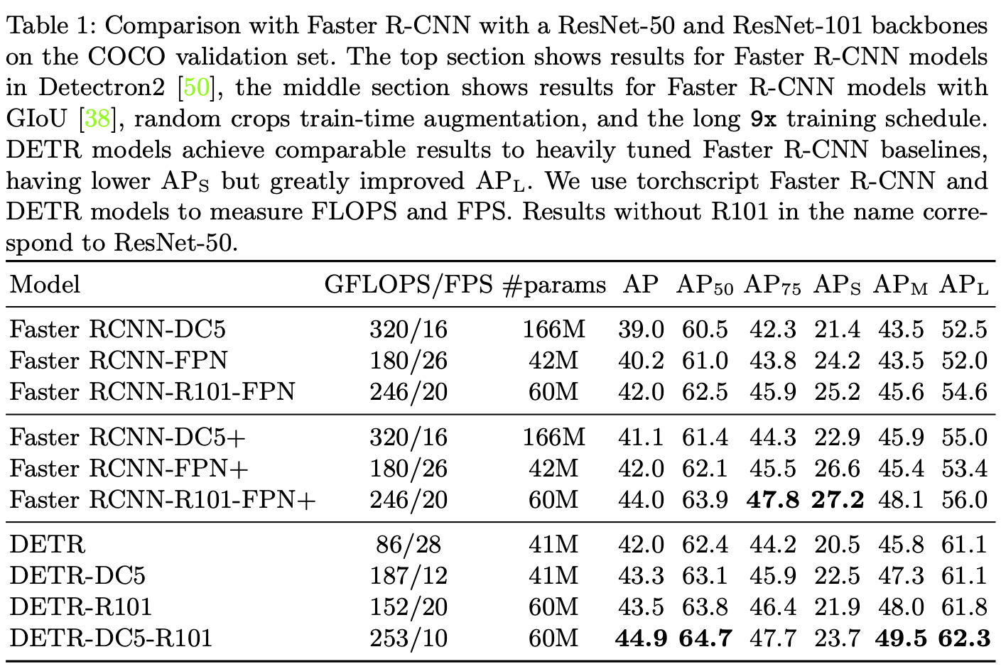
Comparison against Faster RCNN

Slide 36
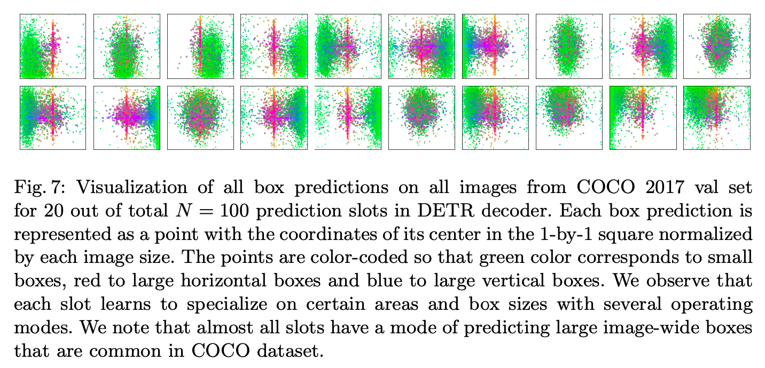
What do object queries learn?

