Slide 1
Self-Supervision
Saurabh Gupta
CS 543 / ECE 549

Slide 2
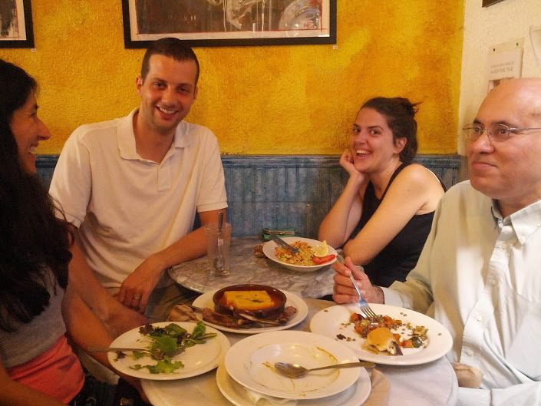
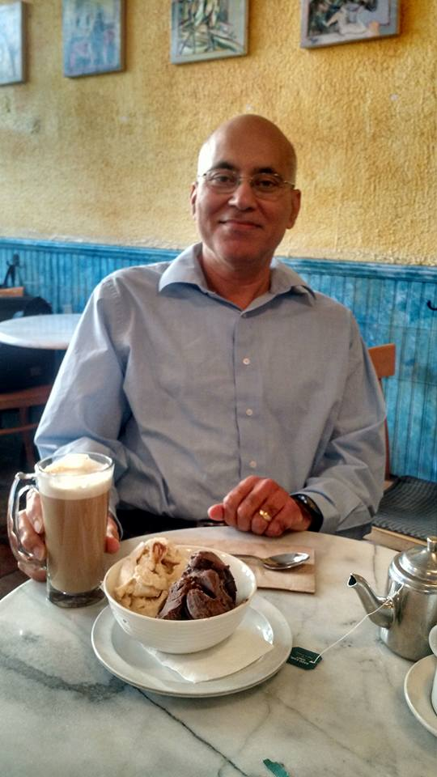
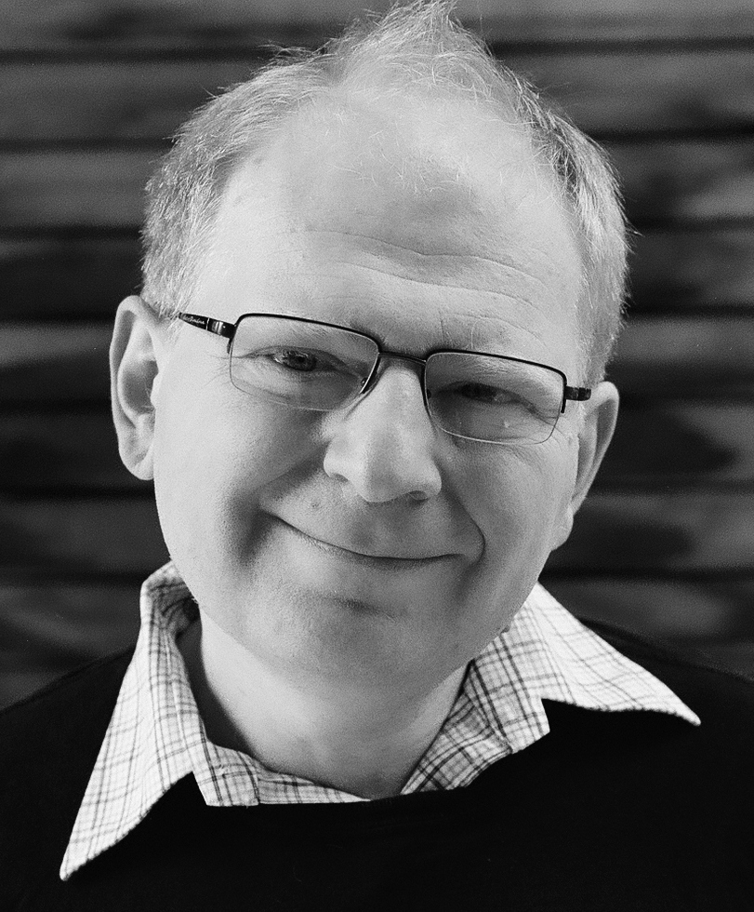
Is semantic supervision necessary to learn good representations?
Manual labeling doesn’t scale, suffers from biases
Plenty of unlabeled visual data already, and growing really fast
And subject of the Gelato Bet:
If, by the first day of autumn (Sept 23) of 2015, a method will exist that can match or beat the performance of R-CNN on Pascal VOC detection, without the use of any extra, human annotations (e.g. ImageNet) as pre-training, Mr. Malik promises to buy Mr. Efros one (1) gelato (2 scoops: one chocolate, one vanilla).
The Gelato Bet

Slide 3
Pre-train representations on a pre-text task
E.g. Colorization
Many other possibilities,
Spatial relationship between pair of patches
Predict sound / frame ordering in a video
Encourage two augmentations of same image to be closer to each other than to another image
Predict hidden image patches from context
After pre-training, use representation for down-stream tasks.
Split-Brain Autoencoders: Unsupervised Learning by Cross-Channel Prediction, Zhang et al. CVPR 2017
Context as Supervisory Signal: Discovering Objects with Predictable Context, Doersch et al. ICCV 2015

Slide 4
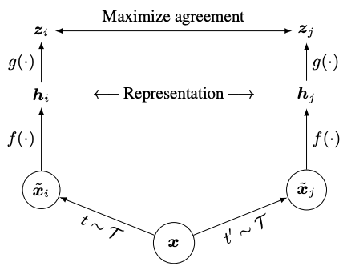
Contrastive Learning
Encourage two augmentations of an image to be close.
Using acontrastive loss:
A Simple Framework for Contrastive Learning of Visual Representations, Chen et al. ICML 2020
See also: Momentum Contrast for Unsupervised Visual Representation Learning, He et al. CVPR 2020

Slide 5
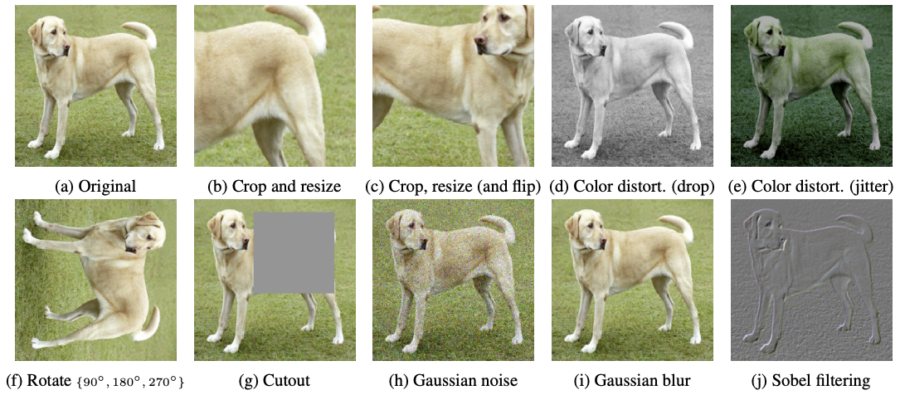
Augmentations
A Simple Framework for Contrastive Learning of Visual Representations, Chen et al. ICML 2020

Slide 6
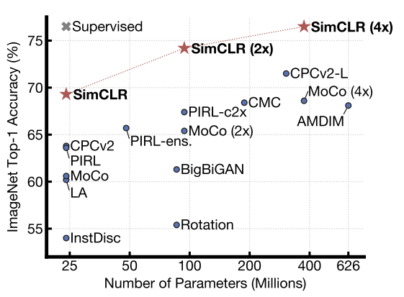
Results
A Simple Framework for Contrastive Learning of Visual Representations, Chen et al. ICML 2020

Slide 7
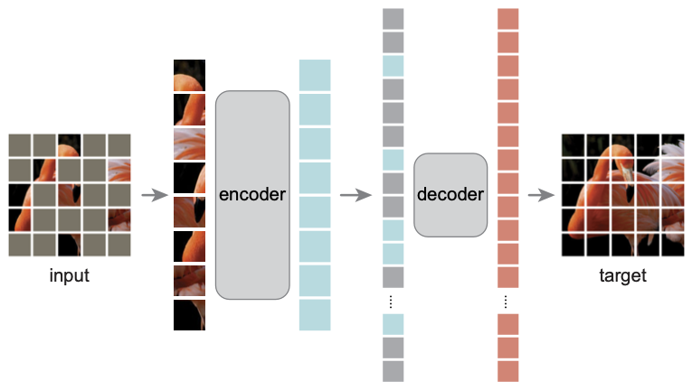
Masked Auto-Encoders
Mask out image patches, predict masked patches from visible patches.
Pre-train encoder & decoder.
Use encoder as an image representation.
Masked Autoencoders Are Scalable Vision Learners, He et al. CVPR 2022

Slide 8
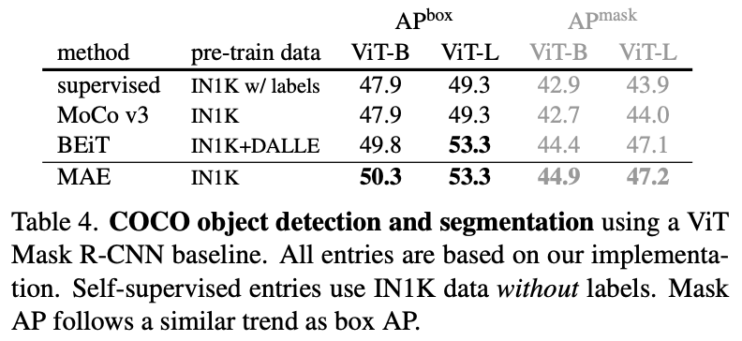
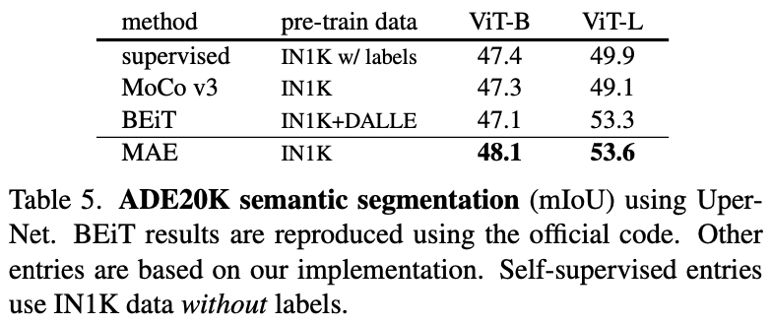
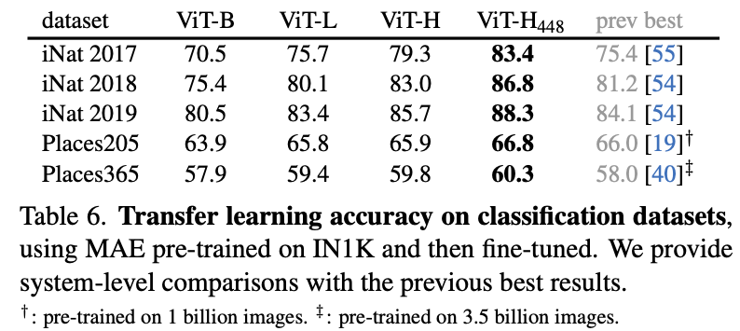
Better than semantic supervision on ImageNet 1K!
Masked Autoencoders Are Scalable Vision Learners, He et al. CVPR 2022

Slide 9
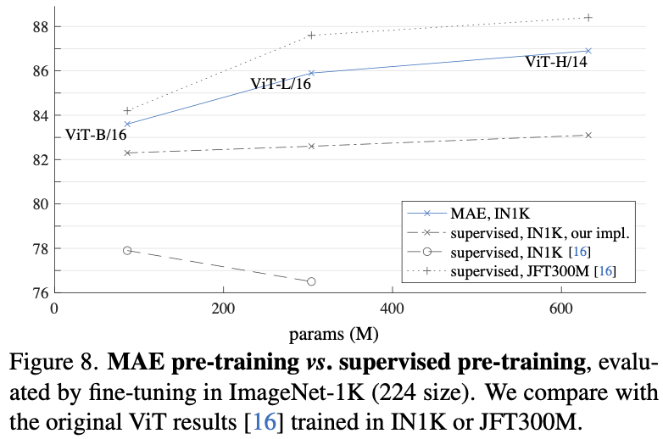
Improves performance on ImageNet itself
Masked Autoencoders Are Scalable Vision Learners, He et al. CVPR 2022

Slide 10
Better than past self-supervision approaches
Masked Autoencoders Are Scalable Vision Learners, He et al. CVPR 2022

Slide 11
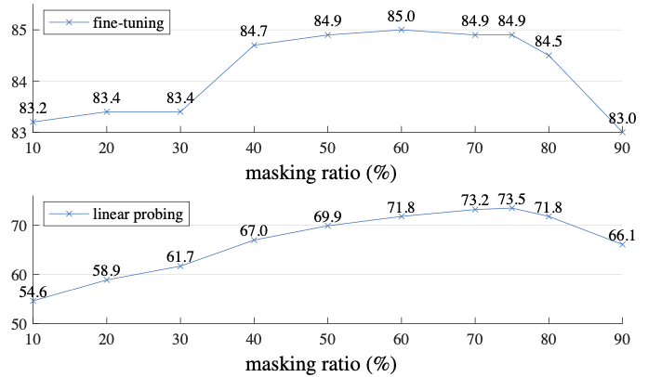
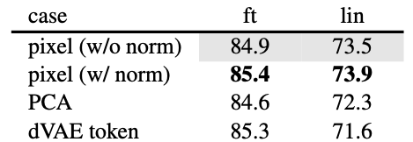
Ablations
Faster and better to not input masked out patches to encoder
Normalized pixels are a better target than discrete tokens / PCA coefficients
Need high masking ratio for good learning. NLP models use 15-20% masking ratio.
Masked Autoencoders Are Scalable Vision Learners, He et al. CVPR 2022

