Slide 1
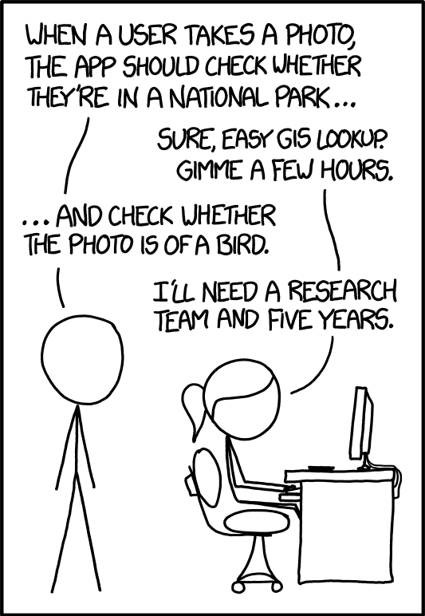
CS543 / ECE549
Computer Vision
Spring 2023
Course webpage URL:
http://saurabhg.web.illinois.edu/teaching/ece549/sp2023/

Slide 2
Course overview
Early vision: Image formation and processing
Mid-level vision: Grouping and fitting
Multi-view geometry
Recognition
Additional topics

Slide 3


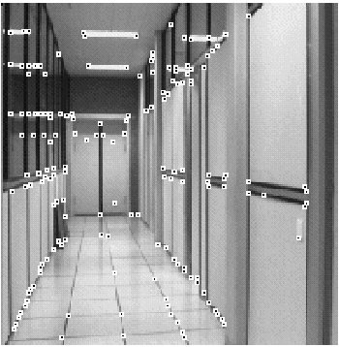
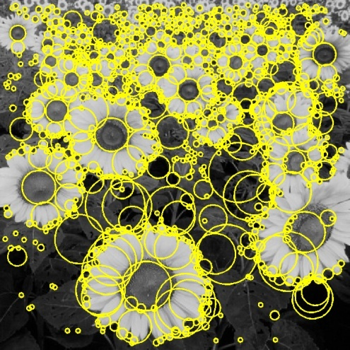
I. Early vision
Basic image formation and processing
*
=
Linear filtering
Edge detection
Cameras and sensors
Light and color
Feature extraction
Optical flow
Source: L. Lazebnik

Slide 4
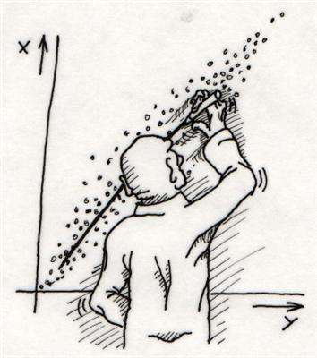
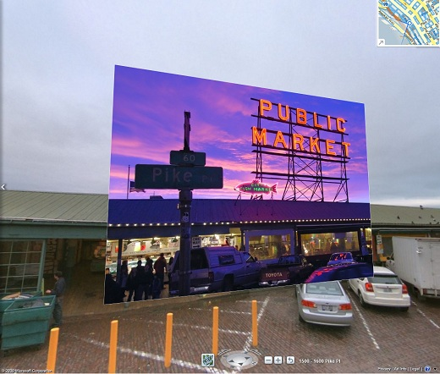
II. “Mid-level vision”
Fitting and grouping
Fitting: Least squares
Voting methods
Alignment
Source: L. Lazebnik

Slide 5
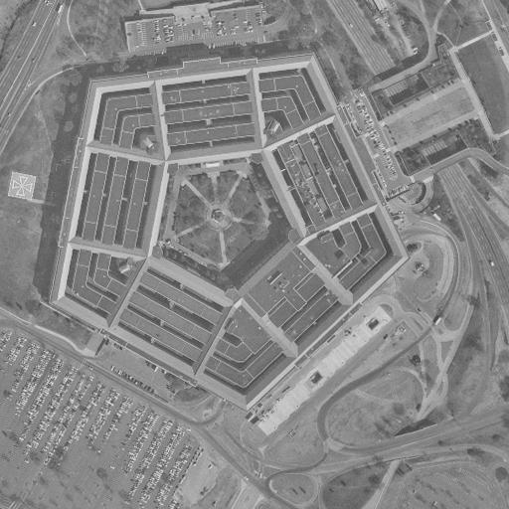
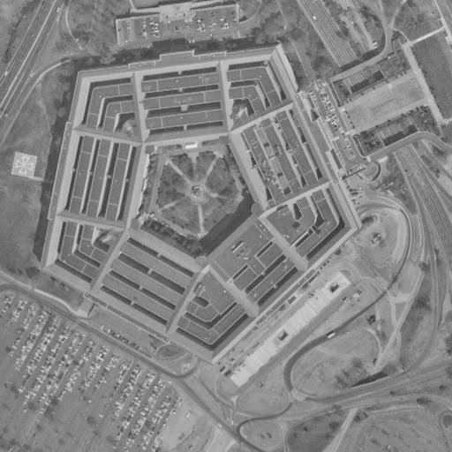
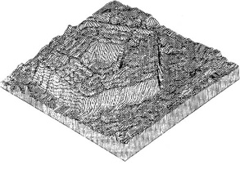
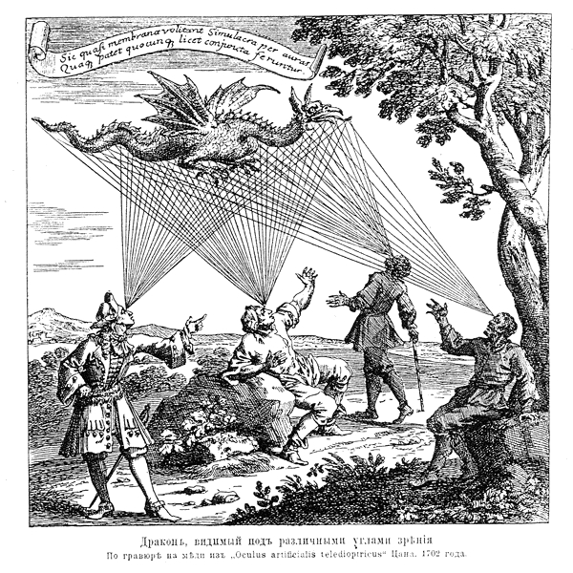

III. Multi-view geometry
Epipolar geometry
Two-view stereo
Structure from motion
Multi-view stereo
Source: L. Lazebnik

Slide 6
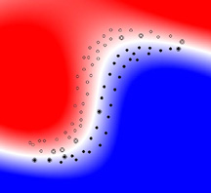
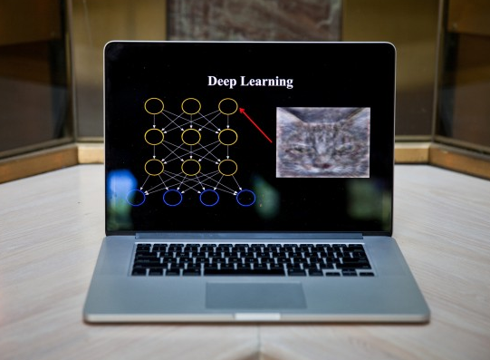
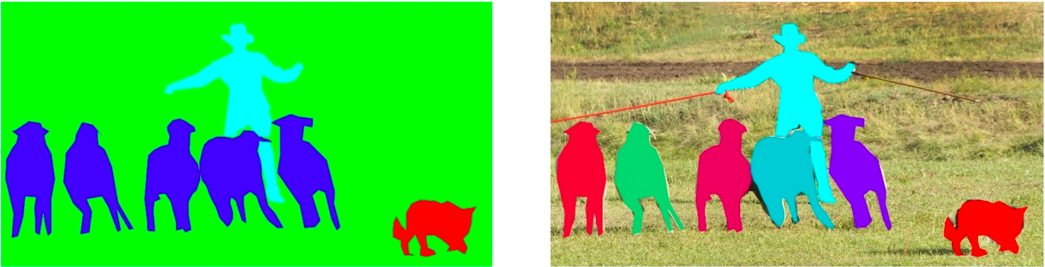
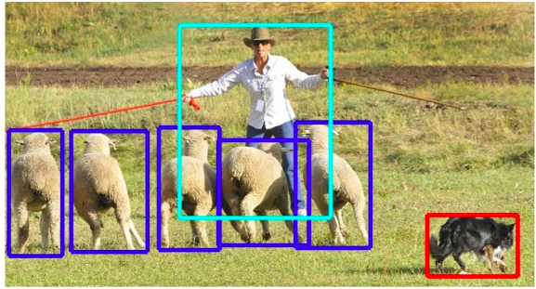
IV. Recognition
Basic classification
Deep learning
Object detection
Source: L. Lazebnik
Segmentation

Slide 7
What’s next?
Machine Learning (CS 446)
Applied Machine Learning (CS 441)
Deep Learning for Computer Vision (CS 444)
Advanced Classes:
  Robot Perception (Shenlong)
  3D Vision (Derek)
  Robot Learning (Saurabh, Yunzhu)
  Autonomous Vehicles (DAF)
  Learning to Learn (Yuxiong)
  Efficient & Predictive Vision (Lynna)
  Meta-Vision (Lana)
  Deep Generative and Dynamical Models (Arindam)

