Slide 1
Review - Computer Vision
Saurabh Gupta
Many slides adapted from B. Hariharan, L. Lazebnik, N. Snavely, Y. Furukawa.

Slide 2
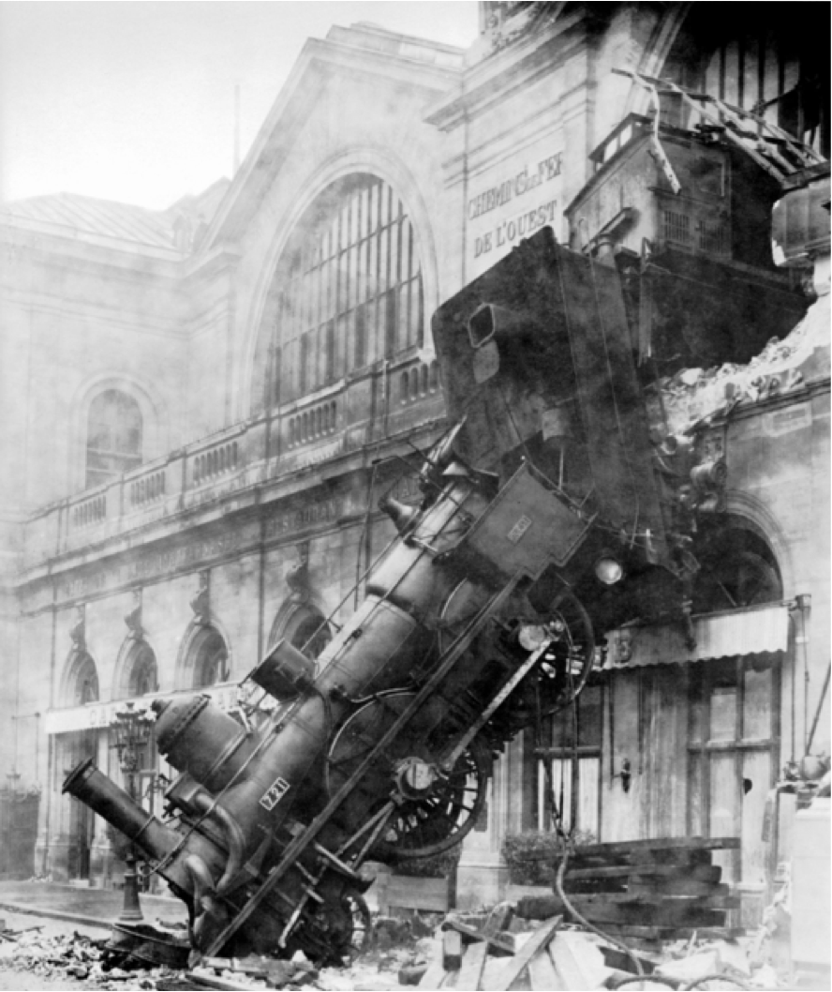
The goal(s) or computer vision
What is the image about?
What objects are in the image?
Where are they?
How are they oriented?
What is the layout of the scene in 3D?
What is the shape of each object?
Source: B. Hariharan

Slide 3
Vision is easy for humans
Source: B. Hariharan

Slide 4
Vision is easy for humans
Source: L. Lazebnik
Source: “80 million tiny images” by Torralba et al.

Slide 5
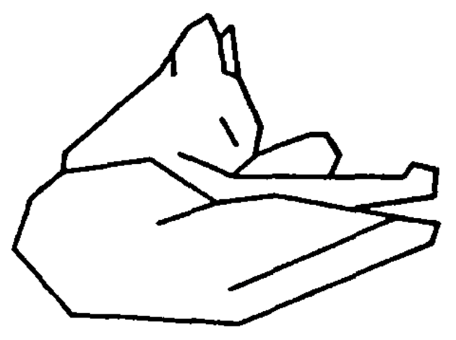
Vision is easy for humans
Attneave’s Cat
Source: B. Hariharan

Slide 6
Vision is easy for humans
Mooney Faces
Source: B. Hariharan

Slide 7
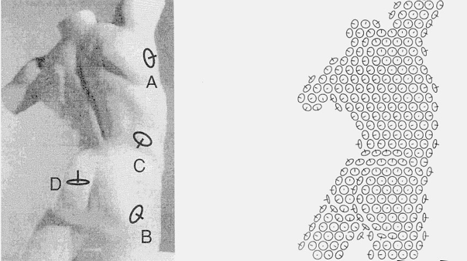
Vision is easy for humans
Surface perception in pictures. Koenderink, van Doorn and Kappers, 1992
Source: J. Malik

Slide 8
Remarkably Hard for Computers
Source: XKCD

Slide 9
Vision is hard: Objects Blend Together
Source: B. Hariharan

Slide 10
Vision is hard: Objects Blend Together
Source: B. Hariharan

Slide 11
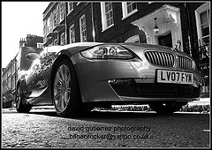
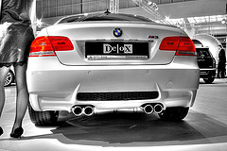
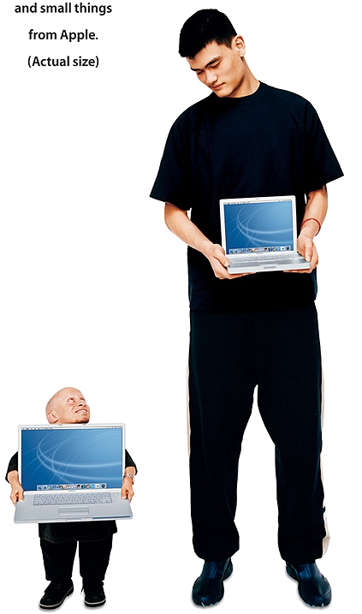
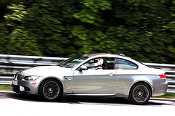
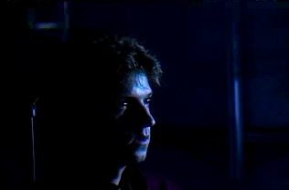
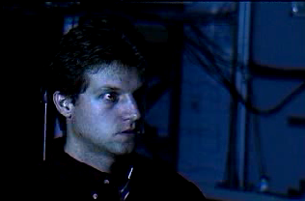
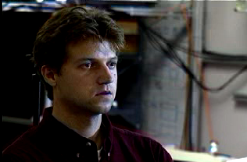
Vision is hard: Intra-class Variation
Viewpoint variation
Illumination
Scale
Source: B. Hariharan

Slide 12
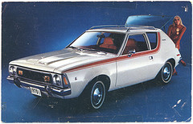
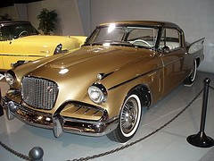
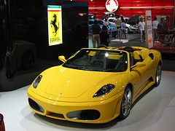
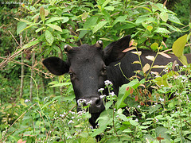
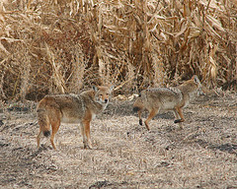
Vision is hard: Intra-class Variation
Shape variation
Occlusion
Background clutter
Source: B. Hariharan

Slide 13
Vision is hard: Intra-class Variation
Source: B. Hariharan

Slide 14
Vision is hard: Concepts are subtle
Tennessee Warbler
Orange Crowned Warbler
Source: B. Hariharan
https://www.allaboutbirds.org
Notes:
In addition, there is also a lot of variation among instances of the same kind of object.
This here, for example, is a very weird kind of chair.
It looks nothing like a chair, but it offers exactly the same functionality as a chair.
Our vision systems need to ignore, or be invariant to, such vast variations, and recognize things for what they really are.

Slide 15
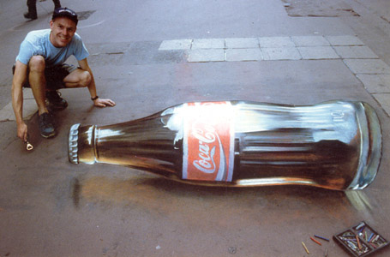
Vision is hard: Images are ambiguous
Source: B. Hariharan

Slide 16
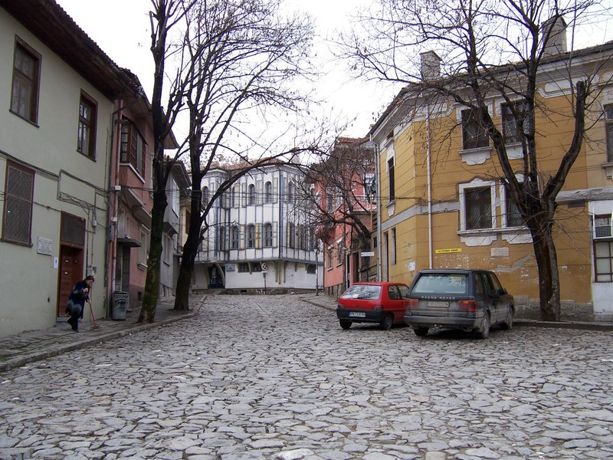
What kind of information can be extracted from an image?
…
Source: L. Lazebnik

Slide 17
What kind of information can be extracted from an image?
…
Geometric information
Source: L. Lazebnik

Slide 18
What kind of information can be extracted from an image?
roof
tree
tree
sky
chimney
building
building
window
door
trashcan
car
car
person
Outdoor scene
ground
City
European
…
Geometric information
Semantic information
Source: L. Lazebnik

Slide 19
Vision is hard: Images are ambiguous
Source: B. Hariharan

Slide 20
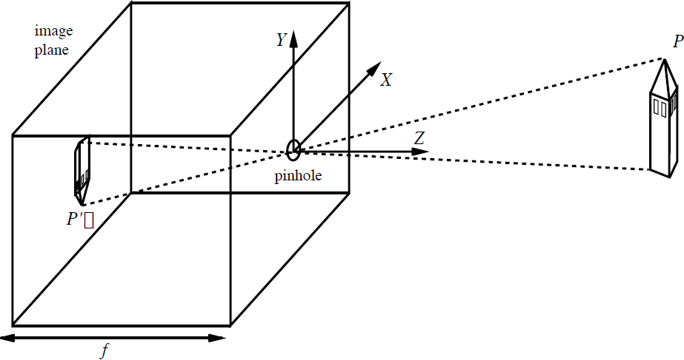
The Pinhole Camera
y
x
Source: J. Malik

Slide 21
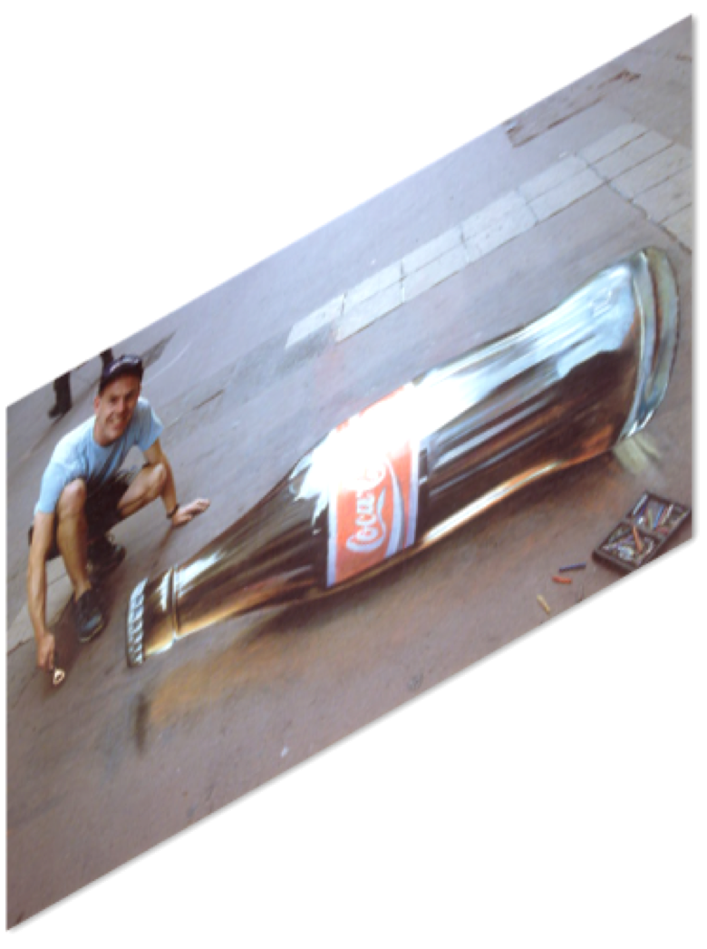

Slide 22
Get additional images!

Slide 23
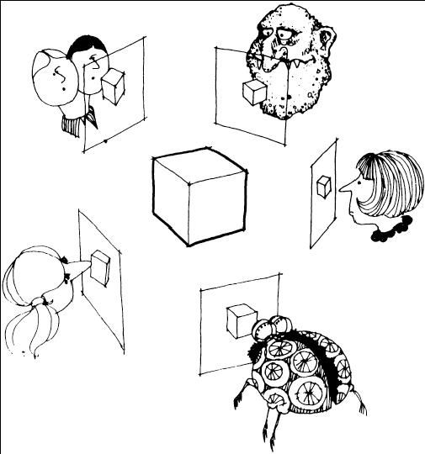
Structure from Motion
Many slides adapted from S. Seitz, Y. Furukawa, N. Snavely

Slide 24
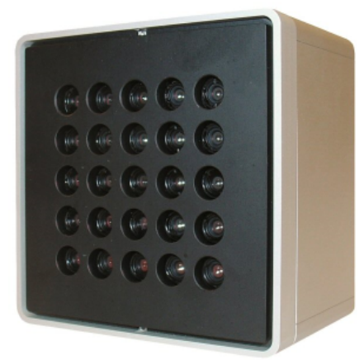
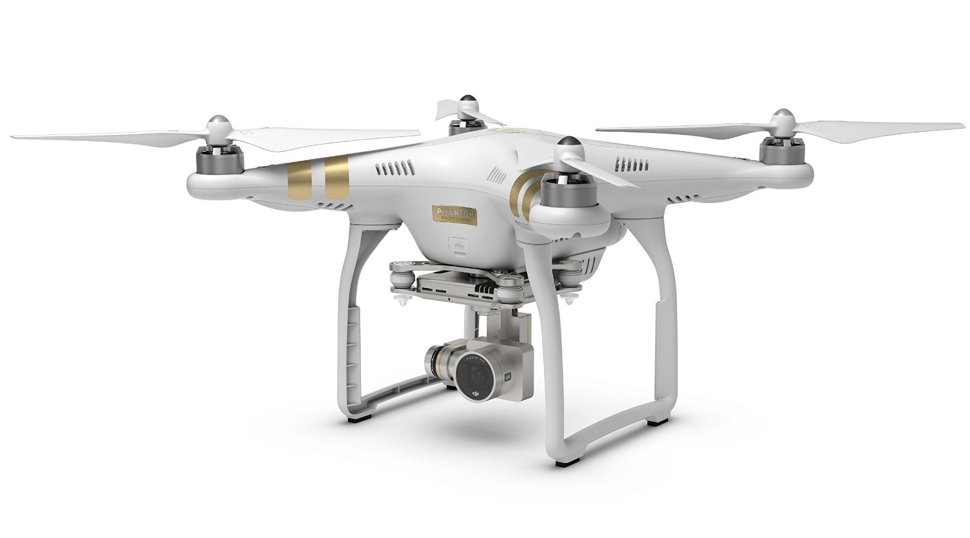
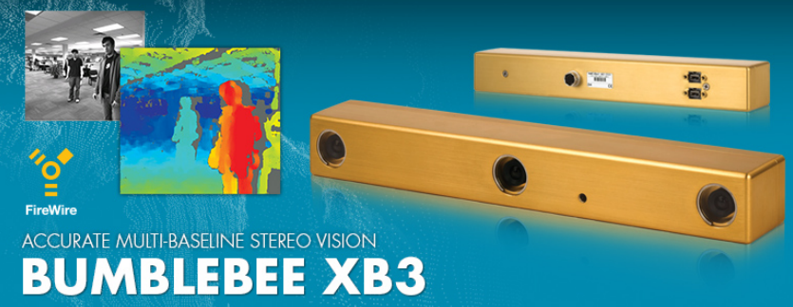
Structure from motion
Generic problem formulation: given several images of the same object or scene, compute a representation of its 3D shape
Images of the same object or scene
Arbitrary number of images (from two to thousands)
Arbitrary camera positions (special rig, camera network or video sequence)
Camera parameters may be known or unknown

Slide 25
Structure from motion
Given a set of corresponding points in two or more images, compute the camera parameters and the 3D point coordinates
?
Camera 1
?
Camera 2
?
?
Camera 3
R₁,t₁
R₃,t₃
R₂,t₂
Slide credit: Noah Snavely
Notes:
Structure from motion solves the following problem:
Given a set of images of a static scene with 2D points in correspondence, shown here as color-coded points, find…
a set of 3D points P and
a rotation R and position t of the cameras that explain the observed correspondences. In other words, when we project a point into any of the cameras, the reprojection error between the projected and observed 2D points is low.
This problem can be formulated as an optimization problem where we want to find the rotations R, positions t, and 3D point locations P that minimize sum of squared reprojection errors f. This is a non-linear least squares problem and can be solved with algorithms such as Levenberg-Marquart. However, because the problem is non-linear, it can be susceptible to local minima. Therefore, it’s important to initialize the parameters of the system carefully. In addition, we need to be able to deal with erroneous correspondences.

Slide 26
Structure from motion
Given: m images of n fixed 3D points
λ_{ij} x_{ij} = P_{i} X_{j} , i = 1, … , m, j = 1, … , n
Problem: estimate m projection matrices P_{i} and n 3D points X_{j} from the mn correspondences x_{ij}
X_{j}
x_{1j}
x_{3j}
x_{2j}
P₁
P₃
P₂

Slide 27
Structure from motion
Triangulation
Camera calibration

Slide 28
Incremental structure from motion
Initialize motion from two images using fundamental matrix
Initialize structure by triangulation
For each additional view:
Determine projection matrix of new camera using all the known 3D points that are visible in its image – calibration
points
cameras

Slide 29
Incremental structure from motion
Initialize motion from two images using fundamental matrix
Initialize structure by triangulation
For each additional view:
Determine projection matrix of new camera using all the known 3D points that are visible in its image – calibration
Refine and extend structure: compute new 3D points, re-optimize existing points that are also seen by this camera – triangulation
points
cameras

Slide 30
Incremental structure from motion
Initialize motion from two images using fundamental matrix
Initialize structure by triangulation
For each additional view:
Determine projection matrix of new camera using all the known 3D points that are visible in its image – calibration
Refine and extend structure: compute new 3D points, re-optimize existing points that are also seen by this camera – triangulation
Refine structure and motion: bundle adjustment
points
cameras

Slide 31
Bundle adjustment
Non-linear method for refining structure and motion
Minimize reprojection error
X_{j}
visibility flag: is point j visible in view i?
P₁X_{j}
x_{1j}
x_{3j}
P₃X_{j}
P₂X_{j}
x_{2j}
P₁
P₃
P₂

Slide 32
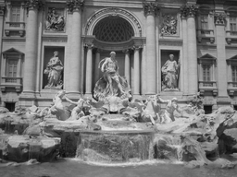
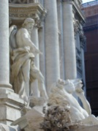
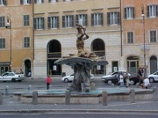
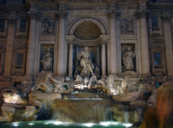
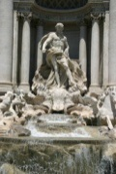
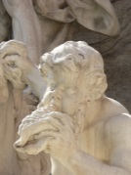
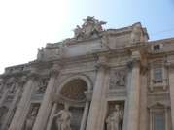
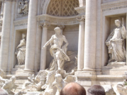
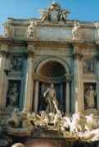
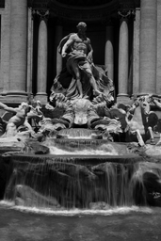
Feature detection
Source: N. Snavely
Notes:
So, we begin by detecting SIFT features in each photo.
[We detect SIFT features in each photo, resulting in a set of feature locations and 128-byte feature descriptors…]

Slide 33
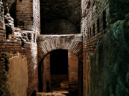
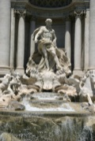
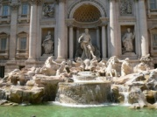
Feature detection
Detect SIFT features
Source: N. Snavely

Slide 34
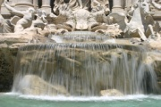
Feature matching
Match features between each pair of images
Source: N. Snavely
Notes:
Next, we match features across each pair of photos using approximate nearest neighbor matching.

Slide 35
The devil is in the details
Handling ambiguities
Handling degenerate configurations (e.g., homographies)
Eliminating outliers
Dealing with repetitions and symmetries

Slide 36
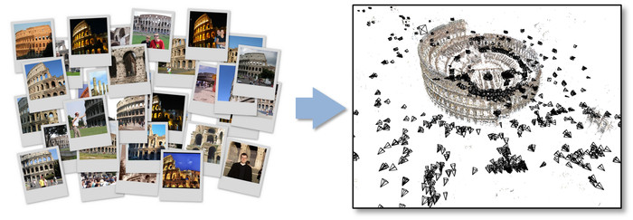
Photo Tourism
N. Snavely, S. Seitz, and R. Szeliski, Photo tourism: Exploring photo collections in 3D, SIGGRAPH 2006.
http://phototour.cs.washington.edu/, http://grail.cs.washington.edu/projects/rome/
Notes:
Here’s how the same set of photos appear in our photo explorer. Our system takes the set of photos and automatically determines the relative positions and orientations from which each photo was taken. We can then load the photos into our immersive 3D browser where the user can visualize and explore the photos using spatial relationships.

Slide 37
Depth from Triangulation
Camera 1
Camera 2
Camera
Projector
Passive Stereopsis
Active Stereopsis
Active sensing simplifies the problem of estimating point correspondences

Slide 38
Active stereo with structured light
Project “structured” light patterns onto the object
Simplifies the correspondence problem
Allows us to use only one camera
camera
projector
L. Zhang, B. Curless, and S. M. Seitz. Rapid Shape Acquisition Using Color Structured Light and Multi-pass Dynamic Programming. 3DPVT 2002
Slide from L. Lazebnik.

Slide 39
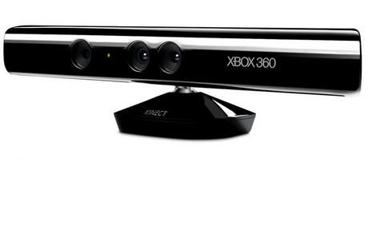
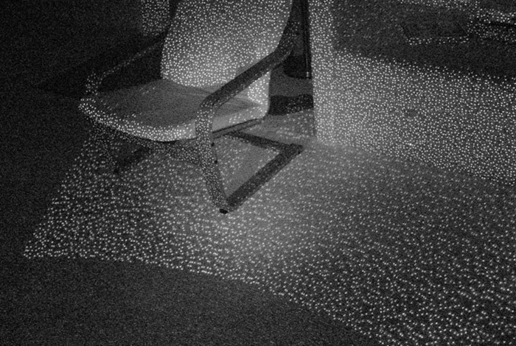
Kinect: Structured infrared light
http://bbzippo.wordpress.com/2010/11/28/kinect-in-infrared/
Slide from L. Lazebnik.

Slide 40
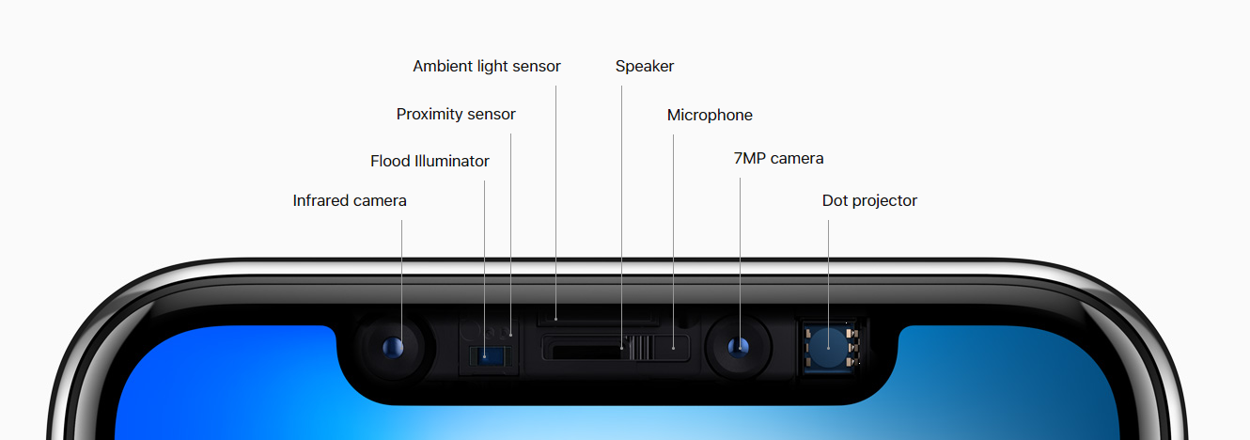
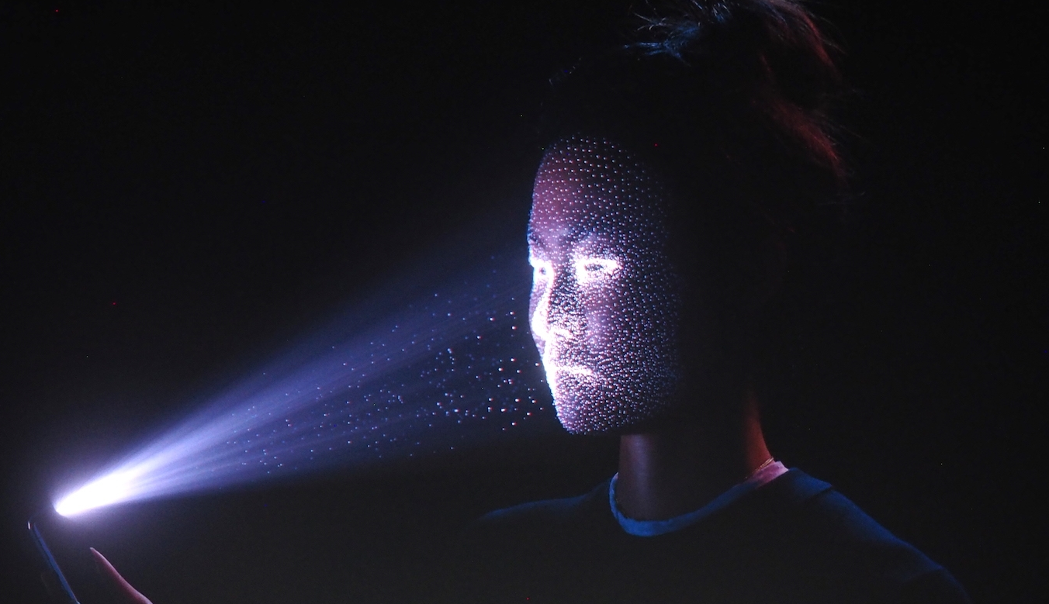
Apple TrueDepth
https://www.cnet.com/news/apple-face-id-truedepth-how-it-works/
Slide from L. Lazebnik.

Slide 41
SFM software
Bundler
OpenSfM
OpenMVG
VisualSFM
Colmap
See also Wikipedia’s list of toolboxes

Slide 42
Basis for SLAM
Specialized sensors
Approximately know camera location
Need dense reconstructions for path-planning
Needs to be fast

Slide 43
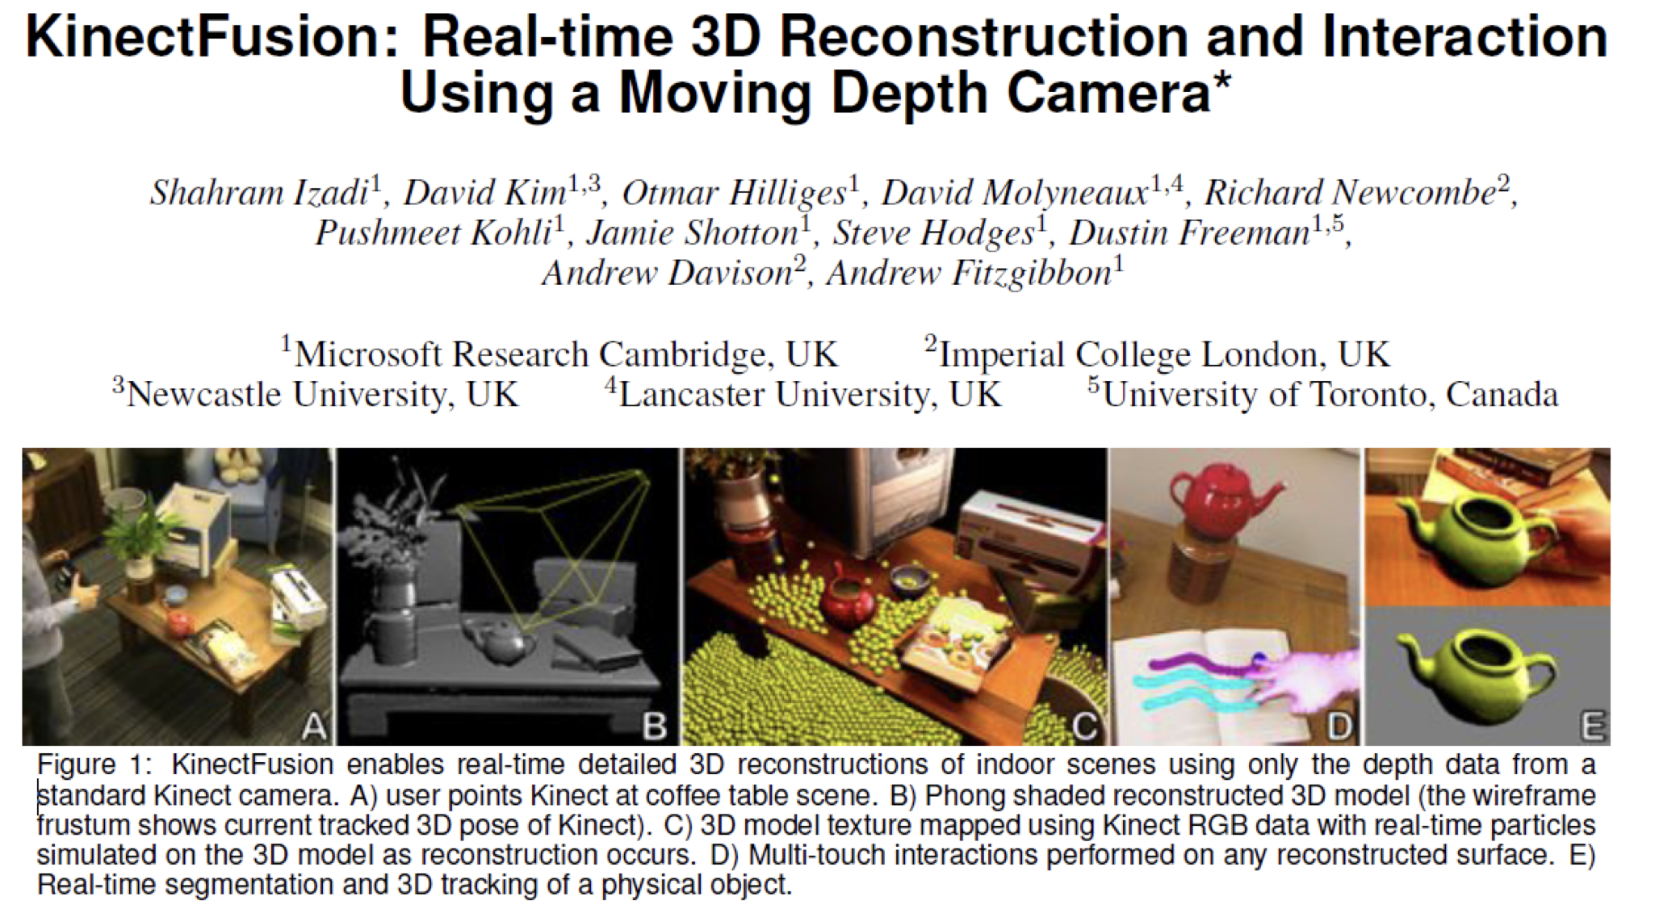
Kinect Fusion
Paper link (ACM Symposium on User Interface Software and Technology, October 2011)
YouTube Video

Slide 44
Reconstruction in construction industry
reconstructinc.com
Source: L. Lazebnik
Source: D. Hoiem

Slide 45
Applications
Source: N. Snavely
Interactive Example : https://matterport.com/en-gb/media/2486

Slide 46
What kind of information can be extracted from an image?
roof
tree
tree
sky
chimney
building
building
window
door
trashcan
car
car
person
Outdoor scene
ground
City
European
…
Geometric information
Semantic information
Source: L. Lazebnik

