Slide 1
Six Lessons from Babies
Linda Smith and Michael Gasser

Slide 2
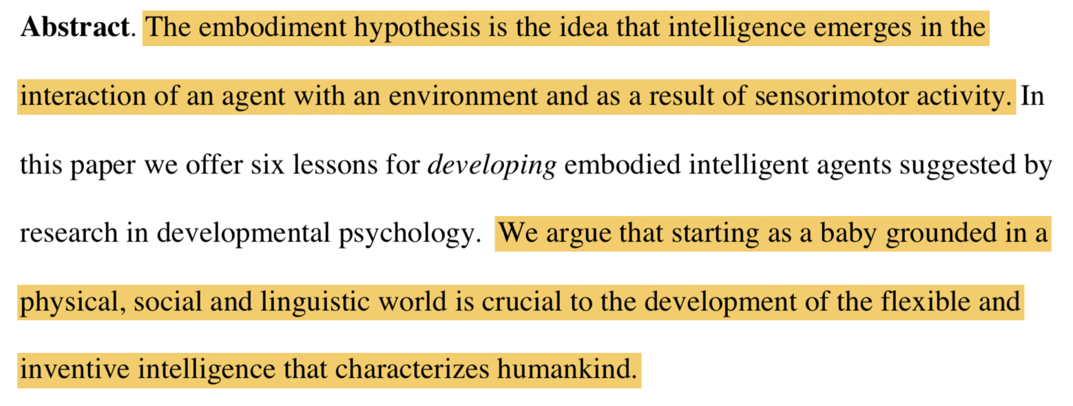
Embodiment Hypothesis

Slide 3
6 Lessons
Be Multi-model
Be Incremental
Be Physical
Explore
Be Social
Learn a Language

Slide 4
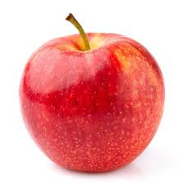
Be Multi-Modal
Babies experience of the world is profoundly multi-modal. We propose that multiple overlapping and time-locked sensory systems enable the developing system to educate itself – without defined external tasks or teachers – just by perceiving and acting in the world.
Vision
Haptics

Slide 5
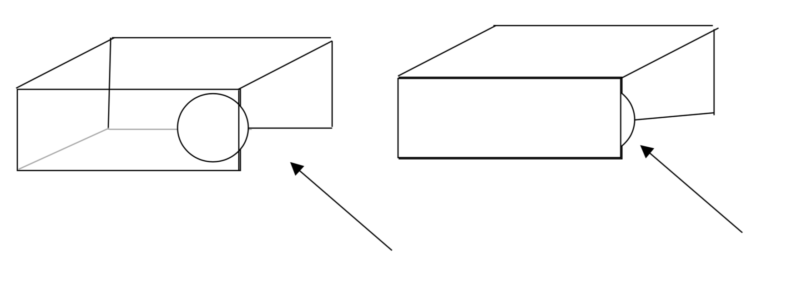
Transparent Objects
9 month old babies are better at retrieving object from opaque box than from the transparent box.
Infants who played with the transparent containers: sought out and rapidly found the openings and retrieved the object from the transparent boxes.

Slide 6
Tucker and Ellis task
Is this a pitcher?
Yes
No
Yes
No
No
Yes
No
Yes
Faster response, when Yes button is on the same side as the handle.

Slide 7
2. Be Incremental
Babies develop incrementally, and they are not smart at the start. We propose that their initial prematurity and the particular path they take to development are crucial to their eventual outpacing of the world's smartest AI programs.
Experience of babies changes over time as their capabilities increase.

Slide 8
Audition and Vision
Infants look in the direction of sound.
Infants look at visual events that match what they hear.
Children without audition show altered and more disorganized visual attention.

Slide 9
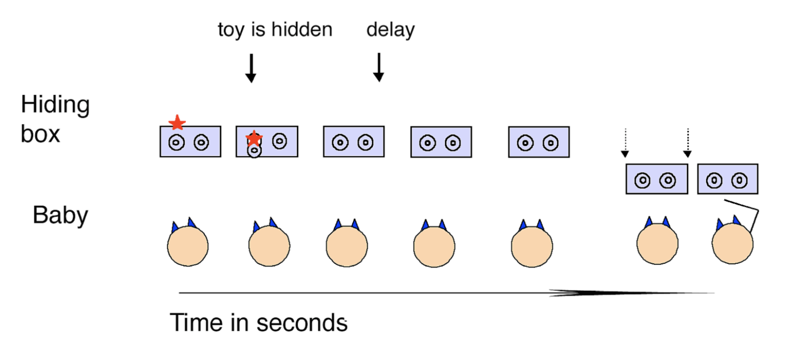
A-not-B and Self-Locomotion
Children that have self-locomoted reach for where the toy is hidden as opposed to children who haven’t yet self-locomoted who search where they searched before.

Slide 10
Ordering Matters
Opening kittens eyes early disrupts olfactory development and the subsequent coordination of vision and olfaction.
Disrupting the developmental order of audition and vision in owls disrupts spatial localization in both modalities.

Slide 11
3. Be Physical
Babies live in a physical world, full of rich regularities that organize perception, action, and ultimately thought. The intelligence of babies resides not just inside themselves but is distributed across their interactions and experiences in the physical world. The physical world serves to bootstrap higher mental functions.

Slide 12
3. Be Physical

Slide 13
3. Be Physical
People routinely and apparently unconsciously gesture with one hand when speaking of one protagonist in a story and gesture with the other hand when speaking of a different protagonist.
People also use space as a mnemonic, looking in the direction of a past event to help remember that event. (Hollywood Square experiment)

Slide 14
4. Explore
Babies explore – they move and act in highly variable and playful ways that are not goal-oriented and are seemingly random. In doing so, they discover new problems and new solutions. Exploration makes intelligence open-ended and inventive.

Slide 15
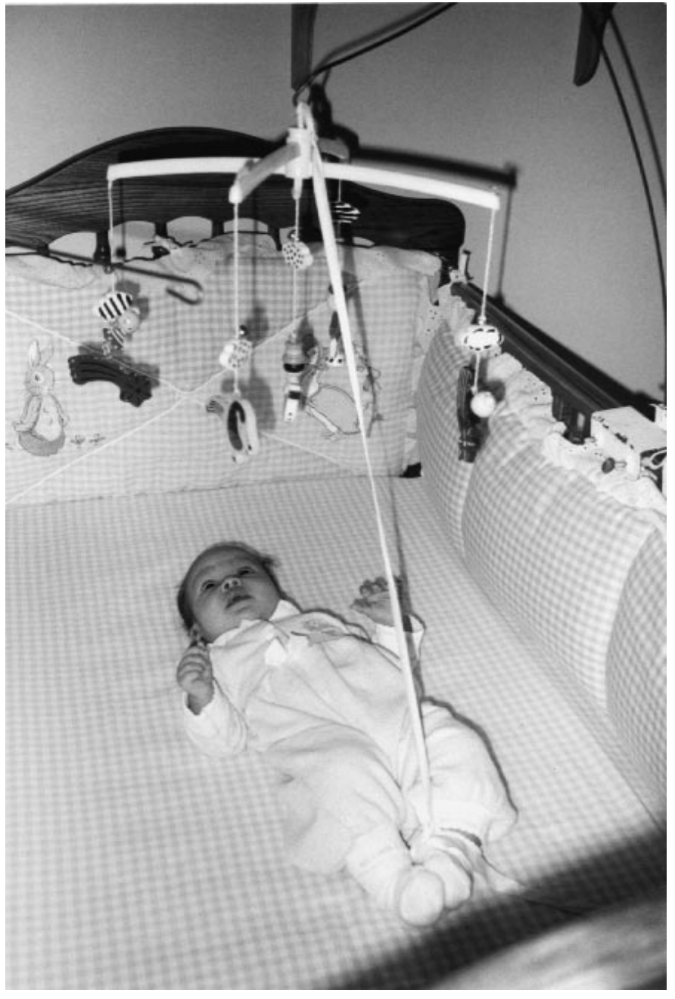
4. Explore
Reaching: Different babies go about learning how to reach objects in different ways.
Infant Conjugate Reinforcement: Infants increase kicking above baseline levels (where they don’t control the mobile toy).

Slide 16
5. Be Social
Babies act and learn in a social world in which more mature partners guide learning and add supporting structures to that learning.

Slide 17
5. Be Social
Mothers’ facial gestures and the sounds they make are tightly coupled to the babies’ behavior.
Parents provide the structure for learning by imitating their babies.
Parents introduce objects, call out their names, shake them to make babies attend to them.

Slide 18
6. Learn a language
Babies learn a language, a shared communicative system that is symbolic. And this changes everything, enabling children to form even higher-level and more abstract distinctions.

Slide 19
6. Learn a language
Gain direct access to knowledge of other people.
Explicit categorization and generalizations for supervised category learning.
Language learning may be key to becoming symbolic.

Slide 20
6. Learn a language
Languages are symbol systems: symbols are abstract. Most words by themselves do not indicate what we are referring to.
Infact, if symbols are too close to the actual world, they aren’t used as symbols.
It has long been suggested that the way into symbolic processing is through language, and though this idea remains controversial, we believe it is worth taking seriously.

Slide 21
6 Lessons
Be Multi-modal
Be Incremental
Be Physical
Explore
Be Social
Learn a Language
How can we operationalize these?

Slide 22
Discussion
Think of 2 examples among papers we have read in class that operationalize these insights
Think of 2 ways, not covered in class, in which we can invoke insights from this paper

