Slide 1
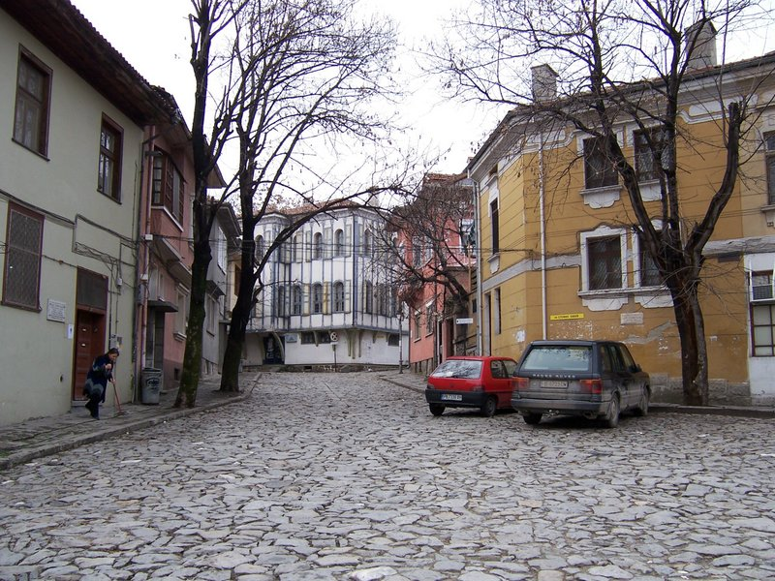
What kind of information can be extracted from an image?
roof
tree
tree
sky
chimney
building
building
window
door
trashcan
car
car
person
Outdoor scene
ground
City
European
…
Geometric information
Semantic information
Source: L. Lazebnik

Slide 2
Today’s plan
Extracting semantic information from images
  The statistical learning framework
  Neural networks and how to train them
  Building blocks for designing neural networks for images
  Extending neural networks for more complex tasks
  Sequence modeling

Slide 3
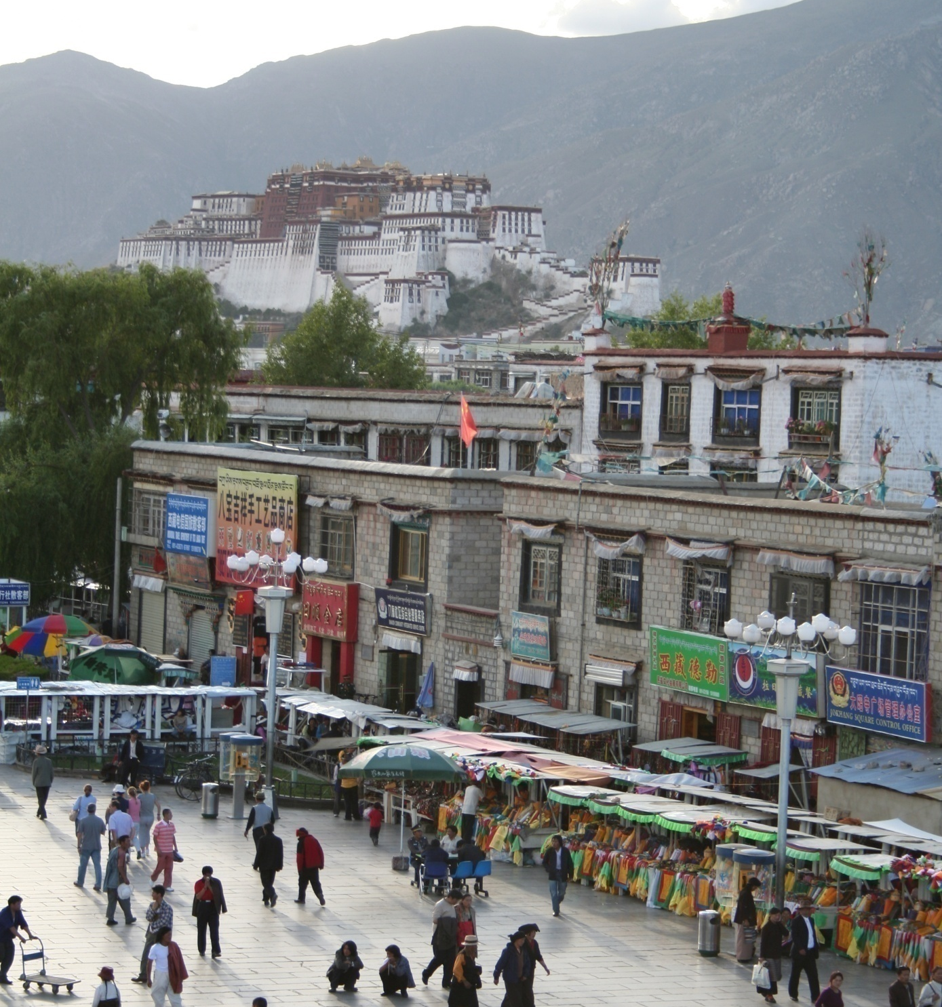
Common recognition tasks
Adapted from Fei-Fei Li
Slide from L. Lazebnik.

Slide 4
Image classification and tagging
outdoor
mountains
city
Asia
Lhasa
…
Adapted from Fei-Fei Li
Slide from L. Lazebnik.

Slide 5
Object detection
find pedestrians
Adapted from Fei-Fei Li
Slide from L. Lazebnik.

Slide 6
Activity recognition
walking
shopping
rolling a cart
sitting
talking
…
Adapted from Fei-Fei Li
Slide from L. Lazebnik.

Slide 7
Semantic segmentation
Adapted from Fei-Fei Li
Slide from L. Lazebnik.

Slide 8
Semantic segmentation
sky
mountain
building
tree
building
lamp
lamp
umbrella
umbrella
person
market stall
person
person
person
person
ground
Adapted from Fei-Fei Li
Slide from L. Lazebnik.

Slide 9
Image description
This is a busy street in an Asian city. Mountains and a large palace or fortress loom in the background. In the foreground, we see colorful souvenir stalls and people walking around and shopping. One person in the lower left is pushing an empty cart, and a couple of people in the middle are sitting, possibly posing for a photograph.
Adapted from Fei-Fei Li
Slide from L. Lazebnik.

Slide 10



The statistical learning framework
Apply a prediction function to a feature representation of the image to get the desired output:
f( ) = “apple”
f( ) = “tomato”
f( ) = “cow”
Slide from L. Lazebnik.

Slide 11
The statistical learning framework
y = f(x)
Training: given a training set of labeled examples
{(x₁,y₁), …, (x_{N},y_{N})}, estimate the prediction function f by minimizing the prediction error on the training set
Testing: apply f to a never before seen test example x and output the predicted value y = f(x)
output
prediction function
feature representation
Slide from L. Lazebnik.

Slide 12
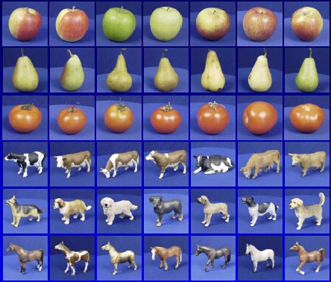

Steps
Training
Training Labels
Training Images
Image Features
Training
Learned model
Learned model
Testing
Image Features
Prediction
Test Image
Slide credit: D. Hoiem

Slide 13
“Classic” recognition pipeline
Feature representation
Trainable
classifier
Image
Pixels
Class label
  Hand-crafted feature representation
  Off-the-shelf trainable classifier
Slide from L. Lazebnik.

Slide 14
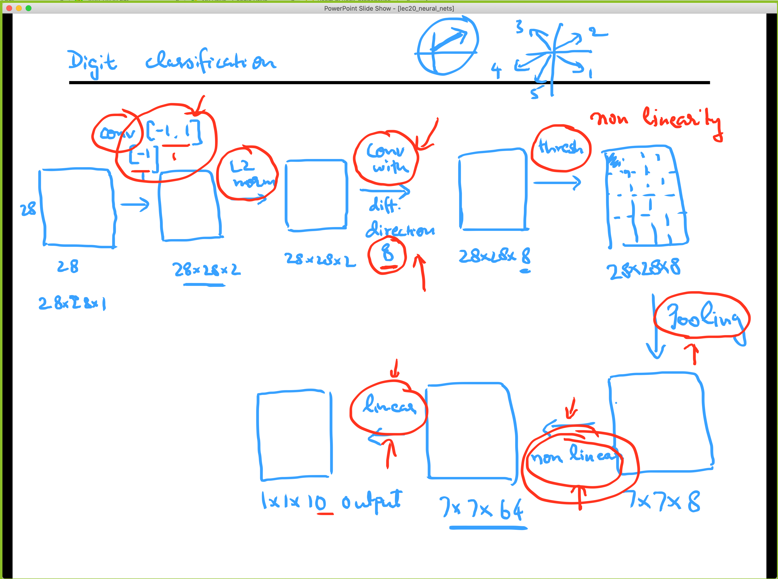

Slide 15

Neural networks or Multi-layer perceptrons
Flexible way of defining non-linear functions
  Linear layers interleaved with non-linearities

Slide 16
Neural networks or Multi-layer perceptrons
Flexible way of defining non-linear functions
  Linear layers interleaved with non-linearities
  To be trainable, the nonlinearity should be differentiable
Sigmoid:
Rectified linear unit (ReLU): g(t) = max(0,t)

Slide 17
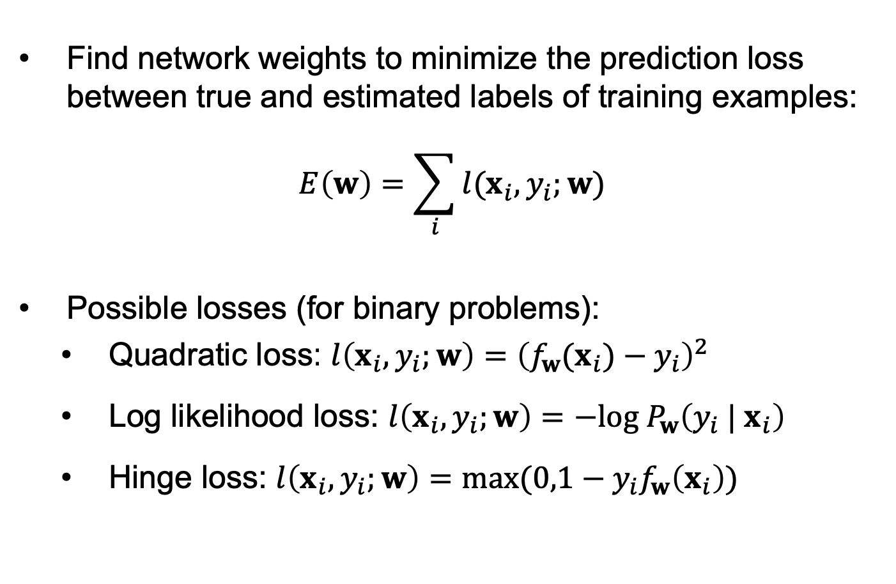
Training of multi-layer networks
Find network weights to minimize the prediction loss between true and estimated labels of training examples:
$$E\left(w\right)=\sum_{i}{l(x_{i},y_{i};w)}$$
Possible losses (for binary problems):
  Quadratic loss: $l\left(x_{i},y_{i};w\right)={\left(f_{w}(x_{i})−y_{i}\right)}^{2}$
  Log likelihood loss: $l\left(x_{i},y_{i};w\right)=−log⁡{ P}_{w}\left({y_{i} | x}_{i}\right)$
  Hinge loss: $l\left(x_{i},y_{i};w\right)=max⁡(0,1−y_{i}f_{w}\left(x_{i}\right))$

Slide 18
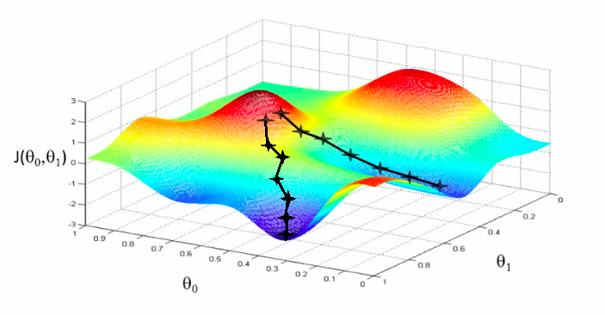
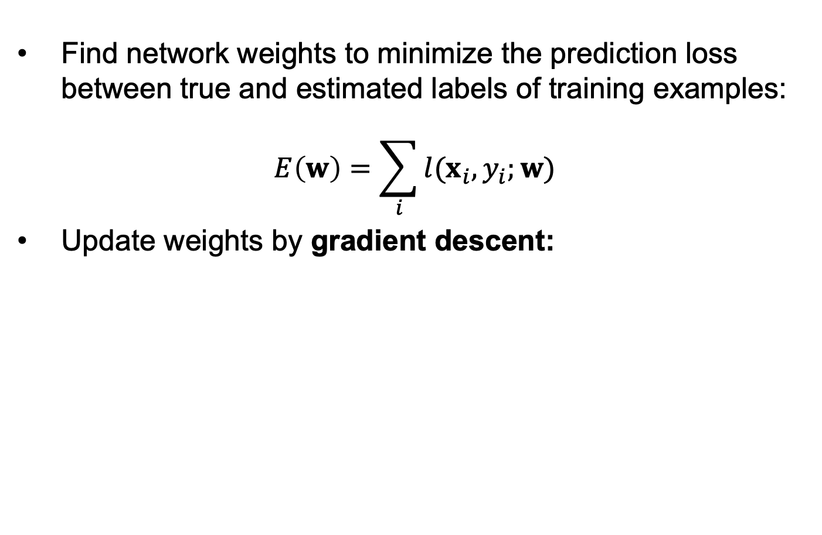
Training of multi-layer networks
Find network weights to minimize the prediction loss between true and estimated labels of training examples:
$$E\left(w\right)=\sum_{i}{l(x_{i},y_{i};w)}$$
Update weights by gradient descent:
w₂
w₁

Slide 19
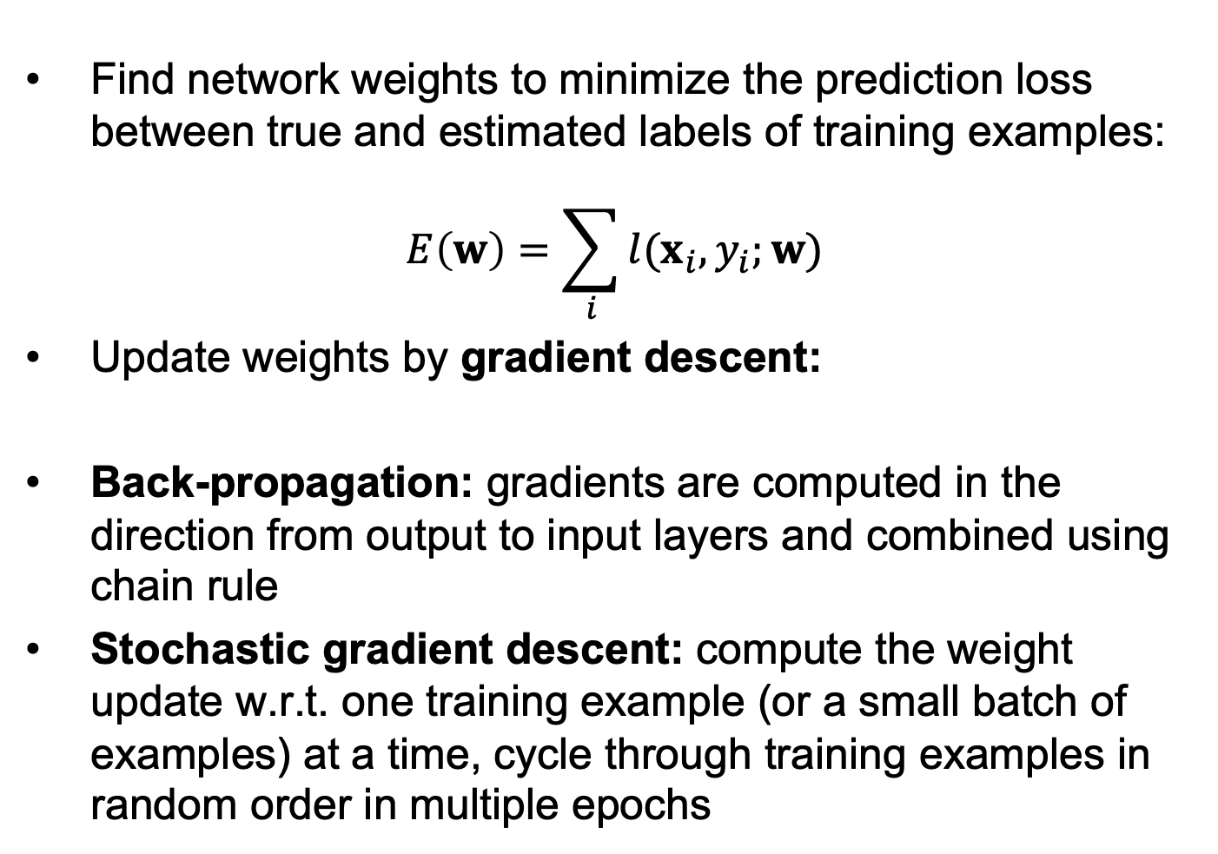
Training of multi-layer networks
Find network weights to minimize the prediction loss between true and estimated labels of training examples:
$$E\left(w\right)=\sum_{i}{l(x_{i},y_{i};w)}$$
Update weights by gradient descent:
Back-propagation: gradients are computed in the direction from output to input layers and combined using chain rule
Stochastic gradient descent: compute the weight update w.r.t. one training example (or a small batch of examples) at a time, cycle through training examples in random order in multiple epochs

Slide 20
Back-propagation

Slide 21
Back-propagation
Convolutional network
Gradient descent update
Slide from B. Hariharan

Slide 22
Computing the gradient of the loss
Slide from B. Hariharan

Slide 23
Convolutional networks
conv
subsample
conv
subsample
linear
filters
filters
weights
Slide from B. Hariharan

Slide 24
Gradient Computation
z₁
z₂
z₃
z₄
z₅ = z
f₁
f₂
f₃
f₄
f₅
x
w₁
w₂
w₃
w₄
w₅
Slide from B. Hariharan

Slide 25
Gradient Computation
z₁
z₂
z₃
z₄
z₅ = z
f₁
f₂
f₃
f₄
f₅
x
w₁
w₂
w₃
w₄
w₅
Slide from B. Hariharan

Slide 26
Gradient Computation
z₁
z₂
z₃
z₄
z₅ = z
f₁
f₂
f₃
f₄
f₅
x
w₁
w₂
w₃
w₄
w₅
Slide from B. Hariharan

Slide 27
Gradient Computation
z₁
z₂
z₃
z₄
z₅ = z
f₁
f₂
f₃
f₄
f₅
x
w₁
w₂
w₃
w₄
w₅
Slide from B. Hariharan

Slide 28
Gradient Computation
z₁
z₂
z₃
z₄
z₅ = z
f₁
f₂
f₃
f₄
f₅
x
w₁
w₂
w₃
w₄
w₅
Slide from B. Hariharan

Slide 29
Gradient Computation
z₁
z₂
z₃
z₄
z₅ = z
f₁
f₂
f₃
f₄
f₅
x
w₁
w₂
w₃
w₄
w₅
Slide from B. Hariharan

Slide 30
Gradient Computation
z₁
z₂
z₃
z₄
z₅ = z
f₁
f₂
f₃
f₄
f₅
x
w₁
w₂
w₃
w₄
w₅
Slide from B. Hariharan

Slide 31
Gradient Computation
z₁
z₂
z₃
z₄
z₅ = z
f₁
f₂
f₃
f₄
f₅
x
w₁
w₂
w₃
w₄
w₅
Slide from B. Hariharan

Slide 32
Gradient Computation
z₁
z₂
z₃
z₄
z₅ = z
f₁
f₂
f₃
f₄
f₅
x
w₁
w₂
w₃
w₄
w₅
Slide from B. Hariharan

Slide 33
Gradient Computation
z₁
z₂
z₃
z₄
z₅ = z
f₁
f₂
f₃
f₄
f₅
x
w₁
w₂
w₃
w₄
w₅
Slide from B. Hariharan

Slide 34
Gradient Computation
z₁
z₂
z₃
z₄
z₅ = z
f₁
f₂
f₃
f₄
f₅
x
w₁
w₂
w₃
w₄
w₅
Slide from B. Hariharan

Slide 35
Gradient Computation
z₁
z₂
z₃
z₄
z₅ = z
f₁
f₂
f₃
f₄
f₅
x
w₁
w₂
w₃
w₄
w₅
Slide from B. Hariharan

Slide 36
Gradient Computation
z₁
z₂
z₃
z₄
z₅ = z
f₁
f₂
f₃
f₄
f₅
x
w₁
w₂
w₃
w₄
w₅
Slide from B. Hariharan

Slide 37
Gradient Computation
z₁
z₂
z₃
z₄
z₅ = z
f₁
f₂
f₃
f₄
f₅
x
w₁
w₂
w₃
w₄
w₅
Recurrence going backward!!
Slide from B. Hariharan

Slide 38
Gradient Computation
z₁
z₂
z₃
z₄
z₅ = z
f₁
f₂
f₃
f₄
f₅
x
w₁
w₂
w₃
w₄
w₅
Back-Propagation
Slide from B. Hariharan

Slide 39
Backpropagation for a sequence of functions
Each “function” has a “forward” and “backward” module
Forward module for f_{i}
  takes z_{i-1} and weight w_{i} as input
  produces z_{i} as output
Backward module for f_{i}
  takes g(z_{i} ) as input
  produces g(z_{i-1} ) and g(w_{i}) as output
Slide from B. Hariharan

Slide 40
Backpropagation for a sequence of functions
z_{i-1}
f_{i}
z_{i}
w_{i}
Slide from B. Hariharan

Slide 41
Backpropagation for a sequence of functions
g(z_{i-1})
f_{i}
g(z_{i})
g(w_{i})
Slide from B. Hariharan

Slide 42
Computation graph - Functions
Each node implements two functions
  A “forward”
    Computes output given input
  A “backward”
    Computes derivative of z w.r.t input, given derivative of z w.r.t output
Slide from B. Hariharan

Slide 43
Computation graphs
a
f_{i}
b
d
c
Slide from B. Hariharan

Slide 44
Computation graphs
f_{i}
Slide from B. Hariharan

Slide 45
Computation graphs
a
f_{i}
b
d
c
Slide from B. Hariharan

Slide 46
Computation graphs
f_{i}
Slide from B. Hariharan

Slide 47




Neural network frameworks
Slide from B. Hariharan

Slide 48
Building blocks
Convolutional Layers
Non-linearities
Pooling
Fully-connected Layers
Attention Layers
Rationale?

Slide 49
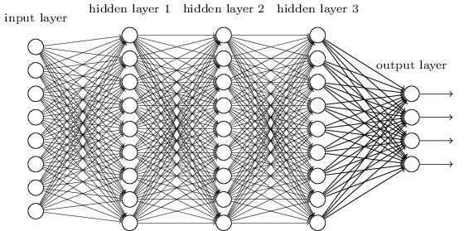
Neural networks for images
image
Fully connected layer

Slide 50
Neural networks for images
image

Slide 51
Neural networks for images
feature map
learned weights
image

Slide 52
Neural networks for images
another feature map
another set of learned weights
image

Slide 53
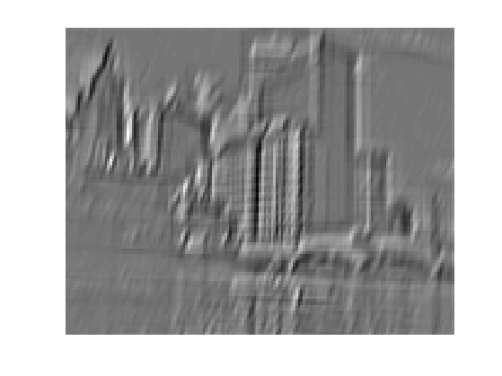
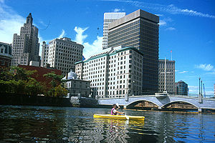
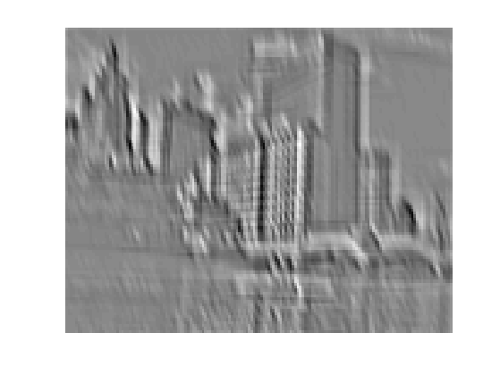
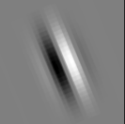
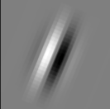
Convolution as feature extraction
bank of K filters
K feature maps
...
image
feature map

Slide 54
Convolutional layer
K feature maps
K filters
image
convolutional layer

Slide 55
Convolutional layer
L feature maps in the next layer
K feature maps
F x F x K filter
L filters
image
convolutional layer

Slide 56
Convolutional layer
Input
Convolutional Hyper-Parameters
  Kernel Size
  Number of Filters
  Padding
  Stride
Parameters
  Weights
  Biases
Output Size

Slide 57
Convolutional layer
K feature maps
Spatial resolution: (roughly) the same if stride of 1 is used, reduced by 1/S if stride of S is used
K filters
image
convolutional layer

Slide 58
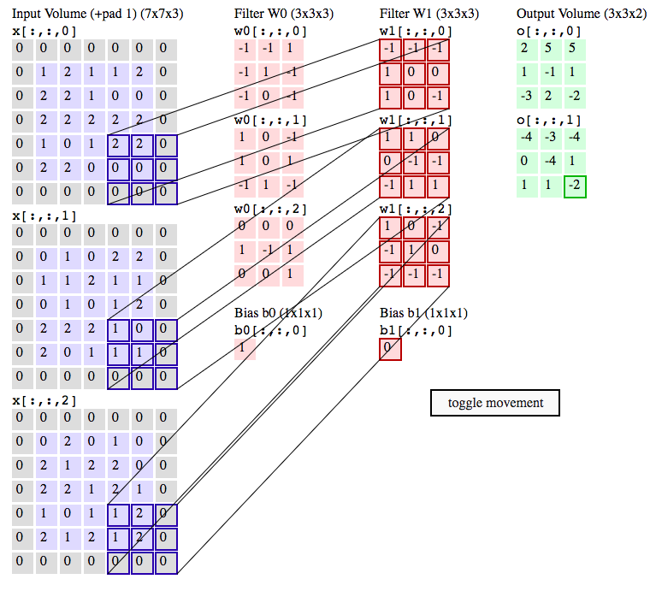
Convolutional layer demo
http://cs231n.github.io/convolutional-networks/#conv

Slide 59
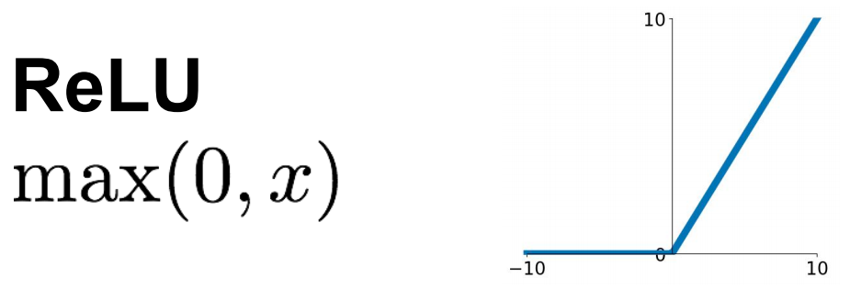
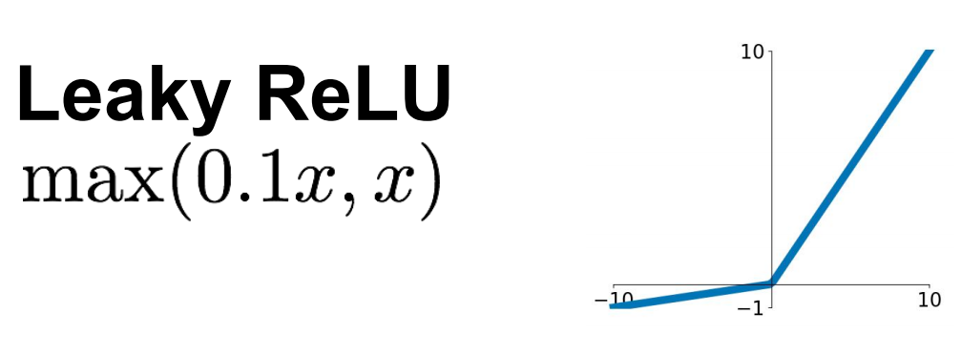
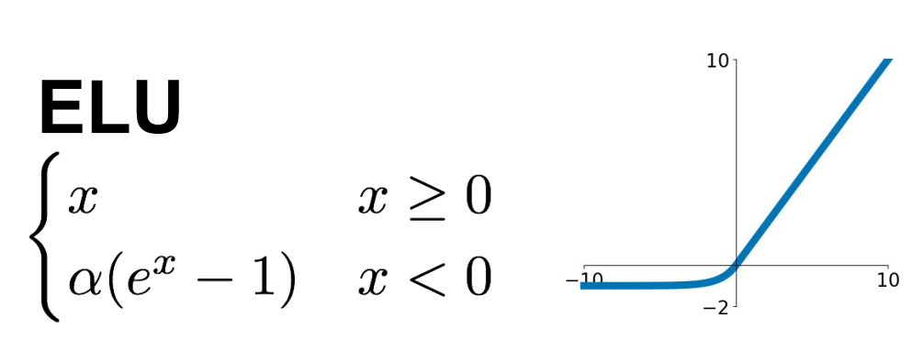
Non-Linearities
Source: R. Fergus, Y. LeCun
Source: Stanford 231n

Slide 60
ReLU vs tanh
A. Krizhevsky, I. Sutskever, and G. Hinton, ImageNet Classification with Deep Convolutional Neural Networks, NIPS 2012
Notes:
Two-GPU architecture

Slide 61
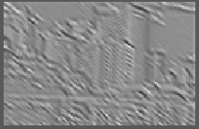
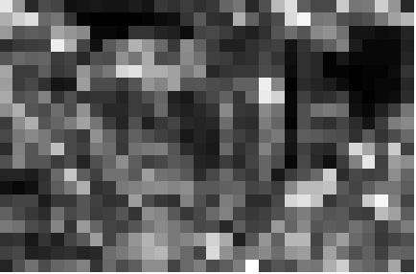
Pooling Layers
  Max
  (or Avg)
Source: R. Fergus, Y. LeCun

Slide 62
Pooling Layers
K feature maps, resolution 1/S
K feature maps
max value
F x F pooling filter, stride S
Usually: F=2 or 3, S=2

Slide 63
Max pooling layer
K feature maps, resolution 1/S
K feature maps
max value
F x F pooling filter, stride S
Usually: F=2 or 3, S=2
Slide from L. Lazebnik.

Slide 64

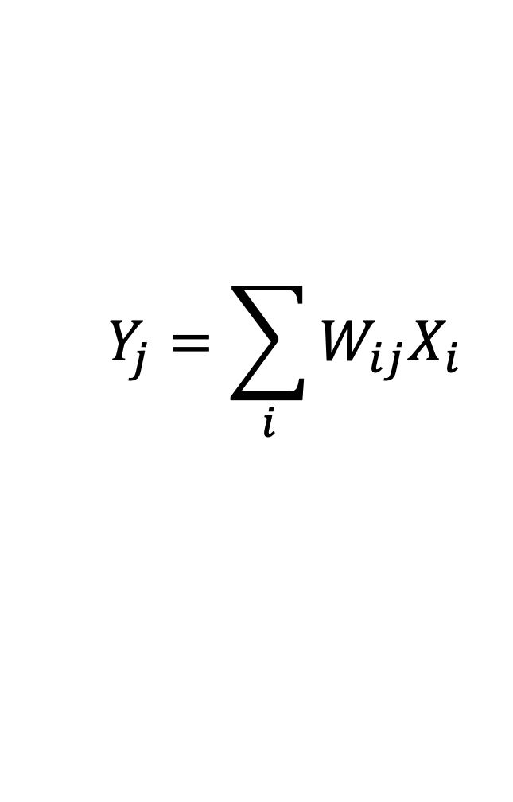


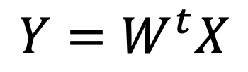
Fully-connected Layers
$$X$$
$Y=W^{t}X$
$$Y_{j}$$
$$X_{i}$$
$$Y_{j}=\sum_{i}{W_{ij}X_{i}}$$

Slide 65
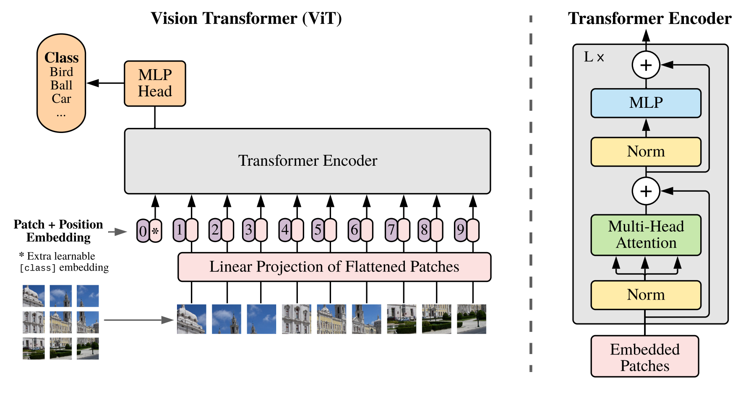
Attention (Vision Transformers)
A. Dosovitskiy et al., An Image is Worth 16x16 Words: Transformers for Image Recognition at Scale.

Slide 66
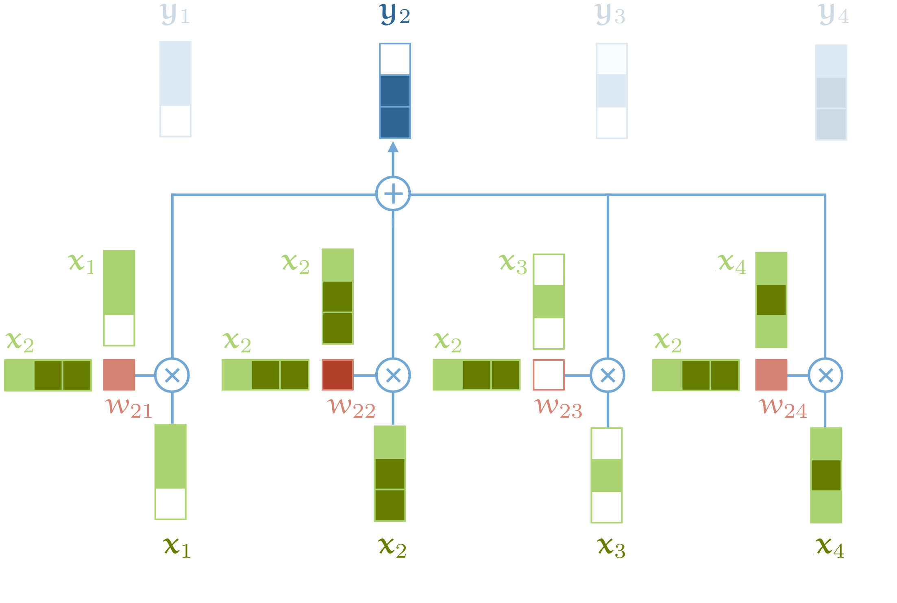
Attention
Source: http://peterbloem.nl/blog/transformers
See also: Attention is all you need

Slide 67
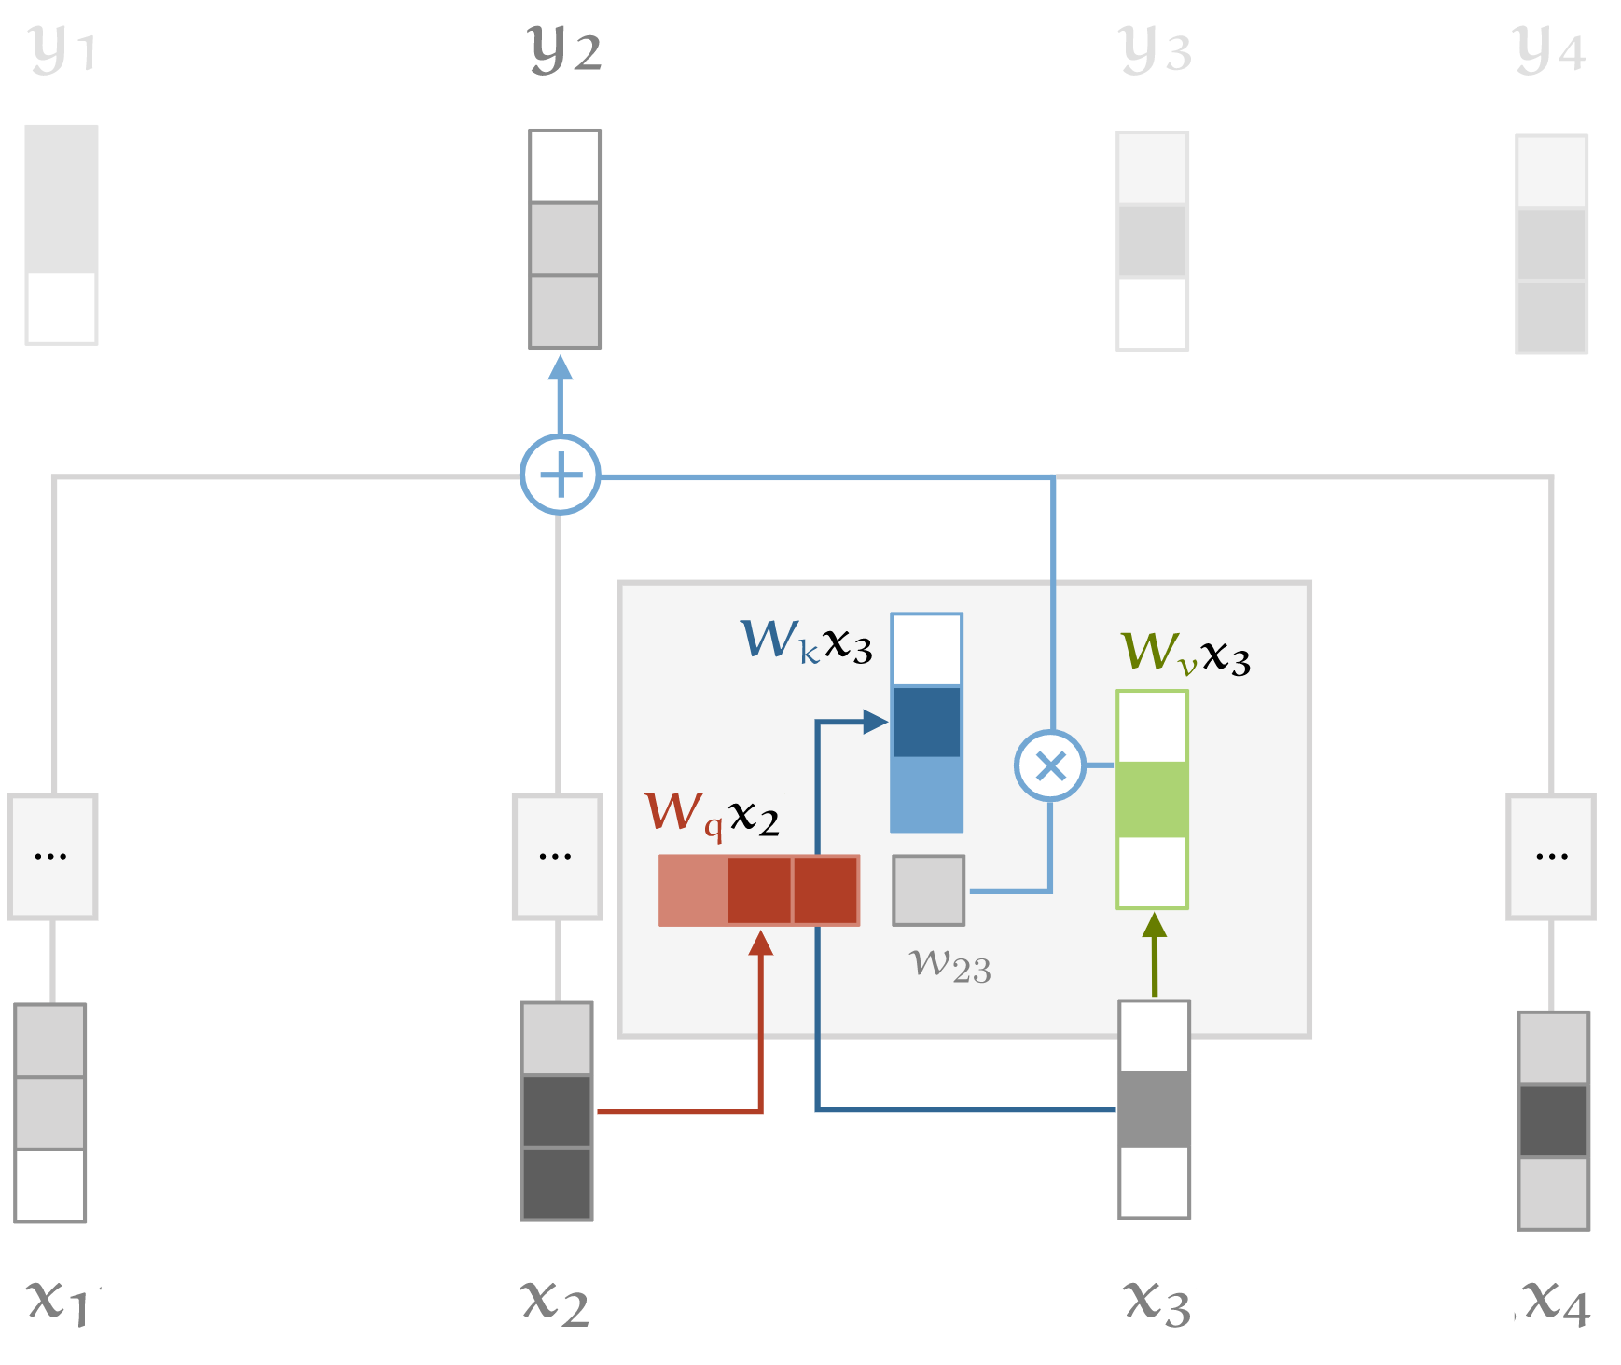
Attention (with key, query and value)
Source: http://peterbloem.nl/blog/transformers
See also: Attention is all you need

Slide 68
Representing Positions
Positional Embeddings
  Learn embeddings for different positions
Positional Encodings
  Explicitly encode positions using sin, cos terms
See also: Attention is all you need

Slide 69
Components of a CNN architecture
Convolutional Layers
Non-linearities
Pooling
Fully-connected Layers
Attention

Slide 70
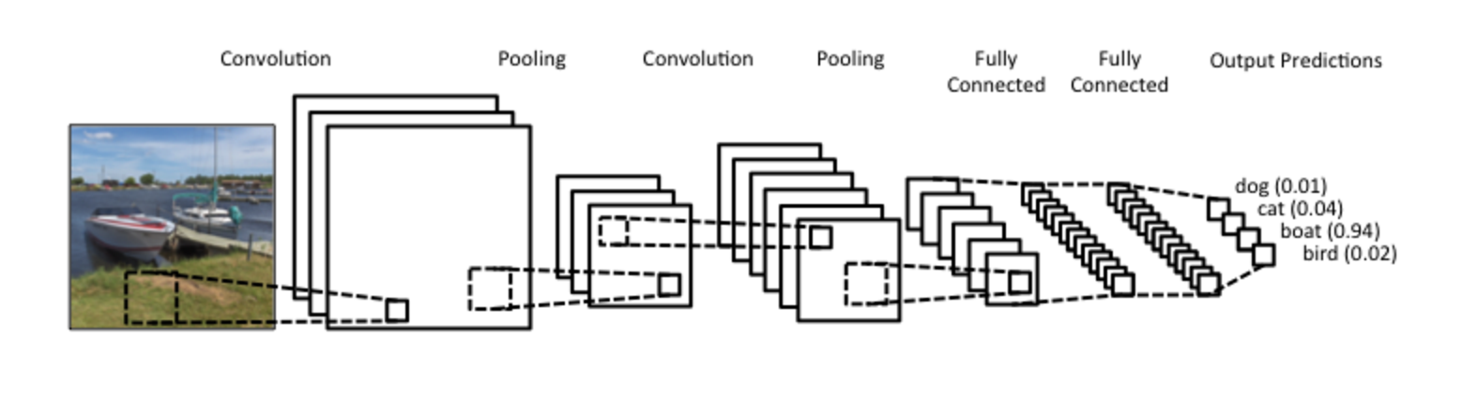
Putting it together
Softmax layer:

Slide 71
Many different models
Source: https://paperswithcode.com/

Slide 72
Learned Representations are Useful in General
Features extracted from CNNs trained on ImageNet were effective for many CV tasks.
Furthermore, learned network weights serve as an excellent starting point for other tasks.
J. Donahue, Y. Jia et al. DeCAF: A Deep Convolutional Activation Feature for Generic Visual Recognition. ICML 2014

Slide 73
How to use a trained network for a new task?
Caltech 101
Caltech 101
Fine-grained Classification
Domain Adaptation
Scene Classification
J. Donahue, Y. Jia et al. DeCAF: A Deep Convolutional Activation Feature for Generic Visual Recognition. ICML 2014

Slide 74
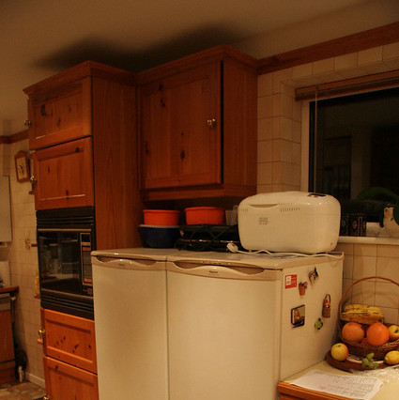
How to use a trained network for a new task?
Kitchen
Bedroom
Patio
Copy over
Classifier layer
Trained on ImageNet

Slide 75
How to use a trained network for a new task?
Classifier layer
FC vector
Take the vector of activations from one of the fully connected (FC) layers and treat it as an off-the-shelf feature
  Train a new classifier layer on top of the FC layer
Fine-tune the whole network

Slide 76
Other tasks: Object detection
find pedestrians
Adapted from Fei-Fei Li

Slide 77
R-CNN
SVMs
Classify regions with SVMs
SVMs
ConvNet
SVMs
ConvNet
Forward each region through ConvNet
ConvNet
Warped image regions
Region proposals
Input image
R. Girshick, J. Donahue, T. Darrell, and J. Malik, Rich Feature Hierarchies for Accurate Object Detection and Semantic Segmentation, CVPR 2014.
Notes:
The features are also sent to a linear regressor that improves object localization.
The components outlined in purple are “post hoc” in the sense that they are learned after the convnet weights are trained and forever frozen.

Slide 78
Fast R-CNN
Softmax classifier
Linear +
softmax
Linear
Bounding-box regressors
FCs
Fully-connected layers
“RoI Pooling” layer
Region proposals
“conv5” feature map of image
ConvNet
Forward whole image through ConvNet
R. Girshick, Fast R-CNN, ICCV 2015
Notes:
Rather than using post-hoc bounding-box regressors, bounding-box regression is implemented as an additional linear layer in the network

Slide 79
Steady Progress on Detection
Source: https://paperswithcode.com/
Notes:
Rather than using post-hoc bounding-box regressors, bounding-box regression is implemented as an additional linear layer in the network

Slide 80
Other Tasks: Semantic segmentation
sky
mountain
building
tree
building
lamp
lamp
umbrella
umbrella
person
market stall
person
person
person
person
ground
Adapted from Fei-Fei Li

Slide 81
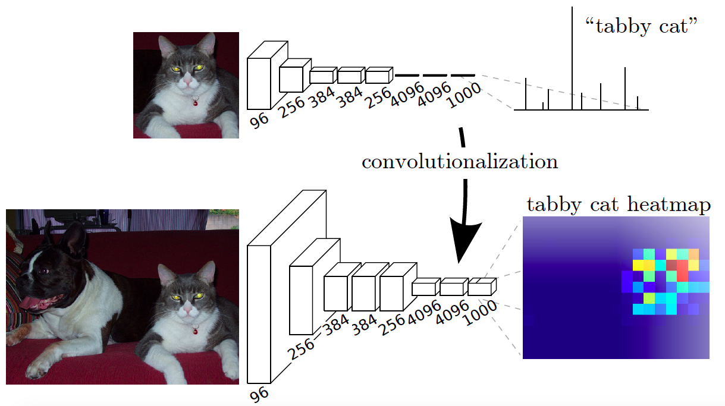
Convolutionalization
Design a network with only convolutional layers, make predictions for all pixels at once
J. Long, E. Shelhamer, and T. Darrell, Fully Convolutional Networks for Semantic Segmentation, CVPR 2015

Slide 82
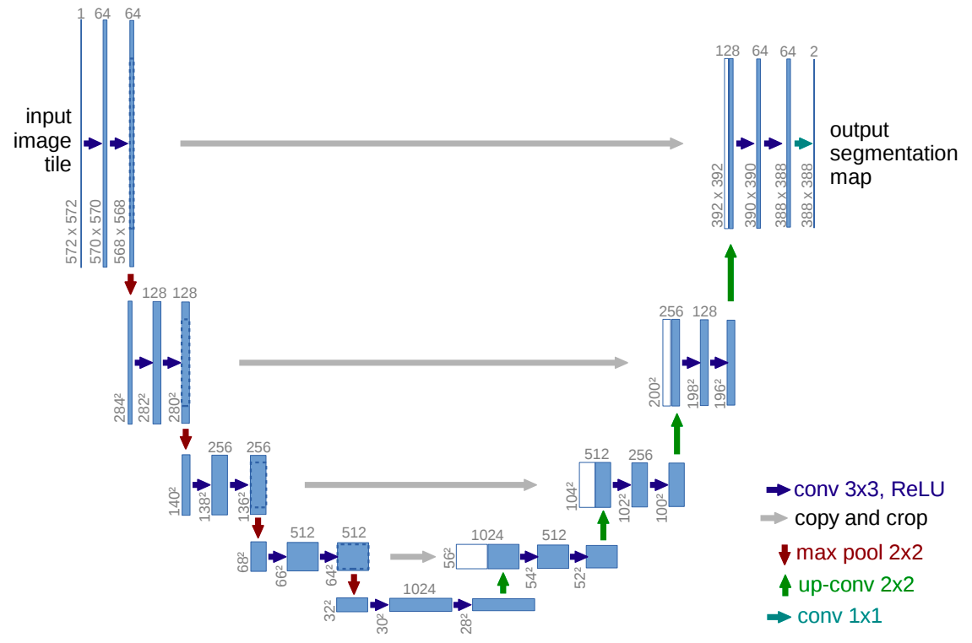
U-Net
Like FCN, fuse upsampled higher-level feature maps with higher-res, lower-level feature maps
Unlike FCN, fuse by concatenation, predict at the end
O. Ronneberger, P. Fischer, T. Brox U-Net: Convolutional Networks for Biomedical Image Segmentation, MICCAI 2015

Slide 83
Image description
This is a busy street in an Asian city. Mountains and a large palace or fortress loom in the background. In the foreground, we see colorful souvenir stalls and people walking around and shopping. One person in the lower left is pushing an empty cart, and a couple of people in the middle are sitting, possibly posing for a photograph.
Adapted from Fei-Fei Li

Slide 84
Sequence Modeling

Slide 85
Slide from D. Fouhey
See also: https://colah.github.io/posts/2015-08-Understanding-LSTMs/

Slide 86
Vision Review
The vision problem
Why is vision hard?
3D Reconstruction (basis from SLAM)
Recognition
Additional Resources:
See CS 543 / ECE 549 at UIUC: http://saurabhg.web.illinois.edu/teaching/ece549/sp2021
See: CS 231n at Stanford: http://cs231n.stanford.edu/
See Prof. A. Davison’s Robotics course: https://www.doc.ic.ac.uk/~ajd/Robotics/
Prof. Shenlong Wang’s course on Robot Perception

