Slide 1
Linear Classifiers
CS 444: Deep Learning for Computer Vision
Saurabh Gupta
Slides from Lana Lazebnik

Slide 2
Outline
Examples of classification models: nearest neighbor, linear
Empirical loss minimization framework
Linear classification models
Linear regression
Logistic regression
Perceptron training algorithm
Support vector machines

Slide 3
Recall: The basic supervised learning framework
$$y = f(x)$$
Training (or learning): given a training set of labeled examples $\{(x1,y1), …, (xN,y_{N})\}$, instantiate a predictor $f$
Testing (or inference): apply $f$ to a new test example $x$ and output the predicted value $y = f(x)$
output
prediction function
input

Slide 4
Nearest neighbor classifier
Test example
Training examples from class 2
Training examples from class 1
$f(x) =$ label of the training example nearest to $x$
All we need is a distance function for our inputs
No training required!

Slide 5
Linear classifier
Find a linear function to separate the classes:
$$f\left(x\right)=\operatorname{sgn}\left(w^{(1)}x^{(1)}+w^{(2)}x^{(2)}+…+w^{(D)}x^{(D)}+b\right)=sgn⁡\left(w ⋅ x + b\right)$$

Slide 6
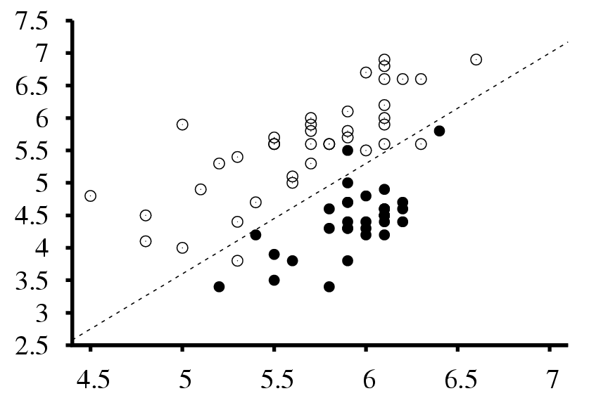
Visualizing linear classifiers
Seismic data classification
Earthquakes
Surface wave magnitude
Nuclear explosions
Body wave magnitude

Slide 7
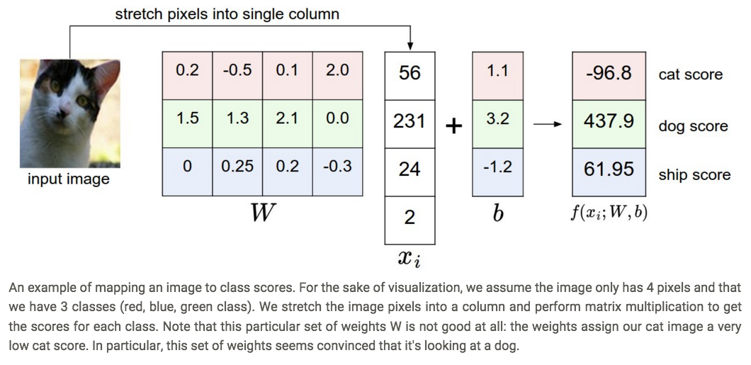
Visualizing linear classifiers
Source: http://cs231n.github.io/linear-classify/

Slide 8
Linear classifier: Perceptron view
Input
Weights
$$x^{(1)}$$
$$w^{(1)}$$
$$x^{(2)}$$
$$w^{(2)}$$
Output: $sgn⁡(wx + b)$
$$x^{(3)}$$
$$w^{(3)}$$
.
.
.
$$w^{(D)}$$
$$x^{(D)}$$

Slide 9
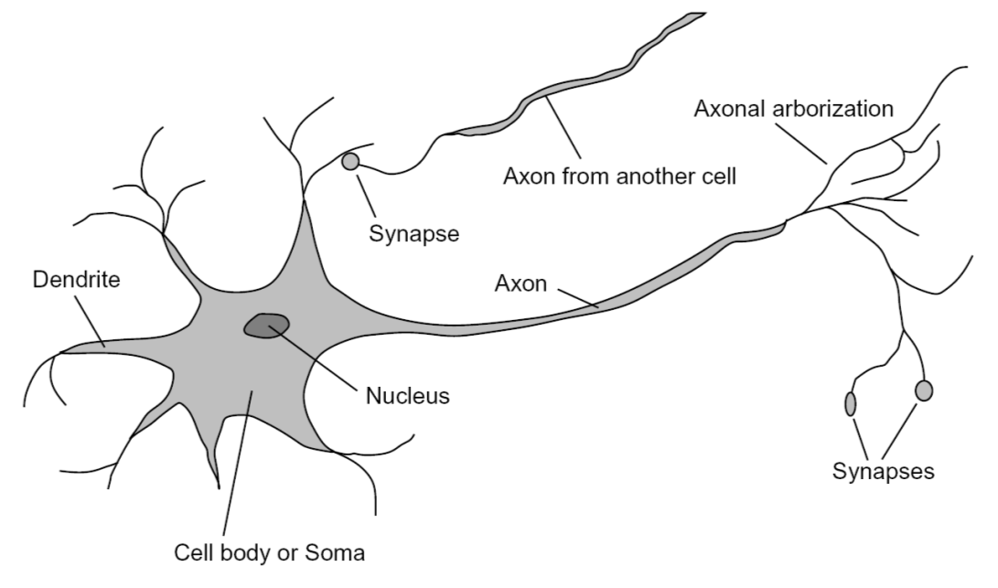
Loose inspiration: Biological neurons
Notes:
From Wikipedia: At the majority of synapses, signals are sent from the axon of one neuron to a dendrite of another... All neurons are electrically excitable, maintaining voltage gradients across their membranes… If the voltage changes by a large enough amount, an all-or-none electrochemical pulse called an action potential is generated, which travels rapidly along the cell's axon, and activates synaptic connections with other cells when it arrives.

Slide 10
NN vs. linear classifiers: Pros and cons
NN pros:
Simple to implement
Decision boundaries not necessarily linear
Works for any number of classes
Nonparametric method
NN cons:
Need good distance function
Slow at test time
Linear pros:
Low-dimensional parametric representation
Very fast at test time
Linear cons:
Works for two classes
How to train the linear function?
What if data is not linearly separable?

Slide 11
Outline
Examples of classification models: nearest neighbor, linear
Empirical loss minimization framework

Slide 12
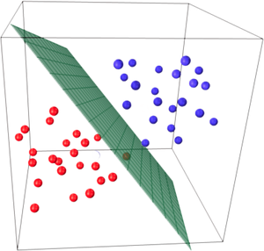
Empirical loss minimization
Let’s formalize the setting for learning of a parametric model in a supervised scenario
Image source

Slide 13
Empirical loss minimization
Given: training data $\left\{\left(x_{i},y_{i}\right), i=1,…,n\right\}$
Find: predictor $f$
Goal: make good predictions $\hat{y}=f(x)$ on test data
Source: Y. Liang

Slide 14
Empirical loss minimization
Given: training data $\left\{\left(x_{i},y_{i}\right), i=1,…,n\right\}$
Find: predictor $f$
Goal: make good predictions $\hat{y}=f(x)$ on test data
What kinds of functions?
Source: Y. Liang

Slide 15
Empirical loss minimization
Given: training data $\left\{\left(x_{i},y_{i}\right), i=1,…,n\right\}$
Find: predictor $f∈ℋ$
Goal: make good predictions $\hat{y}=f(x)$ on test data
Hypothesis class
Source: Y. Liang

Slide 16
Empirical loss minimization
Given: training data $\left\{\left(x_{i},y_{i}\right), i=1,…,n\right\}$
Find: predictor $f∈ℋ$
Goal: make good predictions $\hat{y}=f(x)$ on test data
Connection between training and test data?
Source: Y. Liang

Slide 17
Empirical loss minimization
Given: training data $\left\{\left(x_{i},y_{i}\right), i=1,…,n\right\}$ i.i.d. from distribution $D$
Find: predictor $f∈ℋ$
Goal: make good predictions $\hat{y}=f(x)$ on test data i.i.d. from distribution $D$
Source: Y. Liang

Slide 18
Empirical loss minimization
Given: training data $\left\{\left(x_{i},y_{i}\right), i=1,…,n\right\}$ i.i.d. from distribution $D$
Find: predictor $f∈ℋ$
Goal: make good predictions $\hat{y}=f(x)$ on test data i.i.d. from distribution $D$
What kind of performance measure?
Source: Y. Liang

Slide 19
Empirical loss minimization
Given: training data $\left\{\left(x_{i},y_{i}\right), i=1,…,n\right\}$ i.i.d. from distribution $D$
Find: predictor $f∈ℋ$
S.t. the expected loss is small: $L\left(f\right)=𝔼_{(x,y)∽D}[l\left(f,x,y\right)]$
Various loss functions
Source: Y. Liang

Slide 20
Empirical loss minimization
Given: training data $\left\{\left(x_{i},y_{i}\right), i=1,…,n\right\}$ i.i.d. from distribution $D$
Find: predictor $f∈ℋ$
S.t. the expected loss is small: $L\left(f\right)=𝔼_{(x,y)∽D}\left[l\left(f,x,y\right)\right]$
Example losses:
$0−1$ loss: $l\left(f,x,y\right)=𝕀[f(x)≠y]$ and $L\left(f\right)=Pr⁡[f(x)≠y$]
$l_{2}$ loss: $l\left(f,x,y\right)={[f\left(x\right)−y]}^{2}$ and $L\left(f\right)=$ $𝔼\left[{ [f\left(x\right)−y]}^{2}\right]$
Source: Y. Liang

Slide 21
Empirical loss minimization
Given: training data $\left\{\left(x_{i},y_{i}\right), i=1,…,n\right\}$ i.i.d. from distribution $D$
Find: predictor $f∈ℋ$
S.t. the expected loss is small: $L\left(f\right)=𝔼_{(x,y)∽D}\left[l\left(f,x,y\right)\right]$
Can’t optimize this directly
Source: Y. Liang

Slide 22
Empirical loss minimization
Given: training data $\left\{\left(x_{i},y_{i}\right), i=1,…,n\right\}$ i.i.d. from distribution $D$
Find: predictor $f∈ℋ$ that minimizes $\hat{L}\left(f\right)=\frac{1}{n}\sum_{i=1}^{n}{l(f,x_{i},y_{i})}$
Empirical loss
Source: Y. Liang

Slide 23
Supervised learning in a nutshell
Collect training data and labels
Specify model: select hypothesis class and loss function
Train model: find the function in the hypothesis class that minimizes the empirical loss on the training data

Slide 24
Outline
Example classification models: nearest neighbor, linear
Empirical loss minimization
Linear classification models
Linear regression
Logistic regression
Perceptron training algorithm
Support vector machines

Slide 25
Training linear classifiers
Given: i.i.d. training data $\left\{\left(x_{i},y_{i}\right), i=1,…,n\right\}$, $y_{i}∈\{−1,1\}$
Hypothesis class: $f_{w}(x)={sgn⁡(w}^{T}x)$
Classification with bias, i.e. $f_{w}\left(x\right)={sgn⁡(w}^{T}x+b)$, can be reduced to the case w/o bias by letting $\tilde{w}=\left[w;b\right]$ and $\tilde{x}=[x;1]$
Source: Y. Liang

Slide 26
Training linear classifiers
Given: i.i.d. training data $\left\{\left(x_{i},y_{i}\right), i=1,…,n\right\}$, $y_{i}∈\{−1,1\}$
Hypothesis class: $f_{w}(x)={sgn⁡(w}^{T}x)$
Loss: how about minimizing the number of mistakes on the training data? $\hat{L}\left(f_{w}\right)=\frac{1}{n}\sum_{i=1}^{n}{𝕀[sgn\left(w^{T}x_{i}\right)≠y_{i}]}$
Difficult to optimize directly (NP-hard), so people resort to surrogate loss functions
Source: Y. Liang

Slide 27
Linear regression (“straw man” model)
Find $f_{w}(x)=w^{T}x$ that minimizes $l_{2}$ loss or mean squared error $\hat{L}\left(f_{w}\right)=\frac{1}{n}\sum_{i=1}^{n}{{(w^{T}x_{i}−y_{i})}^{2}}$
Ignores the fact that $y∈\{−1,1\}$ but is easy to optimize
Source: Y. Liang

Slide 28
Linear regression: Optimization
Let $X$ be a matrix whose ith row is $x_{i}^{T}$, $Y$ be the vector ${(y_{1},…, y_{n})}^{T}$
$$\hat{L}\left(f_{w}\right)=\frac{1}{n}\sum_{i=1}^{n}{{(w^{T}x_{i}−y_{i})}^{2}}=\frac{1}{n}{\left\|Xw−Y\right\|}_{2}^{2}$$
Source: Y. Liang

Slide 29
Linear regression: Optimization
Let $X$ be a matrix whose ith row is $x_{i}^{T}$, $Y$ be the vector ${(y_{1},…, y_{n})}^{T}$
$$\hat{L}\left(f_{w}\right)=\frac{1}{n}\sum_{i=1}^{n}{{(w^{T}x_{i}−y_{i})}^{2}}=\frac{1}{n}{\left\|Xw−Y\right\|}_{2}^{2}$$
This is a convex function of the weights
Source: Y. Liang

Slide 30
Linear regression: Optimization
Let $X$ be a matrix whose ith row is $x_{i}^{T}$, $Y$ be the vector ${(y_{1},…, y_{n})}^{T}$
$$\hat{L}\left(f_{w}\right)=\frac{1}{n}\sum_{i=1}^{n}{{(w^{T}x_{i}−y_{i})}^{2}}=\frac{1}{n}{\left\|Xw−Y\right\|}_{2}^{2}$$
Find the gradient w.r.t. $w$: ${∇_{w}\left\|Xw−Y\right\|}_{2}^{2}$
Source: Y. Liang

Slide 31
Linear regression: Optimization
Let $X$ be a matrix whose ith row is $x_{i}^{T}$, $Y$ be the vector ${(y_{1},…, y_{n})}^{T}$
$$\hat{L}\left(f_{w}\right)=\frac{1}{n}\sum_{i=1}^{n}{{(w^{T}x_{i}−y_{i})}^{2}}=\frac{1}{n}{\left\|Xw−Y\right\|}_{2}^{2}$$
Find the gradient w.r.t. $w$: ${∇_{w}\left\|Xw−Y\right\|}_{2}^{2}=∇_{w}\left[{\left(Xw−Y\right)}^{T}\left(Xw−Y\right)\right]$
$=∇_{w}\left[w^{T}X^{T}Xw−2w^{T}X^{T}Y+Y^{T}Y\right]$
$=2X^{T}Xw−2X^{T}Y$
Set gradient to zero to get the minimizer:
$$X^{T}Xw=X^{T}Y$$
$$w={(X^{T}X)}^{−1}X^{T}Y$$
Source: Y. Liang

Slide 32
Linear regression: Optimization
Linear algebra view
If $X$ is invertible, simply solve $Xw=Y$ and get $w=X^{−1}Y$
But typically $X$ is a “tall” matrix so you need to find the least squares solution to an over-constrained system
Source: Y. Liang

Slide 33
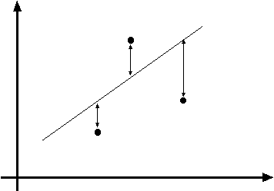
Linear regression as maximum likelihood estimation
Interpretation of $l_{2}$ loss: negative log likelihood assuming $y$ is normally distributed with mean $f_{w}\left(x\right)=w^{T}x+b$
y = w^{T}x + b
(x_{i}, y_{i})
$$P\left(y | x\right)=Normal(y;wTx + b,σ^{2})$$

Slide 34
Maximum likelihood estimation
Given: i.i.d. training data $\left\{\left(x_{i},y_{i}\right), i=1,…,n\right\}$
Let $\left\{P_{θ}\left(y | x\right), θ∈Θ\right\}$ be a family of distributions parameterized by $θ$
Maximum (conditional) likelihood estimate: $θ_{ML}={argmax}_{θ}\prod_{i}{P_{θ}(y_{i}|x_{i})}$
$={argmin}_{θ}−\sum_{i}{log}$ $P_{θ}(y_{i}|x_{i})$

Slide 35
Maximum likelihood estimation
$θ_{ML}={argmin}_{θ}−\sum_{i}{log}$ $P_{θ}(y_{i}|x_{i})$
Assume $P_{θ}\left(y | x\right)=Normal(y;f_{θ}\left(x\right),σ^{2})$
$$log P_{θ}\left(y | x\right)=\log\left[\frac{1}{\sqrt{2πσ^{2}}}exp\left[−\frac{{\left(y−f_{θ}\left(x\right)\right)}^{2}}{{2σ}^{2}}\right]\right]$$
$$=−\frac{1}{2σ^{2}}{\left(y−f_{θ}\left(x\right)\right)}^{2}−\log{σ}−\frac{1}{2}log⁡(2π)$$
$$θ_{ML}={argmin}_{θ}\sum_{i}{{\left(y_{i}−f_{θ}\left(x_{i}\right)\right)}^{2}}$$

Slide 36
Linear regression as maximum likelihood estimation
Interpretation of $l_{2}$ loss: negative log likelihood assuming $y$ is normally distributed with mean $f_{w}\left(x\right)=w^{T}x+b$
Does this make sense for binary classification?
y = w^{T}x + b
(x_{i}, y_{i})
$$P\left(y | x\right)=Normal(y;wTx + b,σ^{2})$$

Slide 37
Problem with linear regression
In practice, very sensitive to outliers
Figure from Pattern Recognition and Machine Learning, Bishop

Slide 38
Problem with linear regression
In practice, very sensitive to outliers
+1
-1

Slide 39
Next idea
Instead of a linear function, how about we fit a function representing the confidence of the classifier?
1
$$P(y=1|x)$$
0.5
0

Slide 40
Linear classifiers: Outline
Example classification models: nearest neighbor, linear
Empirical loss minimization
Linear classification models
Linear regression (least squares)
Logistic regression

Slide 41
Logistic regression
Let’s learn a probabilistic classifier estimating the probability of the input $x$ having a positive label, given by putting a sigmoid function around the linear response $w^{T}x$:
${ P}_{w}\left(y=1 | x\right)=σ\left(w^{T}x\right)=\frac{1}{1+exp⁡(−w^{T}x)}$

Slide 42
Sigmoid: Properties
$$P_{w}\left(y=1 | x\right)=σ\left(w^{T}x\right)=\frac{1}{1+exp⁡(−w^{T}x)}$$
What is the range?
What is $σ\left(0\right)$?
What is $P_{w}\left(y=−1 | x\right)$?

Slide 43
Sigmoid: Properties
$$P_{w}\left(y=1 | x\right)=σ\left(w^{T}x\right)=\frac{1}{1+exp⁡(−w^{T}x)}$$
What is the range?
What is $σ\left(0\right)$?
What is $P_{w}\left(y=−1 | x\right)$?
$$P_{w}\left(y=−1 | x\right)=1−P_{w}\left(y=1 | x\right)=1−σ\left(w^{T}x\right)$$
$=\frac{1+\exp\left(−w^{T}x\right)−1}{1+\exp\left(−w^{T}x\right)}=\frac{exp⁡(−w^{T}x)}{1+exp⁡(−w^{T}x)}=\frac{1}{\exp\left(w^{T}x\right)+1}$
$$=σ\left({−w}^{T}x\right)$$

Slide 44
Sigmoid: Properties
$$P_{w}\left(y=1 | x\right)=σ\left(w^{T}x\right)=\frac{1}{1+exp⁡(−w^{T}x)}$$
Sigmoid is symmetric in the following sense: $1−σ\left(t\right)=σ\left(−t\right)$
Notes:
Reflecting the sigmoid along the horizontal line y = 0.5 is the same as reflecting it along the vertical line t = 0

Slide 45
Sigmoid: Properties
$$P_{w}\left(y=1 | x\right)=σ\left(w^{T}x\right)=\frac{1}{1+exp⁡(−w^{T}x)}$$
What happens if we scale $w$ by a constant?

Slide 46
Sigmoid: Properties
$$P_{w}\left(y=1 | x\right)=σ\left(w^{T}x\right)=\frac{1}{1+exp⁡(−w^{T}x)}$$
What happens if we scale $w$ by a constant?
Image source

Slide 47
Logistic loss
Given: $\left\{\left(x_{i},y_{i}\right), i=1,…,n\right\}$, $y_{i}∈\{−1,1\}$
Maximum (conditional) likelihood estimate: find $w$that minimizes
$$\hat{L}\left(w\right)=−\frac{1}{n}\sum_{i=1}^{n}{\log{P_{w}\left(y_{i} | x_{i}\right)}}$$
$$l\left(w,x_{i}, y_{i}\right)=−\log{P_{w}\left(y_{i} | x_{i}\right)}$$
If $y_{i}=1:$
$$P_{w}\left(y_{i} | x_{i}\right)={σ\left(w^{T}x_{i}\right)}$$
If $y_{i}=−1:$
$$P_{w}\left(y_{i} | x_{i}\right)={1−σ\left(w^{T}x_{i}\right)=σ\left(−w^{T}x_{i}\right)}$$
Thus,
$$l\left(w,x_{i}, y_{i}\right)=−\log{σ\left(y_{i}w^{T}x_{i}\right)}$$

Slide 48
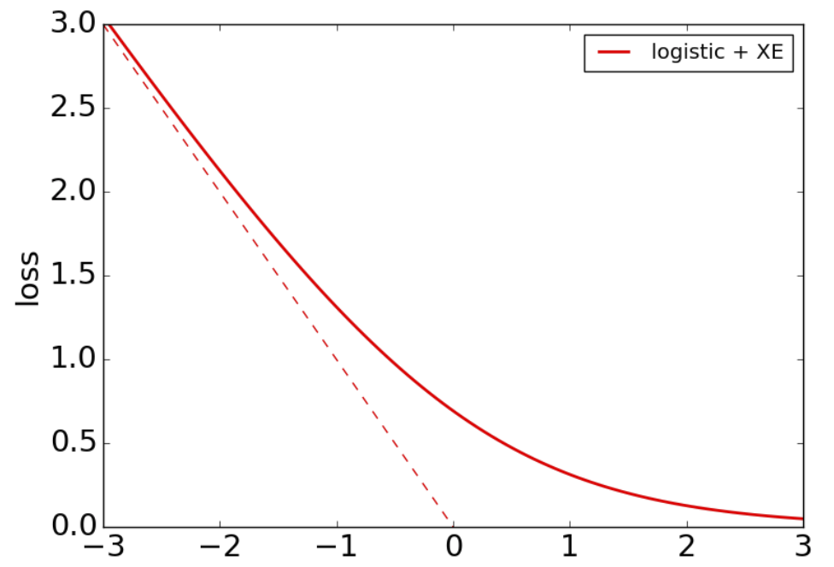
Logistic loss
$$l\left(w,x_{i}, y_{i}\right)=−\log{σ\left(y_{i}w^{T}x_{i}\right)}$$
$$y_{i}w^{T}x_{i}$$
Figure source

Slide 49
Logistic loss: Optimization
Given: $\left\{\left(x_{i},y_{i}\right), i=1,…,n\right\}$, $y_{i}∈\{−1,1\}$
Find $w$that minimizes
$$\hat{L}\left(w\right)=−\frac{1}{n}\sum_{i=1}^{n}{\log{P_{w}\left(y_{i} | x_{i}\right)}}$$
There is no closed-form expression for the minimum and we need to use gradient descent to find it

Slide 50
Gradient descent
Goal: find $w$ to minimize loss $\hat{L}(w)$
Start with some initial estimate of $w$
Repeat until convergence:
Find $∇\hat{L}(w)$, the gradient of the loss w.r.t. $w$
Take a small step in the opposite direction: $w←w−η ∇\hat{L}(w)$

Slide 51
The gradient vector
$$\hat{L}$$
$$\hat{L}(w)$$
Fastest rate of increase
$$w^{2}$$
$$∇\hat{L}(w)$$
$$w$$
$$w^{1}$$

Slide 52
The gradient vector
$$\hat{L}$$
$$\hat{L}(w)$$
Fastest rate of decrease
$$w^{2}$$
$$−∇\hat{L}(w)$$
$$w$$
$$w^{1}$$

Slide 53
Gradient descent
$$\hat{L}$$
$$\hat{L}(w−η∇\hat{L}(w))$$
$$w^{2}$$
$$w−η∇\hat{L}(w)$$
$$w^{1}$$

Slide 54
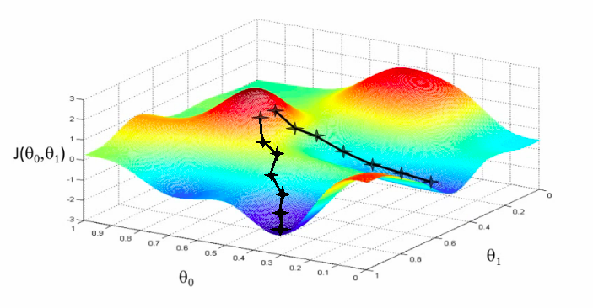
Gradient descent
Goal: find $w$ to minimize loss $\hat{L}(w)$
Start with some initial estimate of $w$
Repeat until convergence:
Find $∇\hat{L}(w)$, the gradient of the loss w.r.t. $w$
Take a small step in the opposite direction: $w←w−η ∇\hat{L}(w)$
$$\hat{L}$$
$$w^{2}$$
$$w^{1}$$

Slide 55
Gradient descent
Goal: find $w$ to minimize loss $\hat{L}(w)$
Start with some initial estimate of $w$
Repeat until convergence:
Find $∇\hat{L}(w)$, the gradient of the loss w.r.t. $w$
Take a small step in the opposite direction: $w←w−η ∇\hat{L}(w)$
$η$is the step size or learning rate
Figure source

Slide 56
Full batch gradient descent
Since $\hat{L}\left(w\right)=\frac{1}{n}\sum_{i=1}^{n}{l\left(w,x_{i}, y_{i}\right)}$, we have
$$∇\hat{L}\left(w\right)=\frac{1}{n}\sum_{i=1}^{n}{∇l\left(w,x_{i}, y_{i}\right)}$$
For a single parameter update, need to cycle through the entire training set!

Slide 57
Stochastic gradient descent (SGD)
At each iteration, take a single data point $\left(x_{i},y_{i}\right)$ and perform a parameter update using $∇l\left(w,x_{i},y_{i}\right)$, the gradient of the loss for that point:
$$w←w−η ∇l\left(w,x_{i},y_{i}\right)$$
This is called an online or stochastic update
In practice, mini-batch SGD is typically used:
Group data into mini-batches of size $b$
Compute gradient of the loss for the mini-batch $\left(x_{1},y_{1}\right),…, {(x}_{b},y_{b})$:
$$∇\hat{L}=\frac{1}{b}\sum_{i=1}^{b}{∇l(w,x_{i},y_{i})}$$
Update parameters: $w←w−η∇\hat{L}$

Slide 58
SGD for logistic regression
$$l\left(w,x_{i}, y_{i}\right)=−\log{σ\left(y_{i}w^{T}x_{i}\right)}$$
Let’s find the gradient:
$$∇l\left(w,x_{i}, y_{i}\right)=−∇_{w}\log{σ\left(y_{i}w^{T}x_{i}\right)}$$
$$=−\frac{∇_{w}σ\left(y_{i}w^{T}x_{i}\right)}{σ\left(y_{i}w^{T}x_{i}\right)}$$
Derivative of log:
$${\left[log\left(g\left(a\right)\right)\right]}^{′}=\frac{g′(a)}{g(a)}$$

Slide 59
SGD for logistic regression
$$l\left(w,x_{i}, y_{i}\right)=−\log{σ\left(y_{i}w^{T}x_{i}\right)}$$
Let’s find the gradient:
$$∇l\left(w,x_{i}, y_{i}\right)=−∇_{w}\log{σ\left(y_{i}w^{T}x_{i}\right)}$$
$$=−\frac{∇_{w}σ\left(y_{i}w^{T}x_{i}\right)}{σ\left(y_{i}w^{T}x_{i}\right)}$$
$$=−\frac{σ\left(y_{i}w^{T}x_{i}\right)σ\left({−y}_{i}w^{T}x_{i}\right)y_{i}x_{i}}{σ\left(y_{i}w^{T}x_{i}\right)}$$
Derivative of sigmoid:
$σ^{′}\left(a\right)=σ\left(a\right)\left(1−σ(a)\right)=$ $σ\left(a\right)σ\left(−a\right)$

Slide 60
SGD for logistic regression
$$l\left(w,x_{i}, y_{i}\right)=−\log{σ\left(y_{i}w^{T}x_{i}\right)}$$
Let’s find the gradient:
$$∇l\left(w,x_{i}, y_{i}\right)=−∇_{w}\log{σ\left(y_{i}w^{T}x_{i}\right)}$$
$$=−\frac{∇_{w}σ\left(y_{i}w^{T}x_{i}\right)}{σ\left(y_{i}w^{T}x_{i}\right)}$$
$$=−\frac{σ\left(y_{i}w^{T}x_{i}\right)σ\left({−y}_{i}w^{T}x_{i}\right)y_{i}x_{i}}{σ\left(y_{i}w^{T}x_{i}\right)}$$
We also used the chain rule: ${\left[g_{2}\left(g_{1}\left(a\right)\right)\right]}^{′}={g_{2}}^{′}\left(g_{1}\left(a\right)\right){g_{1}}^{′}(a)$

Slide 61
SGD for logistic regression
$$l\left(w,x_{i}, y_{i}\right)=−\log{σ\left(y_{i}w^{T}x_{i}\right)}$$
Let’s find the gradient:
$$∇l\left(w,x_{i}, y_{i}\right)=−∇_{w}\log{σ\left(y_{i}w^{T}x_{i}\right)}$$
$$=−\frac{∇_{w}σ\left(y_{i}w^{T}x_{i}\right)}{σ\left(y_{i}w^{T}x_{i}\right)}$$
$$=−\frac{σ\left(y_{i}w^{T}x_{i}\right)σ\left({−y}_{i}w^{T}x_{i}\right)y_{i}x_{i}}{σ\left(y_{i}w^{T}x_{i}\right)}$$
$$=−σ\left({−y}_{i}w^{T}x_{i}\right)y_{i}x_{i}$$
SGD update:
$$w←w+η σ\left({−y}_{i}w^{T}x_{i}\right)y_{i}x_{i}$$

Slide 62
SGD for logistic regression
Let’s take a closer look at the SGD update:
$$w←w+η σ\left({−y}_{i}w^{T}x_{i}\right)y_{i}x_{i}$$
What happens if $x_{i}$ is incorrectly, but confidently, classified?
The update rule approaches $w←w+η y_{i}x_{i}$
What happens if $x_{i}$ is correctly, and confidently, classified?
The update approaches zero (but never actually reaches zero)

Slide 63
SGD for logistic regression
Logistic regression does not converge for linearly separable data!
Scaling $w$ by ever larger constants makes the classifier more confident and keeps increasing the likelihood of the data
Image source

Slide 64
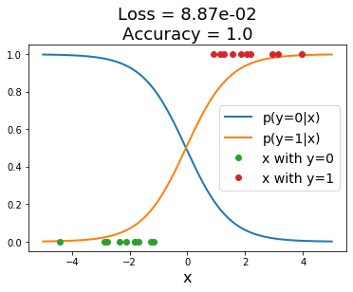
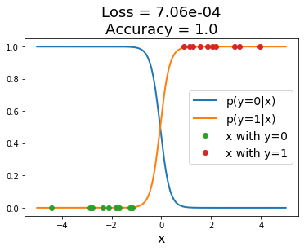
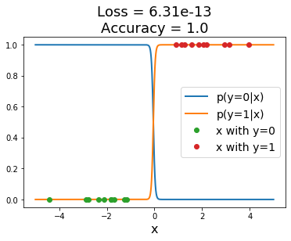
SGD for logistic regression
Logistic regression does not converge for linearly separable data!
Scaling $w$ by ever larger constants makes the classifier more confident and keeps increasing the likelihood of the data
Source: J. Johnson

Slide 65
Sigmoid: Interpretation
We can write out the connection between the posteriors $P(y|x)$ and the class-conditional densities $P\left(x | y\right)$:
$$P\left(y=1 | x\right)=\frac{P\left(x | y=1\right)P\left(y=1\right)}{P(x)}$$
$$=\frac{P\left(x | y=1\right)P\left(y=1\right)}{P\left(x | y=1\right)P\left(y=1\right)+P\left(x | y=−1\right)P(y=−1)}$$
$$=\frac{1}{1+exp⁡(−a)}=σ(a), a=log\frac{P(y=1|x)}{P(y=−1|x)}$$

Slide 66
Sigmoid: Interpretation
Adopting a linear + sigmoid model is equivalent to assuming linear log odds:
$$log\frac{P(y=1|x)}{P(y=−1|x)}=w^{T}x+b$$
This happens when $P\left(x | y=1\right)$ and $P\left(x | y=−1\right)$ are Gaussians with different means and the same covariance matrices ($w$ is related to the difference between the means)

Slide 67
Linear classifiers: Outline
Example classification models: nearest neighbor, linear
Empirical loss minimization
Linear classification models
Linear regression (least squares)
Logistic regression
Perceptron loss

Slide 68
Recall: The shape of logistic loss
$$l\left(w,x_{i}, y_{i}\right)=−\log{σ\left(y_{i}w^{T}x_{i}\right)}$$
Approaches $−y_{i}w^{T}x_{i}$
Approaches 0
$$y_{i}w^{T}x_{i}$$
Figure source

Slide 69
Perceptron
Let’s define the perceptron hinge loss:
$$l\left(w,x_{i}, y_{i}\right)=max\left(0,{−y}_{i}w^{T}x_{i}\right)$$
Perceptron hinge loss
Incorrectly classified
Correctly classified
$$y_{i}w^{T}x_{i}$$

Slide 70
Perceptron
Let’s define the perceptron hinge loss:
$$l\left(w,x_{i}, y_{i}\right)=max\left(0,{−y}_{i}w^{T}x_{i}\right)$$
Training: find $w$ that minimizes
$$\hat{L}\left(w\right)=\frac{1}{n}\sum_{i=1}^{n}{l\left(w,x_{i}, y_{i}\right)}=\frac{1}{n}\sum_{i=1}^{n}{max\left(0,{−y}_{i}w^{T}x_{i}\right)}$$
Once again, there is no closed-form solution, so let’s go straight to SGD

Slide 71
Deriving the perceptron update
Let’s differentiate the perceptron hinge loss:
$$l\left(w,x_{i}, y_{i}\right)=max\left(0,{−y}_{i}w^{T}x_{i}\right)$$
(Strictly speaking, this loss is not differentiable, so we need to find a sub-gradient: A vector $g∈R^{n}$ is a sub-gradient of $f:R^{n}→R$ at $x$if for all $z$, $f\left(z\right)≥f\left(x\right)+g^{T}(z−x)$.)
Incorrectly classified
Correctly classified
$$y_{i}w^{T}x_{i}$$

Slide 72
Deriving the perceptron update
Let’s differentiate the perceptron hinge loss:
$$l\left(w,x_{i}, y_{i}\right)=max\left(0,{−y}_{i}w^{T}x_{i}\right)$$
$$∇l\left(w,x_{i}, y_{i}\right)=−𝕀[y_{i}w^{T}x_{i}<0]y_{i}x_{i}$$
$\frac{d}{da}\max\left(0,a\right)=𝕀[a>0]$
Incorrectly classified
Correctly classified
$$y_{i}w^{T}x_{i}$$

Slide 73
Deriving the perceptron update
Let’s differentiate the perceptron hinge loss:
$$l\left(w,x_{i}, y_{i}\right)=max\left(0,{−y}_{i}w^{T}x_{i}\right)$$
$$∇l\left(w,x_{i}, y_{i}\right)=−𝕀[y_{i}w^{T}x_{i}<0]y_{i}x_{i}$$
We also used the chain rule: ${\left[g_{2}\left(g_{1}\left(a\right)\right)\right]}^{′}={g_{2}}^{′}\left(g_{1}\left(a\right)\right){g_{1}}^{′}(a)$

Slide 74
Deriving the perceptron update
Let’s differentiate the perceptron hinge loss:
$$l\left(w,x_{i}, y_{i}\right)=max\left(0,{−y}_{i}w^{T}x_{i}\right)$$
$$∇l\left(w,x_{i}, y_{i}\right)=−𝕀[y_{i}w^{T}x_{i}<0]y_{i}x_{i}$$
Corresponding SGD update ($w←w−η ∇l\left(w,x_{i},y_{i}\right)$):
$$w←w+η 𝕀[y_{i}w^{T}x_{i}<0]y_{i}x_{i}$$
If $x_{i}$is correctly classified: do nothing
If $x_{i}$ is incorrectly classified: $w←w+η y_{i}x_{i}$

Slide 75
Understanding the perceptron update rule
Perceptron update rule: If $y_{i}≠sgn⁡(w^{T}x_{i})$ then update weights:
$$w←w+η y_{i}x_{i}$$
The raw response of the classifier changes to
$$w^{T}x_{i}+η y_{i}{\left\|x_{i}\right\|}^{2}$$
How does the response change if $y_{i}=1$?
The response $w^{T}x_{i}$is initially negative and will be increased
How does the response change if $y_{i}=−1$?
The response $w^{T}x_{i}$is initially positive and will be decreased

Slide 76
Linear classifiers: Outline
Example classification models: nearest neighbor, linear
Empirical loss minimization
Linear classification models
Linear regression (least squares)
Logistic regression
Perceptron loss
Support vector machine (SVM) loss

Slide 77
Support vector machines
When the data is linearly separable, which of the many possible solutions should we prefer?
Perceptron training algorithm: no special criterion, solution depends on initialization

Slide 78
Support vector machines
When the data is linearly separable, which of the many possible solutions should we prefer?
Perceptron training algorithm: no special criterion, solution depends on initialization
SVM criterion: maximize the margin, or distance between the hyperplane and the closest training example
Margin
Support vectors
Separating hyperplane

Slide 79
Finding the maximum margin hyperplane
We want to maximize the margin, or distance between the hyperplane $w^{T}x=0$ and the closest training example $x_{0}$
This distance is given by $\frac{{|w}^{T}x_{0}|}{\left\|w\right\|}$ (for derivation see, e.g., here)
Assuming the data is linearly separable, we can fix the scale of $w$ so that $y_{i}w^{T}x_{i}=1$ for support vectors and $y_{i}w^{T}x_{i}$ $≥1$ for all other points
Then the margin is given by $\frac{1}{\left\|w\right\|}$

Slide 80
Finding the maximum margin hyperplane
We want to maximize margin $\frac{1}{\left\|w\right\|}$ while correctly classifying all training data: ${y_{i}w}^{T}x_{i}≥1$
Equivalent problem:
$$\min_{w}\frac{1}{2}{\left\|w\right\|}^{2} s.t. {y_{i}w}^{T}x_{i}≥1 ∀i$$
This is a quadratic objective with linear constraints: convex optimization problem, global optimum can be found using well-studied methods

Slide 81
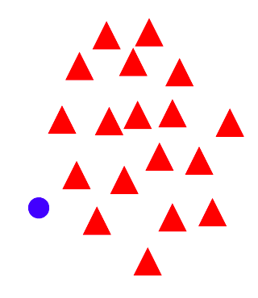
“Soft margin” formulation
What about non-separable data?
And even for separable data, we may prefer a larger margin with a few constraints violated
Source

Slide 82
“Soft margin” formulation
What about non-separable data?
And even for separable data, we may prefer a larger margin with a few constraints violated
Source

Slide 83
“Soft margin” formulation
Penalize margin violations using SVM hinge loss:
$$\min_{w}\frac{λ}{2}{\left\|w\right\|}^{2} + \sum_{i=1}^{n}{max⁡[0,1−}{y_{i}w}^{T}x_{i}]$$
Hinge loss
$$(0,1)$$
Incorrectly classified
$$(1,0)$$
Correctly classified
$$y_{i}w^{T}x_{i}$$
+1
0
-1

Slide 84
“Soft margin” formulation
Penalize margin violations using SVM hinge loss:
$$\min_{w}\frac{λ}{2}{\left\|w\right\|}^{2} + \sum_{i=1}^{n}{max⁡[0,1−}{y_{i}w}^{T}x_{i}]$$
Hinge loss
$$(0,1)$$
Incorrectly classified
$$(1,0)$$
Correctly classified
$$y_{i}w^{T}x_{i}$$
+1
0
Recall hinge loss used by the perceptron update algorithm!
-1

Slide 85
“Soft margin” formulation
Penalize margin violations using SVM hinge loss:
$$\min_{w}\frac{λ}{2}{\left\|w\right\|}^{2} + \sum_{i=1}^{n}{max⁡[0,1−}{y_{i}w}^{T}x_{i}]$$
Maximize margin –
a.k.a. regularization
Minimize misclassification loss

Slide 86
SGD update for SVM
$l\left(w,x_{i},y_{i}\right)=$ $\frac{λ}{2n}{\left\|w\right\|}^{2}+max⁡[0, 1−{y_{i}w}^{T}x_{i}]$
$∇l\left(w,x_{i},y_{i}\right)=$ $\frac{λ}{n}w−𝕀[{y_{i}w}^{T}x_{i}<1]y_{i}x_{i}$
Recall: $\frac{d}{da}\max\left(0,a\right)=𝕀[a>0]$

Slide 87
SGD update for SVM
$l\left(w,x_{i},y_{i}\right)=$ $\frac{λ}{2n}{\left\|w\right\|}^{2}+max⁡[0, 1−{y_{i}w}^{T}x_{i}]$
$∇l\left(w,x_{i},y_{i}\right)=$ $\frac{λ}{n}w−𝕀[{y_{i}w}^{T}x_{i}<1]y_{i}x_{i}$
SGD update:
If ${y_{i}w}^{T}x_{i}≥1$: $w←w$ $−η\frac{λ}{n}w$
If ${y_{i}w}^{T}x_{i}<1$: $w←w+η\left(y_{i}x_{i}−\frac{λ}{n}w\right)$
S. Shalev-Schwartz et al., Pegasos: Primal Estimated sub-GrAdient SOlver for SVM, Mathematical Programming, 2011

Slide 88
Linear classifiers: Outline
Examples of classification models: nearest neighbor, linear
Empirical loss minimization framework
Linear classification models
Linear regression
Logistic regression
Perceptron training algorithm
Support vector machines
General recipe: data loss, regularization

Slide 89
General recipe
Find parameters $w$that minimize the sum of a regularization loss and a data loss:
$$\hat{L}\left(w\right) = λR\left(w\right) + \frac{1}{n}\sum_{i=1}^{n}{l({w,x}_{i},y_{i})}$$
empirical loss
regularization
data loss
L2 regularization: $$R(w)=\frac{1}{2}{\left\|w\right\|}_{2}^{2}$$

Slide 90
Closer look at L2 regularization
Regularized objective: $\hat{L}(w)=\frac{λ}{2}{\left\|w\right\|}_{2}^{2}+\sum_{i=1}^{n}{l(w,x_{i},y_{i})}$
Gradient of objective:
$$∇\hat{L}(w)=λw+\sum_{i=1}^{n}{∇l(w,x_{i},y_{i})}$$
SGD update:
$$w←w−η\left(\frac{λ}{n}w+∇l\left(w,x_{i},y_{i}\right)\right)$$
$$w←\left(1−\frac{ηλ}{n}\right)w−η∇l\left(w,x_{i},y_{i}\right)$$
Interpretation: weight decay

Slide 91
General recipe
Find parameters $w$that minimize the sum of a regularization loss and a data loss:
$$\hat{L}\left(w\right) = λR\left(w\right) + \frac{1}{n}\sum_{i=1}^{n}{l({w,x}_{i},y_{i})}$$
empirical loss
regularization
data loss
L2 regularization: $$R(w)=\frac{1}{2}{\left\|w\right\|}_{2}^{2}$$
L1 regularization: $$R(w)={\left\|w\right\|}_{1}^{}$$

Slide 92
Closer look at L1 regularization
Regularized objective:
$$\hat{L}\left(w\right)=λ{\left\|w\right\|}_{1}+\sum_{i=1}^{n}{l\left(w,x_{i},y_{i}\right)}$$
$$=λ\sum_{d}{\left|w^{(d)}\right|}+\sum_{i=1}^{n}{l\left(w,x_{i},y_{i}\right)}$$
Gradient: $∇\hat{L}\left(w\right)=λ sgn⁡(w)+\sum_{i=1}^{n}{∇l(w,x_{i},y_{i})}$
(here sgn is an elementwise function)
SGD update:
$$w←w−\frac{ηλ}{n}\operatorname{sgn}\left(w\right)−η∇l\left(w,x_{i},y_{i}\right)$$
Interpretation: encouraging sparsity
Notes:
The update always drives the weights to zero by a constant amount (not a multiple of the weight)

Slide 93
Linear classifiers: Outline
Examples of classification models: nearest neighbor, linear
Empirical loss minimization framework
Linear classification models
Linear regression
Logistic regression
Perceptron training algorithm
Support vector machines
General recipe: data loss, regularization
Multi-class classification with a Softmax Function

Slide 94
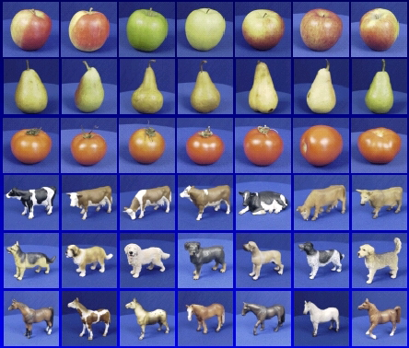
One-vs-all Classification with a Softmax
Let $y∈\{1,…,C\}$
Learn $C$ scoring functions $f_{1}, f_{2},…,f_{C}$
We can squash the vector of responses $\left(f_{1},…,f_{c}\right)$ into a vector of “probabilities”:
$$softmax\left(f_{1},…,f_{c}\right)=\left(\frac{exp⁡(f_{1})}{\sum_{j}{exp⁡(f_{j})}},…,\frac{exp⁡(f_{C})}{\sum_{j}{exp⁡(f_{j})}}\right)$$
The outputs are between 0 and 1 and sum to 1
If one of the inputs (logits) is much larger than the others, then the corresponding softmax value will be close to 1 and others will be close to 0

Slide 95
Softmax and sigmoid
For two classes:
$$softmax\left(0, f\right)=\left(\frac{exp⁡(0)}{\exp{(0)}+exp⁡(f)},\frac{exp⁡(f)}{\exp\left(0\right)+exp⁡(f)}\right)$$
$=\left(\frac{1}{1+exp⁡(f)},\frac{exp⁡(f)}{1+ exp\left(f\right)}\right)$
$=\left(1−σ\left(f\right),σ(f)\right)$
Thus, softmax is the generalization of sigmoid for more than two classes

Slide 96
Cross-entropy loss
It is natural to use negative log likelihood loss with softmax:
$$l\left(W,x_{i},y_{i}\right)=−\log{P_{W}\left(y_{i} | x_{i}\right)}=−log\left(\frac{\exp\left(w_{y_{i}}^{T}x_{i}\right)}{\sum_{j}{\exp\left(w_{j}^{T}x_{i}\right)}}\right)$$
This is also the cross-entropy between the “empirical” distribution $\hat{P}\left(c | x_{i}\right)=𝕀[{c=y}_{i}]$ and “estimated” distribution $P_{W}(c|x_{i})$:
$$−\sum_{c}{\hat{P}\left(c | x_{i}\right)\log{P_{W}(c|x_{i})}}$$
$P$(correct class | $x_{i}$) $= 1$
$P$(incorrect class | $x_{i}$) $= 0$
Empirical distribution $\hat{P}\left(c | x_{i}\right)$
Estimated distribution $P_{W}(c|x_{i})$

Slide 97
SGD with cross-entropy loss
$$l\left(W,x_{i},y_{i}\right)=−\log{P_{W}\left(y_{i} | x_{i}\right)}=−log\left(\frac{\exp\left(w_{y_{i}}^{T}x_{i}\right)}{\sum_{j}{\exp\left(w_{j}^{T}x_{i}\right)}}\right)$$
$$={−w}_{y_{i}}^{T}x_{i}+log\left(\sum_{j}{\exp\left(w_{j}^{T}x_{i}\right)}\right)$$
Gradient w.r.t. $w_{y_{i}}$:
$$−x_{i}+\frac{\exp\left(w_{y_{i}}^{T}x_{i}\right)x_{i}}{\sum_{j}{\exp\left(w_{j}^{T}x_{i}\right)}}=(P_{W}\left(y_{i} | x_{i}\right)−1)x_{i}$$
Gradient w.r.t. $w_{c}$, $c≠y_{i}$:
$$\frac{\exp\left(w_{c}^{T}x_{i}\right)x_{i}}{\sum_{j}{\exp\left(w_{j}^{T}x_{i}\right)}}=P_{W}\left(c | x_{i}\right)x_{i}$$

Slide 98
SGD with cross-entropy loss
Gradient w.r.t. $w_{y_{i}}$: $(P_{W}\left(y_{i} | x_{i}\right)−1)x_{i}$
Gradient w.r.t. $w_{c}$, $c≠y_{i}$: $P_{W}\left(c | x_{i}\right)x_{i}$
Update rule:
For $y_{i}:$
$$w_{y_{i}}←w_{y_{i}}+η\left({1−P}_{W}\left(y_{i} | x_{i}\right)\right)x_{i}$$
For $c≠y_{i}:$
$$w_{c}←w_{c}−ηP_{W}\left(c | x_{i}\right)x_{i}$$

Slide 99
Softmax trick: Avoiding overflow
Exponentiated values $\exp\left(f_{c}\right)$can become very large and cause overflow
Note that adding the same constant to all softmax inputs (logits) does not change the output of the softmax:
$$\frac{\exp\left(f_{c}+K\right)}{\sum_{j}{\exp\left(f_{j}+K\right)}}=\frac{exp\left(K\right)exp\left(f_{c}\right)}{\sum_{j}{exp(K) exp\left(f_{j}\right)}}=\frac{\exp\left(f_{c}\right)}{\sum_{j}{\exp\left(f_{j}\right)}}$$
Then we can let $K={−max}_{j}{ f}_{j}$ (i.e., make largest input to softmax be 0)

Slide 100
Softmax trick: Temperature scaling
Suppose we divide every input to the softmax by the same constant $T$:
$$softmax\left(f_{1},…,f_{c};T\right)=\left(\frac{exp⁡(f_{1}/T)}{\sum_{j}{exp⁡(f_{j}/T)}},…,\frac{exp⁡(f_{C}/T)}{\sum_{j}{exp⁡(f_{j}/T)}}\right)$$
What does this accomplish?
Prior to normalization, each entry $exp⁡(f_{1})$ is raised to the power $1/T$
If $T$ is close to 0, the largest entry will dominate and output distribution will tend to one-hot
If $T$ is high, output distribution will tend to uniform

Slide 101
Softmax trick: Temperature scaling
Low temperature:
More concentrated distribution
Higher temperature:
More uniform distribution
Figure source

Slide 102
Linear classifiers: Outline
Examples of classification models: nearest neighbor, linear
Empirical loss minimization framework
Linear classification models
Linear regression
Logistic regression
Perceptron training algorithm
Support vector machines
General recipe: data loss, regularization
Multi-class classification with a Softmax Function
Multi-class SVMs and Perceptron (Self-study)

Slide 103
Multi-class perceptrons
Let $y∈\{1,…,C\}$
Learn $C$ scoring functions $f_{1}, f_{2},…,f_{C}$
Classify $x$to class $\hat{y}={argmax}_{c} f_{c}(x)$
Multi-class perceptrons: $f_{c}\left(x\right)=w_{c}^{T}x$
Let $W$ be the matrix with rows $w_{c}$
What loss should we use for multi-class classification?
Figure source: Stanford 231n

Slide 104
Multi-class perceptrons
Let $y∈\{1,…,C\}$
Learn $C$ scoring functions $f_{1}, f_{2},…,f_{C}$
Classify $x$to class $\hat{y}={argmax}_{c} f_{c}(x)$
Multi-class perceptrons: $f_{c}\left(x\right)=w_{c}^{T}x$
Let $W$ be the matrix with rows $w_{c}$
What loss should we use for multi-class classification?
For ${(x}_{i},y_{i})$, let the loss be the sum of hinge losses associated with predictions for all incorrect classes:
$$l\left(W,x_{i},y_{i}\right)=\sum_{c≠y_{i}}{max[0,{w_{c}^{T}x_{i}−w}_{y_{i}}^{T}x_{i}]}$$
Score for correct class ($y_{i}$) has to be greater than the score for the incorrect class ($c$)
Figure source: Stanford 231n

Slide 105
Multi-class perceptrons
$$l\left(W,x_{i},y_{i}\right)=\sum_{c≠y_{i}}{max[0,{w_{c}^{T}x_{i}−w}_{y_{i}}^{T}x_{i}]}$$
Gradient w.r.t. $w_{y_{i}}$:
$$−\sum_{c≠y_{i}}{𝕀}[{w_{c}^{T}x_{i}>w}_{y_{i}}^{T}x_{i}]x_{i}$$
Recall: $\frac{d}{da}\max\left(0,a\right)=𝕀[a>0]$

Slide 106
Multi-class perceptrons
$$l\left(W,x_{i},y_{i}\right)=\sum_{c≠y_{i}}{max[0,{w_{c}^{T}x_{i}−w}_{y_{i}}^{T}x_{i}]}$$
Gradient w.r.t. $w_{y_{i}}$:
$$−\sum_{c≠y_{i}}{𝕀}[{w_{c}^{T}x_{i}>w}_{y_{i}}^{T}x_{i}]x_{i}$$
Gradient w.r.t. $w_{c}$, $c≠y_{i}$:
$$𝕀[{w_{c}^{T}x_{i}>w}_{y_{i}}^{T}x_{i}]x_{i}$$
Update rule: for each $c$ s.t. ${w_{c}^{T}x_{i}>w}_{y_{i}}^{T}x_{i}$:
$$w_{y_{i}}←w_{y_{i}}+ηx_{i}$$
$$w_{c}←w_{c}−ηx_{i}$$

Slide 107
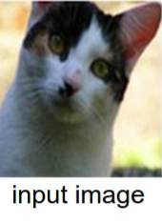
Multi-class perceptrons
Update rule: for each $c$ s.t. ${w_{c}^{T}x_{i}>w}_{y_{i}}^{T}x_{i}$:
$$w_{y_{i}}←w_{y_{i}}+ηx_{i}$$
$$w_{c}←w_{c}−ηx_{i}$$
Is this equivalent to training $C$ independent one-vs-all classifiers?
Independent
Do nothing
Decrease
Decrease
Multi-class
Increase
Decrease
Do nothing
Cat score: 65.1
Dog score: 101.4
Ship score: 24.9

Slide 108
Multi-class SVM
Recall single-class SVM loss:
$l\left(w,x_{i},y_{i}\right)=$ $\frac{λ}{2n}{\left\|w\right\|}^{2}+max⁡[0, 1−{y_{i}w}^{T}x_{i}]$
Generalization to multi-class:
$l\left(W,x_{i},y_{i}\right)=$ $\frac{λ}{2n}{\left\|W\right\|}^{2}+\sum_{c≠y_{i}}{max[0,{1−w}_{y_{i}}^{T}x_{i}+w_{c}^{T}x_{i}]}$
Score for correct class has to be greater than the score for the incorrect class by at least a margin of 1
$$(0,1)$$
$$(1,0)$$
Score for correct class – score for incorrect class
Source: Stanford 231n

Slide 109
Multi-class SVM
$l\left(W,x_{i},y_{i}\right)=$ $\frac{λ}{2n}{\left\|W\right\|}^{2}+\sum_{c≠y_{i}}{max[0,{1−w}_{y_{i}}^{T}x_{i}+w_{c}^{T}x_{i}]}$
Gradient w.r.t. $w_{y_{i}}$:
$$\frac{λ}{n}w_{y_{i}}−\sum_{c≠y_{i}}{𝕀\left[w_{y_{i}}^{T}x_{i}−w_{c}^{T}x_{i}<1\right]x_{i}}$$
Gradient w.r.t. $w_{c}$, $c≠y_{i}$:
$$\frac{λ}{n}w_{c}+𝕀[w_{y_{i}}^{T}x_{i}−w_{c}^{T}x_{i}<1]x_{i}$$
Update rule (almost* equivalent to above):
For each $c≠y_{i}$s.t. $w_{y_{i}}^{T}x_{i}−w_{c}^{T}x_{i}<1$: $w_{y_{i}}←w_{y_{i}}+ηx_{i}$, $w_{c}←w_{c}−ηx_{i}$
For ${c=1, …, C: w}_{c}←\left(1−η\frac{λ}{n}\right)w_{c}$

Slide 110
SVM loss vs. cross-entropy loss
Correct class is the third one (blue)
Source: Stanford 231n

Slide 111
Linear classifiers: Outline
Examples of classification models: nearest neighbor, linear
Empirical loss minimization framework
Linear classification models
Linear regression
Logistic regression
Perceptron training algorithm
Support vector machines
General recipe: data loss, regularization
Multi-class classification with a Softmax Function
Multi-class SVMs and Perceptron (Self-study)
Probabilistic Interpretation

Slide 112
Linear regression as maximum likelihood estimation?
Interpretation of $l_{2}$ loss: negative log likelihood assuming $y$ is normally distributed with mean $f_{w}\left(x\right)=w^{T}x+b$
y = w^{T}x + b
(x_{i}, y_{i})
$$P\left(y | x\right)=Normal(y;wTx + b,σ^{2})$$

Slide 113
Maximum likelihood estimation
Given: i.i.d. training data $\left\{\left(x_{i},y_{i}\right), i=1,…,n\right\}$
Let $\left\{P_{θ}\left(y | x\right), θ∈Θ\right\}$ be a family of distributions parameterized by $θ$
Maximum (conditional) likelihood estimate: $θ_{ML}={argmax}_{θ}\prod_{i}{P_{θ}(y_{i}|x_{i})}$
$={argmin}_{θ}−\sum_{i}{log}$ $P_{θ}(y_{i}|x_{i})$

Slide 114
Maximum likelihood estimation
$θ_{ML}={argmin}_{θ}−\sum_{i}{log}$ $P_{θ}(y_{i}|x_{i})$
Assume $P_{θ}\left(y | x\right)=Normal(y;f_{θ}\left(x\right),σ^{2})$
$$log P_{θ}\left(y | x\right)=\log\left[\frac{1}{\sqrt{2πσ^{2}}}exp\left[−\frac{{\left(y−f_{θ}\left(x\right)\right)}^{2}}{{2σ}^{2}}\right]\right]$$
$$=−\frac{1}{2σ^{2}}{\left(y−f_{θ}\left(x\right)\right)}^{2}−\log{σ}−\frac{1}{2}log⁡(2π)$$
$$θ_{ML}={argmin}_{θ}\sum_{i}{{\left(y_{i}−f_{θ}\left(x_{i}\right)\right)}^{2}}$$

Slide 115
Linear regression as maximum likelihood estimation
Interpretation of $l_{2}$ loss: negative log likelihood assuming $y$ is normally distributed with mean $f_{w}\left(x\right)=w^{T}x+b$
Does this make sense for binary classification?
y = w^{T}x + b
(x_{i}, y_{i})
$$P\left(y | x\right)=Normal(y;wTx + b,σ^{2})$$

Slide 116
Sigmoid: Interpretation
Adopting a linear + sigmoid model is equivalent to assuming linear log odds:
$$log\frac{P(y=1|x)}{P(y=−1|x)}=w^{T}x+b$$
This happens when $P\left(x | y=1\right)$ and $P\left(x | y=−1\right)$ are Gaussians with different means and the same covariance matrices ($w$ is related to the difference between the means)

Slide 117
Linear classifiers: Outline
Examples of classification models: nearest neighbor, linear
Empirical loss minimization framework
Linear classification models
Linear regression
Logistic regression
Perceptron training algorithm
Support vector machines
General recipe: data loss, regularization
Multi-class classification with a Softmax Function
Multi-class SVMs and Perceptron (Self-study)
Probabilistic Interpretation

