Slide 1
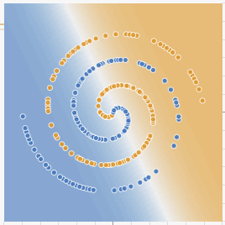
Feature engineering, Nonlinear classifiers, bias-variance tradeoff
CS 444: Deep Learning for Computer Vision
Saurabh Gupta
Many slides from Lana Lazebnik

Slide 2
Overview
Feature Design
Nonlinear classifiers
  “Shallow” approach: Kernel support vector machines (SVMs)
  “Deep” approach: Multi-layer neural networks
Controlling classifier complexity
  Hyperparameters
  Bias-variance tradeoff
  Overfitting and underfitting
  Hyperparameter search in practice

Slide 3
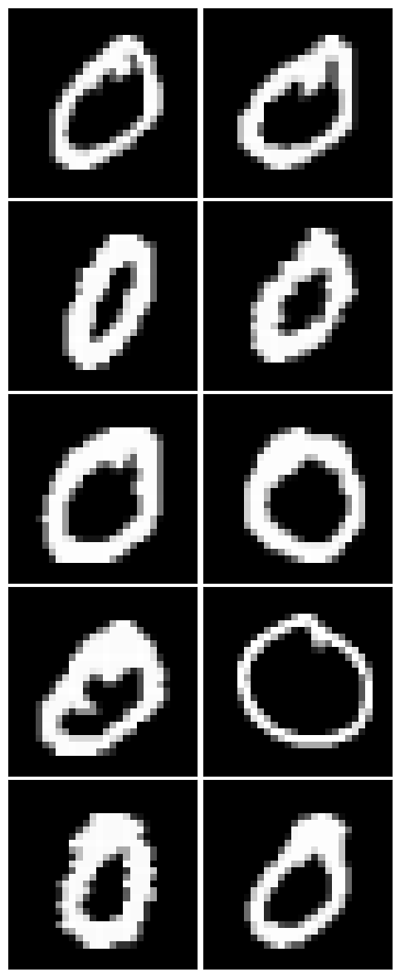
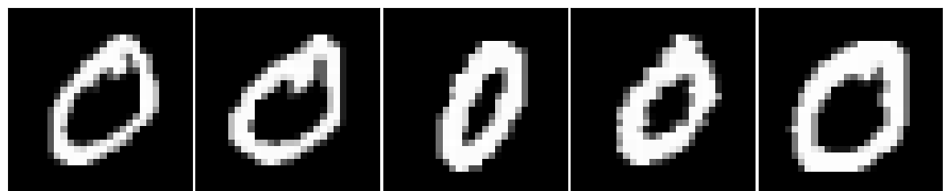
Hand-designing Feature Spaces using Domain Knowledge
Edges / gradients more useful than raw pixel values
Invariance to local deformations
  Spatial pooling
  Quantization into coarse bins

Slide 4
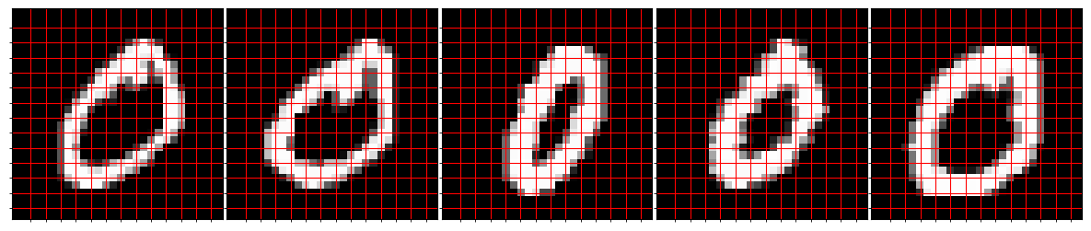
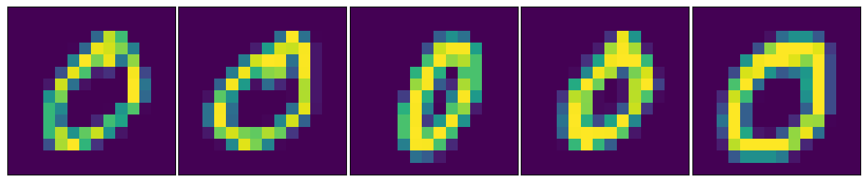
Hand-designing Feature Spaces using Domain Knowledge
E.g. Spatial pooling of raw pixels

Slide 5
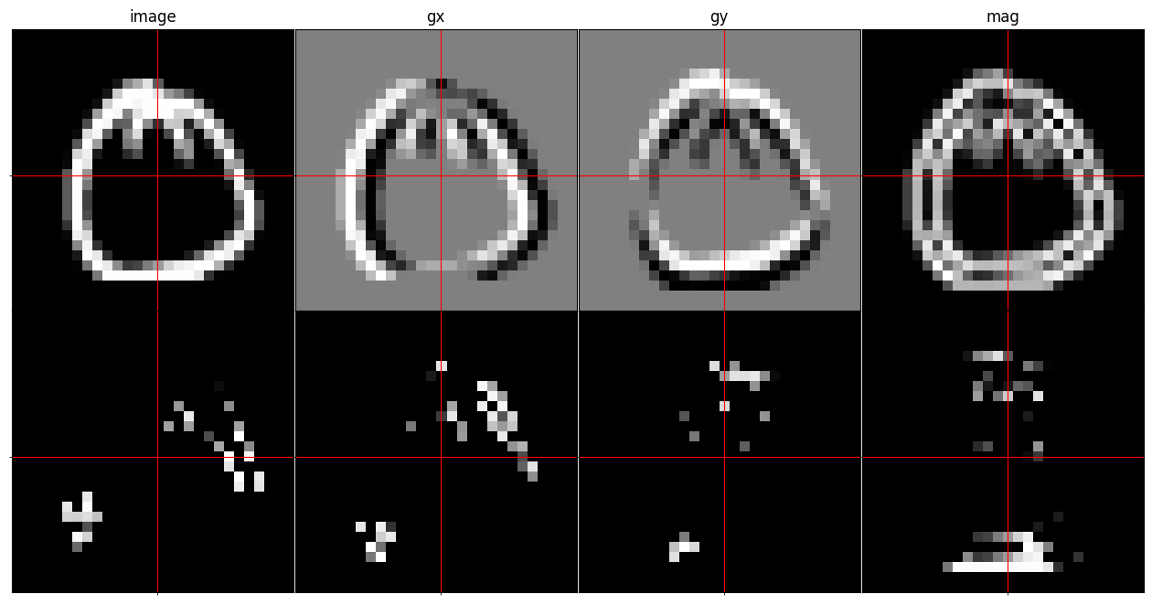
Hand-designing Feature Spaces using Domain Knowledge
E.g. Histogram of Oriented Gradients
Map to orientation bins

Slide 6
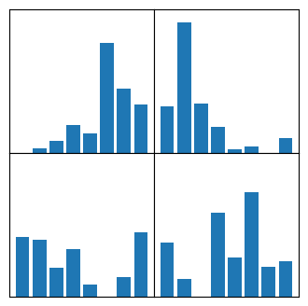
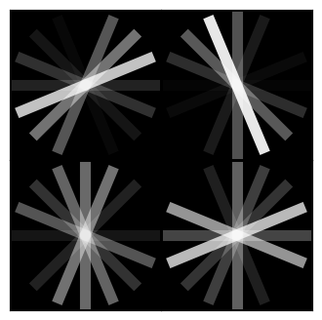
Hand-designing Feature Spaces using Domain Knowledge
Histogram of Oriented Gradients
Histogram of Oriented Gradients

Slide 7
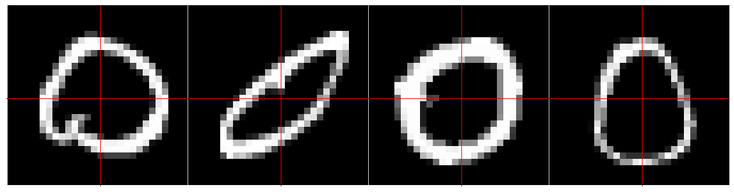
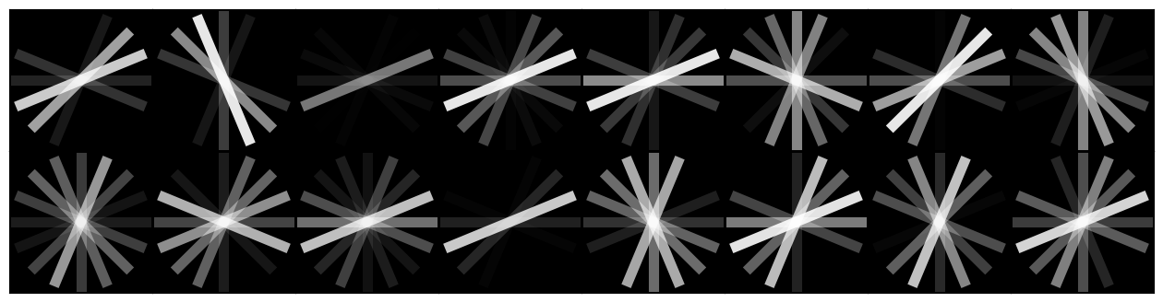
Hand-designing Feature Spaces using Domain Knowledge

Slide 8
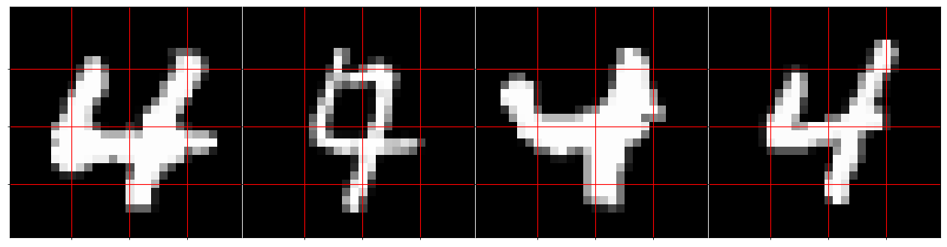
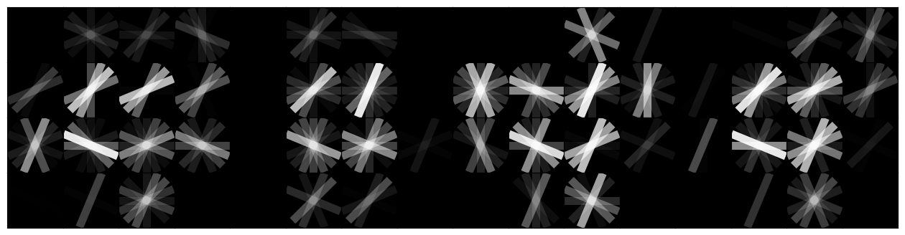
Hand-designing Feature Spaces using Domain Knowledge

Slide 9
Hand-designing Feature Spaces using Domain Knowledge
Actual HOG descriptor use many more tricks:
Normalization
Histograms in overlapping regions
Histograms over varying spatial scales (pyramid-hog)
Image smoothing before computing gradients
Signed gradients
…

Slide 10
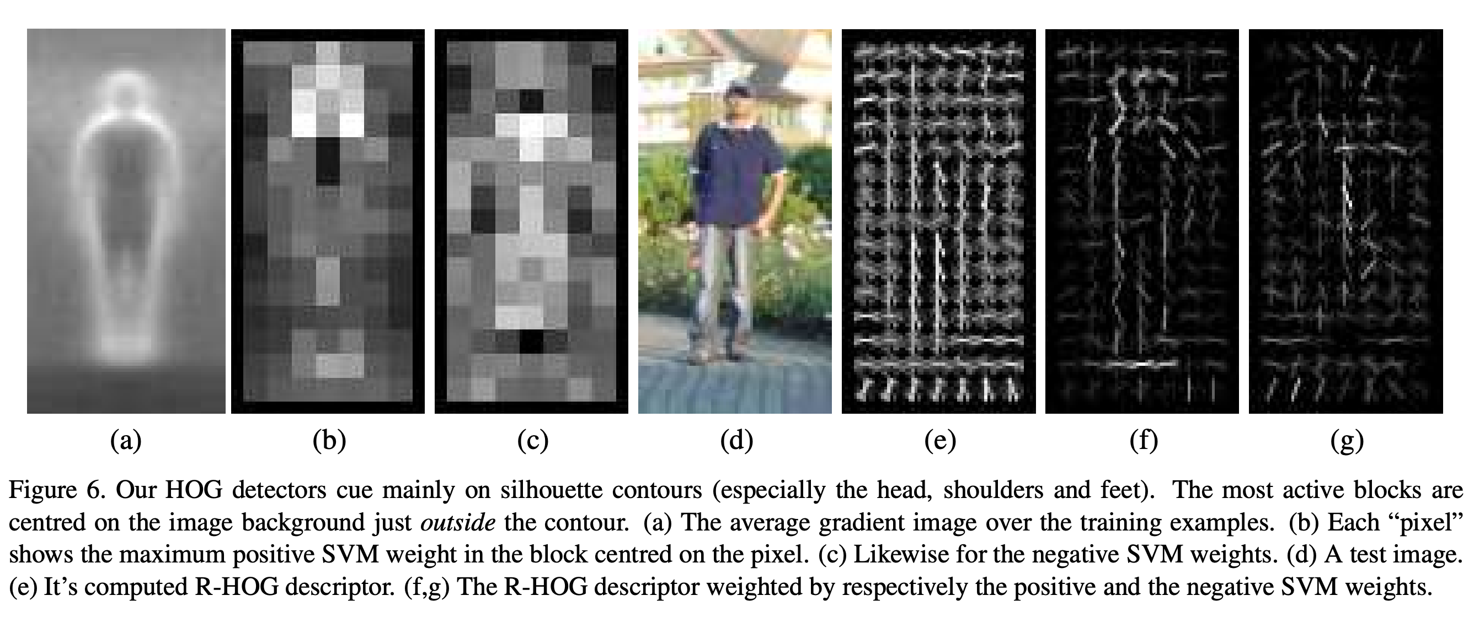
Hand-designing Feature Spaces using Domain Knowledge
Dalal and Triggs. Histograms of Oriented Gradients for Human Detection. CVPR 2005.

Slide 11
Beyond Linear Decision Boundaries
Feature design approach: design features that work well with linear classifiers
Non-linear classifier approach:
  “Shallow” approach: nonlinear feature transformation followed by linear classifier
  “Deep” approach: stack multiple layers of linear predictors (interspersed with nonlinearities)
Feature transformation
Linear
classifier
Input
Output
Layer 1
Layer 2
…
Layer L
Input
Output

Slide 12
Shallow approach
Feature transformation
Linear
classifier
Input
Output
Image credit: Andrew Moore

Slide 13

Nonlinear SVMs
General idea: map the original feature space to a higher-dimensional one where the training data is (hopefully) separable
  Because of the special properties of SVM optimization, this can be done without explicitly performing the lifting transformation
$$Φ:x →φ(x)$$
Image credit: Andrew Moore

Slide 14
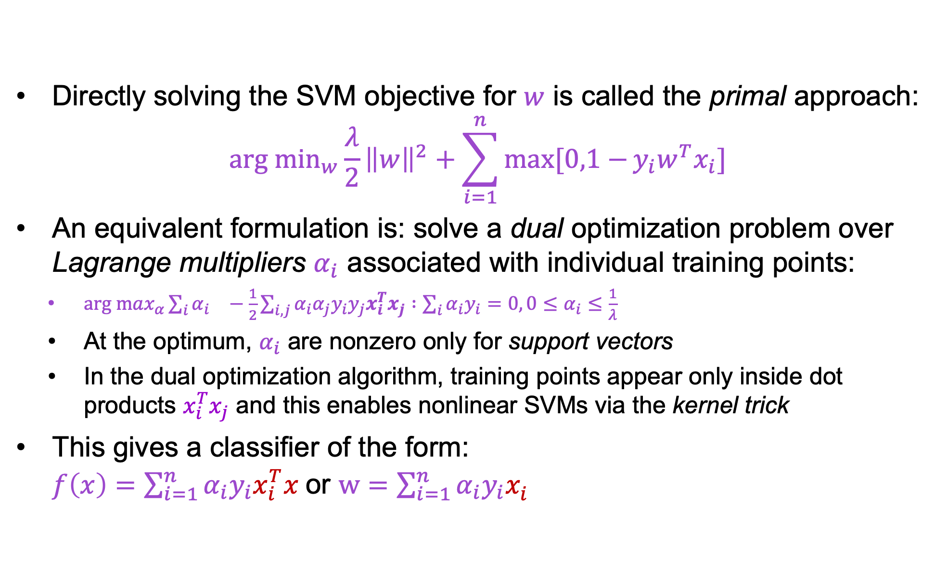
Dual SVM formulation
Directly solving the SVM objective for $w$ is called the primal approach:
$${arg min}_{w}\frac{λ}{2}{\left\|w\right\|}^{2}+\sum_{i=1}^{n}{max⁡[0,1−}{y_{i}w}^{T}x_{i}]$$
An equivalent formulation is: solve a dual optimization problem over Lagrange multipliers $α_{i}$ associated with individual training points:
  ${arg max}_{α}{\sum_{i}{α_{i}}}^{}−\frac{1}{2}\sum_{i,j}{α_{i}α_{j}y_{i}y_{j}x_{i}^{T}x_{j}} :\sum_{i}{α_{i}y_{i}=0, 0≤α_{i}≤\frac{1}{λ}}$
  At the optimum, $α_{i}$ are nonzero only for support vectors
  In the dual optimization algorithm, training points appear only inside dot products $x_{i}^{T}x_{j}$ and this enables nonlinear SVMs via the kernel trick
This gives a classifier of the form:
$f\left(x\right)=\sum_{i=1}^{n}{α_{i}{y_{i}x}_{i}^{T}x}$or $w=\sum_{i=1}^{n}{α_{i}{y_{i}x}_{i}^{}}$

Slide 15
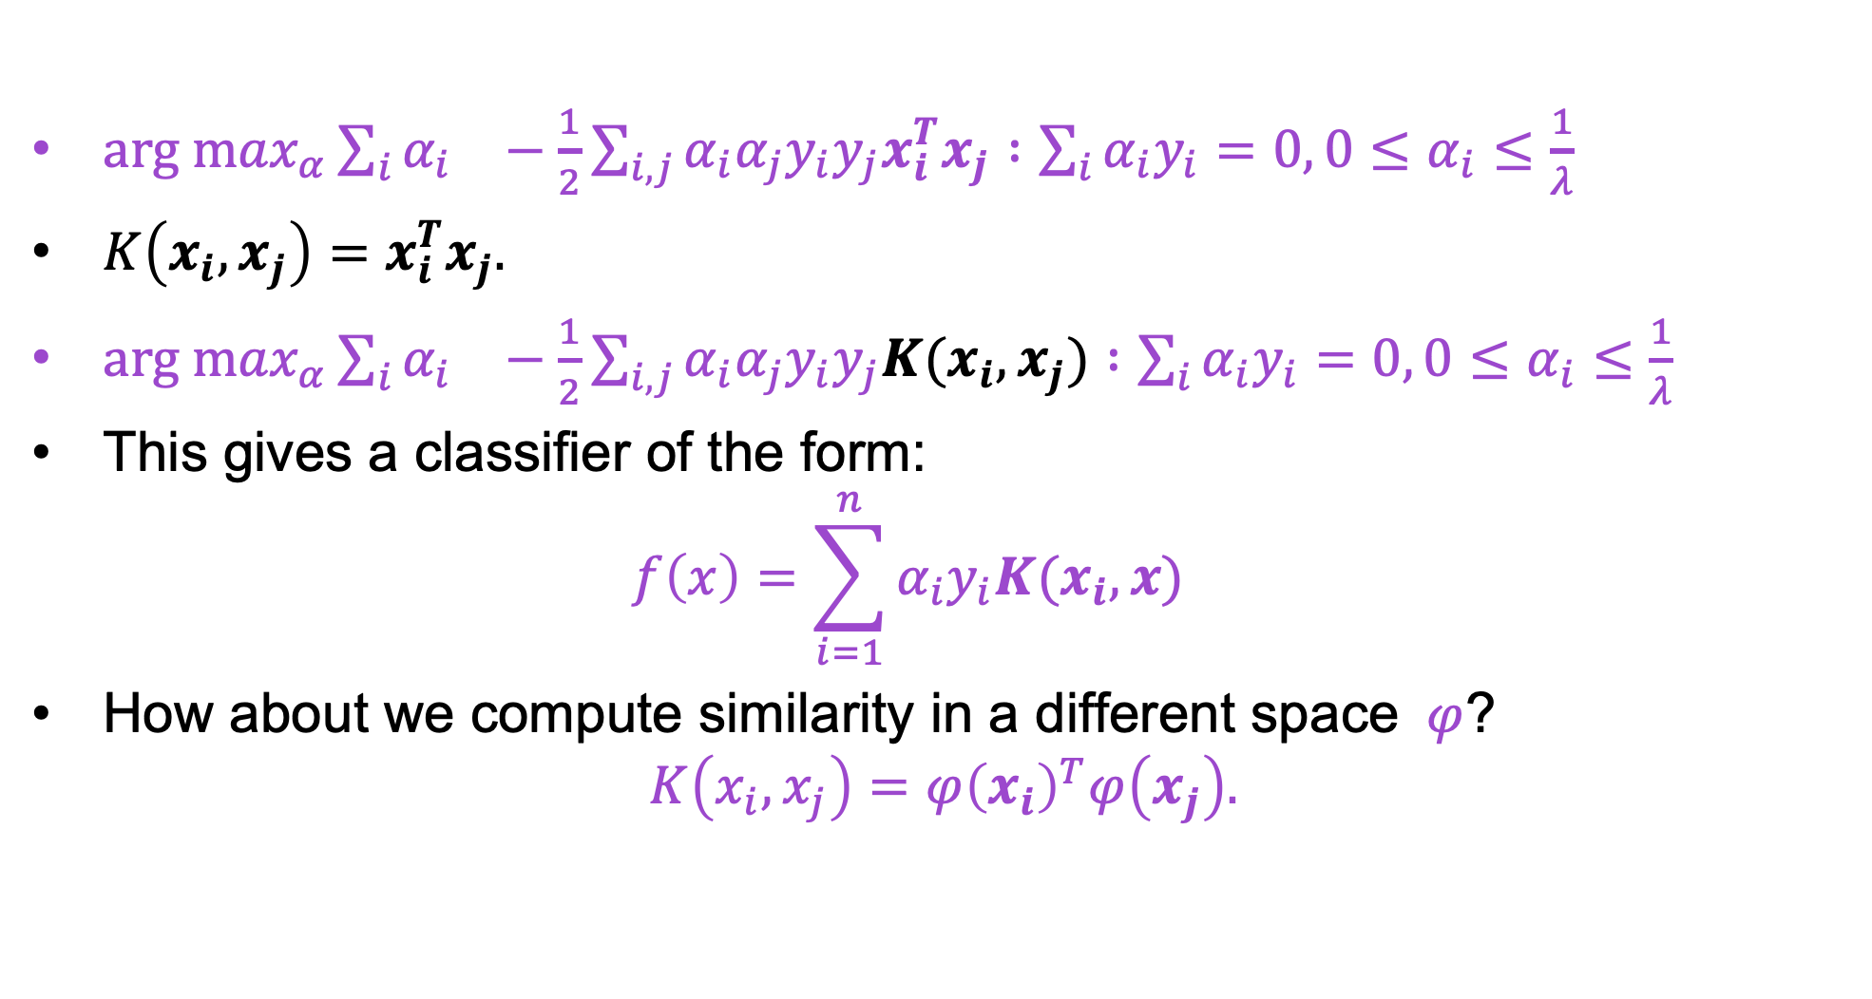
Dual SVM formulation
${arg max}_{α}{\sum_{i}{α_{i}}}^{}−\frac{1}{2}\sum_{i,j}{α_{i}α_{j}y_{i}y_{j}x_{i}^{T}x_{j}} :\sum_{i}{α_{i}y_{i}=0, 0≤α_{i}≤\frac{1}{λ}}$
$K\left(x_{i},x_{j}\right)=x_{i}^{T}x_{j}.$
${arg max}_{α}{\sum_{i}{α_{i}}}^{}−\frac{1}{2}\sum_{i,j}{α_{i}α_{j}y_{i}y_{j}K(x_{i},x_{j})} :\sum_{i}{α_{i}y_{i}=0, 0≤α_{i}≤\frac{1}{λ}}$
This gives a classifier of the form:
$f\left(x\right)=\sum_{i=1}^{n}{α_{i}y_{i}K(x_{i}, x)}$
How about we compute similarity in a different space $φ$?
$K\left(x_{i},x_{j}\right)=φ{\left(x_{i}\right)}^{T}φ\left(x_{j}\right).$

Slide 16
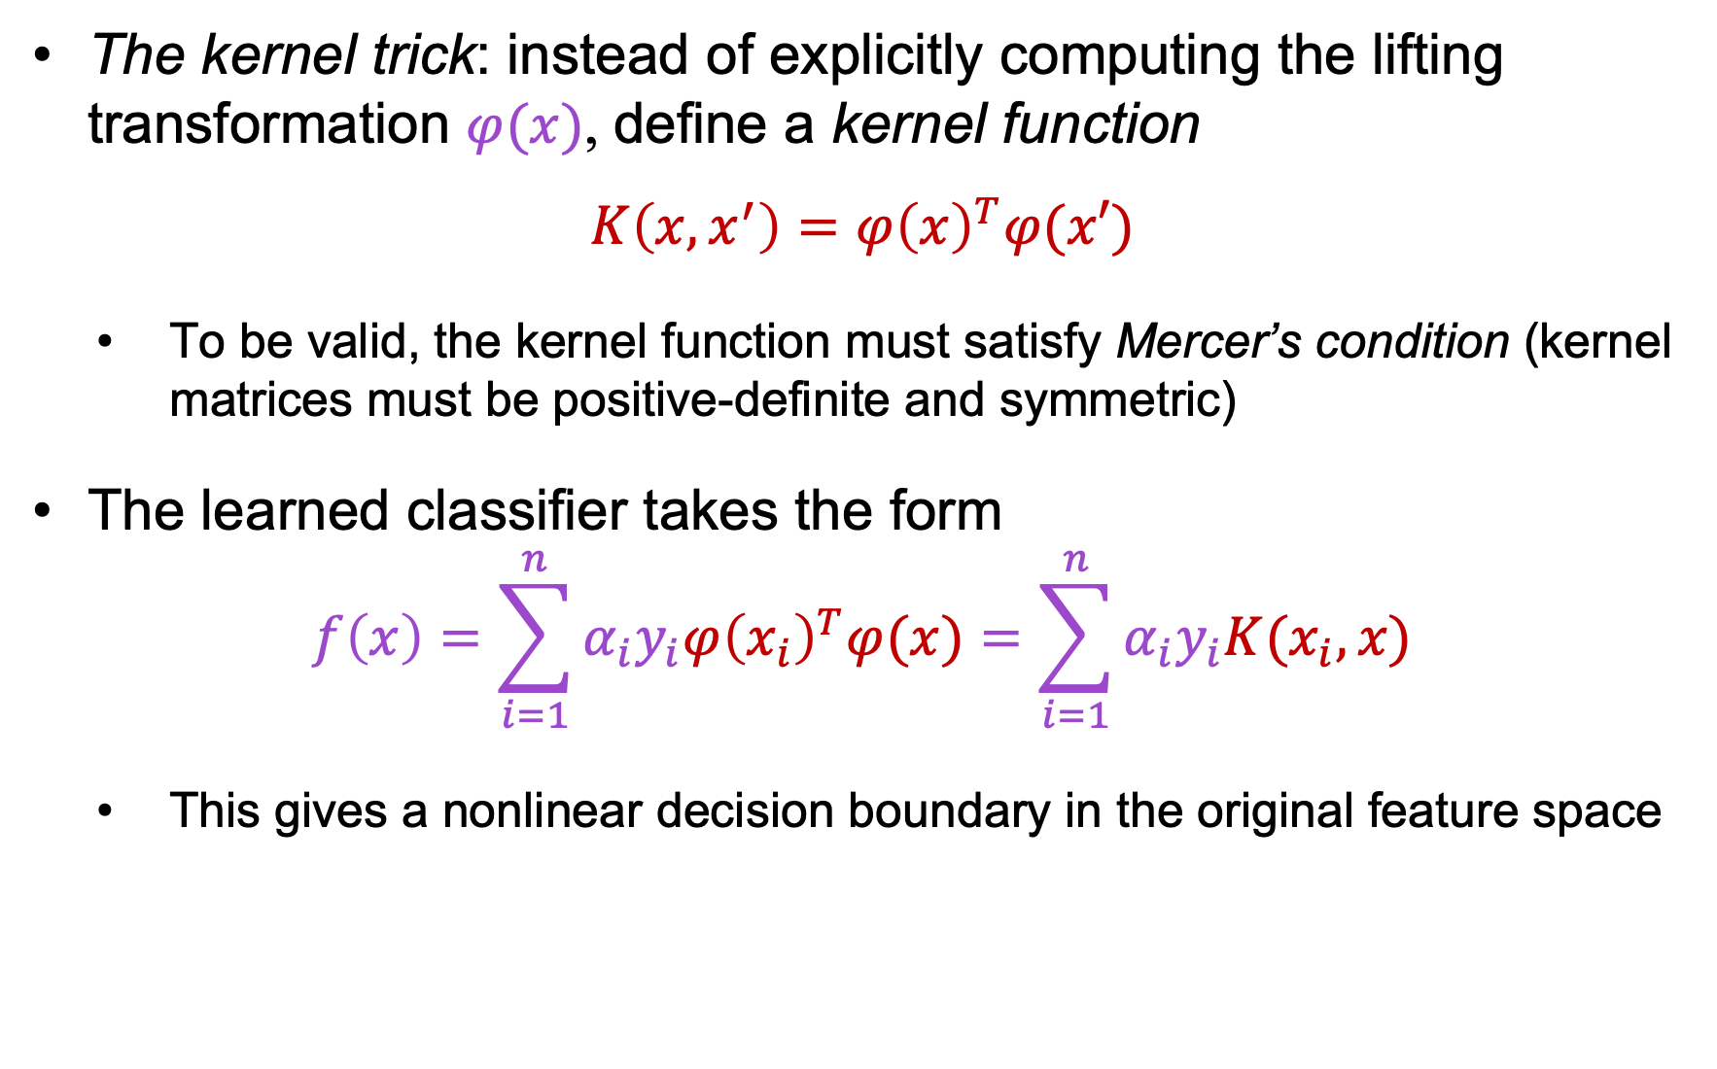
Kernel SVMs
The kernel trick: instead of explicitly computing the lifting transformation $φ(x)$, define a kernel function
$$K\left(x,x^{′}\right)={φ\left(x\right)}^{T}φ(x′)$$
  To be valid, the kernel function must satisfy Mercer’s condition (kernel matrices must be positive-definite and symmetric)
The learned classifier takes the form
$$f\left(x\right)=\sum_{i=1}^{n}{α_{i}y_{i}{φ\left(x_{i}\right)}^{T}φ(x)}=\sum_{i=1}^{n}{α_{i}y_{i}K(x_{i},x)}$$
  This gives a nonlinear decision boundary in the original feature space

Slide 17
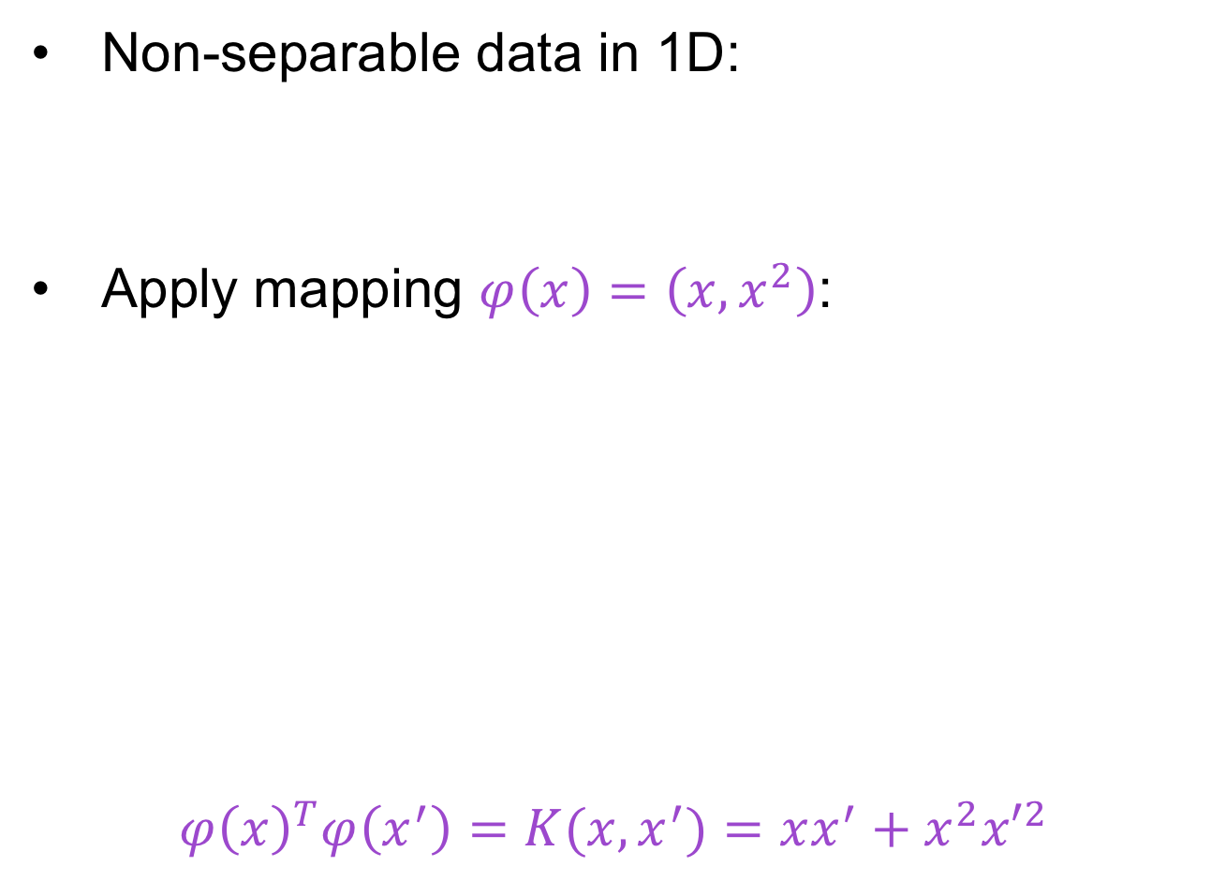
Toy example
Non-separable data in 1D:
Apply mapping $φ\left(x\right)=\left(x,x^{2}\right)$:
$${φ\left(x\right)}^{T}φ\left(x^{′}\right)=K(x,x^{′})=xx^{′}+x^{2}{x′}^{2}$$
0
x
x²
0
x

Slide 18
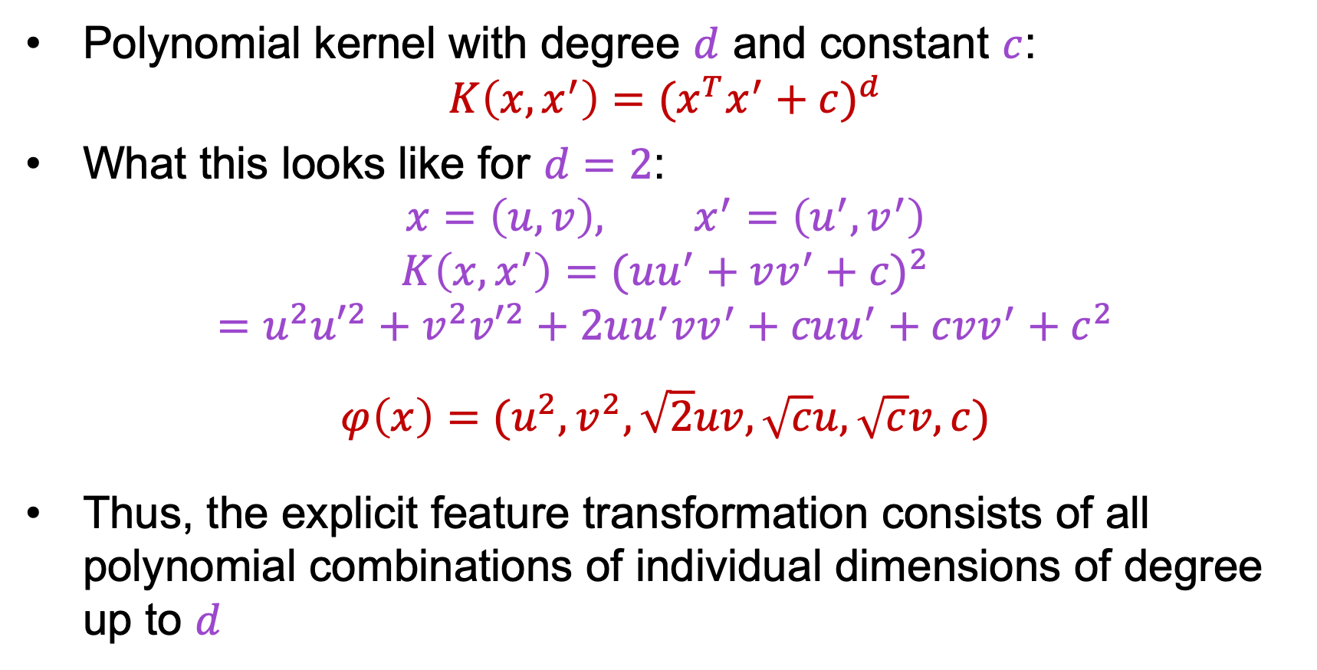
Kernel example 1: Polynomial
Polynomial kernel with degree $d$ and constant $c$:
$$K\left(x,x^{′}\right)={(x^{T}x^{′}+c)}^{d}$$
What this looks like for $d=2$:
$$x=\left(u,v\right), x^{′}=\left(u^{′},v^{′}\right)$$
$$K\left(x,x^{′}\right)={(uu^{′}+vv^{′}+c)}^{2}$$
$$=u^{2}{u′}^{2}+v^{2}{v′}^{2}+2uu^{′}vv^{′}+cuu^{′}+cvv^{′}+c^{2}$$
$$φ\left(x\right)=(u^{2},v^{2},\sqrt{2}uv,\sqrt{c}u,\sqrt{c}v,c)$$
Thus, the explicit feature transformation consists of all polynomial combinations of individual dimensions of degree up to $d$

Slide 19
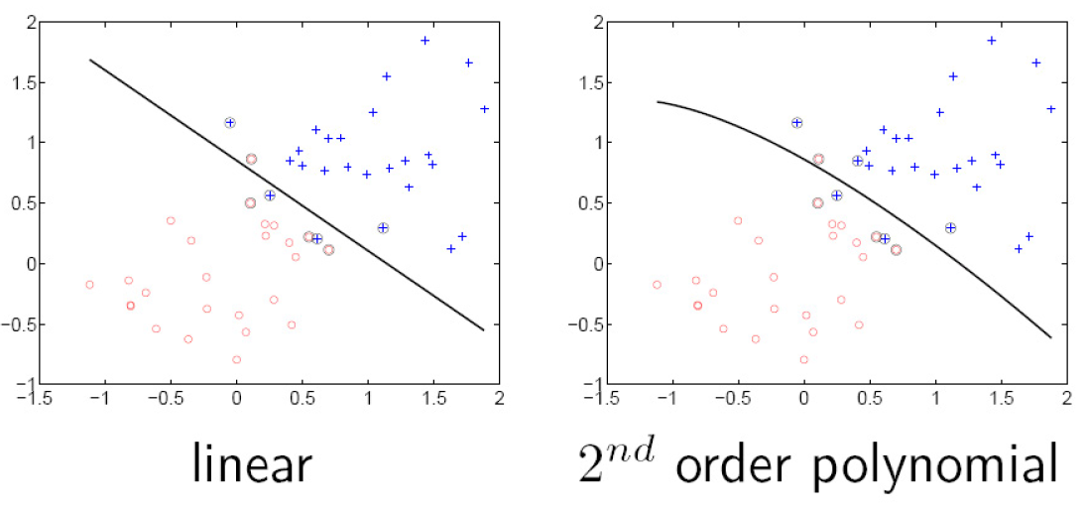
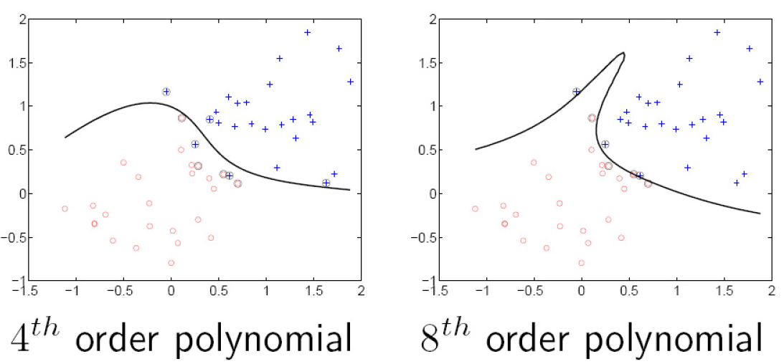
Kernel example 1: Polynomial

Slide 20
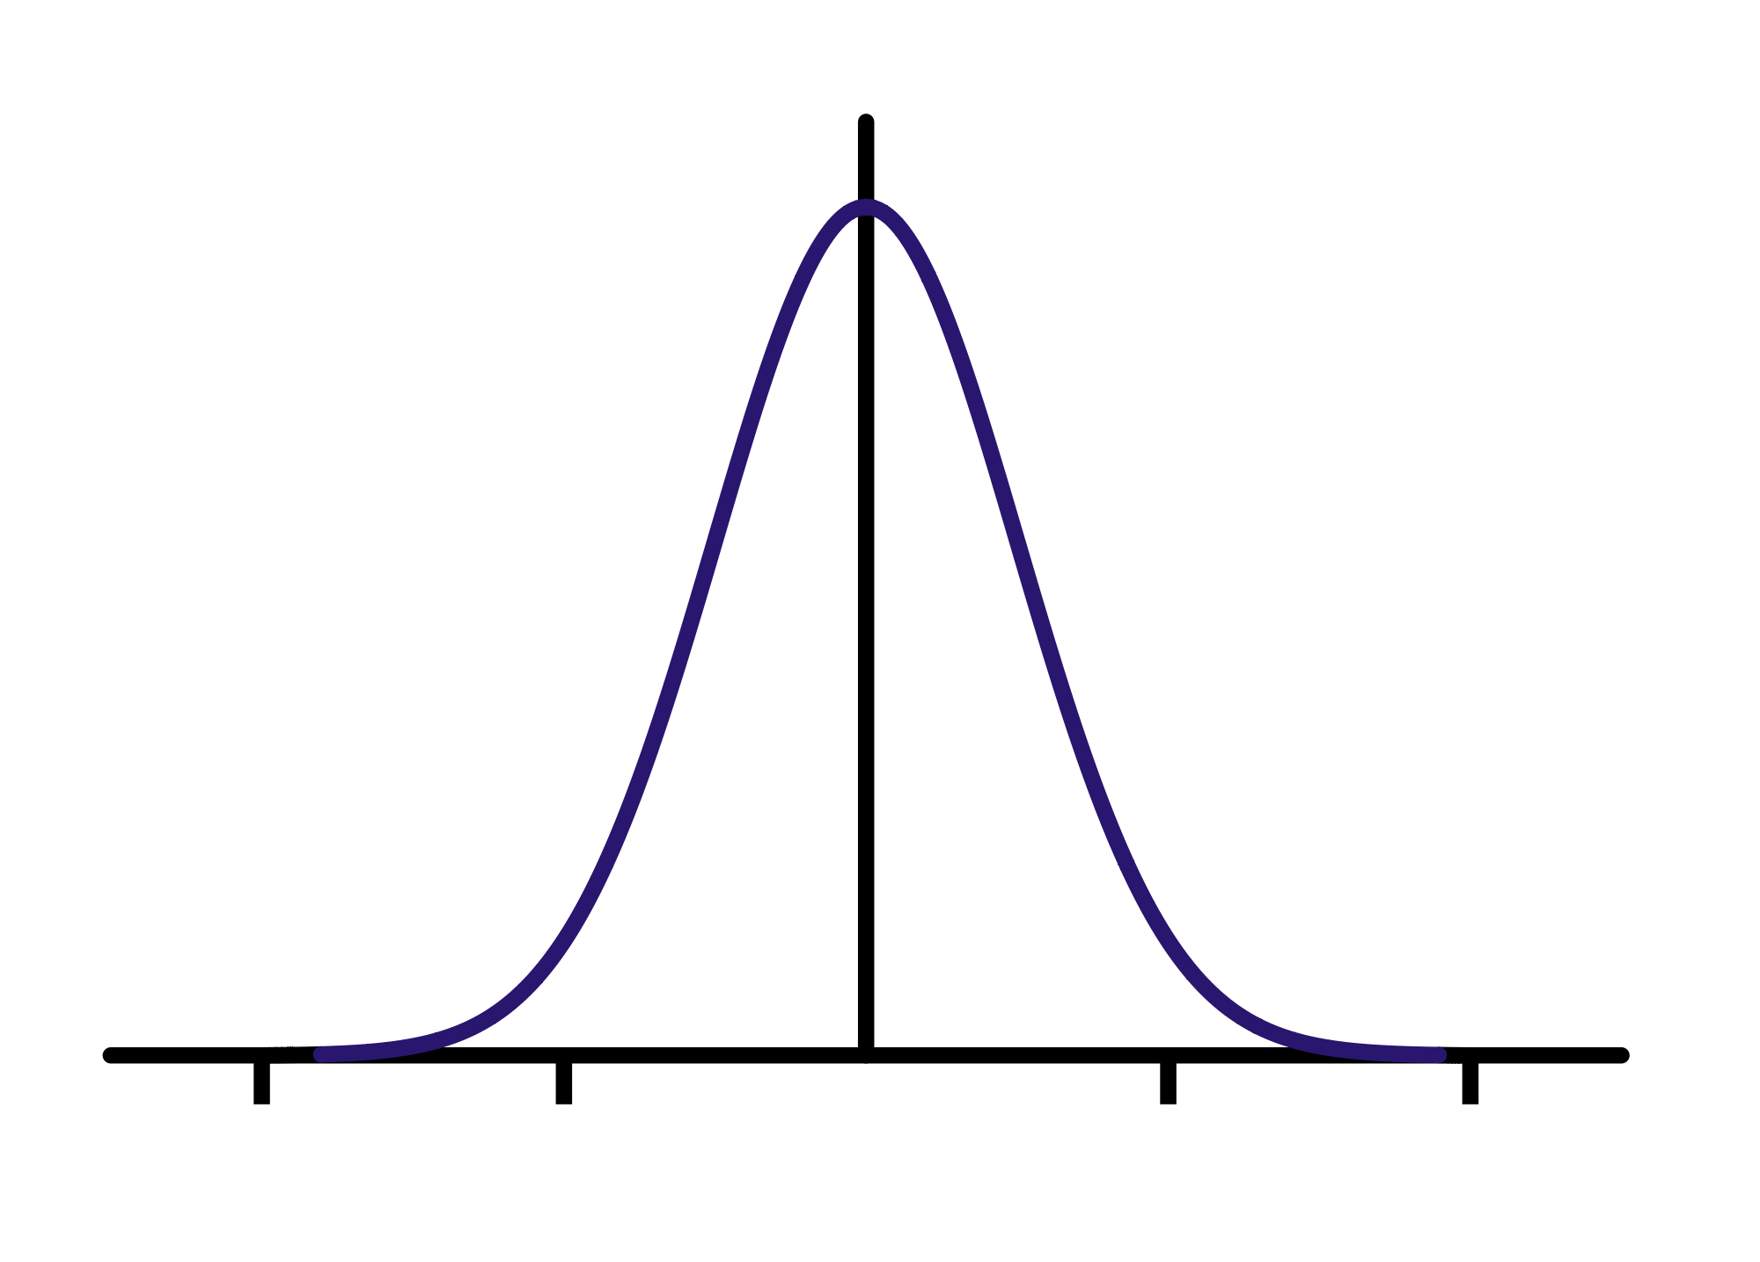



Kernel example 2: Gaussian
Gaussian kernel with bandwidth $σ$:
$$K\left(x,x^{′}\right)=exp\left(⁡−\frac{1}{σ^{2}}{\left\|x−x′\right\|}^{2}\right)$$
Fun fact: the corresponding mapping $φ\left(x\right)$ is infinite-dimensional!
$$K(x, x’)$$
$$||x – x’||$$

Slide 21
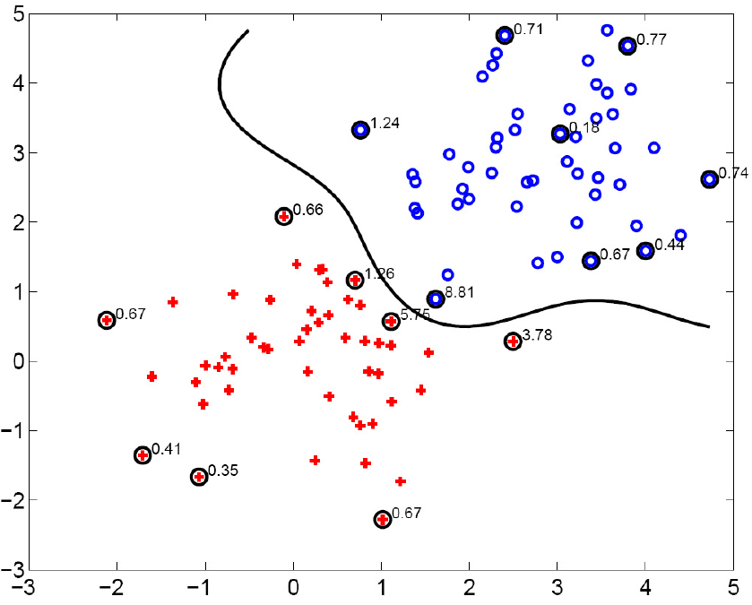
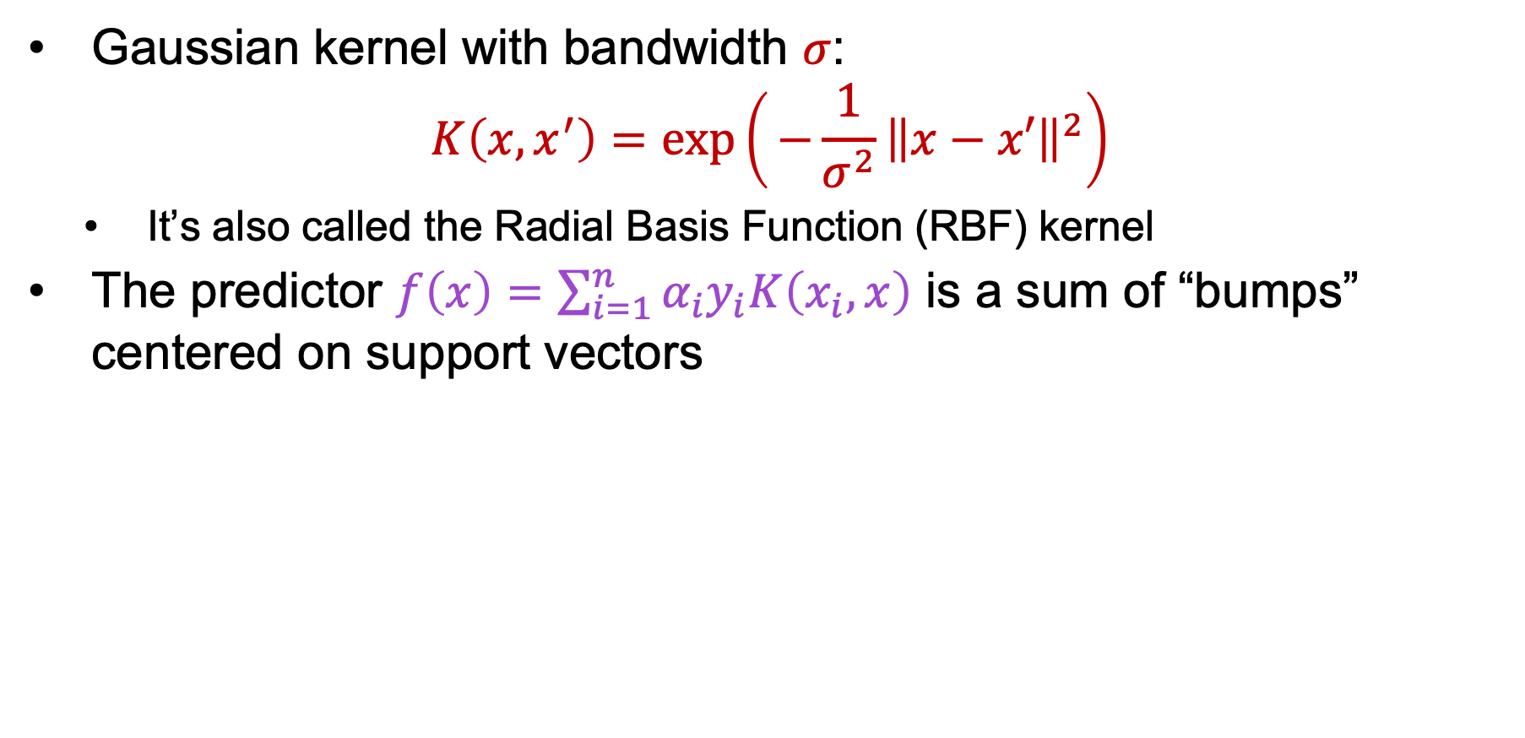
Kernel example 2: Gaussian
Gaussian kernel with bandwidth $σ$:
$$K\left(x,x^{′}\right)=exp\left(⁡−\frac{1}{σ^{2}}{\left\|x−x′\right\|}^{2}\right)$$
  It’s also called the Radial Basis Function (RBF) kernel
The predictor $f\left(x\right)=\sum_{i=1}^{n}{α_{i}y_{i}K\left(x_{i},x\right)}$ is a sum of “bumps” centered on support vectors
SV’s

Slide 22
SVM: Pros and cons
Pros
  Margin maximization and kernel trick are elegant, amenable to convex optimization and theoretical analysis
  Kernel SVMs are flexible, can be used with problem-specific kernels
  SVM loss gives very good accuracy in practice
  Perfect “off-the-shelf” classifier, many packages are available
  Linear SVMs can scale to large datasets
Con
  Kernel SVM training does not scale to large datasets: memory cost is quadratic and computation cost even worse

Slide 23
Overview
Feature Design
Nonlinear classifiers
  “Shallow” approach: Kernel support vector machines (SVMs)
  “Deep” approach: Multi-layer neural networks
Feature transformation
Linear
classifier
Input
Output
Layer 1
Layer 2
Layer 3
Input
Output

Slide 24


From linear classifiers to multi-layer networks
$$x$$
$$y=w^{T}x$$

Slide 25



From linear classifiers to multi-layer networks
Linear layer
$$y^{(1)}=w^{(1)}∙x$$
$$y^{(2)}=w^{(2)}∙x$$
$$x$$
$$⋮$$

Slide 26
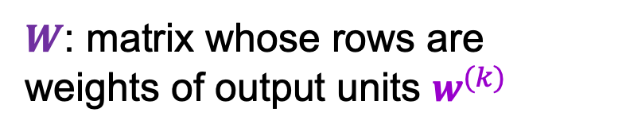

From linear classifiers to multi-layer networks
Linear layer
$$x$$
$$y=Wx$$
$W$: matrix whose rows are weights of output units $w^{(k)}$

Slide 27



From linear classifiers to multi-layer networks
Linear layer
Nonlinearity
$$y$$
$$x$$
$$z=g(y)$$
$$y=Wx$$

Slide 28
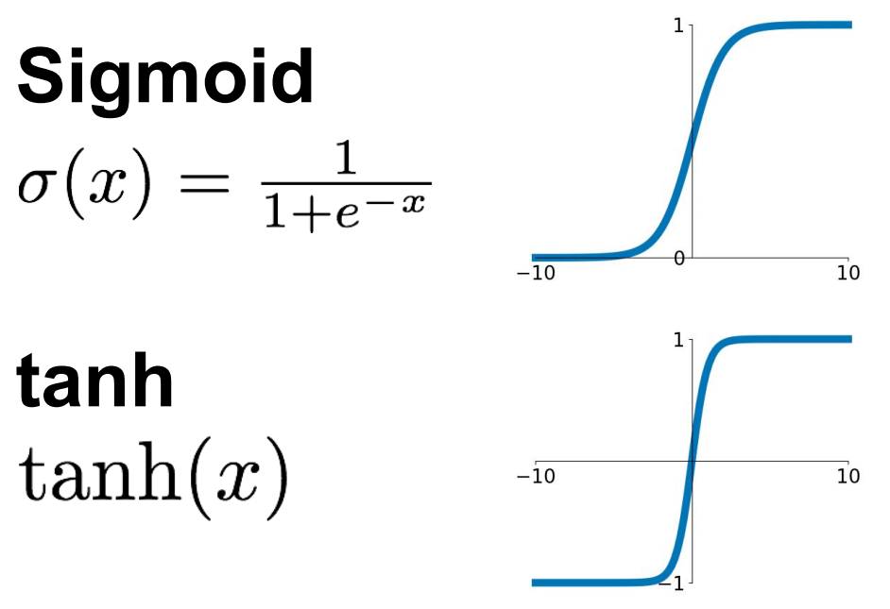
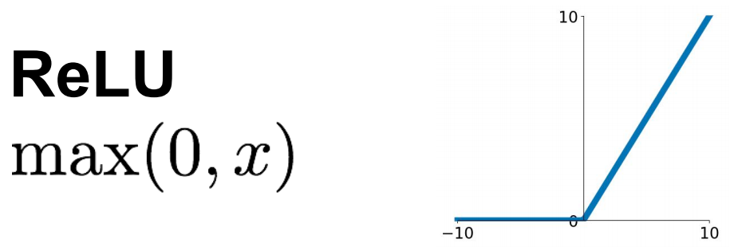
Common nonlinearities (or activation functions)
Source: Stanford 231n

Slide 29
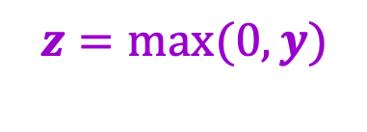
From linear classifiers to multi-layer networks
Linear layer
Nonlinearity
$$y$$
$$x$$
$$z=g(y)$$
…
Why do we need the nonlinearity?
$$y=Wx$$
$$z=max(0,y)$$

Slide 30


The power of nonlinearities
Points not linearly separable in original space
$$x^{(2)}$$
$$x^{(1)}$$
Source: J. Johnson

Slide 31
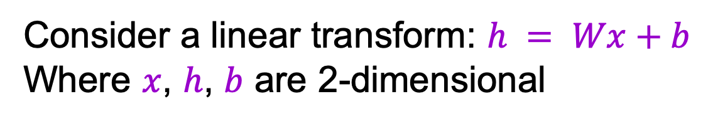
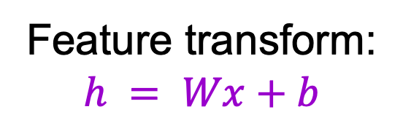
The power of nonlinearities
Points not linearly separable in original space
Consider a linear transform: $h = Wx+b$
Where $x$, $h$, $b$ are 2-dimensional
$$x^{(2)}$$
Feature transform:
$$h = Wx+b$$
$$x^{(1)}$$
Source: J. Johnson

Slide 32


The power of nonlinearities
Points not linearly separable in original space
Consider a linear transform: $h = Wx+b$
Where $x$, $h$, $b$ are 2-dimensional
$$x^{(2)}$$
$$h^{(2)}$$
Feature transform:
$$h = Wx+b$$
$$x^{(1)}$$
$$h^{(1)}$$
Still not linearly separable!
Source: J. Johnson

Slide 33
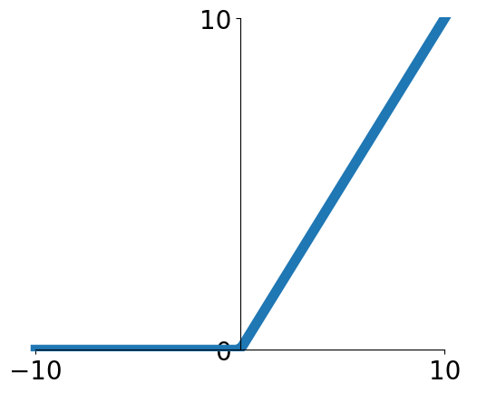
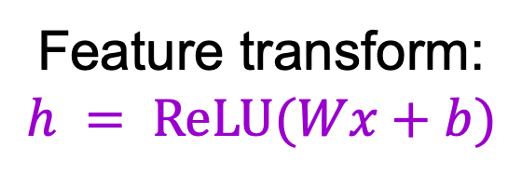
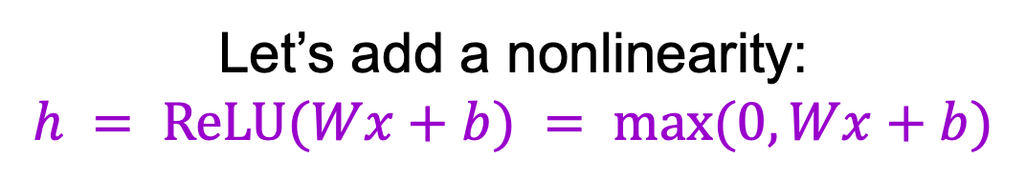
The power of nonlinearities
Let’s add a nonlinearity:
$$h = ReLU(Wx+b) = max⁡(0, Wx+b)$$
$$x^{(2)}$$
$$h^{(2)}$$
Feature transform:
$$h = ReLU(Wx+b)$$
$$x^{(1)}$$
$$h^{(1)}$$
Source: J. Johnson

Slide 34
The power of nonlinearities
Let’s add a nonlinearity:
$$h = ReLU(Wx+b) = max⁡(0, Wx+b)$$
$$x^{(2)}$$
$$h^{(2)}$$
A
Feature transform:
$$h = ReLU(Wx+b)$$
A
$$x^{(1)}$$
$$h^{(1)}$$
Source: J. Johnson

Slide 35
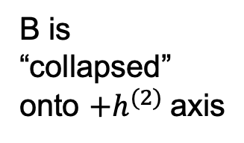
The power of nonlinearities
Let’s add a nonlinearity:
$$h = ReLU(Wx+b) = max⁡(0, Wx+b)$$
$$x^{(2)}$$
$$h^{(2)}$$
A
Feature transform:
$$h = ReLU(Wx+b)$$
B
B
A
B is “collapsed” onto ${+h}^{(2)}$axis
$$x^{(1)}$$
$$h^{(1)}$$
Source: J. Johnson

Slide 36
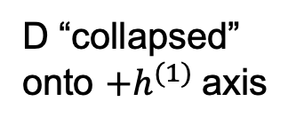
The power of nonlinearities
Let’s add a nonlinearity:
$$h = ReLU(Wx+b) = max⁡(0, Wx+b)$$
$$x^{(2)}$$
$$h^{(2)}$$
A
Feature transform:
$$h = ReLU(Wx+b)$$
B
B
A
B is “collapsed” onto ${+h}^{(2)}$axis
D
$$x^{(1)}$$
$$h^{(1)}$$
D
D “collapsed” onto ${+h}^{(1)}$axis
Source: J. Johnson

Slide 37
The power of nonlinearities
Let’s add a nonlinearity:
$$h = ReLU(Wx+b) = max⁡(0, Wx+b)$$
$$x^{(2)}$$
$$h^{(2)}$$
A
Feature transform:
$$h = ReLU(Wx+b)$$
B
B
A
B is “collapsed” onto ${+h}^{(2)}$axis
D
$$x^{(1)}$$
$$h^{(1)}$$
C
C
D
C “collapsed” onto origin
D “collapsed” onto ${+h}^{(1)}$axis
Source: J. Johnson

Slide 38
The power of nonlinearities
Points not linearly separable in original space
Let’s add a nonlinearity:
$$h = ReLU(Wx+b) = max⁡(0, Wx+b)$$
$$x^{(2)}$$
$$h^{(2)}$$
Feature transform:
$$h = ReLU(Wx+b)$$
$$x^{(1)}$$
$$h^{(1)}$$
Source: J. Johnson

Slide 39
The power of nonlinearities
Points not linearly separable in original space
Let’s add a nonlinearity:
$$h = ReLU(Wx+b) = max⁡(0, Wx+b)$$
$$x^{(2)}$$
$$h^{(2)}$$
Feature transform:
$$h = ReLU(Wx+b)$$
$$x^{(1)}$$
$$h^{(1)}$$
Source: J. Johnson

Slide 40
The power of nonlinearities
Points not linearly separable in original space
Let’s add a nonlinearity:
$$h = ReLU(Wx+b) = max⁡(0, Wx+b)$$
$$x^{(2)}$$
$$h^{(2)}$$
Feature transform:
$$h = ReLU(Wx+b)$$
$$x^{(1)}$$
$$h^{(1)}$$
Points are linearly separable in feature space!
Source: J. Johnson

Slide 41
The power of nonlinearities
Points not linearly separable in original space
Let’s add a nonlinearity:
$$h = ReLU(Wx+b) = max⁡(0, Wx+b)$$
$$x^{(2)}$$
$$h^{(2)}$$
Feature transform:
$$h = ReLU(Wx+b)$$
$$x^{(1)}$$
$$h^{(1)}$$
Points are linearly separable in feature space!
Linear classifier in feature space gives nonlinear classifier in original space
Source: J. Johnson

Slide 42



Two-layer neural network
Individual dimensions of $x$
Output of hidden layer: $g(W_{1}x)$
Final output: $g\left(W_{2}g(W_{1}x)\right)$
Image source

Slide 43

Two-layer networks as combinations of templates
Linear classifier: One template per class

Slide 44
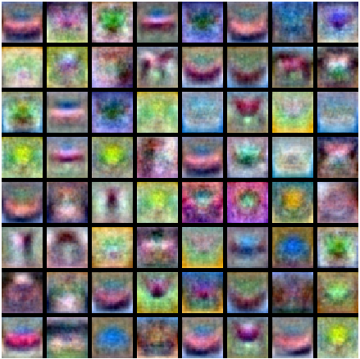
Two-layer networks as combinations of templates
First layer: bank of templates
Second layer: recombines templates
Source: J. Johnson

Slide 45
Two-layer networks as combinations of templates
First layer: bank of templates
Second layer: recombines templates
Can use different templates to cover multiple modes of a class
Source: J. Johnson

Slide 46
Two-layer networks as combinations of templates
First layer: bank of templates
Second layer: recombines templates
It’s a “distributed” representation:
Most templates are
not interpretable
Source: J. Johnson

Slide 47
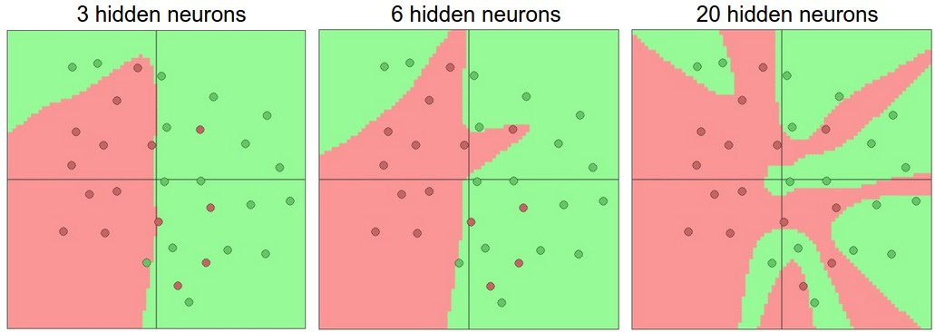
Expressiveness of two-layer networks
How complex can we make the decision boundary in a two-layer network?
The bigger the hidden layer, the more complex the model
A two-layer network is a universal function approximator
  But the hidden layer may need to be huge
Figure source

Slide 48
Comparing two-layer networks to nonlinear SVMs
Feature transformation
Linear
classifier
Input
Output

Slide 49











Comparing two-layer networks to nonlinear SVMs
Example: predictor for polynomial kernel of degree 2
Feature transformation
Linear
classifier
Input
Output
$$u^{2}$$
$$v^{2}$$
$$u$$
$$\sqrt{2}uv$$
$$y=sgn\left(w^{T}φ(x)\right)$$
$$\sqrt{c}u$$
$$v$$
$$\sqrt{c}v$$
$$c$$
Input:
$$x=(u,v)$$
Fixed transformation $φ(x)$
Linear predictor

Slide 50
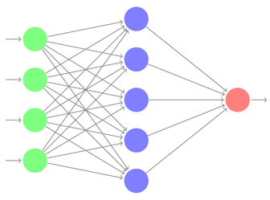

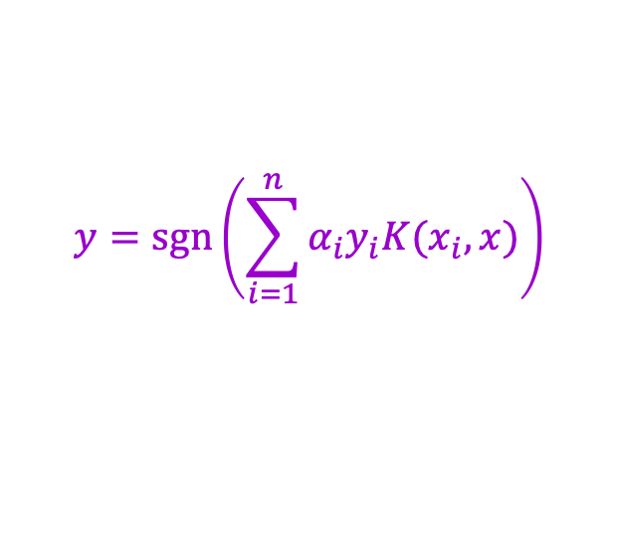



Comparing two-layer networks to nonlinear SVMs
Dual view: compute kernel function value of input with every support vector, apply linear classifier
Feature transformation
Linear
classifier
Input
Output
$${K(x}_{1},x)$$
$${K(x}_{2},x)$$
$$y=sgn\left(\sum_{i=1}^{n}{α_{i}y_{i}K(x_{i},x)}\right)$$
Individual dimensions of $x$
$${K(x}_{n},x)$$

Slide 51
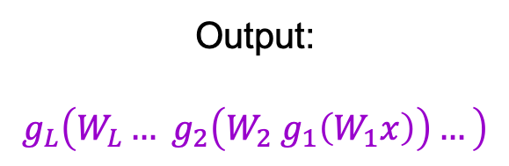

Neural networks beyond two layers
Output:
$$g_{L}\left(W_{L}… g_{2}\left(W_{2}{ g}_{1}\left(W_{1}x\right)\right)…\right)$$
Individual dimensions of $x$
Image source

Slide 52
“Deep” pipeline
Layer 1
Layer 2
…
Layer L
Input
Output
  Learn a feature hierarchy
  Each layer extracts features from the output of previous layer
  All layers are trained jointly

Slide 53
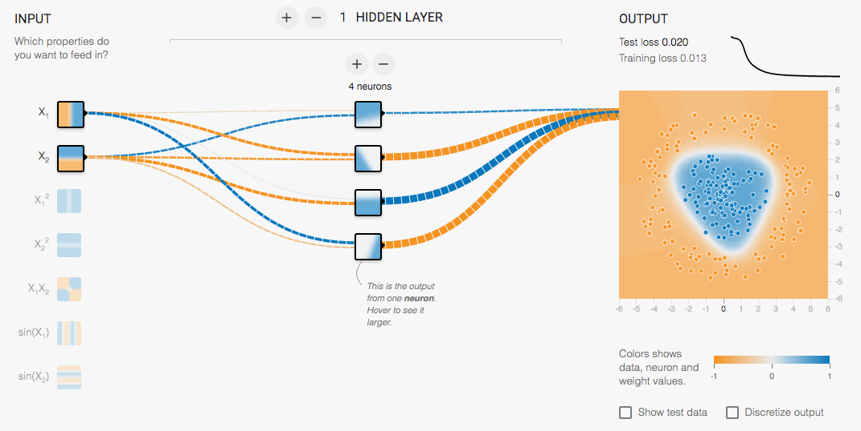
Multi-Layer network demo
http://playground.tensorflow.org/

Slide 54
Overview
Feature Design
Nonlinear classifiers
  “Shallow” approach: Kernel support vector machines (SVMs)
  “Deep” approach: Multi-layer neural networks
Controlling classifier complexity
  Hyperparameters
  Bias-variance tradeoff
  Overfitting and underfitting
  Hyperparameter search in practice

Slide 55
Supervised learning outline revisited
Collect data and labels
Specify model: select model class and loss function
Train model: find the parameters of the model that minimize the empirical loss on the training data
This involves hyperparameters that affect the generalization ability of the trained model

Slide 56
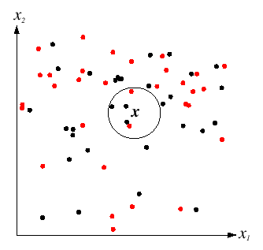

Hyperparameters
$K$ in $K$-nearest-neighbor
  What if $K$ is too large?
  What if $K$ is too small?

Slide 57
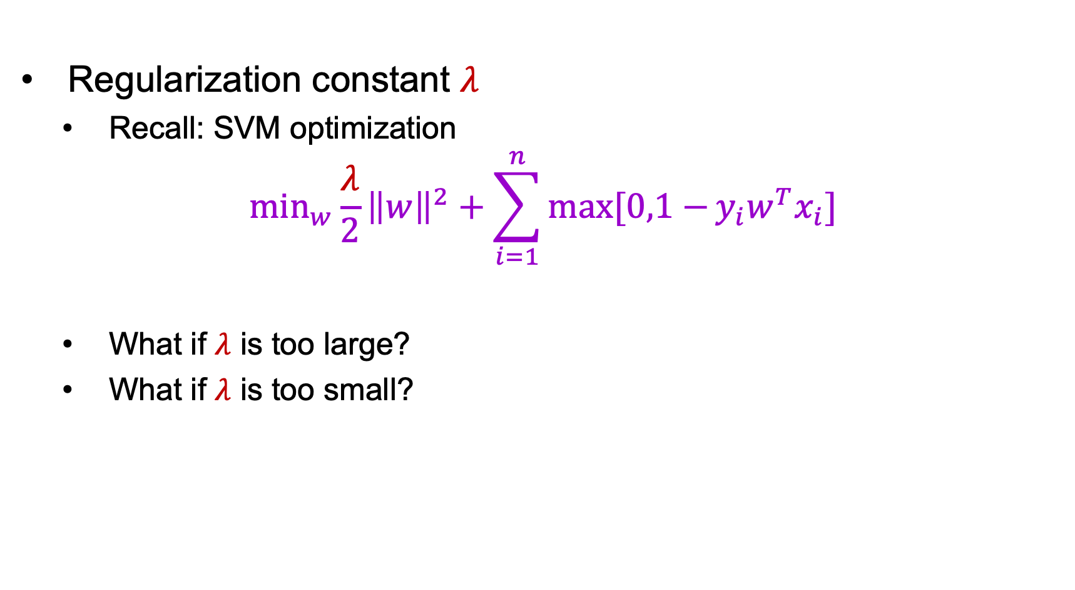
Hyperparameters
Regularization constant $λ$
  Recall: SVM optimization
$$\min_{w}\frac{λ}{2}{\left\|w\right\|}^{2}+\sum_{i=1}^{n}{max⁡[0,1−}{y_{i}w}^{T}x_{i}]$$
  What if $λ$ is too large?
  What if $λ$ is too small?

Slide 58
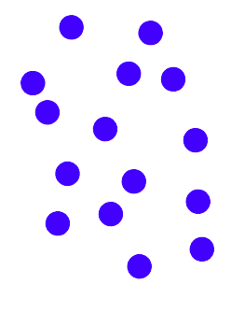
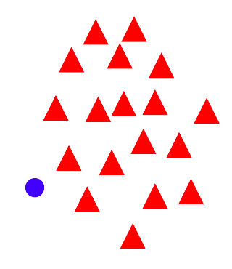

Hyperparameters
Regularization constant $λ$
  Tradeoff between margin and classification errors
Source

Slide 59
Hyperparameters
Regularization constant $λ$
  Tradeoff between margin and classification errors
Source

Slide 60
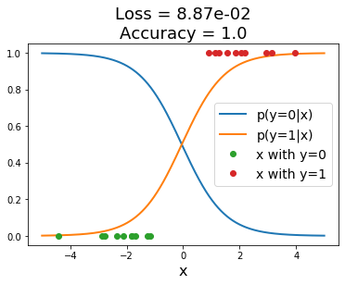
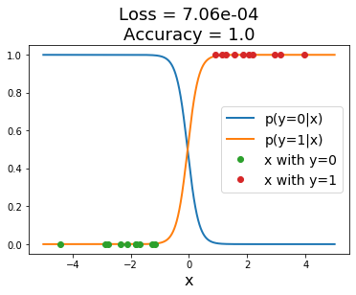
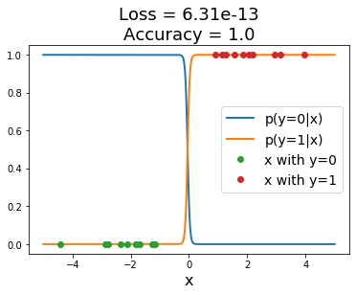

Hyperparameters
Regularization constant $λ$
  Related: preventing the classifier from getting over-confident
Sigmoid classifier, logistic loss
Source: J. Johnson

Slide 61
Hyperparameters
What about nonlinear SVMs?
  Choice of kernel (and any associated constants)

Slide 62
Polynomial kernel: ${K\left(x,x^{′}\right)=(x^{T}x^{′}+c)}^{d}$

Slide 63

Gaussian kernel
Gaussian kernel with bandwidth $σ$:
$$K\left(x,x^{′}\right)=exp\left(⁡−\frac{1}{σ^{2}}{\left\|x−x′\right\|}^{2}\right)$$
Recall: the predictor $f\left(x\right)=\sum_{i=1}^{n}{α_{i}y_{i}K\left(x_{i},x\right)}$ is a sum of “bumps” centered on support vectors
SV’s

Slide 64

Gaussian kernel
Gaussian kernel with bandwidth $σ$:
$$K\left(x,x^{′}\right)=exp\left(⁡−\frac{1}{σ^{2}}{\left\|x−x′\right\|}^{2}\right)$$
Recall: the predictor $f\left(x\right)=\sum_{i=1}^{n}{α_{i}y_{i}K\left(x_{i},x\right)}$ is a sum of “bumps” centered on support vectors
How does the value of $σ$ affect the behavior of the predictor?
  What if $σ$ is close to zero?
  What if $σ$ is very large?

Slide 65

Hyperparameters in multi-layer networks
Number of layers, number of units per layer
Source: Stanford 231n

Slide 66
Hyperparameters in multi-layer networks
Number of layers, number of units per layer
Number of hidden units in a two-layer network
Source: Stanford 231n

Slide 67

Hyperparameters in multi-layer networks
Number of layers, number of units per layer
Type of nonlinearity
Type of loss function
Regularization constant
Source: Stanford 231n

Slide 68
Hyperparameters in multi-layer networks
Number of layers, number of units per layer
Type of nonlinearity
Type of loss function
Regularization constant
SGD settings: learning rate schedule, number of epochs, minibatch size, etc.

Slide 69
Summary: Hyperparameters
Examples of hyperparameters
  K in K-NN
  In SVMs: regularization constant, kernel type and constants
  In neural networks: number of layers, number of units per layer, type of nonlinearity, type of loss function, regularization constant
  SGD settings: learning rate schedule, number of epochs, minibatch size, etc.
We can think of our hyperparameter choices as determining the “complexity” of the model and controlling its generalization ability

Slide 70
Overview
Nonlinear classifiers
  Kernel support vector machines (SVMs)
  Multi-layer neural networks
Controlling classifier complexity
  Hyperparameters
  Bias-variance tradeoff
  Overfitting and underfitting
  Hyperparameter search in practice

Slide 71

Model complexity and generalization
Generalization (test) error of learning algorithms can be broken down into three components (see notes):
  Noise: unavoidable error
  Bias: error due to simplifying model assumptions
  Variance: error due to randomness of training set
“Simple” model
“Intermediate” model
“Complex” model
High bias, low variance
Low bias, high variance
Figure source

Slide 72
Bias-variance tradeoff
What if your model bias is too high?
  Your model is underfitting – it is incapable of capturing the important characteristics of the training data
What if your model variance is too high?
  Your model is overfitting – it is fitting noise and unimportant characteristics of the data
How to recognize underfitting or overfitting?
Underfitting
Overfitting
Figure source

Slide 73
Bias-variance tradeoff
What if your model bias is too high?
  Your model is underfitting – it is incapable of capturing the important characteristics of the training data
What if your model variance is too high?
  Your model is overfitting – it is fitting noise and unimportant characteristics of the data
How to recognize underfitting or overfitting?
  Need to look at both training and test error
  Underfitting: training and test error are both high
  Overfitting: training error is low, test error is high

Slide 74
Behavior of training and test error
Test error
Error
Training error
High Bias
Low Variance
Complexity
Low Bias
High Variance
Source: D. Hoiem

Slide 75
Dependence on training set size
Few training examples
Test Error
Many training examples
High Bias
Low Variance
Complexity
Low Bias
High Variance
Source: D. Hoiem
Notes:
Note: these figures don’t work in pdf

Slide 76
Dependence on training set size
Error
Testing
Generalization gap
Training
Number of training examples
(fixed model)
Source: D. Hoiem

Slide 77

Dependence on training set size
Digit classification case study

Slide 78

Dependence on training set size
Digit classification case study
Maji and Malik. 2009 Fast and Accurate Digit Classification

Slide 79
Looking at training and test error
In most practical situations, you are faced with a fixed dataset and have to find the hyperparameter settings that give you the best generalization performance
Test error
Error
Training error
High Bias
Low Variance
Complexity
Low Bias
High Variance
Source: D. Hoiem

Slide 80

Hyperparameter search in practice
For a range of hyperparameter choices, iterate:
  Learn parameters on the training data
  Measure accuracy on the held-out or
  validation data
Finally, measure accuracy on the test data
Crucial: do not peek at test set during hyperparameter search!
  The test set needs to be used sparingly since it is supposed to represent never before seen data

Slide 81

Hyperparameter search in practice
Variant: K-fold cross-validation
  Partition the entire training set into K groups
  In each run (or fold), select one of the groups as the validation set and train on the other K-1 groups. At the end, average the accuracies across the K folds
  Typically not used for deep learning due to computational expense
Training
Validation
Source: J. Johnson

Slide 82
What’s the big deal?
If you don’t maintain proper training-validation-test hygiene, you will be fooling yourself or others (professors, reviewers, employers, customers)
It may even cause a public scandal!

Slide 83







What’s the big deal?

Slide 84

http://www.image-net.org/challenges/LSVRC/announcement-June-2-2015

