Slide 1
Backpropagation
CS 444: Deep Learning for Computer Vision
Saurabh Gupta
Many slides from Lana Lazebnik

Slide 2
Overview
Computation graphs
Using the chain rule
General backpropagation algorithm
Toy examples of backward pass
Matrix-vector calculations: ReLU, linear layer

Slide 3








Recall: Multi-layer neural networks
The function computed by the network is a composition of the functions computed by individual layers (e.g., linear layers and nonlinearities):
More precisely:
Layer 1
Layer 2
…
Layer K
Input
Output
hidden representation
$$h_{1}$$
$$h_{2}$$
$$h_{K−1}$$
$$f_{1}(x,w_{1})$$
$$f_{2}(h_{1},w_{2})$$
$$f_{K}(h_{K−1},w_{K})$$
$$x$$
…
$$h_{K}$$
input
first layer transformation
second layer transformation
output layer
output

Slide 4

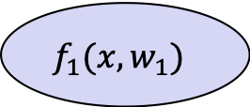


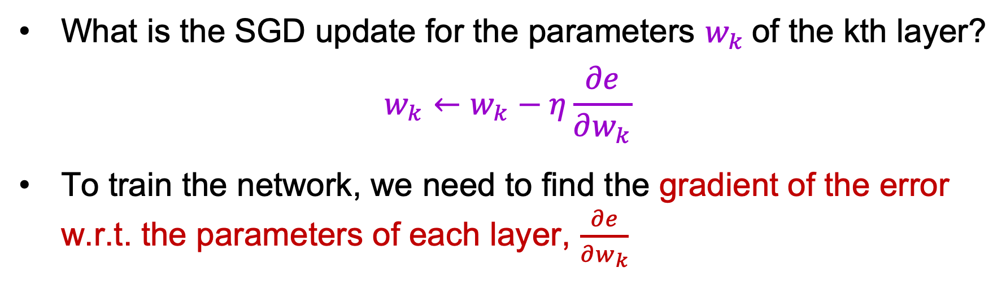
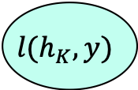





Training a multi-layer network
hidden representation
output
$$h_{1}$$
$$h_{2}$$
$$h_{K−1}$$
$$h_{K}$$
$$f_{1}(x,w_{1})$$
$$f_{2}(h_{1},w_{2})$$
$$f_{K}(h_{K−1},w_{K})$$
$$l(h_{K},y)$$
$$x$$
…
$$e$$
input
first layer transformation
second layer transformation
output layer
loss function
error
What is the SGD update for the parameters $w_{k}$of the kth layer?
$$w_{k}←w_{k}−η\frac{∂e}{∂w_{k}}$$
To train the network, we need to find the gradient of the error w.r.t. the parameters of each layer, $\frac{∂e}{∂w_{k}}$

Slide 5



Computation graph
$$w_{1}$$
$$w_{2}$$
$$w_{K}$$
$$h_{1}$$
$$h_{2}$$
$$h_{K−1}$$
$$h_{K}$$
$$f_{1}(x,w_{1})$$
$$f_{2}(h_{1},w_{2})$$
$$f_{K}(h_{K−1},w_{K})$$
$$l(h_{K},y)$$
$$x$$
…
$$e$$

Slide 6
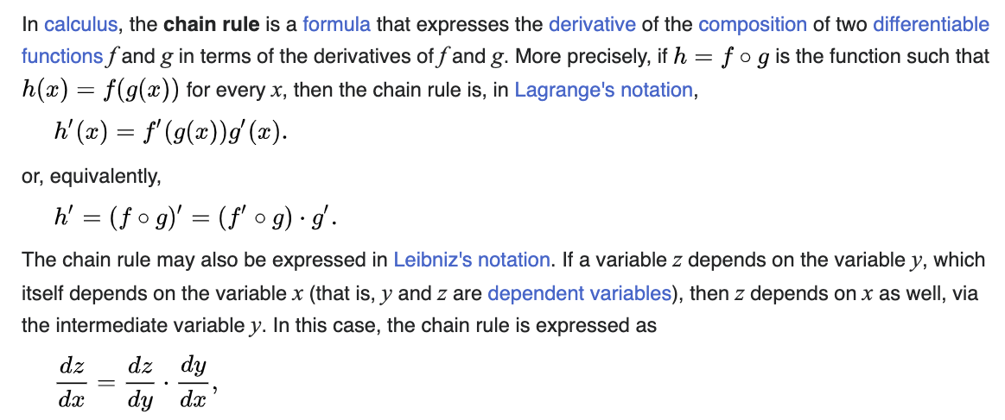

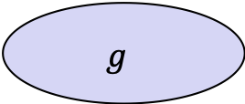
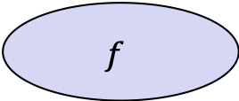
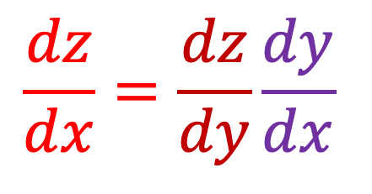


The chain rule
$$y$$
$$\frac{dz}{dx}=\frac{dz}{dy}\frac{dy}{dx}$$
$$g$$
$$f$$
$$z$$
$$x$$
https://en.wikipedia.org/wiki/Chain_rule
Notes:
From Wikipedia: The chain rule may be expressed in Leibniz’s notation. If a variable z depends on the variable y, which itself depends on the variable x (that is, y and z are dependent variables), then z depends on x as well, via the intermediate variable y. In this case, the chain rule is expressed as dz/dx = dz/dy * dy/dx.

Slide 7
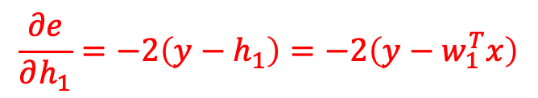
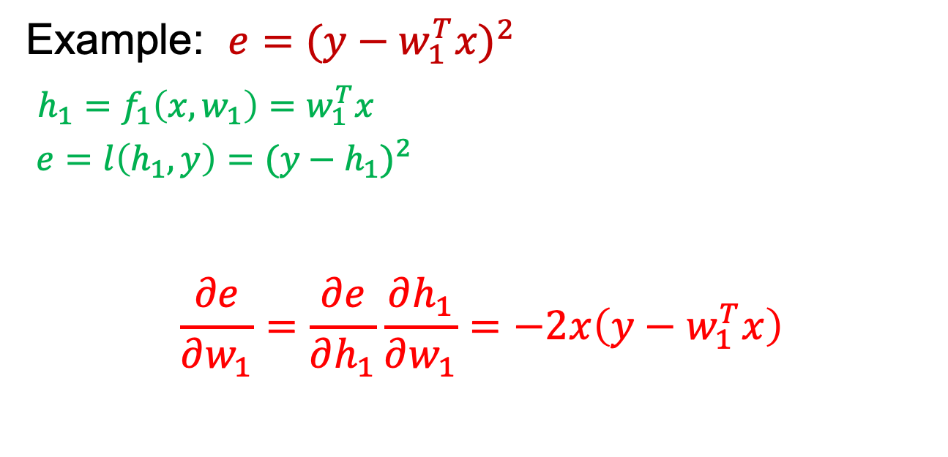

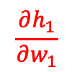

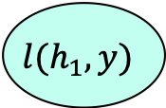
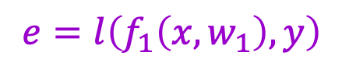
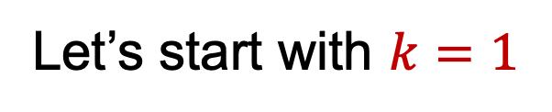
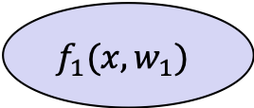

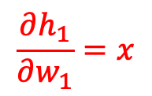
Applying the chain rule
$$w_{1}$$
$$\frac{∂h_{1}}{∂w_{1}}$$
$$h_{1}$$
Let’s start with $k=1$
$$f_{1}(x,w_{1})$$
$$l(h_{1},y)$$
$$x$$
$$e$$
$$\frac{∂e}{∂h_{1}}$$
$e=l\left(f_{1}\left(x,w_{1}\right),y\right)$
Example: $e{=(y−w_{1}^{T}x)}^{2}$
$h_{1}=f_{1}\left(x,w_{1}\right)=w_{1}^{T}x$
$e=l\left(h_{1},y\right)={(y−h_{1})}^{2}$
$$\frac{∂e}{∂w_{1}}=\frac{∂e}{∂h_{1}}\frac{∂h_{1}}{∂w_{1}}=−2x\left(y−w_{1}^{T}x\right)$$
$$\frac{∂h_{1}}{∂w_{1}}=x$$
$$\frac{∂e}{∂h_{1}}=−2\left(y−h_{1}\right)=−2\left(y−w_{1}^{T}x\right)$$
Notes:
From Wikipedia: The chain rule may be expressed in Leibniz’s notation. If a variable z depends on the variable y, which itself depends on the variable x (that is, y and z are dependent variables), then z depends on x as well, via the intermediate variable y. In this case, the chain rule is expressed as dz/dx = dz/dy * dy/dx.

Slide 8

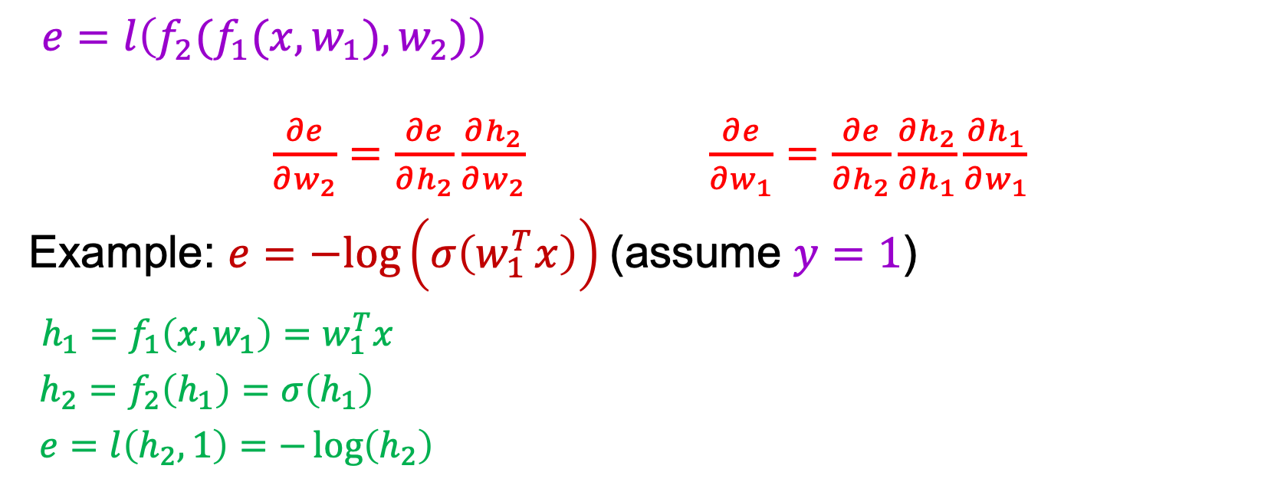




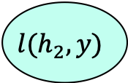

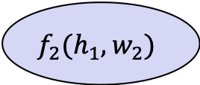
Applying the chain rule
$$w_{1}$$
$$w_{2}$$
$$h_{1}$$
$$h_{2}$$
$$k=2$$
$$f_{1}(x,w_{1})$$
$$f_{2}(h_{1},w_{2})$$
$$l(h_{2},y)$$
$$x$$
$$e$$
$e=l\left(f_{2}(f_{1}(x,w_{1}),w_{2})\right)$
$\frac{∂e}{∂w_{2}}=\frac{∂e}{∂h_{2}}\frac{∂h_{2}}{∂w_{2}} \frac{∂e}{∂w_{1}}=\frac{∂e}{∂h_{2}}\frac{∂h_{2}}{∂h_{1}}\frac{∂h_{1}}{∂w_{1}}$
Example: $e=−log\left(σ\left(w_{1}^{T}x\right)\right)$ (assume $y=1$)
$h_{1}=f_{1}\left(x,w_{1}\right)=w_{1}^{T}x$
$h_{2}=f_{2}\left(h_{1}\right)=σ\left(h_{1}\right)$
$e=l\left(h_{2},1\right)=−\log\left(h_{2}\right)$

Slide 9



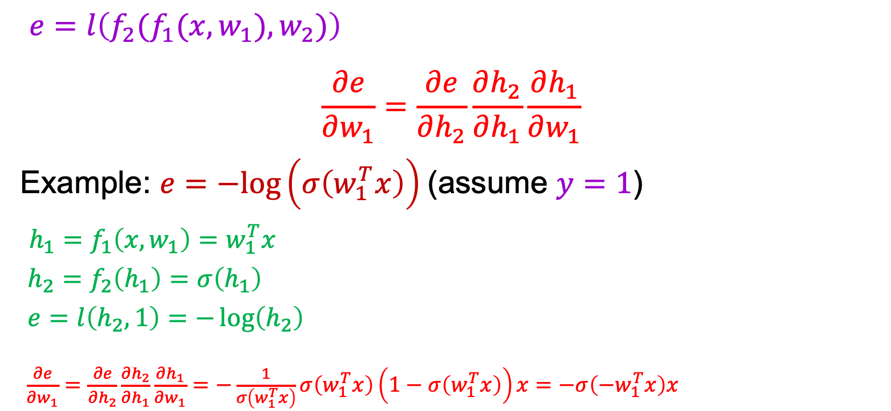

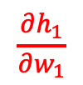


Applying the chain rule
$$w_{1}$$
$$\frac{∂h_{1}}{∂w_{1}}$$
$$w_{2}$$
$$h_{1}$$
$$h_{2}$$
$$k=2$$
$$f_{1}(x,w_{1})$$
$$f_{2}(h_{1},w_{2})$$
$$l(h_{2},y)$$
$$x$$
$$e$$
$$\frac{∂e}{∂h_{1}}$$
$$\frac{∂e}{∂h_{2}}$$
$$\frac{∂h_{2}}{∂h_{1}}$$
$e=l\left(f_{2}(f_{1}(x,w_{1}),w_{2})\right)$
$$\frac{∂e}{∂w_{1}}=\frac{∂e}{∂h_{2}}\frac{∂h_{2}}{∂h_{1}}\frac{∂h_{1}}{∂w_{1}}$$
Example: $e=−log\left(σ\left(w_{1}^{T}x\right)\right)$ (assume $y=1$)
$h_{1}=f_{1}\left(x,w_{1}\right)=w_{1}^{T}x$
$h_{2}=f_{2}\left(h_{1}\right)=σ\left(h_{1}\right)$
$e=l\left(h_{2},1\right)=−\log\left(h_{2}\right)$
$\frac{∂e}{∂w_{1}}=\frac{∂e}{∂h_{2}}\frac{∂h_{2}}{∂h_{1}}\frac{∂h_{1}}{∂w_{1}}=−\frac{1}{σ\left(w_{1}^{T}x\right)}σ\left(w_{1}^{T}x\right)\left(1−σ\left(w_{1}^{T}x\right)\right)x=−σ\left(−w_{1}^{T}x\right)x$
$$\frac{∂h_{1}}{∂w_{1}}=x$$
$$\frac{∂h_{2}}{∂h_{1}}=σ^{′}\left(h_{1}\right)=σ\left(h_{1}\right)(1−σ\left(h_{1}\right))$$
$$\frac{∂e}{∂h_{2}}=−\frac{1}{h_{2}}$$

Slide 10
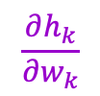
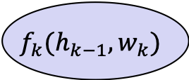



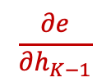
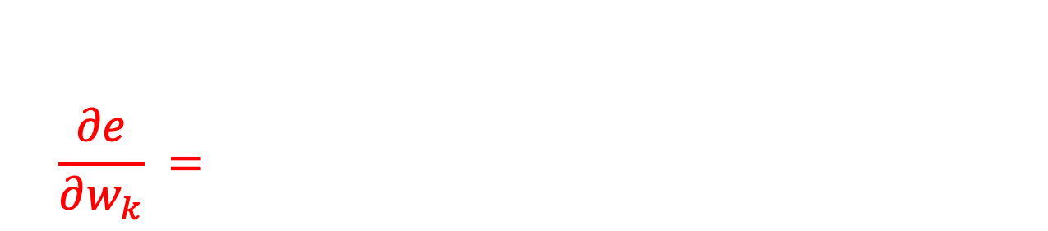
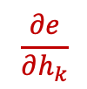


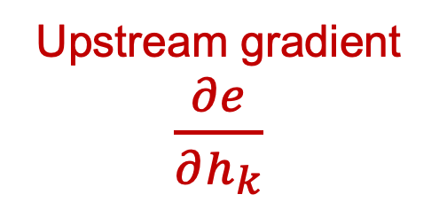
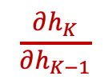

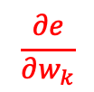
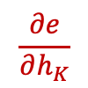
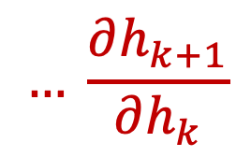
Chain rule: General case
$$\frac{∂e}{∂w_{k}}$$
$$w_{k}$$
$$\frac{∂h_{k}}{∂w_{k}}$$
$$w_{K}$$
$$h_{k−1}$$
$$h_{k}$$
$$h_{K−1}$$
$$h_{K}$$
$$f_{k}(h_{k−1},w_{k})$$
$$f_{K}(h_{K−1},w_{K})$$
$$l(h_{K},y)$$
…
…
$$e$$
$$\frac{∂e}{∂h_{k}}$$
$$\frac{∂e}{∂h_{K−1}}$$
$$\frac{∂e}{∂h_{K}}$$
$$\frac{∂h_{K}}{∂h_{K−1}}$$
$$\frac{∂e}{∂w_{k}} =$$
$$\frac{∂e}{∂h_{K}}$$
$$\frac{∂h_{K}}{∂h_{K−1}}$$
$$… \frac{∂h_{k+1}}{∂h_{k}}$$
$$\frac{∂h_{k}}{∂w_{k}}$$
Upstream gradient $\frac{∂e}{∂h_{k}}$
Local gradient

Slide 11
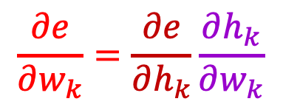
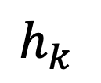
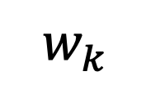
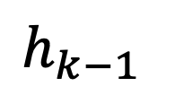

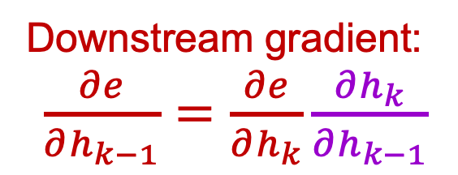
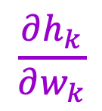
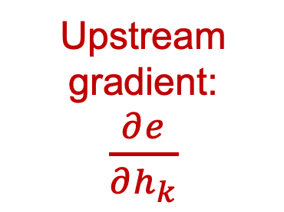
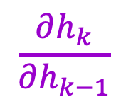
Backpropagation summary
Parameter update:
$$\frac{∂e}{∂w_{k}}=\frac{∂e}{∂h_{k}}\frac{∂h_{k}}{∂w_{k}}$$
$$w_{k}$$
Upstream gradient:
$\frac{∂e}{∂h_{k}}$
$$\frac{∂h_{k}}{∂w_{k}}$$
Local gradient
$$f_{k}$$
$$h_{k}$$
$$\frac{∂h_{k}}{∂h_{k−1}}$$
Local gradient
$$h_{k−1}$$
Downstream gradient:
$\frac{∂e}{∂h_{k−1}}=\frac{∂e}{∂h_{k}}\frac{∂h_{k}}{∂h_{k−1}}$
Forward pass
Backward pass

Slide 12
What about more general computation graphs?
ResNet
ResNeXt
Figure source

Slide 13

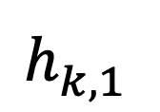
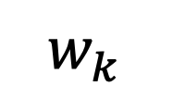
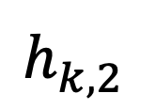
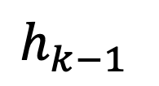






What about more general computation graphs?
Parameter update:
Upstream gradient:
$\frac{∂e}{∂h_{k,1}^{}}$
$$\frac{∂e}{∂w_{k}}=\frac{∂e}{∂h_{k}}\frac{∂h_{k}}{∂w_{k}}$$
$$w_{k}$$
$$h_{k,1}^{}$$
$$\frac{∂h_{k}}{∂w_{k}}$$
Local gradient
$$f_{k}$$
+ Gradients add at branches
$$\frac{∂h_{k}}{∂h_{k−1}}$$
Local gradient
$$h_{k,2}^{}$$
$\frac{∂e}{∂h_{k,2}^{}}$
$$h_{k−1}$$
Downstream gradient:
$\frac{∂e}{∂h_{k−1}}=\frac{∂e}{∂h_{k}}\frac{∂h_{k}}{∂h_{k−1}}$

Slide 14
Overview
Computation graphs
Using the chain rule
General backprop algorithm
Toy examples of backward pass

Slide 15


A detailed example
$$f\left(x,w\right)=\frac{1}{1+exp\left[−\left(w^{(0)}x^{(0)}+w^{(1)}x^{(1)}+w^{(2)}\right)\right]}$$
Source: Stanford 231n

Slide 16


A detailed example
$$f\left(x,w\right)=\frac{1}{1+exp\left[−\left(w^{(0)}x^{(0)}+w^{(1)}x^{(1)}+w^{(2)}\right)\right]}$$
Local gradient
Upstream gradient
*
$${\left(1/x\right)}^{′}=−1/x^{2}$$
$$−\frac{1}{{1.37}^{2}} ∗ 1=−0.53$$
Source: Stanford 231n

Slide 17
A detailed example
$$f\left(x,w\right)=\frac{1}{1+exp\left[−\left(w^{(0)}x^{(0)}+w^{(1)}x^{(1)}+w^{(2)}\right)\right]}$$
Local gradient
Upstream gradient
*
Source: Stanford 231n

Slide 18

A detailed example
$$f\left(x,w\right)=\frac{1}{1+exp\left[−\left(w^{(0)}x^{(0)}+w^{(1)}x^{(1)}+w^{(2)}\right)\right]}$$
Local gradient
Upstream gradient
*
$$\exp\left(−1\right)∗\left(−0.53\right)=−0.20$$
Source: Stanford 231n

Slide 19
A detailed example
$$f\left(x,w\right)=\frac{1}{1+exp\left[−\left(w^{(0)}x^{(0)}+w^{(1)}x^{(1)}+w^{(2)}\right)\right]}$$
Local gradient
Upstream gradient
*
Source: Stanford 231n

Slide 20
A detailed example
$$f\left(x,w\right)=\frac{1}{1+exp\left[−\left(w^{(0)}x^{(0)}+w^{(1)}x^{(1)}+w^{(2)}\right)\right]}$$
Local gradient
Upstream gradient
*
Source: Stanford 231n

Slide 21
A detailed example
$$f\left(x,w\right)=\frac{1}{1+exp\left[−\left(w^{(0)}x^{(0)}+w^{(1)}x^{(1)}+w^{(2)}\right)\right]}$$
Local gradient
Upstream gradient
*
Source: Stanford 231n

Slide 22
A detailed example
$$f\left(x,w\right)=\frac{1}{1+exp\left[−\left(w^{(0)}x^{(0)}+w^{(1)}x^{(1)}+w^{(2)}\right)\right]}$$
Source: Stanford 231n

Slide 23
A detailed example
$$f\left(x,w\right)=\frac{1}{1+exp\left[−\left(w^{(0)}x^{(0)}+w^{(1)}x^{(1)}+w^{(2)}\right)\right]}$$
Source: Stanford 231n

Slide 24
A detailed example
$$f\left(x,w\right)=\frac{1}{1+exp\left[−\left(w^{(0)}x^{(0)}+w^{(1)}x^{(1)}+w^{(2)}\right)\right]}$$
-0.60
Source: Stanford 231n

Slide 25
A detailed example
$$f\left(x,w\right)=\frac{1}{1+exp\left[−\left(w^{(0)}x^{(0)}+w^{(1)}x^{(1)}+w^{(2)}\right)\right]}$$
-0.40
-0.60
Source: Stanford 231n

Slide 26
A detailed example
$$f\left(x,w\right)=\frac{1}{1+exp\left[−\left(w^{(0)}x^{(0)}+w^{(1)}x^{(1)}+w^{(2)}\right)\right]}$$
0.40
-0.40
-0.60
Source: Stanford 231n

Slide 27
A detailed example
$$f\left(x,w\right)=\frac{1}{1+exp\left[−\left(w^{(0)}x^{(0)}+w^{(1)}x^{(1)}+w^{(2)}\right)\right]}$$
0.40
-0.40
-0.60
Source: Stanford 231n

Slide 28

A detailed example
$$f\left(x,w\right)=\frac{1}{1+exp\left[−\left(w^{(0)}x^{(0)}+w^{(1)}x^{(1)}+w^{(2)}\right)\right]}$$
0.40
Can simplify computation graph
-0.40
-0.60
Sigmoid gate $σ\left(x\right)$
$$σ^{′}\left(x\right)=σ\left(x\right)\left(1−σ\left(x\right)\right)$$
$$σ\left(1\right)\left(1−σ\left(1\right)\right)=0.73∗\left(1−0.73\right)=0.20$$
Source: Stanford 231n

Slide 29

Another example
Source: Stanford 231n

Slide 30
Another example
Add gate: “gradient distributor”
Source: Stanford 231n

Slide 31
Another example
Add gate: “gradient distributor”
Multiply gate: “gradient switcher”
Source: Stanford 231n

Slide 32
Another example
Add gate: “gradient distributor”
Multiply gate: “gradient switcher”
Max gate: “gradient router”
Source: Stanford 231n

Slide 33
Overview: Backpropagation
Computation graphs
Using the chain rule
General backprop algorithm
Toy examples of backward pass
Matrix-vector calculations: ReLU, linear layer

Slide 34

Backpropagation summary
$$\frac{∂e}{∂w_{k}}$$
$$w_{k}$$
$$\frac{∂h_{k}}{∂w_{k}}$$
$$w_{K}$$
$$h_{k−1}$$
$$h_{k}$$
$$h_{K−1}$$
$$h_{K}$$
$$f_{k}(h_{k−1},w_{k})$$
$$f_{K}(h_{K−1},w_{K})$$
$$l(h_{K},y)$$
…
…
$$e$$
$$\frac{∂e}{∂h_{k}}$$
$$\frac{∂e}{∂h_{K−1}}$$
$$\frac{∂e}{∂h_{K}}$$
$$\frac{∂h_{K}}{∂h_{K−1}}$$
Chain rule:
$$\frac{∂e}{∂w_{k}} =$$
$$\frac{∂e}{∂h_{K}}$$
$$\frac{∂h_{K}}{∂h_{K−1}}$$
$$… \frac{∂h_{k+1}}{∂h_{k}}$$
$$\frac{∂h_{k}}{∂w_{k}}$$
Upstream gradient $\frac{∂e}{∂h_{k}}$
Local gradient

Slide 35
Backpropagation summary
Parameter update:
$$\frac{∂e}{∂w_{k}}=\frac{∂e}{∂h_{k}}\frac{∂h_{k}}{∂w_{k}}$$
$$w_{k}$$
Upstream gradient:
$\frac{∂e}{∂h_{k}}$
$$\frac{∂h_{k}}{∂w_{k}}$$
Local gradient
$$f_{k}$$
$$h_{k}$$
$$\frac{∂h_{k}}{∂h_{k−1}}$$
Local gradient
$$h_{k−1}$$
Downstream gradient:
$\frac{∂e}{∂h_{k−1}}=\frac{∂e}{∂h_{k}}\frac{∂h_{k}}{∂h_{k−1}}$
Forward pass
Backward pass

Slide 36
What about more general computation graphs?
Parameter update:
Upstream gradient:
$\frac{∂e}{∂h_{k,1}^{}}$
$$\frac{∂e}{∂w_{k}}=\frac{∂e}{∂h_{k}}\frac{∂h_{k}}{∂w_{k}}$$
$$w_{k}$$
$$h_{k,1}^{}$$
$$\frac{∂h_{k}}{∂w_{k}}$$
Local gradient
$$f_{k}$$
+ Gradients add at branches
$$\frac{∂h_{k}}{∂h_{k−1}}$$
Local gradient
$$h_{k,2}^{}$$
$\frac{∂e}{∂h_{k,2}^{}}$
$$h_{k−1}$$
Downstream gradient:
$\frac{∂e}{∂h_{k−1}}=\frac{∂e}{∂h_{k}}\frac{∂h_{k}}{∂h_{k−1}}$

Slide 37















Dealing with vectors
$$=\left(\begin{matrix}\frac{∂z^{(1)}}{∂x^{(1)}} & … & \frac{∂z^{(1)}}{∂x^{(M)}} \\ ⋮ & ⋱ & ⋮ \\ \frac{∂z^{(N)}}{∂x^{(1)}} & … & \frac{∂z^{(N)}}{∂x^{(M)}}\end{matrix}\right)$$
Jacobian: row indices correspond to outputs, column indices correspond to inputs. The $i,j$th element of the Jacobian is the partial derivative of the $i$th output w.r.t. $j$th input
$$\frac{∂z}{∂x}$$
$N×M$ Jacobian
$$x$$
$$f(x)$$
$$z$$
$1×M$
$$\frac{∂e}{∂x} = \frac{∂e}{∂z} \frac{∂z}{∂x}$$
$\frac{∂e}{∂z}$
$1×N$
$1×M$
$1×N$
$N×M$
$1×N$
Notes:
Jacobian: rows correspond to outputs, columns correspond to inputs. i,jth element of the Jacobian is the partial derivative of the ith output w.r.t. jth input

Slide 38
Simple case: Elementwise operation

Slide 39












Simple case: Elementwise operation (ReLU layer)
$$=\left(\begin{matrix}\frac{∂z^{(1)}}{∂x^{(1)}} & … & \frac{∂z^{(1)}}{∂x^{(M)}} \\ ⋮ & ⋱ & ⋮ \\ \frac{∂z^{(M)}}{∂x^{(1)}} & … & \frac{∂z^{(M)}}{∂x^{(M)}}\end{matrix}\right)$$
What does the Jacobian for an elementwise
function look like?
$$\frac{∂z}{∂x}$$
$M×M$ Jacobian
$$x$$
$$f(x)=max⁡(0,x)$$
$$z$$
$1×M$
$\frac{∂e}{∂z}$
$1×M$
$$\frac{∂e}{∂x} = \frac{∂e}{∂z} \frac{∂z}{∂x}$$
$1×M$
$1×M$
$M×M$
$1×M$

Slide 40

Simple case: Elementwise operation (ReLU layer)
$$=\left(\begin{matrix}\frac{∂z^{(1)}}{∂x^{(1)}} & … & 0 \\ ⋮ & ⋱ & ⋮ \\ 0 & … & \frac{∂z^{(M)}}{∂x^{(M)}}\end{matrix}\right)$$
What does the Jacobian for an elementwise
function look like?
$$\frac{∂z}{∂x}$$
$M×M$ Jacobian
$$x$$
$$f(x)=max⁡(0,x)$$
$$z$$
$1×M$
$\frac{∂e}{∂z}$
$1×M$
$$\frac{∂e}{∂x} = \frac{∂e}{∂z} \frac{∂z}{∂x}$$
$1×M$
$1×M$
$M×M$
$1×M$

Slide 41





Simple case: Elementwise operation (ReLU layer)
$$=\left(\begin{matrix}𝕀[x^{(1)}>0] & … & 0 \\ ⋮ & ⋱ & ⋮ \\ 0 & … & 𝕀[x^{(M)}>0]\end{matrix}\right)$$
$$\frac{∂z}{∂x}$$
$M×M$ Jacobian
$$x$$
$$f(x)=max⁡(0,x)$$
$$z$$
$1×M$
$\frac{∂e}{∂z}$
$1×M$
$$\frac{∂e}{∂x} = \frac{∂e}{∂z} \frac{∂z}{∂x}$$
$1×M$
$1×M$
$M×M$
$1×M$
$$\frac{∂e}{∂x^{(i)}}=$$
$$\frac{∂e}{∂z^{(i)}}𝕀\left[x^{(i)}>0\right]$$
What happens if some $x^{(i)}$ is always negative?
$$\frac{∂e}{∂x}=$$
$$\frac{∂e}{∂z}⨀𝕀\left[x>0\right]$$
This is known as the “dead ReLU” problem

Slide 42




















Matrix-vector multiplication (linear layer)
$$\frac{∂e}{∂W} = \frac{∂e}{∂z} \frac{∂z}{∂W}$$
$$\frac{∂z}{∂W}$$
$$M×N$$
$1×N$
$$N×(M×N)$$
$$W$$
$$N×(M×N)$$
$$M×N$$
$$f(x,W)=xW$$
$$z$$
$\frac{∂e}{∂z}$
$$1×N$$
$$\frac{∂z}{∂x}$$
$$1×N$$
$$x$$
$$\frac{∂e}{∂x}= \frac{∂e}{∂z} \frac{∂z}{∂x}$$
$$1×M$$
$N×M$
$1×M$
$1×N$
$N×M$

Slide 43






Matrix-vector multiplication (linear layer)
$\left(\begin{matrix}z^{(1)} & … & z^{(N)}\end{matrix}\right)=\left(\begin{matrix}x^{(1)} & … & x^{(M)}\end{matrix}\right)\left(\begin{matrix}W^{(11)} & … & W^{(1N)} \\ ⋮ & ⋱ & ⋮ \\ W^{(M1)} & … & W^{(MN)}\end{matrix}\right)$
Want: $\frac{∂e}{∂x}=\frac{∂e}{∂z} \frac{∂z}{∂x}$
$$\frac{∂z^{(j)}}{∂x^{(i)}}=W^{(ij)}$$
$$\frac{∂z}{∂x}=W^{T}$$
$$z^{(j)}=\sum_{i=1}^{M}{x^{(i)}W^{(ij)}}$$
$1×M$
$$1×N$$
$N×M$
$j$th row, $i$th column of Jacobian

Slide 44

Matrix-vector multiplication (linear layer)
$\left(\begin{matrix}z^{(1)} & … & z^{(N)}\end{matrix}\right)=\left(\begin{matrix}x^{(1)} & … & x^{(M)}\end{matrix}\right)\left(\begin{matrix}W^{(11)} & … & W^{(1N)} \\ ⋮ & ⋱ & ⋮ \\ W^{(M1)} & … & W^{(MN)}\end{matrix}\right)$
Want: $\frac{∂e}{∂x}=\frac{∂e}{∂z} \frac{∂z}{∂x}$
$$\frac{∂z^{(j)}}{∂x^{(i)}}=W^{(ij)}$$
$$\frac{∂z}{∂x}=W^{T}$$
$$\frac{∂e}{∂x}=\frac{∂e}{∂z}\frac{∂z}{∂x}=\frac{∂e}{∂z}W^{T}$$
$$z^{(j)}=\sum_{i=1}^{M}{x^{(i)}W^{(ij)}}$$
$1×M$
$$1×N$$
$N×M$
$j$th row, $i$th column of Jacobian

Slide 45





Matrix-vector multiplication (linear layer)
$$z^{(j)}=\sum_{i=1}^{M}{x^{(i)}W^{(ij)}}$$
$\left(\begin{matrix}z^{(1)} & … & z^{(N)}\end{matrix}\right)=\left(\begin{matrix}x^{(1)} & … & x^{(M)}\end{matrix}\right)\left(\begin{matrix}W^{(11)} & … & W^{(1N)} \\ ⋮ & ⋱ & ⋮ \\ W^{(M1)} & … & W^{(MN)}\end{matrix}\right)$
Want: $\frac{∂e}{∂W}=\frac{∂e}{∂z} \frac{∂z}{∂W}$
$$\frac{∂z^{(k)}}{∂W^{(ij)}}=𝕀[k=j]x^{(i)}$$
$M×N$
$$1×N$$
$$N×(M×N)$$
$z^{(k)}$ depends only on $k$th column of $W$

Slide 46

Matrix-vector multiplication (linear layer)
$$z^{(j)}=\sum_{i=1}^{M}{x^{(i)}W^{(ij)}}$$
$\left(\begin{matrix}z^{(1)} & … & z^{(N)}\end{matrix}\right)=\left(\begin{matrix}x^{(1)} & … & x^{(M)}\end{matrix}\right)\left(\begin{matrix}W^{(11)} & … & W^{(1N)} \\ ⋮ & ⋱ & ⋮ \\ W^{(M1)} & … & W^{(MN)}\end{matrix}\right)$
Want: $\frac{∂e}{∂W}=\frac{∂e}{∂z} \frac{∂z}{∂W}$
$$\frac{∂z^{(k)}}{∂W^{(ij)}}=𝕀[k=j]x^{(i)}$$
$$\frac{∂e}{∂W^{(ij)}}=\frac{∂e}{∂z} \frac{∂z}{∂W^{(ij)}}=\sum_{k=1}^{N}{\frac{∂e}{∂z^{(k)}}\frac{∂z^{(k)}}{∂W^{(ij)}}}=\frac{∂e}{∂z^{(j)}}\frac{∂z^{(j)}}{W^{(ij)}}=\frac{∂e}{∂z^{(j)}}x^{(i)}$$
$M×N$
$$1×N$$
$$N×(M×N)$$
$z^{(k)}$ depends only on $k$th column of $W$

Slide 47


Matrix-vector multiplication (linear layer)
$$z^{(j)}=\sum_{i=1}^{M}{x^{(i)}W^{(ij)}}$$
$\left(\begin{matrix}z^{(1)} & … & z^{(N)}\end{matrix}\right)=\left(\begin{matrix}x^{(1)} & … & x^{(M)}\end{matrix}\right)\left(\begin{matrix}W^{(11)} & … & W^{(1N)} \\ ⋮ & ⋱ & ⋮ \\ W^{(M1)} & … & W^{(MN)}\end{matrix}\right)$
Want: $\frac{∂e}{∂W}=\frac{∂e}{∂z} \frac{∂z}{∂W}$
$$\frac{∂e}{∂W^{(ij)}}=\frac{∂e}{∂z^{(j)}}x^{(i)}$$
$M×N$
$$1×N$$
$$N×(M×N)$$
$\frac{∂e}{∂W}=$ $\left(\begin{matrix}\frac{∂e}{∂z^{(1)}}x^{(1)} & … & \frac{∂e}{∂z^{(N)}}x^{(1)} \\ ⋮ & ⋱ & ⋮ \\ \frac{∂e}{∂z^{(1)}}x^{(M)} & … & \frac{∂e}{∂z^{(N)}}x^{(M)}\end{matrix}\right)=\left(\begin{matrix}x^{(1)} \\ ⋮ \\ x^{(M)}\end{matrix}\right)$ $\left(\begin{matrix}\frac{∂e}{∂z^{(1)}} & … & \frac{∂e}{∂z^{(N)}}\end{matrix}\right)=x^{T}\frac{∂e}{∂z}$

Slide 48

Matrix-vector multiplication (linear layer)
$$z^{(j)}=\sum_{i=1}^{M}{x^{(i)}W^{(ij)}}$$
$\left(\begin{matrix}z^{(1)} & … & z^{(N)}\end{matrix}\right)=\left(\begin{matrix}x^{(1)} & … & x^{(M)}\end{matrix}\right)\left(\begin{matrix}W^{(11)} & … & W^{(1N)} \\ ⋮ & ⋱ & ⋮ \\ W^{(M1)} & … & W^{(MN)}\end{matrix}\right)$
Want: $\frac{∂e}{∂W}=\frac{∂e}{∂z} \frac{∂z}{∂W}$
$$\frac{∂e}{∂W}=x^{T}\frac{∂e}{∂z}$$
$M×N$
$$1×N$$
$$N×(M×N)$$

Slide 49


Matrix-vector multiplication (linear layer)
Summary of backward pass:
$$\frac{∂e}{∂W}=x^{T}\frac{∂e}{∂z}$$
$$W$$
$$M×N$$
$$f(x,W)=xW$$
$$z$$
$\frac{∂e}{∂z}$
$$1×N$$
$$x$$
$$\frac{∂e}{∂x}=\frac{∂e}{∂z}W^{T}$$
$$1×M$$

Slide 50
General tips
Derive error signal (upstream gradient) directly, avoid explicit computation of huge local derivatives
Write out expression for a single element of the Jacobian, then deduce the overall formula
Keep consistent indexing conventions, order of operations
Use dimension analysis
Compare analytical gradients to numerical gradient
For further reading:
  Lecture 4 of Stanford 231n and associated links in the syllabus
  Yes you should understand backprop by Andrej Karpathy

