Slide 1
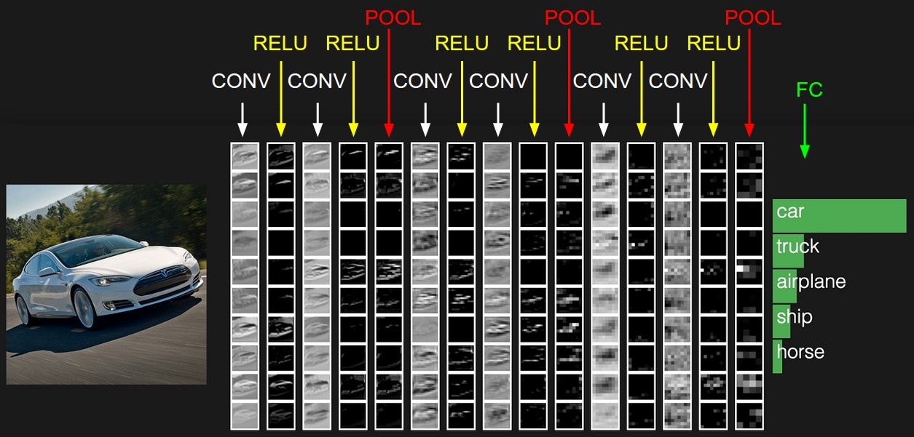
Convolutional neural networks
Many slides from Rob Fergus, Andrej Karpathy

Slide 2
Outline
Basic convolutional layer
Backward pass
Max pooling layer

Slide 3
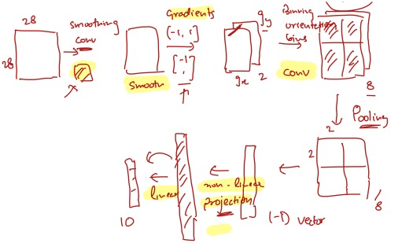
Designing Neural Network for Images
Recall the Digit Classification Case Study

Slide 4
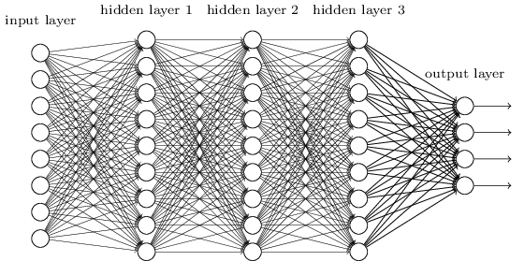
Let’s design a neural network for images
This kind of design is known as multi-layer perceptron (MLP)
image
Fully connected layer

Slide 5
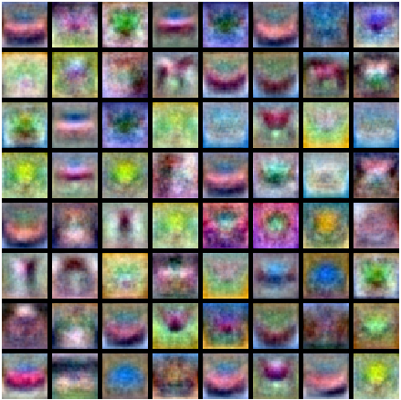
Let’s design a neural network for images
This kind of design is known as multi-layer perceptron (MLP)
What is wrong with this?
Recall: MLP as bank of whole-image templates
image
Fully connected layer

Slide 6
Convolutional architecture
Let’s limit the receptive fields of units, tile them over the input image, and share their weights
image

Slide 7
Convolutional architecture
Let’s limit the receptive fields of units, tile them over the input image, and share their weights
image

Slide 8
Convolutional architecture
feature map
learned weights
Let’s limit the receptive fields of units, tile them over the input image, and share their weights
This is equivalent to sliding the learned filter over the image, computing dot products at every location
image

Slide 9
Convolution example
Input
Filter
Output
$$x11$$
$$x12$$
$$x13$$
$$x14$$
$$x15$$
$$x16$$
$$x21$$
$$x22$$
$$x23$$
$$x24$$
$$x25$$
$$x26$$
$$w11$$
$$w12$$
$$w13$$
$$x31$$
$$x32$$
$$x33$$
$$x34$$
$$x35$$
$$x36$$
$$∗$$
$$w21$$
$$w22$$
$$w23$$
$$=$$
$$x41$$
$$x42$$
$$x43$$
$$x44$$
$$x45$$
$$x46$$
$$w31$$
$$w32$$
$$w33$$
$$x51$$
$$x52$$
$$x53$$
$$x54$$
$$x55$$
$$x56$$
Adapted from D. Fouhey and J. Johnson

Slide 10
Convolution example
Input
Filter
Output
$$x11$$
$$x12$$
$$x13$$
$$x14$$
$$x15$$
$$x16$$
$$x21$$
$$x22$$
$$x23$$
$$x24$$
$$x25$$
$$x26$$
$$w11$$
$$w12$$
$$w13$$
$$y11$$
$$x31$$
$$x32$$
$$x33$$
$$x34$$
$$x35$$
$$x36$$
$$∗$$
$$w21$$
$$w22$$
$$w23$$
$$=$$
$$x41$$
$$x42$$
$$x43$$
$$x44$$
$$x45$$
$$x46$$
$$w31$$
$$w32$$
$$w33$$
$$x51$$
$$x52$$
$$x53$$
$$x54$$
$$x55$$
$$x56$$
$$y11 =x11∙w11 +x12∙w12+x13∙w13+ … +x33∙w33$$
Adapted from D. Fouhey and J. Johnson

Slide 11
Convolution example
Input
Filter
Output
$$x11$$
$$x12$$
$$x13$$
$$x14$$
$$x15$$
$$x16$$
$$x21$$
$$x22$$
$$x23$$
$$x24$$
$$x25$$
$$x26$$
$$w11$$
$$w12$$
$$w13$$
$$y11$$
$$y12$$
$$x31$$
$$x32$$
$$x33$$
$$x34$$
$$x35$$
$$x36$$
$$∗$$
$$w21$$
$$w22$$
$$w23$$
$$=$$
$$x41$$
$$x42$$
$$x43$$
$$x44$$
$$x45$$
$$x46$$
$$w31$$
$$w32$$
$$w33$$
$$x51$$
$$x52$$
$$x53$$
$$x54$$
$$x55$$
$$x56$$
$$y12 =x12∙w11 +x13∙w12+x14∙w13+ … +x34∙w33$$
Adapted from D. Fouhey and J. Johnson

Slide 12
Convolution example
Input
Filter
Output
$$x11$$
$$x12$$
$$x13$$
$$x14$$
$$x15$$
$$x16$$
$$x21$$
$$x22$$
$$x23$$
$$x24$$
$$x25$$
$$x26$$
$$w11$$
$$w12$$
$$w13$$
$$y11$$
$$y12$$
$$y13$$
$$x31$$
$$x32$$
$$x33$$
$$x34$$
$$x35$$
$$x36$$
$$∗$$
$$w21$$
$$w22$$
$$w23$$
$$=$$
$$x41$$
$$x42$$
$$x43$$
$$x44$$
$$x45$$
$$x46$$
$$w31$$
$$w32$$
$$w33$$
$$x51$$
$$x52$$
$$x53$$
$$x54$$
$$x55$$
$$x56$$
$$y13 =x13∙w11 +x14∙w12+x15∙w13+ … +x35∙w33$$
Adapted from D. Fouhey and J. Johnson

Slide 13
Convolution example
Input
Filter
Output
$$x11$$
$$x12$$
$$x13$$
$$x14$$
$$x15$$
$$x16$$
$$x21$$
$$x22$$
$$x23$$
$$x24$$
$$x25$$
$$x26$$
$$w11$$
$$w12$$
$$w13$$
$$y11$$
$$y12$$
$$y13$$
$$y14$$
$$x31$$
$$x32$$
$$x33$$
$$x34$$
$$x35$$
$$x36$$
$$∗$$
$$w21$$
$$w22$$
$$w23$$
$$=$$
$$x41$$
$$x42$$
$$x43$$
$$x44$$
$$x45$$
$$x46$$
$$w31$$
$$w32$$
$$w33$$
$$x51$$
$$x52$$
$$x53$$
$$x54$$
$$x55$$
$$x56$$
$$y14 =x14∙w11 +x15∙w12+x16∙w13+ … +x36∙w33$$
Adapted from D. Fouhey and J. Johnson

Slide 14
Convolution example
Input
Filter
Output
$$x11$$
$$x12$$
$$x13$$
$$x14$$
$$x15$$
$$x16$$
$$x21$$
$$x22$$
$$x23$$
$$x24$$
$$x25$$
$$x26$$
$$w11$$
$$w12$$
$$w13$$
$$y11$$
$$y12$$
$$y13$$
$$y14$$
$$x31$$
$$x32$$
$$x33$$
$$x34$$
$$x35$$
$$x36$$
$$∗$$
$$w21$$
$$w22$$
$$w23$$
$$=$$
$$y21$$
$$x41$$
$$x42$$
$$x43$$
$$x44$$
$$x45$$
$$x46$$
$$w31$$
$$w32$$
$$w33$$
$$x51$$
$$x52$$
$$x53$$
$$x54$$
$$x55$$
$$x56$$
$$y21 =x21∙w11 +x22∙w12+x23∙w13+ … +x43∙w33$$
Adapted from D. Fouhey and J. Johnson

Slide 15
Convolution example
Input
Filter
Output
$$x11$$
$$x12$$
$$x13$$
$$x14$$
$$x15$$
$$x16$$
$$x21$$
$$x22$$
$$x23$$
$$x24$$
$$x25$$
$$x26$$
$$w11$$
$$w12$$
$$w13$$
$$y11$$
$$y12$$
$$y13$$
$$y14$$
$$x31$$
$$x32$$
$$x33$$
$$x34$$
$$x35$$
$$x36$$
$$∗$$
$$w21$$
$$w22$$
$$w23$$
$$=$$
$$y21$$
$$y22$$
$$x41$$
$$x42$$
$$x43$$
$$x44$$
$$x45$$
$$x46$$
$$w31$$
$$w32$$
$$w33$$
$$x51$$
$$x52$$
$$x53$$
$$x54$$
$$x55$$
$$x56$$
$$y22 =x22∙w11 +x23∙w12+x24∙w13+ … +x44∙w33$$
Adapted from D. Fouhey and J. Johnson

Slide 16
Convolution example
Input
Filter
Output
$$x11$$
$$x12$$
$$x13$$
$$x14$$
$$x15$$
$$x16$$
$$x21$$
$$x22$$
$$x23$$
$$x24$$
$$x25$$
$$x26$$
$$w11$$
$$w12$$
$$w13$$
$$y11$$
$$y12$$
$$y13$$
$$y14$$
$$x31$$
$$x32$$
$$x33$$
$$x34$$
$$x35$$
$$x36$$
$$∗$$
$$w21$$
$$w22$$
$$w23$$
$$=$$
$$y21$$
$$y22$$
$$y23$$
$$x41$$
$$x42$$
$$x43$$
$$x44$$
$$x45$$
$$x46$$
$$w31$$
$$w32$$
$$w33$$
$$x51$$
$$x52$$
$$x53$$
$$x54$$
$$x55$$
$$x56$$
$$y23 =x23∙w11 +x24∙w12+x25∙w13+ … +x45∙w33$$
Adapted from D. Fouhey and J. Johnson

Slide 17
Convolution example
Input
Filter
Output
$$x11$$
$$x12$$
$$x13$$
$$x14$$
$$x15$$
$$x16$$
$$x21$$
$$x22$$
$$x23$$
$$x24$$
$$x25$$
$$x26$$
$$w11$$
$$w12$$
$$w13$$
$$y11$$
$$y12$$
$$y13$$
$$y14$$
$$x31$$
$$x32$$
$$x33$$
$$x34$$
$$x35$$
$$x36$$
$$∗$$
$$w21$$
$$w22$$
$$w23$$
$$=$$
$$y21$$
$$y22$$
$$y23$$
$$y24$$
$$x41$$
$$x42$$
$$x43$$
$$x44$$
$$x45$$
$$x46$$
$$w31$$
$$w32$$
$$w33$$
$$y31$$
$$y32$$
$$y33$$
$$y34$$
$$x51$$
$$x52$$
$$x53$$
$$x54$$
$$x55$$
$$x56$$
Adapted from D. Fouhey and J. Johnson

Slide 18
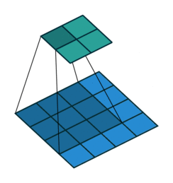
Convolutional architecture
feature map
Output feature map resolution depends on padding and stride
learned weights
Output
Input
image
No padding, stride 1
Animation source

Slide 19
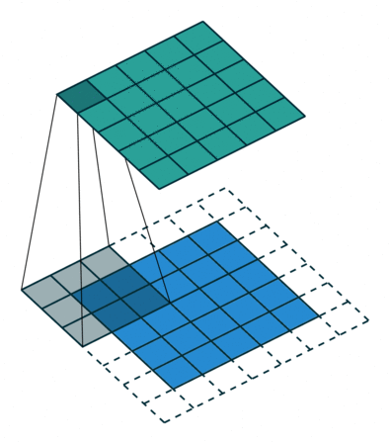
Convolutional architecture
feature map
Output feature map resolution depends on padding and stride
learned weights
Output
Input
image
With padding, stride 1
Animation source

Slide 20
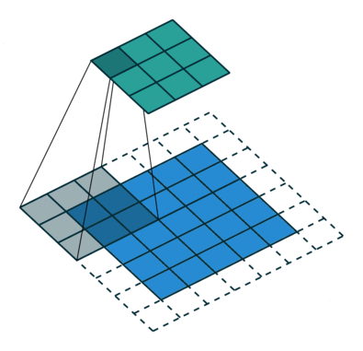
Convolutional architecture
feature map
Output feature map resolution depends on padding and stride
learned weights
Output
Input
image
With padding, stride 2

Slide 21
Convolutional architecture
feature map
Output feature map resolution depends on padding and stride
learned weights
With padding, spatial resolution remains the same if stride of $1$ is used, is reduced by factor of $1/S$ if stride of $S$ is used
image

Slide 22
Convolutional architecture
feature map
learned weights
image

Slide 23
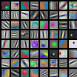
Convolutional architecture
another feature map
another set of learned weights
Learned weights can be thought of as local templates
image

Slide 24
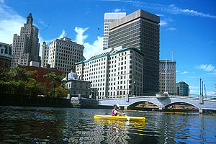
Convolution and traditional feature extraction
bank of $K$ filters
$K$ feature maps
...
image
feature map

Slide 25
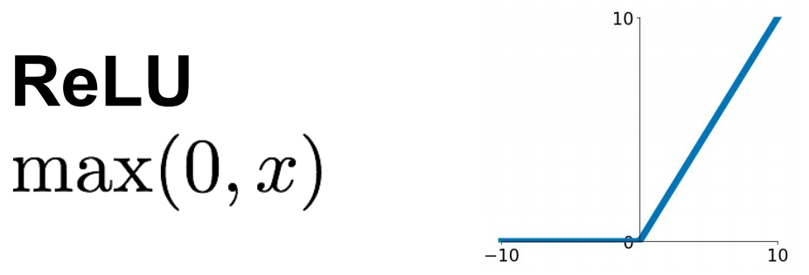
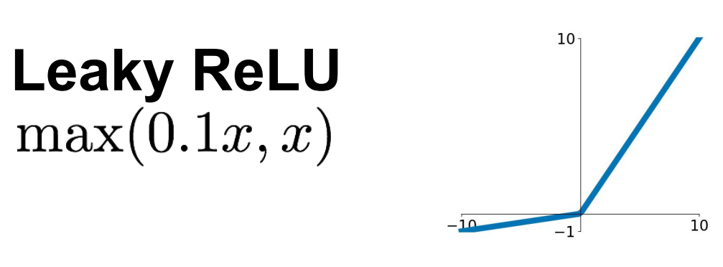
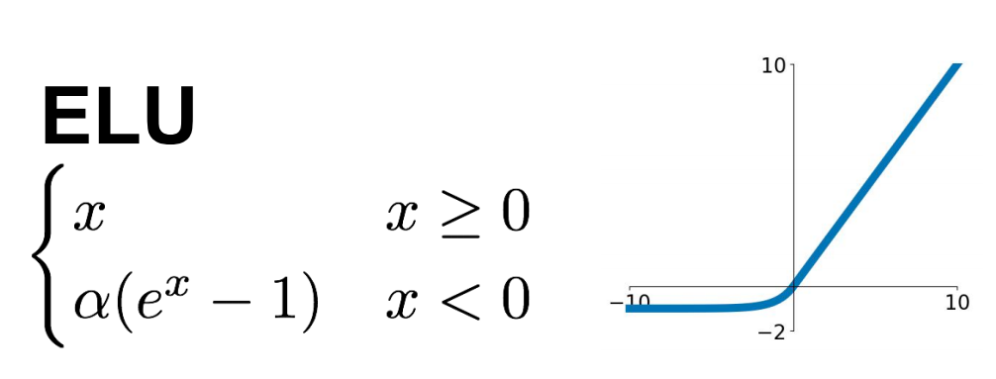
Elementwise nonlinearity
Almost always directly followed by a ReLU:
$K$ feature maps
$K$ filters
Some alternatives to ReLU:
image
convolutional layer
Source: Stanford 231n

Slide 26
Three-dimensional convolutions
What if the input to a convolutional layer is a stack of $K$ feature maps?
$K$ feature maps
One output feature map
$$F×F×K$$
filter

Slide 27
Three-dimensional convolutions
What if the input to a convolutional layer is a stack of $K$ feature maps?
$K$ feature maps
$L$ output feature maps
$$F×F×K$$
filter
$L$ filters

Slide 28
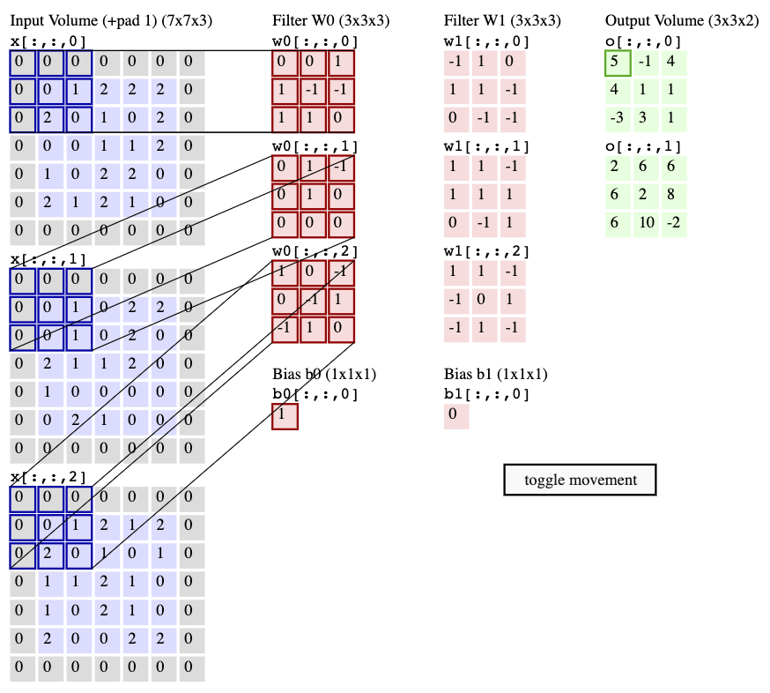
Convolutional layer example
Stride = 2
Animation:
http://cs231n.github.io/convolutional-networks/#conv

Slide 29
Convolutional layer example
?
Stride = 2
Animation:
http://cs231n.github.io/convolutional-networks/#conv

Slide 30
Convolutional layer: Computational cost
$K$ input feature maps
$L$ output feature maps
$$F×F×K$$
filter
$L$ filters
Assuming the input feature maps have spatial resolution $H×W$, how many operations are needed to compute the output feature volume?
$F^{2}KLHW$

Slide 31
Outline
Basic convolutional layer
Variants: 1x1 convolutions, depthwise convolutions

Slide 32
1x1 convolutional layer
$K$ input feature maps
$L$ output feature maps
$$F×F×K$$
filter
$L$ filters
What if we make $F=1$?

Slide 33
1x1 convolutional layer
$K$ input feature maps
$L$ output feature maps
$1×1×K$ filter
$L$ filters
What if we make $F=1$?

Slide 34
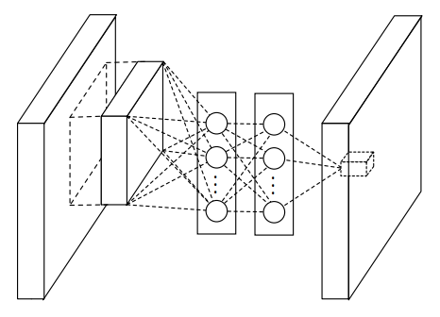
1x1 convolutional layer
“network in network”
M. Lin, Q. Chen, and S. Yan, Network in network, ICLR 2014

Slide 35
Why 1x1 convolutions?
Option 1: $3×3$ conv layer with $256$ channels at input and output
$256×256×3×3 ≈ 600,000$ weights and operations (per location)
Option 2: “bottleneck module”
$1×1$ conv layer, $256 → 64$ channels
$3×3$ conv layer, $64 → 64$ channels
$1×1$ conv layer, $64 →256$ channels
$256×64×1×1 ≈ 16,000$
$64×64×3×3 ≈ 36,000$
$64×256×1×1 ≈ 16,000$
Total $≈ 70,000$ weights and operations

Slide 36
Alternative to 3D convolutions: Depthwise convolutions
$K$ input feature maps
$K$ output feature maps
$$K F×F$$
filters
$F^{2}KHW$ instead of $F^{2}K^{2}HW$ operations
Can be followed by a 1D convolution to mix values across channels

Slide 37
MobileNets: Depthwise separable convolutions
Depthwise separable convolution block:
3$×3$ conv layer, $256→256$ channels (for example)
$1×1$ conv layer, $K→K$ channels
$9×256≈2,300$ operations (per location)
$256×256≈65,500$ operations
Total$≈67,800$operations
Regular $3×3$ conv layer, $256→256$ channels
$9×256×256$ $≈590,000$operations
Speedup factor: 8.7
A. Howard et al., MobileNets: Efficient Convolutional Neural Networks for Mobile Vision Applications, arXiv 2017

Slide 38
More generally: Groupwise convolutions
$G$ input feature groups
$G$ output feature groups
Split up the $K$ feature maps into $G$ groups, perform convolutions within each group separately, concatenate the results

Slide 39
Convolutional layer: Details
Efficient implementation: reshape all image neighborhoods into columns (im2col operation), do matrix-vector multiplication
Image source

Slide 40
Convolutional layer: Details
Efficient implementation: reshape all image neighborhoods into columns (im2col operation), do matrix-vector multiplication
Backward pass: special case of linear layer, operations also turn out to be convolutions
Downstream gradient (of error w.r.t. input) is a transposed convolution, or convolution of output with filter flipped both horizontally and vertically

Slide 41
Outline
Basic convolutional layer
Backward pass

Slide 42
Convolutional layer: Backward pass
Let’s take a 1D example with a filter of width 3:
Filter:
$$\begin{matrix}w^{1} & w^{2} & { w}^{3}\end{matrix}$$
Input:
$$\begin{matrix} & ⋯ & x^{i−1} & x^{i} & x^{i+1} & ⋯ & \end{matrix}$$
$$w^{1}$$
$$w^{2}$$
$$w^{3}$$
$$\begin{matrix} & ⋯ & z^{i−1} & z^{i} & z^{i+1} & ⋯ & \end{matrix}$$
Output:
$$z^{i}={w^{1}x}^{i−1}+{w^{2}x}^{i}+{w^{3}x}^{i+1}$$

Slide 43
Review: Backward pass
Parameter update:
$$\frac{∂e}{∂w}=\frac{∂e}{∂z}\frac{∂z}{∂w}$$
$$w$$
Upstream gradient:
$\frac{∂e}{∂z}$
$$\frac{∂z}{∂w}$$
Local gradient
$$f$$
$$z$$
$$\frac{∂z}{∂x}$$
Local gradient
$$x$$
Downstream gradient:
$\frac{∂e}{∂x}=\frac{∂e}{∂z}\frac{∂z}{∂x}$
Forward pass
Backward pass

Slide 44
Convolutional layer: Backward pass
Backward pass (w.r.t. $x$)
$$\frac{∂e}{∂x}=\frac{∂e}{∂z}\frac{∂z}{∂x}$$
Vector-matrix form:
$$1×N$$
$$1×N$$
$$N×N$$
$$\begin{matrix} & ⋯ & \frac{∂e}{∂x^{i−1}} & \frac{∂e}{∂x^{i}} & \frac{∂e}{∂x^{i+1}} & ⋯ & \end{matrix}$$
$$\begin{matrix} & ⋯ & x^{i−1} & x^{i} & x^{i+1} & ⋯ & \end{matrix}$$
Output:
$$w^{1}$$
$$w^{2}$$
$$w^{3}$$
$$\begin{matrix} & ⋯ & \frac{∂e}{∂z^{i−1}} & \frac{∂e}{∂z^{i}} & \frac{∂e}{∂z^{i+1}} & ⋯ & \end{matrix}$$
$$\begin{matrix} & ⋯ & z^{i−1} & z^{i} & z^{i+1} & ⋯ & \end{matrix}$$
Input:
$$z^{i}={w^{1}x}^{i−1}+{w^{2}x}^{i}+{w^{3}x}^{i+1}$$

Slide 45
Convolutional layer: Backward pass
Backward pass (w.r.t. $x$)
$$\frac{∂e}{∂x}=\frac{∂e}{∂z}\frac{∂z}{∂x}$$
Vector-matrix form:
$$1×N$$
$$1×N$$
$$N×N$$
$$\begin{matrix} & ⋯ & \frac{∂e}{∂x^{i−1}} & \frac{∂e}{∂x^{i}} & \frac{∂e}{∂x^{i+1}} & ⋯ & \end{matrix}$$
$$\begin{matrix} & ⋯ & x^{i−1} & x^{i} & x^{i+1} & ⋯ & \end{matrix}$$
Output:
$$w^{1}$$
$$w^{2}$$
$$w^{3}$$
$$\begin{matrix} & ⋯ & \frac{∂e}{∂z^{i−1}} & \frac{∂e}{∂z^{i}} & \frac{∂e}{∂z^{i+1}} & ⋯ & \end{matrix}$$
$$\begin{matrix} & ⋯ & z^{i−1} & z^{i} & z^{i+1} & ⋯ & \end{matrix}$$
Input:
$$z^{i}={w^{1}x}^{i−1}+{w^{2}x}^{i}+{w^{3}x}^{i+1}$$

Slide 46
Convolutional layer: Backward pass
Backward pass (w.r.t. $x$)
$$\frac{∂e}{∂x^{i}}=\sum_{j=1}^{N}{\frac{∂e}{∂z^{j}}\frac{∂z^{j}}{∂x^{i}}}$$
$$=\frac{∂e}{∂z^{i−1}}\frac{∂z^{i−1}}{∂x^{i}}+\frac{∂e}{∂z^{i}}\frac{∂z^{i}}{∂x^{i}}+\frac{∂e}{∂z^{i+1}}\frac{∂z^{i+1}}{∂x^{i}}$$
$$\begin{matrix} & ⋯ & \frac{∂e}{∂x^{i−1}} & \frac{∂e}{∂x^{i}} & \frac{∂e}{∂x^{i+1}} & ⋯ & \end{matrix}$$
$$\begin{matrix} & ⋯ & x^{i−1} & x^{i} & x^{i+1} & ⋯ & \end{matrix}$$
Output:
$$w^{1}$$
$$w^{2}$$
$$w^{3}$$
$$\begin{matrix} & ⋯ & \frac{∂e}{∂z^{i−1}} & \frac{∂e}{∂z^{i}} & \frac{∂e}{∂z^{i+1}} & ⋯ & \end{matrix}$$
$$\begin{matrix} & ⋯ & z^{i−1} & z^{i} & z^{i+1} & ⋯ & \end{matrix}$$
Input:
$$z^{i}={w^{1}x}^{i−1}+{w^{2}x}^{i}+{w^{3}x}^{i+1}$$

Slide 47
Convolutional layer: Backward pass
Backward pass (w.r.t. $x$)
$$\frac{∂e}{∂x^{i}}=\sum_{j=1}^{N}{\frac{∂e}{∂z^{j}}\frac{∂z^{j}}{∂x^{i}}}$$
$$=\frac{∂e}{∂z^{i−1}}\frac{∂z^{i−1}}{∂x^{i}}+\frac{∂e}{∂z^{i}}\frac{∂z^{i}}{∂x^{i}}+\frac{∂e}{∂z^{i+1}}\frac{∂z^{i+1}}{∂x^{i}}$$
$$=w^{3}\frac{∂e}{∂z^{i−1}}+w^{2}\frac{∂e}{∂z^{i}}+w^{1}\frac{∂e}{∂z^{i+1}}$$
$$\begin{matrix} & ⋯ & \frac{∂e}{∂x^{i−1}} & \frac{∂e}{∂x^{i}} & \frac{∂e}{∂x^{i+1}} & ⋯ & \end{matrix}$$
$$\begin{matrix} & ⋯ & x^{i−1} & x^{i} & x^{i+1} & ⋯ & \end{matrix}$$
Output:
$$w^{1}$$
$$w^{2}$$
$$w^{3}$$
$$w^{3}$$
$$w^{2}$$
$$w^{1}$$
$$\begin{matrix} & ⋯ & \frac{∂e}{∂z^{i−1}} & \frac{∂e}{∂z^{i}} & \frac{∂e}{∂z^{i+1}} & ⋯ & \end{matrix}$$
$$\begin{matrix} & ⋯ & z^{i−1} & z^{i} & z^{i+1} & ⋯ & \end{matrix}$$
Input:
$$z^{i}={w^{1}x}^{i−1}+{w^{2}x}^{i}+{w^{3}x}^{i+1}$$

Slide 48
Convolutional layer: Backward pass
Backward pass (w.r.t. $x$)
This is called a transposed convolution
$$\frac{∂e}{∂x^{i}}$$
$$=w^{3}\frac{∂e}{∂z^{i−1}}+w^{2}\frac{∂e}{∂z^{i}}+w^{1}\frac{∂e}{∂z^{i+1}}$$
$$\begin{matrix} & ⋯ & \frac{∂e}{∂x^{i−1}} & \frac{∂e}{∂x^{i}} & \frac{∂e}{∂x^{i+1}} & ⋯ & \end{matrix}$$
$$\begin{matrix} & ⋯ & x^{i−1} & x^{i} & x^{i+1} & ⋯ & \end{matrix}$$
Output:
$$w^{1}$$
$$w^{2}$$
$$w^{3}$$
$$w^{3}$$
$$w^{2}$$
$$w^{1}$$
$$\begin{matrix} & ⋯ & \frac{∂e}{∂z^{i−1}} & \frac{∂e}{∂z^{i}} & \frac{∂e}{∂z^{i+1}} & ⋯ & \end{matrix}$$
$$\begin{matrix} & ⋯ & z^{i−1} & z^{i} & z^{i+1} & ⋯ & \end{matrix}$$
Input:
$$z^{i}={w^{1}x}^{i−1}+{w^{2}x}^{i}+{w^{3}x}^{i+1}$$

Slide 49
Backward pass
Backward pass (w.r.t. $w$)
$$\frac{∂e}{∂w}=\frac{∂e}{∂z}\frac{∂z}{∂w}$$
$$\begin{matrix}\frac{∂e}{∂w^{1}} & \frac{∂e}{∂w^{2}} & \frac{∂e}{∂w^{3}}\end{matrix}$$
Output:
$$\begin{matrix} & ⋯ & x^{i−1} & x^{i} & x^{i+1} & ⋯ & \end{matrix}$$
$$w^{1}$$
$$w^{2}$$
$$w^{3}$$
$$\begin{matrix} & ⋯ & \frac{∂e}{∂z^{i−1}} & \frac{∂e}{∂z^{i}} & \frac{∂e}{∂z^{i+1}} & ⋯ & \end{matrix}$$
$$\begin{matrix} & ⋯ & z^{i−1} & z^{i} & z^{i+1} & ⋯ & \end{matrix}$$
Input:
$$z^{i}={w^{1}x}^{i−1}+{w^{2}x}^{i}+{w^{3}x}^{i+1}$$

Slide 50
Backward pass
Backward pass (w.r.t. $w$)
$$\frac{∂e}{∂w^{1}}=\sum_{i}{\frac{∂e}{∂z^{i}}\frac{∂z^{i}}{∂w^{1}}}$$
$$=\sum_{i}{\frac{∂e}{∂z^{i}}x^{i−1}}$$
$$\begin{matrix}\frac{∂e}{∂w^{1}} & \frac{∂e}{∂w^{2}} & \frac{∂e}{∂w^{3}}\end{matrix}$$
Output:
$$\begin{matrix} & ⋯ & x^{i−1} & x^{i} & x^{i+1} & ⋯ & \end{matrix}$$
$$\begin{matrix} & ⋯ & x^{i−1} & x^{i} & x^{i+1} & ⋯ & \end{matrix}$$
$$w^{1}$$
$$w^{2}$$
$$w^{3}$$
$$\begin{matrix} & ⋯ & \frac{∂e}{∂z^{i−1}} & \frac{∂e}{∂z^{i}} & \frac{∂e}{∂z^{i+1}} & ⋯ & \end{matrix}$$
$$\begin{matrix} & ⋯ & z^{i−1} & z^{i} & z^{i+1} & ⋯ & \end{matrix}$$
Input:
$$z^{i}={w^{1}x}^{i−1}+{w^{2}x}^{i}+{w^{3}x}^{i+1}$$

Slide 51
Backward pass
Backward pass (w.r.t. $w$)
$$\frac{∂e}{∂w^{2}}=\sum_{i}{\frac{∂e}{∂z^{i}}\frac{∂z^{i}}{∂w^{2}}}$$
$$=\sum_{i}{\frac{∂e}{∂z^{i}}x^{i}}$$
$$\begin{matrix}\frac{∂e}{∂w^{1}} & \frac{∂e}{∂w^{2}} & \frac{∂e}{∂w^{3}}\end{matrix}$$
Output:
$$\begin{matrix} & ⋯ & x^{i−1} & x^{i} & x^{i+1} & ⋯ & \end{matrix}$$
$$\begin{matrix} & ⋯ & x^{i−1} & x^{i} & x^{i+1} & ⋯ & \end{matrix}$$
$$w^{1}$$
$$w^{2}$$
$$w^{3}$$
$$\begin{matrix} & ⋯ & \frac{∂e}{∂z^{i−1}} & \frac{∂e}{∂z^{i}} & \frac{∂e}{∂z^{i+1}} & ⋯ & \end{matrix}$$
$$\begin{matrix} & ⋯ & z^{i−1} & z^{i} & z^{i+1} & ⋯ & \end{matrix}$$
Input:
$$z^{i}={w^{1}x}^{i−1}+{w^{2}x}^{i}+{w^{3}x}^{i+1}$$

Slide 52
Backward pass
Backward pass (w.r.t. $w$)
$$\frac{∂e}{∂w^{3}}=\sum_{i}{\frac{∂e}{∂z^{i}}\frac{∂z^{i}}{∂w^{3}}}$$
$$=\sum_{i}{\frac{∂e}{∂z^{i}}x^{i+1}}$$
$$\begin{matrix}\frac{∂e}{∂w^{1}} & \frac{∂e}{∂w^{2}} & \frac{∂e}{∂w^{3}}\end{matrix}$$
Output:
$$\begin{matrix} & ⋯ & x^{i−1} & x^{i} & x^{i+1} & ⋯ & \end{matrix}$$
$$\begin{matrix} & ⋯ & x^{i−1} & x^{i} & x^{i+1} & ⋯ & \end{matrix}$$
$$w^{1}$$
$$w^{2}$$
$$w^{3}$$
$$\begin{matrix} & ⋯ & \frac{∂e}{∂z^{i−1}} & \frac{∂e}{∂z^{i}} & \frac{∂e}{∂z^{i+1}} & ⋯ & \end{matrix}$$
$$\begin{matrix} & ⋯ & z^{i−1} & z^{i} & z^{i+1} & ⋯ & \end{matrix}$$
Input:
$$z^{i}={w^{1}x}^{i−1}+{w^{2}x}^{i}+{w^{3}x}^{i+1}$$

Slide 53
Outline
Basic convolutional layer
Backward pass
Max pooling layer

Slide 54
Max pooling layer
Feature map
max value
$F × F$ pooling window, stride $S$
Usually: $F=2$ or $3$, $S=2$

Slide 55
Max pooling: Example
Single channel
1 | 1 | 2 | 4
5 | 6 | 7 | 8
3 | 2 | 1 | 0
1 | 2 | 3 | 4
Max pooling with $2×2$ kernel size and stride 2
Source: J. Johnson

Slide 56
Max pooling: Example
Single channel
1 | 1 | 2 | 4
5 | 6 | 7 | 8
3 | 2 | 1 | 0
1 | 2 | 3 | 4
Max pooling with $2×2$ kernel size and stride 2
Source: J. Johnson

Slide 57
Max pooling: Example
Single channel
1 | 1 | 2 | 4
5 | 6 | 7 | 8
3 | 2 | 1 | 0
1 | 2 | 3 | 4
Max pooling with $2×2$ kernel size and stride 2
6 | 8
3 | 4
Source: J. Johnson

Slide 58
Max pooling layer
$K$ feature maps, resolution $1/S$
$K$ feature maps
max value
$F × F$ pooling window, stride $S$
Backward pass: upstream gradient is passed back only to the unit with max value
Usually: $F=2$ or $3$, $S=2$

Slide 59
Simplified CNN pipeline
Softmax layer:

Slide 60
Receptive field
3x3 convolutions, stride 1
Input
Output
The receptive field of a unit is the region of the input feature map whose values contribute to the response of that unit (either in the previous layer or in the initial image)
Receptive field size: 3

Slide 61
Receptive field
3x3 convolutions, stride 1
Input
Output
Receptive field size: 5

Slide 62
Receptive field
3x3 convolutions, stride 1
Input
Output
Receptive field size: 7
Each successive convolution adds $F – 1$ to the receptive field size
With $L$ layers the receptive field size is $1 +L ∗ (F – 1)$

Slide 63
Receptive field
3x3 convolutions, stride 2
Input
Output
Receptive field size: 3

Slide 64
Receptive field
3x3 convolutions, stride 2
Input
Output

Slide 65
Receptive field
3x3 convolutions, stride 2
Input
Output
Receptive field size: 7
With a stride of 2, receptive field size is given by $2^{L+1}−1$, i.e., it grows exponentially (though spatial resolution decreases exponentially)

