Slide 1
Neural network training: The basics and beyond
Slides from Lana Lazebnik

Slide 2
Outline
Optimization
Mini-batch SGD
Learning rate decay
Diagnosing learning curves
Adaptive optimization methods: SGD with momentum, RMSProp, Adam
Massaging the numbers
Data augmentation
Data preprocessing
Weight initialization
Batch normalization
Regularization
Test time: averaging predictions, ensembles

Slide 3
Mini-batch SGD
Iterate over epochs
Group data into mini-batches of size $b$
Compute gradient of the loss for the mini-batch $\left(x_{1},y_{1}\right),…, {(x}_{b},y_{b})$:
$$∇\hat{L}=\frac{1}{b}\sum_{i=1}^{b}{∇l(w,x_{i},y_{i})}$$
Update parameters:
$$w←w−η∇\hat{L}$$
Check for convergence, decide whether to decay learning rate
What are the hyperparameters?
Mini-batch size, learning rate decay schedule, deciding when to stop

Slide 4
Setting the mini-batch size
Smaller mini-batches: less memory overhead, less parallelizable, more gradient noise (which could work as regularization – see, e.g., Keskar et al., 2017)
Larger mini-batches: more expensive and less frequent updates, lower gradient variance, more parallelizable. Can be made to work well with good choices of learning rate and other aspects of optimization (Goyal et al., 2018)

Slide 5
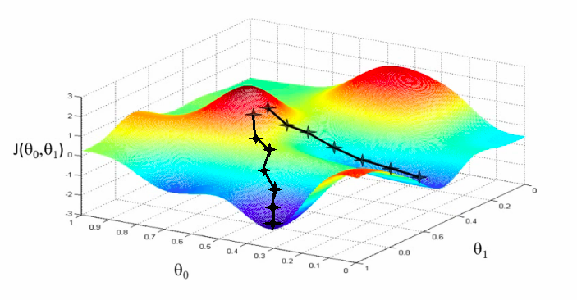
Setting the learning rate

Slide 6
Setting the learning rate
Too high
Too low
Want: good decay schedule
Figure source

Slide 7
Setting the learning rate
Too high
Too low
Want: good decay schedule
Figure source
Source: Stanford CS231n

Slide 8
Learning rate decay
Decay formulas
Exponential: $η_{t}=η_{0}e^{−kt}$, where $η_{0}$ and $k$ are hyperparameters, $t$ is the iteration or epoch number
Inverse: $η_{t}=η_{0}/(1+kt)$
Inverse sqrt: $η_{t}=η_{0}/\sqrt{t}$
$\text{Linear}\text{: }η_{t}=η_{0}(1−t/T)$, where T is the total number of epochs
Cosine: $η_{t}={\frac{1}{2}η}_{0}(1+cos⁡(tπ/T))$

Slide 9
Learning rate decay
Decay formulas
Most common in practice:
Step decay: reduce rate by a constant factor every few epochs, e.g., by 0.5 every 5 epochs, 0.1 every 20 epochs
Manual: watch validation error and reduce learning rate whenever it stops improving
“Patience” hyperparameter: number of epochs without improvement before reducing learning rate

Slide 10
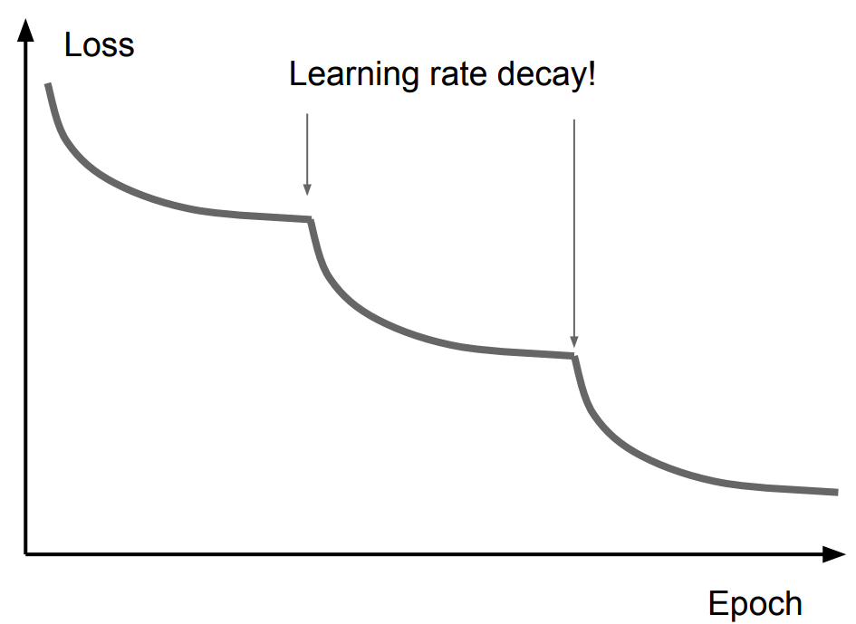
A typical phenomenon
Possible explanation
Image source: Stanford CS231n
Image source
Notes:
From Stanford CS231n: Good intuition to have in mind is that with a high learning rate, the system contains too much kinetic energy and the parameter vector bounces around chaotically, unable to settle down into deeper, but narrower parts of the loss function. Knowing when to decay the learning rate can be tricky: Decay it slowly and you’ll be wasting computation bouncing around chaotically with little improvement for a long time.

Slide 11
Learning rate decay
Decay formulas
Most common in practice:
Step decay: reduce rate by a constant factor every few epochs, e.g., by 0.5 every 5 epochs, 0.1 every 20 epochs
Manual: watch validation error and reduce learning rate whenever it stops improving
“Patience” hyperparameter: number of epochs without improvement before reducing learning rate
Warmup: train with a low learning rate for a first few epochs, or linearly increase learning rate before transitioning to normal decay schedule (Goyal et al., 2018)

Slide 12
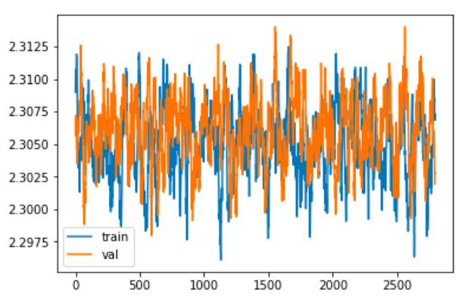
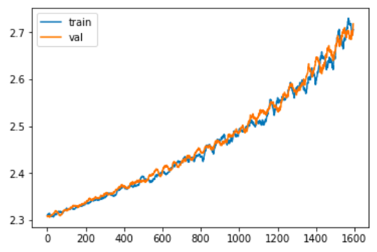
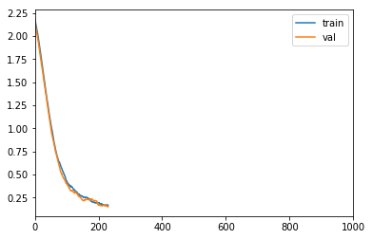
Diagnosing learning curves: Obvious problems
Not training
Bug in update calculation?
Error increasing
Bug in update calculation?
Shuffling off
Shuffling on
Get NaNs in the loss after a number of iterations: Numerical instability
Weird cyclical patterns in loss:
Data not shuffled
Source: Stanford CS231n

Slide 13
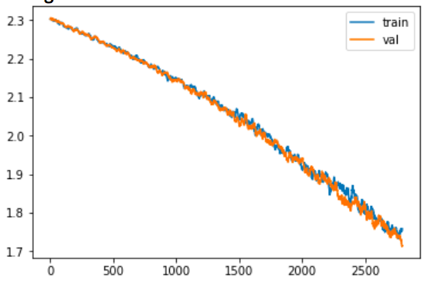
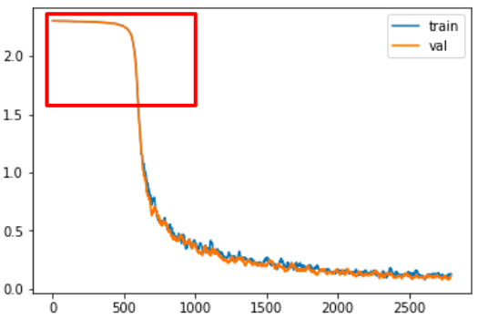
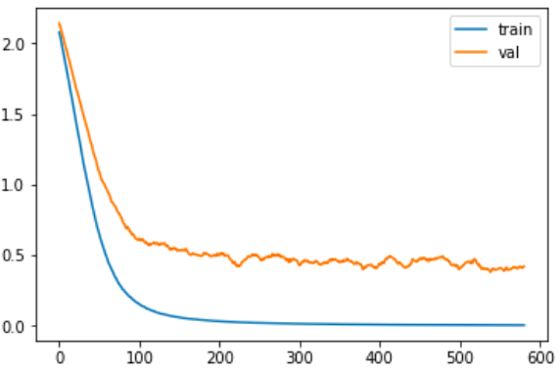
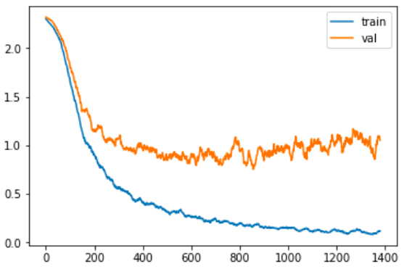
Diagnosing learning curves: Subtler behaviors
Not converged yet
Keep training, possibly increase learning rate
Slow start
Bad initialization?
Possible overfitting
Definite overfitting
Source: Stanford CS231n

Slide 14
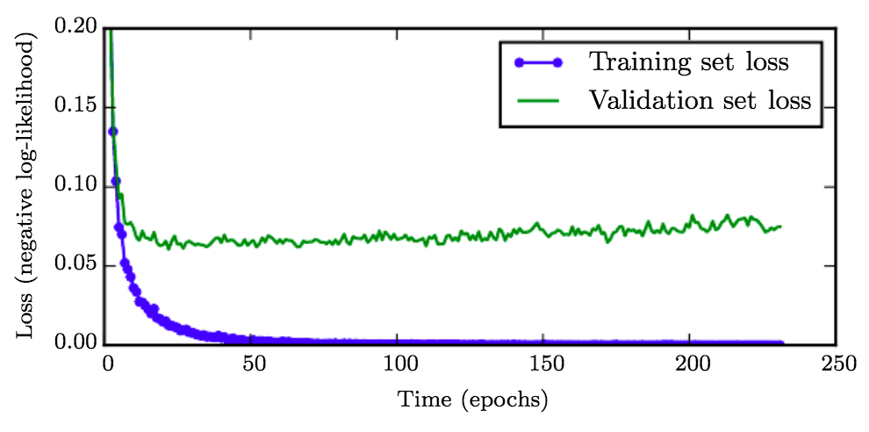
When to stop training?
Monitor validation error to decide when to stop
“Patience” hyperparameter: number of epochs without improvement before stopping
Early stopping can be viewed as a kind of regularization
Figure from Deep Learning Book

Slide 15
Neural network training: The basics and beyond
Optimization
Mini-batch SGD
Learning rate decay
Diagnosing learning curves
Adaptive optimization methods: SGD with momentum, RMSProp, Adam
Massaging the numbers
Data augmentation
Data preprocessing
Weight initialization
Batch normalization
Regularization
Test time: averaging predictions, ensembles

Slide 16
Outline
Optimization
Mini-batch SGD
Learning rate decay
Diagnosing learning curves
Adaptive optimization methods: SGD with momentum, RMSProp, Adam

Slide 17
Where does SGD run into trouble?
Notes:
What if loss changes quickly in one direction and slowly in another?
What does gradient descent do?
Very slow progress along shallow dimension, jitter along steep direction
Loss function has high condition number: ratio of largest to smallest singular value of the Hessian matrix is large

Slide 18
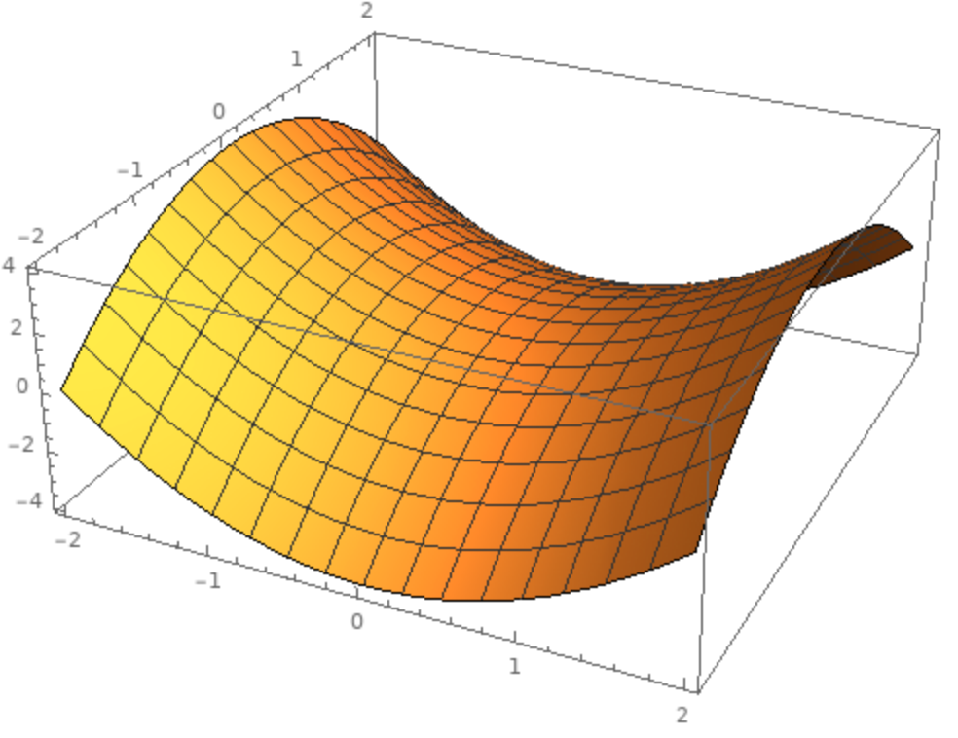
Where does SGD run into trouble?
Local minima
Saddle points
Poor conditioning
Source: J. Johnson
Notes:
What if loss changes quickly in one direction and slowly in another?
What does gradient descent do?
Very slow progress along shallow dimension, jitter along steep direction
Loss function has high condition number: ratio of largest to smallest singular value of the Hessian matrix is large

Slide 19
SGD with momentum
Goal: move faster in directions with consistent gradient, avoid oscillating in directions with large but inconsistent gradients
Standard SGD
SGD with momentum
Image source

Slide 20
SGD with momentum
Introduce a “momentum” variable $m$ and associated “friction” coefficient $β$:
$$m←βm−η∇L$$
$$w←w+m$$
Typically start with $β=0.5$, gradually increase over time
$$βm$$
actual step
momentum step
$$w$$
$$−η∇L$$
gradient step
Image source

Slide 21
SGD with momentum
Introduce a “momentum” variable $m$ and associated “friction” coefficient $β$:
$$m←βm−η∇L$$
$$w←w+m$$
Nesterov momentum: evaluate gradient at “lookahead” position $w+βm$
$$βm$$
$$βm$$
$$−η∇L(w+βm)$$
$$w$$
$$−η∇L$$
$$w$$
Image source

Slide 22
Adagrad: Adaptive per-parameter learning rates
Keep track of history of gradient magnitudes, scale the learning rate for each parameter based on this history
For each dimension $k$ of the weight vector:
$$v^{(k)}←v^{(k)}+{\left(\frac{∂L}{∂w^{(k)}}\right)}^{2}$$
$$w^{(k)}←w^{(k)}−\frac{η}{\sqrt{v^{(k)}}+ε} \frac{∂L}{∂w^{(k)}}$$
Parameters with small gradients get large updates and vice versa
Problem: long-ago gradient magnitudes are not “forgotten” so learning rate decays too quickly
Update running sum of squared magnitudes of gradient w.r.t. $k$th weight
Scale learning rate for $k$th weight by inverse of the magnitude, update $k$th weight
J. Duchi, Adaptive subgradient methods for online learning and stochastic optimization, JMLR 2011

Slide 23
RMSProp
Introduce decay factor $β$ (typically $≥0.9$) to downweight past history exponentially:
$$v^{(k)}←βv^{(k)}+(1−β){\left(\frac{∂L}{∂w^{(k)}}\right)}^{2}$$
$$w^{(k)}←w^{(k)}−\frac{η}{\sqrt{v^{(k)}}+ε} \frac{∂L}{∂w^{(k)}}$$
http://www.cs.toronto.edu/~tijmen/csc321/slides/lecture_slides_lec6.pdf

Slide 24
Adam: Combine RMSProp with momentum
Update momentum:
$$m←β_{1}m+\left(1−β_{1}\right)∇L$$
For each dimension $k$ of the weight vector:
$$v^{(k)}←β_{2}v^{(k)}+(1−β_{2}){\left(\frac{∂L}{∂w^{(k)}}\right)}^{2}$$
$$w^{(k)}←w^{(k)}−\frac{η}{\sqrt{v^{(k)}}+ε}m^{(k)}$$
Full algorithm includes bias correction to account for $m$ and $v$ starting at 0: $\hat{m}=\frac{m}{1−β_{1}^{t}}$, $\hat{v}=\frac{v}{1−β_{2}^{t}}$ ($t$ is the timestep)
Default parameters from paper are reputed to work well for many models: $β_{1}=0.9$, $β_{2}=0.999$, $η=1e−3$, $ε=1e−8$
D. Kingma and J. Ba, Adam: A method for stochastic optimization, ICLR 2015

Slide 25
Which optimizer to use in practice?
Adaptive methods tend to reduce initial training error faster than SGD and are “safer”
Andrej Karpathy: “In the early stages of setting baselines I like to use Adam with a learning rate of 3e-4. In my experience Adam is much more forgiving to hyperparameters, including a bad learning rate. For ConvNets a well-tuned SGD will almost always slightly outperform Adam, but the optimal learning rate region is much more narrow and problem-specific.”
Use Adam early in training, switch to SGD for later epochs?
Notes:
See also:
Descending through a Crowded Valley — Benchmarking Deep Learning Optimizers
https://arxiv.org/pdf/2007.01547.pdf

Slide 26
Which optimizer to use in practice?
Adaptive methods tend to reduce initial training error faster than SGD and are “safer”
Some literature has reported problems with adaptive methods, such as failing to converge or generalizing poorly (Wilson et al. 2017, Reddi et al. 2018)
More recent comparative study (Schmidt et al., 2021): “We observe that evaluating multiple optimizers with default parameters works approximately as well as tuning the hyperparameters of a single, fixed optimizer.”

Slide 27
Misc. optimization tricks and topics
Adding noise to gradients: SGD with Langevin dynamics helps to jump out of local minima (e.g., Welling and Teh, 2011)
Cyclical learning rates: increase learning rate from time to time to jump out of local minima (Smith 2017)
Second-order methods (e.g., L-BFGS)
Non-gradient or non-backprop methods

Slide 28
Outline
Optimization
Mini-batch SGD
Learning rate decay
Diagnosing learning curves
Adaptive methods: SGD with momentum, RMSProp, Adam
Massaging the numbers
Data augmentation
Data preprocessing
Weight initialization
Batch normalization

Slide 29
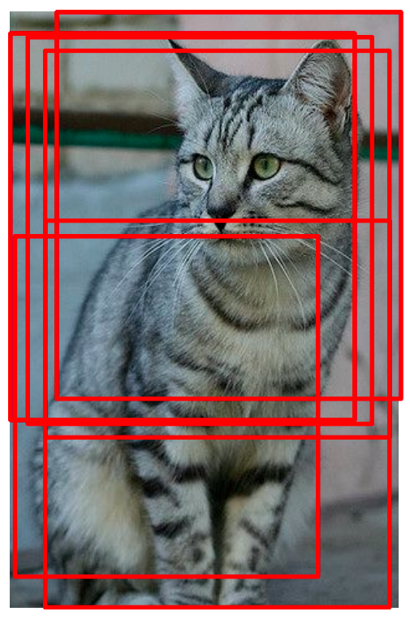
Data augmentation
Introduce transformations not adequately sampled in the training data
Geometric: flipping, rotation, shearing, multiple crops
Image source
Image source

Slide 30
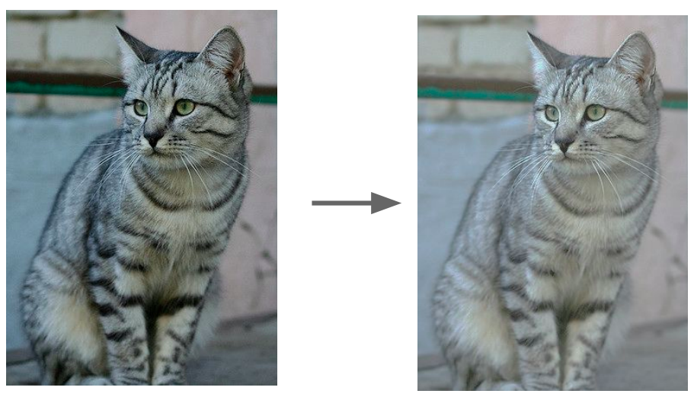
Data augmentation
Introduce transformations not adequately sampled in the training data
Geometric: flipping, rotation, shearing, multiple crops
Photometric: color transformations
Image source

Slide 31
Data augmentation
Introduce transformations not adequately sampled in the training data
Geometric: flipping, rotation, shearing, multiple crops
Photometric: color transformations
Other: add noise, compression artifacts, lens distortions, etc.
Image source

Slide 32
Data augmentation
Introduce transformations not adequately sampled in the training data
Limited only by your imagination and time/memory constraints!
Avoid introducing artifacts
Image source

Slide 33
Data augmentation
Introduce transformations not adequately sampled in the training data
Limited only by your imagination and time/memory constraints!
Avoid introducing artifacts
Automatic augmentation strategies: AutoAugment, RandAugment

Slide 34
Data preprocessing
Zero centering
Subtract mean image – all input images need to have the same resolution
Subtract per-channel means – images don’t need to have the same resolution
Optional: rescaling – divide each value by (per-pixel or per-channel) standard deviation
Be sure to apply the same transformation at training and test time!
Save training set statistics and apply to test data

Slide 35
The importance of preprocessing and initialization
Consider the behavior of a linear+ReLU unit: $h = ReLU(w^{T}x+b)$
$w$: normal to a hyperplane
Bias $b$: (unnormalized) distance from hyperplane to origin
$$x^{(2)}$$
$$x^{(1)}$$
$$h>0$$
$$h<0$$

Slide 36
Review: Backward pass for ReLU
$$\frac{∂h}{∂x}=𝕀[x>0]$$
$$x$$
$$f(x)=max⁡(0,x)$$
$$h$$
$$\frac{∂e}{∂x} = \frac{∂e}{∂h} \frac{∂h}{∂x}$$
$\frac{∂e}{∂h}$
$$\frac{∂e}{∂x} = \frac{∂e}{∂h}𝕀\left[x>0\right]$$

Slide 37
The importance of preprocessing and initialization
Linear+ReLU unit: $h = ReLU(w^{T}x+b)$
$w$: normal to a hyperplane
Bias $b$: (unnormalized) distance from hyperplane to origin
$$x^{(2)}$$
$$x^{(1)}$$
What happens in this case?
Nonlinearity plays no role
Upstream gradients can still back-propagate

Slide 38
The importance of preprocessing and initialization
Linear+ReLU unit: $h = ReLU(w^{T}x+b)$
$w$: normal to a hyperplane
Bias $b$: (unnormalized) distance from hyperplane to origin
$$x^{(2)}$$
$$x^{(1)}$$
What happens in this case?
All inputs to ReLU are negative
No gradients propagate back – dead ReLU!

Slide 39
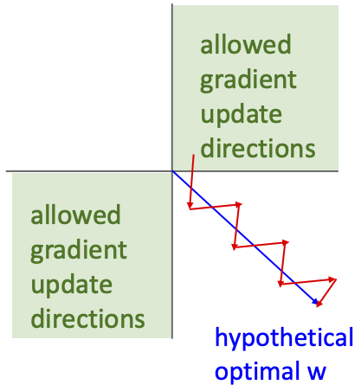
The importance of preprocessing and initialization
Suppose all data is positive
Linear perceptron with $b=0$, initially all points are misclassified
Recall the perceptron update: $w←w+ηy_{i}x_{i}$
Updates are all positive or all negative along individual dimensions!
$$x^{(2)}$$
$$y=−1$$
$$y=1$$
$$x^{(1)}$$
Source: J. Johnson

Slide 40
The importance of preprocessing and initialization
What’s wrong with initializing all weights to the same number (e.g., zero)?

Slide 41
Weight initialization
Typically: initialize to random values sampled from zero-mean Gaussian: $w \sim 𝒩(0, σ^{2})$
Standard deviation matters!
Key idea: avoid reducing or amplifying the variance of layer responses, which would lead to vanishing or exploding gradients
Common heuristics:
Xavier initialization: $σ^{2}={1/n}_{in}$ or $σ^{2} ={2/(n}_{in}+n_{out})$, where $n_{in}$ and $n_{out}$are the numbers of inputs and outputs to a layer (Glorot and Bengio, 2010)
Kaiming initialization (goes with ReLU): $σ^{2} ={2/n}_{in}$ (He et al., 2015)
Initializing biases: just set them to 0
More details: http://cs231n.github.io/neural-networks-2/#init

Slide 42
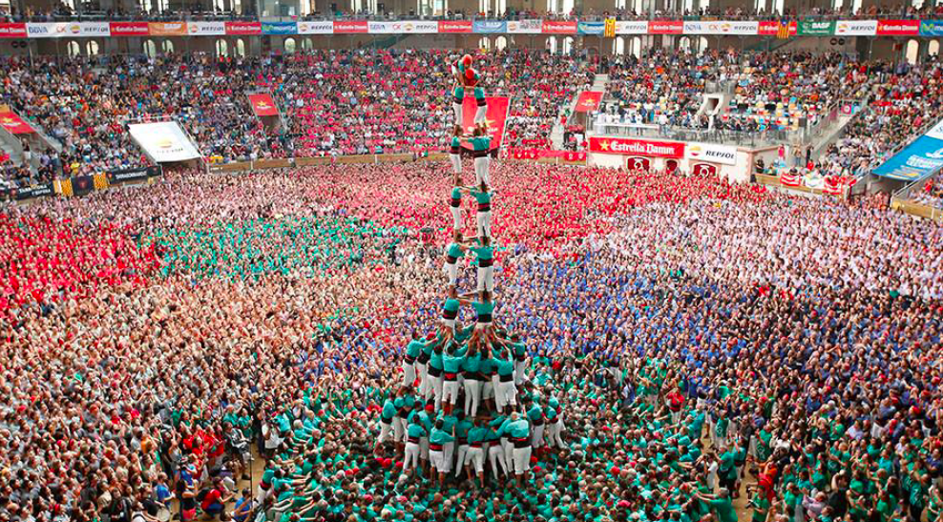
Batch normalization
The authors’ intuition
Image source, via Prajit Ramachandran
S. Ioffe, C. Szegedy, Batch Normalization: Accelerating Deep Network Training by Reducing Internal Covariate Shift, ICML 2015

Slide 43
Normalization
I omitted a crucial detail so far:
It is often useful to standardize statistics of hidden layers
through use of normalization layers
to mitigate vanishing / exploding gradients
when training deeper networks
Many forms of normalization:

Slide 44
Batch normalization
Key idea: shifting and rescaling are differentiable operations, so the network can learn how to best normalize the data
Statistics of activations (outputs) from a given layer across the dataset can be approximated by statistics from a mini-batch
S. Ioffe, C. Szegedy, Batch Normalization: Accelerating Deep Network Training by Reducing Internal Covariate Shift, ICML 2015

Slide 45
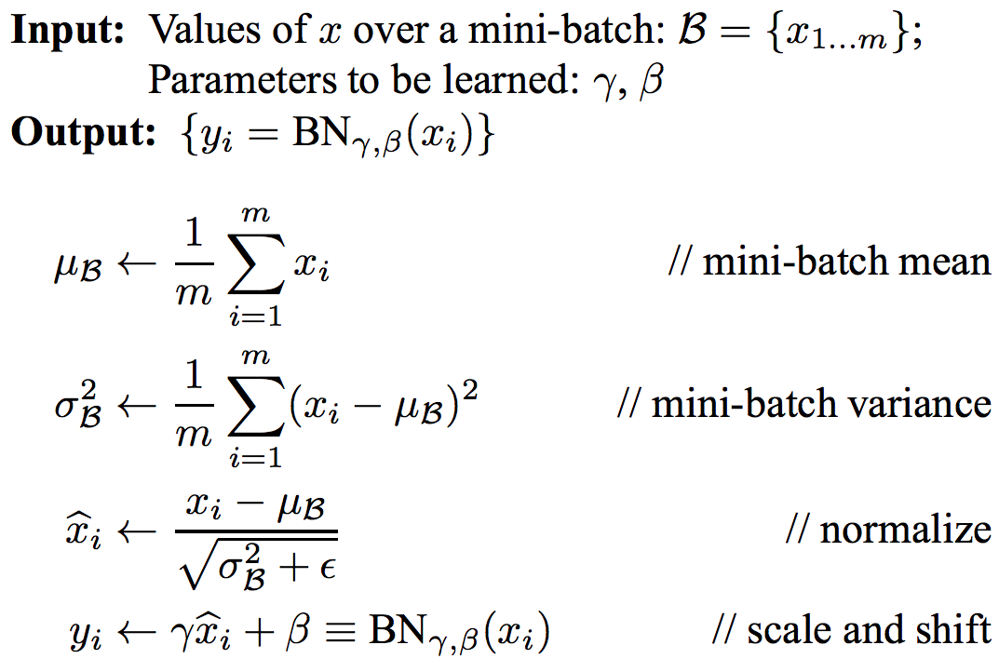
Batch normalization
S. Ioffe, C. Szegedy, Batch Normalization: Accelerating Deep Network Training by Reducing Internal Covariate Shift, ICML 2015
Notes:
From the paper: Note that simply normalizing each input of a layer may change what the layer can represent. For instance, normalizing the inputs of a sigmoid would constrain them to the linear regime of the nonlinearity. To address this, we make sure that the transformation inserted in the network can represent the identity transform. To accomplish this, we introduce, for each activation x (k) , a pair of parameters γ (k) , β(k) , which scale and shift the normalized value. Indeed, by setting γ (k) = p Var[x (k) ] and β (k) = E[x (k) ], we could recover the original activations, if that were the optimal thing to do.

Slide 46
Batch normalization
At test time (usually):
training set
training set
S. Ioffe, C. Szegedy, Batch Normalization: Accelerating Deep Network Training by Reducing Internal Covariate Shift, ICML 2015

Slide 47
Batch normalization
Common configuration: insert BN layers right after conv or FC layers, before ReLU nonlinearity (but this is purely empirical)
conv
BN
ReLU
conv
BN
ReLU
S. Ioffe, C. Szegedy, Batch Normalization: Accelerating Deep Network Training by Reducing Internal Covariate Shift, ICML 2015

Slide 48
Batch normalization
Benefits
Prevents exploding and vanishing gradients
Keeps most activations away from saturation regions of non-linearities
Accelerates convergence of training
Makes training more robust w.r.t. hyperparameter choice, initialization
Pitfalls
Behavior depends on composition of mini-batches, can lead to hard-to-catch bugs if there is a mismatch between training and test regime (example)
Doesn’t work well for small mini-batch sizes
Cannot be used for certain types of models (recurrent models, transformers)

Slide 49
Why does BatchNorm really work?
It may have to do not with internal covariate shift (ICS), but with making the optimization problem much smoother (Santurkar et al., 2018)
Is ICS even a thing? (Lipton and Steinhardt, 2018)

Slide 50
Other types of normalization
Layer normalization (Ba et al., 2016)
Instance normalization (Ulyanov et al., 2017)
Group normalization (Wu and He, 2018)
Weight normalization (Salimans et al., 2016)
Y. Wu and K. He, Group Normalization, ECCV 2018

Slide 51
Outline
Optimization
Mini-batch SGD
Learning rate decay
Diagnosing learning curves
Adaptive methods: SGD with momentum, RMSProp, Adam
Massaging the numbers
Data augmentation
Data preprocessing
Weight initialization
Batch normalization
Regularization

Slide 52
Regularization
Techniques for controlling the capacity of a neural network to prevent overfitting – short of explicit reduction of the number of parameters
Recall: classic regularization: L1, L2
Image source

Slide 53
Weight decay
Generic optimization step:
$$L\left(w\right)=L_{data}\left(w\right)+L_{reg}\left(w\right)$$
$$g_{t}=∇L\left(w_{t}\right)$$
$$s_{t}=optimizer\left(g_{t}\right)$$
$$w_{t+1}=w_{t}−ηs_{t}$$
Optimization with weight decay:
$$L\left(w\right)=L_{data}\left(w\right)$$
$$g_{t}=∇L\left(w_{t}\right)$$
$$s_{t}=optimizer\left(g_{t}\right)$$
$$w_{t+1}=(1−ηλ)w_{t}−ηs_{t}$$
SGD with L2 regularization:
$$L\left(w\right)=L_{data}\left(w\right)+\frac{λ}{2}{\left\|w\right\|}^{2}$$
$$g_{t}=∇L_{data}\left(w_{t}\right)+λw$$
$$w_{t+1} =w_{t}−ηg_{t}$$
$=\left(1−ηλ\right)w_{t}−η∇L_{data}\left(w_{t}\right)$
I. Loshchilov and F. Hutter, Decoupled Weight Decay Regularization, ICLR 2019
Adapted from J. Johnson

Slide 54
Other types of regularization
Adding noise to the inputs
Recall motivation of max margin criterion
In simple scenario (linear model, quadratic loss, Gaussian noise), this is equivalent to weight decay
Data augmentation is a more general form of this
Adding noise to the weights
Label smoothing
When using softmax loss, replace hard 1 and 0 prediction targets with “soft” targets of $1−ε$ and $\frac{ε}{C−1}$

Slide 55
Dropout
At training time, in each forward pass, turn off some neurons with probability $p$
At test time, to have deterministic behavior, multiply output of neuron by $p$
N. Srivastava, G. Hinton, A. Krizhevsky, I. Sutskever, R. Salakhutdinov. Dropout: A Simple Way to Prevent Neural Networks from Overfitting. JMLR 2014

Slide 56
Dropout
Intuitions
Prevent “co-adaptation” of units, increase robustness to noise
Train implicit ensemble
N. Srivastava, G. Hinton, A. Krizhevsky, I. Sutskever, R. Salakhutdinov. Dropout: A Simple Way to Prevent Neural Networks from Overfitting. JMLR 2014

Slide 57
Current status of dropout
Against
Slows down convergence
Made redundant by batch normalization or possibly even clashes with it
Unnecessary for larger datasets or with sufficient data augmentation
In favor
Can still help for certain models and in certain situations: e.g., used in Wide Residual Networks

Slide 58
Outline
Optimization
Mini-batch SGD
Learning rate decay
Diagnosing learning curves
Adaptive methods: SGD with momentum, RMSProp, Adam
Massaging the numbers
Data augmentation
Data preprocessing
Weight initialization
Batch normalization
Regularization
Test time: averaging predictions, ensembles

Slide 59
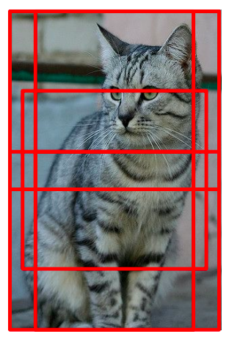
Test time
Average predictions across multiple crops of test image
There is a more elegant way to do this with fully convolutional networks (FCNs)

Slide 60
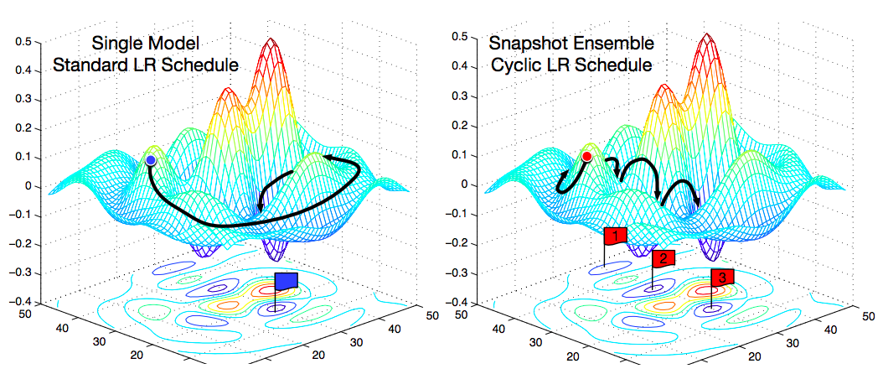
Test time
Ensembles: train multiple independent models, then average their predicted label distributions
Gives 1-2% improvement in most cases
Can take multiple snapshots of models obtained during training, especially if you cycle the learning rate (increase to jump out of local minima)
G. Huang et al., Snapshot ensembles: Train 1, get M for free, ICLR 2017

Slide 61
Important Considerations
Data
Supervision
Loss functions
Optimization / Initialization
Inductive Bias

Slide 62
Development Process
Collect lots of labeled data
Setup network architecture
Setup loss function
Sanity checks
Is your data correct?
Can you overfit to a small set?
Hyperparameters
Learning hyperparameters: batch size, learning rates, how much to train, regularization, optimizer.
Architectural hyper-parameters: Non-linearities, #layers, #neurons, loss functions.
Hacking
Reducing iteration time
Maximizing GPU utilization

Slide 63
Some take-aways
Training neural networks is still a black art
Process requires close “babysitting”
For many techniques, the reasons why, when, and whether they work are in active dispute – read everything but don’t trust anything
It all comes down to (principled) trial and error
Further reading: A. Karpathy, A recipe for training neural networks

