Slide 1
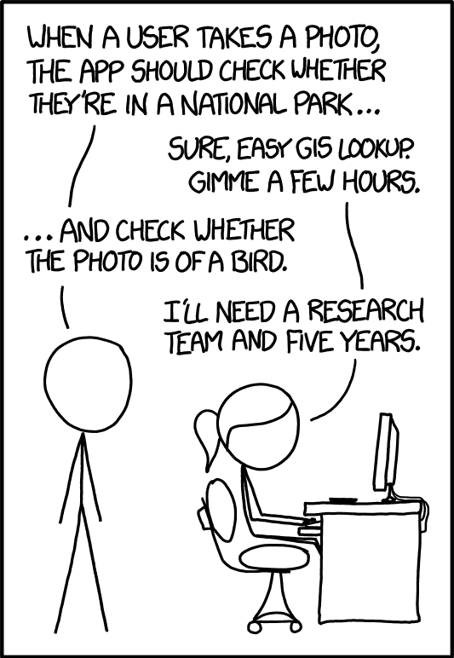
CS543 / ECE549
Computer Vision
Spring 2023
Course webpage URL:
http://saurabhg.web.illinois.edu/teaching/ece549/sp2023/

Slide 2
Plan for today
Course Introduction
Logistics

Slide 3
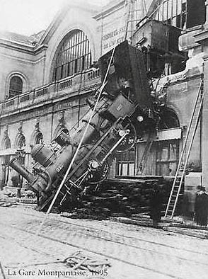

The goal of computer vision
To extract “meaning” from pixels
What we see
What a computer sees
Source: S. Narasimhan
Notes:
Gare Montparnasse, 1895

Slide 4
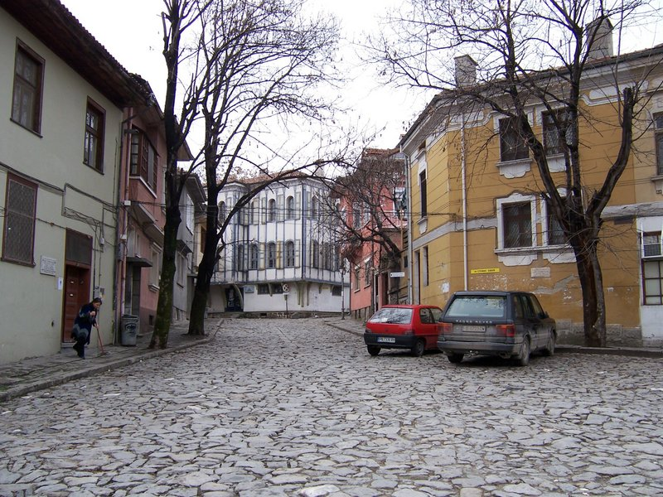
What kind of information can be extracted from an image?
…
Source: L. Lazebnik

Slide 5
What kind of information can be extracted from an image?
…
Geometric information
Source: L. Lazebnik

Slide 6
What kind of information can be extracted from an image?
roof
tree
tree
sky
chimney
building
building
window
door
trashcan
car
car
person
Outdoor scene
ground
City
European
…
Geometric information
Semantic information
Source: L. Lazebnik

Slide 7

Vision is easy for humans
Source: L. Lazebnik
Source: “80 million tiny images” by Torralba et al.

Slide 8
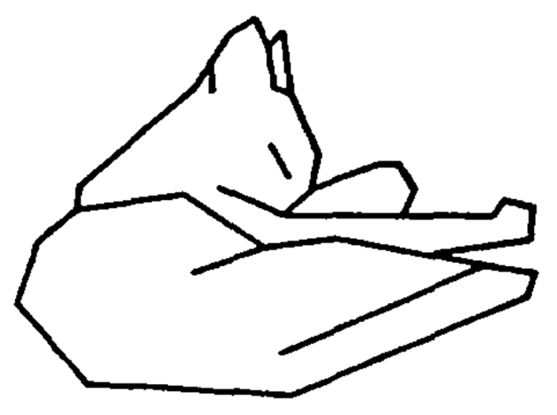
Vision is easy for humans
Attneave’s Cat
Source: B. Hariharan

Slide 9
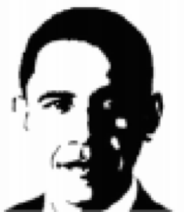
Vision is easy for humans
Mooney Faces
Source: B. Hariharan

Slide 10
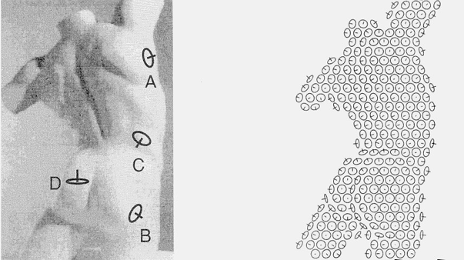
Vision is easy for humans
Surface perception in pictures. Koenderink, van Doorn and Kappers, 1992
Source: J. Malik

Slide 11

Remarkably Hard for Computers
Source: XKCD

Slide 12
Vision is hard: Objects Blend Together
Source: B. Hariharan

Slide 13
Vision is hard: Objects Blend Together
Source: B. Hariharan

Slide 14
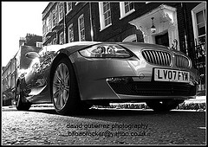
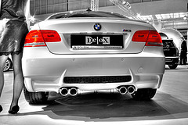
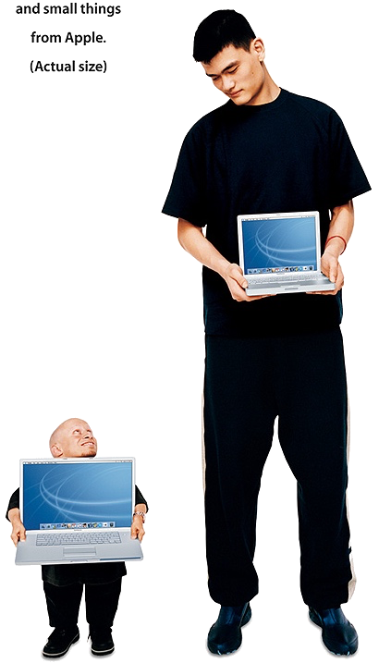
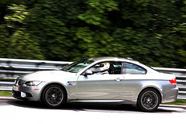
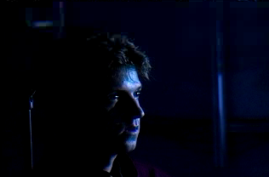
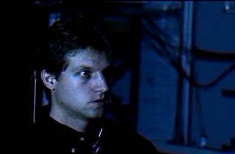
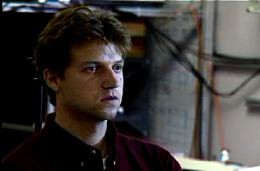
Vision is hard: Intra-class Variation
Viewpoint variation
Illumination
Scale
Source: B. Hariharan

Slide 15
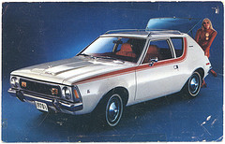
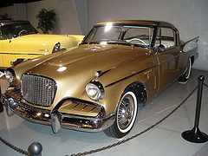
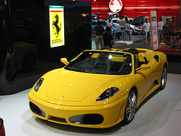
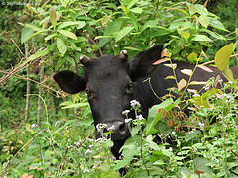
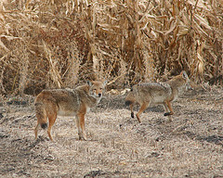
Vision is hard: Intra-class Variation
Shape variation
Occlusion
Background clutter
Source: B. Hariharan

Slide 16
Vision is hard: Intra-class Variation
Source: B. Hariharan

Slide 17
Vision is hard: Concepts are subtle
Tennessee Warbler
Orange Crowned Warbler
Source: B. Hariharan
https://www.allaboutbirds.org
Notes:
In addition, there is also a lot of variation among instances of the same kind of object.
This here, for example, is a very weird kind of chair.
It looks nothing like a chair, but it offers exactly the same functionality as a chair.
Our vision systems need to ignore, or be invariant to, such vast variations, and recognize things for what they really are.

Slide 18
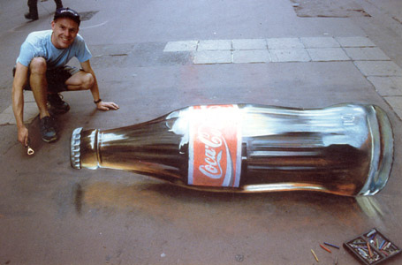
Vision is hard: Images are ambiguous
Source: B. Hariharan

Slide 19
What can computer vision do today?

Slide 20
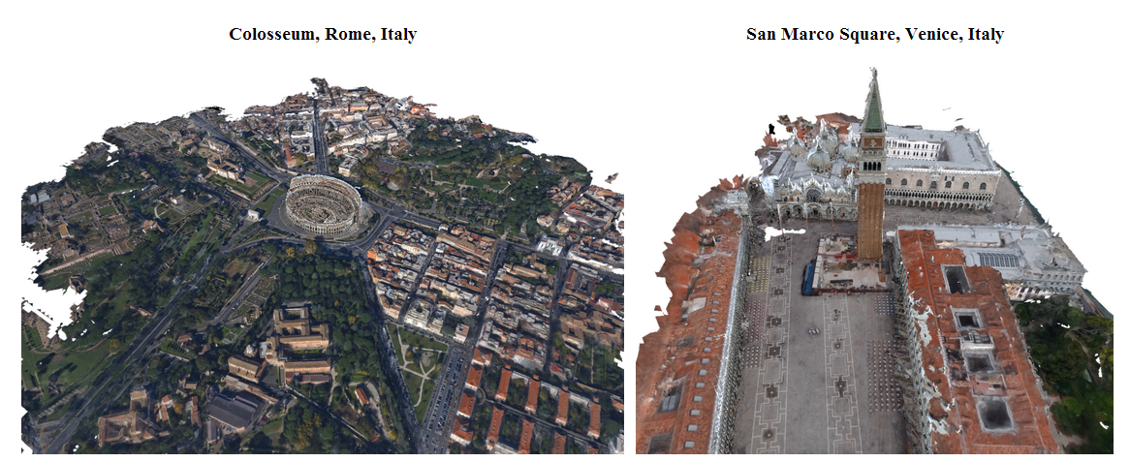
Reconstruction: 3D from photo collections
Q. Shan, R. Adams, B. Curless, Y. Furukawa, and S. Seitz, The Visual Turing Test for Scene Reconstruction, 3DV 2013
YouTube Video
See also: NYTimes Article
Source: L. Lazebnik
Notes:
We present the first large scale system for capturing and rendering relightable scene reconstructions from massive unstructured photo collections taken under different illumination conditions and viewpoints. We combine photos taken from many sources, Flickr-based ground-level imagery, oblique aerial views, and streetview, to recover models that are significantly more complete and detailed than previously demonstrated. We demonstrate the ability to match both the viewpoint and illumination of arbitrary input photos, enabling a Visual Turing Test in which photo and rendering are viewed side-by-side and the observer has to guess which is which. While we cannot yet fool human perception, the gap is closing.

Slide 21
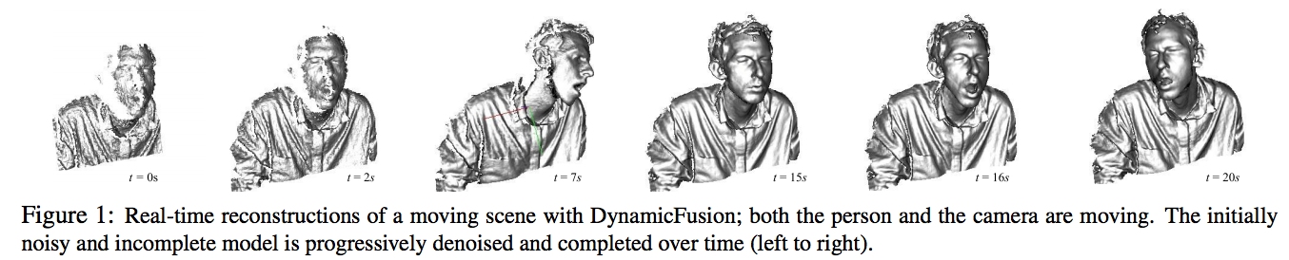
Reconstruction: 4D from depth cameras
R. Newcombe, D. Fox, and S. Seitz, DynamicFusion: Reconstruction and Tracking of Non-rigid Scenes in Real-Time, CVPR 2015
YouTube Video
Also see: NeRF
Source: L. Lazebnik
Notes:
We present the first dense SLAM system capable of reconstructing non-rigidly deforming scenes in real-time, by fusing together RGBD scans captured from commodity sensors. Our DynamicFusion approach reconstructs scene geometry whilst simultaneously estimating a dense volumetric 6D motion field that warps the estimated geometry into a live frame. Like KinectFusion, our system produces increasingly denoised, detailed, and complete reconstructions as more measurements are fused, and displays the updated model in real time. Because we do not require a template or other prior scene model, the approach is applicable to a wide range of moving objects and scenes.

Slide 22
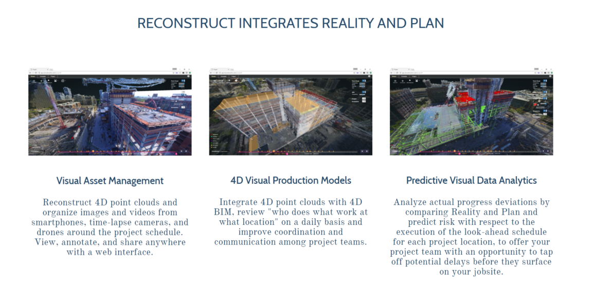
Reconstruction in construction industry
reconstructinc.com
Source: L. Lazebnik
Source: D. Hoiem

Slide 23
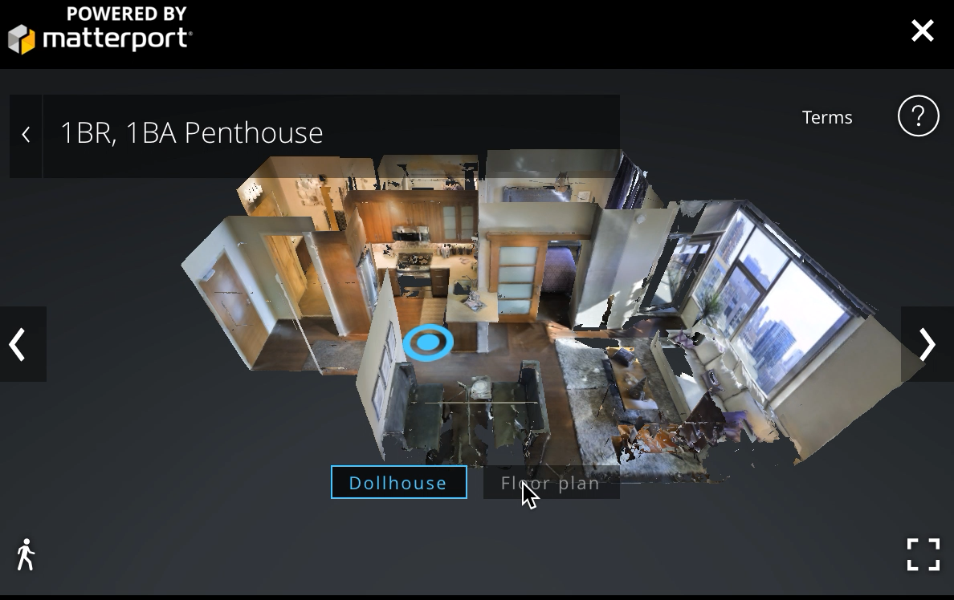
Applications
Source: N. Snavely

Slide 24
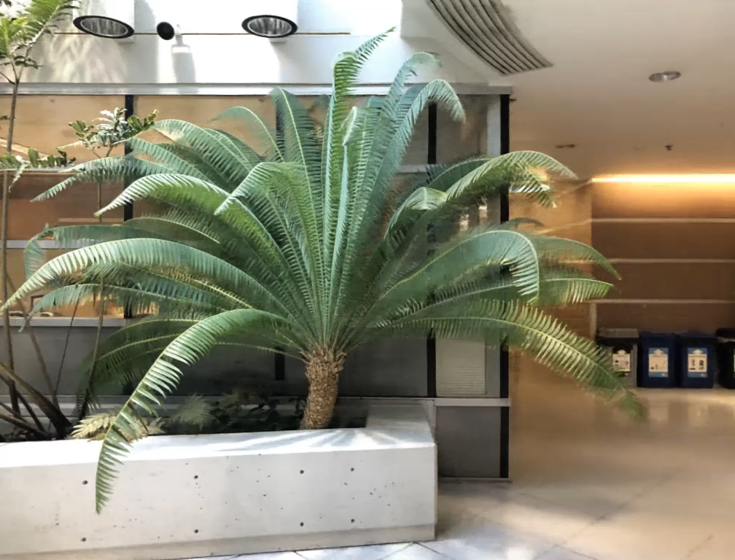
Novel View Synthesis
B. Mildenhall*, P. Srinivasan*, M. Tancik*, J. Barron, R. Ramamoorthi, R. Ng. Representing Scenes as Neural Radiance Fields for View Synthesis, ECCV 2020
Notes:
We present the first dense SLAM system capable of reconstructing non-rigidly deforming scenes in real-time, by fusing together RGBD scans captured from commodity sensors. Our DynamicFusion approach reconstructs scene geometry whilst simultaneously estimating a dense volumetric 6D motion field that warps the estimated geometry into a live frame. Like KinectFusion, our system produces increasingly denoised, detailed, and complete reconstructions as more measurements are fused, and displays the updated model in real time. Because we do not require a template or other prior scene model, the approach is applicable to a wide range of moving objects and scenes.

Slide 25
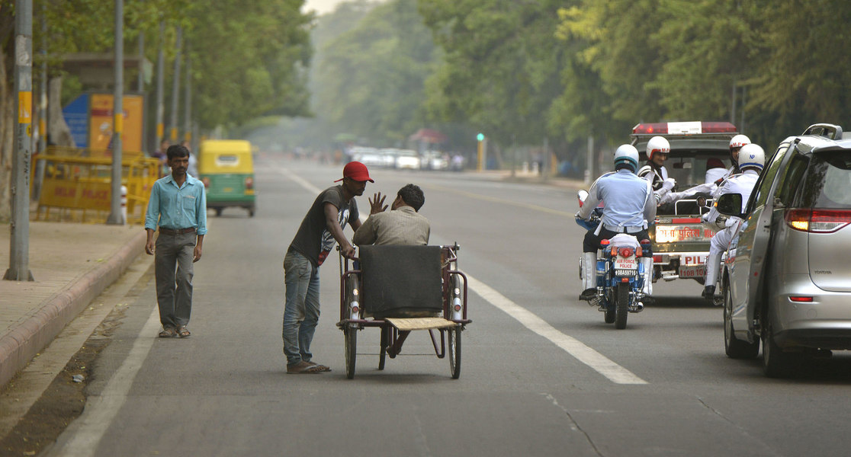
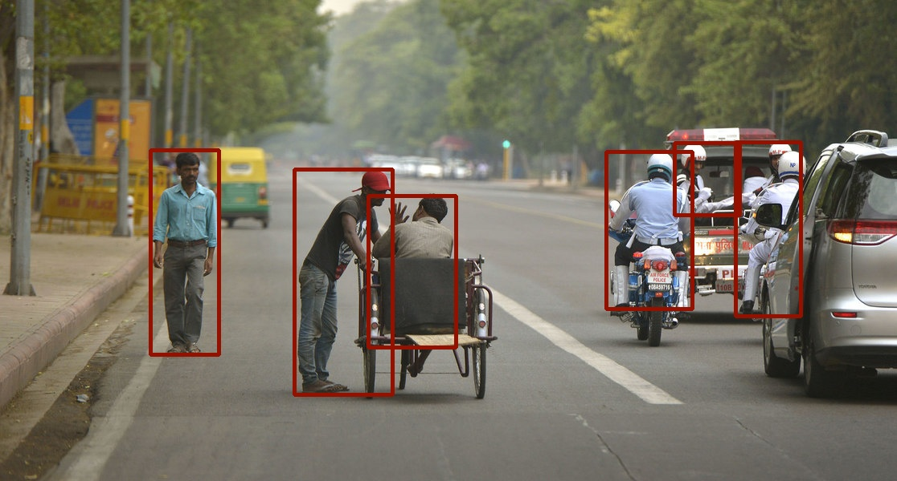
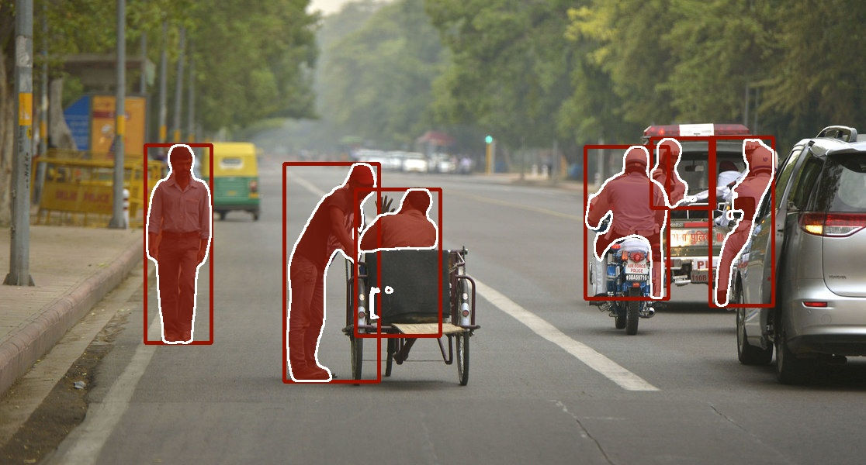
Image Labeling Tasks
person, motorcycle, car, chair
person, motorcycle, car, chair
K. He et al. Mask R-CNN ICCV 2017
Notes:
Include images of detection, segmentation, pose estimation, action recognition.

Slide 26
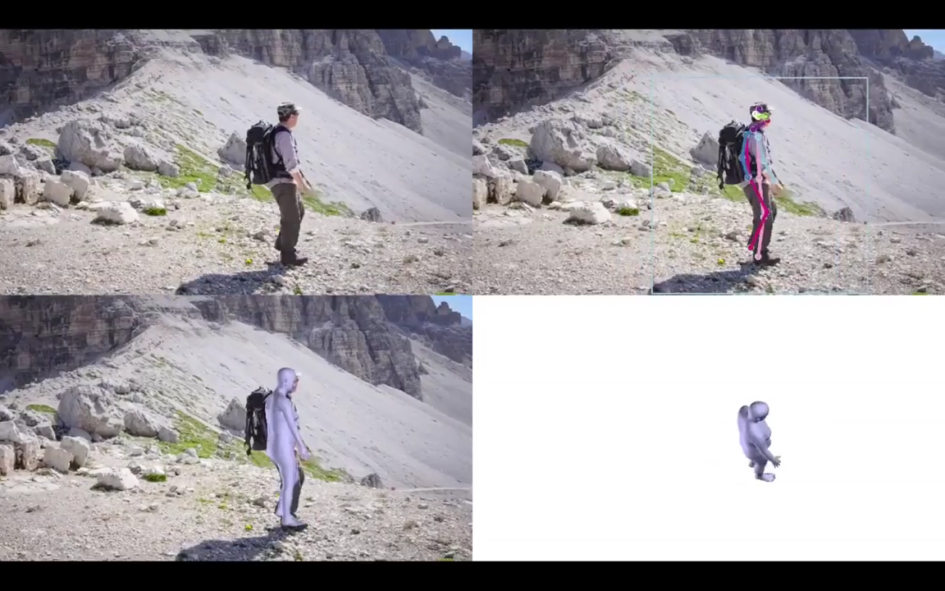
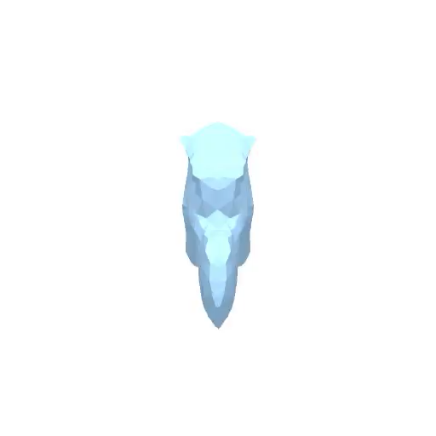
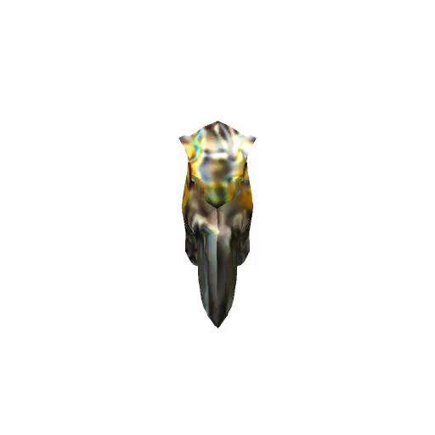
Full 3D from a single image
Shape and Pose Estimation for Objects and Humans
S. Goel et al. Shape and Viewpoint without Keypoints. ECCV 2020
A. Kanawaza et al. End-to-end Recovery of Human Shape and Pose. CVPR 2018
Notes:
Include images of detection, segmentation, pose estimation, action recognition.

Slide 27
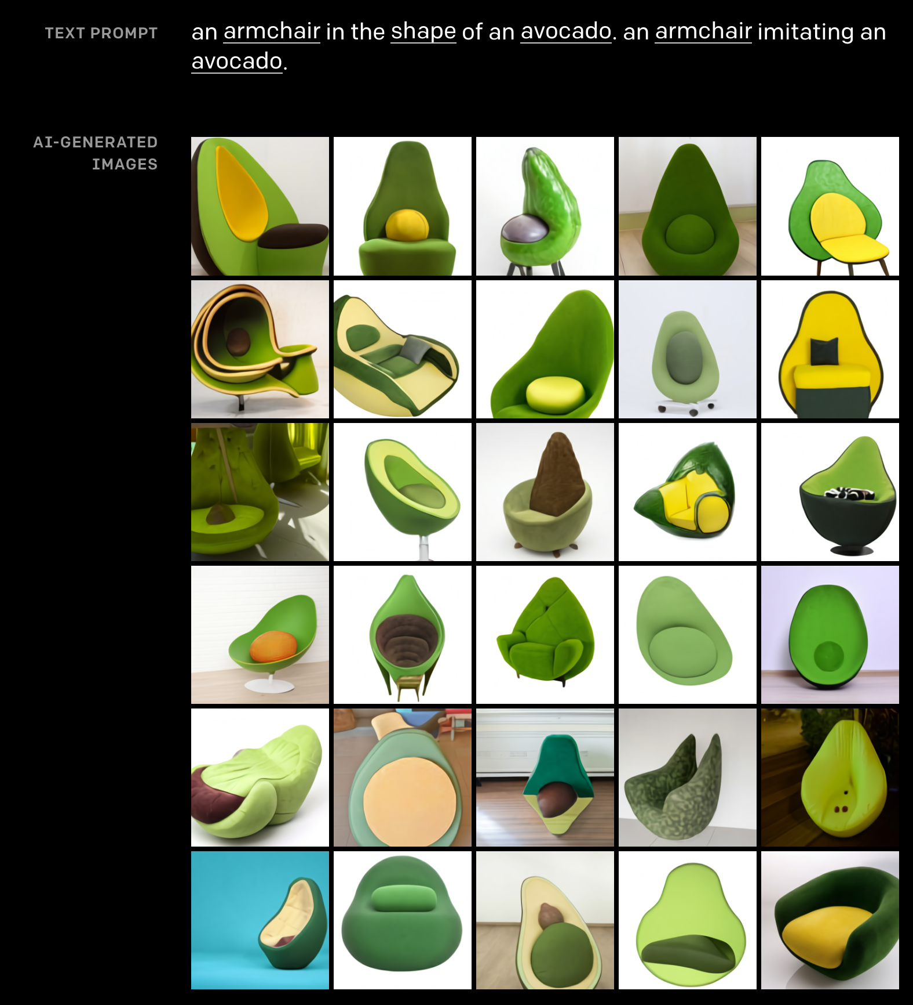
Image Generation
A. Ramesh et al. Zero-Shot Text-to-Image Generation. ICML 2021.
Notes:
Include images of detection, segmentation, pose estimation, action recognition.

Slide 28
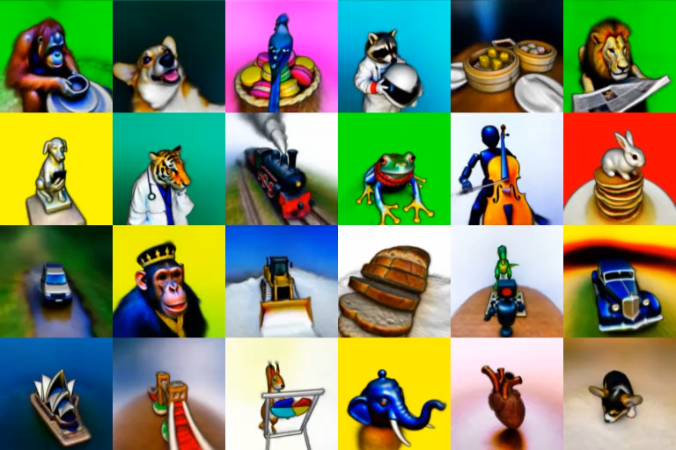
3D Scene Generation
B. Poole, A. Jain, J. Barron, B. Mildenhall. DreamFusion: Text-to-3D using 2D Diffusion. arXiv 2022
Notes:
Include images of detection, segmentation, pose estimation, action recognition.

Slide 29
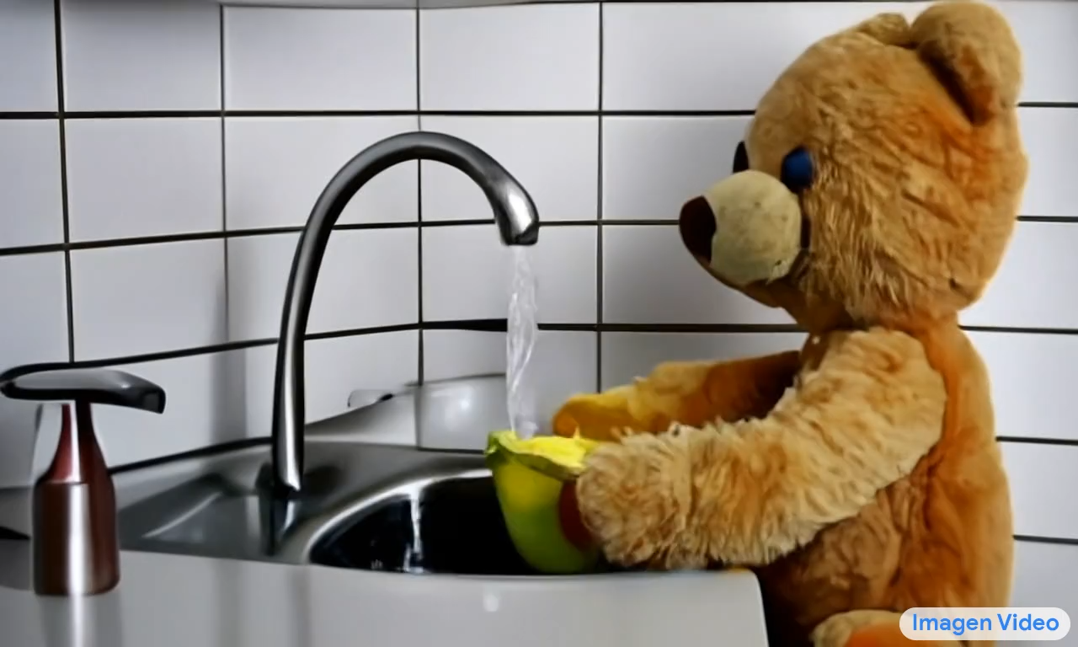
Video Generation
A teddy bear washing dishes
Jonathan Ho*, William Chan*, Chitwan Saharia*, Jay Whang*, Ruiqi Gao, Alexey Gritsenko, Diederik P. Kingma, Ben Poole, Mohammad Norouzi, David Fleet, Tim Salimans*. Imagen Video: High-definition video generation with diffusion models arXiv 2022
Notes:
Include images of detection, segmentation, pose estimation, action recognition.

Slide 30
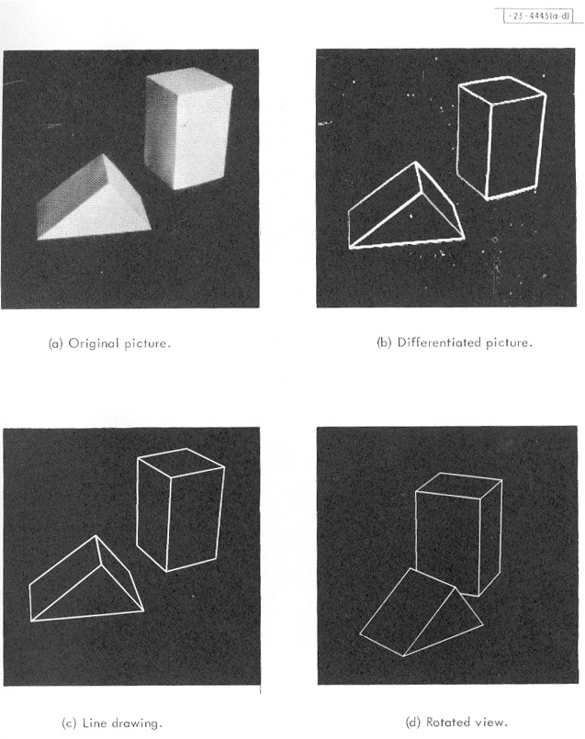
Origins of computer vision
L. G. Roberts, Machine Perception of Three Dimensional Solids, Ph.D. thesis, MIT Department of Electrical Engineering, 1963.
Source: L. Lazebnik

Slide 31
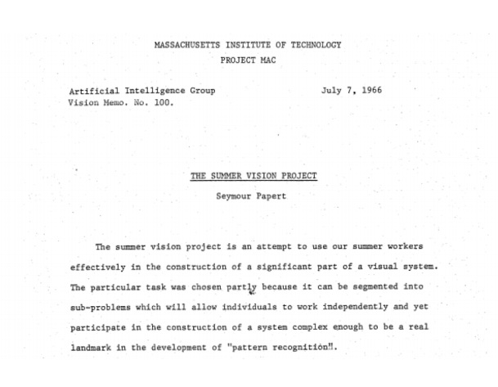
Origins of computer vision
Source: L. Lazebnik

Slide 32
Six decades of computer vision
1960s: Beginnings in artificial intelligence, image processing and pattern recognition
1970s: Foundational work on image formation: Horn, Koenderink, Longuet-Higgins …
1980s: Vision as applied mathematics: geometry, multi-scale analysis, probabilistic modeling, control theory, optimization
1990s: Geometric analysis largely completed, vision meets graphics, statistical learning approaches resurface
2000s: Significant advances in visual recognition
2010s: Progress continues, aided by the availability of large amounts of visual data and massive computing power. Deep learning has become pre-eminent
Source: J. Malik

Slide 33
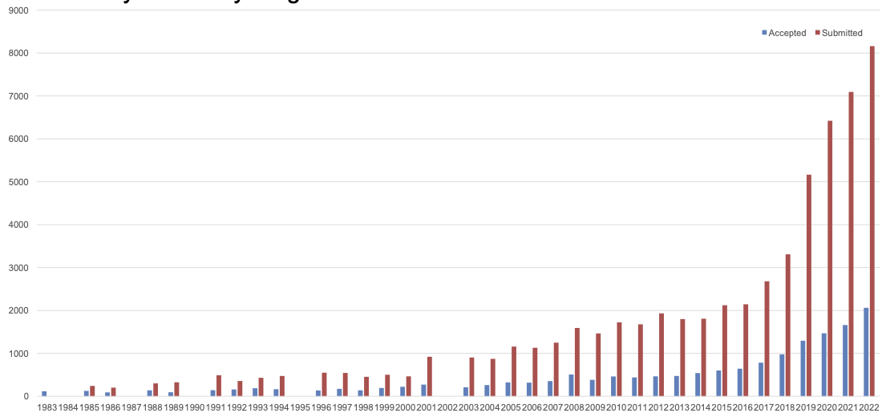
Growth of the field: CVPR papers
More accepted papers in 2022 than submitted papers in 2012!
Source: L. Lazebnik
Source: CVPR 2022 opening sides

Slide 34
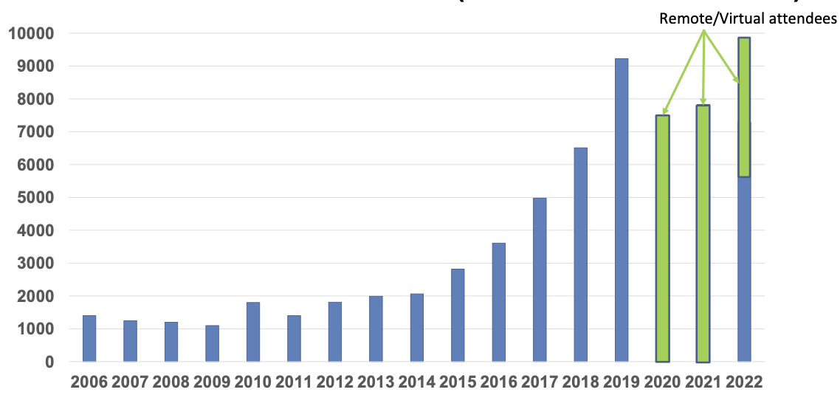
Growth of the field: CVPR attendance
Source: L. Lazebnik
Source: CVPR 2022 opening sides

Slide 35
Course overview
Early vision: Image formation and processing
Mid-level vision: Grouping and fitting
Multi-view geometry
Recognition
Additional topics

Slide 36


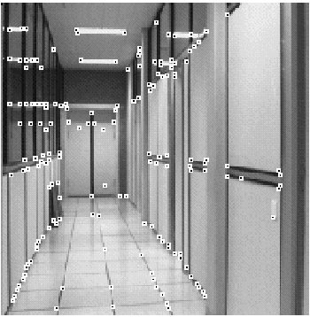
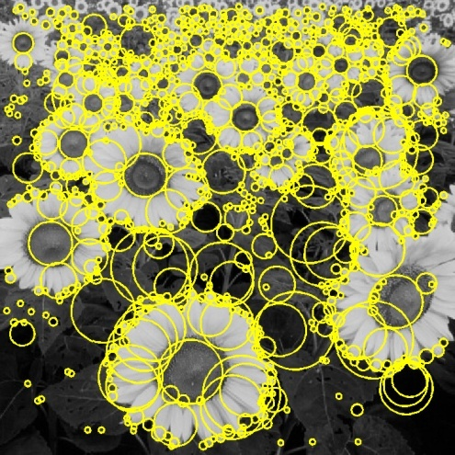
I. Early vision
Basic image formation and processing
*
=
Linear filtering
Edge detection
Cameras and sensors
Light and color
Feature extraction
Optical flow
Source: L. Lazebnik

Slide 37
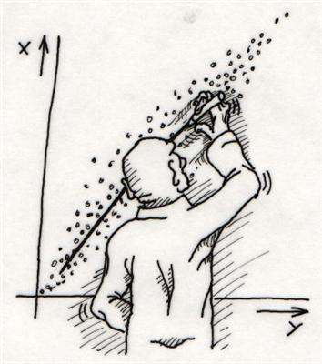
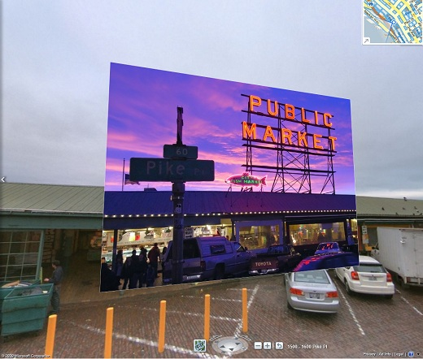
II. “Mid-level vision”
Fitting and grouping
Fitting: Least squares
Voting methods
Alignment
Source: L. Lazebnik

Slide 38
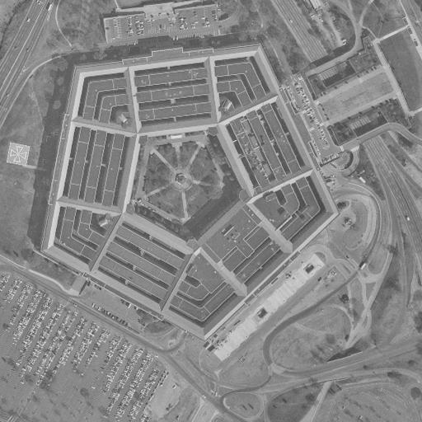
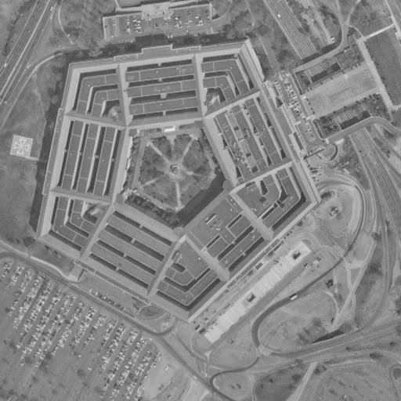
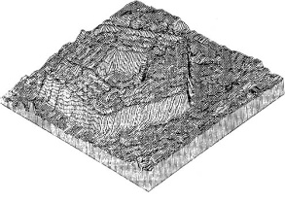
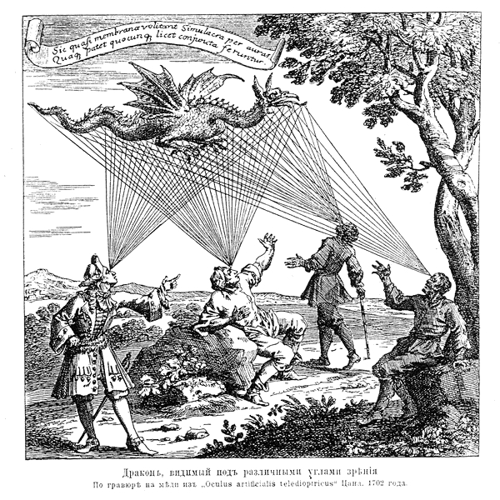

III. Multi-view geometry
Epipolar geometry
Two-view stereo
Structure from motion
Multi-view stereo
Source: L. Lazebnik

Slide 39
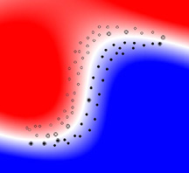
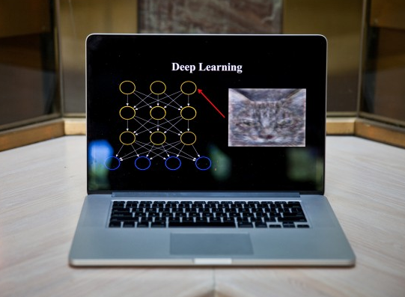
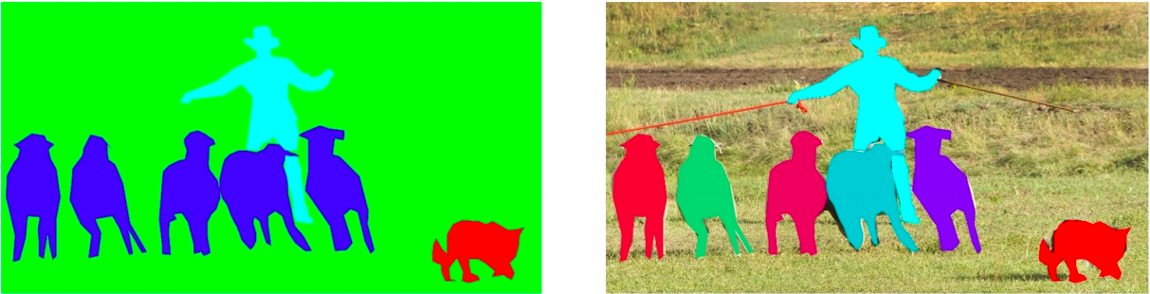
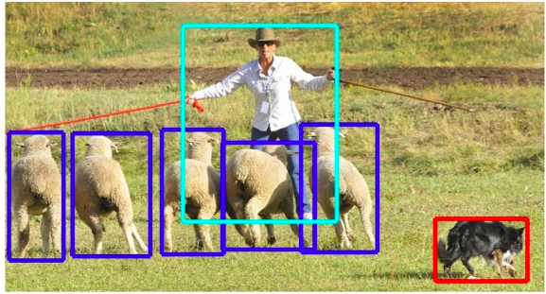
IV. Recognition
Basic classification
Deep learning
Object detection
Source: L. Lazebnik
Segmentation

Slide 40
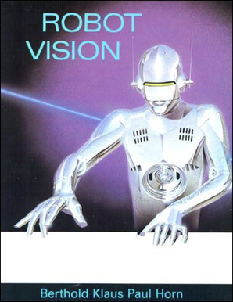


V. Additional Topics (time permitting)
Video
Generation
Vision and Robotics
Bias and Ethical Considerations
Source: L. Lazebnik

Slide 41



Logistics
Course TAs
Class website: http://saurabhg.web.illinois.edu/teaching/ece549/sp2023/
Shaowei Liu
Jiachen Li
Viraj Shah

