Slide 1
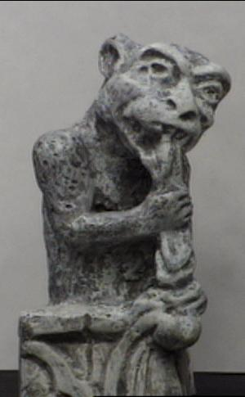
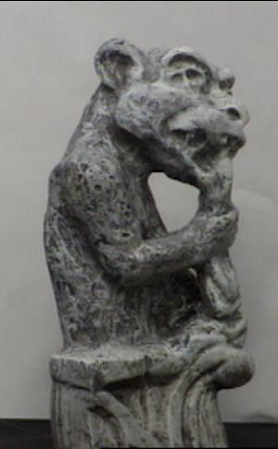
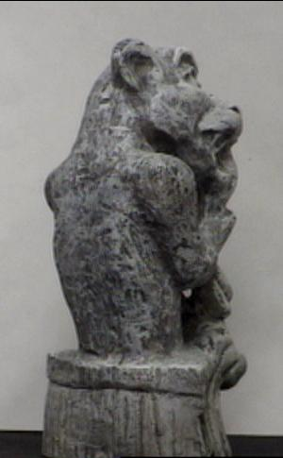
Multi-view geometry
Slides from L. Lazebnik

Slide 2
Structure from motion
Camera 1
Camera 3
R₁,t₁
Camera 2
R₃,t₃
R₂,t₂
Figure credit: Noah Snavely
Notes:
Structure from motion solves the following problem:
Given a set of images of a static scene with 2D points in correspondence, shown here as color-coded points, find…
a set of 3D points P and
a rotation R and position t of the cameras that explain the observed correspondences. In other words, when we project a point into any of the cameras, the reprojection error between the projected and observed 2D points is low.
This problem can be formulated as an optimization problem where we want to find the rotations R, positions t, and 3D point locations P that minimize sum of squared reprojection errors f. This is a non-linear least squares problem and can be solved with algorithms such as Levenberg-Marquart. However, because the problem is non-linear, it can be susceptible to local minima. Therefore, it’s important to initialize the parameters of the system carefully. In addition, we need to be able to deal with erroneous correspondences.

Slide 3
Structure from motion
?
Camera 1
Camera 3
R₁,t₁
Camera 2
R₃,t₃
R₂,t₂
Structure: Given known cameras and projections of the same 3D point in two or more images, compute the 3D coordinates of that point
Notes:
Structure from motion solves the following problem:
Given a set of images of a static scene with 2D points in correspondence, shown here as color-coded points, find…
a set of 3D points P and
a rotation R and position t of the cameras that explain the observed correspondences. In other words, when we project a point into any of the cameras, the reprojection error between the projected and observed 2D points is low.
This problem can be formulated as an optimization problem where we want to find the rotations R, positions t, and 3D point locations P that minimize sum of squared reprojection errors f. This is a non-linear least squares problem and can be solved with algorithms such as Levenberg-Marquart. However, because the problem is non-linear, it can be susceptible to local minima. Therefore, it’s important to initialize the parameters of the system carefully. In addition, we need to be able to deal with erroneous correspondences.

Slide 4
Structure from motion
Camera 1
?
Camera 3
R₁,t₁
Camera 2
?
?
R₂,t₂
R₃,t₃
Motion: Given a set of known 3D points seen by a camera, compute the camera parameters
Notes:
Structure from motion solves the following problem:
Given a set of images of a static scene with 2D points in correspondence, shown here as color-coded points, find…
a set of 3D points P and
a rotation R and position t of the cameras that explain the observed correspondences. In other words, when we project a point into any of the cameras, the reprojection error between the projected and observed 2D points is low.
This problem can be formulated as an optimization problem where we want to find the rotations R, positions t, and 3D point locations P that minimize sum of squared reprojection errors f. This is a non-linear least squares problem and can be solved with algorithms such as Levenberg-Marquart. However, because the problem is non-linear, it can be susceptible to local minima. Therefore, it’s important to initialize the parameters of the system carefully. In addition, we need to be able to deal with erroneous correspondences.

Slide 5
Structure from motion
Camera 1
?
R₁,t₁
Camera 2
?
R₂,t₂
Bootstrapping the process: Given a set of 2D point correspondences in two images, compute the camera parameters
Notes:
Structure from motion solves the following problem:
Given a set of images of a static scene with 2D points in correspondence, shown here as color-coded points, find…
a set of 3D points P and
a rotation R and position t of the cameras that explain the observed correspondences. In other words, when we project a point into any of the cameras, the reprojection error between the projected and observed 2D points is low.
This problem can be formulated as an optimization problem where we want to find the rotations R, positions t, and 3D point locations P that minimize sum of squared reprojection errors f. This is a non-linear least squares problem and can be solved with algorithms such as Levenberg-Marquart. However, because the problem is non-linear, it can be susceptible to local minima. Therefore, it’s important to initialize the parameters of the system carefully. In addition, we need to be able to deal with erroneous correspondences.

Slide 6


Two-view geometry

Slide 7

Epipolar geometry
X
x
x’
Baseline – line connecting the two camera centers
Epipolar Plane – plane containing baseline (1D family)
Epipoles
= intersections of baseline with image planes
= projections of the other camera center
= vanishing points of the motion direction

Slide 8
Epipolar geometry
X
x
x’
Baseline – line connecting the two camera centers
Epipolar Plane – plane containing baseline (1D family)
Epipoles
= intersections of baseline with image planes
= projections of the other camera center
= vanishing points of the motion direction
Epipolar Lines - intersections of epipolar plane with image
planes (always come in corresponding pairs)

Slide 9

Example 1
Converging cameras

Slide 10



Example 2
Motion parallel to the image plane

Slide 11
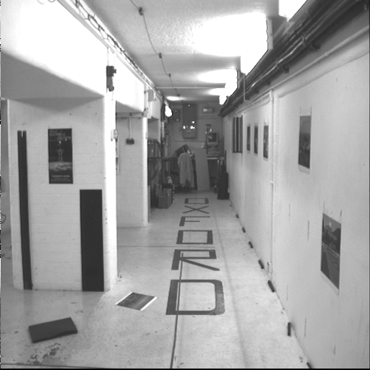
Example 3

Slide 12
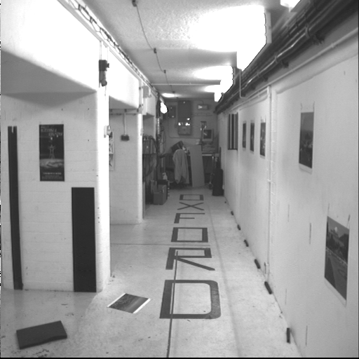
Example 3
Motion is perpendicular to the image plane
Epipole is the “focus of expansion” and the principal point

Slide 13
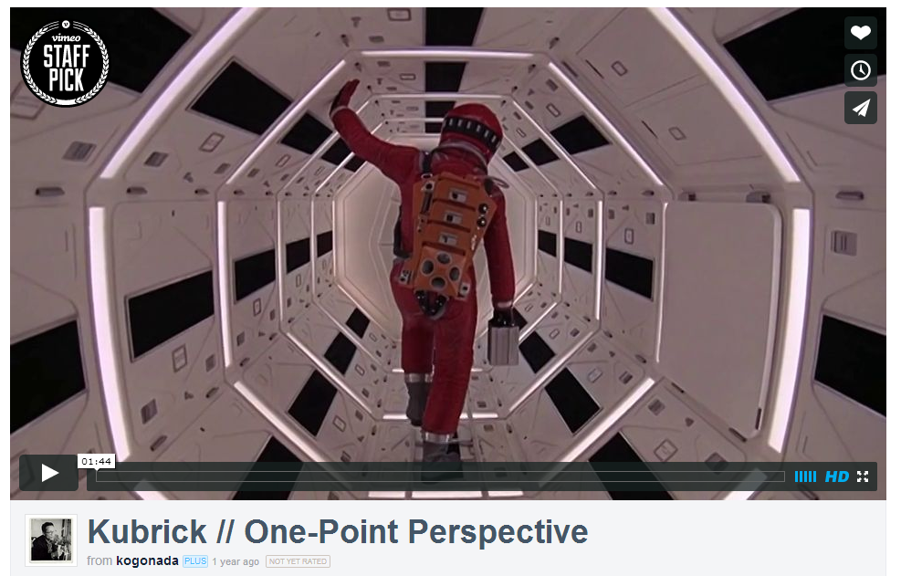
Motion perpendicular to image plane
http://vimeo.com/48425421

Slide 14

Epipolar constraint
X
x
x’
If we observe a point x in one image, where can the corresponding point x’ be in the other image?

Slide 15
Epipolar constraint
X
X
X
x
x’
x’
x’
Potential matches for x have to lie on the corresponding
epipolar line l’.
Potential matches for x’ have to lie on the corresponding
epipolar line l.

Slide 16
Epipolar constraint example

Slide 17
Epipolar constraint: Calibrated case
X
x
x’

Slide 18


Epipolar constraint: Calibrated case
X
x
x’
Intrinsic and extrinsic parameters of the cameras are known, world coordinate system is set to that of the first camera
Then the projection matrices are given by K[I | 0] and K’[R | t]
We can multiply the projection matrices (and the image points) by the inverse of the calibration matrices to get normalized image coordinates:
$$x_{norm}=K^{−1}x_{pixel}=\left[I 0\right]X$$
$${x′}_{norm}={K′}^{−1}{x′}_{pixel}=\left[R t\right]X$$

Slide 19
Epipolar constraint: Calibrated case
Derivation
X
x
x’

Slide 20
Epipolar constraint: Calibrated case
Derivation
X
x
x’

Slide 21

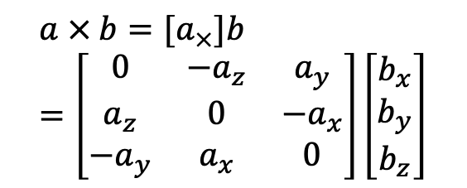



Epipolar constraint: Calibrated case
X
= (x,1)^{T}
x
x’
$$x′$$
$$Rx$$
t
$$t$$
R
Recall:
$$a × b=[a_{×}]b=\left[\begin{matrix}0 & −a_{z} & a_{y} \\ a_{z} & 0 & −a_{x} \\ −a_{y} & a_{x} & 0\end{matrix}\right]\left[\begin{matrix}b_{x} \\ b_{y} \\ b_{z}\end{matrix}\right]$$
The vectors $Rx$, $t$, and $x′$ are coplanar
Notes:
X’ is X in the second camera’s coordinate system
We can identify the non-homogeneous 3D vectors X and X’ with the homogeneous coordinate vectors x and x’ of the projections of the two points into the two respective images

Slide 22



Epipolar constraint: Calibrated case
Simplification
X
= (x,1)^{T}
x
x’
$$x′$$
$$Rx$$
t
$$t$$
R
Recall:
$$a × b=[a_{×}]b=\left[\begin{matrix}0 & −a_{z} & a_{y} \\ a_{z} & 0 & −a_{x} \\ −a_{y} & a_{x} & 0\end{matrix}\right]\left[\begin{matrix}b_{x} \\ b_{y} \\ b_{z}\end{matrix}\right]$$
$$x^{′}.\left[t×\left(Rx\right)\right]=0$$
$$x^{′T}Ex=0$$
$$x^{′}. \left[t_{×}\right]Rx=0$$
The vectors $Rx$, $t$, and $x′$ are coplanar
Notes:
X’ is X in the second camera’s coordinate system
We can identify the non-homogeneous 3D vectors X and X’ with the homogeneous coordinate vectors x and x’ of the projections of the two points into the two respective images

Slide 23



Epipolar constraint: Calibrated case
X
= (x,1)^{T}
x
x’
$$x′$$
$$Rx$$
$$t$$
$$x^{′}⋅\left[t ×\left(Rx\right)\right]=0$$
$$x^{′T}\left[t_{×}\right]Rx=0$$
$$x^{′T}Ex=0$$
Essential Matrix
(Longuet-Higgins, 1981)
The vectors $Rx$, $t$, and $x′$ are coplanar
Notes:
X’ is X in the second camera’s coordinate system
We can identify the non-homogeneous 3D vectors X and X’ with the homogeneous coordinate vectors x and x’ of the projections of the two points into the two respective images

Slide 24
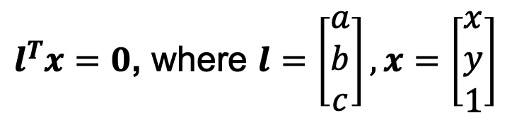

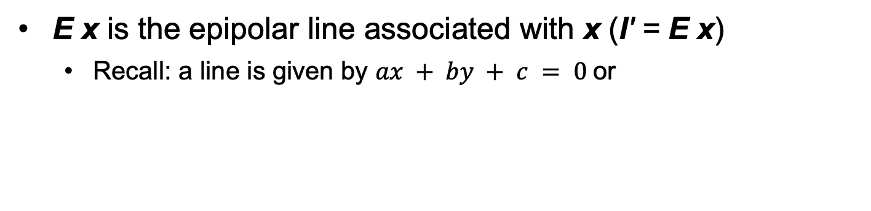
Epipolar constraint: Calibrated case
X
x
x’
$$x^{′T}Ex=0$$
E x is the epipolar line associated with x (l' = E x)
  Recall: a line is given by $ax + by + c = 0$or
$l^{T}x=0$, where $l=\left[\begin{matrix}a \\ b \\ c\end{matrix}\right], x=\left[\begin{matrix}x \\ y \\ 1\end{matrix}\right]$

Slide 25
Epipolar constraint: Calibrated case
X
x
x’
$$x^{′T}Ex=0$$
E x is the epipolar line associated with x (l' = E x)
E^{T}x' is the epipolar line associated with x' (l = E^{T}x')
E e = 0 and E^{T}e' = 0
E is singular (rank two)
E has five degrees of freedom

Slide 26
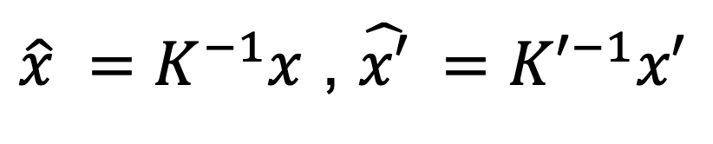
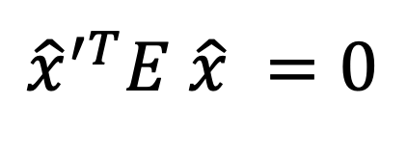
Epipolar constraint: Uncalibrated case
X
x
x’
The calibration matrices K and K’ of the two cameras are unknown
We can write the epipolar constraint in terms of unknown normalized coordinates:
$${\hat{x}}^{′T}E \hat{x} =0$$
$\hat{x} =K^{−1}x$ , $\hat{x′} ={K′}^{−1}x′$

Slide 27
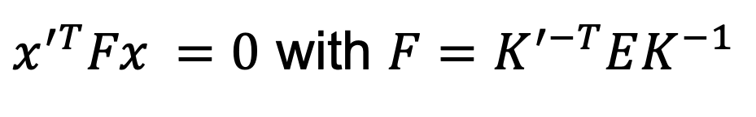
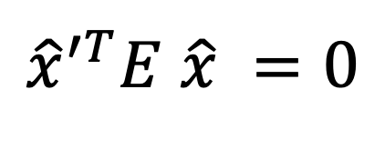
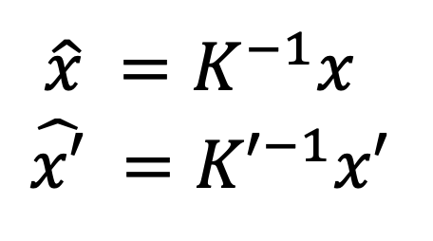
Epipolar constraint: Uncalibrated case
X
x
x’
$${\hat{x}}^{′T}E \hat{x} =0$$
$x^{′T}Fx =0$ with $F=K^{′−T}EK^{−1}$
$\hat{x} =K^{−1}x$
$$\hat{x′} ={K′}^{−1}x′$$
Fundamental Matrix
(Faugeras and Luong, 1992)

Slide 28
Epipolar constraint: Uncalibrated case
X
x
x’
$${\hat{x}}^{′T}E \hat{x} =0$$
$x^{′T}Fx =0$ with $F=K^{′−T}EK^{−1}$
F x is the epipolar line associated with x (l' = F x)
F^{T}x' is the epipolar line associated with x' (l = F^{T}x')
F e = 0 and F^{T}e' = 0
F is singular (rank two)
F has seven degrees of freedom

Slide 29
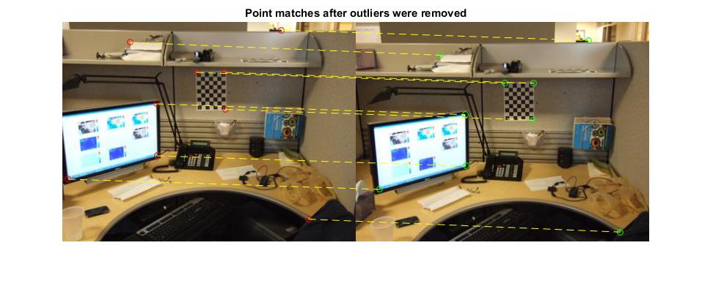
Estimating the fundamental matrix

Slide 30
The eight-point algorithm

Slide 31
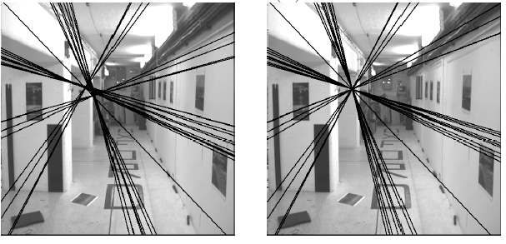
The eight-point algorithm
Solve homogeneous linear system using eight or more matches
Enforce rank-2 constraint (take SVD
of F and throw out the smallest singular value)

Slide 32
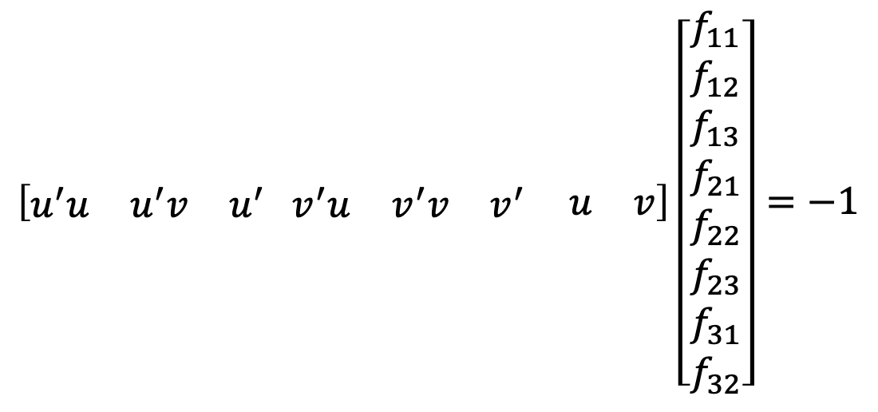
Problem with eight-point algorithm
$$\left[\begin{matrix}u^{′}u & u^{′}v & u^{′}\end{matrix} \begin{matrix}v^{′}u & v^{′}v & v^{′} \begin{matrix} u & v\end{matrix}\end{matrix}\right]\left[\begin{aligned}f_{11} \\ f_{12} \\ f_{13} \\ f_{21} \\ f_{22} \\ f_{23} \\ f_{31} \\ f_{32}\end{aligned}\right]=−1$$

Slide 33
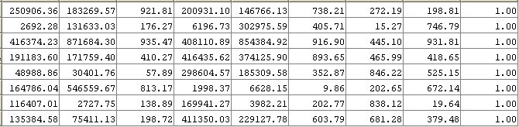
Problem with eight-point algorithm
$$\left[\begin{matrix}u^{′}u & u^{′}v & u^{′}\end{matrix} \begin{matrix}v^{′}u & v^{′}v & v^{′} \begin{matrix} u & v\end{matrix}\end{matrix}\right]\left[\begin{aligned}f_{11} \\ f_{12} \\ f_{13} \\ f_{21} \\ f_{22} \\ f_{23} \\ f_{31} \\ f_{32}\end{aligned}\right]=−1$$
Poor numerical conditioning
Can be fixed by rescaling the data

Slide 34
The normalized eight-point algorithm
(Hartley, 1995)
Center the image data at the origin, and scale it so the mean squared distance between the origin and the data points is 2 pixels
Use the eight-point algorithm to compute F from the normalized points
Enforce the rank-2 constraint (for example, take SVD of F and throw out the smallest singular value)
Transform fundamental matrix back to original units: if T and T’ are the normalizing transformations in the two images, than the fundamental matrix in original coordinates is T’^{T} F T

Slide 35
Seven-point algorithm
Set up least squares system with seven pairs of correspondences and solve for null space (two vectors) using SVD
Solve for linear combination of null space vectors that satisfies det(F)=0
Source: D. Hoiem

Slide 36
Nonlinear estimation
Linear estimation minimizes the sum of squared algebraic distances between points x’_{i} and epipolar lines F x_{i} (or points x_{i} and epipolar lines F^{T}x’_{i}):
Nonlinear approach: minimize sum of squared geometric distances
x_{i}

Slide 37

Comparison of estimation algorithms
 | 8-point | Normalized 8-point | Nonlinear least squares
Av. Dist. 1 | 2.33 pixels | 0.92 pixel | 0.86 pixel
Av. Dist. 2 | 2.18 pixels | 0.85 pixel | 0.80 pixel

Slide 38
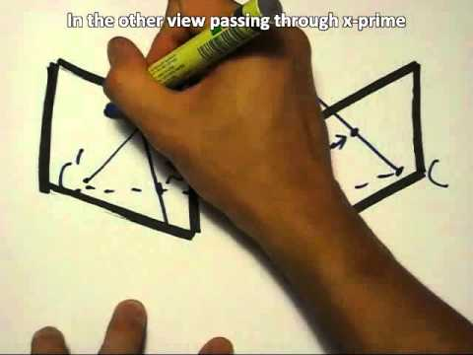
The Fundamental Matrix Song
http://danielwedge.com/fmatrix/

Slide 39
From epipolar geometry to camera calibration
Estimating the fundamental matrix is known as “weak calibration”
If we know the calibration matrices of the two cameras, we can estimate the essential matrix: E = K’^{T}FK
The essential matrix gives us the relative rotation and translation between the cameras, or their extrinsic parameters
Alternatively, if the calibration matrices are known, the five-point algorithm can be used to estimate relative camera pose

Slide 40
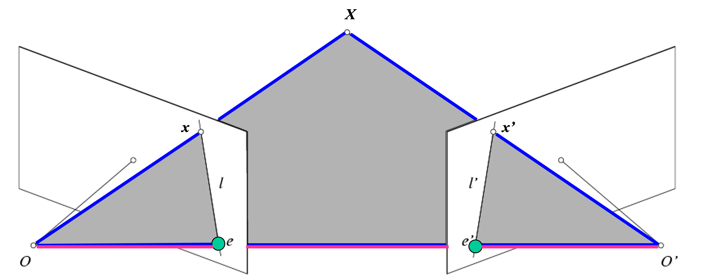
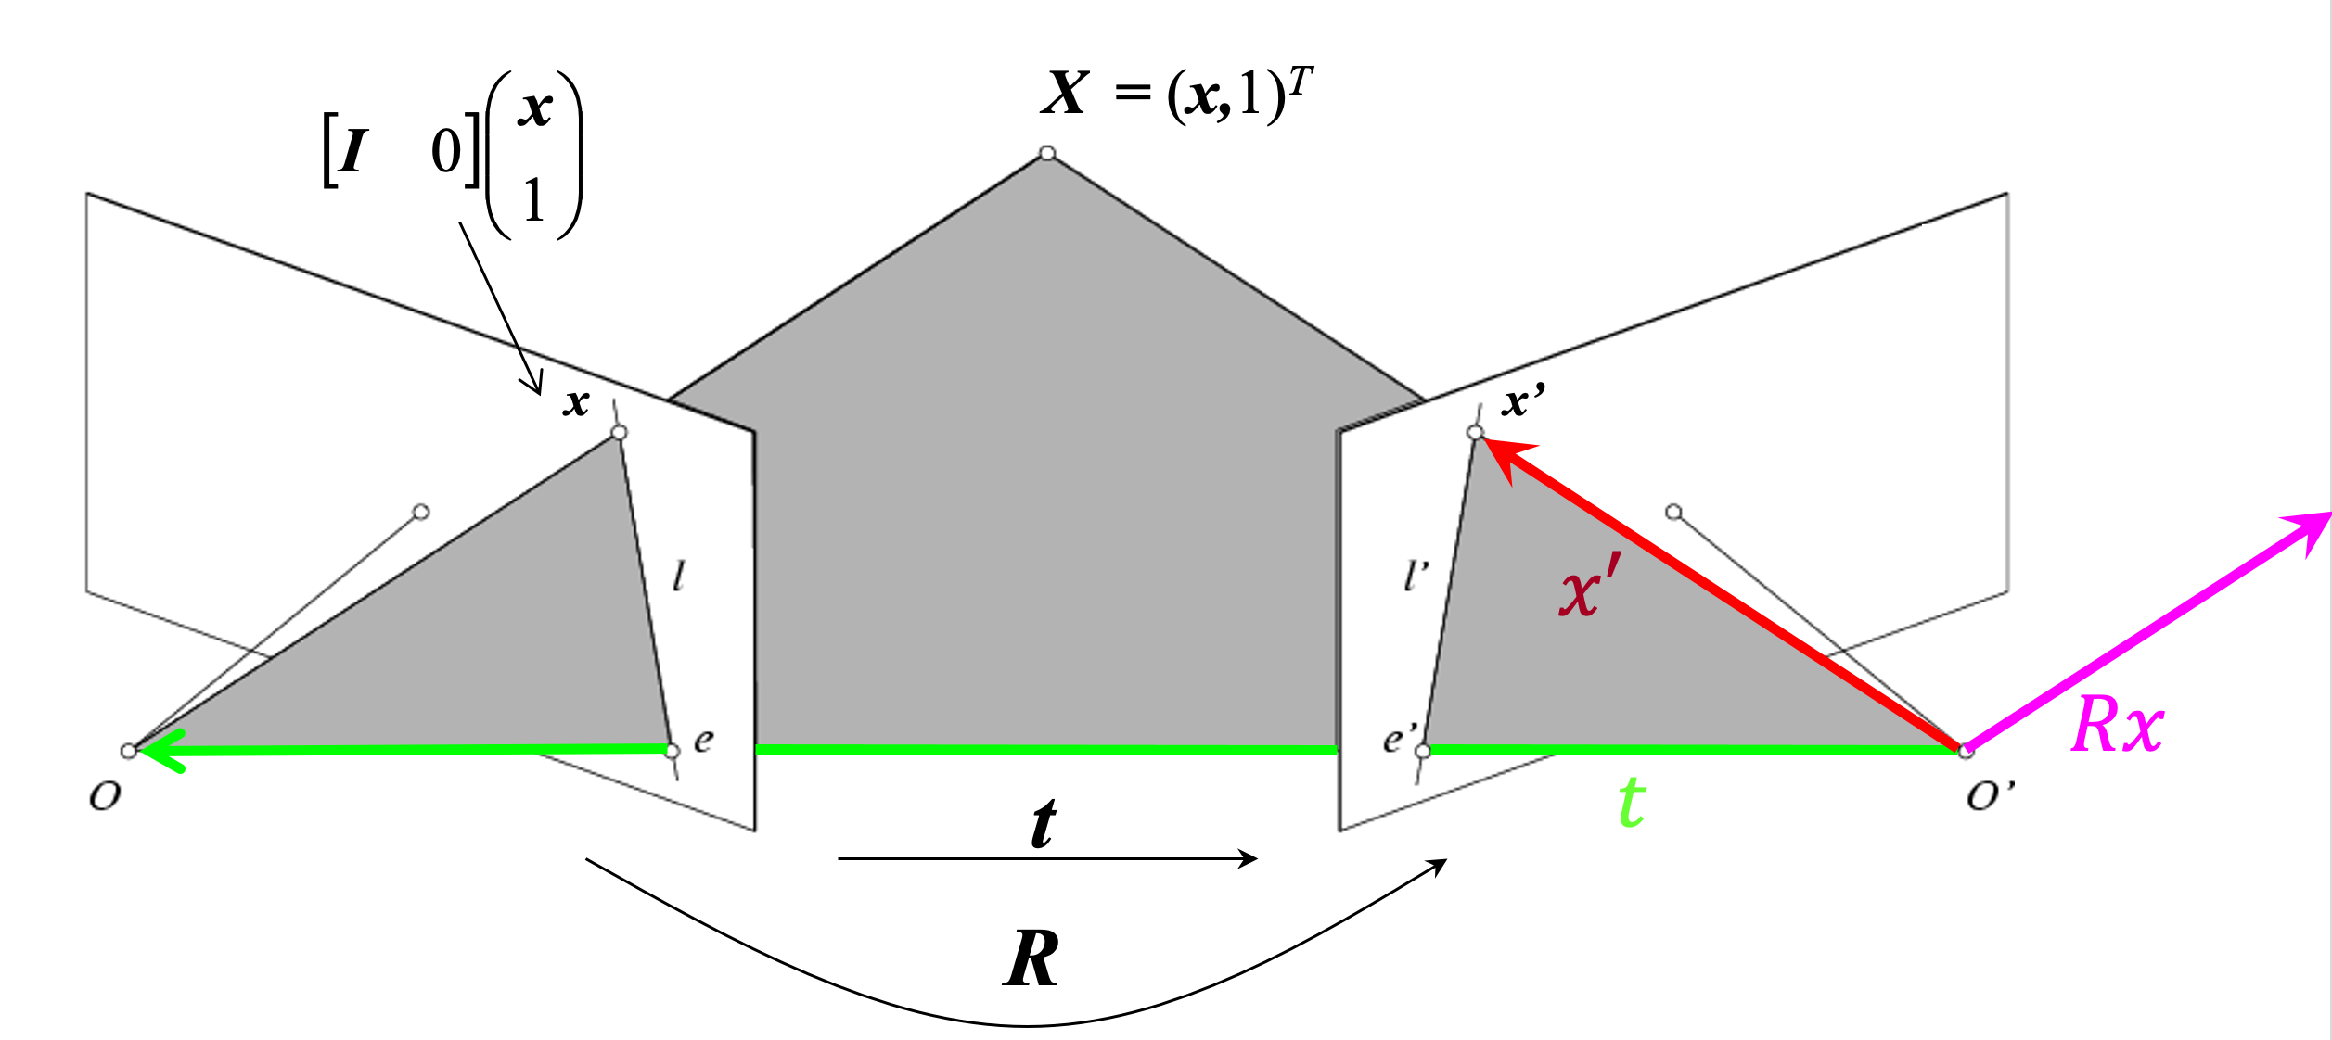


Recap (Two-view Geometry)
Epipolar geometry terminology
Derived the Epipolar constraint
$$x^{′T}Ex=x^{′T}\left[t_{×}\right]Rx=0$$
$x^{′T}Fx =0$ with $F=K^{′−T}EK^{−1}$
Essential Matrix
Fundamental Matrix
Properties of Essential and Fundamental Matrix
Estimation of Fundamental Matrix from point correspondences

Slide 41
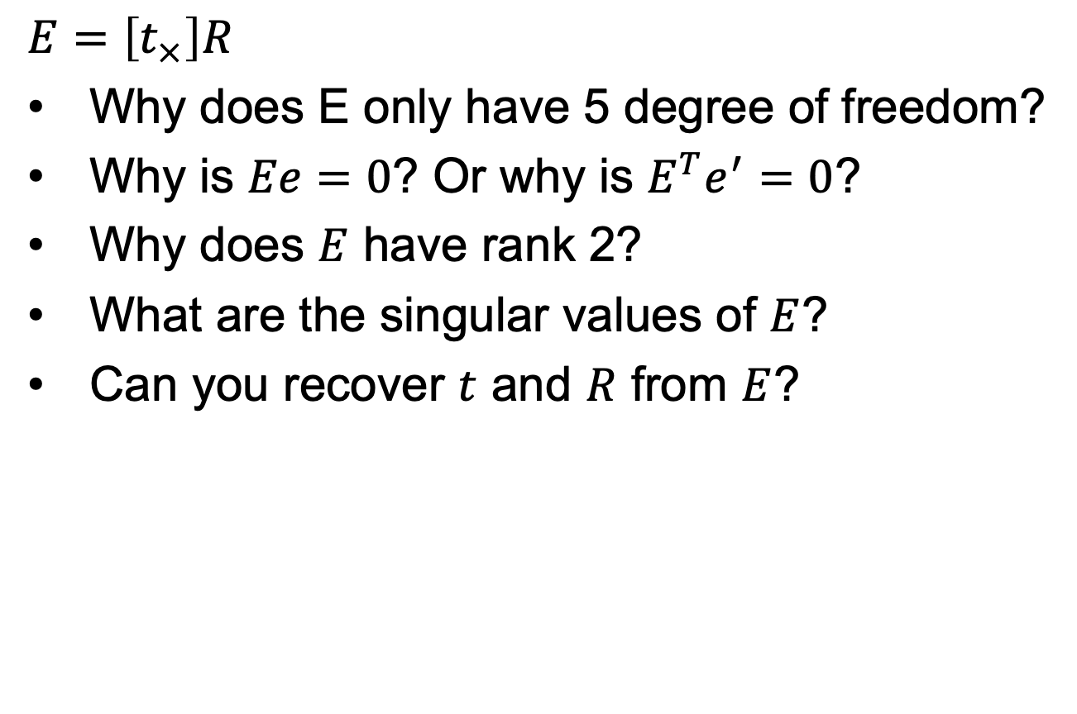
Questions?
$$E=\left[t_{×}\right]R$$
Why does E only have 5 degree of freedom?
Why is $Ee=0$? Or why is $E^{T}e^{′}=0$?
Why does $E$ have rank 2?
What are the singular values of $E$?
Can you recover $t$ and $R$ from $E$?

Slide 42
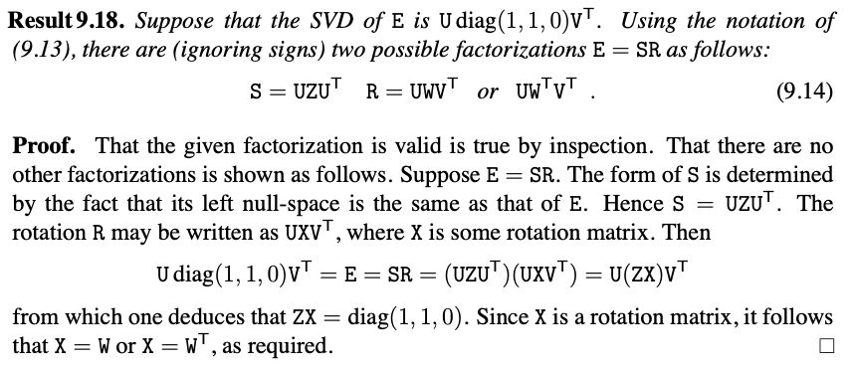
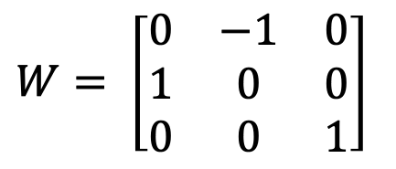
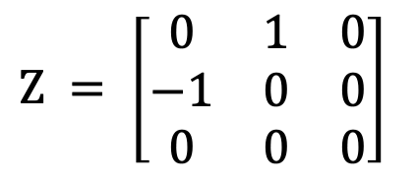
Translation and Rotation from E
$$W= \left[\begin{matrix}0 & −1 & 0 \\ 1 & 0 & 0 \\ 0 & 0 & 1\end{matrix}\right]$$
$$Z = \left[\begin{matrix}0 & 1 & 0 \\ −1 & 0 & 0 \\ 0 & 0 & 0\end{matrix}\right]$$
Source: Hartley and Zisserman

