Slide 1
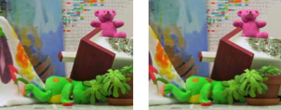

Two-View Stereo
Slides from S. Lazebnik, S. Seitz, Y. Furukawa

Slide 2
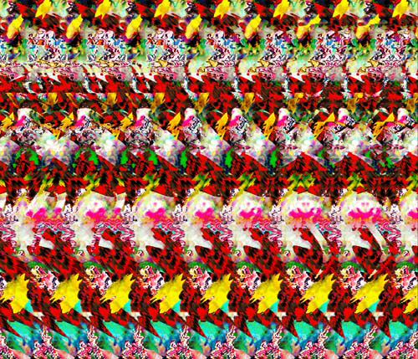
What do you see in this image?
Autostereograms: www.magiceye.com
Slide from L. Lazebnik.

Slide 3
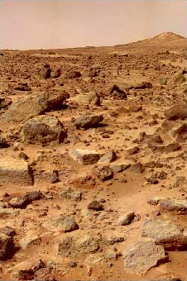
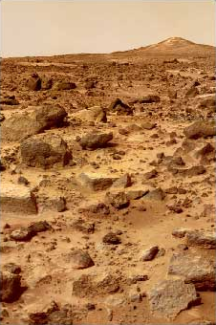
Stereo
What cues tell us about scene depth?
Slide from L. Lazebnik.

Slide 4
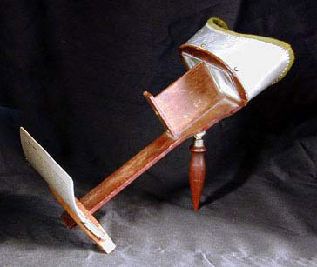
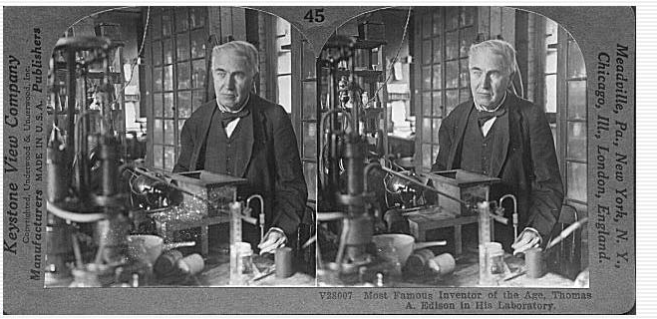
Stereograms
Humans can fuse pairs of images to get a sensation of depth
Stereograms: Invented by Sir Charles Wheatstone, 1838
Slide from L. Lazebnik.

Slide 5
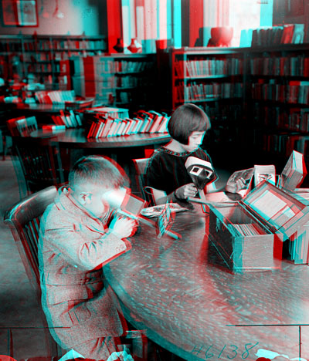
Stereograms
Slide from L. Lazebnik.

Slide 6
Stereograms
Humans can fuse pairs of images to get a sensation of depth
Autostereograms: www.magiceye.com
Slide from L. Lazebnik.

Slide 7
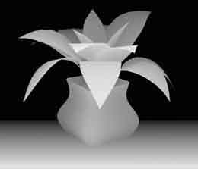
Stereograms
Humans can fuse pairs of images to get a sensation of depth
Autostereograms: www.magiceye.com
Slide from L. Lazebnik.

Slide 8



Problem formulation
Given a calibrated binocular stereo pair, fuse it to produce a depth image
image 1
image 2
Dense depth map
Slide from L. Lazebnik.

Slide 9

Basic stereo matching algorithm
For each pixel in the first image
  Find corresponding epipolar line in the right image
  Examine all pixels on the epipolar line and pick the best match
  Triangulate the matches to get depth information
Simplest case: epipolar lines are corresponding scanlines
  When does this happen?
Slide from L. Lazebnik.

Slide 10
Simplest Case: Parallel images
Image planes of cameras are parallel to each other and to the baseline
Camera centers are at same height
Focal lengths are the same
Slide from L. Lazebnik.

Slide 11
Simplest Case: Parallel images
Image planes of cameras are parallel to each other and to the baseline
Camera centers are at same height
Focal lengths are the same
Then epipolar lines fall along the horizontal scan lines of the images
Slide from L. Lazebnik.

Slide 12
Essential matrix for parallel images
Epipolar constraint:
R = I t = (T, 0, 0)
x
x’
t
The y-coordinates of corresponding points are the same!

Slide 13
Stereo image rectification
Slide from L. Lazebnik.

Slide 14
Stereo image rectification
Reproject image planes onto a common
plane parallel to the line between optical centers
C. Loop and Z. Zhang. Computing Rectifying Homographies for Stereo Vision. CVPR 1999
Slide from L. Lazebnik.

Slide 15
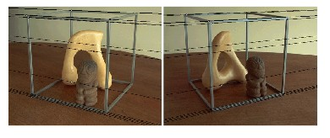
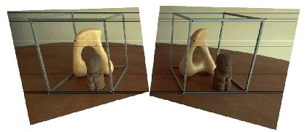
Rectification example
Slide from L. Lazebnik.

Slide 16
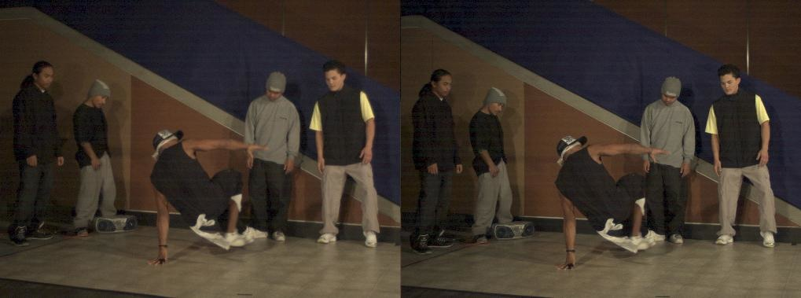
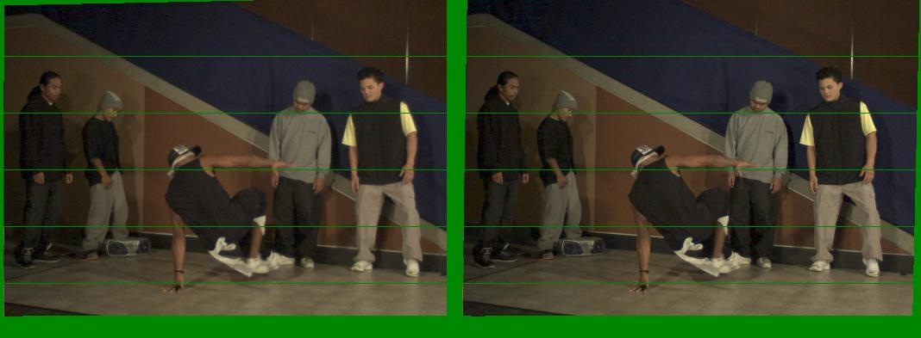
Another rectification example
Unrectified
Rectified
Slide from L. Lazebnik.

Slide 17
Basic stereo matching algorithm
If necessary, rectify the two stereo images to transform epipolar lines into scanlines
For each pixel in the first image
  Find corresponding epipolar line in the right image
  Examine all pixels on the epipolar line and pick the best match
Slide from L. Lazebnik.

Slide 18


Correspondence search
Left
Right
scanline
Matching cost
disparity
Slide a window along the right scanline and compare contents of that window with the reference window in the left image
Matching cost: SSD or normalized correlation
Slide from L. Lazebnik.

Slide 19
Correspondence search
Left
Right
scanline
SSD
Slide from L. Lazebnik.

Slide 20
Correspondence search
Left
Right
scanline
Norm. corr
Slide from L. Lazebnik.

Slide 21
Basic stereo matching algorithm
If necessary, rectify the two stereo images to transform epipolar lines into scanlines
For each pixel x in the first image
  Find corresponding epipolar scanline in the right image
  Examine all pixels on the scanline and pick the best match x’
  Triangulate the matches to get depth information
Slide from L. Lazebnik.

Slide 22
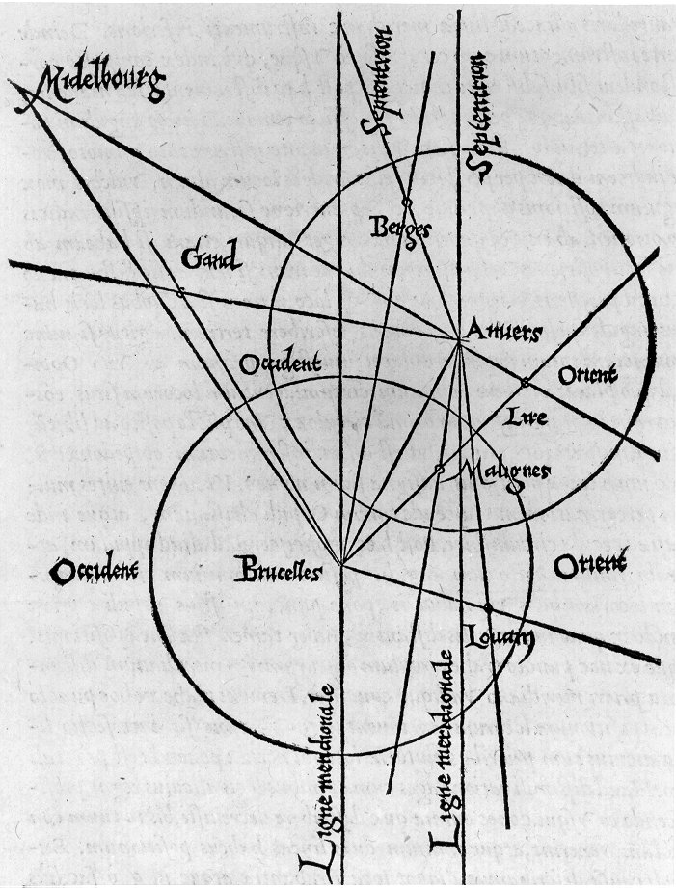
Triangulation: History
From Wikipedia: Gemma Frisius's 1533 diagram introducing the idea of triangulation into the science of surveying. Having established a baseline, e.g. the cities of Brussels and Antwerp, the location of other cities, e.g. Middelburg, Ghent etc., can be found by taking a compass direction from each end of the baseline, and plotting where the two directions cross. This was only a theoretical presentation of the concept — due to topographical restrictions, it is impossible to see Middelburg from either Brussels or Antwerp. Nevertheless, the figure soon became well known all across Europe.
Slide from L. Lazebnik.

Slide 23
Depth from disparity
X
z
x
x’
f
B₁
B₂
f
O
Baseline
B
O’
Disparity is inversely proportional to depth!
Slide from L. Lazebnik.

Slide 24
Depth from disparity
X
z
x
x’
f
B
f
O
O’
B₁
B₂
Slide from L. Lazebnik.

Slide 25
Basic stereo matching algorithm
If necessary, rectify the two stereo images to transform epipolar lines into scanlines
For each pixel x in the first image
  Find corresponding epipolar scanline in the right image
  Examine all pixels on the scanline and pick the best match x’
  Compute disparity x–x’ and set depth(x) = B*f/(x–x’)
Slide from L. Lazebnik.

Slide 26


Failures of correspondence search
Textureless surfaces
Occlusions, repetition
Non-Lambertian surfaces, specularities
Slide from L. Lazebnik.

Slide 27


Effect of window size
W = 3
W = 20
  Smaller window
    More detail
    More noise
  Larger window
    Smoother disparity maps
    Less detail
Slide from L. Lazebnik.
Notes:
smaller window: more detail, more noise
bigger window: less noise, more detail

Slide 28



Results with window search
Data
Window-based matching
Ground truth
Slide from L. Lazebnik.

Slide 29

Better methods exist...
Graph cuts
Ground truth
  Y. Boykov, O. Veksler, and R. Zabih, Fast Approximate Energy Minimization via Graph Cuts, PAMI 2001
    For the latest and greatest: http://www.middlebury.edu/stereo/
Slide from L. Lazebnik.

Slide 30
How can we improve window-based matching?
The similarity constraint is local (each reference window is matched independently)
Need to enforce non-local correspondence constraints
Slide from L. Lazebnik.

Slide 31
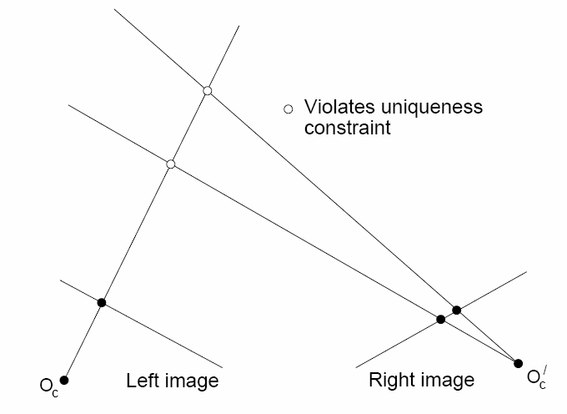
Non-local constraints
Uniqueness
  For any point in one image, there should be at most one matching point in the other image
Slide from L. Lazebnik.

Slide 32
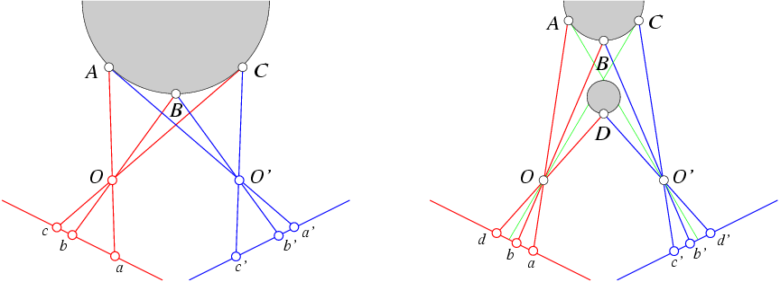
Non-local constraints
Uniqueness
  For any point in one image, there should be at most one matching point in the other image
Ordering
  Corresponding points should be in the same order in both views
Slide from L. Lazebnik.

Slide 33
Non-local constraints
Uniqueness
  For any point in one image, there should be at most one matching point in the other image
Ordering
  Corresponding points should be in the same order in both views
Slide from L. Lazebnik.
Ordering constraint doesn’t hold

Slide 34
Non-local constraints
Uniqueness
  For any point in one image, there should be at most one matching point in the other image
Ordering
  Corresponding points should be in the same order in both views
Smoothness
  We expect disparity values to change slowly (for the most part)
Slide from L. Lazebnik.

Slide 35
Scanline stereo
Try to coherently match pixels on the entire scanline
Different scanlines are still optimized independently
Left image
Right image
Slide from L. Lazebnik.

Slide 36
Stereo matching as global optimization
I₁
I₂
D
W₁(i )
W₂(i+D(i ))
D(i )
data term
smoothness term
Energy functions of this form can be minimized using graph cuts
  Y. Boykov, O. Veksler, and R. Zabih, Fast Approximate Energy Minimization via Graph Cuts, PAMI 2001
Slide from L. Lazebnik.

Slide 37
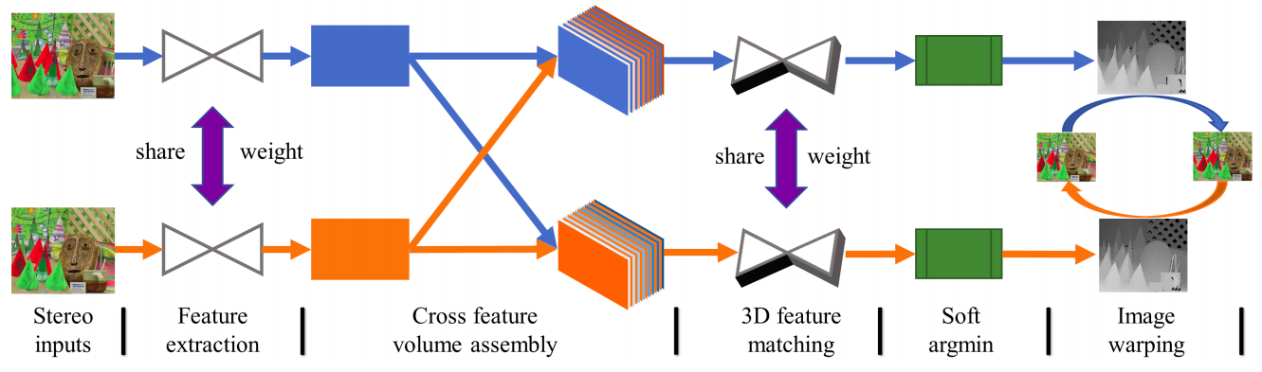
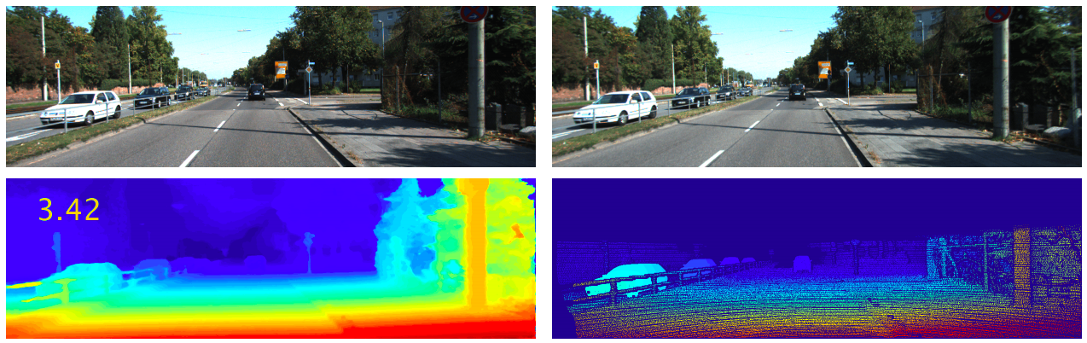
Stereo matching as a prediction problem
Y. Zhong, Y. Dai, and H. Li, Self-Supervised Learning for Stereo Matching with Self-Improving Ability, arXiv 2017
Slide from L. Lazebnik.

Slide 38
Review: Basic stereo matching algorithm
For each pixel x in the reference image
  Find corresponding epipolar scanline in the other image
  Examine all pixels on the scanline and pick the best match x’
  Compute disparity x–x’ and set depth(x) = B*f/(x–x’)
Slide from L. Lazebnik.

Slide 39
Depth from Triangulation
Camera 1
Camera 2
Camera
Projector
Passive Stereopsis
Active Stereopsis
Active sensing simplifies the problem of estimating point correspondences

Slide 40
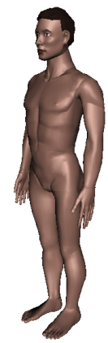
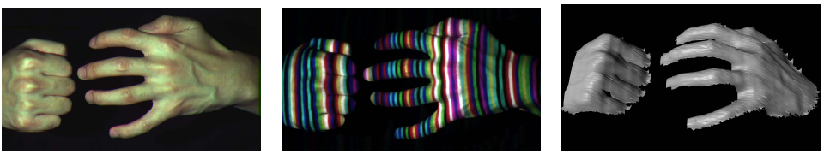
Active stereo with structured light
Project “structured” light patterns onto the object
  Simplifies the correspondence problem
  Allows us to use only one camera
camera
projector
L. Zhang, B. Curless, and S. M. Seitz. Rapid Shape Acquisition Using Color Structured Light and Multi-pass Dynamic Programming. 3DPVT 2002
Slide from L. Lazebnik.

Slide 41
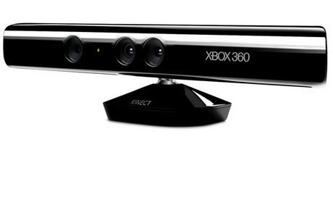
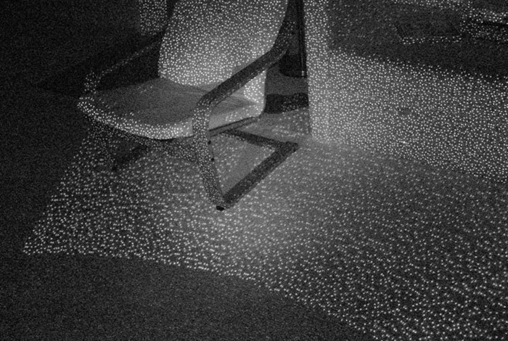
Kinect: Structured infrared light
http://bbzippo.wordpress.com/2010/11/28/kinect-in-infrared/
Slide from L. Lazebnik.

Slide 42
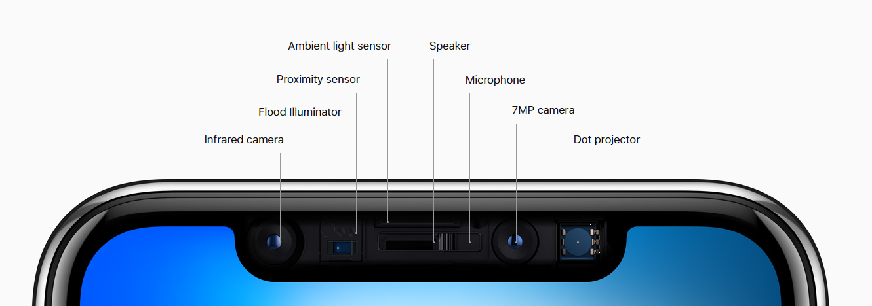
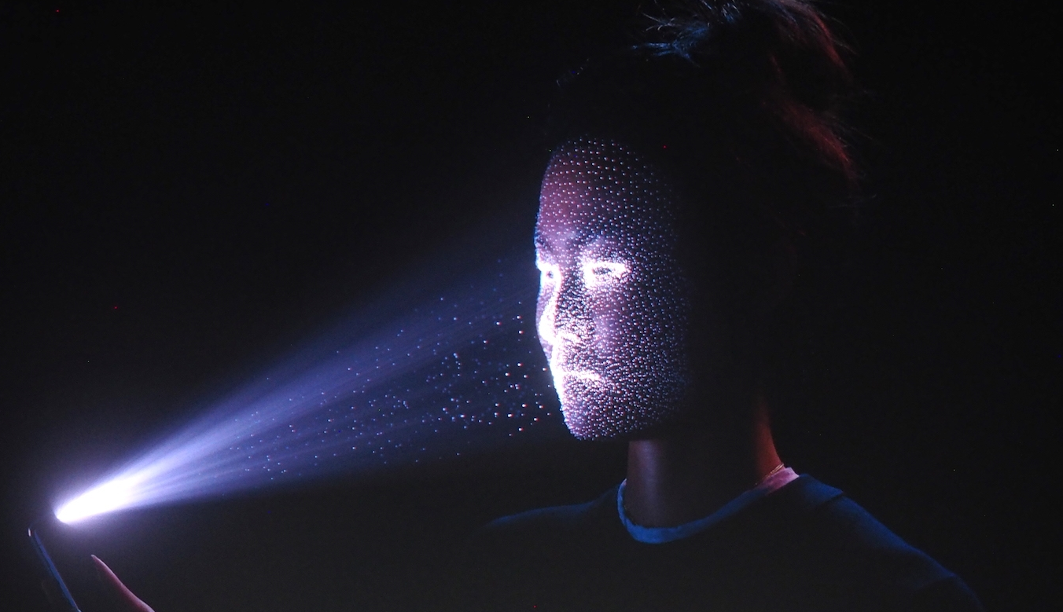
Apple TrueDepth
https://www.cnet.com/news/apple-face-id-truedepth-how-it-works/
Slide from L. Lazebnik.

Slide 43

Laser scanning
Digital Michelangelo Project
Levoy et al.
http://graphics.stanford.edu/projects/mich/
Optical triangulation
  Project a single stripe of laser light
  Scan it across the surface of the object
  This is a very precise version of structured light scanning
Source: S. Seitz

Slide 44
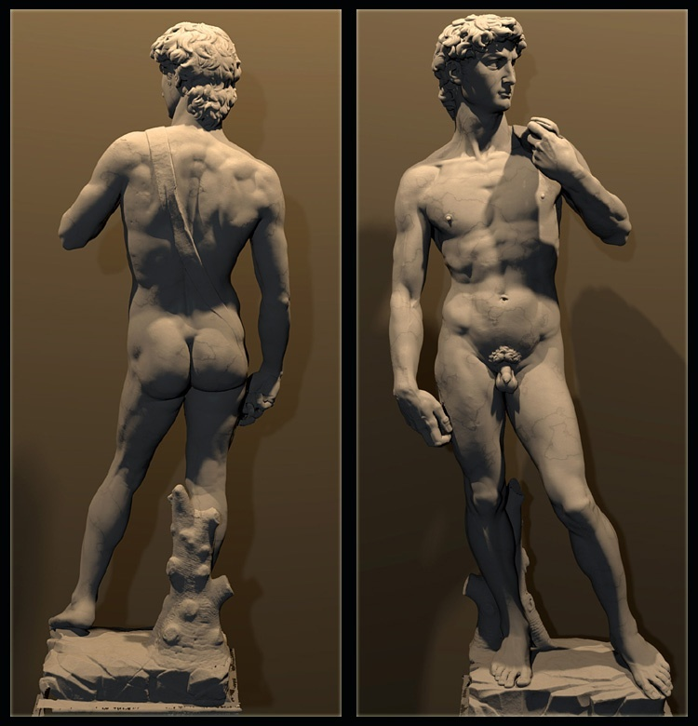
Laser scanned models
  The Digital Michelangelo Project, Levoy et al.
Source: S. Seitz

Slide 45
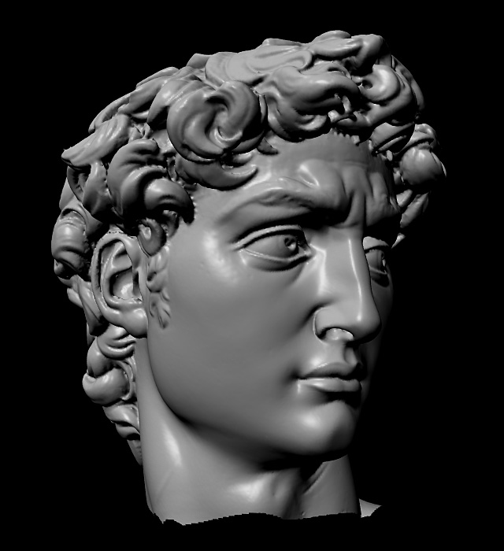
Laser scanned models
  The Digital Michelangelo Project, Levoy et al.
Source: S. Seitz

Slide 46
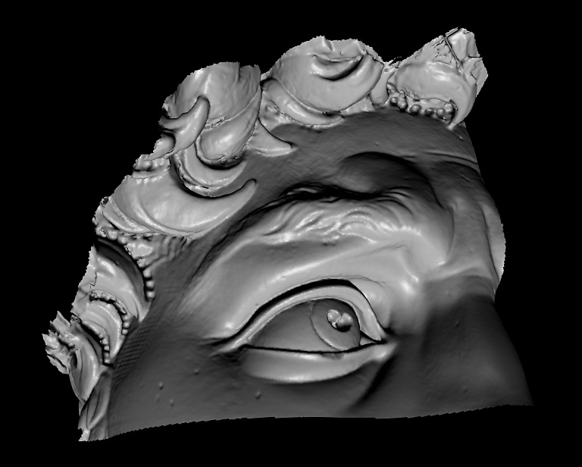
Laser scanned models
  The Digital Michelangelo Project, Levoy et al.
Source: S. Seitz

Slide 47
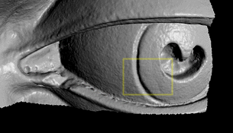
Laser scanned models
  The Digital Michelangelo Project, Levoy et al.
Source: S. Seitz

Slide 48
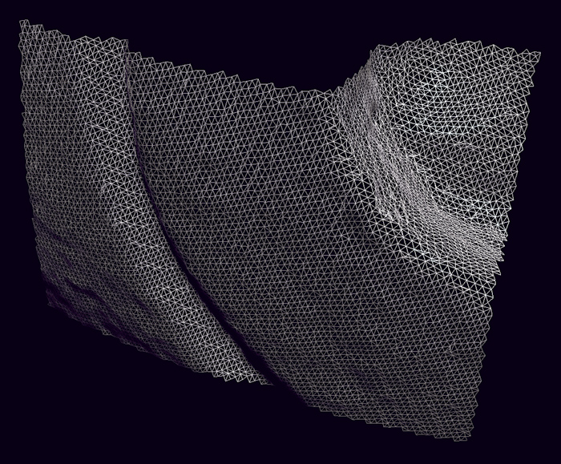
Laser scanned models
1.0 mm resolution (56 million triangles)
  The Digital Michelangelo Project, Levoy et al.
Source: S. Seitz

Slide 49
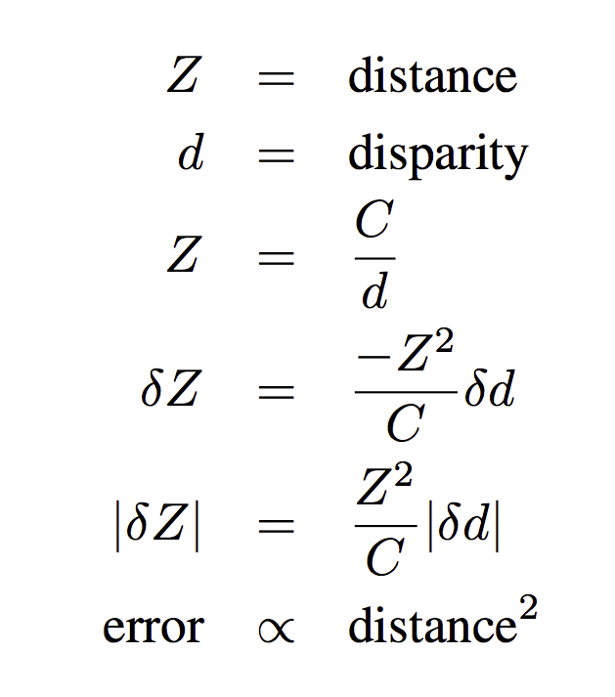
Stereo error(distance)
Error in distance estimate increases quadratically with the distance

Slide 50
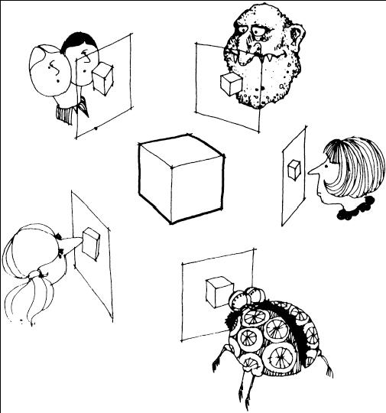
Multi-view stereo
Slide from L. Lazebnik.

Slide 51
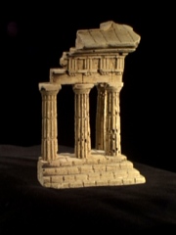
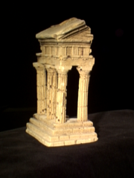
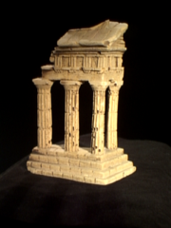
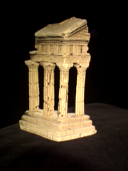
Multi-view stereo: Basic idea
Source: Y. Furukawa

Slide 52
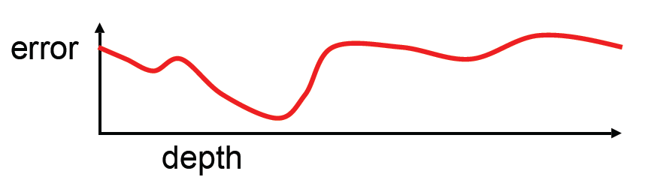
Multi-view stereo: Basic idea
Source: Y. Furukawa

Slide 53
Multi-view stereo: Basic idea
Source: Y. Furukawa

Slide 54
Multi-view stereo: Basic idea
Source: Y. Furukawa

Slide 55
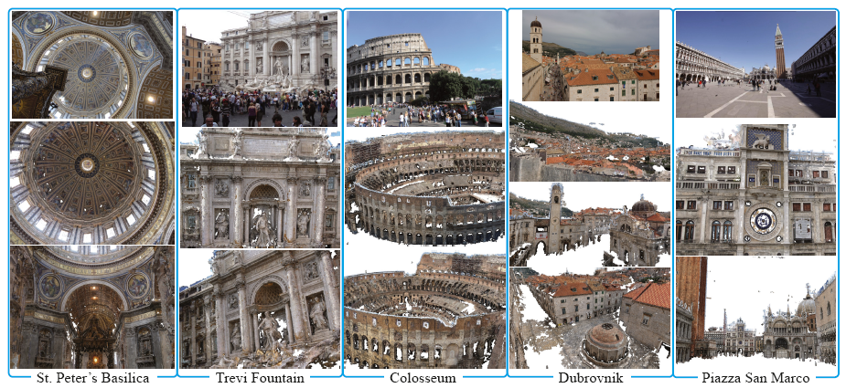
Towards Internet-Scale Multi-View Stereo
YouTube video, CMVS software
Y. Furukawa, B. Curless, S. Seitz and R. Szeliski, Towards Internet-scale Multi-view Stereo, CVPR 2010.

Slide 56
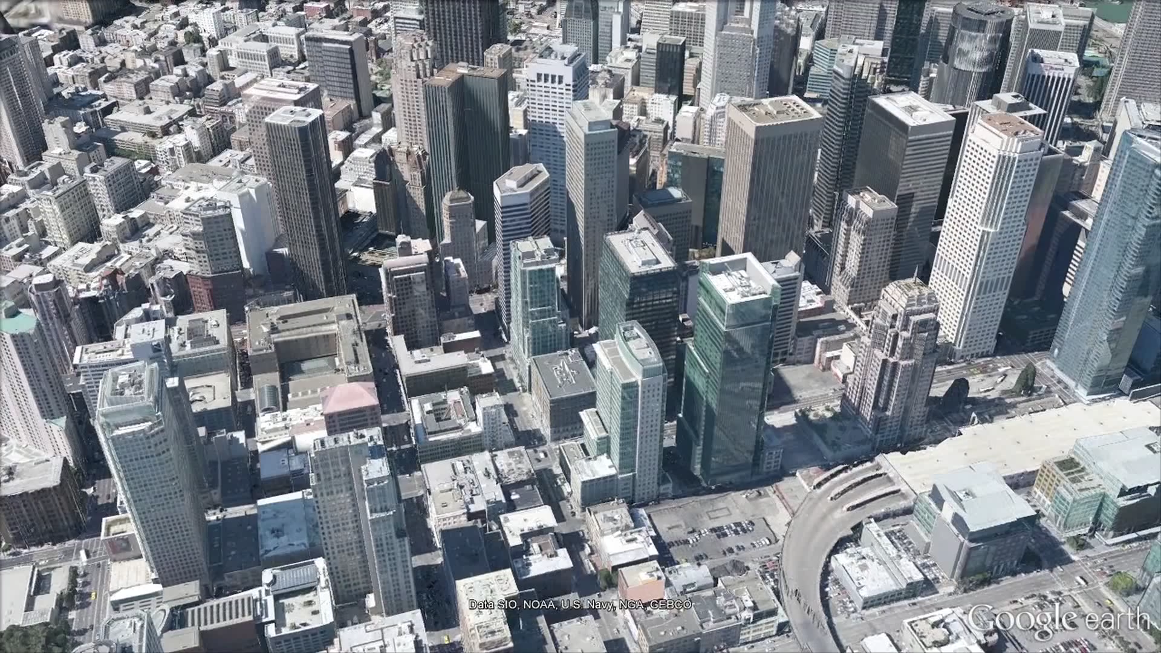
Applications
Source: N. Snavely

Slide 57
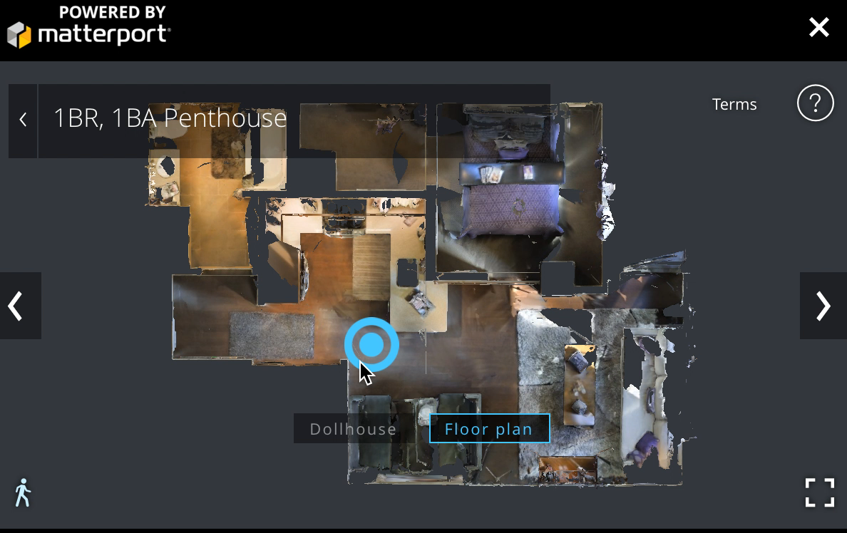
Applications
Source: N. Snavely

Slide 58
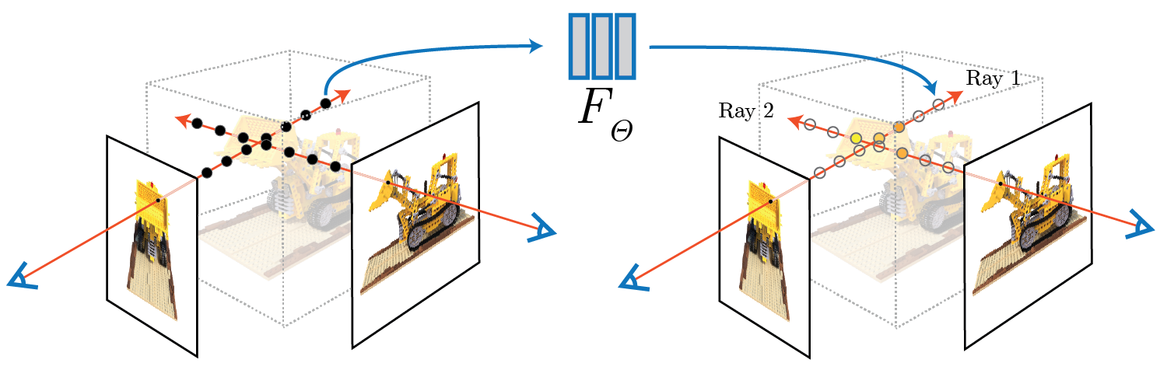
Latest and greatest: NeRF
Representing Scenes as Neural Radiance Fields for View Synthesis. ECCV 2020.
Ben Mildenhall, Pratul P. Srinivasan, Matthew Tancik, Jonathan T. Barron, Ravi Ramamoorthi, Ren Ng.

