Slide 1
Introduction to Recognition
Computer Vision
CS 543 / ECE 549
University of Illinois
Many Slides from D. Hoiem, L. Lazebnik.

Slide 2
Outline
Overview
  Task descriptions
  Basic approach
Classifiers
Features
Basic Machine Learning Concepts
Convolutional neural networks (CNNs)

Slide 3
Recognition as 3D Matching
http://www.robots.ox.ac.uk/~vgg/research/oxbuildings/index.html

Slide 4
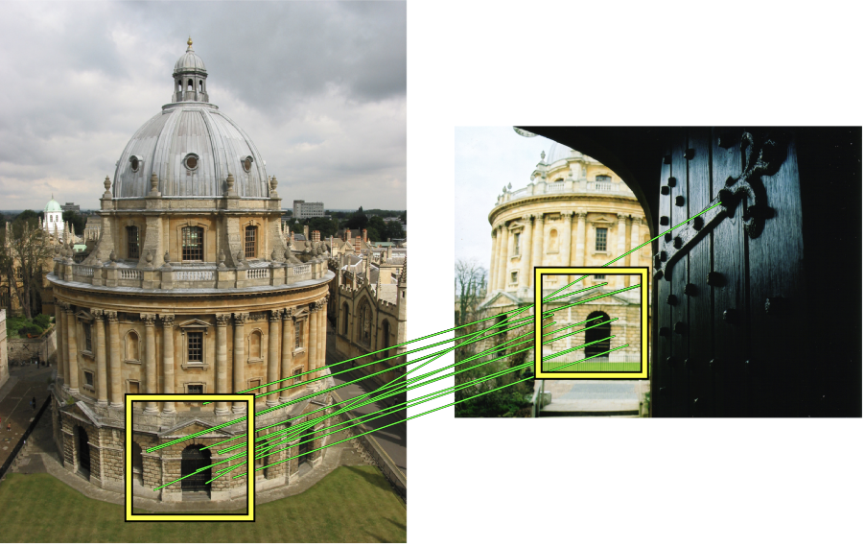
Recognition as 3D Matching
Recognizing solid objects by alignment with an image. Huttenlocher and Ullman IJCV 1990.

Slide 5
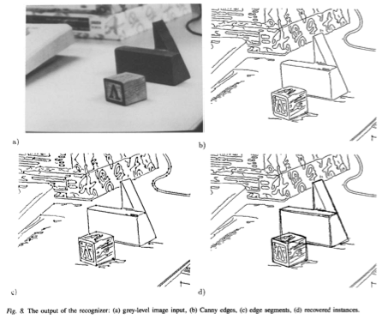
Recognition as 3D Matching
“Instance” Recognition
“Category-level” Recognition
Recognizing solid objects by alignment with an image. Huttenlocher and Ullman IJCV 1990.

Slide 6
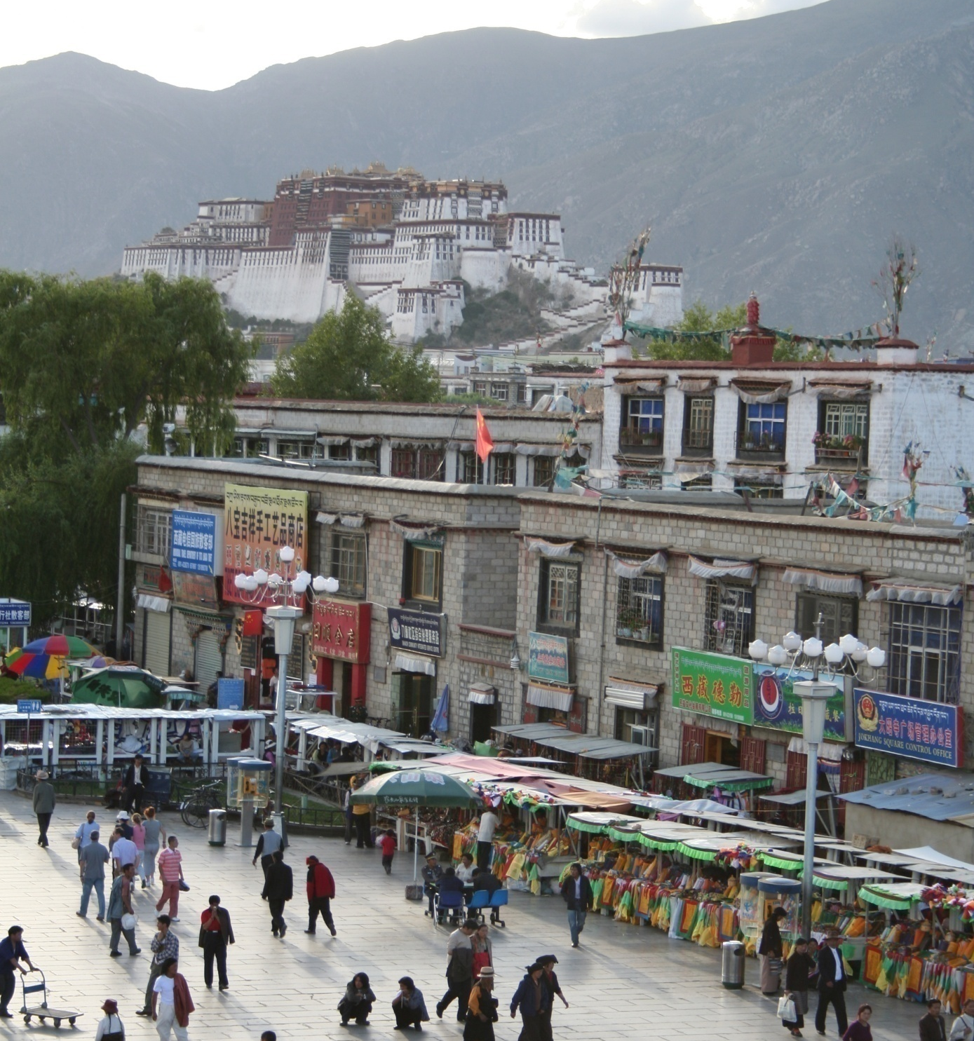
Common recognition tasks
Adapted from Fei-Fei Li

Slide 7
Image classification and tagging
outdoor
mountains
city
Asia
Lhasa
…
Adapted from Fei-Fei Li

Slide 8
Object detection
find pedestrians
Adapted from Fei-Fei Li

Slide 9
Activity recognition
walking
shopping
rolling a cart
sitting
talking
…
Adapted from Fei-Fei Li

Slide 10
Semantic segmentation
Adapted from Fei-Fei Li

Slide 11
Semantic segmentation
sky
mountain
building
tree
building
lamp
lamp
umbrella
umbrella
person
market stall
person
person
person
person
ground
Adapted from Fei-Fei Li

Slide 12
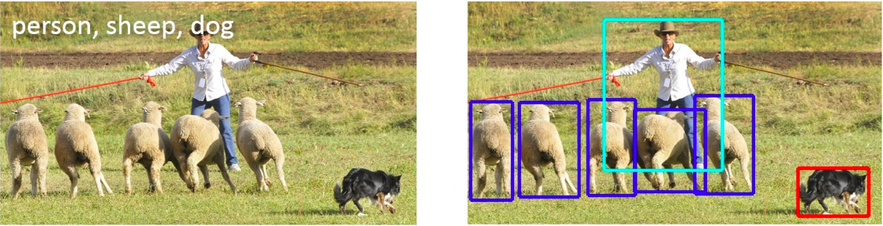
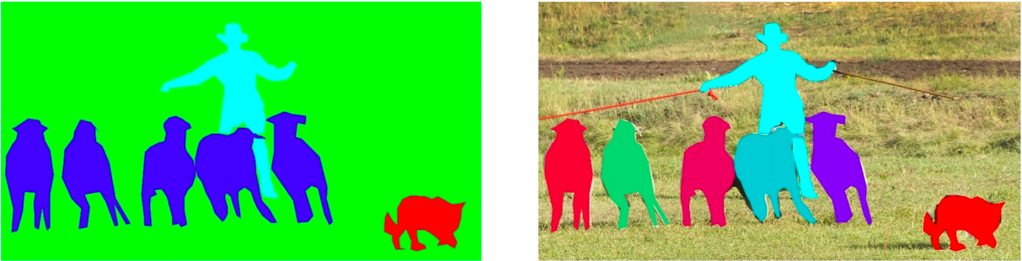
Detection, semantic segmentation, instance segmentation
image classification
object detection
semantic segmentation
instance segmentation
Image source

Slide 13
Image description
This is a busy street in an Asian city. Mountains and a large palace or fortress loom in the background. In the foreground, we see colorful souvenir stalls and people walking around and shopping. One person in the lower left is pushing an empty cart, and a couple of people in the middle are sitting, possibly posing for a photograph.
Adapted from Fei-Fei Li

Slide 14
Many vision problems involve categorization
Image: Classify as indoor/outdoor, which room, what objects are there, etc.
Object Detection: classify location (bounding box or region) as object or non-object
Semantic Segmentation: classify pixel into an object, material, part, etc.
Action Recognition: classify a frame or sequence into an action type
…

Slide 15


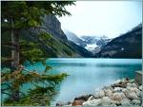


Basic Approach: Supervised Learning
Training
Training Labels
Training Images
Image Features
Classifier Training
Trained Classifier
Testing
Image Features
Trained Classifier
Prediction
Outdoor
Test Image
Notes:
At testing time, we are given a new image, we also represent it in terms of image features and apply the trained model to obtain the prediction

Slide 16
Do you know about the following? (Pick all)
  Nearest Neighbor Classifiers
  Support Vector Machines
  Kernelized Support Vector Machines
  Decision Tress
  Random Forests

Slide 17
Classifiers: Nearest neighbor
Test example
Training examples from class 2
Training examples from class 1
f(x) = label of the training example nearest to x
All we need is a distance or similarity function for our inputs
No training required!
Notes:
“Non-parametric” classifier: the entire training set is essentially the model parameters.
Pros:
Very fast at training time
Flexible: all it requires is a way to compute similarity or distances between pairs of features. Applies to many different kinds of features.
Works with any number of classes.
Works well in practice for large datasets (but see cons)
Cons:
Slow at test time (need to compute distances between test example and every training example)

Slide 18
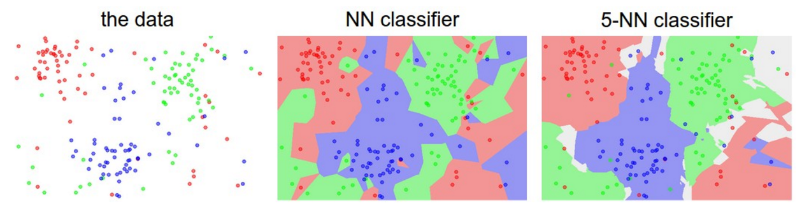
K-nearest neighbor classifier
Which classifier is more robust to outliers?
Credit: Andrej Karpathy, http://cs231n.github.io/classification/

Slide 19
Linear classifiers
Find a linear function to separate the classes:
f(x) = sign(w ⋅ x + b)
Notes:
“Parametric” classifier: model defined by a small number of parameters (w, b)
Pros:
Very fast at test time
Cons:
Slow at training time: need to estimate the parameters
Only works for two classes
Data may not be linearly separable

Slide 20
Linear classifiers
When the data is linearly separable, there may be more than one separator (hyperplane)
Which separator
is best?

Slide 21
Support vector machines
Find hyperplane that maximizes the margin between the positive and negative examples
For support vectors,
Distance between point and hyperplane:
Therefore, the margin is 2 / ||w||
Support vectors
Margin
C. Burges, A Tutorial on Support Vector Machines for Pattern Recognition, Data Mining and Knowledge Discovery, 1998

Slide 22
Finding the maximum margin hyperplane
Maximize margin 2 / ||w||
Correctly classify all training data:
Quadratic optimization problem:
C. Burges, A Tutorial on Support Vector Machines for Pattern Recognition, Data Mining and Knowledge Discovery, 1998

Slide 23
SVM parameter learning
Separable data:
Non-separable data:
Maximize margin
Classify training data correctly
Maximize margin
Minimize classification mistakes

Slide 24
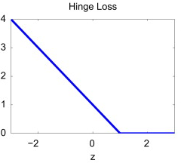
SVM parameter learning
+1
Margin
0
-1
Demo: http://cs.stanford.edu/people/karpathy/svmjs/demo

Slide 25
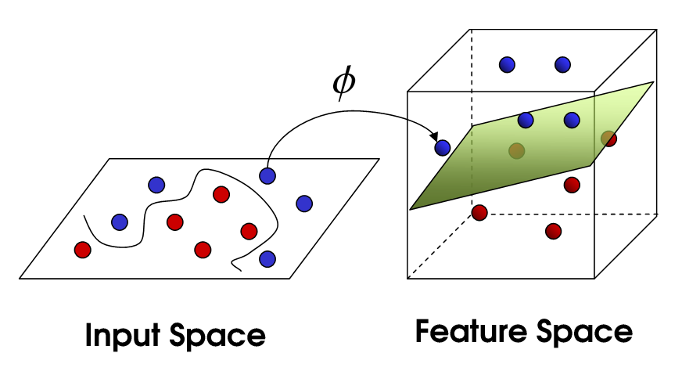
Nonlinear SVMs
General idea: the original input space can always be mapped to some higher-dimensional feature space where the training set is separable
Φ: x → φ(x)
Image source

Slide 26
Nonlinear SVMs
Linearly separable dataset in 1D:
Non-separable dataset in 1D:
We can map the data to a higher-dimensional space:
0
x
0
x
x²
0
x
Slide credit: Andrew Moore

Slide 27
The kernel trick
General idea: the original input space can always be mapped to some higher-dimensional feature space where the training set is separable
The kernel trick: instead of explicitly computing the lifting transformation φ(x), define a kernel function K such that
K(x , y) = φ(x) · φ(y)
(to be valid, the kernel function must satisfy Mercer’s condition)

Slide 28
The kernel trick
Linear SVM decision function:
learned
weight
Support
vector
C. Burges, A Tutorial on Support Vector Machines for Pattern Recognition, Data Mining and Knowledge Discovery, 1998

Slide 29
The kernel trick
Linear SVM decision function:
Kernel SVM decision function:
This gives a nonlinear decision boundary in the original feature space
C. Burges, A Tutorial on Support Vector Machines for Pattern Recognition, Data Mining and Knowledge Discovery, 1998

Slide 30
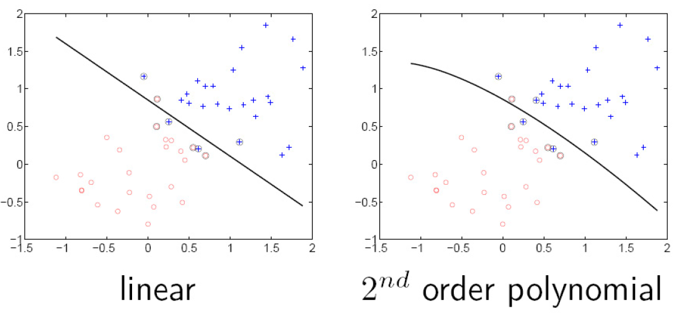
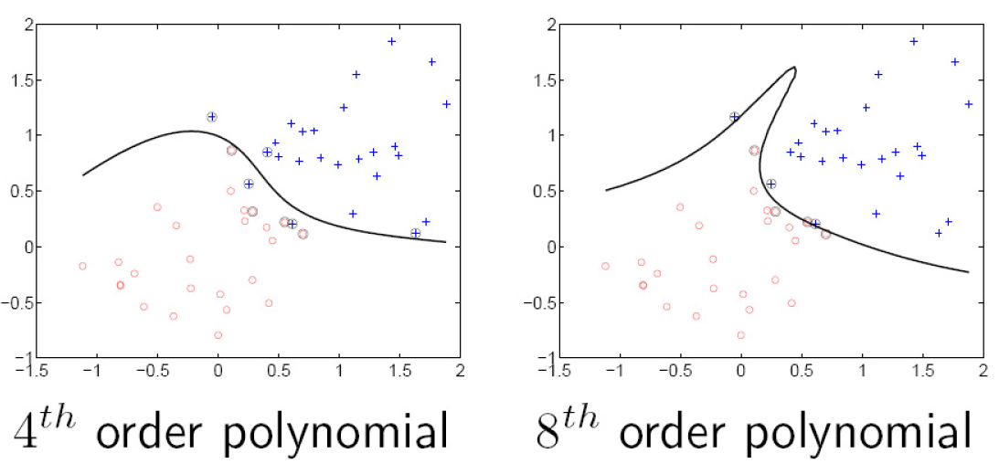
Polynomial kernel:

Slide 31
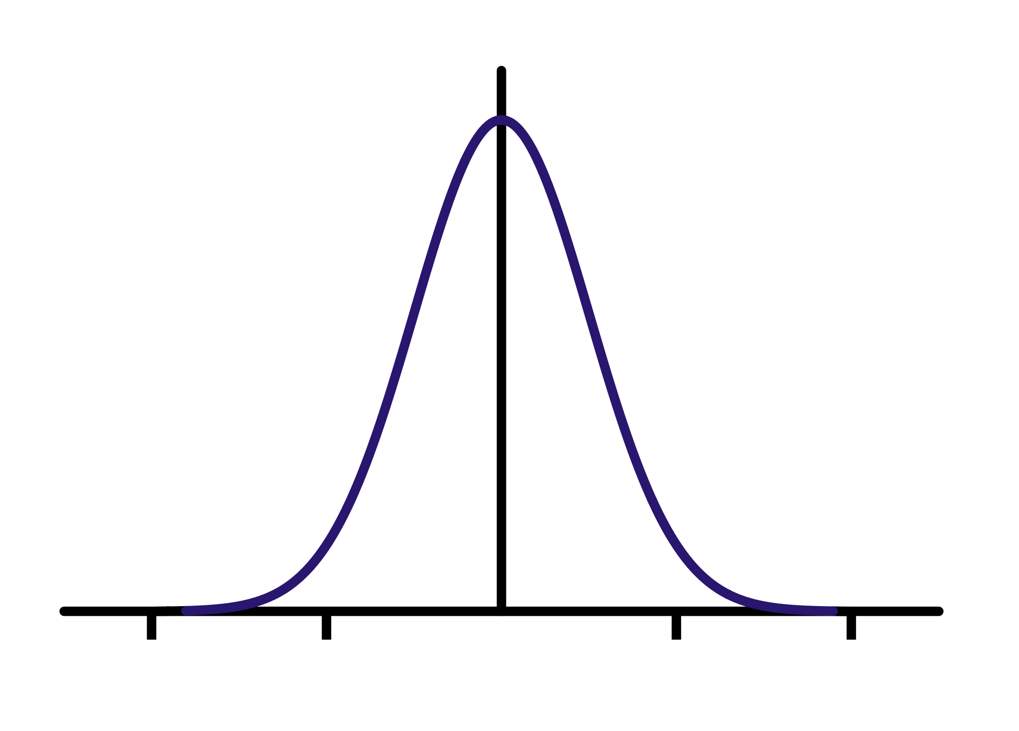
Gaussian kernel
Also known as the radial basis function (RBF) kernel:
K(x, y)
||x – y||

Slide 32
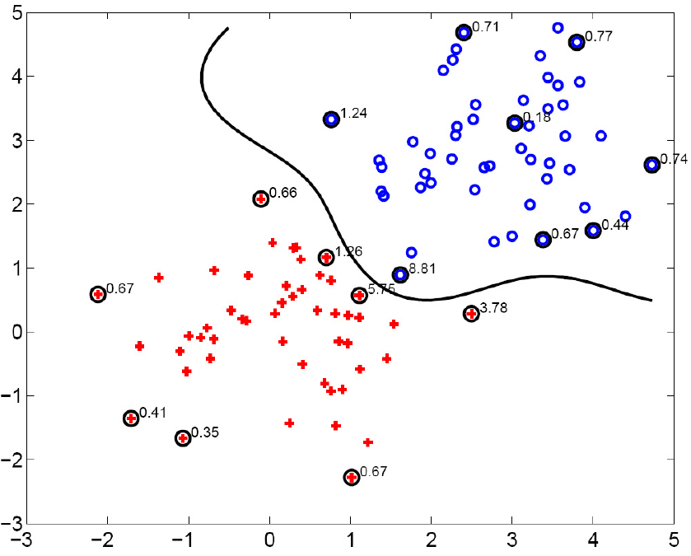
Gaussian kernel
SV’s

Slide 33



Bag of features
Extract local features
Learn “visual vocabulary”
Quantize local features using visual vocabulary
Represent images by frequencies of “visual words”

Slide 34
Outline
Overview
  Task descriptions
  Basic approach
Classifiers
Features
Basic Machine Learning Concepts
Convolutional neural networks (CNNs)

Slide 35
Digit Classification Case Study
Notes:
At testing time, we are given a new image, we also represent it in terms of image features and apply the trained model to obtain the prediction

Slide 36
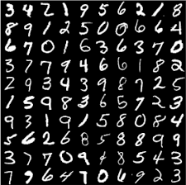
The MNIST DATABASE of handwritten digits
Yann LeCun & Corinna Cortes
Has a training set of 60 K examples (6K examples for each digit), and a test set of 10K examples.
Each digit is a 28 x 28 pixel grey level image. The digit itself occupies the central 20 x 20 pixels, and the center of mass lies at the center of the box.

Slide 37
Generalization Error
Fixed classifier
Error
Testing
Generalization Error
Training
Number of Training Examples

Slide 38
Bias-Variance Trade-off
E(MSE) = noise² + bias² + variance
Error due to variance parameter estimates from training samples
Unavoidable error
Error due to incorrect assumptions
See the following for explanation of bias-variance (also Bishop’s “Neural Networks” book):
http://www.inf.ed.ac.uk/teaching/courses/mlsc/Notes/Lecture4/BiasVariance.pdf

Slide 39
Bias and Variance
Error = noise² + bias² + variance
Few training examples
Test Error
Many training examples
High Bias
Low Variance
Complexity
Low Bias
High Variance
Notes:
Note: these figures don’t work in pdf

Slide 40
Back to the case study
Notes:
At testing time, we are given a new image, we also represent it in terms of image features and apply the trained model to obtain the prediction

Slide 41
What are the right features?
Depend on what you want to know!
Object: shape
  Local shape info, shading, shadows, texture
Scene : geometric layout
  linear perspective, gradients, line segments
Material properties: albedo, feel, hardness
  Color, texture
Action: motion
  Optical flow, tracked points
Notes:
Object: shape, shadows

Slide 42
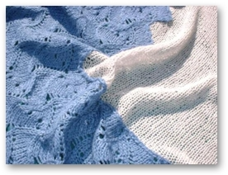
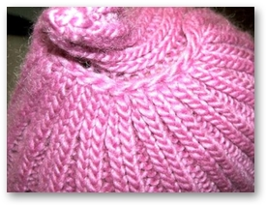
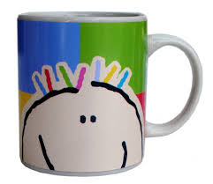
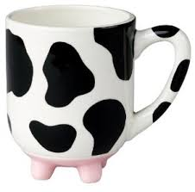
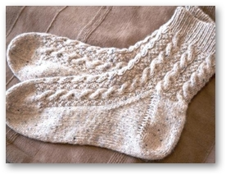
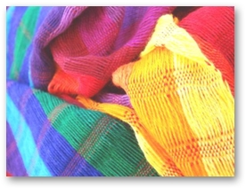
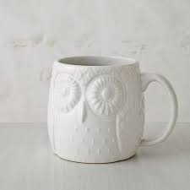


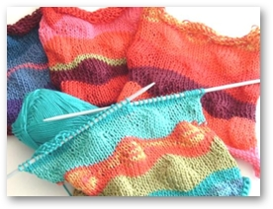

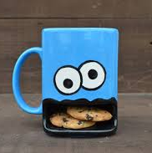
Stuff vs Objects
recognizing cloth fabric vs recognizing cups

Slide 43
Feature Design Process
Start with a model
Look at errors on development set
Think of features that can improve performance
Develop new model, test whether new features help.
If not happy, go to step 1.
“Ablations”: Simplify system, prune out features that don’t help anymore in presence of other features.

Slide 44
Features vs Classifiers
Notes:
At testing time, we are given a new image, we also represent it in terms of image features and apply the trained model to obtain the prediction

Slide 45
“Classic” recognition pipeline
Feature representation
Trainable
classifier
Image
Pixels
Class label

Slide 46
Categorization involves features and a classifier
Training Images
Training
Training Labels
Image Features
Classifier Training
Trained Classifier
Testing
Image Features
Trained Classifier
Prediction
Outdoor
Test Image
Notes:
At testing time, we are given with an new image, we also represent it in terms of image features and apply the trained model to obtain the prediction

Slide 47
New training setup with moderate sized datasets
Training Labels
Training Images
Tune CNN features and
Neural Network classifier
Trained Classifier
Initialize CNN Features
Dataset similar to task with millions of labeled examples

