Slide 1
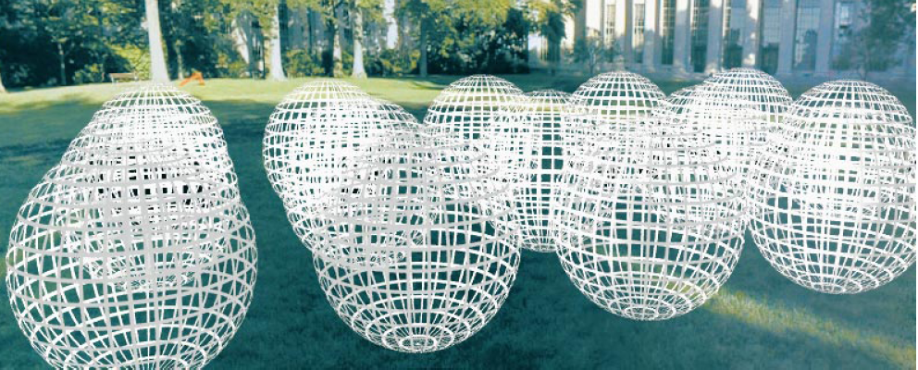
Modeling the plenoptic function
Adopted from: CS194: Intro to Comp. Vision, and Comp. Photo
Alexei Efros & Angjoo Kanazawa, UC Berkeley, Fall 2021 and Lana Lazebnik

Slide 2
Outline
The plenoptic function
Two-plane light fields
Neural radiance fields (NeRFs)

Slide 3
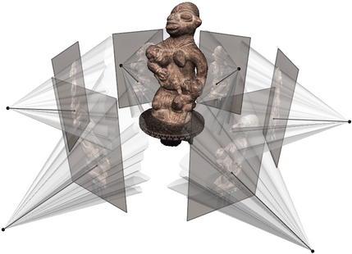
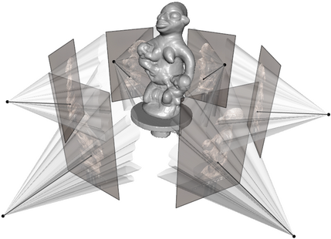
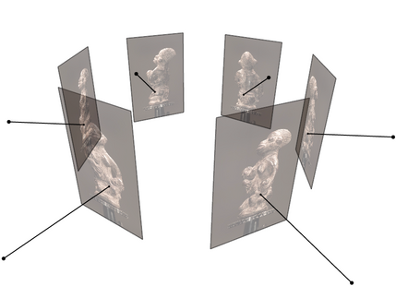
Goal: Novel view rendering
Given several images of the same object or scene from known viewpoints, how can we generate a rendering of the same scene from a novel viewpoint?
Multiview stereo answer: create a textured 3D model from the images, use traditional graphics to render
Figure source: C. Hernandez, N. Snavely

Slide 4
Goal: Novel view rendering
Given several images of the same object or scene from known viewpoints, how can we generate a rendering of the same scene from a novel viewpoint?
Multiview stereo answer: create a textured 3D model from the images, use traditional graphics to render
Alternate answer: model the light field of the scene, sample new views from it

Slide 5
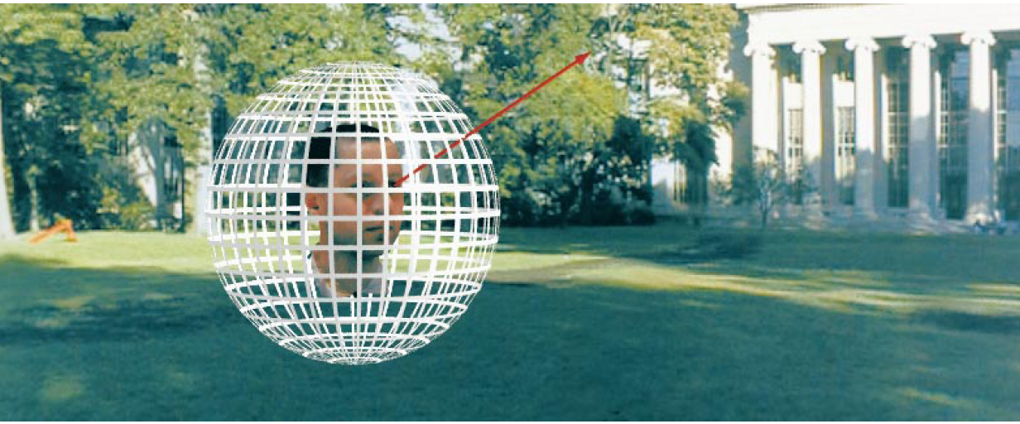
The light field, or plenoptic function
Figure by Leonard McMillan
Q: What is the set of all things that we can ever see?
A: The plenoptic function
E. Adelson and J. Bergen. The plenoptic function and the elements of early vision.
Computational models of visual processing, MIT Press, 1991

Slide 6
The light field, or plenoptic function
Figure by Leonard McMillan
Q: What is the set of all things that we can ever see?
A: The plenoptic function
Let’s start with a stationary person and try to parameterize everything that they can see…

Slide 7
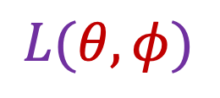
Grayscale snapshot
$$L(θ,φ)$$
Intensity of light
  Seen from a single view point
  At a single time
  Averaged over the wavelengths of the visible spectrum

Slide 8
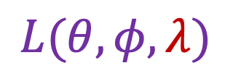
Color snapshot
$$L(θ,φ,λ)$$
Intensity of light
  Seen from a single view point
  At a single time
  As a function of wavelength

Slide 9
Modeling the light field
3D world
2D image
Figures © Stephen E. Palmer, 2002

Slide 10
Modeling the light field
3D world
2D image
Painted
backdrop

Slide 11
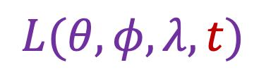
A movie
$$L(θ,φ,λ,t)$$
Intensity of light
  Seen from a single view point
  Over time
  As a function of wavelength

Slide 12
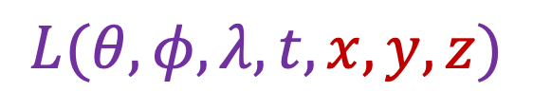
Holographic movie
$$L(θ,φ,λ,t,x,y,z)$$
Intensity of light
  Seen from ANY viewpoint
  Over time
  As a function of wavelength

Slide 13
Light field modeling: Outline
The plenoptic function
Two-plane light fields
Neural radiance fields (NeRFs)

Slide 14
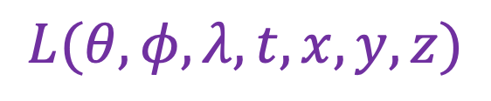
The plenoptic function
$$L(θ,φ,λ,t,x,y,z)$$
  Can reconstruct every possible view, at every moment, from every position, at every wavelength
  Contains every photograph, every movie, everything that anyone has ever seen! it completely captures our visual reality!
  Not bad for a function…

Slide 15
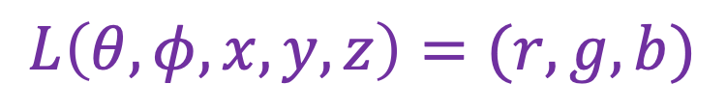
The plenoptic function: More practical version
$$L\left(θ,φ,x,y,z\right)=(r,g,b)$$
  Other simplifications/variants are possible, as we will see

Slide 16
Modeling the plenoptic function
Capture
  Create a special camera setup to capture a slice of the plenoptic function
  Combine captured rays for novel view synthesis, defocus, and other effects
Optimization
  Given a set of multi-view calibrated images, optimize a parametric representation of the plenoptic function of the scene

Slide 17
Outline
The plenoptic function
Two-plane light fields

Slide 18
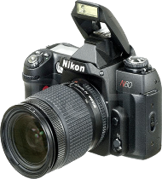
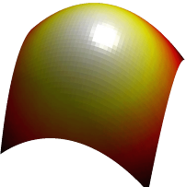
Two-plane light fields
Key idea: assuming light is constant along rays, we can create a 4D parameterization of the light field
No change in
radiance
Surface
Camera
If there is no occlusion or fog
S. Gortler, R. Grzeszczuk, S. Szeliski, M. Cohen. The Lumigraph. Proceedings of the 23rd Annual Conference on Computer Graphics and Interactive Techniques, 1996
M. Levoy and P. Hanrahan. Light field rendering. SIGGRAPH 1996

Slide 19
Two-plane light fields
Two-plane parameterization:
Scene
Observer

Slide 20
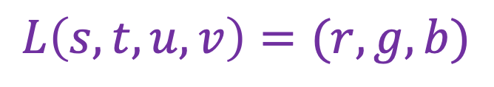






Two-plane light fields
Two-plane parameterization:
$$s,t$$
$$v$$
$$u,v$$
$$t$$
$$L\left(s,t,u,v\right)=(r,g,b)$$
$$u$$
$$s$$

Slide 21


Two-plane light fields
Two-plane parameterization:
$$u,v$$
$$s,t$$
$$L\left(s,t,u,v\right)=(r,g,b)$$

Slide 22



Two-plane light fields
What do we get if we hold
$u, v$ constant and let $s, t$ vary?
An image!
$$u, v$$
$$s, t$$
Notes:
Novel view synthesis

Slide 23
Two-plane light fields
What do we get if we hold
$u, v$ constant and let $s, t$ vary?
An image!
“Camera plane”
$$u, v$$
$$s, t$$
Notes:
Novel view synthesis

Slide 24

Two-plane light fields
What do we get if we hold
$s, t$ constant and let $u, v$ vary?
A set of rays leaving a point in the
scene in a bundle of directions
towards the image plane
“Focal plane”
$$u, v$$
$$s, t$$
Notes:
Novel view synthesis

Slide 25
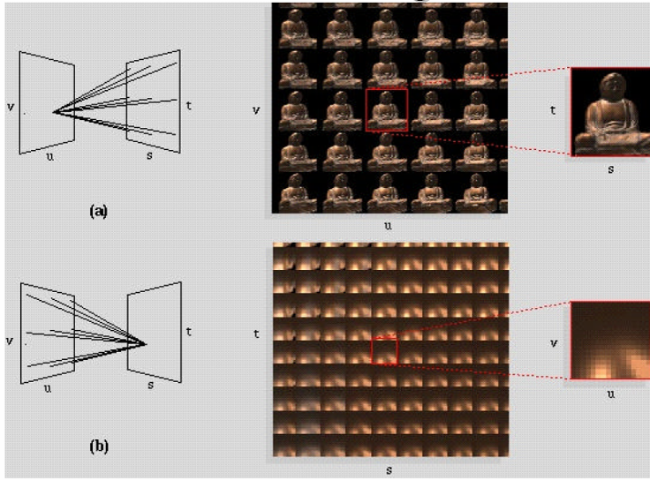
Light field visualization
Figure source: M. Levoy and P. Hanrahan

Slide 26
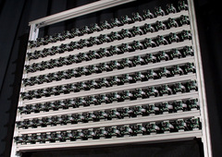
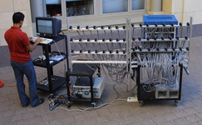



Light field capture
Idea 1: move camera carefully over $u, v$ plane
$$u,v$$
$$s,t$$

Slide 27
Stanford multi-camera array
640 × 480 pixels ×
30 fps × 128 cameras
Synchronized timing
Continuous streaming
Flexible arrangement
http://graphics.stanford.edu/projects/array/

Slide 28
Light field capture
Idea 2: move camera anywhere, use rebinning or resampling

Slide 29
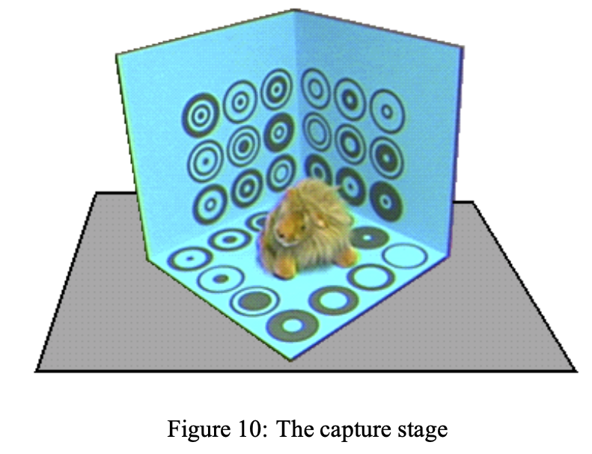

Light field capture
Idea 2: move camera anywhere, use rebinning or resampling
$$u,v$$
$$s,t$$
Figure source: S. Gortler et al.

Slide 30

Novel view synthesis
For each output pixel,
determine $s,t,u,v$, then either use
closest discrete RGB or interpolate
several nearby values
Slide by Rick Szeliski and Michael Cohen

Slide 31
Outline
The plenoptic function
Two-plane light fields

Slide 32
Outline
The plenoptic function
Two-plane light fields
Neural radiance fields (NeRFs)

Slide 33











NeRF: Representing Scenes as
Neural Radiance Fields for View Synthesis
ECCV 2020 (best paper honorable mention)
Ben Mildenhall*
Pratul Srinivasan*
Matt Tancik*
Jon Barron
Ravi Ramamoorthi
Ren Ng
UC Berkeley
UC Berkeley
UC Berkeley
Google Research
UC San Diego
UC Berkeley
https://www.matthewtancik.com/nerf
Notes:
Hi I’m Ben Mildenhall from UC Berkeley, and I’ll be talking about Neural Radiance Fields, a new scene representation for view synthesis. This is joint work with Pratul Srinivasan, Matt Tancik, Jon Barron, Ravi ramamoorthi, and Ren ng.

Slide 34
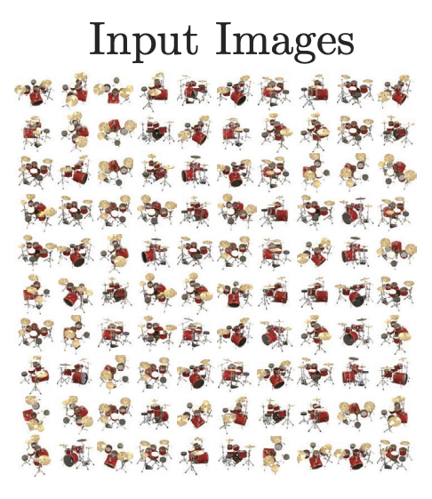
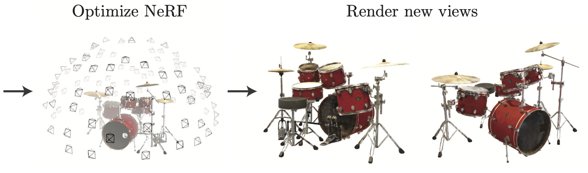
NeRF: Representing Scenes as
Neural Radiance Fields for View Synthesis
ECCV 2020 (best paper honorable mention)
Notes:
Hi I’m Ben Mildenhall from UC Berkeley, and I’ll be talking about Neural Radiance Fields, a new scene representation for view synthesis. This is joint work with Pratul Srinivasan, Matt Tancik, Jon Barron, Ravi ramamoorthi, and Ren ng.

Slide 35


Train a neural network to represent the plenoptic function
Inputs: sparsely sampled images of scene
Outputs: new views of same scene
tancik.com/nerf
Slide credit: Jon Barron

Slide 36
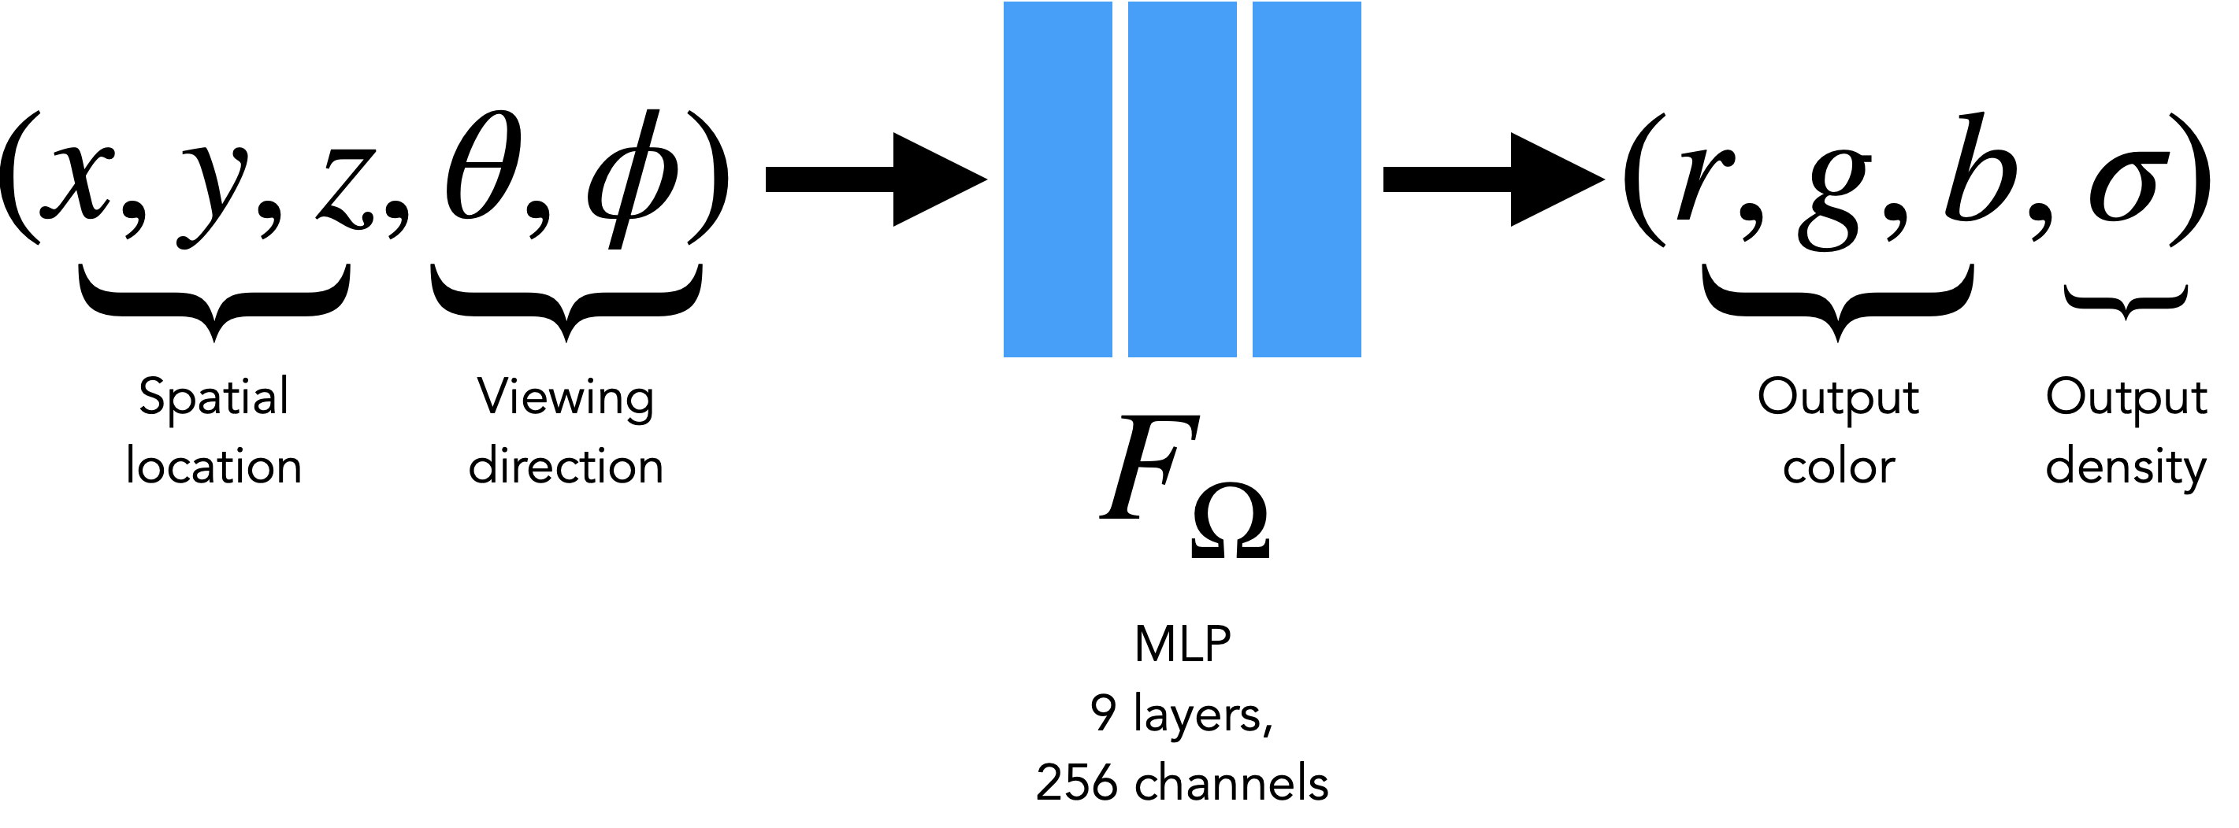
Neural radiance field
Volumetric “fog” model: Every 5D input gets mapped to Color and Density

Slide 37
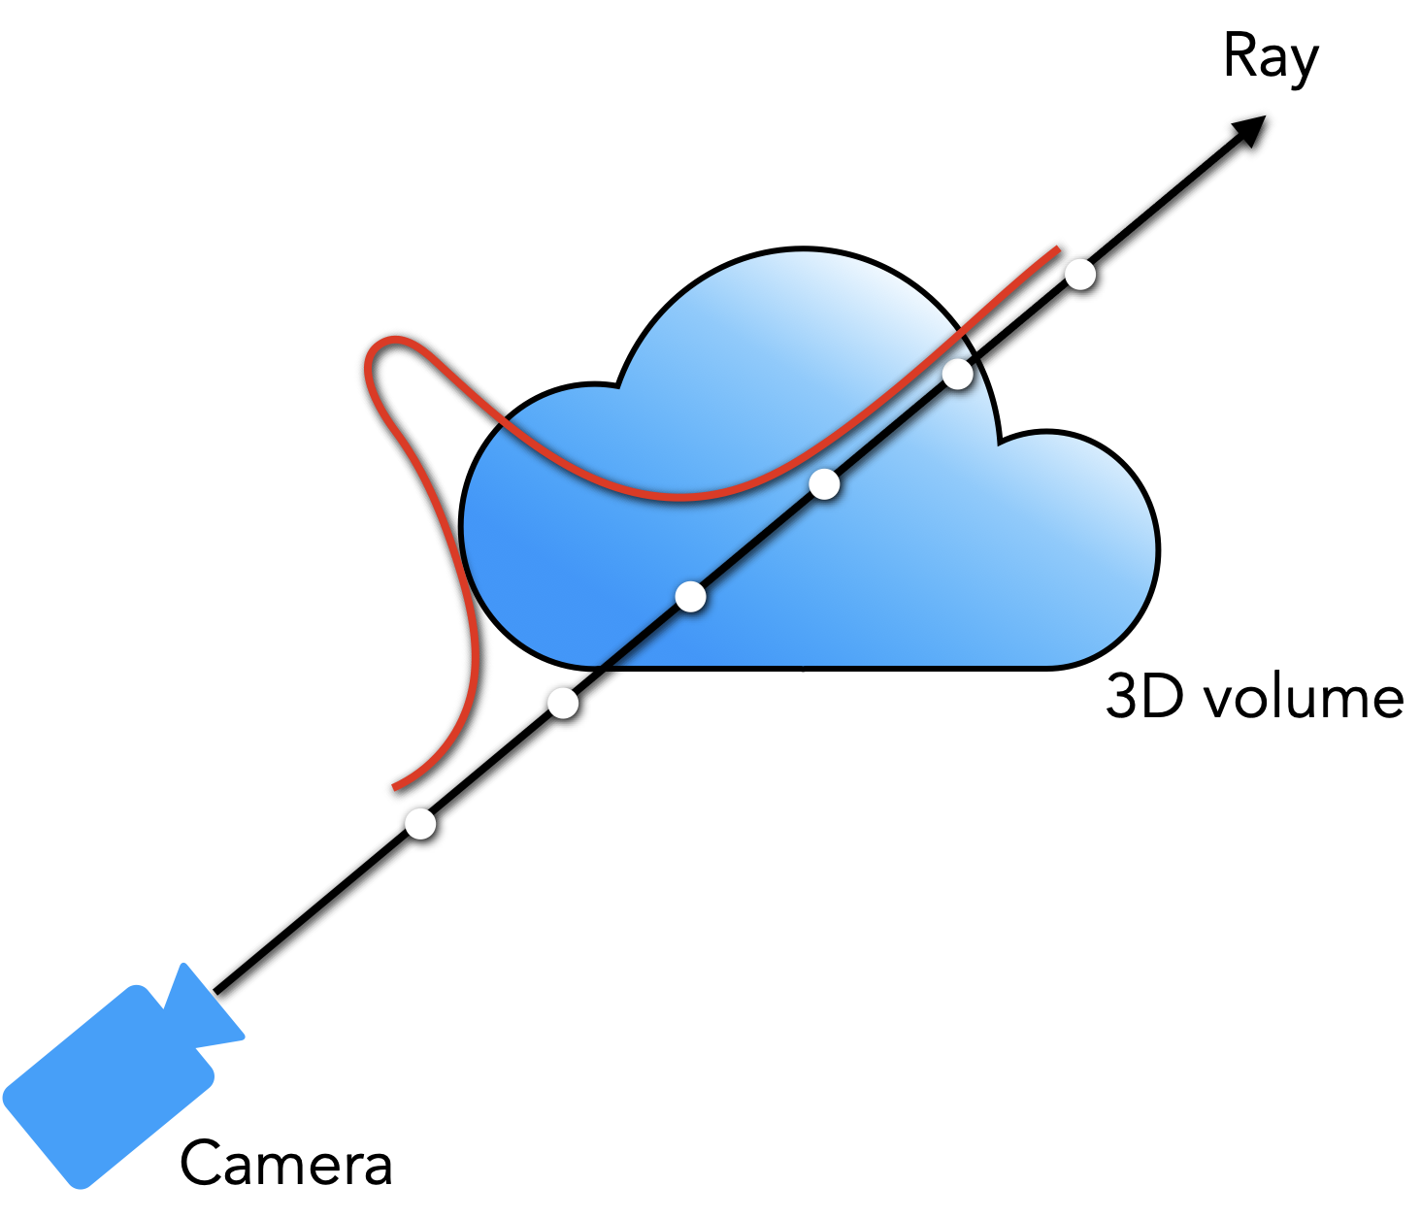
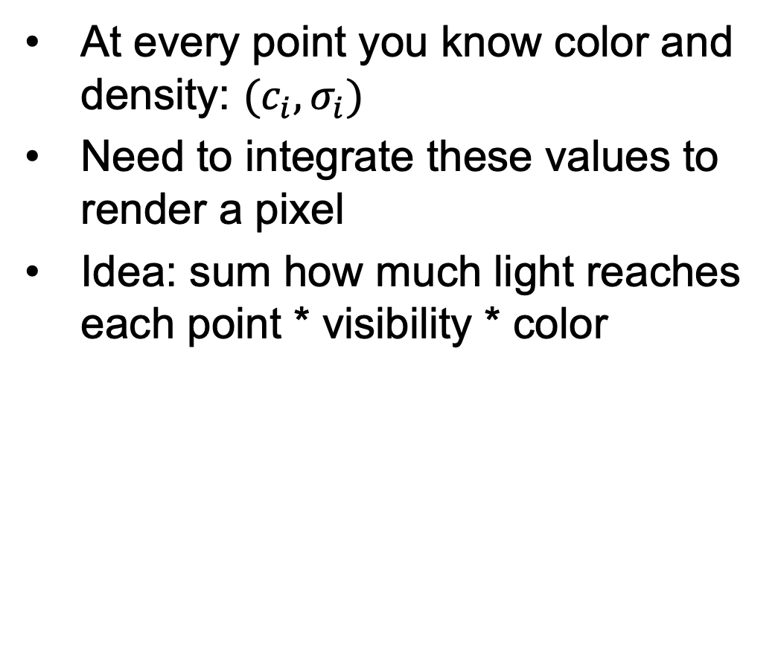
NeRF rendering
At every point you know color and density: $(c_{i},σ_{i})$
Need to integrate these values to render a pixel
Idea: sum how much light reaches each point * visibility * color
Notes:
illustration of the density

Slide 38
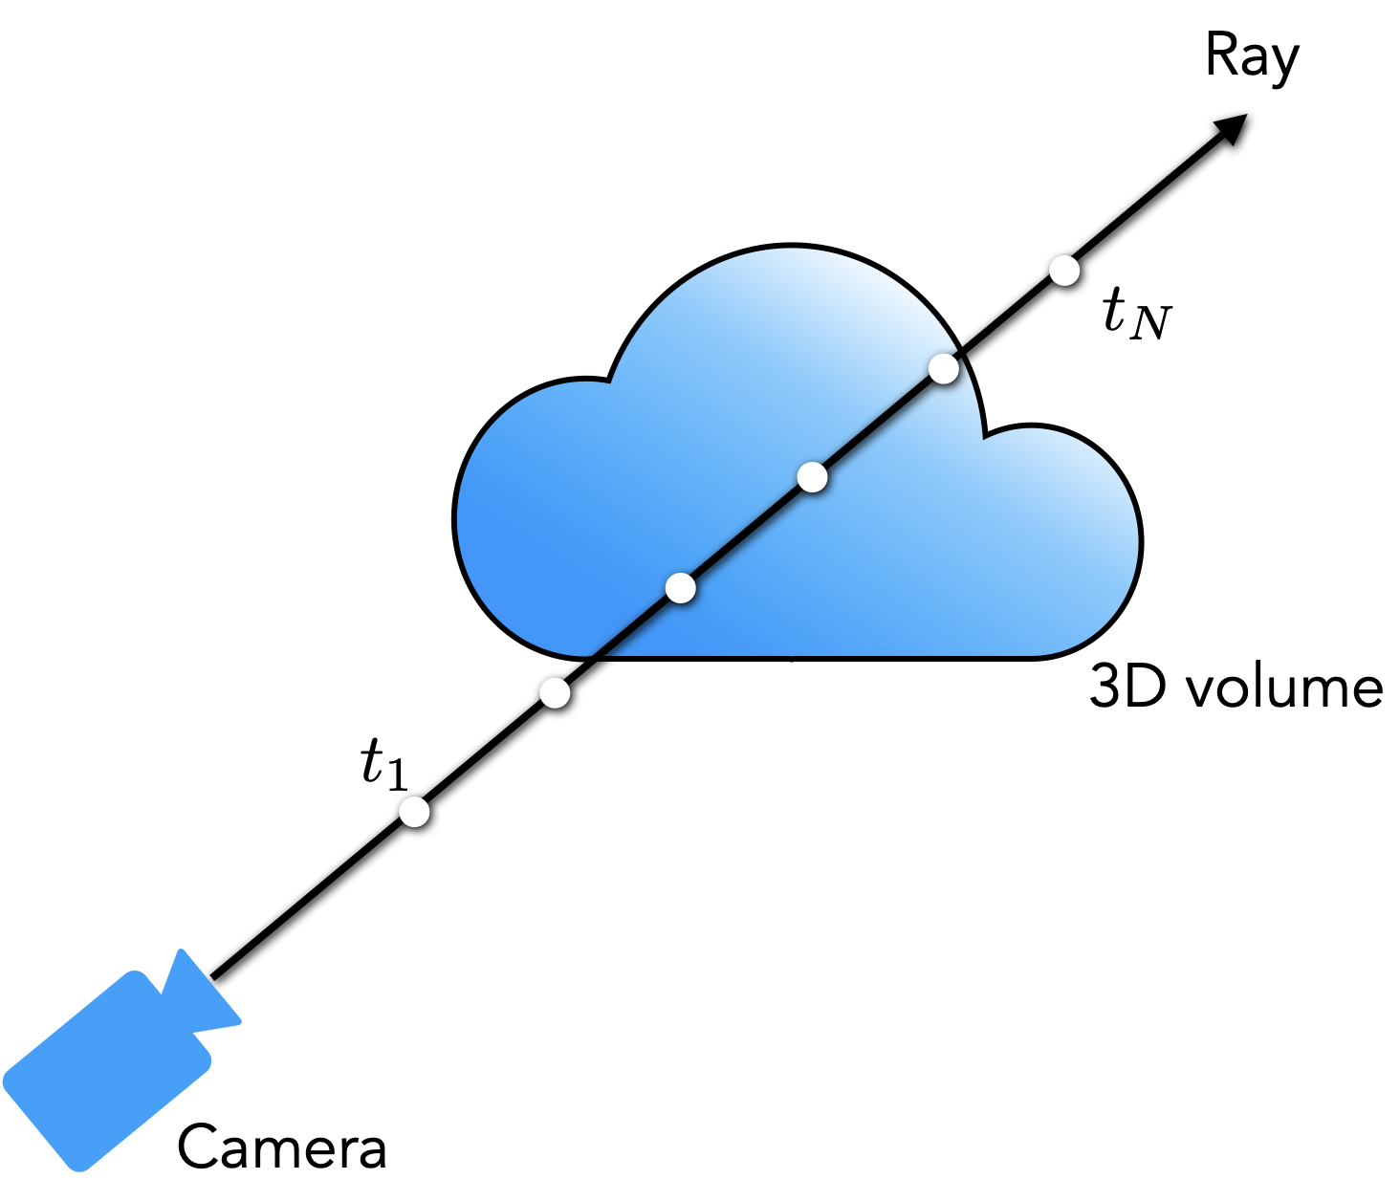
How to render a pixel: Volume rendering
Given: a ray
At every point you know:
Alpha: How much light a ray segment contributes
Transmittance: how much light reaches point $i$
Notes:
high density value ➔exp(-1000) = 0, so 1-0 = 1, this is a dense point
density = 0 → exp(-00 = 1, so 1-1 = 0

Slide 39
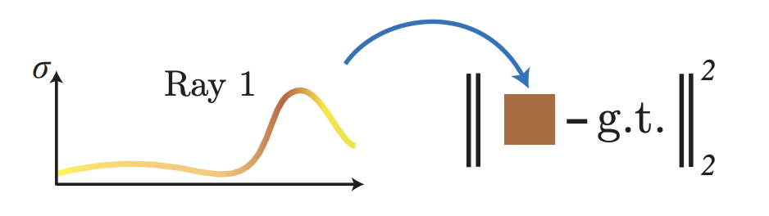
Training: Optimization with reconstruction loss

Slide 40
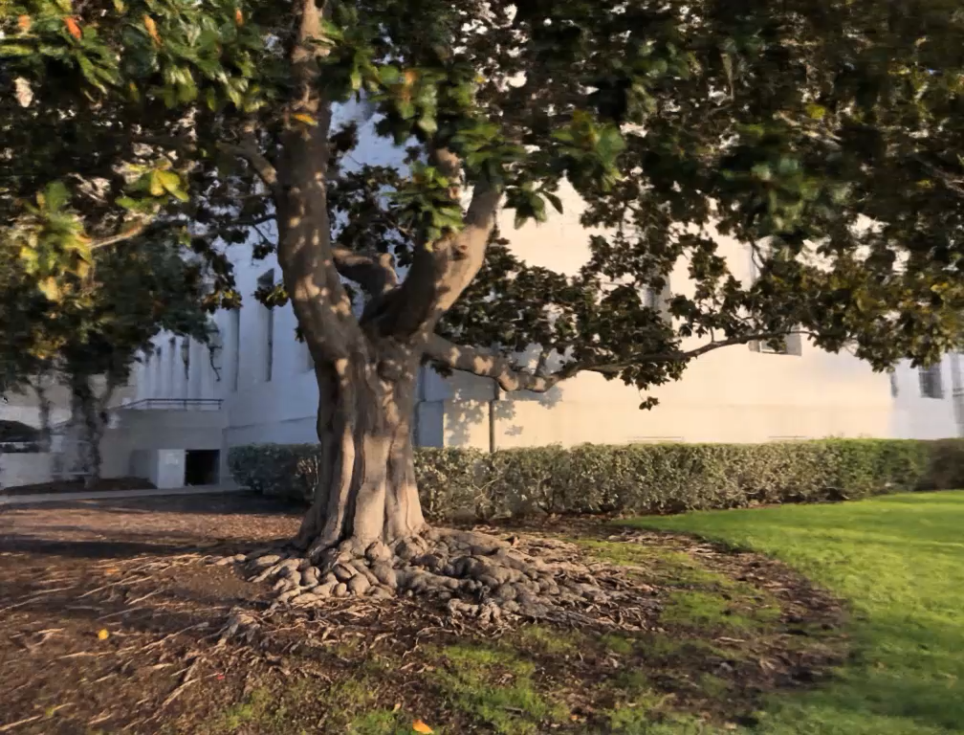
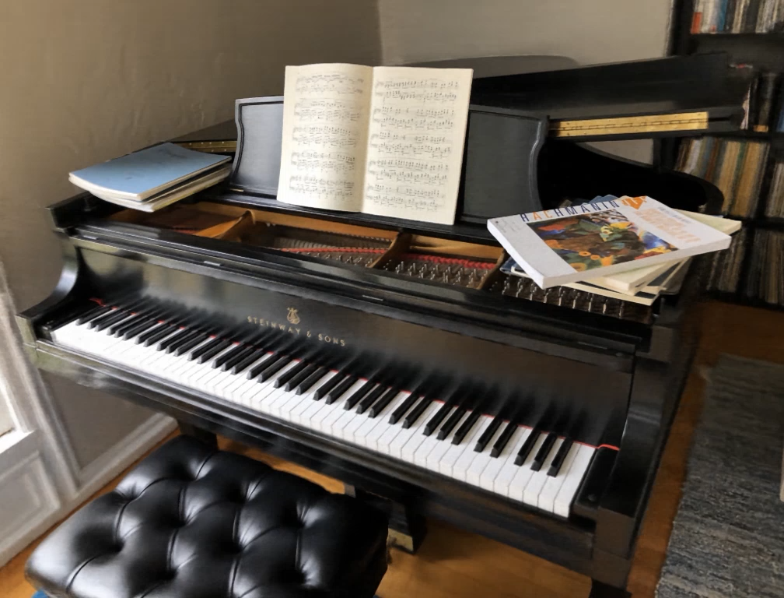
Example results
Notes:
Summer of NeRF. This talk: developments of how things have been developing

Slide 41
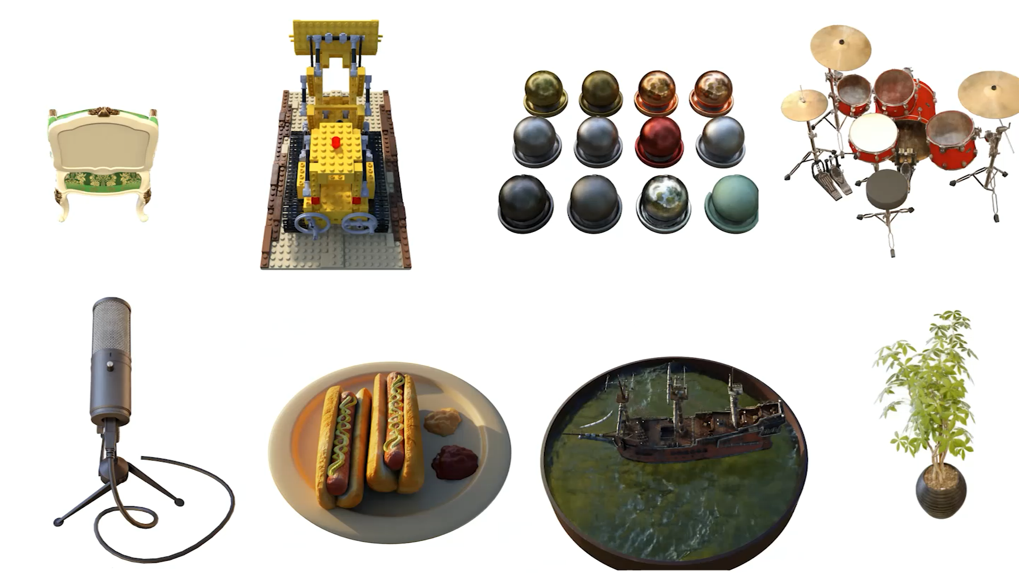

Slide 42
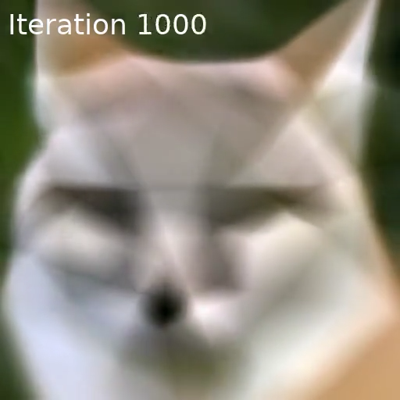
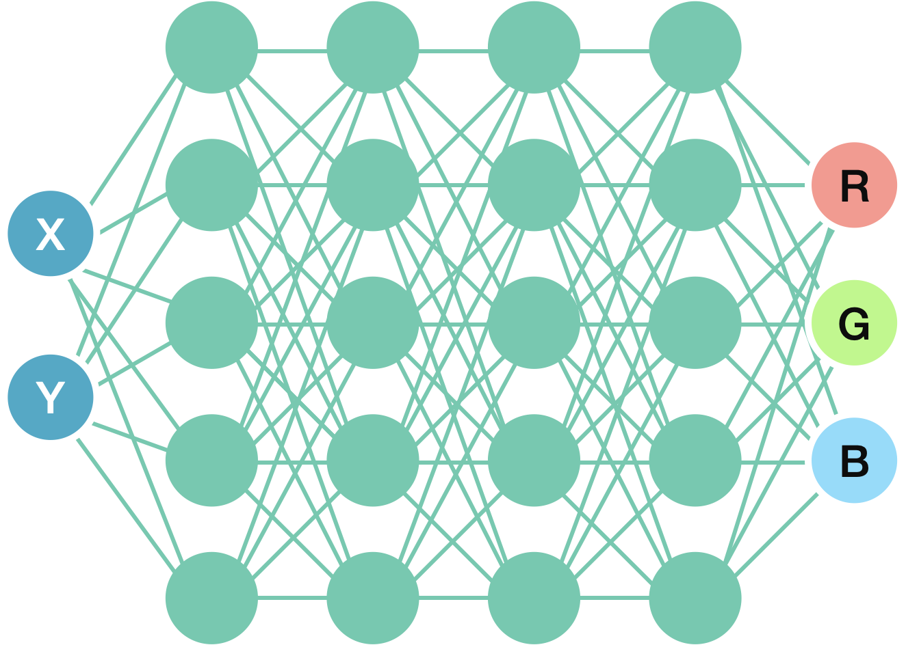
Positional Encoding
As is, MLPs don’t like to represent high-frequency functions
MLP output
Supervision image
Rahaman et al. 2019, Basri et al. 2020
Notes:
illustration of the density

Slide 43
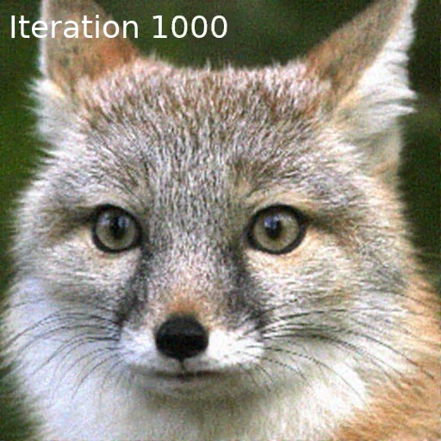
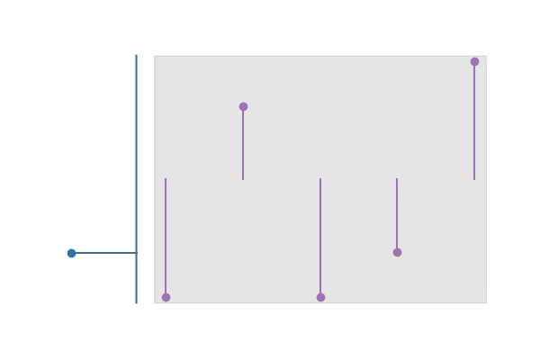







Positional Encoding
Help the MLP by providing it with high-frequency transformations of input coordinates
Rahaman et al. 2019, Basri et al. 2020
Notes:
illustration of the density

Slide 44
Why does positional encoding help?
Input
Target
x
y
A
y
B
A
B
With Positional Encoding
x
y
Target Image
A
B
Notes:
illustration of the density

Slide 45
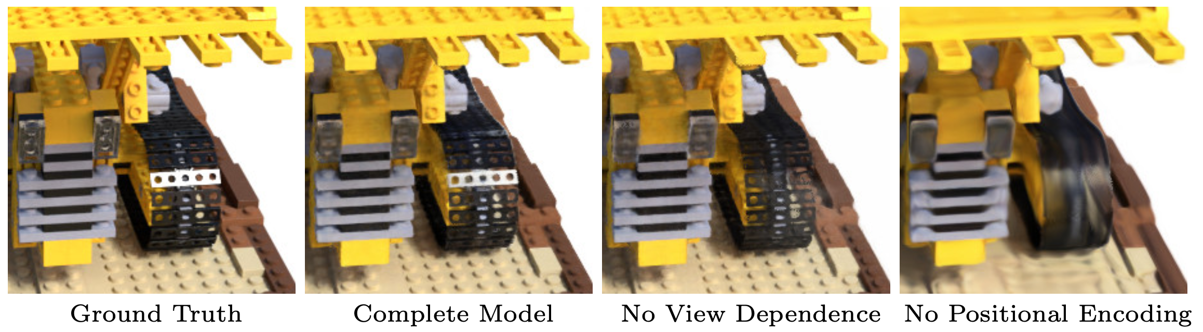
Positional Encoding (Results)
Notes:
illustration of the density

Slide 46
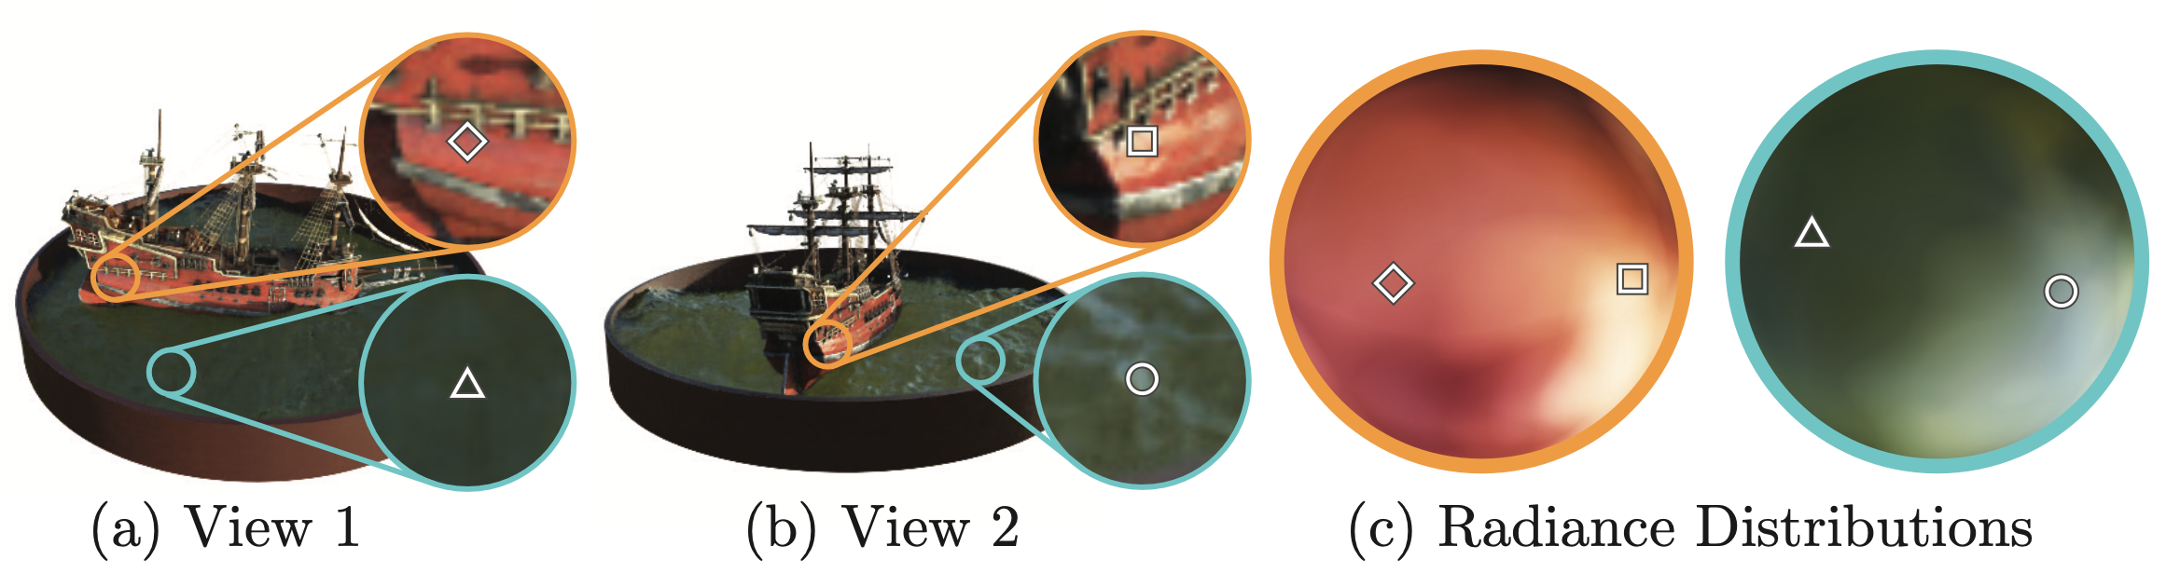
View Dependent Emitted Radiance
Notes:
illustration of the density

Slide 47

Viewpoint-dependent effects
Notes:
Here we visualize the view-dependent appearance encoded in our NeRF representation by fixing the camera viewpoint but changing the queried viewing direction.

Slide 48
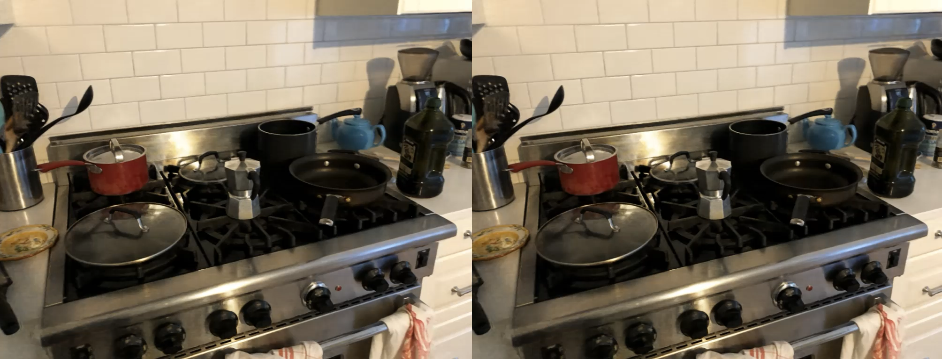
Viewpoint-dependent effects

Slide 49

Rendering expected depth

Slide 50
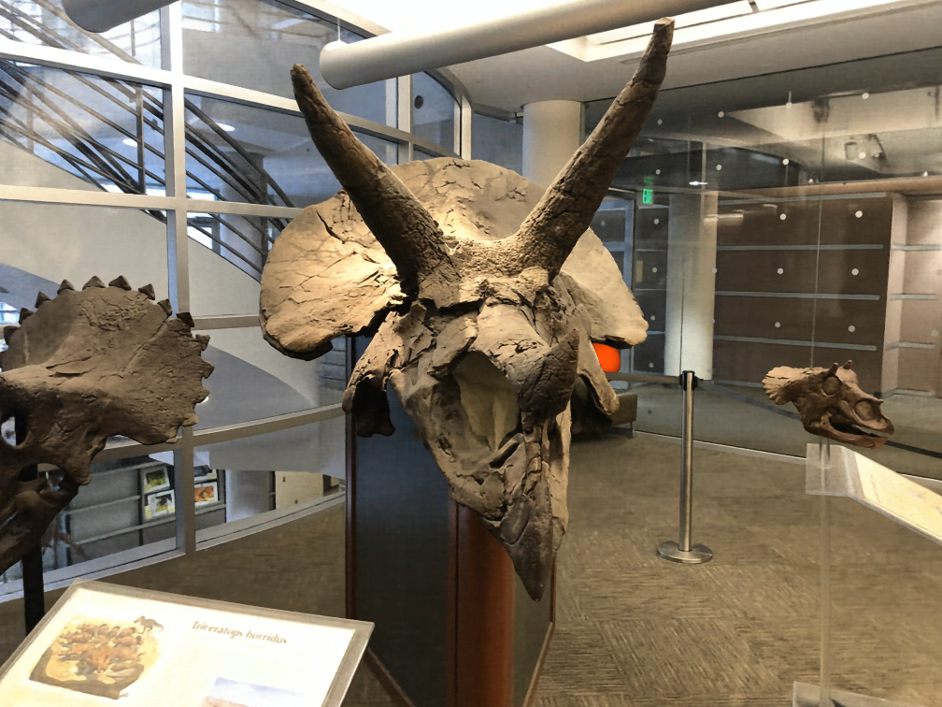
Because it models the entire plenoptic function you can insert objects with proper occlusion effects
(in contrast to lightfields)

Slide 51
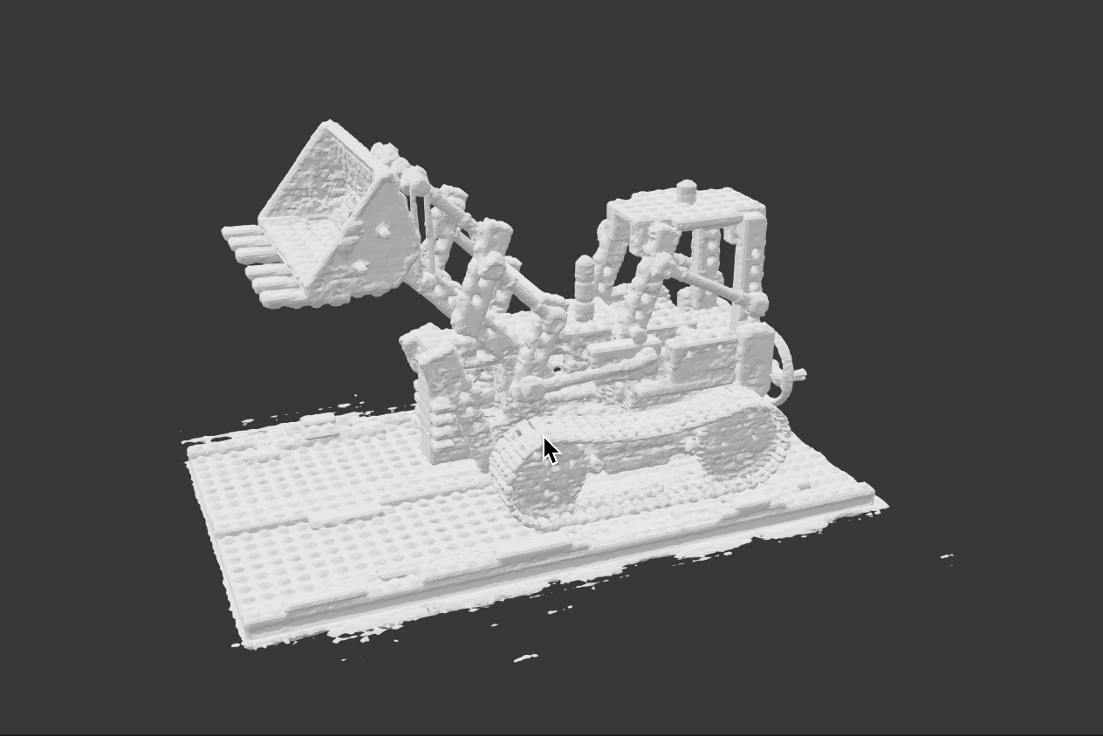
Extract surface on high density regions

Slide 52
NeRF limitations
Expensive / slow to train and render
Sensitive to sampling strategy
Does not generalize between scenes
Sensitive to pose accuracy
Assumes static scene
Assumes static lighting and camera focus
Not a mesh

Slide 53
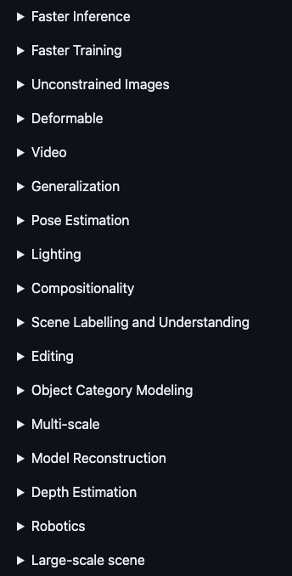
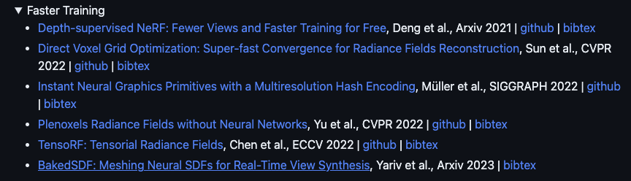
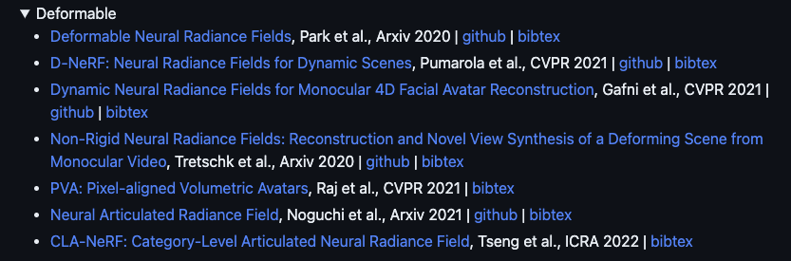
NeRF explosion
https://github.com/yenchenlin/awesome-NeRF
Notes:
Summer of NeRF. This talk: developments of how things have been developing

Slide 54
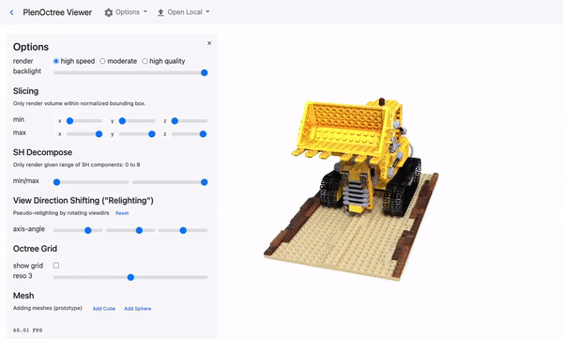
Fast Inference
PlenOctrees [Yu et al. ICCV’21]
SNeRG [Hedman et al. ICCV’21]
FastNeRF [Garbin et al. ICCV’21]
KiloNeRF [Reiser et al. ICCV’21]
AutoInt [Lindell et al. CVPR’21]
…
PlenOctrees [Yu et al. ICCV’21]

Slide 55
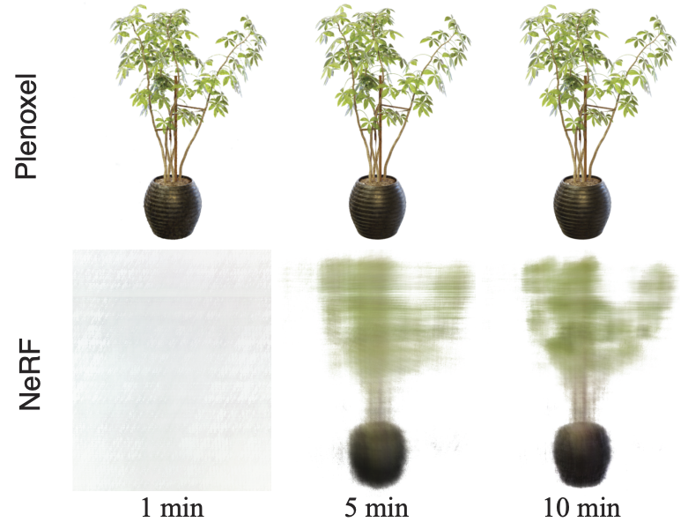
Plenoxels
S. Fridovich-Kiel et al. Plenoxels: Radiance Fields without Neural Networks. CVPR 2022

Slide 56
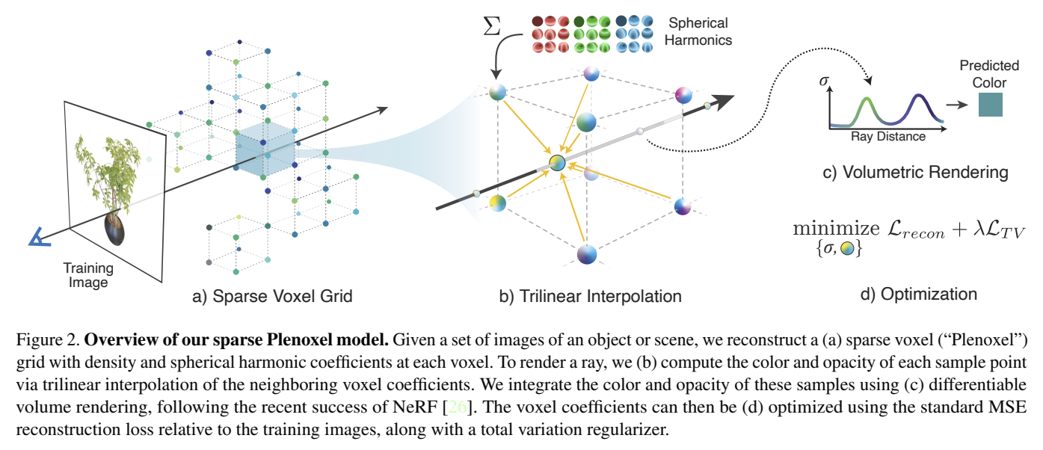
Plenoxels
S. Fridovich-Kiel et al. Plenoxels: Radiance Fields without Neural Networks. CVPR 2022

Slide 57
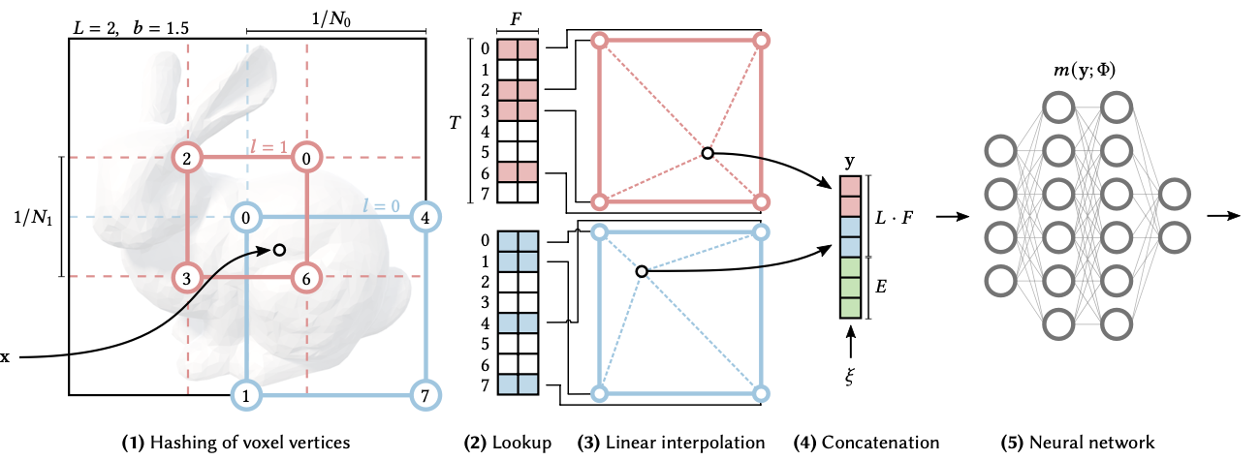
Instant NGP
Multi-resolution hash encoding to use sparse feature maps
Let NN deal with collisions at higher resolutions
Müller et al. Instant neural graphics primitives with a multiresolution hash encoding. SIGGRAPH 2022

Slide 58
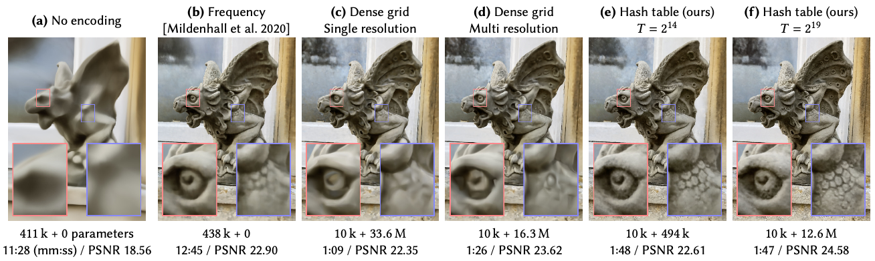
Instant NGP
Müller et al. Instant neural graphics primitives with a multiresolution hash encoding. SIGGRAPH 2022

Slide 59

Instant NGP
Applicable to many other implicit functions
Müller et al. Instant neural graphics primitives with a multiresolution hash encoding. SIGGRAPH 2022

